Slide 1
Oregon’s Experience
“Using probe vehicle data to support transportation planning and analysis”
Richard Arnold, P.E.
Oregon Department of Transportation
2019 TRB Transportation Planning Applications Conference
Portland, Oregon
June 4, 2019

Slide 2
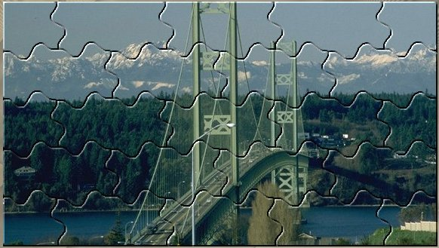
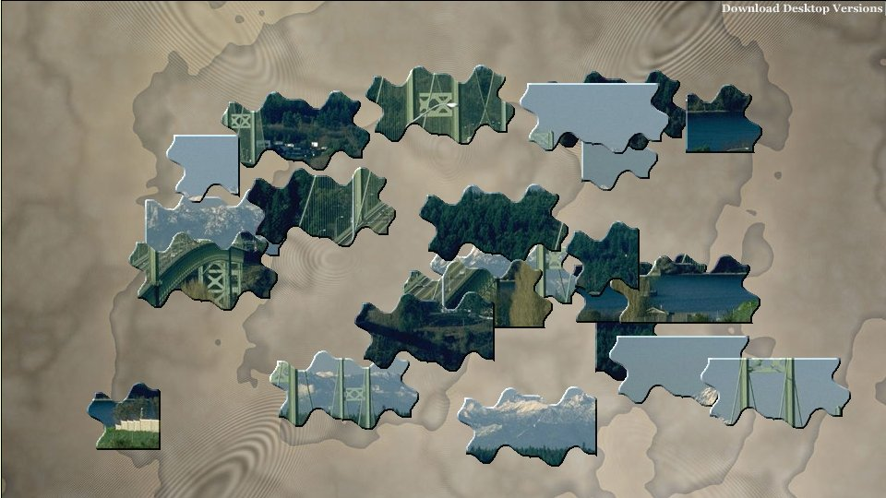
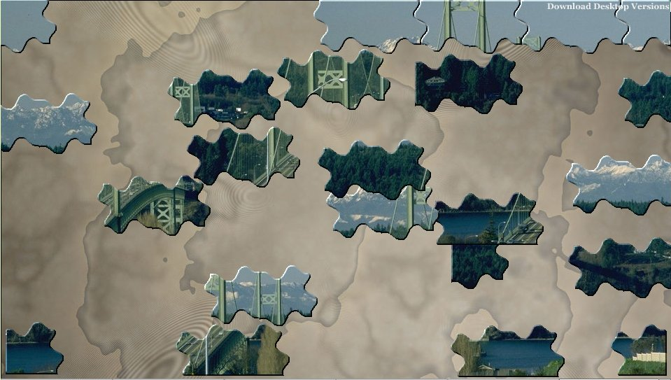
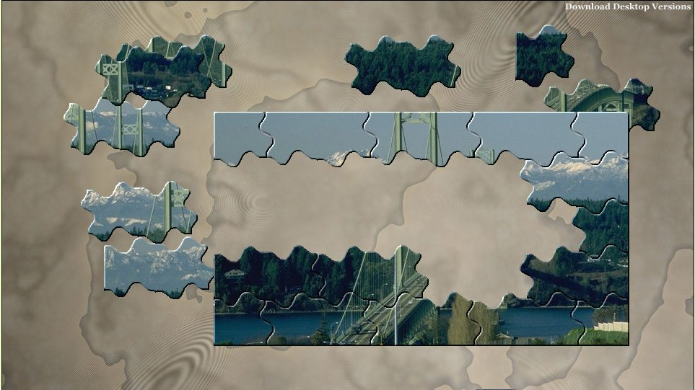
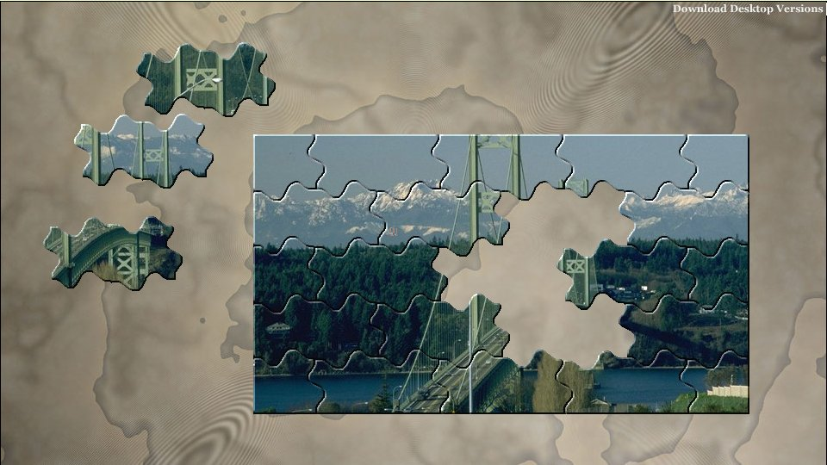
Telling the Story….

Slide 3
Understanding the Data
This is vehicle probe data. It is a non-statistical sample of what is actually on the road
Collected through a variety of sources, including Mobile Devices, Portable Navigation, Commercial Fleet, Sensors, etc
Speed/Travel Time Data only (no volumes)
No vehicles => no data (usually late PM)
No vehicle => historical data

Slide 4
Different Venders, Similar Products, Different Visuals
Date providers are similar (INRIX/HERE)
There are somethings the RITIS (INRIX) does well
There are somethings that iPeMS (HERE) does well
There are somethings that neither one does best
FHWA ➔ NPMRDS (FREE…)
https://ops.fhwa.dot.gov/freight/freight_analysis/perform_meas/vpds/npmrdsfaqs.htm

Slide 5
Types of Applications
Corridor performance
  Trends (annual, monthly, etc)
  Before/after construction
Work zone analysis
Bottleneck analysis
  Identify locations, categorize severity
  Congestion “heat map” scans
Reliability analysis

Slide 6
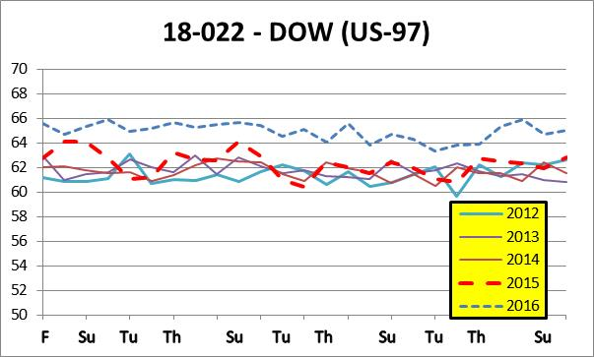
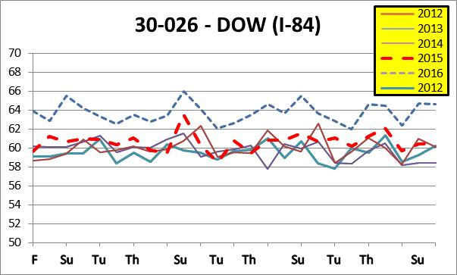
Example: Before & After
2016 Speed Limit Changes in Central & Eastern Oregon
Looking at specific time periods with similar weather

Slide 7
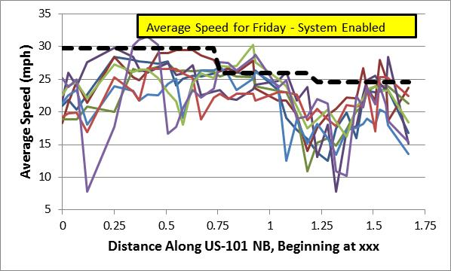
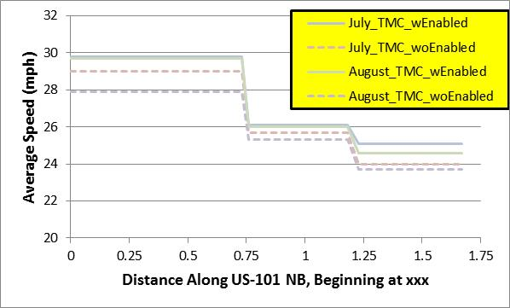
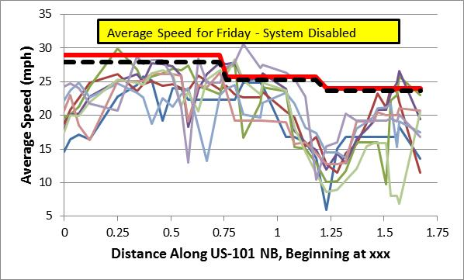
Example: Before & After
Signal Controller on US-101 through Lincoln City, OR
The speed profiles for the "DISABLED" are similar to those of the "ENABLED", however, the range is greater, suggesting that travel across the "DISABLED" is less reliable; the assumption is that the on/off switch is the major factor in this different; that the weather, volumes, incidents and special events are all the same.

Slide 8
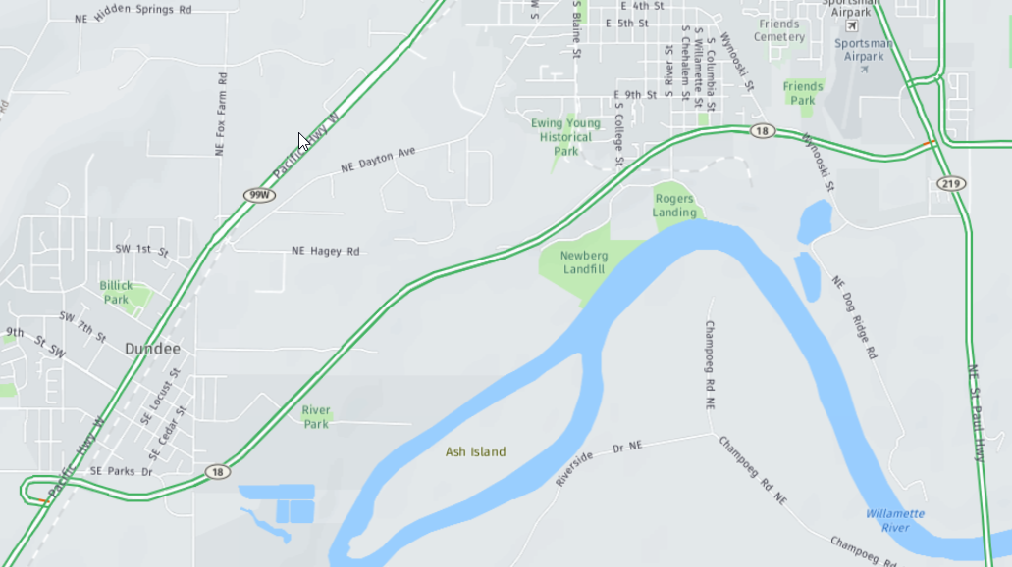
Example: Before & After
?
Newberg-Dundee Bypass
The new roadway alignment opened to the public in January 2018. However, due to data update schedules, the new segments were not immediately available; the Before/After study could only be done on the OR99W segment.

Slide 9
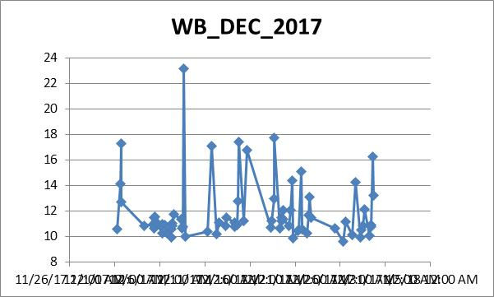
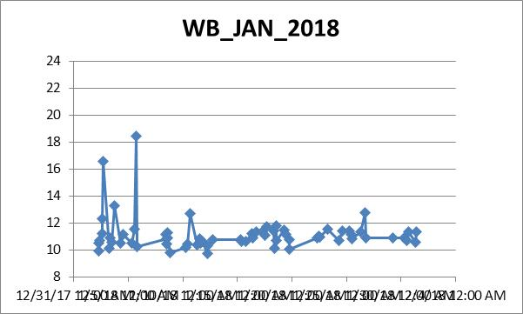
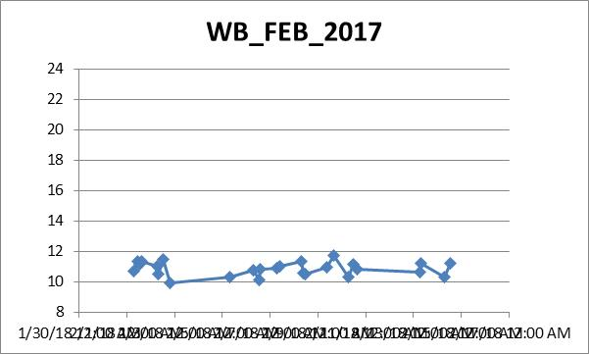
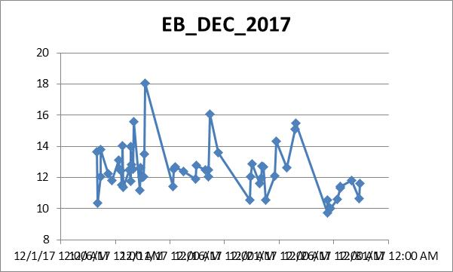
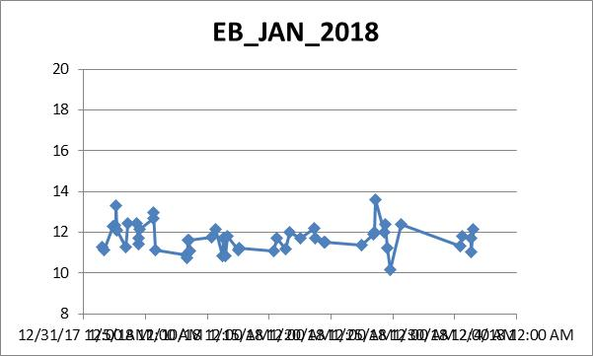
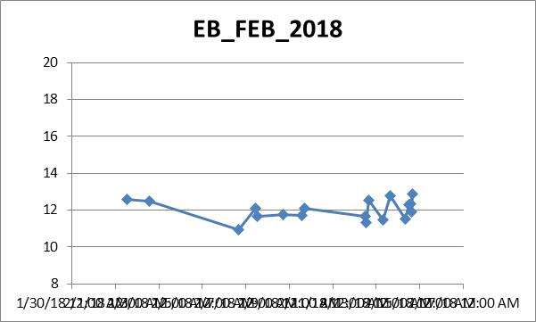
Initial Look (Travel Times)
Highly Unreliable
Opening
Improved Reliable

Slide 10
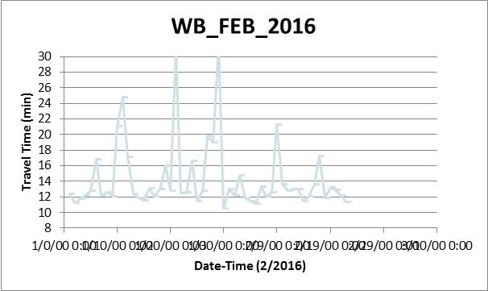
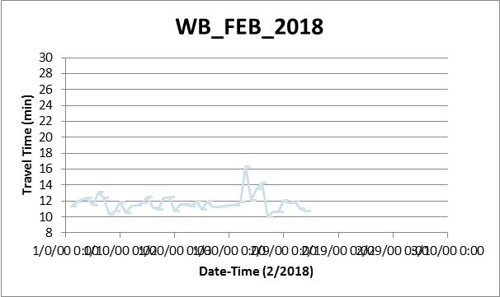
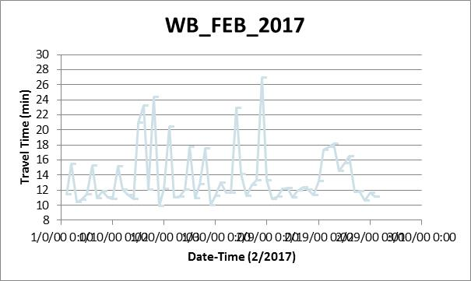
Expanded Look (OR99W)

Slide 11
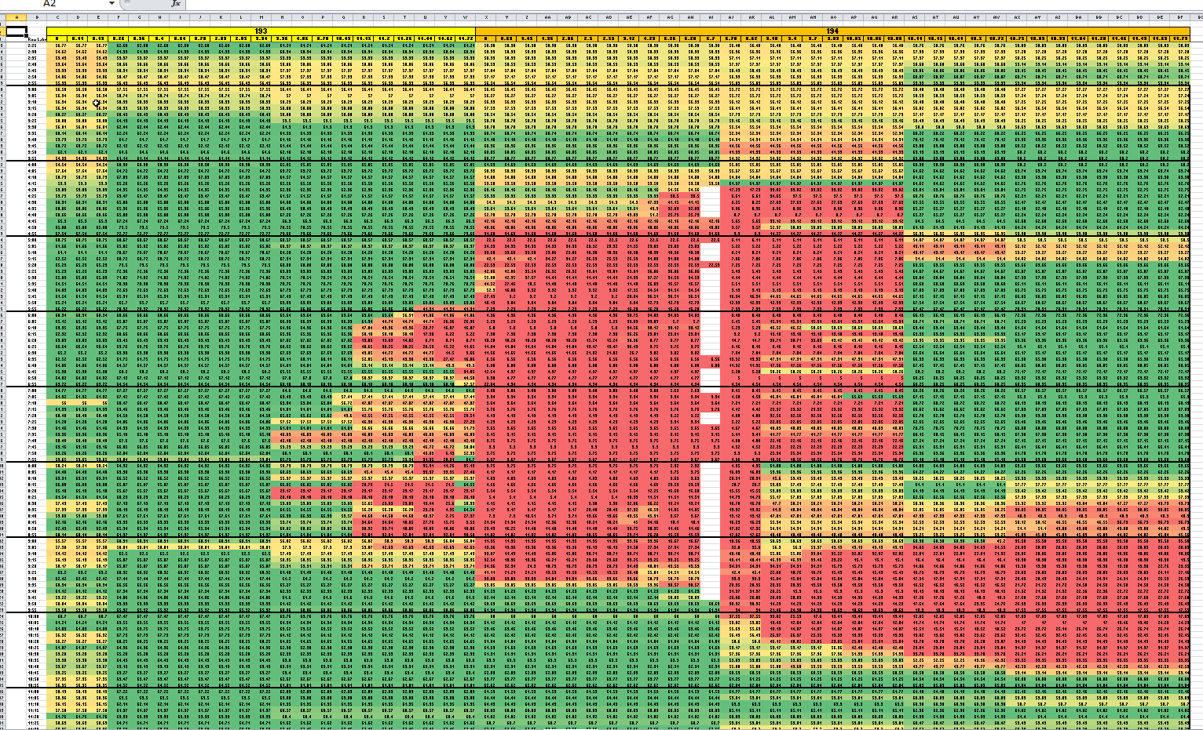
Example: Work Zone Analysis
Woodburn
I-5 NB ➔
Wilsonville
Incident Location & Time
⬅ Time of Day

Slide 12
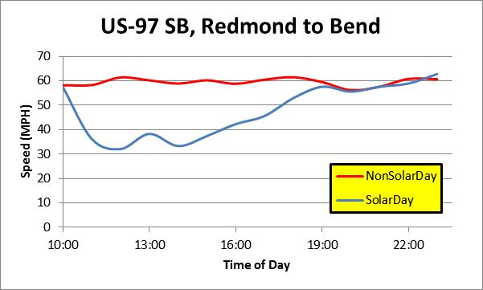
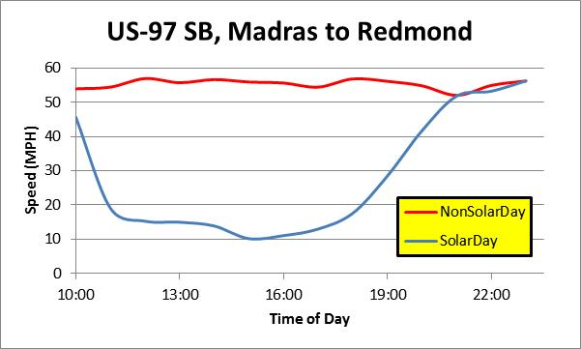
Example: Solar Eclipse
Average Speed
on the routes
Took over 9 hours for average speed to return normal

Slide 13
Example: Solar Eclipse
Quickly identify and evaluate extent of roadway issues.

Slide 14

QUESTIONS???
Richard.Arnold@odot.state.or.us (503.986.4218)

