Slide 1
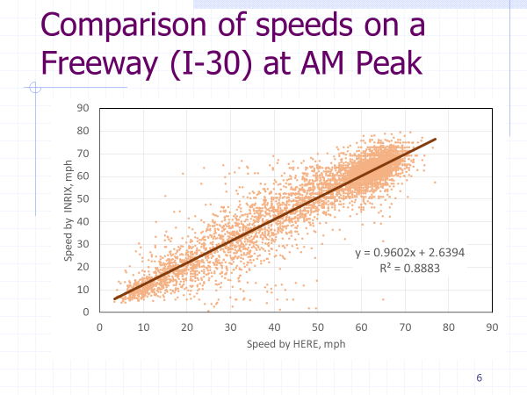
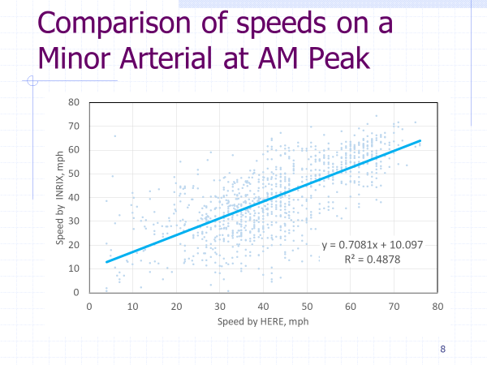
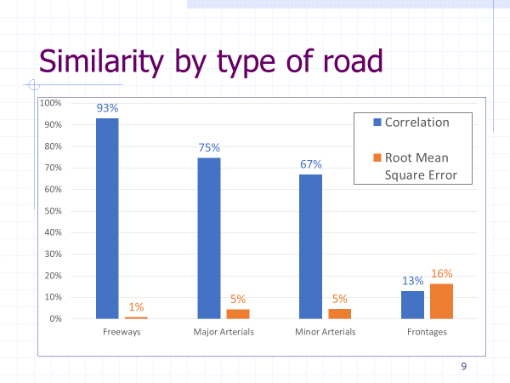
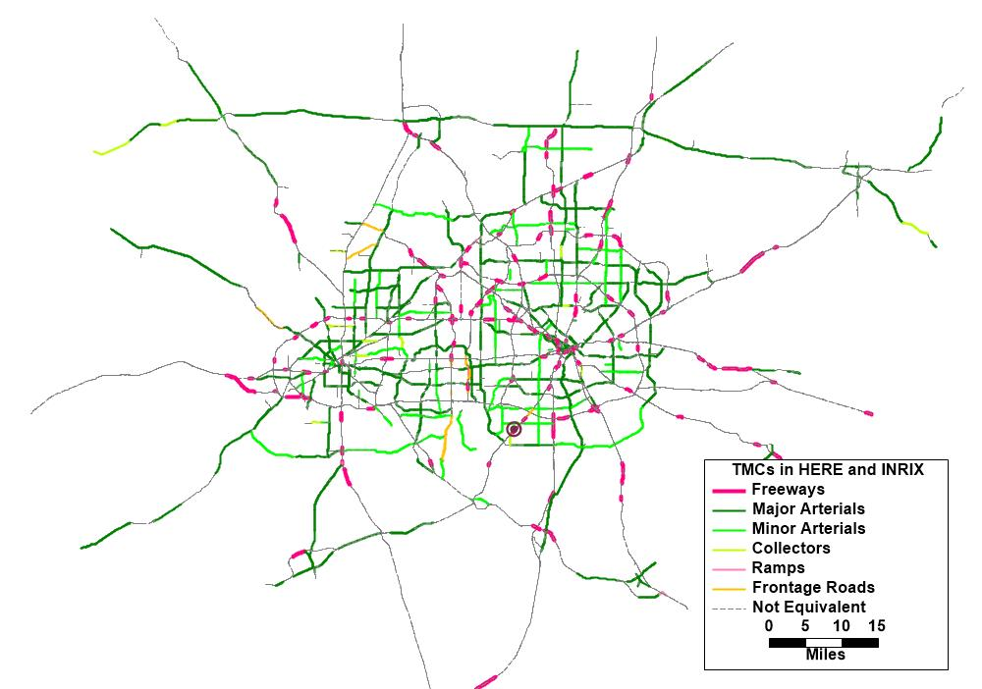
Comparing Speed NPMRDS Data between providers
in the Dallas-Fort Worth Metropolitan Area
Background
The North Central Texas Council of Government (NCTCOG) has been using the NPMRDS speeds and travel time for several analyses since it was made available in 2013 As part of the validation and calibration of our travel demand model, we observed that the speeds on arterials are significantly different between the two providers of the data: HERE, before January 2017, and INRIX afterward
Results
C$orrelation and Root Mean Square Error \left(RMSE\right)\frac{s}{ẋ}$were used
Introduction
The GIS layer TMCs (roadway segments) changed significantly in January 2017.
INRIX and HERE have same coverage on freeways
The INRIX layer has less coverage on non-freeways
Only 5% of the TMCs are similar in shape between INRIX and HERE
Comparison
Travel times were provided by FHWA from HERE and INRIX for January 2017.
The comparison was made for January 2017 on similar TMCs
Only typical weekdays were considered: Tuesday, Wednesday and Thursday
Data Available
Only 5% of the TMCs (roadway segments) are geographically similar
Conclusions
The TMCs definitions of INRIX and HERE are completely different more the majority of the roadway network
Speeds on freeways are generally similar.
For non-freeways the speeds are significantly different
Contact
Francisco J. Torres, P.E.
Data Applications Manager
Model Development and Data Management | NCTCOG
Phone: (817) 608-2356 | ftorres@nctcog.org
Notes:
Copyright Colin Purrington (http://colinpurrington.com/tips/academic/posterdesign).

