Slide 1
Examining the Equity Impacts of AVs – A Travel Demand Model Approach
Jesse Cohn, AICP

Slide 2
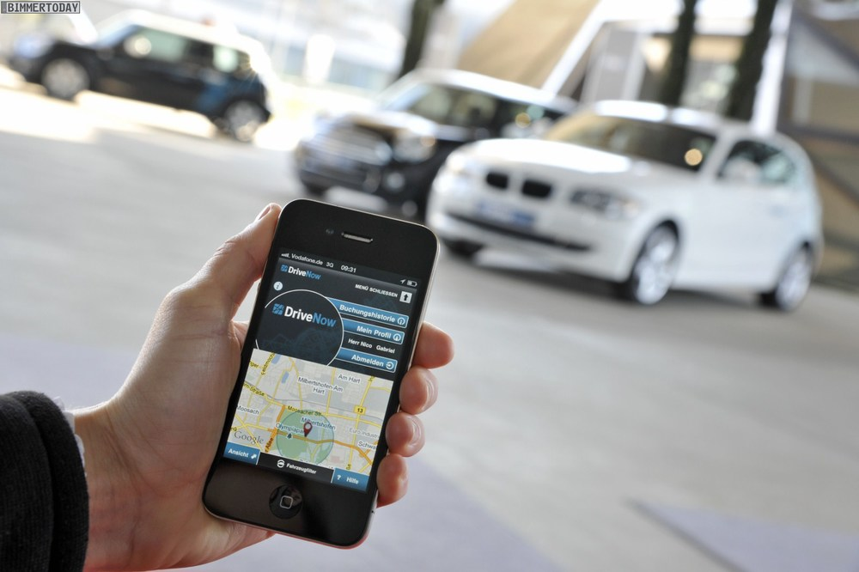
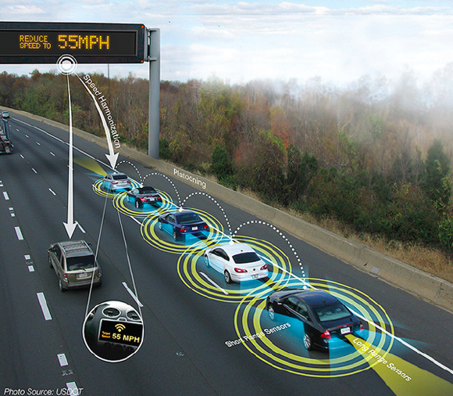
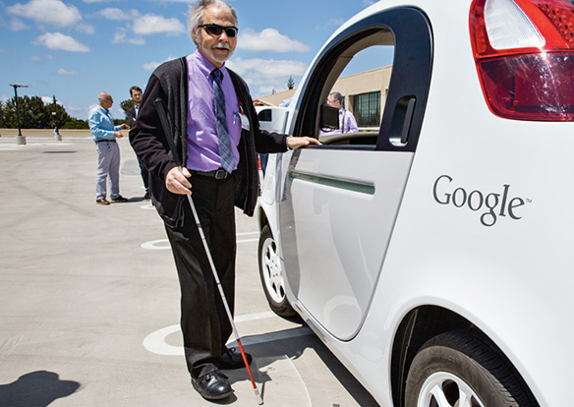
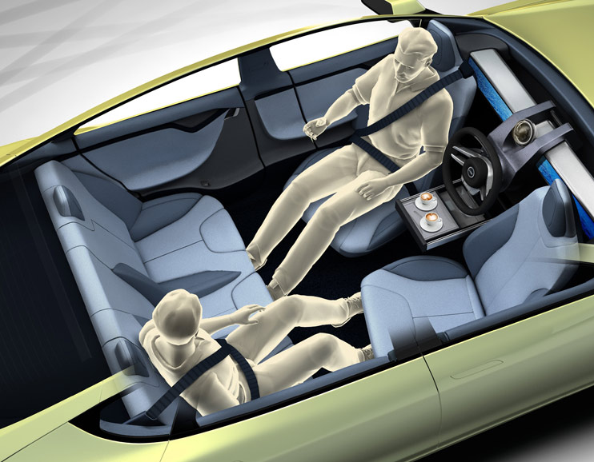
Notes:
http://www.bmwblog.com/2011/03/21/bmw-and-sixt-establish-drivenow-joint-venture-for-premium-car-sharing/
http://www.rinspeed.eu/aktuelles.php?aid=14

Slide 3
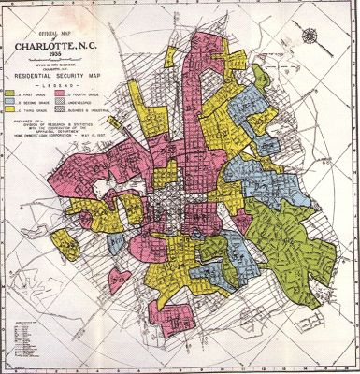
Discrimination & Disparate Outcomes
Notes:
Vision Zero Network

Slide 4
Equity refers to the fairness with which impacts
– both benefits and costs – are distributed.
Notes:
Robert Wood Johnson Foundation

Slide 5
Existing Research – AVs & Equity
Emissions impacts of AVs and their disproportionate burden (Fagnant and Kockleman, 2013)
Pricing schemes and limited access during adoption (Chen and Kockelman, 2016)
Unequal access to safety and mobility benefits (Appleyard and Riggs, 2018; Sperling, 2018)
Municipal government spending priorities (Clark, 2018; Arbib, 2017)

Slide 6
Key Questions
How will AVs impact travel in the region?
Are outcomes different in underserved communities – both today and under different AV futures?
Do AVs mitigate, maintain, or exacerbate existing differences?

Slide 7
General Approach
DC regional travel demand model
Adjust auto mode to mimic AVs
Adjust transit & vehicle occupancy
to develop different AV scenarios
Assess regional, equity areas, and affluent area outcomes for key performance measures

Slide 8
Assumptions
AUTONOMOUS
VEHICLES
TRANSIT SERVICE & OPERATIONS
Roadway Capacity
Auto Access and Park Time
Parking Cost
Value of Time
Auto Availability
Discretionary Trips
Zero-Occupancy Trips
Vehicle Occupancy
Transit Fares
Speeds
Frequencies
Number of Routes

Slide 9
Scenarios
2017 Unmodified
2040 Unmodified
2040 Single-Occupancy AVs
2040 Shared AVs
2040 Single-Occupancy AVs + Limited Transit
2040 Shared + Limited Transit
2040 Single-Occupancy + Enhanced Transit
2040 Shared+ Enhanced Transit

Slide 10
Equity Emphasis Areas
Census tracts meeting one of three criteria:
high concentration of low-income individuals,
high concentration of two or more minority population groups
high concentration of one or more minority population groups and low-income concentration
Concentration: between 1 and 1.5 times the regional average
High Concentration: greater than 1.5 times the regional average

Slide 11
Equity Emphasis Areas
Location Characteristics |  | Region | Equity Emphasis Areas | Non-Equity Emphasis Areas
Land Use | Population | 6,820,772 | 1,769,589 | 5,051,183
 | Population Density | 2,197 | 7,451 | 1,762
 | Employment | 4,186,373 | 1,096,084 | 3,090,289
 | Employment Density | 1,349 | 4,615 | 1,078
Income | < $50,000 | 29% | 43% | 24%
 | $50,000-$100,000 | 31% | 32% | 30%
 | $100,000-$150,000 | 20% | 16% | 22%
 | > $150,000 | 21% | 10% | 25%
Vehicle Availability | 0 vehicles | 14% | 25% | 10%
 | 1 vehicle | 33% | 36% | 32%
 | 2 vehicles | 35% | 30% | 36%
 | 3+ vehicles | 18% | 10% | 21%
Notes:
Remove?

Slide 12
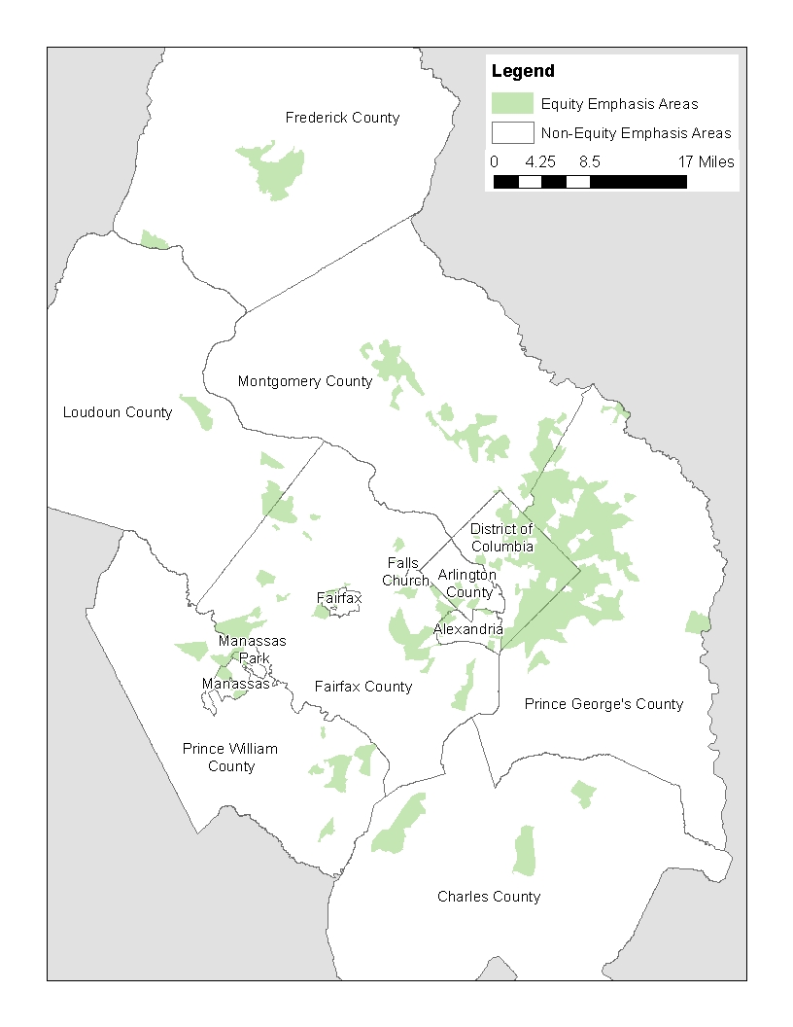

Slide 13
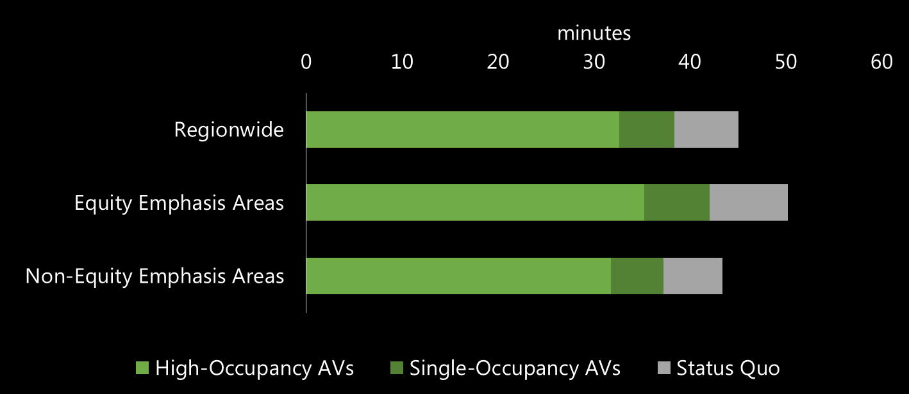
Auto Travel Times
AVs could reduce travel times regionwide and reduce disparities – particularly when AVs are shared

Slide 14
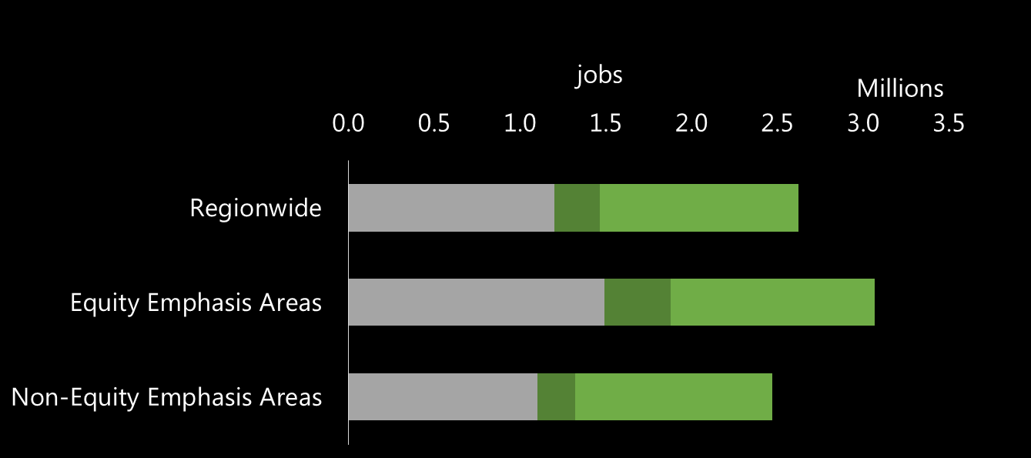
Auto Job Accessibility
Equity Emphasis Areas have better job accessibility given their centrality; their advantage increases with AVs

Slide 15
Exposure
AVs could increase vehicle miles traveled, increasing collision exposure, as well as exposure to noise and air pollution
Daily VMT

Slide 16
Results Summary
Baseline
Implication
Policy Recommendations
AV Impact
AVs increase Equity Emphasis Area’s advantage
Accessibility is linked to density and centrality
Auto Job Accessibility
Smart growth,
transit investments
AVs reduce the disparity in auto travel time for Equity Emphasis Areas
Incentives and regulations promoting carpooling
Auto Trip Duration
Congestion can be mitigated by shared rides
AVs exacerbate the existing disparity
Sharing and transit are not sufficient to address disparity
Electrification regulations or incentives
Vehicle Miles Traveled

Slide 17
Limitations
Regional travel demand model framework
Examining zonal trips in aggregate
Simplification of travel behavior
No feedbacks related to land use and employment
Generous assumptions
Universal AV access; no change in vehicle operating costs
Equity Emphasis Areas as static locations

Slide 18
An Equitable AV Future
Incentives for pooling and shared rides
Smart growth policies & investment in transit
Vehicle electrification

Slide 19
THANK YOU!
Jesse Cohn
j.cohn@fehrandpeersdc.com
This research was completed in partnership with the Union of Concerned Scientists.

