Slide 1
Visitor Models from Passively Collected Data
Hadi Sadrsadat, PhD
Vincent Bernardin Jr., PhD
Stephen Tuttle
Jesse Frankovich
June 4, 2019

Slide 2
Visitor Models from Passively Collected Data
  Passively collected big data from mobile devices such as AirSage
  Information on visitor trips separate from trips by residents of the region
  A relatively cost effective but very valuable source of data to calibrate models of visitor travel within a region
DEVELOPED VISITOR MODELS
CHATS Travel Demand Model for Berkeley-Charleston-Dorchester Council of Government (BCDCOG)
Michigan Statewide Travel Demand Forecasting Model

Slide 3
Developed Visitor Models
CHATS VISITOR MODEL
  AirSage raw resident and visitor trips expansion
    Through a multi-step procedure
    Socio-economic data at TAZ level and
    Traffic counts on the street network
  Using expanded visitor trips to develop both generation and distribution models
SOURCE | OD PAIRS | % OBSERVED
NHTS | 39 | 0.01%
AIRSAGE | 54,582 | 7.18%

Slide 4
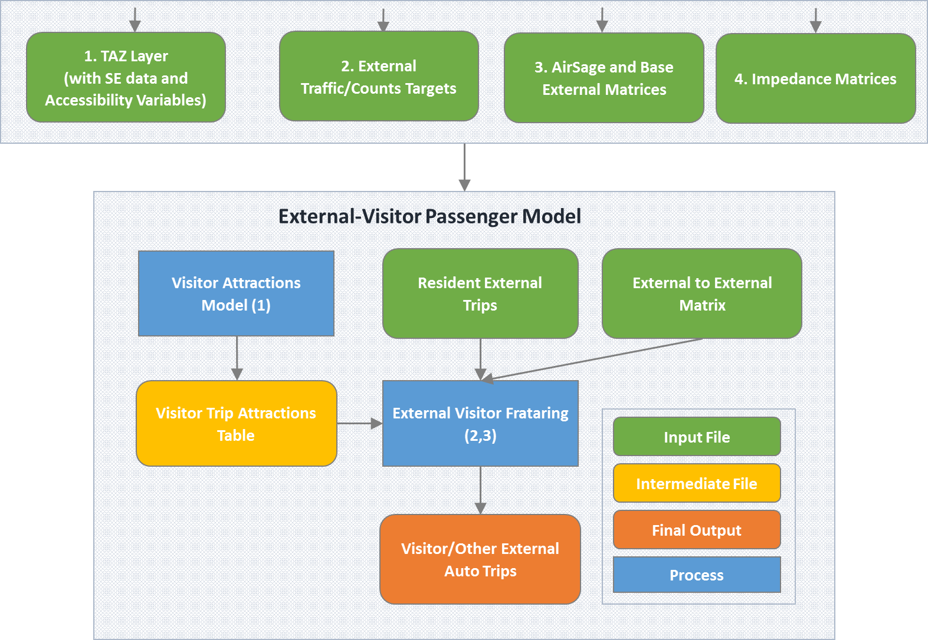
Developed Visitor Models
CHATS VISITOR MODEL

Slide 5
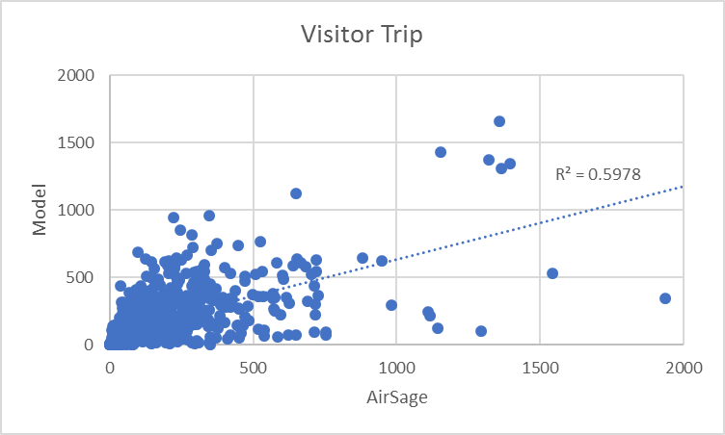
Developed Visitor Models
CHATS VISITOR MODEL
  Regression models to estimate internal visitor productions/attractions
    Zonal population, employment
    Intersection density
    Presence of beach shores
AirSage expanded internal-internal visitor trips: 171,332
Model internal-internal visitor trips: 171,765

Slide 6
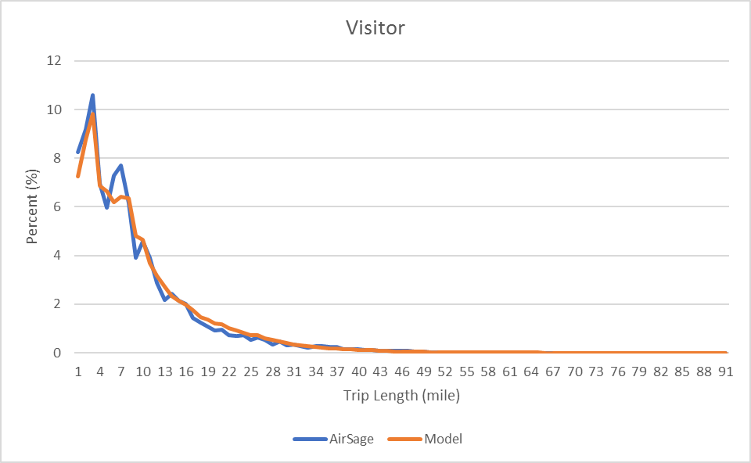
Developed Visitor Models
CHATS VISITOR MODEL
  Adding visitor special generators
    Airport
    College and universities
    Major malls or outlets
Trip Length Frequency Distribution

Slide 7
Developed Visitor Models
MDOT VISITOR MODEL
  Visitor trips proceed from long distance trips
  Coupling visitor trips to long distance trips
    To ensure spatial consistency
    To improve the estimation of visitor trips linked to vacation homes rather than hotel employment
Long-Distance Trips
Visitor Trips
Trip Generation
Destination Choice
Trip Generation
Michigan + Halo Resident
Michigan + Halo Resident
Other
Other
Destination Choice

Slide 8
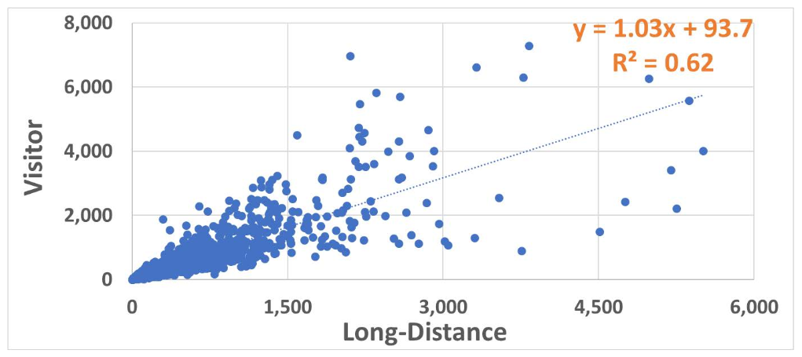
Developed Visitor Models
MDOT VISITOR MODEL
  Visitor trips are modeled as a function of:
    Long distance destinations
    Zonal attributes such as employment types associated with tourist attractions
    Other amenity variables such as lakefront miles

Slide 9
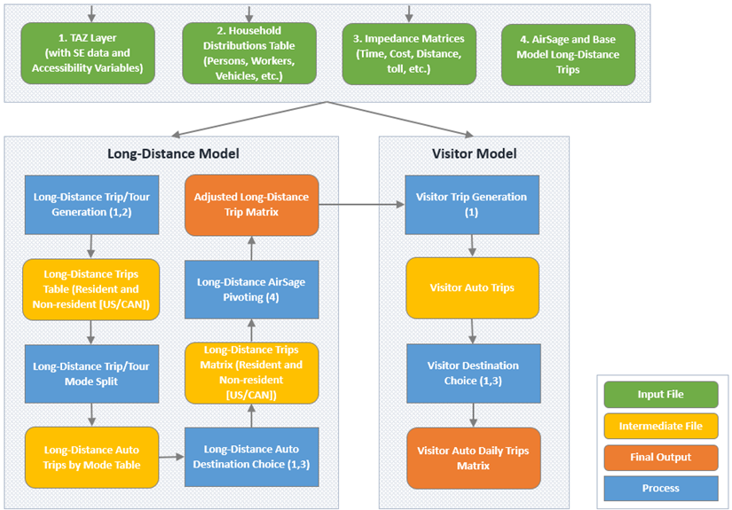
Long Distance and Visitor Models
Model Architecture
  Long Distance: One End > 50 miles from home
  Visitor: Both Ends > 50 miles from home
  Separate LD models for Residents and Non-Residents
`

Slide 10
Visitor Generation Model
  Visitor demand linked to LD Attractions
  Simple linear models segmented by distance of LD trips
Trips | Variable | Value
< 125 Miles | LD Trips | 1.33
 | Retail | 0.04
> 125 Miles | LD Trips | 4.49
 | Lake Shoreline | 7.43
 | Park Area | 7.62
 | Retail | 0.23
Model Trips: 688K
AirSage Trips: 558K

Slide 11
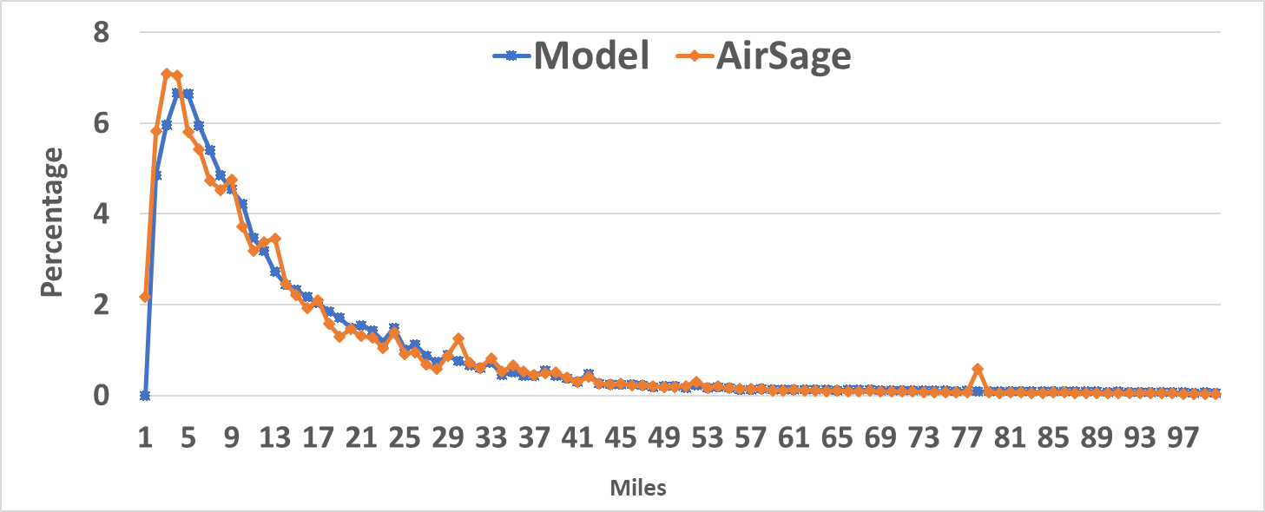
Visitor Gravity
  Gravity model distributes visitor ends by mode
  Friction Factors calibrated based on AirSage Data
Trip Length Frequency Distribution

Slide 12
Contact
Vince Bernardin, Jr, PhD
DIRECTOR
Vince.Bernardin@rsginc.com
812.200.2351
www.rsginc.com
Hadi Sadrsadat, PhD
CONSULTANT
Hadi.Sadrsadat@rsginc.com
240.283.0636

