Slide 1
Exploratory Modeling and Analysis with TMIP-EMAT
Beta-Test Scoping
TRB Planning Applications Conference
Session: Saying Something Useful When All You Have is a Crystal Ball
Rachel Copperman, Cambridge Systematics
June 4, 2019

Slide 2
Acknowledgements and Disclaimer
Co-authors:
FHWA: Sarah Sun
CS: Marty Milkovits
The views expressed in this presentation do not necessarily represent the opinions of FHWA and do not constitute an endorsement, recommendation, or specification by FHWA.

Slide 3
Current State of the Practice
Point prediction
Uncertainty Space
Best Guess on All Concerns
Scenario planning
Several Best Guesses
We Should do more
(and we can)
Core Model

Slide 4
Exploratory Modeling and Analysis
Strategy presence and combinations (lever combinations)
Model input ranges/distributions/correlations (scenarios)
Decision Space
Uncertainty Space
Each unique combination of strategy levers and scenarios is an Experiment
Model
Outcome Space

Slide 5
TMIP-EMAT Workflow Details
Scope
Model
Analyze
Step 1: Scoping—Define uncertainty and decision space
Step 2: Meta-model development to produce outcome space
Step 3: Simulation (populate outcome space) and analysis
Scoping
Strategy levers
Measures
Uncertainties
Trivial core model runtimes: simulate directly
Monte Carlo simulation of experiments
Non-trivial
meta-models
Measures by Experiment
Run times
Simulate
Meta-model development
Design experiments
Run experiments in core model
Derive meta-model
Risk analysis
Exploratory analysis
Where necessary, leverages Core Model outputs to produce Meta-models that can quickly explore the range of uncertainty
Meta-models are regression models of the Core Model outputs that run very fast.

Slide 6
Beta-Test Motivation
Oregon Department of Transportation (ODOT):
“We were planning on running our new ABM to see how it performed around questions related to emerging technologies and trends (AVs, TNCs, light weight personal vehicles…). TMIP-EMAT offered a much more structured way to approach this testing than the informal “run-and-pull, run-and-pull, run a couple more times and call it good” approach that was planned prior to TMIP-EMAT.”
Greater Buffalo-Niagara Regional Council (GBNRTC):
“Never before have we faced so many uncertainties about the future of travel in our region due to new technologies and generational travel preferences. We envision TMIP-EMAT as an ideal add-on to our existing regional model as it will allow us to test a vast array of scenarios while saving us a great deal of time to best educate our policy makers.”
San Diego Association of Governments (SANDAG):
“We are interested in using TMIP-EMAT to evaluate uncertainties associated with investment, pricing, and regulatory policies related to crossings at point of entries along San Diego and Mexico border. Eventually, We want to use TMIP-EMT to analyze uncertainties associated with emerging technologies on transportation accessibilities, congestions, green house gas emissions, and social equities in the San Diego region.”

Slide 7
ODOT Beta-Test Overview
Region
Core Model
Goal
Rogue Valley in Southern Oregon
Activity-based travel demand model
Explore the potential of a region-wide paratransit/shared mobility transit system to improve accessibility and decrease auto dependency and usage under various alternative futures.

Slide 8
ODOT Beta-Test Scope
Policy/Strategy
Subsidized Shared Mobility
Parking policy
Metrics/Performance Measures
Accessibility measures
Congestion and vehicle usage measures
Multi-modal usage: mode split, transit ridership
Transportation revenue
Uncertainties
Autonomous vehicles (adjust highway capacity and VOT)
land-use and population (household spatial distribution)
economy (number of workers and employment)
electric vehicles and fuel prices (auto operating cost)
Micromobility

Slide 9
SANDAG Beta-Test Overview
Region
Core Model
Goal
San Diego border with Mexico
San Diego cross-border sub-model to regional ABM
Explore the potential of increased transit and micromobility options and incentivizing shared-auto usage to promote non-SOV border crossings and reduce congestion under various uncertainties

Slide 10
SANDAG Beta-Test Scope
Policy/Strategy
New transit service
Increased micromobility options
Toll levels at new border crossing
Metrics/Performance Measures
Congestion and vehicle usage measures
Multi-modal usage: mode split, transit ridership
Toll road usage/volume
Uncertainties
Travel behavior (VOT)
Auto competitiveness (auto operating cost)
Border crossing wait time
Land-use (retail employment, Mexico population density)

Slide 11
GBNRTC Beta-Test Overview
Region
Core Model
Goal
Greater Buffalo area
Regional trip-based model
Explore the potential for transit improvements within a corridor to improve multi-modal accessibility, decrease congestion and VMT, and increase transit ridership under a range of land-use and transportation technology uncertainties.

Slide 12
GBNRTC Beta-Test Scope
Policy/Strategy
Transit improvements along a corridor
Metrics/Performance Measures
Congestion and vehicle usage measures
Uncertainties
Autonomous vehicles (adjust highway capacity)
Multi-modal usage: mode split, transit ridership
Accessibility
Land-use and population (employment and household location and levels, demographics, household density, school enrollment levels)
Non-motorized connectivity and attractiveness (non-motorized distance, walk speeds)

Slide 13
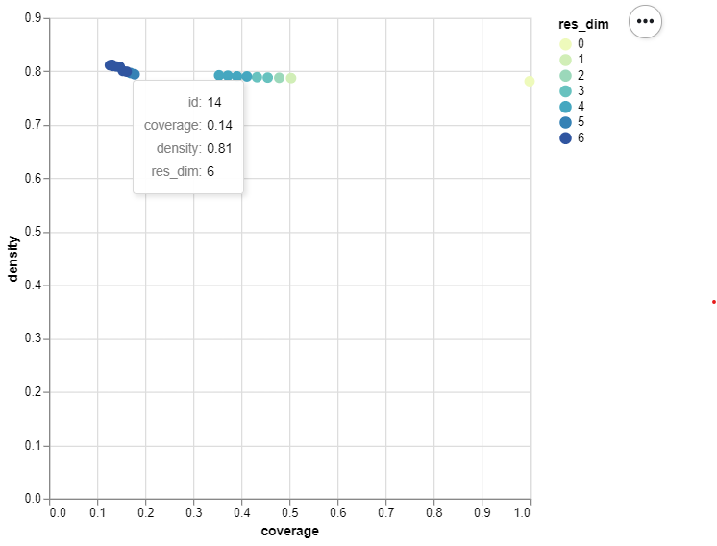
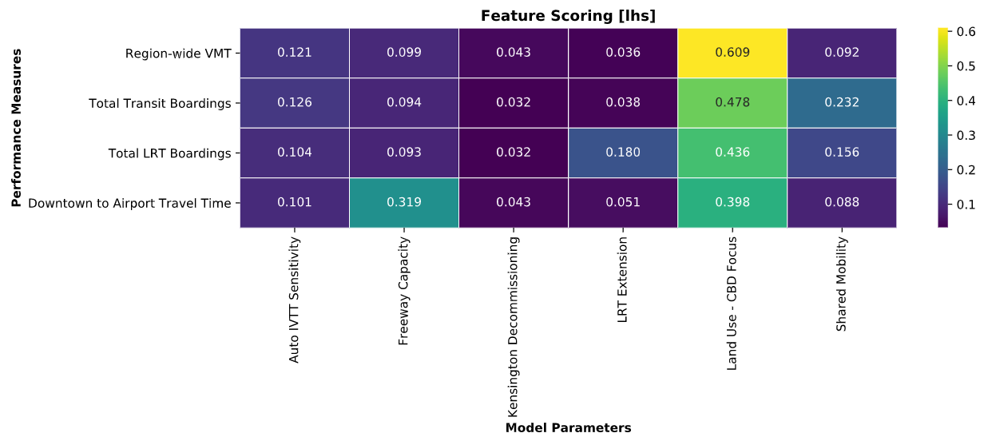
Beta-Test Analysis [Scenario Discovery]
Patient Rule Induction Method: PRIM
Feature Scoring

Slide 14
Beta-Test Analysis [Directed Search]

Slide 15
Thank You!
Rachel Copperman – rcopperman@camsys.com
Sarah Sun – sarah.sun@dot.gov
Marty Milkovits – mmilkovits@camsys.com
Open Source Software: https://github.com/tmip-emat

Slide 16
reference

Slide 17
Robust Decision-Making
Mitigation Strategies
Shaping Strategies
Strategies to mitigate impacts or shape future
Performs well (no regrets) across plausible futures?
No
Reliable signposts?
No
Yes
Sufficient lead time?
No
Yes
Yes
Near-term robust strategy (low risk)
Deferred adaptive strategy (low risk)
Near-term hedging and shaping strategies (higher risk)

Slide 18
What is TMIP-EMAT?
EMAT: Exploratory Modeling and Analysis Tool
Development funded by FHWA Travel Model Improvement Program
Continued support through Spring 2020
Tool to support a quantitative Robust Decision-Making approach to transportation planning with deep uncertainty
Complements and enhances (does not replace) existing models, visualizations, or planning tools

Slide 19
TMIP-EMAT Components
EMAT Scoping
Risk Variables, Performance Measures, Strategies
Analysis Visualizers
Model Manager
Simulation Results
Core Model API
Core Model
Standard EMAT Components
Deployment Specific
Requirements
Region/Application Specific Materials

Slide 20
Next Steps for Beta-Test and Project
Finalize Strategy and Uncertainty Ranges: Underway
Develop API: Underway
Meta-model development (i.e. run core model runs): Summer
Evaluate proposed strategy: late summer/early fall

