Slide 1
Performance-Based Planning:
Increasing Transparency & Understanding in Decision Making
2017 TRB Transportation Planning Applications Conference
Maria Roell
Atlanta Regional Commission

Slide 2
Outline
Background
ARC’s Project Evaluation Objectives
Big Data Challenges and Solutions
Criteria for The Atlanta Region’s Plan
Project Evaluation Visualization
Lessons Learned
Next Steps

Slide 3
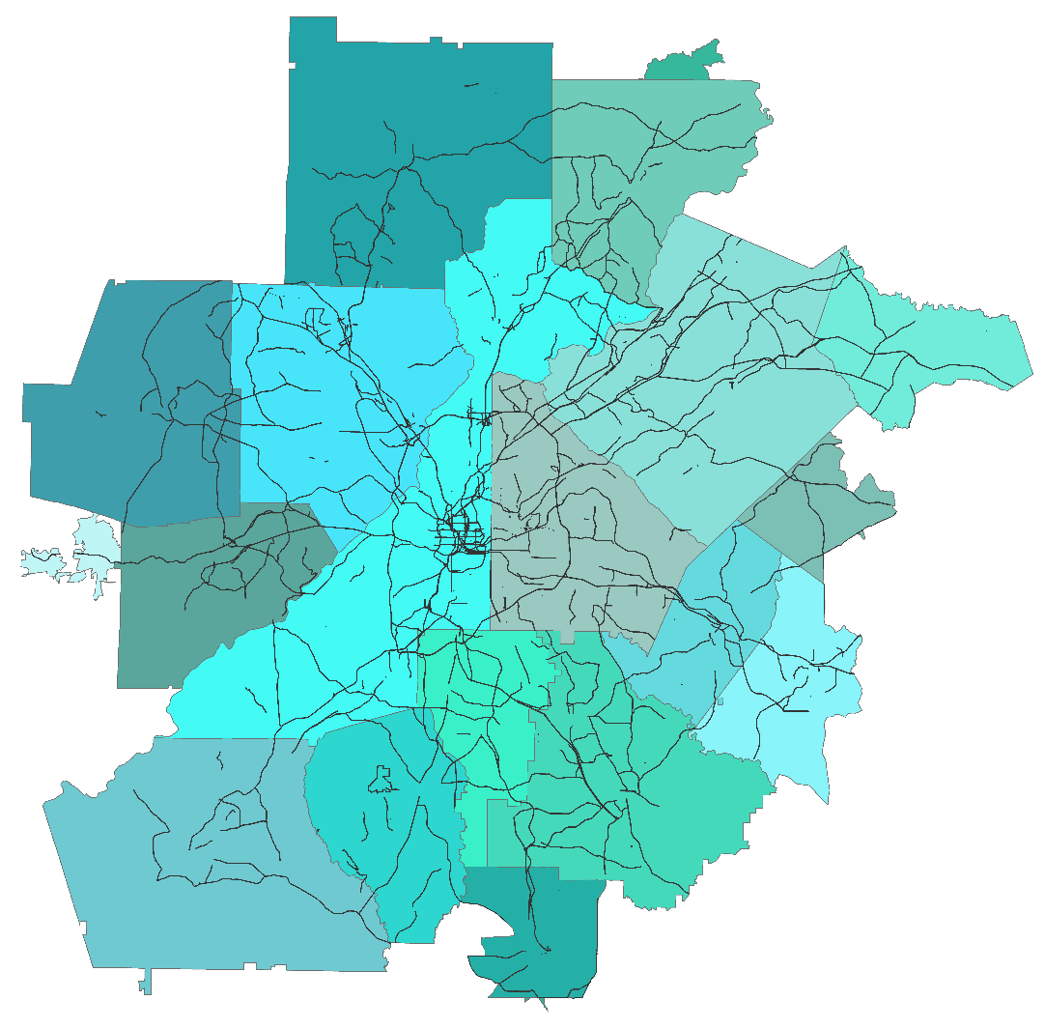
Background
20 Counties
Population: 5 Million
726 Projects
340 Programmed
114 Long Range
272 Aspirations

Slide 4
ARC’s Project Evaluation Objectives
Understand need and performance separately
Find individual projects’ significance
Bring comprehensive dataset to public and decision makers

Slide 5
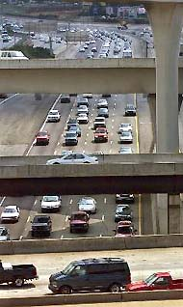
Big Data
Challenges
Choosing a provider
Cost
Collection Methodologies
Different Networks/Coverage
Produce Understandable Results
Solutions
Try to fill current data gaps
Set aside time to analyze
Aggregate and tell stories

Slide 6
Data Sources and Networks
Project Data
Estimated
Real World Data
Project ID
Project Cost
Model
Crashes
NAVTEQ & INRIX
Equity
Other
Resources
B/C
Volume,
VMT, VHT,
Accessibility
Crash
Rate
TTI
ETA
RTN
ASTRO
NHS
Model Network
Separate Networks
2015 Key Network

Slide 7
Criteria for The Atlanta Region’s Plan
Need Metrics- Current
Variable | Measure | Calculation | Source
Congestion | Travel Time Index | Avg. TTI by Project | NAVTEQ/INRIX
Accessibility | Percent Volume | Flow Bundle Analysis | VISUM
Safety | Crash Rate | Crash Rate/ Avg Crash Rate By Facility Type | CARE
Air Quality | Particulate Matter | Avg. Level of PM by Project | AREES
Reliability | Buffer Index | 95th Percentile Avg Travel Time | NAVTEQ/INRIX
Equity | Equitable Target Area | Inside or Outside | ETA Index
Freight | Truck Network | On or Off Network | ASTRoMaP
Performance Metrics- Future
Variable | Measure | Calculation
Congestion | Vehicle Hours Delay | Project Build -No Build
Accessibility | Percent Volume | Project Build -No Build
Freight | Truck VMT | Project Build -No Build
Air Quality | Particulate Matter kg/year | Project Build -No Build
Deliverability | Environmental Impacts | Avg. Number of Environmental Obstacles
Impact | Volume/Mile | Categorized

Slide 8
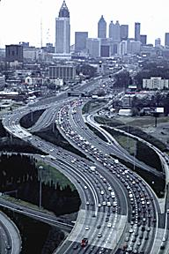
Benefit Cost, Need & Performance
Benefit Cost
Cost of Project
Change in emissions
Change in congestion
Need and Performance
Each measure indexed
Each measure weighted to reflect region’s policies and goals

Slide 9
Visualization
Tell a Story
Can customize chart
Can focus on what is most important to them
Increased Transparency
Graphics help to picture differences
Between need and performance
Between projects
Can look for projects in specific area

Slide 10
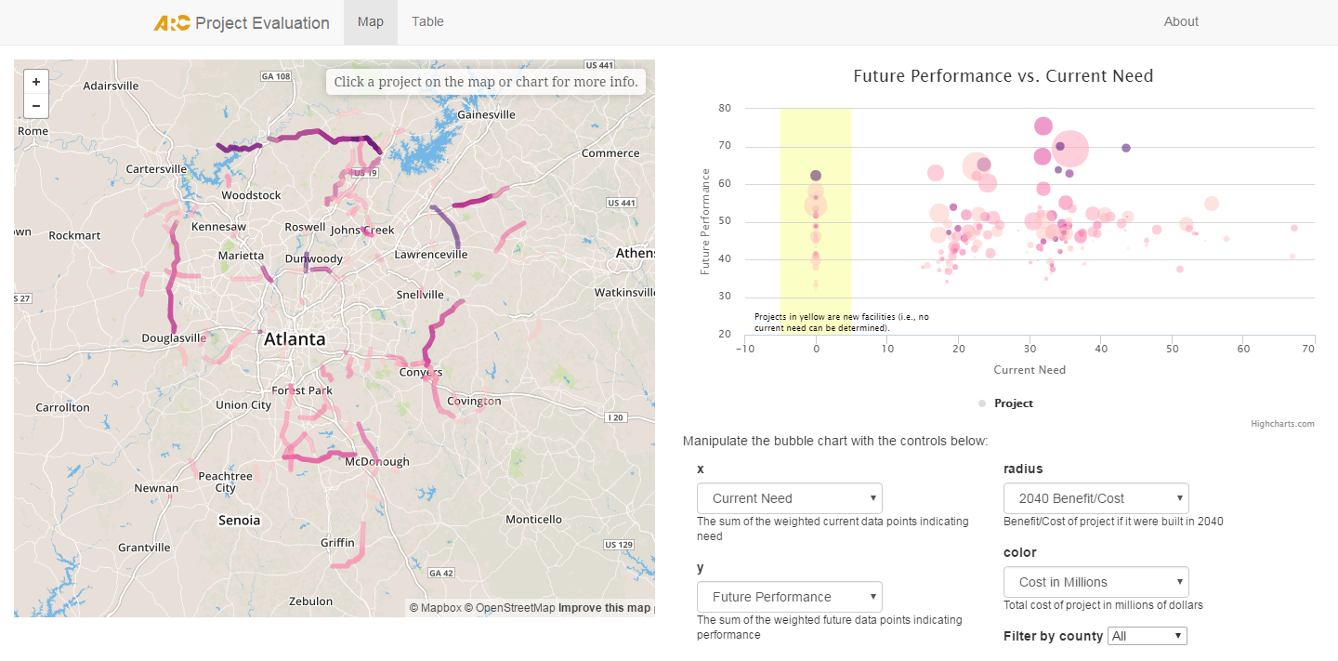
Visualization

Slide 12
Lessons Learned
Future Performance Measures
Mostly modelled data
No data for non-roadway expansion projects and new construction
Education
Project selections had been made already
Not a resource for public input, just transparency
Usage
Need to set up analytics to track how much site is used

Slide 13
Staying Relevant
Recent Overhaul of Project Prioritization
New performance measures by project type
Mostly real world data
All need measures
New Equity Advisory Group
New Resiliency Plan
Update Code
Need to add functionality

Slide 14
New Project Prioritization
Project Types
Bicycle
Pedestrian
Trail
Roadway Asset Management & Resiliency
Roadway Expansion
Roadway: Transportation Systems Management & Operation
Transit Expansion
Transit Asset Management & System Upgrades
Criteria
Mobility / Congestion
Reliability
Network Connectivity
Multimodalism
Asset Management & Resiliency
Safety
Air Quality & Climate Change
Cultural/Environmental Resources
Social Equity
Land Use Compatibility
Goods Movement
Employment Accessibility

Slide 15
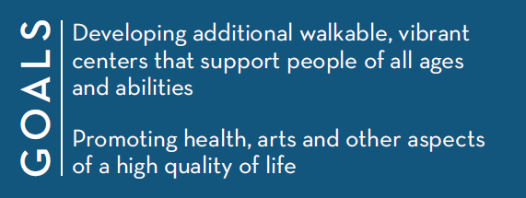
The Atlanta Region’s Plan Policy Goals
Objectives and Policies from the Atlanta Region’s Plan Policy Framework are directly incorporated into the project evaluation
Some objectives are incorporated as policy filters
Some objectives are incorporated as performance measures, metrics and weights

Slide 16
Next Steps
Recode
Include new project evaluation measures
Include more project types
Better address equity & resiliency
Increase Visibility
Advertise tool on website
Educate public on TIP process

Slide 17
Summary
Project evaluation measures are complicated
Big data requires a storytelling platform
Data visualization is not a static project
Notes:
Project evaluation measures are complicated
Many sources and types
Needs to be broken down logically
Should provide a way to consume the data
Should provide data storytelling platform
Data visualization can be a powerful tool for this
Data visualization is not a static project
Should evolve with changing methods and data

Slide 18
Thank you!
Maria Roell- MRoell@atlantaregional.com
Project Evaluation Visualization
http://atlregional.github.io/proj-eval/#

