Slide 1
Calculating the benefits of Transit in North Carolina
Kai Monast
kcmonast@ncsu.edu
919-515-8768
Project Sponsor: NCDOT
Public Transportation Group

Slide 2
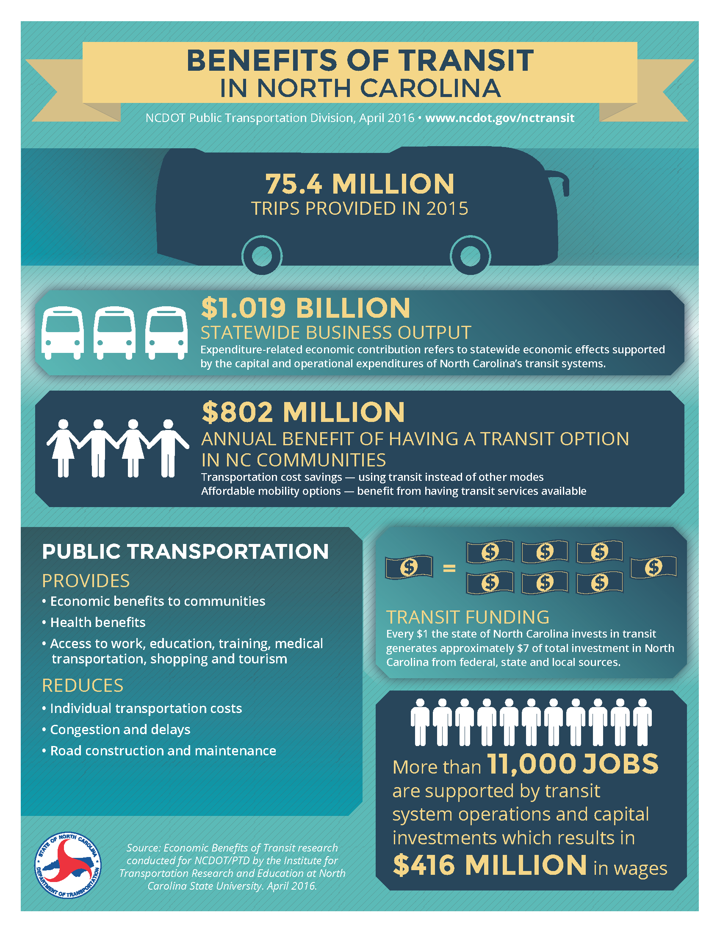
Summary
Consistent methodology for estimating the benefits of public transportation to stakeholders
Contained in a single-page handout
Designed to be updated annually
Calculated at the individual transit system level
Can be aggregated to regional and state levels

Slide 3
State Funding Leverage
$66 million in State funds
Helps bring in $376 million in Federal and Local funds
Every $1 of State Investment results in $7 of direct investment

Slide 4
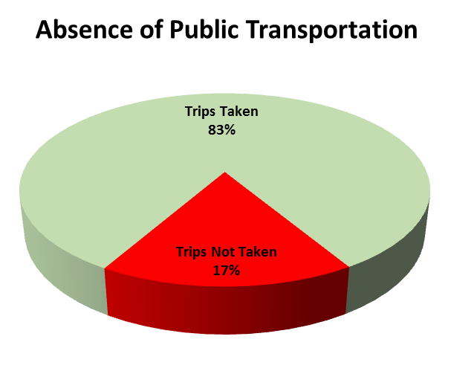
Purpose of Study
What are the economic and mobility benefits created by public transportation in North Carolina?
62.6 million trips would be taken via other modes
Individual transportation costs
Congestion and delay
Road maintenance and construction
Health impacts
12.8 million trips would not be taken
Delayed medical treatment
Work productivity
Education/training
Shopping and tourism
Lost Economic Contribution
Wages
Business output
Jobs
Value added/State product
Sources: NCTR 2014 and NC OpStats FY15

Slide 5
Research Approach Overview
Utilize existing, accepted methodologies
Update with current information and known values for North Carolina
Take conservative path to estimate the minimum contributions
Combined data and methods from multiple resources:
Small Urban and Rural Transportation Center (SURTC), at Upper Great Plains Transportation Institute, North Dakota State University
Center for Urban Transportation Research (CUTR), University of South Florida
TTI at Texas A&M University
NC Operating Statistics Data (compiled annually by ITRE)
TREDIS

Slide 6
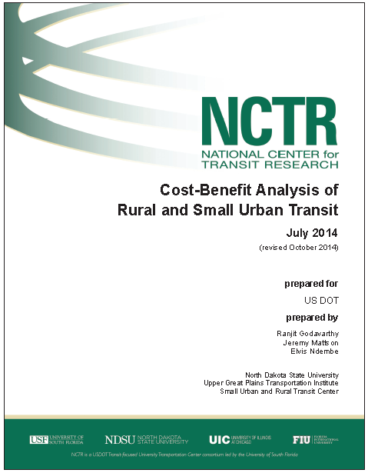
Resources—National Center for Transit Research, SURTC, North Dakota State University
Recent methodology for estimating benefits from rural and small urban transit
Peer reviewed and presented at 2015 Transportation Research Board Annual Meeting
Additional national presentations
http://www.ugpti.org/resources/reports/downloads/2014-07-cost-benefit-analysis.pdf

Slide 7
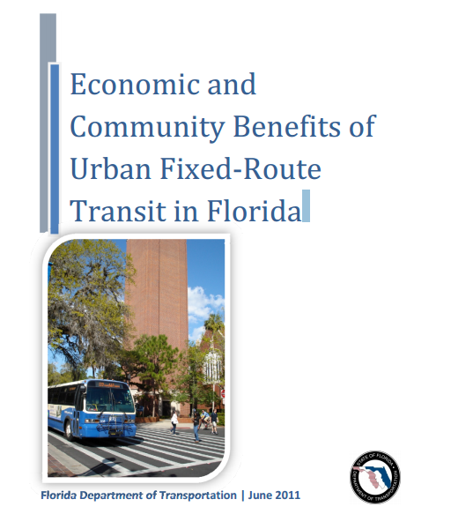
Resources—Center for Urban Transportation Research (CUTR), University of South Florida
Methodology for estimating benefits for urban fixed- route
Developed for Florida DOT
http://www.dot.state.fl.us/transit/Pages/Economicsand
CommunityBenefits.pdf

Slide 8
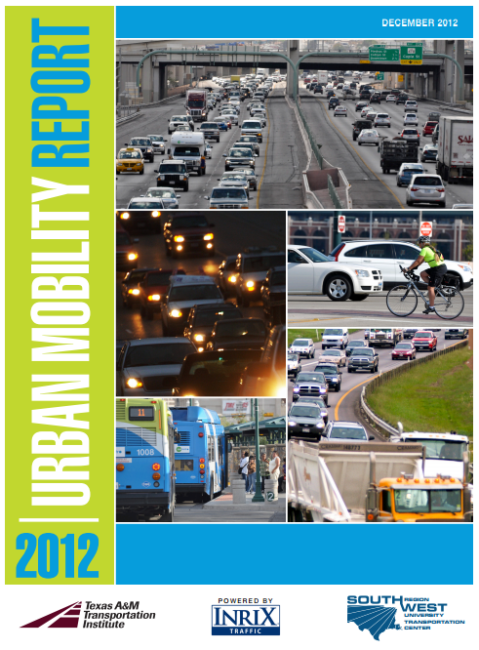
Resources—Texas Transportation Institute at Texas A&M University
Prominent national method for estimating congestion costs in urbanized areas
http://d2dtl5nnlpfr0r.cloudfront.net/tti.tamu.edu/documents/mobility-report-2012.pdf

Slide 9
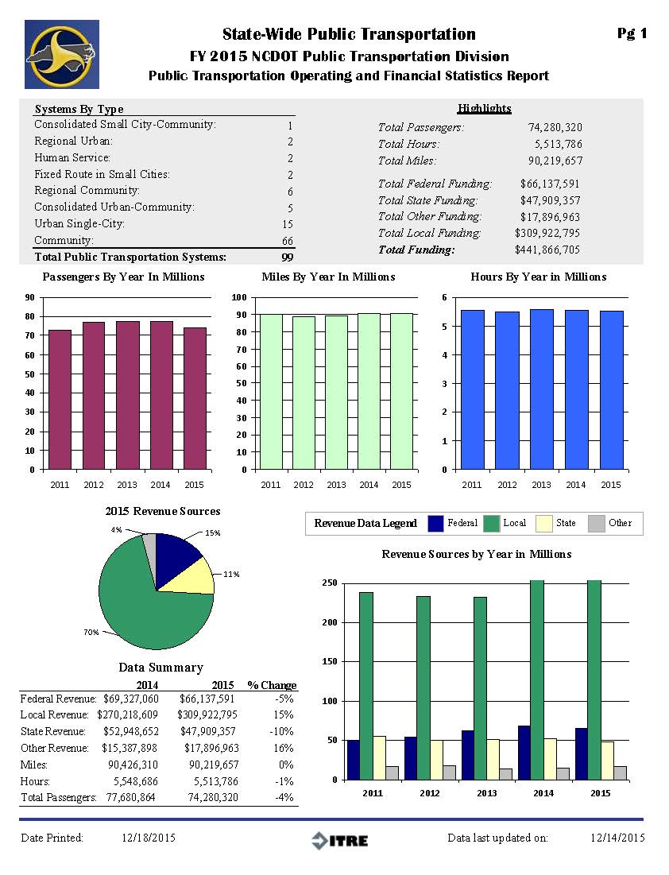
Resources—NC Transit Operating Statistics
Collected annually by ITRE
FY2015
Most complete, accurate, and timely data available

Slide 10
Resources—TREDIS
NCDOT preferred tool
Estimates economic costs and benefits of transportation projects

Slide 11
Research Approach Overview
Utilize parallel approaches to provide a comprehensive picture of economic and mobility benefits
1. Transportation Cost Savings and Affordable Mobility Benefits:
Methodology developed by SURTC
Augmented by methodology for urban areas developed by CUTR
Utilized information on congestion benefits in urban areas from TTI
Applied NC Operating Statistics Data
2. Economic Contributions Analysis
Utilized TREDIS
Applied NC Operating Statistics Data
Focused on economic inputs/outputs

Slide 12
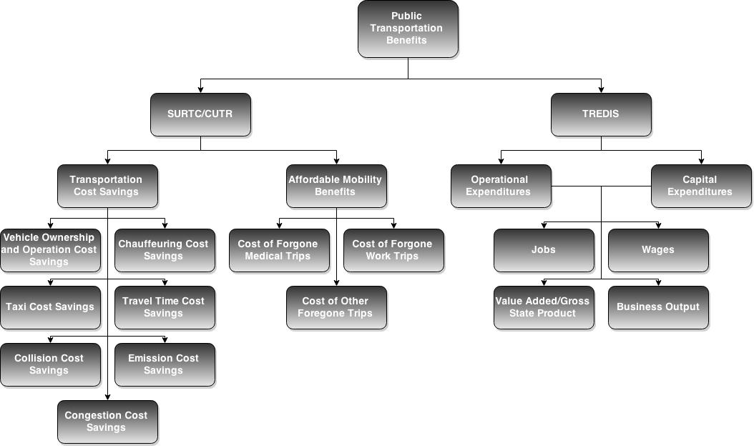
Overall Structure with Parallel Approaches
Notes:
Explain 6 components of Transit Cost Savings
Explain 3 components of Mobility Benefits

Slide 13
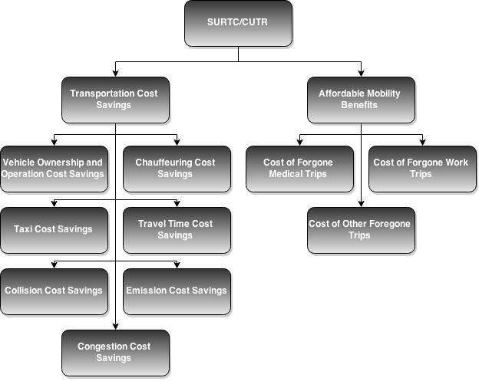
Method 1—Transportation Cost Savings and Affordable Mobility Benefits

Slide 14
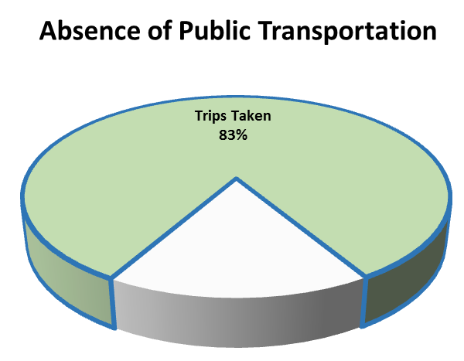
Method 1—Transportation Cost Savings and Affordable Mobility Benefits
Transportation Cost Savings—calculates additional costs that travelers would incur from using other modes, if transit was not available
Savings from using transit vs. other travel modes (owning/maintaining a car to drive, having someone else drive, taking a taxi, walking, bicycling)
Travel time savings—transit vs. other modes
Accident cost savings—transit vs. other modes
Emissions cost savings—transit vs. other modes
Congestion cost savings—transit vs. other modes

Slide 15
Method 1—Transportation Cost Savings and Affordable Mobility Benefits
Affordable Mobility Benefits—calculates costs travelers would incur from not making trips if transit was not available
Costs from poorer quality medical care resulting from fewer trips for healthcare (lack of preventive treatment resulting in aggravated conditions requiring expensive care)
Costs from lack of income from work resulting from inability to travel to employment sites
Costs from lack of educational and training opportunities, etc.

Slide 16
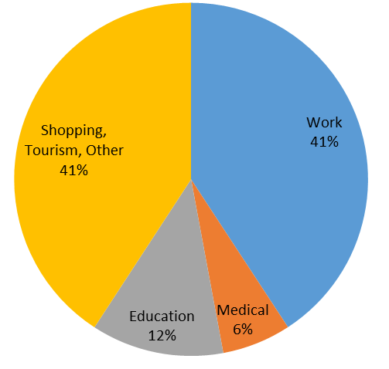
Method 1—Transportation Cost Savings and Affordable Mobility Benefits
Trips Not Taken, By Purpose

Slide 17
Method 1—Transportation Cost Savings and Affordable Mobility Benefits
SURTC/CUTR
$801.6 million
Transportation Cost Savings
$220.6 million
Affordable Mobility Benefits
$581.0 million
Vehicle Ownership and Operation Cost Savings
$50.9 million
Chauffeuring Cost Savings
$78.1 million
Cost of Forgone Medical Trips
$285.3 million
Cost of Forgone Work Trips
$245.9 million
Taxi Cost Savings
$87 million
Travel Time Savings
$63.5 million
Cost of Other Forgone Trips
$42.6 million
Accident Cost Savings
$21.9 million
Emission Cost Savings
$2.6 million
Congestion Cost Savings
$43.9 million

Slide 18
Method 2—Economic Contribution Analysis
Method 2: Economic Contribution Analysis
Calculates
Jobs
Wages
Business Output
Value Added

Slide 19
Method 2—Economic Contribution Analysis
TREDIS
Inputs
Operational Expenditures
$388.6 million
Capital Expenditures
$36.2 million
Jobs
11,000
Wages
$416 million
Results
Value Added/Gross State Product
$517 million
Business Output
$1.019 billion

Slide 20
Method 2—Economic Contribution Analysis
System | Business Output | Value Added | Jobs | Wage Income
Rural Statewide | $228,000,000 | $112,000,000 | 2,458 | $90,000,000
Small Urban Statewide | $83,000,000 | $41,000,000 | 865 | $33,000,000
Urban Statewide | $708,000,000 | $365,000,000 | 7,778 | $293,000,000
Statewide Public Transit | $1,019,000,000 | $517,000,000 | 11,101 | $416,000,000
Notes:
9,000 jobs is about equal to the number of employees at GlaxoSmithKline + Cisco Systems in the Triangle

Slide 21
Conservative Estimates- Additional Benefits Will Result from Including
Parking costs
Congestion savings for 6 of 17 urban transit systems and all small urban transit systems (rural ~ 0)
Local land use investment (Lynx corridor)
Value of trips carried by other providers
No inflation adjustment from SURTC values (2012)

Slide 22
Next Steps
Include benefits that are omitted (ex. parking)
Collect and apply actual statistics instead of using estimates (ex. trip purpose percentages)
Assess confidence in micro-level results
Develop one impact figure by combining business output and annual benefit of having a mobility option
Determine the viability of these outputs as performance measures

Slide 23
Calculating the benefits of Transit in North Carolina
Kai Monast
kcmonast@ncsu.edu
919-515-8768
Project Sponsor: NCDOT
Public Transportation Group

Slide 24
Background—Transit System Categories
Rural- 70 systems
Federal Section 5311 eligible
Small Urban- 17 systems
Federal Section 5307 eligible
Serve urban areas with populations less than 200,000
AppalCART moved to this category by researchers due to unique service characteristics
Urban- 17 systems
Federal Section 5307 eligible
Serve urban areas with populations greater than 200,000

Slide 25
Key Considerations
Charlotte light rail included as fixed route
CUTR reduced congestion benefits because it had specific knowledge concerning trip displacement
Foregone trips and trip purposes for urban systems from CUTR, small urban and rural from SURTC

Slide 26
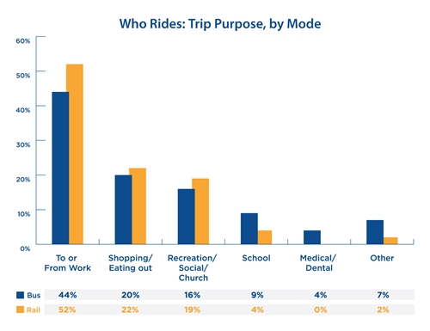
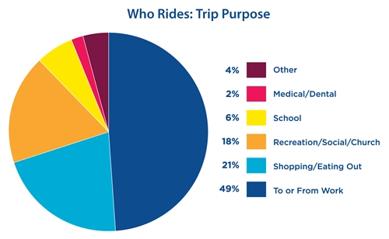
695,748 survey responses from 2008-2015
“Vast Majority of Transit Trips Directly Contribute to Nation’s Economic Strength”, Passenger Transport, March 13, 2017 http://newsmanager.commpartners.com/aptapt/issues/2017-03-10/2.html

Slide 27
Area Type | Urban | Urban | Small Urban | Small Urban | Rural | Rural
Service Type | FR | DR | FR | DR | FR | DR
Trip Percentage- Work | 41% | 41% | 39% | 39% | 41% | 41%
Trip Percentage- Medical | 6% | 6% | 5% | 5% | 7% | 7%
Trip Percentage- Education | 10% | 10% | 19% | 19% | 20% | 20%
Trip Percentage- Shopping | 38% | 38% | 31% | 31% | 29% | 29%
Trip Percentage- Other | 4% | 4% | 5% | 5% | 3% | 3%
Foregone Trip Percentage | 16% | 16% | 22% | 31% | 22% | 31%
In Place of Transit- Drive Themselves Percentage | 13% | 19% | 13% | 5% | 13% | 5%
In Place of Transit- Ride with Others Percentage | 23% | 31% | 23% | 51% | 23% | 51%
Ride with Others- Chauffeur Percentage | 50% | 64% | 50% | 64% | 50% | 64%
Chauffeur Mileage Cost- per Mile | $1.05 | $1.05 | $1.05 | $1.05 | $1.05 | $1.05
In Place of Transit- Taxi Percentage | 12% | 8% | 12% | 7% | 12% | 7%
Taxi Mileage Cost- per Mile | 2.25 | 2.25 | 2.25 | 2.25 | 2.25 | 2.25
In Place of Transit- Walk Percentage | 27% | 16% | 27% | 5% | 27% | 5%
In Place of Transit- Bicycle Percentage | 5% | 8% | 5% | 1% | 5% | 1%
Average Trip Length- Miles | 6 | 6 | 6 | 6 | 6 | 6
Vehicle Ownership Cost- per Mile | $ 0.59 | $ 0.59 | $ 0.59 | $ 0.59 | $ 0.59 | $ 0.59
Foregone Trip Cost- Medical | $357.00 | $357.00 | $357.00 | $357.00 | $357.00 | $357.00
Foregone Trip Cost- Work | $49.00 | $49.00 | $49.00 | $49.00 | $49.00 | $49.00
Foregone Trip- Other, % Taken | 0.5 | 0.5 | 0.5 | 0.5 | 0.5 | 0.5
Foregone Trip Other- Taxi Fare | 2.25 | 2.25 | 2.25 | 2.25 | 2.25 | 2.25
Foregone Trip Other- Trip Cost Reduction | $ 0.78 | $ 0.78 | $ 0.78 | $ 0.78 | $ 0.78 | $ 0.78

Slide 28
Area Type | Urban | Urban | Small Urban | Small Urban | Rural | Rural
Service Type | FR | DR | FR | DR | FR | DR
Travel Time- Minutes | 12.9 | 14.9 | 12.9 | 14.9 | 12.9 | 14.9
Wait Time- Minutes | 10.8 | 0 | 10.8 | 0 | 10.8 | 0
Transit Travel Time Cost- per Hour | $4.14 | $4.14 | $4.14 | $4.14 | $4.14 | $4.14
Personal Car Travel Time Cost- per Hour | $2.76 | $2.76 | $2.76 | $2.76 | $2.76 | $2.76
Personal Car Speed- Miles per Hour | 28.87 | 28.87 | 28.87 | 28.87 | 28.87 | 28.87
Ride with Others Trip Distance Increase | 10% | 10% | 10% | 10% | 10% | 10%
Taxi Travel Time Cost- per Hour | $2.76 | $2.76 | $2.76 | $2.76 | $2.76 | $2.76
Bicycle Speed- Miles per Hour | 10 | 10 | 10 | 10 | 10 | 10
Bicycle Travel Time Cost- per Hour | $3.75 | $3.75 | $3.75 | $3.75 | $3.75 | $3.75
Walk Speed- Miles per Hour | 3 | 3 | 3 | 3 | 3 | 3
Walk Travel Time Cost- per Hour | $3.75 | $3.75 | $3.75 | $3.75 | $3.75 | $3.75
Accident Cost- Transit per Mile | $0.29 | $0.29 | $0.29 | $0.29 | $0.29 | $0.29
Accident Cost- Personal Vehicle per Mile | $0.10 | $0.10 | $0.10 | $0.10 | $0.10 | $0.10
Accident Cost- Ride with Others per Mile | $0.10 | $0.10 | $0.10 | $0.10 | $0.10 | $0.10
Accident Cost- Taxi per Mile | $0.10 | $0.10 | $0.10 | $0.10 | $0.10 | $0.10
Accident Cost- Bicycle per Mile | $0.10 | $0.10 | $0.10 | $0.10 | $0.10 | $0.10
Accident Cost- Walk per Mile | $0.10 | $0.10 | $0.10 | $0.10 | $0.10 | $0.10
Emission Cost- Transit per Mile | $0.15 | $0.15 | $0.15 | $0.15 | $0.15 | $0.15
Emission Cost- Alternative Mode per Mile | $0.06 | $0.06 | $0.06 | $0.06 | $0.06 | $0.06
Congestion Cost Savings | Varies | None | None | None | None | None
Parking Cost Savings | None | None | None | None | None | None
Land Price Increase | None | None | None | None | None | None

