Slide 1
School Travel Patterns in Utah
2017 TRB National Transportation Planning Applications Conference
Raleigh, North Carolina
May 18, 2017
Andy Li, Callie New, Julie Bjornstad, Jon Larsen, and Matthew Silski
Wasatch Front Regional Council
Salt Lake City, Utah

Slide 2
Today’s Talk
Background of the WFRC/MAG Travel Model
Home-Based School Travel Survey
Data Collection
Data Results

Slide 3
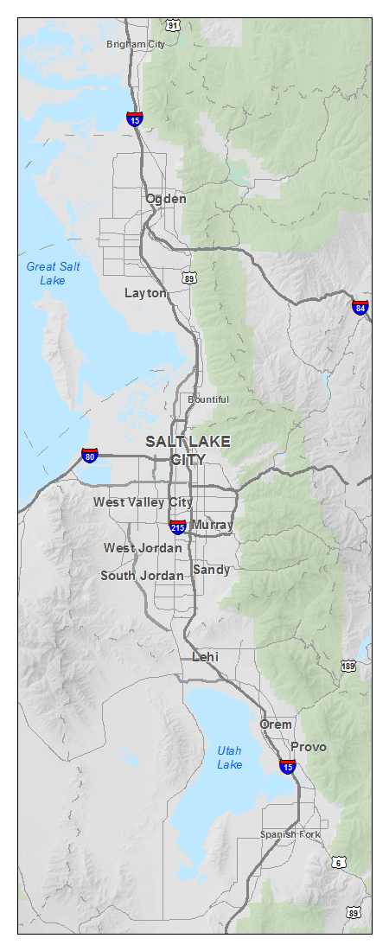
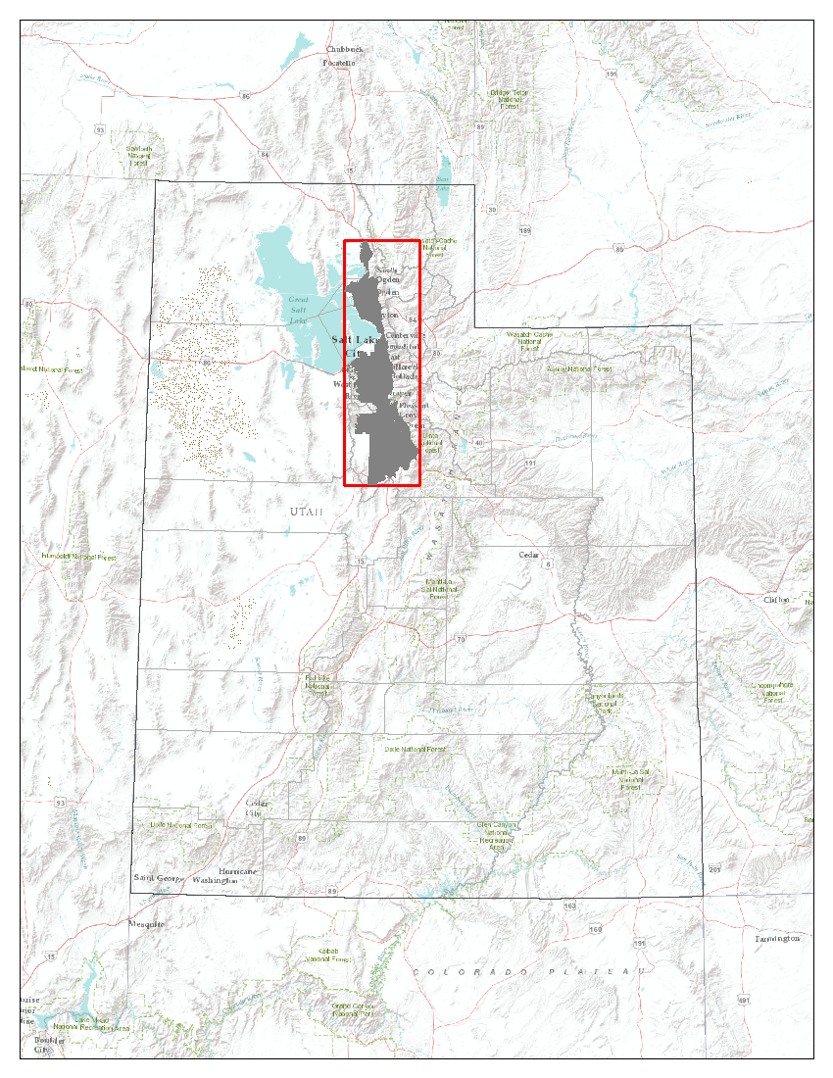
Area Overview
Wasatch Front Regional Council (WFRC)
Mountainland Association of Governments (MAG)
Notes:
Our travel demand model covers two MPO areas in Utah – the Wasatch Front Regional Council (WFRC) to the north and Mountainland Association of Governments (MAG) to the south.

Slide 4
WFRC/MAG Travel Demand Model
Developed over 30 years ago, and updated constantly
Model data initially based on the 1993 household travel survey
Current model uses data from the 2012 Utah household daily travel survey
Sources of home-based school trip parameters
Utah household daily travel survey
Professional judgment

Slide 5
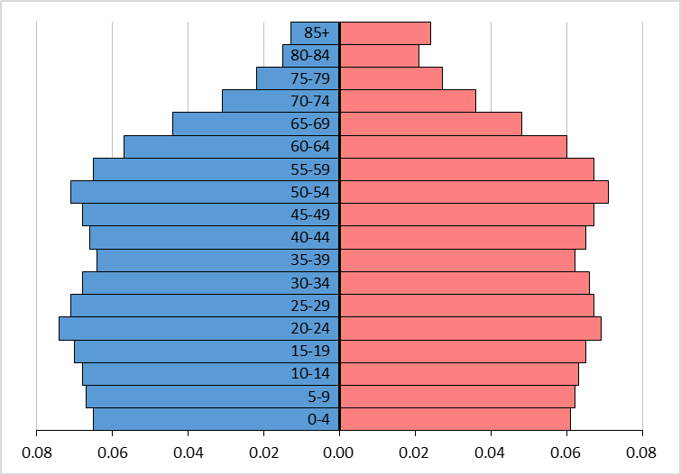
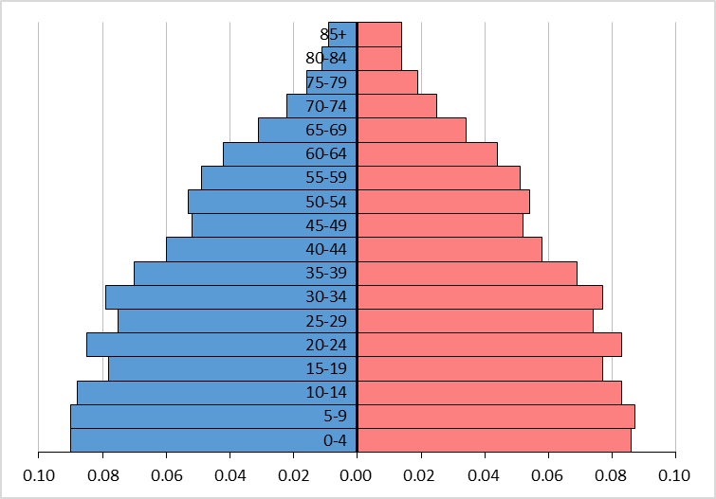
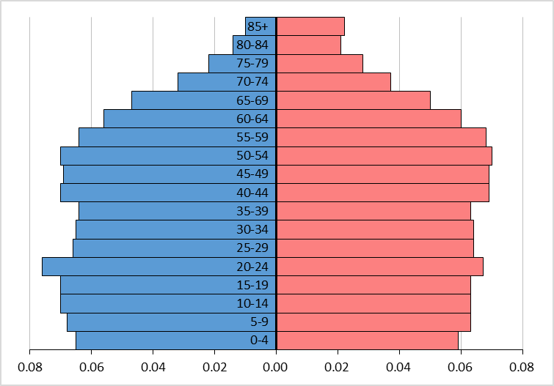
Utah’s Younger Population
United States
Utah
North Carolina
Average Household Size: 2.64
Average Household Size: 3.15
Average Household Size: 2.54
Source: 2011-2015 American Community Survey 5-Year Estimates, Census.gov
Notes:
It is important that our home-based school trip parameters are accurate because of Utah’s unique demographics. As you can see from the population pyramids and average household sizes, Utah has a significantly younger population than the national average (and North Carolina). This means that in Utah, there is a higher percentage of trips taken by school-age children compared to all trips taken.

Slide 6
Recalibrating Parameters
New travel survey created for K-12 students
Distributed to school districts
Questions
Home location
School location
Grade level
Family size
Travel mode(s)
Time of day
etc.
Notes:
In an effort to improve our home-based school trip model parameters, we created a survey for travel behaviors of students in grades K-12. We asked about their home location, school location, travel mode, and demographics to get information about their travel behaviors. Then we distributed it to school districts, who sent it to the parents to complete the survey.

Slide 7
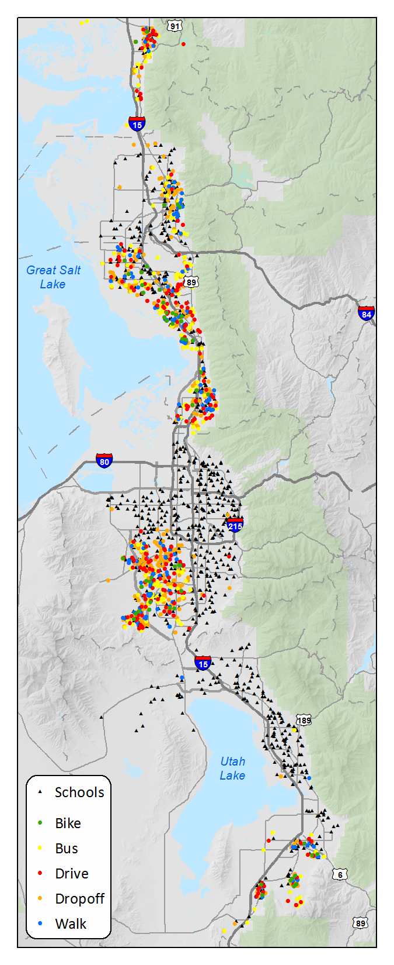
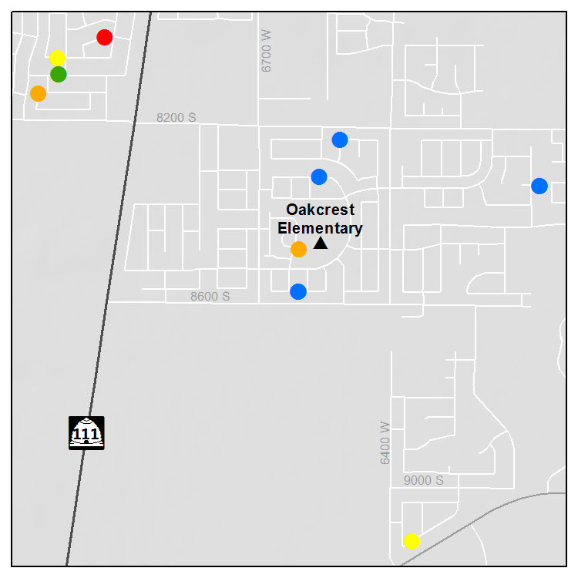
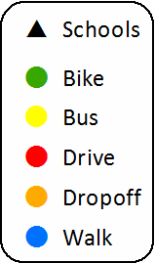
Survey Responses
Box Elder County (216)
Weber County
(94)
Collected from March-June 2016
1,379 unique responses
Davis County
(428)
Salt Lake County
(528)
Utah County
(113)
Notes:
We collected 1,379 unique responses to the survey. As you can see from the map on the right, responses were recorded across the WFRC and MAG MPO areas. One drawback to the survey was that there was an uneven geographic response. With such a large sample size, we believe that the responses are still representative of the travel behaviors of K-12 students along the Wasatch Front.

Slide 8
HBSch Trip Parameters
Trip Production Rates
By Household Size
Life Cycle
Trip Diurnal Distribution
Trip Length Distribution
Travel Mode Split

Slide 9
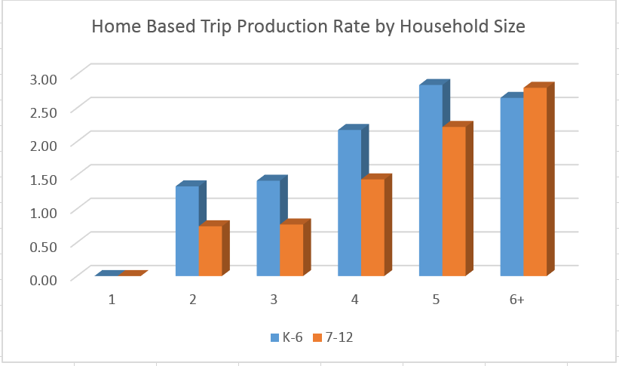

Slide 11
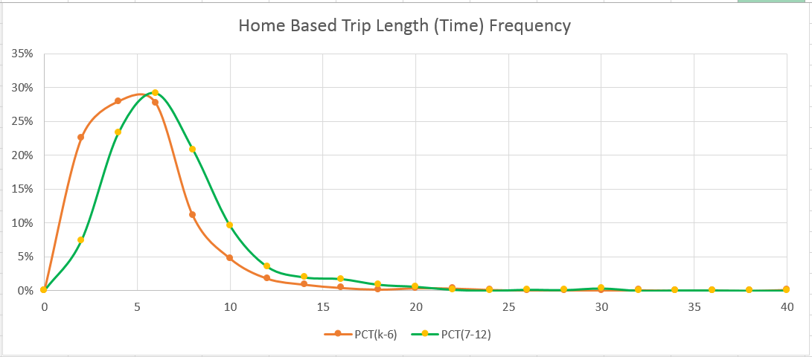
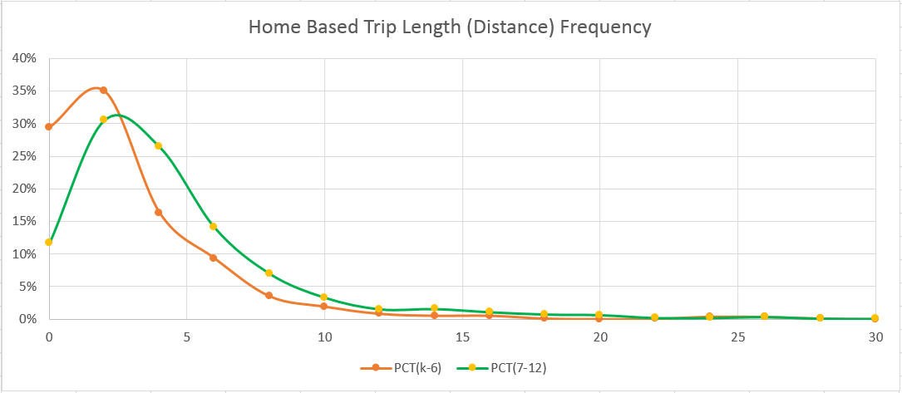

Slide 12
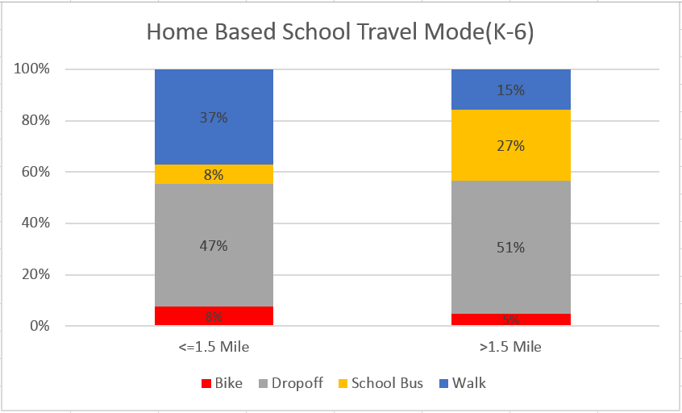
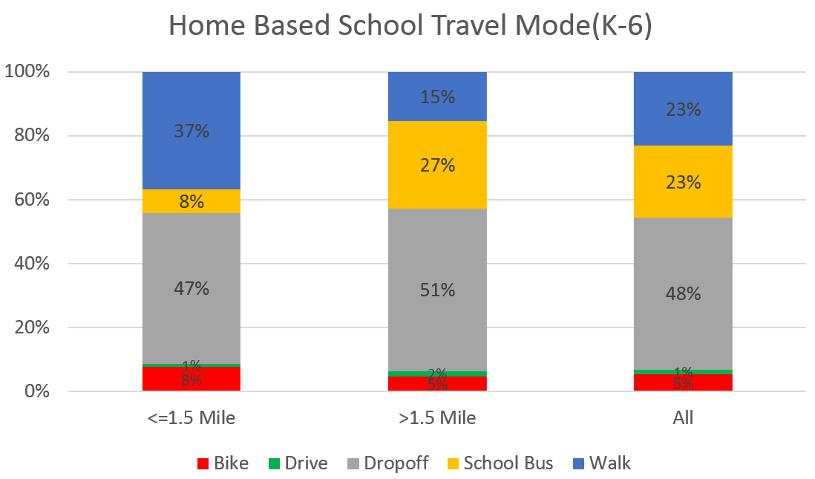

Slide 13
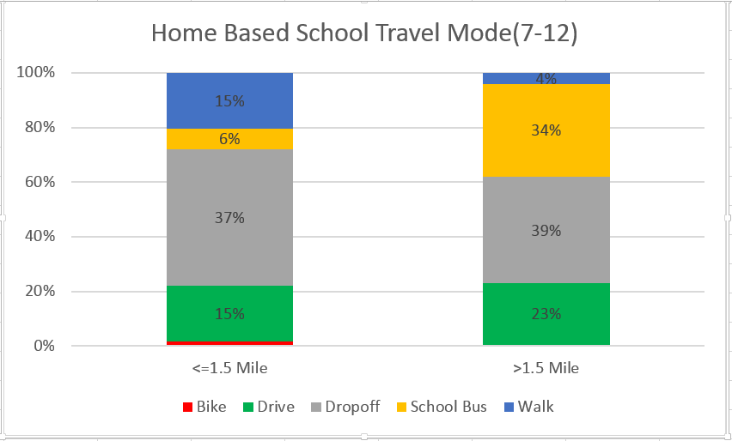

Slide 14
Any Questions Andy Li andyli@wfrc.org 801-363-4230*1138

