Slide 1
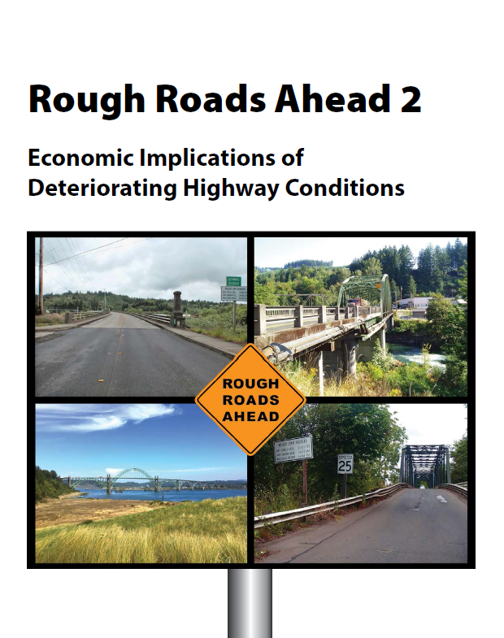
Rough Roads Ahead 2
16th TRB National Transportation Planning Applications Conference
Economic Implications of Deteriorating Highway Conditions
Becky Knudson, Oregon DOT
May15, 2017

Slide 2
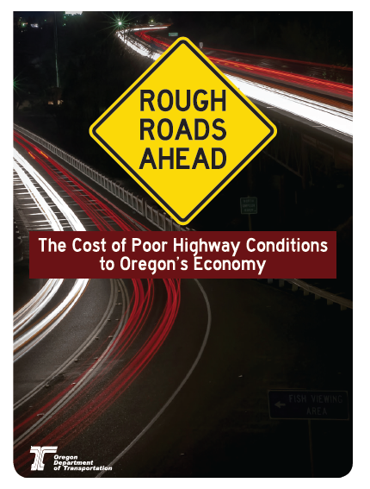
Highway Condition Impacts the Economy
2017
Available online:
https://www.oregon.gov/ODOT/COMM/Documents/RoughRoads2014.pdf
Available online: https://www.oregon.gov/ODOT/COMM/docs/ROUGH_ROADS_AHEAD_2.pdf
2014
2017

Slide 3
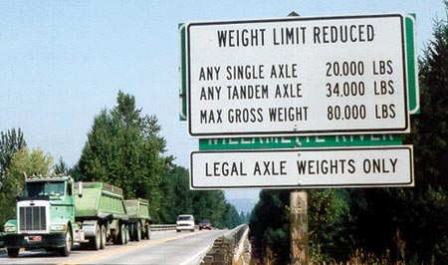
Deteriorating Highway Conditions Impact Transportation Costs

Slide 4
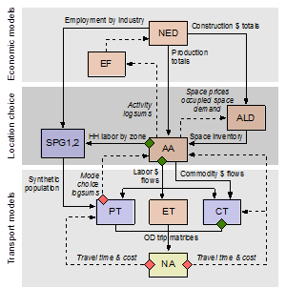

Methodology: Tools
SWIM 2.5
Oregon Statewide Integrated Model Version 2.5

Slide 5
SWIM Schematic

Slide 6
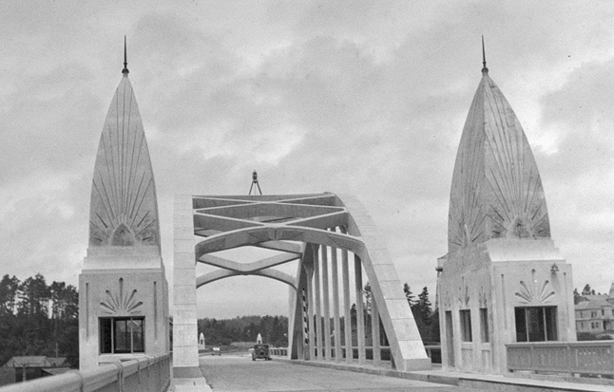
Methodology: Tools
Oregon DOT Bridge Model

Slide 7
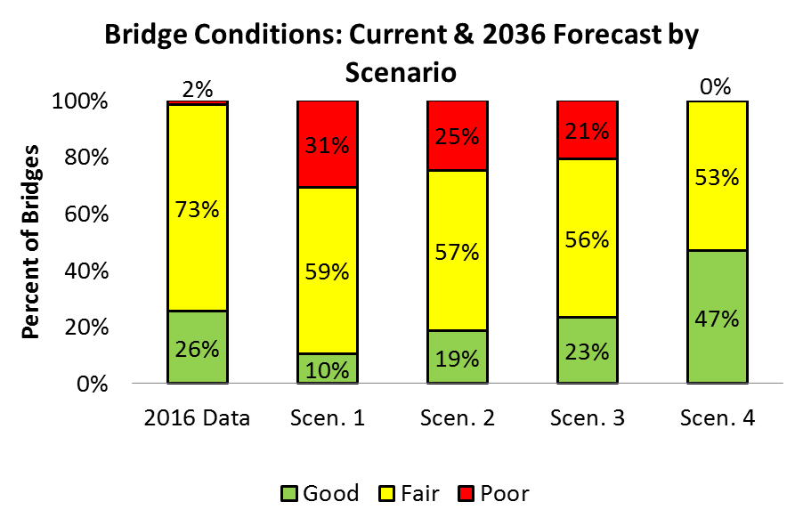
Bridge Model:

Slide 8
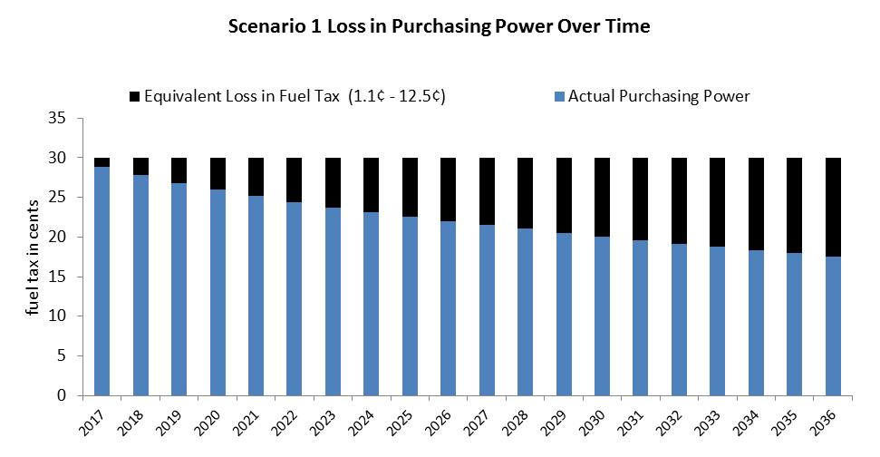
Oregon 30¢ Gallon Fuel Tax Would Have to Rise to Offset Inflation

Slide 9
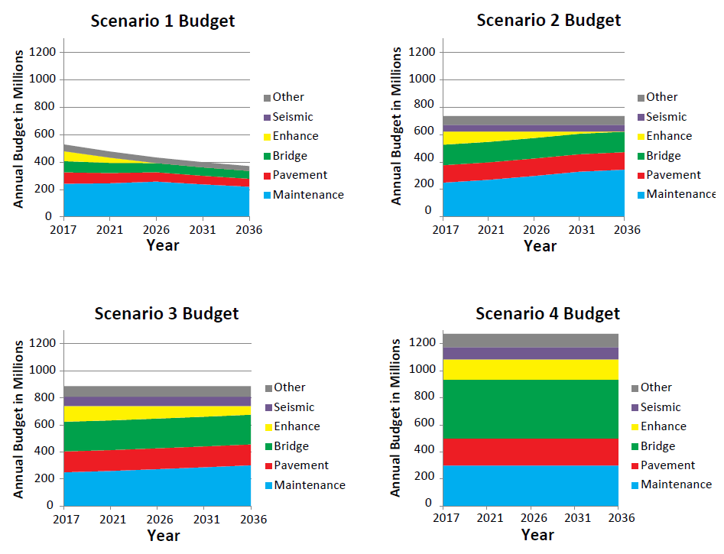

Slide 10
Current Budget
35% Increase (14¢)
134% Increase (52¢) Meets Needs
63% Increase (24¢)

Slide 11
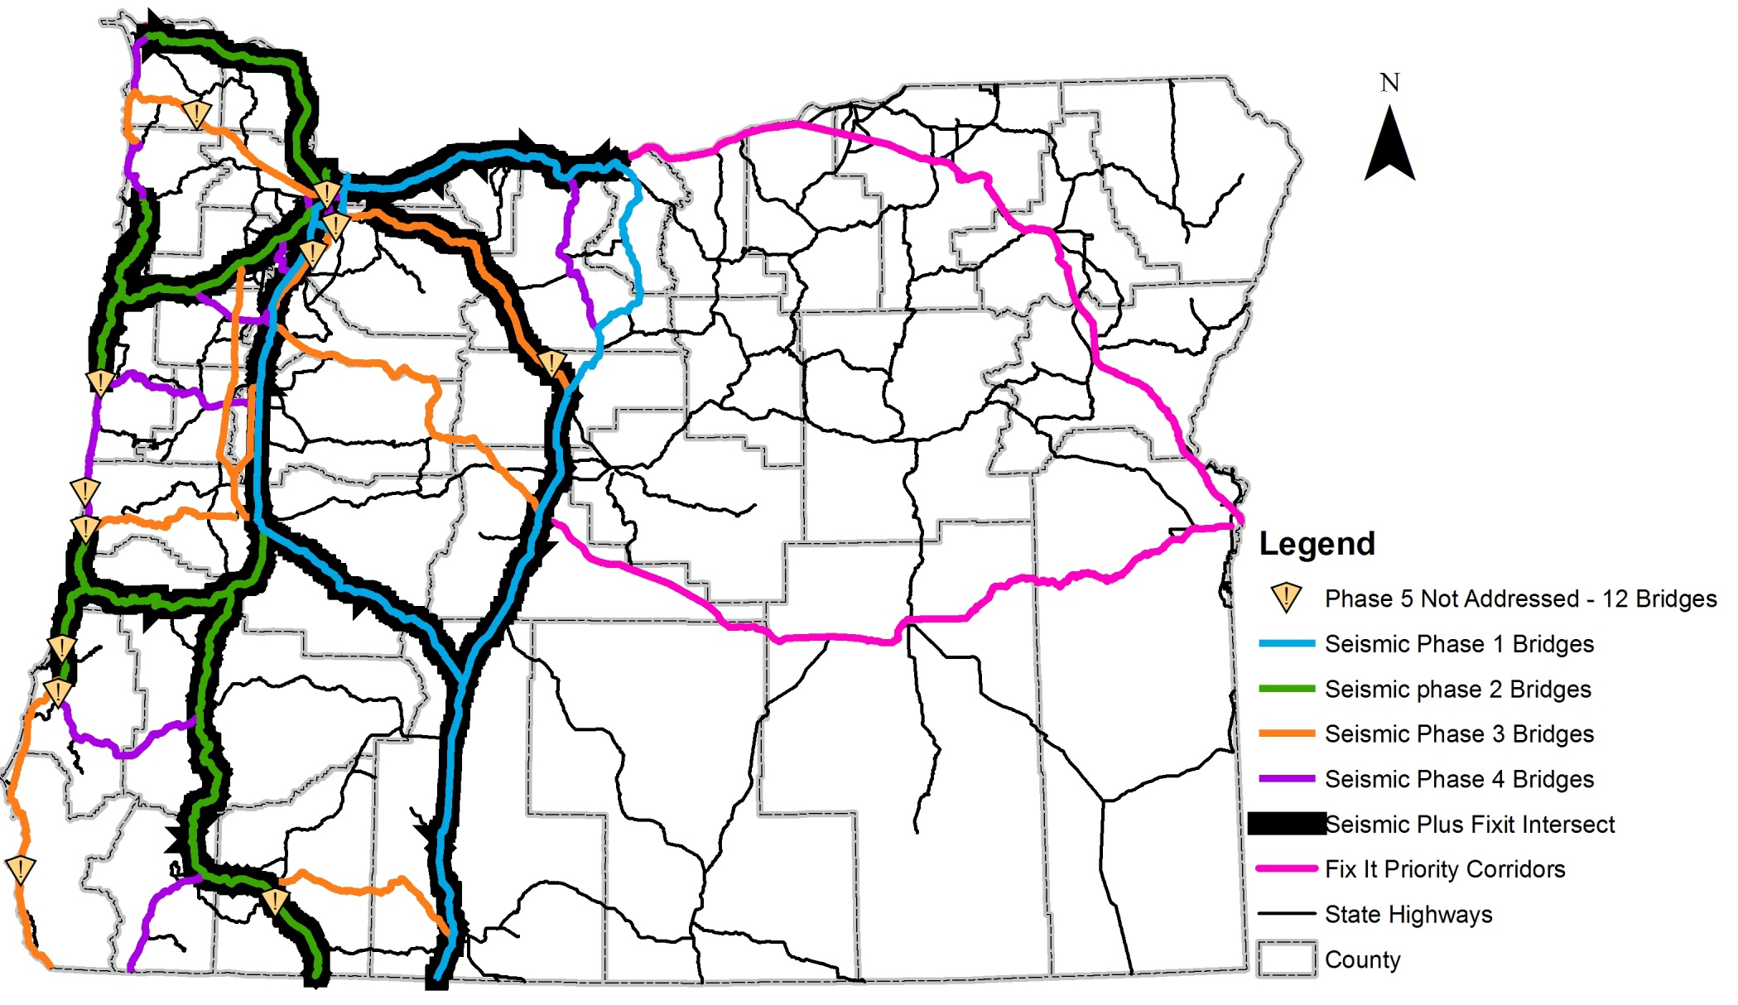
Priority Corridors

Slide 12
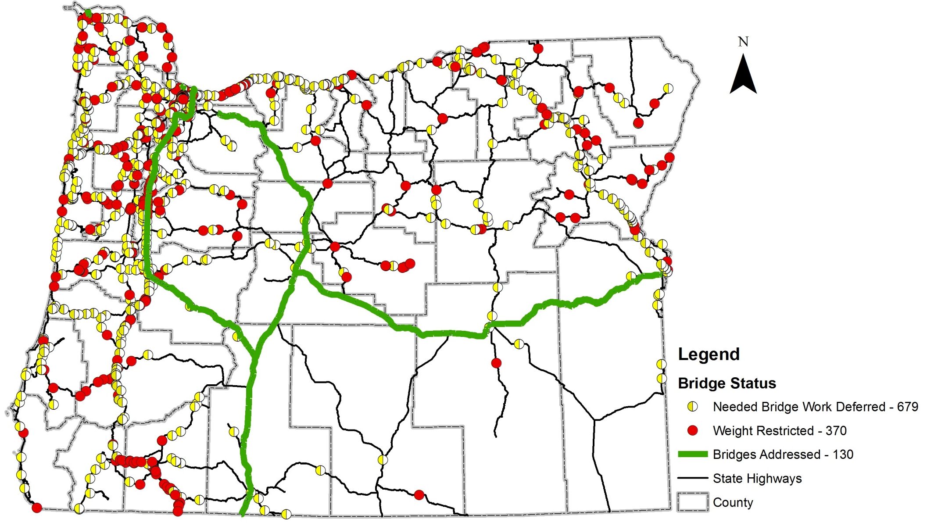
Current Budget Scenario
Treat 130 Bridges Weight Restrict 370
Defer work on 679 No Seismic Investment

Slide 13
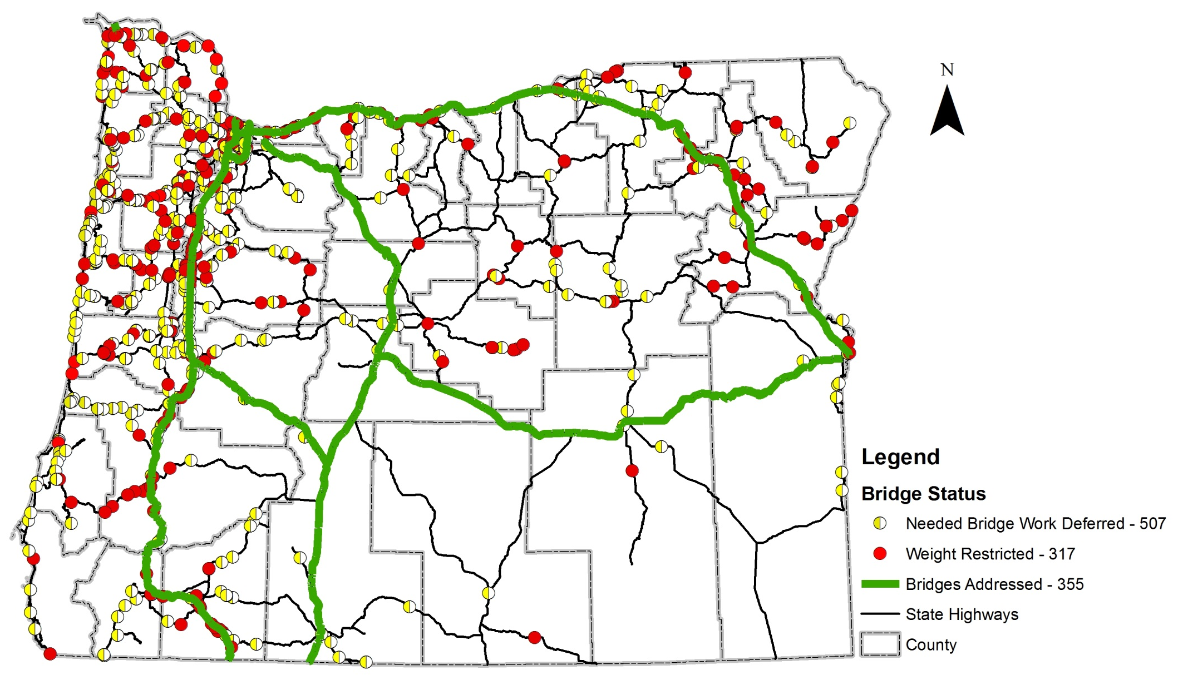
Scenario 2
Treat 355 Bridges Weight Restrict 317
Defer work on 507 Seismic $49M

Slide 14
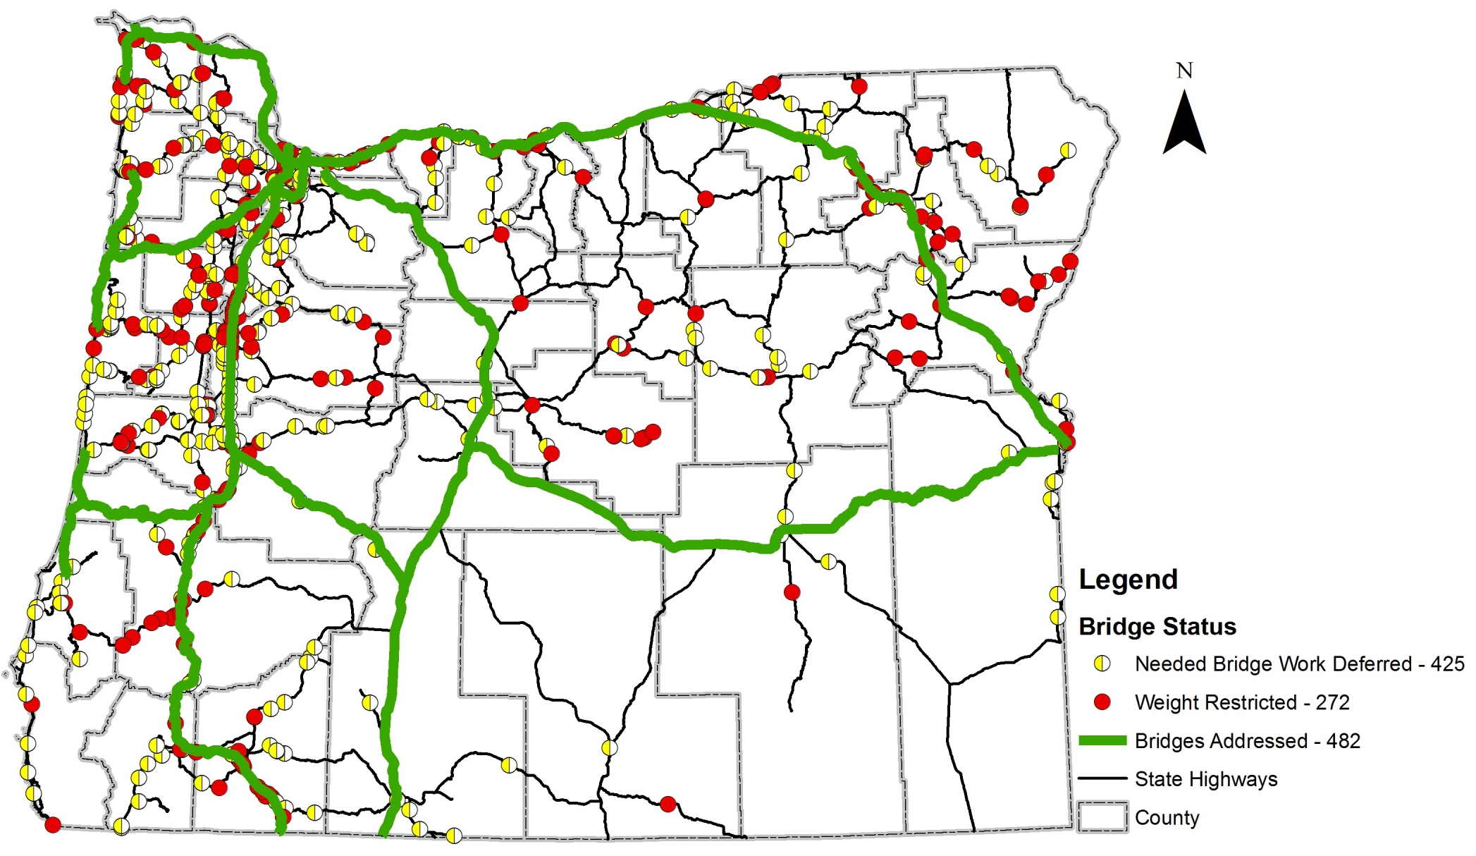
Scenario 3
Treat 482 Bridges Weight Restrict 272
Defer work on 425 Seismic $70

Slide 15
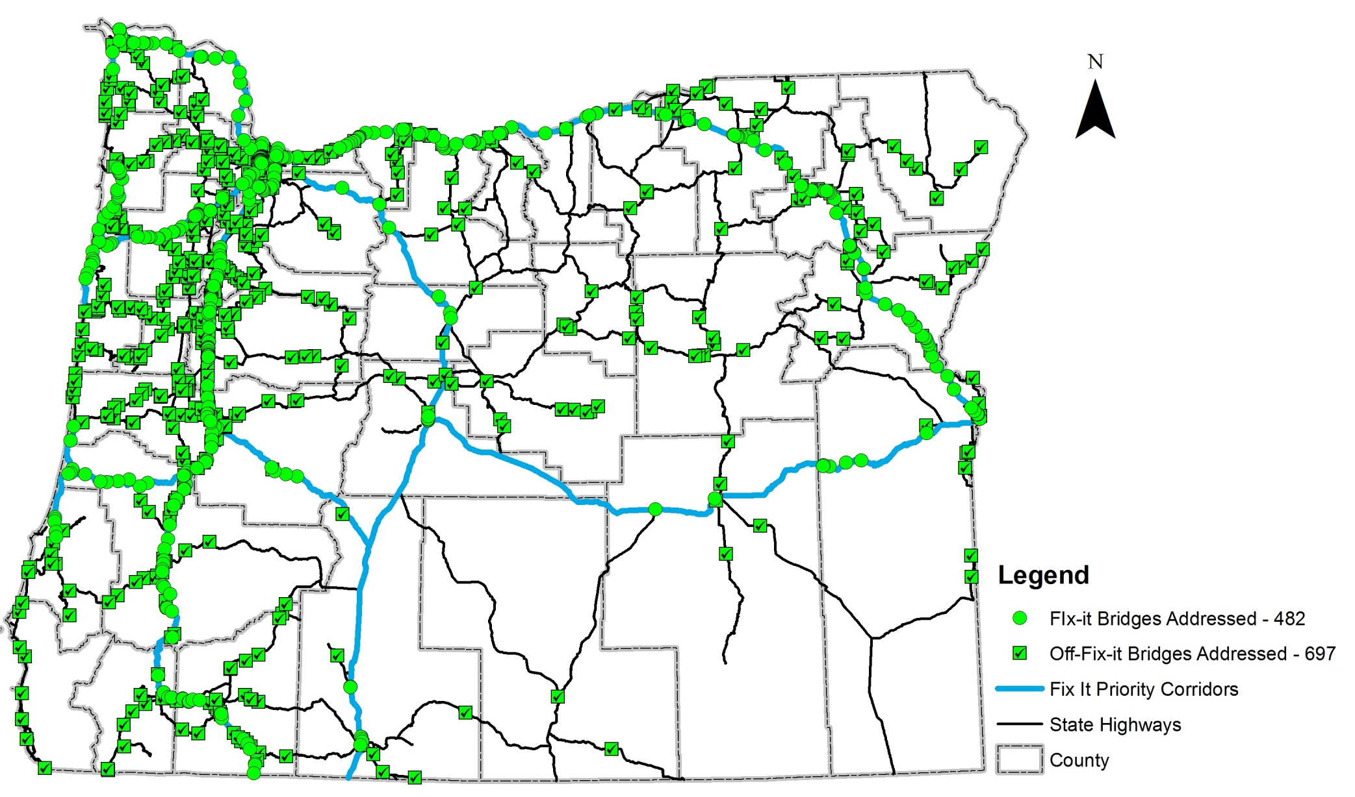
Scenario 4
Treat 1179 Bridges Weight Restrict 0
Defer work on 0 Seismic $90M

Slide 16
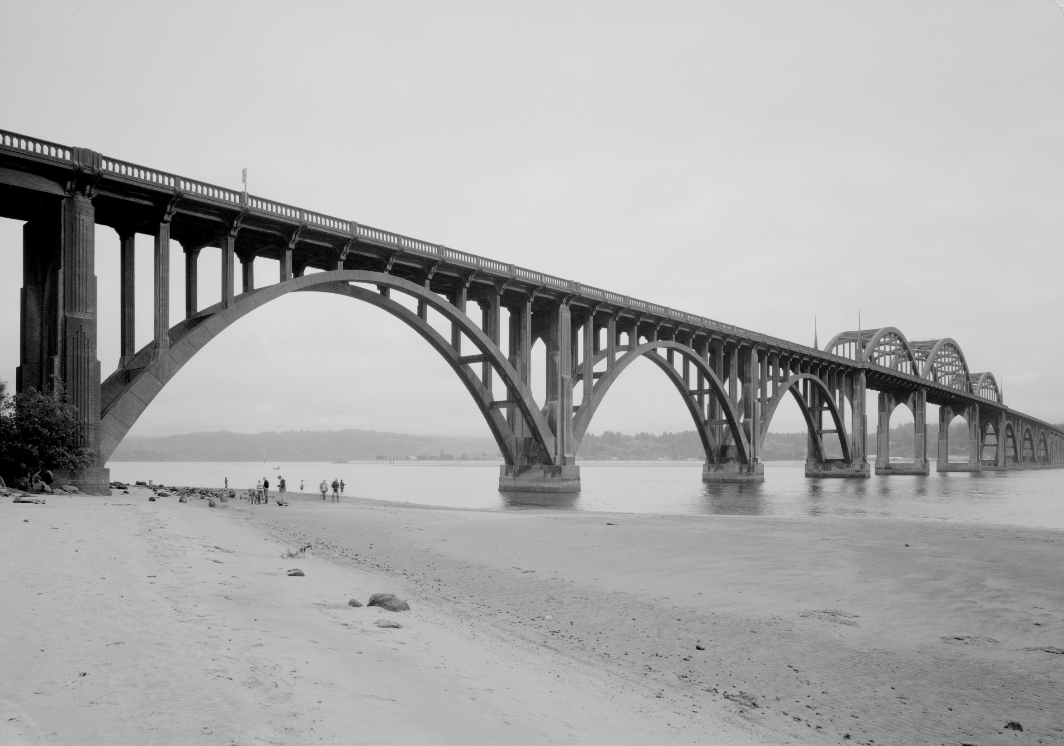
Economic Impacts
Old Alsea Bay Bridge, circa 1936

Slide 17
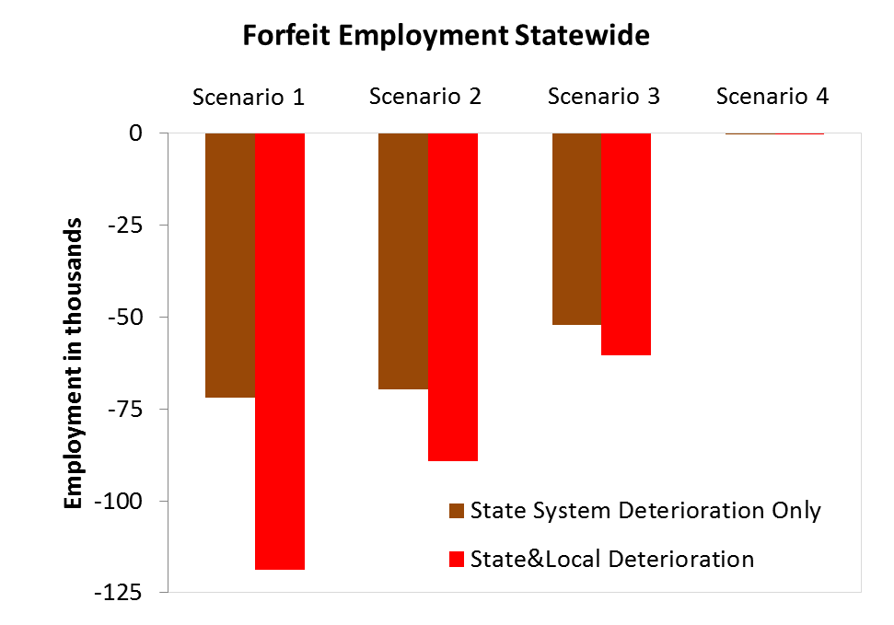

Slide 19
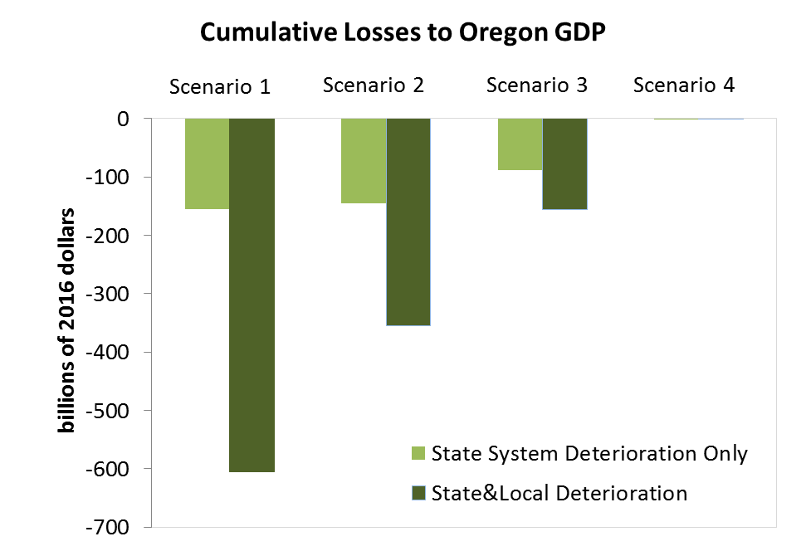

Slide 21
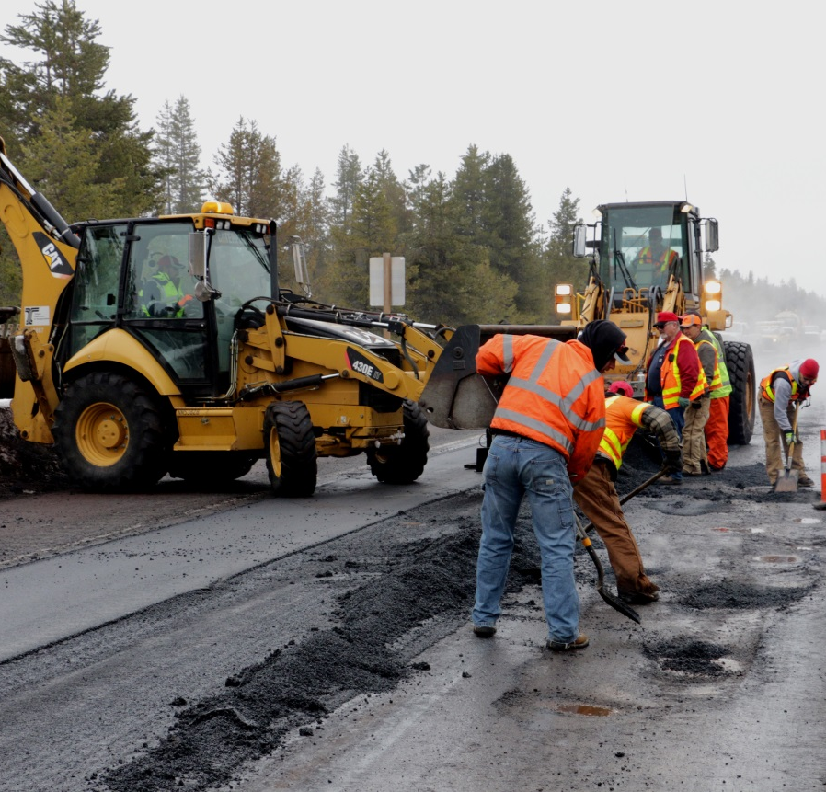
Rough Pavement Increases Vehicle Costs
Driving 20% of VMT on rough pavement increases operating costs over 4%, which translates into over $300 million increase in annual spending
Fuel efficiency declines
Oil and tire costs rise
Repair costs rise

Slide 22
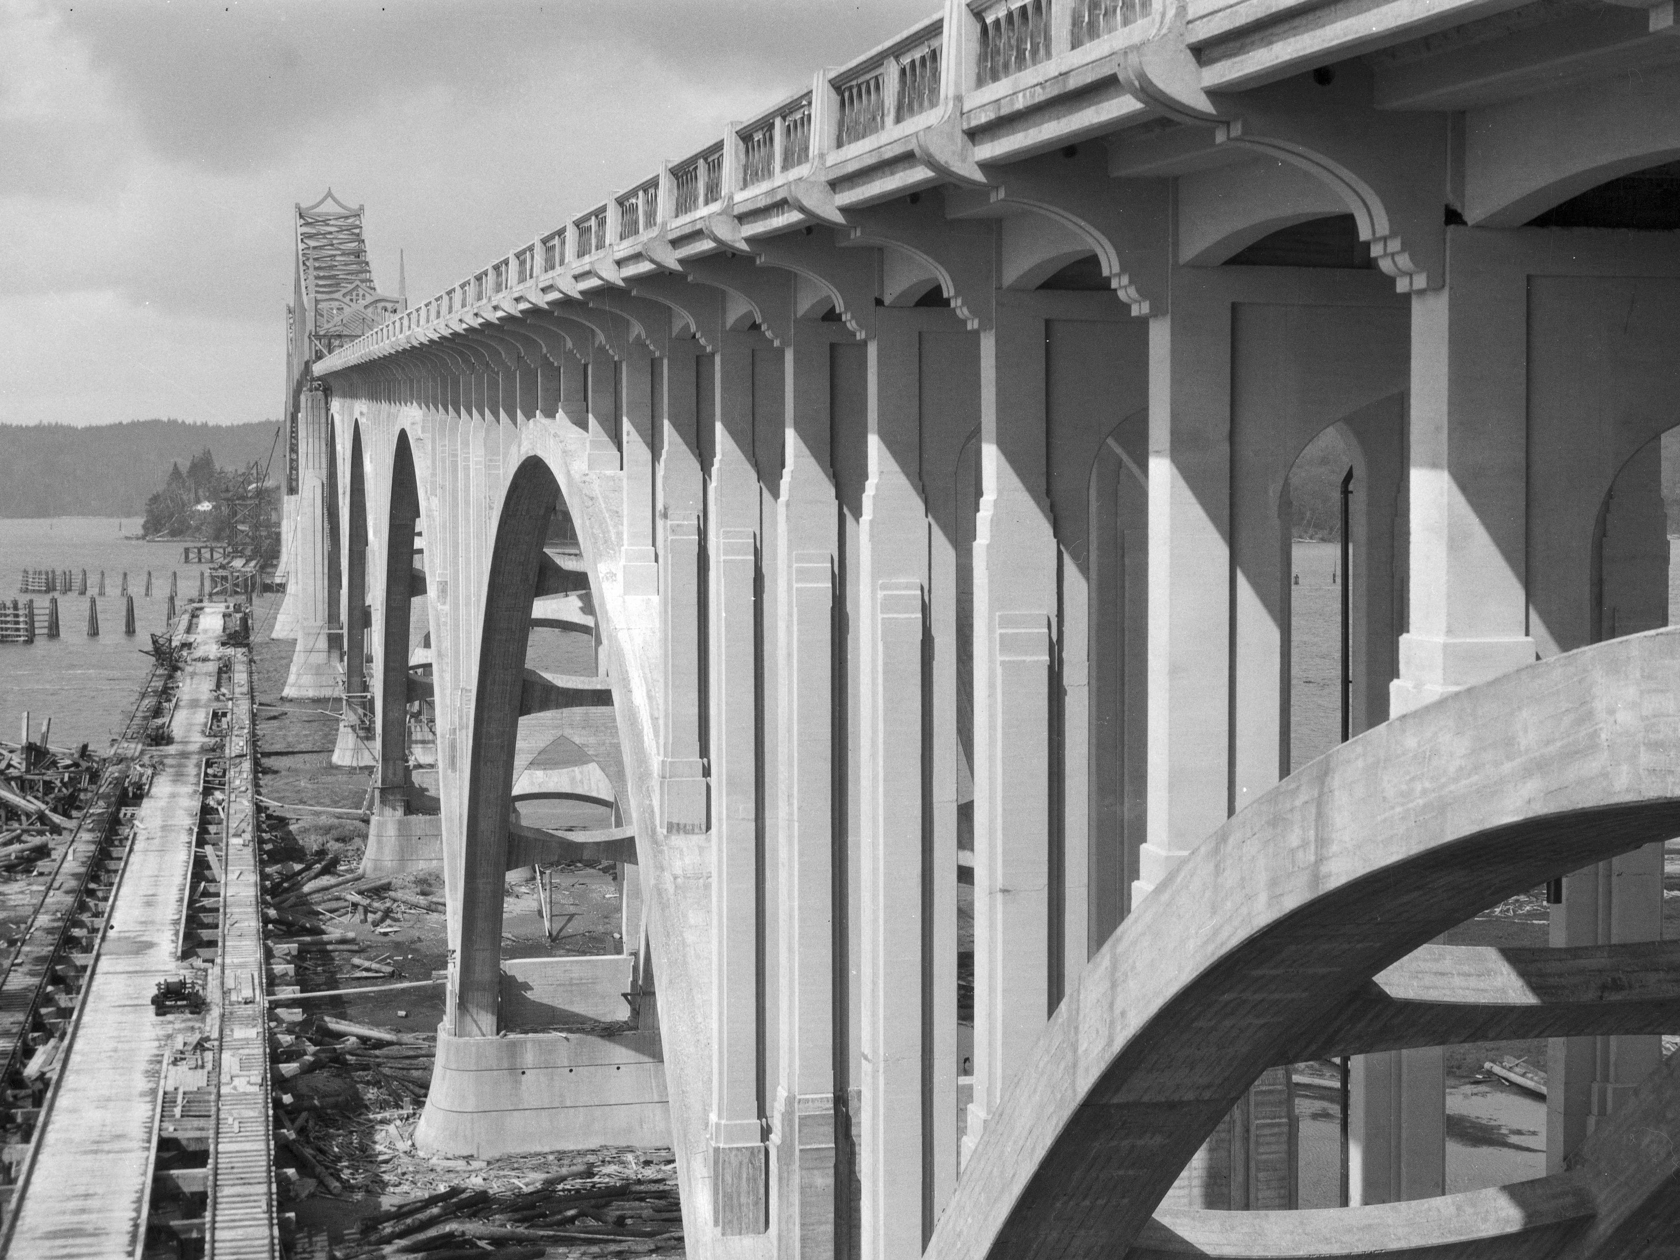
Coos Bay Bridge 1936
Questions?

