Slide 1
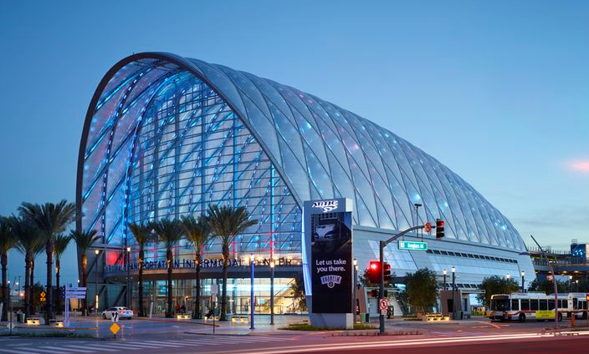
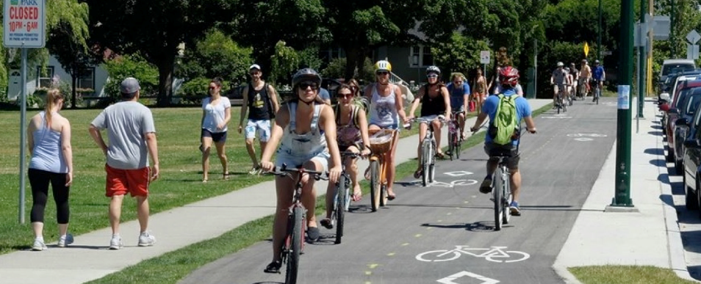
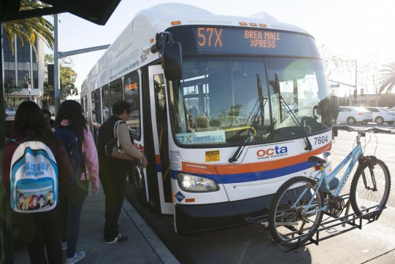
An Analytical Modeling Tool for Active Transportation Strategy ^{Evaluation}
^{Presented by:}
Jinghua Xu, Ph.D., PE
^{May 16, 2017}

Slide 2
TABLE OF CONTENTS
1 | Background
2 | Project Approach
3 | Case Study
4 | Next Step
5 | Questions?

Slide 3
BACKGROUND
Traditional Regional Travel Demand Model
Being relied on to provide key performance metrics, such as:
VMT, Delay, Congestion
Worked well when agencies focused on roadway and transit improvements
But may not fully address new challenges
New types of strategies/New metrics/New technologies and behaviors
Need for a new approach

Slide 4
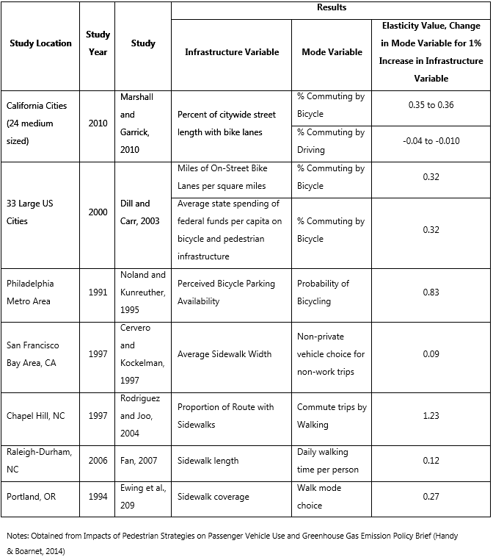
BACKGROUND
Literature Review
Infrastructure Impact on Active Transportation Trips

Slide 5
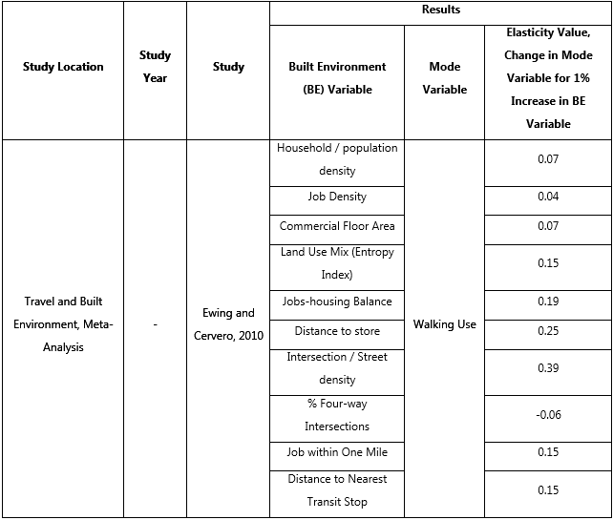
BACKGROUND
Literature Review
Built Environment Attributes on Active Transportation Trips

Slide 6
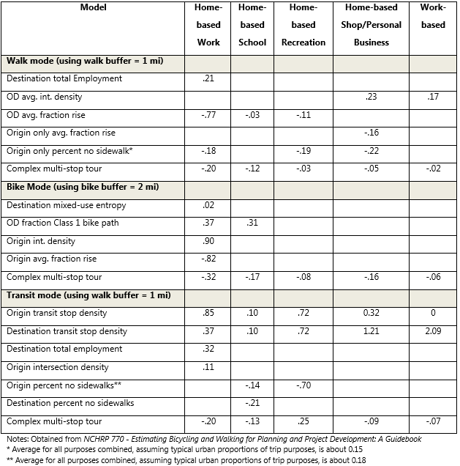
BACKGROUND
Literature Review
Seattle TB Model Elasticities

Slide 7
BACKGROUND
Goals of an Active Transportation Tool:
Develop methodology to augment existing travel model by:
Enhancing sensitivity to active transportation investment
Allowing dynamic assessment of active transportation need/costs/benefits as land-use changes
Provide means to forecast benefit without precision of detailed network

Slide 8
BACKGROUND
Goals of an Active Transportation Tool:
Ensure applicability across the modeling area
Limited to available data on hand
Develop quantitative relationships wherever possible for local conditions

Slide 9
PROJECT APPROACH
To build a quick response tool that can work with travel demand models to provide credible estimates on various land use and active transportation strategies.

Slide 10
PROJECT APPROACH
CA Household Travel Survey
Local travel survey data provides quantitative relationships
About 100K trip records (individual trips) for the Southern California region
80% are auto trips, 20% are other modes
Trip Length by mode
Includes trips of all types
Key Observations
Walking is much more prevalent than we expected
20% of all trips (or portions of trips) in the survey were walking
Significant variation in walking and biking by land use
<10% --- >40%
Key transportation factors
Bike Lanes/Sidewalk/Roadway Speed/Bus Stop/Intersection density/etc.

Slide 11
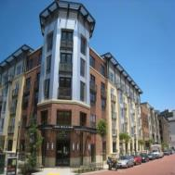
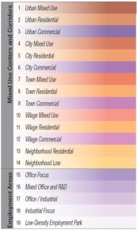
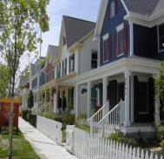
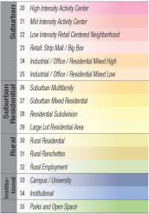
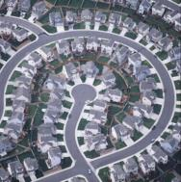
PROJECT APPROACH
Place Type
Density
Urban
Mix of Uses
Compact
Street Connectivity
Location/Accessibility
Standard

Slide 12
PROJECT APPROACH
Tool Development
Using multinomial logistic regression technique , focusing on the probability of using the various available modes of travel, including walking and biking.
Significant Input Variables
Generic socioeconomic variables
Mixed use land use variables
Place Type
AT Facility Variables
Roadway density variables
Transit variables
Travel demand model outputs

Slide 13
PROJECT APPROACH
Tool Outputs
Mode share and trips by mode and by zone (before and after land use/AT investment)
VMT by zone (before and after land use/AT investment)
Non-motorized miles traveled by zone (Walk and Bike)

Slide 14
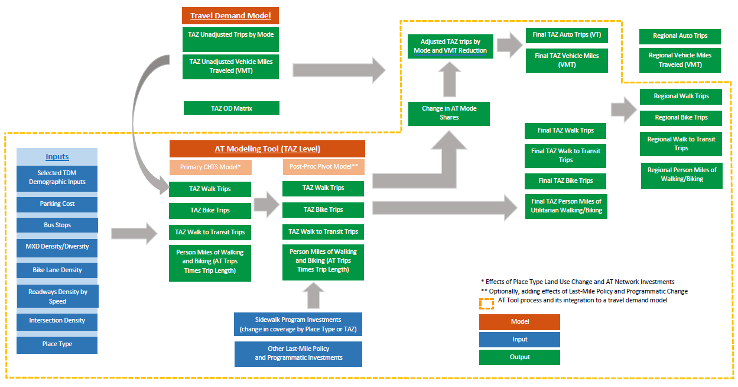
PROJECT APPROACH
Integration of the AT Tool to a Travel Demand Model

Slide 15
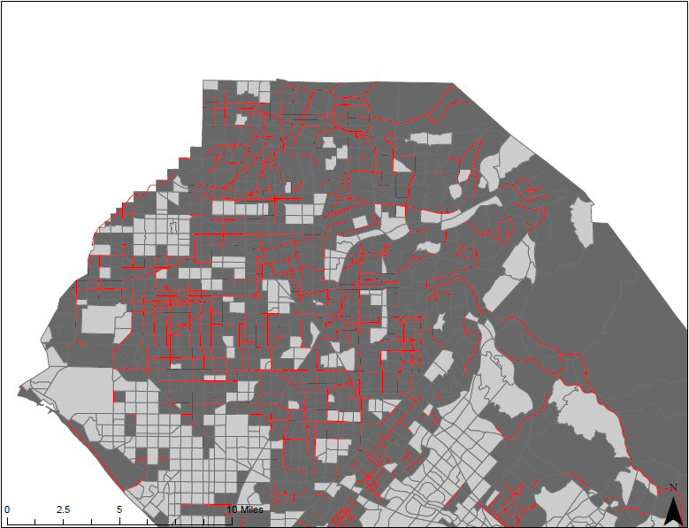
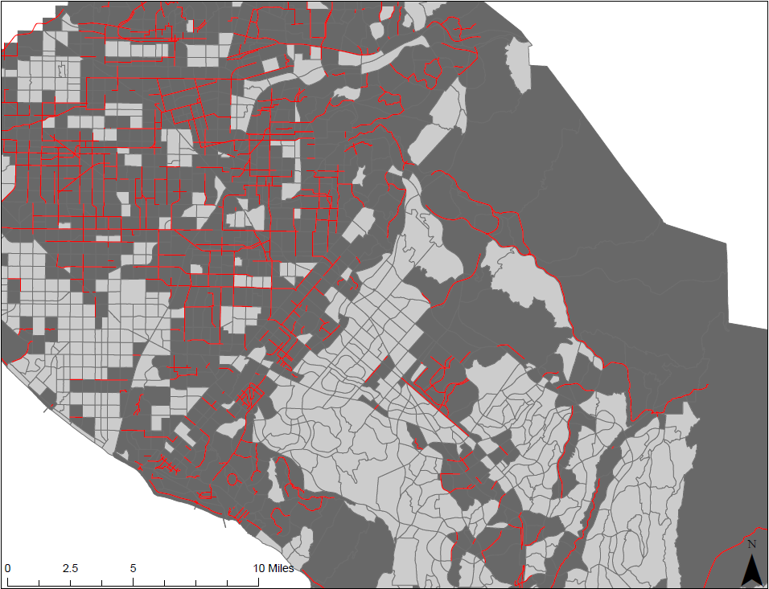
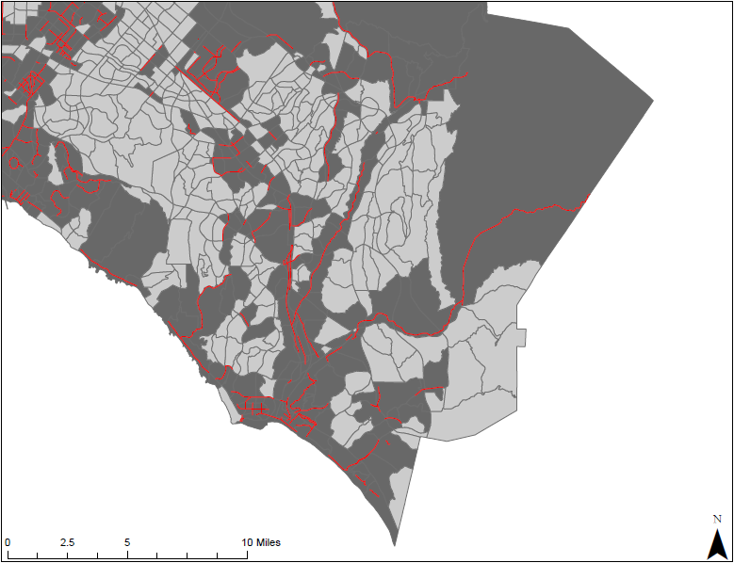
CASE STUDY
Test Case #1: Completion of Build-out Bikeway Network

Slide 16
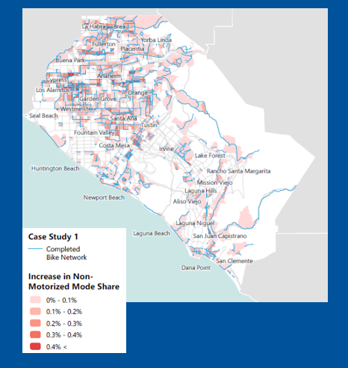
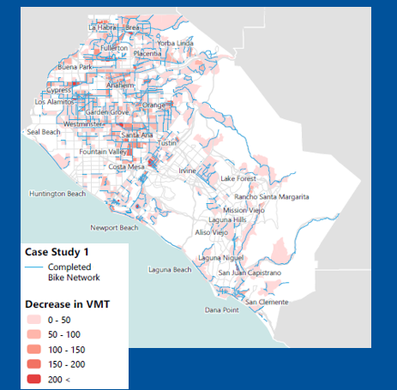
CASE STUDY
Test Case #1: Completion of Build-out Bikeway Network
Geographic Distribution of Project Impact

Slide 17
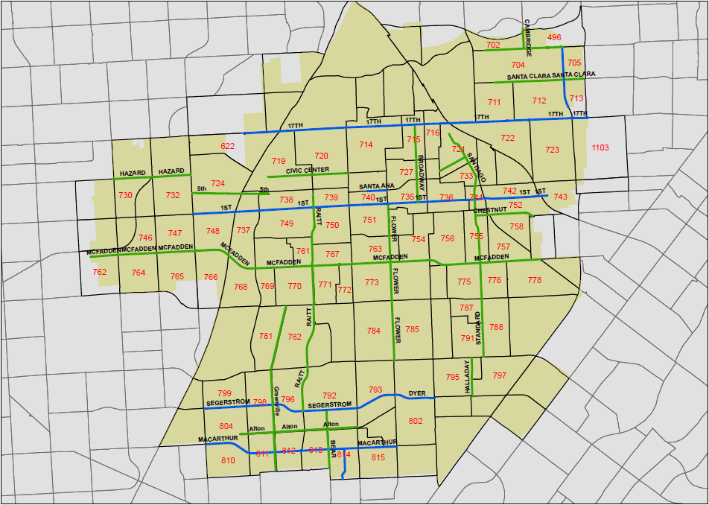
CASE STUDY
Test Case #2: Complete Streets
Assumptions:
"High" level of pedestrian infrastructure in TAZs with Complete Streets.
Class I bicycle facilities on designated Complete Streets
25% increase in parking costs on Complete Streets (if parking costs currently in place)
15% increase in intersection density in TAZs with Complete Streets
15% increase in bus stop density in TAZs with Complete Streets

Slide 18
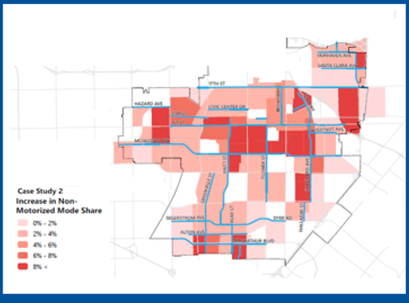
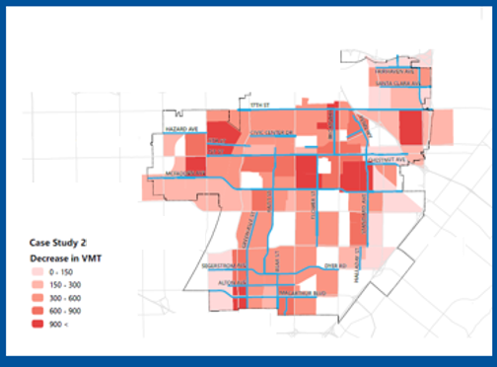
CASE STUDY
Test Case #2: Complete Streets
Geographic Distribution of Project Impact

Slide 19
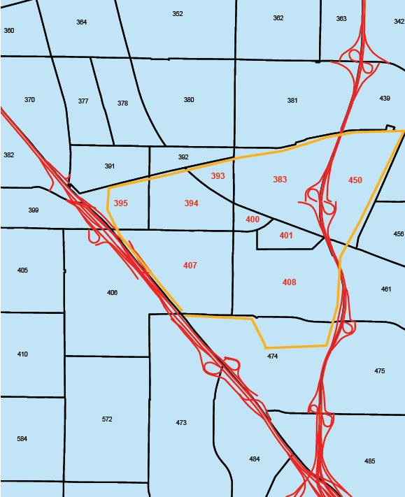
CASE STUDY
Test Case #3: Build-out Community
Assumptions:
Future build-out socioeconomic data from TBF for target community
Place Type Group 1 for project TAZs
15% increase over existing roadway density (less than 25mph).
15% increase over existing intersection density
15% increase over existing bus stop density
Build-out of proposed bikeways in project TAZs
"High" level of pedestrian infrastructure in project TAZs

Slide 20
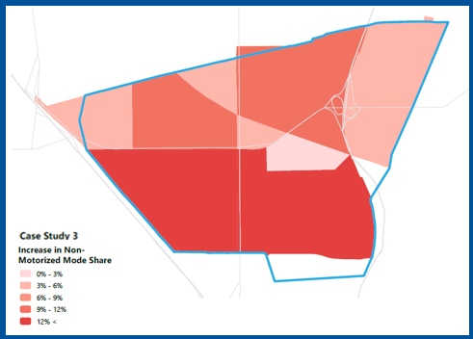
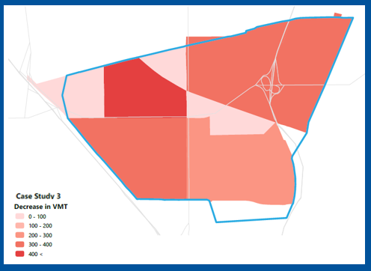
CASE STUDY
Test Case #3: Build-out Community
Geographic Distribution of Project Impact

Slide 21
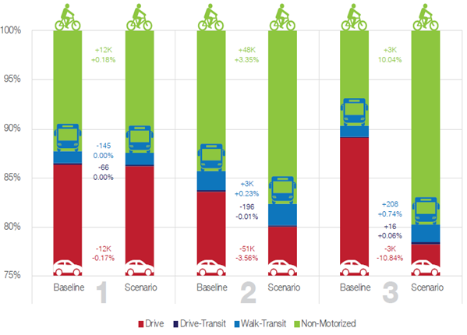
CASE STUDY
Mode Share & Trip Comparison – Project Area Only

Slide 22
CASE STUDY
VMT Comparison – Project Area Only
Test Case #2

Slide 23
NEXT STEP
To develop a GIS-based quick response tool to assist communities in AT analysis
Enhance the tool for the following functionalities:
Induced non-motorized travel
Pedestrian facility quantification
Using localized data if available
Build a GIS-based user-friendly interface
Dynamic data visualization

Slide 24
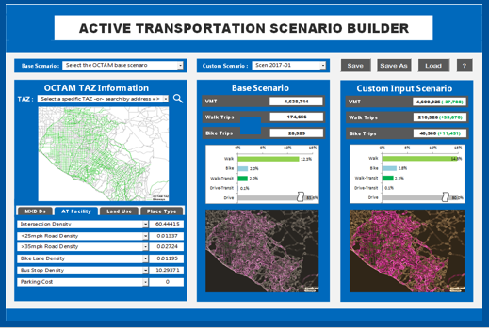
NEXT STEP
To develop a GIS-based quick response tool to assist communities in AT analysis

Slide 25
Questions?
Jinghua Xu Ph.D.,PE
^{714.941.8774}
^{j.xu@fehrandpeers.com}

