Slide 1



A Behavioral Agent-Based Supply Chain And Freight Transportation Model: Application For Arizona Sun Corridor Megaregion Presenter: Shuyao Hong Maricopa Association of Governments
Zahra Pourabdollahi, RS&H
Mark Ehlen, Mark A. Ehlen Consulting
Monique Stinson, MIT
Kyunghwi Jeon, Maricopa Association of Governments
Daehyun You, Maricopa Association of Governments
Haidong Zhu, Maricopa Association of Governments
TRB Applications Conference. Raleigh, NC. May 14-18, 2017

Slide 2

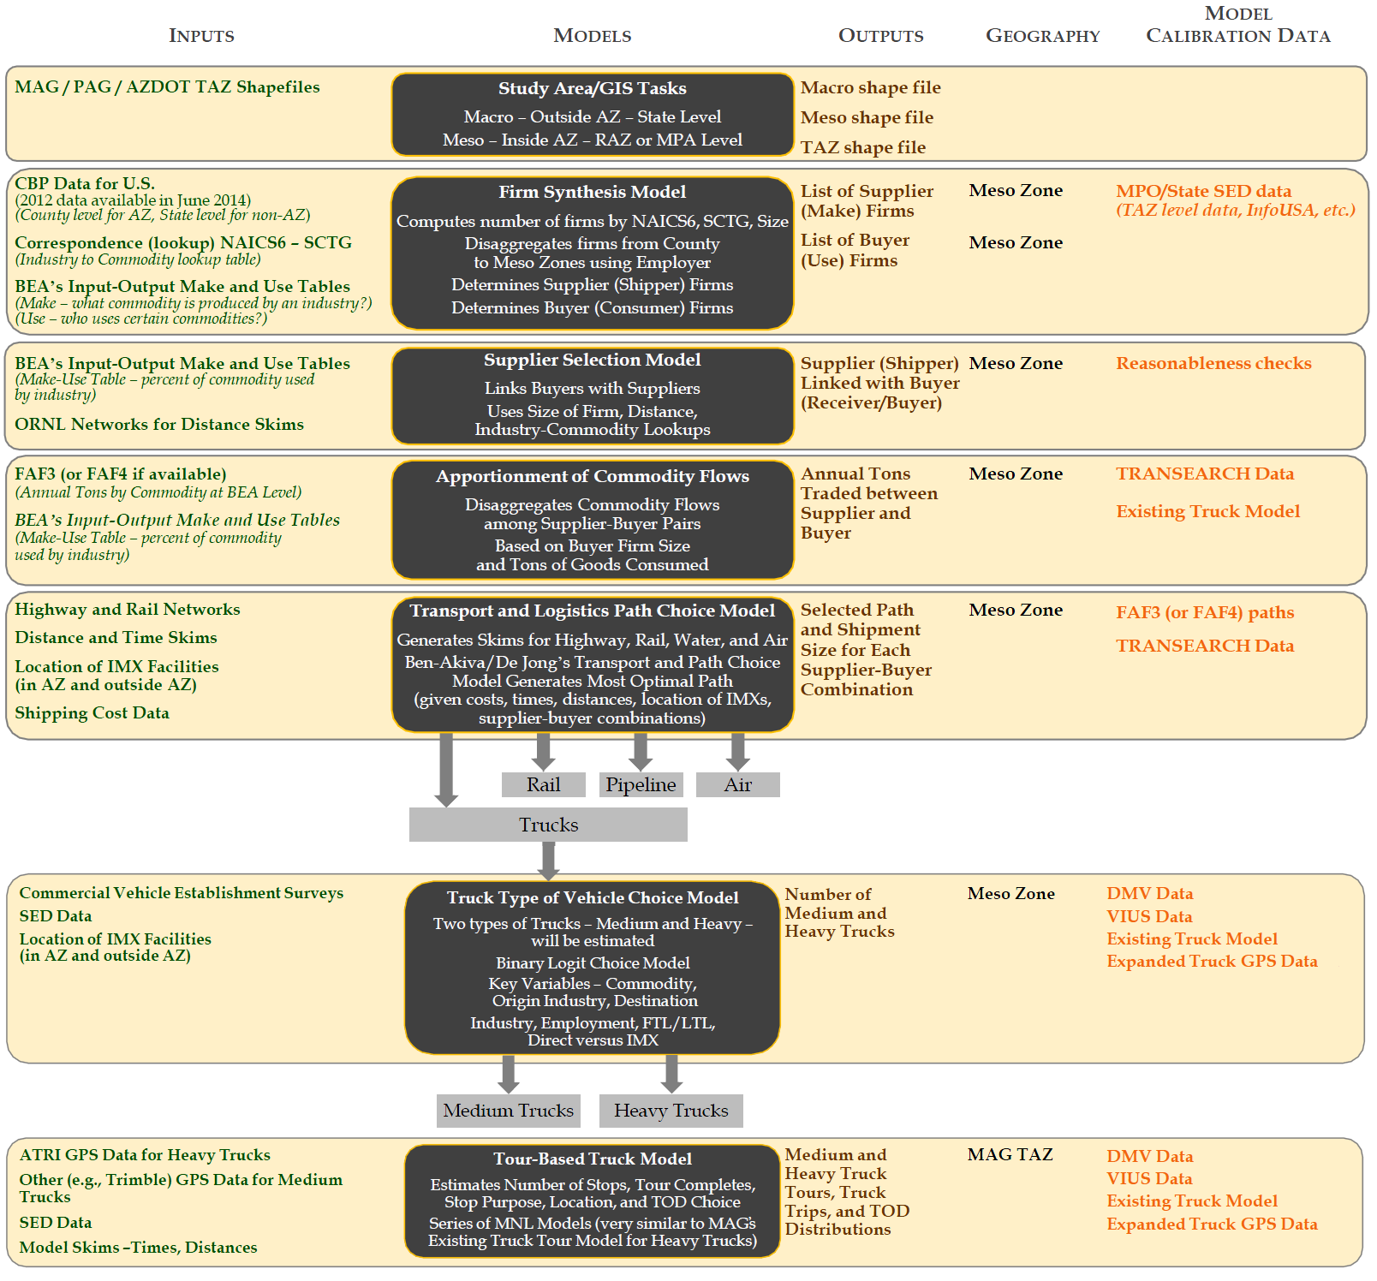


MAG SHRP2 C20
Freight Demand Model
Firm Synthesis Model
↓
Lists of buyer firms and
supplier firms
↓
Supply Chain Model
↓
Commodity flows
between firms
↓
Truck Tour Model
Notes:
Quick go-through of SHRP2 model

Slide 3
US Census CBP
Enumerate and Partition Agents
Firm Synthesizer Output
Model Overview Framework
Zone System
Buyer Agents
NAICS
Size
Location Zone
Input Commodity
Requirements (Kton annual)
List of Firm Clusters:
Industry class, employment, TAZ
BEA Industry IO Accounts
FAF Data
(1) Freight Generation:
Production/Consumption Rates per employee by industry class
IMPLAN Regional Economic Data
Supplier Agents
NAICS
Size
Location Zone
Output Commodity
Production (Kton annual)
3-dimensional Industry- Commodity Crosswalk
(2) Supplier Selection:
Form supplier-buyer pairs
Determine amount of traded commodity
Supplier Evaluation Criteria
Buyer Evaluation Criteria
Measures under each criterion
Annual Firm-to-Firm Commodity Flows
Network Skims
Multimodal Supply Chain Database:
All buyer-supplier partnerships
All firm-level information
Shipment size & frequency
Shipment path configuration (mode, logistics facility, port of entry)
FAF Data
(3) Transport, Mode, and
Path Choice Model:
Mode Choice, Shipment size, Transload location, Port of entry
CFS Microdata

Slide 4
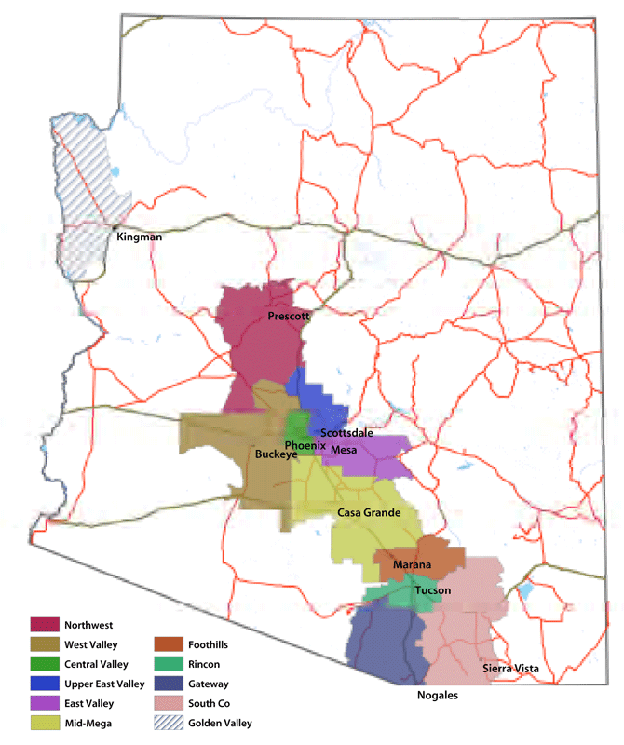
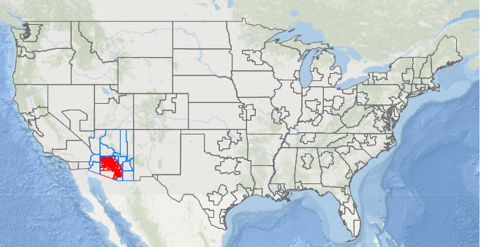
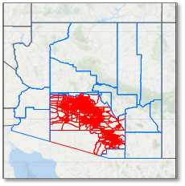
Model Overview Geography
Study Area:
Arizona Sun Corridor Megaregion (MAG+PAG Modeling Area)
Variable Zone System:
MAG-PAG megaregion: TAZ
Rest of Arizona: County
Rest of the US: FAF zones
Figure Credit: Morrison Institute for Public Policy, Arizona State University

Slide 5
8.5 million establishments/firms with 6-digit NAICS industry classification
Within the study area: Outputs from Firm Synthesizer Model
External Firms: County Business Patterns (CBP) data from U.S. Census Bureau
Partitioned by industry class, employment size, and location
Down to 398,385 firm clusters (decision-making agents)
Model Overview Input / Agents
naics | Description | employment | establishments
11 | Agriculture, Forestry, Fishing and Hunting | 15,506 | 5,052
21 | Mining, Quarrying, and Oil and Gas Extraction | 5,533 | 432
22 | Utilities | 8,141 | 557
23 | Construction | 193,354 | 48,038
31-33 | Manufacturing | 187,468 | 16,053
42 | Wholesale Trade | 111,312 | 18,452
44-45 | Retail Trade | 288,057 | 46,665
48-49 | Transportation and Warehousing | 66,407 | 9,190
51 | Information | 54,148 | 9,899
52 | Finance and Insurance | 112,249 | 23,975
53 | Real Estate and Rental and Leasing | 96,916 | 25,476
54 | Professional, Scientific, and Technical Services | 199,234 | 50,644
55 | Management of Companies and Enterprises | 9,723 | 4,214
56 | Administrative and Support and Waste Management and Remediation Services | 248,484 | 88,629
61 | Educational Services | 191,967 | 17,821
62 | Health Care and Social Assistance | 223,814 | 28,275
71 | Arts, Entertainment, and Recreation | 48,174 | 8,284
72 | Accommodation and Food Services | 142,008 | 8,935
81 | Other Services (except Public Administration) | 134,471 | 37,733
92 | Public Administration | 106,603 | 1,738
Total |  | 2,443,569 | 450,062

Slide 6
Model Overview Traded Goods/ Supply Chain Markets
2-digit SCTG
42 Commodity Groups
SCTG | Commodity Description | SCTG | Commodity Description
1 | Live animals and live fish | 22 | Fertilizers
2 | Cereal grains | 23 | Chemical products and preparations, n.e.c.
3 | Other agricultural products | 24 | Plastics and rubber
4 | Animal feed and products of animal origin, n.e.c. | 25 | Logs and other wood in the rough
5 | Meat, fish, seafood, and their preparations | 26 | Wood products
6 | Milled grain products and preparations, bakery products | 27 | Pulp, newsprint, paper, and paperboard
7 | Other prepared foodstuffs and fats and oils | 28 | Paper or paperboard articles
8 | Alcoholic beverages | 29 | Printed products
9 | Tobacco products | 30 | Textiles, leather, and articles of textiles or leather
10 | Monumental or building stone | 31 | Nonmetallic mineral products
11 | Natural sands | 32 | Base metal in primary or semi-finished forms and in finished basic shapes
12 | Gravel and crushed stone | 33 | Articles of base metal
13 | Nonmetallic minerals n.e.c. | 34 | Machinery
14 | Metallic ores and concentrates | 35 | Electronic and other electrical equipment and components and office equipment
15 | Coal | 36 | Motorized and other vehicles (including parts)
16 | Crude Petroleum | 37 | Transportation equipment, n.e.c.
17 | Gasoline and aviation turbine fuel | 38 | Precision instruments and apparatus
18 | Fuel oils | 39 | Furniture, mattresses and mattress supports, lamps, lighting fittings, and illuminated signs
19 | Coal and petroleum products, n.e.c. | 40 | Miscellaneous manufactured products
20 | Basic chemicals | 41 | Waste/Scrap
21 | Pharmaceutical products | 43 | Mixed Freight
Notes:
Standard Classification of Transported Goods (SCTG)

Slide 7
(1) Freight Generation Firm-level Production and Consumption
Input Data
Regional Economic Data by IMPLAN
BEA 2007 Industry Input-Output Accounts data
Employment data Firm Synthesizer and CBP
Commodity-Industry crosswalks
FAF Data
Implementation
Supplier/Buyer Status
Type and amount of commodities produced (supply) & consumed (demand)
Notes:
The first step is the freight generation process in which total annual commodity productions and consumptions are determined at firm level. The national and regional economic activity data and socio-economic factors are used in a systematic procedure to estimate the commodity input-output rates per employee by industry class.

Slide 8
(1) Freight Generation Procedure
Develop Commodity-Industry Crosswalks (NAICS-SCTG & IO-SCTG)
Commodity-Industry crosswalk
IO crosswalk
Identify produced and consumed commodities by industry (supplier/buyer status)
3-dimensional correspondence system
Calculate production and consumption rates by employee by industry
Employment data
BEA Input-Output Accounts data
Convert Monetary rates to tons
Unite value of commodities from FAF data
Calculate annual production and consumptions for each firm and calibrate
Firm database
FAF Production/Consumption Data

Slide 9
(1) Freight Generation Output: Supplier & Buyer Firms Database
Total National Supply & Demand | 18,040,435 k-ton
MAG-PAG Supply | 125,029 k-ton
MAG-PAG Demand | 163,861 k-ton
Firms characteristics
SCTG
Supply/Demand K-ton
Simulated Supplier Agents | 137,328
Simulated Buyer Agents | 4,177,042
Freight Generation Results for Articles of Base Metal (SCTG 33)
Notes:
This freight generation model generates a list buyer and supplier firms with the type and annual amount of commodity purchased or supplied.
The supplier and buyer agents then enter the second step in which business partnerships are evaluated and B-to-B supply chains are formed between agents.

Slide 10
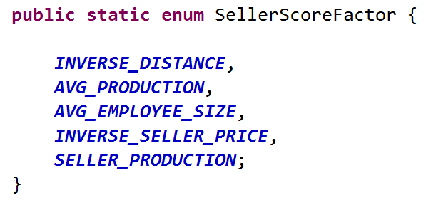
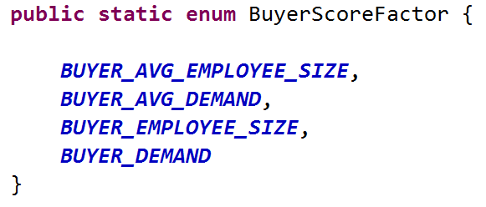
Firm 1
(2) Supplier Selection Roth & Peranson Algorithm
Buyer(s)
Seller(s)
Production(s)
A pareto-optimal and stable market-clearing mechanism to matches buyers to sellers.
Only needs an ordinal ranking of who each buyer would like to purchase from, and an ordinal ranking of whom each seller would like to sell to.
Supplier Selection Score is calculated for each buyer and seller
Shipper
Firm 2
Buyer(s)
Seller(s)
Production(s)
Buyer
Seller
Buyer
Buyer
Seller
Buyer
Seller
Buyer
Roth, Alvin & Elliott Peranson (September 1999). “The Redesign of the Matching Market for American Physicians: Some Engineering Aspects of Economic Design” (PDF). The American Economic Review 89 (4): 756–757. doi:10.1257/aer.89.4.748.
Mark A. Ehlen Consulting
Notes:
The RPA is ideal for the MAG SSM, largely because it only requires ordinal rankings of suppliers and buyers, not quantities and conditions to be met. In other words, the model only needs an ordinal ranking of who each buyer would like to purchase from, and an ordinal ranking of whom each supplier would like to sell to. In the MAG implementation, the ranking is formed using a quantitative Supplier Selection Score for each supplier and buyer, which is comprised of different criteria including prices, distance, capacity and other factors.

Slide 11
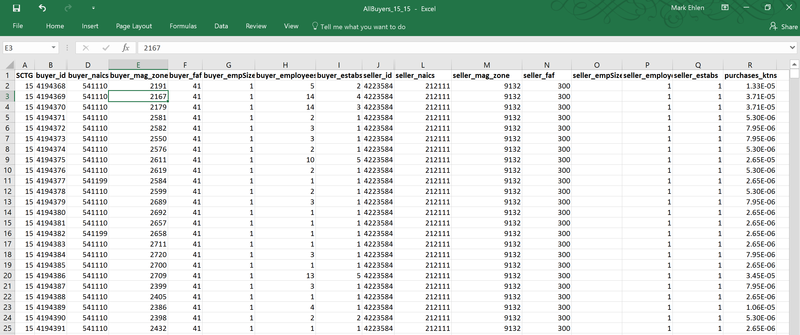
(2) Supplier Selection Output
Mark A. Ehlen Consulting
Notes:
The results of the supplier selection model determines total annual commodity that is traded between each pair of supplier-buyer firms.

Slide 12
(3) Transport, Mode and Path Choice Model Overview
Disaggregate Logistics Choice Model
Evaluates alternatives for each buyer-supplier pair
Joint Mode and Shipment Size Choice
Main estimation source: 2012 Commodity Flow Survey (CFS) Microdata Sample
Notes:
Once the supply chains are formed in the Supplier Selection and Evaluation of Commodity Flows model, the total annual commodity flows between firms are used as input to the Transport, Mode, and Path Choice model in which logistics choices of mode and shipment size are analyzed for the commodity flows to, from, and within the Arizona Sun Corridor Megaregion

Slide 13
(3) Transport, Mode and Path Choice Model Data Sources: 2012 CFS Microdata
Mode | Use in Model Estimation and Application | N
Truck | Yes (combine) | 1
For-hire truck |  | 35,038
Private truck |  | 28,805
Rail | Yes (combine) | 501
Truck and rail |  | 161
Air (incl truck & air) | Yes (combine) | 2,863
Parcel, USPS, or courier |  | 34,107
Mode suppressed | No - unknown mode | 5
Single mode | No - unknown mode | 221
Multiple mode | No - unknown mode | 135
Truck and water | No - water not included | 1
Non-parcel multimode | No - unknown mode | 4
All Shipment Records |  | 101,842
Shipment Records with Complete Mode Information |  | 101,476
Notes:
A disaggregate joint model of mode choice and shipment size was estimated using the Commodity Flow Survey (CFS) 2012 Microdata sample as the primary source. This dataset comprises shipper-based commodity shipments throughout the U.S. in 2012. The model is highly disaggregated and developed using the first generation of Commodity Flow Survey Public Use Microdata (CFS PUM). The data is an invaluable source that provides detailed shipment information for approximately 4.5 million individual shipments obtained from business establishments. The model convert commodity flows into shipments between supplier – buyer.

Slide 14
(3) Transport, Mode and Path Choice Model Travel Time Inputs & Assumptions
Geography | Mode | Distance | Travel Time | Speed (MPH)
All Trips | Rail | Routed | 12 hours + IVT* + (12 hours x Number of Trackage Changes) | 22
Intra-Sun Corridor | Truck | Routed | 4 hours + IVT | 20
 | Parcel or Air | Routed | 1 hour + IVT | 40
External | Truck, 0-650 mi. | Routed | 16 hours + IVT | 65
 | Truck, 651-1,299 mi. | Routed | 16 hours + IVT | 38
 | Truck, 1,300+ mi. | Routed | 16 hours + IVT | 32
 | Parcel or Air | Great Circle | 12 hours + IVT | 250
* IVT = In-vehicle time = distance / speed

Slide 15
(3) Transport, Mode and Path Choice Model Transportation Costs
Alternative(s) | Distance | Cost per Ton-Mile | Minimum Cost ($)
Rail | Routed | $0.0395 | 200
Truck 1 (<150 lbs.) | Great Circle | $2.83 | 10
Truck 3 (150-1,499 lbs.) | Great Circle | $0.50 | 15
Truck 4-5 (1,500+ lbs.) | Great Circle | $0.18 | 15
Parcel or Air 1 (<150 lbs.) | Great Circle | $2.83 | 10
Parcel or Air 3-4 (150+ lbs.) | Great Circle | $2.09 | 15
* Cost per ton-mile from RITA and on-line shipping rate data

Slide 16
(3) Transport, Mode and Path Choice Model Shipments by Mode
Mode | N Shipment | % Total Tons |  | Mean Tons per Shipment
 |  | Unweighted | Weighted | Unweighted | Weighted
truck | 63,844 | 36.42 | 83.69 | 6.2 | 1.6
rail | 662 | 62.44 | 14.53 | 1,046 | 173
parcel/air | 36,970 | 0.05 | 0.49 | 0.0162 | 0.0002
Total Tons (Millions) |  | Unweighted |  | Weighted
 |  | 1.10 |  | 149.51

Slide 17
(3) Transport, Mode and Path Choice Model Geographical distribution of Arizona-based shipment
Origin Region | Destination Region
 | Sun Corridor - Phoenix and Tucson | Remainder of Arizona | California - Southern | California - Other | Nevada | Utah | Colorado | New Mexico | Pacific Northwest | Central-Upper Midwest | Great Lakes | Northeast U.S. | Texas and Oklahoma | Southeast U.S. | Alaska and Hawaii | Total
Sun Corridor - Phoenix and Tucson | 26,498 | 2,407 | 3,868 | 1,585 | 633 | 407 | 562 | 735 | 1,084 | 1,127 | 2,150 | 2,506 | 2,617 | 3,071 | 76 | 49,326
Remainder of Arizona | 1,407 | 9,076 | 1,381 | 889 | 468 | 205 | 321 | 287 | 429 | 479 | 636 | 625 | 665 | 838 | 30 | 17,736
California - Southern | 4,210 | 576 | - | - | - | - | - | - | - | - | - | - | - | - | - | 4,786
California - Other | 2,235 | 436 | - | - | - | - | - | - | - | - | - | - | - | - | - | 2,671
Nevada | 888 | 280 | - | - | - | - | - | - | - | - | - | - | - | - | - | 1,168
Utah | 932 | 189 | - | - | - | - | - | - | - | - | - | - | - | - | - | 1,121
Colorado | 639 | 194 | - | - | - | - | - | - | - | - | - | - | - | - | - | 833
New Mexico | 446 | 286 | - | - | - | - | - | - | - | - | - | - | - | - | - | 732
Pacific Northwest | 1,356 | 242 | - | - | - | - | - | - | - | - | - | - | - | - | - | 1,598
Central-Upper Midwest | 2,370 | 581 | - | - | - | - | - | - | - | - | - | - | - | - | - | 2,951
Great Lakes | 4,565 | 698 | - | - | - | - | - | - | - | - | - | - | - | - | - | 5,263
Northeast U.S. | 4,708 | 558 | - | - | - | - | - | - | - | - | - | - | - | - | - | 5,266
Texas and Oklahoma | 2,169 | 481 | - | - | - | - | - | - | - | - | - | - | - | - | - | 2,650
Southeast U.S. | 4,624 | 769 | - | - | - | - | - | - | - | - | - | - | - | - | - | 5,393
Alaska and Hawaii | 65 | 17 | - | - | - | - | - | - | - | - | - | - | - | - | - | 82
Arizona-Unknown Region | 43 | 28 | 36 | 9 | 1 | 4 | 3 | 5 | 10 | 3 | 16 | 13 | 19 | 32 | 23 | 245
California-Unknown Region | 17 | 4 | - | - | - | - | - | - | - | - | - | - | - | - | - | 21
Total | 57,172 | 16,822 | 5,285 | 2,483 | 1,102 | 616 | 886 | 1,027 | 1,523 | 1,609 | 2,802 | 3,144 | 3,301 | 3,941 | 129 | 101,842
Frequency Missing = 22
Source: CFS 2012 Microdata summarized by the RS&H, Inc. team.

Slide 18
(3) Transport, Mode and Path Choice Model Distribution of Shipments by Mode Across Shipment Size

Slide 19
(3) Transport, Mode and Path Choice Model Value per pound categories used in model estimation
Mode | Value ($) per Pound |  |  | Total Sample Shipments by Mode | % Sample Shipments by Mode
 | LOW (<$1/lb.) | MED ($1-$3.99) | HIGH ($4+/lb.)
Rail/IMX | 83% | 17% | 0% | 614 | 0.60%
Truck | 38% | 30% | 32% | 63,250 | 63%
Parcel/Air | 1% | 8% | 91% | 36,837 | 36%
Total Number of Shipments in Estimation Sample | 24,941 | 22,166 | 53,594 | 100,701 | 100%
% Sample Shipments by Value Category | 25% | 22% | 53% | 100%

Slide 20
(3) Transport, Mode and Path Choice Model Nested Logit structure
Mode and Shipment Size
Parcel / Air
Small
Medium
Large
Rail
(Carload / IMX)
Small
Large
Very Large
Medium
Large
Very Large
Truck
Mode Alternatives | Shipment Size Categories
 | SMALL < 150 lbs. | MEDIUM 150-1,499 lbs. | LARGE 1,500-34,999 lbs. | VERY LARGE 35,000+ lbs.
Rail Carload / IMX | Not included | Not included | Modeled | Modeled
Truck | Modeled | Modeled | Modeled | Modeled
Parcel / Air | Modeled | Modeled | Modeled | Not included
Notes:
The path choice model is a joint model where mode and shipment size decisions are evaluated simultaneously.
Numerous nesting structures were tested, with some grouping alternatives together based primarily on mode and others based more on shipment size. Nesting structures were assessed statistically based on the estimated nesting coefficients (also called logsum parameters or dissimilarity parameters). Based on this rationale, the best nesting structures (those with relatively low nesting coefficients) were structures in which mode was used to group alternatives. The model fit is reasonably good: Rho2 with respect to the constants-only model is 0.318, and Rho2 with respect to zero is 0.513.

Slide 21
(3) Transport, Mode and Path Choice Model Estimation Results
Significant covariates:
Transportation Time
Transportation Cost
Commodity Type
Commodity Value
Export status
Value of Time by commodity:
Low-value goods: Not time-sensitive
Medium-value goods: $22.81/hour
High-value goods: $26.98/hour
Most preferred path option (ceteris paribus):
Medium-sized Truck
Small Truck
Large Truck
Very Large Truck
Small Parcel/Air
Medium, Large Parcel/Air
Rail

Slide 22
(3) Transport, Mode and Path Choice Model Estimation Results
Alternatives | Variables & Estimated Parameters
 | Alternative-Specific Constant (ASC) | Commodity Categories |  |  |  | Export |  |  |  | Transportation Cost (2012 $) |  |  | Time (Hours)
 |  | Bulk Goods | Fuels and Fertilizers | Inter-mediate Products, Foodstuffs and Misc. | Manufactured Goods | Mexico | Canada | Other |  | Low-Value*** Goods | Medium-Value Goods | High-Value Goods | Low-Value Goods | Medium-Value Goods | High-Value Goods
 |  |  |  |  |  |  |  | All Goods | Increment for High-Value Goods
Rail-large | -15.8** | N/A | N/A | 0 | -30.7** | N/A | N/A | N/A | N/A | -0.0002 ** | -0.0057 ** | -0.0063 ** | 0 | -0.130 ** | -0.170 **
Rail-very large | -14.6** | 8.47** | 9.75** | 0 |  | N/A | N/A | N/A | N/A
Truck-small | 0 | 0 | 0 | 0 | 0 | 0 | 0 | 0 | 0
Truck-medium | 0.287** | 0 | 1.15** | 0 | -1.14** | 0 | -0.536** | 0 | 0
Truck 4-large | -0.106** | 2.63** | 2.96** | 0 | -1.98** | 0 | -1.59** | 0 | 0
Truck 5 very large | -0.777** | 4.90** |  | 0 | -3.10** | 1.10** |  | 0.173* | 0
Parcel/Air-small | -5.60** | 0 | 0 | 0 | 3.47** | -2.73** | -1.62** | 6.30** | 2.63**
Parcel/Air-medium | -11.1** | N/A | N/A | 0 | 3.37** | N/A | N/A | 10.6** | 1.42**
Parcel/Air-large | -11.6** | N/A | N/A | 0 | -1.20* | N/A | N/A |  | 0
* indicates 75% or higher; **indicates 98% or higher statistical significance;
*** Low-value is used for goods that are valued at less than $1/lb.; Medium for $1 to less than $4/lb.; and High for $4+/lb.

Slide 23
(4) Model Calibration and Validation
Process
Freight Analysis Framework (FAF) 4.1 is the main data source.
Comparison of modal split and commodity flow aggregately at FAF zone level between modeled and FAF data
Tuning the formation of potential suppliers and buyers sets to minimize the discrepancy

Slide 24
(4) Model Calibration and Validation: Modal Split
Modeled Flows FAF Flows
Modeled Flows FAF Flows
Direction | Truck | Rail | Parcel/Air
II (Internal) | 92.9% | 6.0% | 1.1%
EI (Inbound) | 90.0% | 7.1% | 2.9%
IE (outbound) | 80.3% | 19.7% | 0.0%
total | 89.4% | 9.1% | 1.5%
Direction | Truck | Rail | Parcel/Air
II (Internal) | 94.9% | 4.9% | 0.1%
EI (Inbound) | 83.2% | 12.8% | 4.1%
IE (outbound) | 87.0% | 10.0% | 3.0%
total | 90.2% | 8.0% | 1.7%

Slide 25
(4) Model Calibration and Validation: Commodity Flows
Modeled vs. Observed Total Directional Flows
Modeled Flows (b) FAF Flows
Direction | Flow (kton) | % of Total |  |  |  | Direction | Flow (kton) | % of Total
II (Internal) | 103,945 | 56% |  |  |  | II (Internal) | 104,836 | 56%
EI (Inbound) | 59,916 | 32% |  |  |  | EI (Inbound) | 60,038 | 32%
IE (outbound) | 21,083 | 12% |  |  |  | IE (outbound) | 21,548 | 12%
Total | 184,944 |  |  |  |  | Total | 186,423

Slide 26
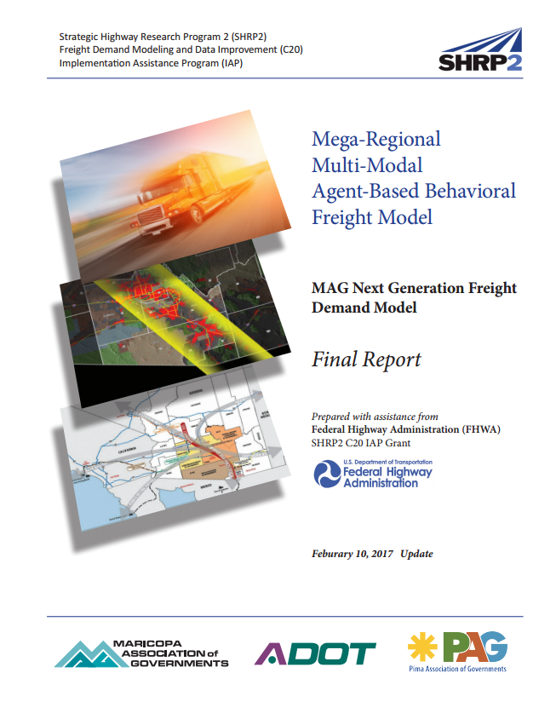
Acknowledgements:
FHWA
MAG SHRP2 C20 Technical Advisor Group
MAG SHRP2 C20 Consultant Team:
Cambridge Systematics, RS&H, ATRI, CDM SMITH, StreetLight
More information:
MAG SHRP2 C20 Mega-Regional Multi-Modal Agent-Based Behavioral Freight Model
Final Report. (http://www.azmag.gov/Projects/Project.asp?CMSID=1137)
Zahra Pourabdollahi <zahra.pourabdollahi@rsandh.com>
Mark Ehlen <mark.ehlen.consulting@gmail.com>
Monique Stinson, <mstinson373@gmail.com>
Kyunghwi Jeon, <KJeon@azmag.gov>
Daehyun You, <DYou@azmag.gov>
Haidong Zhu, <HZhu@azmag.gov>
TRB Applications Conference. Raleigh, NC. May 14-18, 2017

