Slide 1
TRENDD
An Open Source Python-based Dashboard Library
Raymond Gerte & Karthik Konduri
University of Connecticut
May 14th 2017

Slide 2
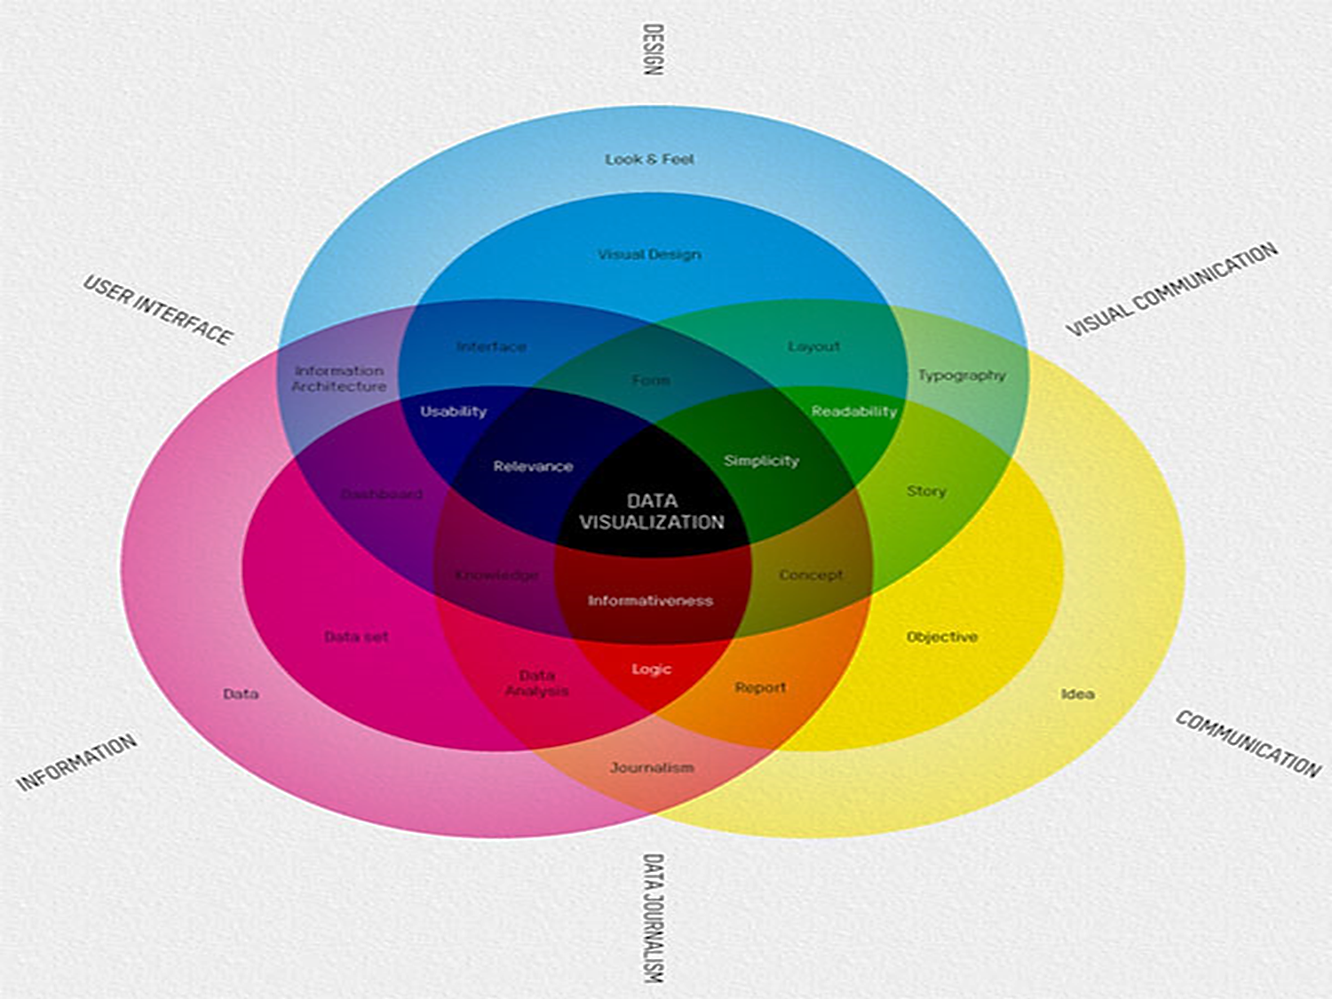
FFunction
Notes:
https://ffctn.com/en/index
http://infosthetics.com/archives/2010/11/what_is_data_visualization.html

Slide 3
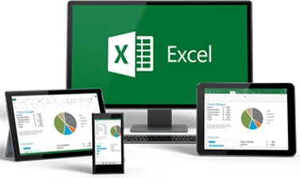
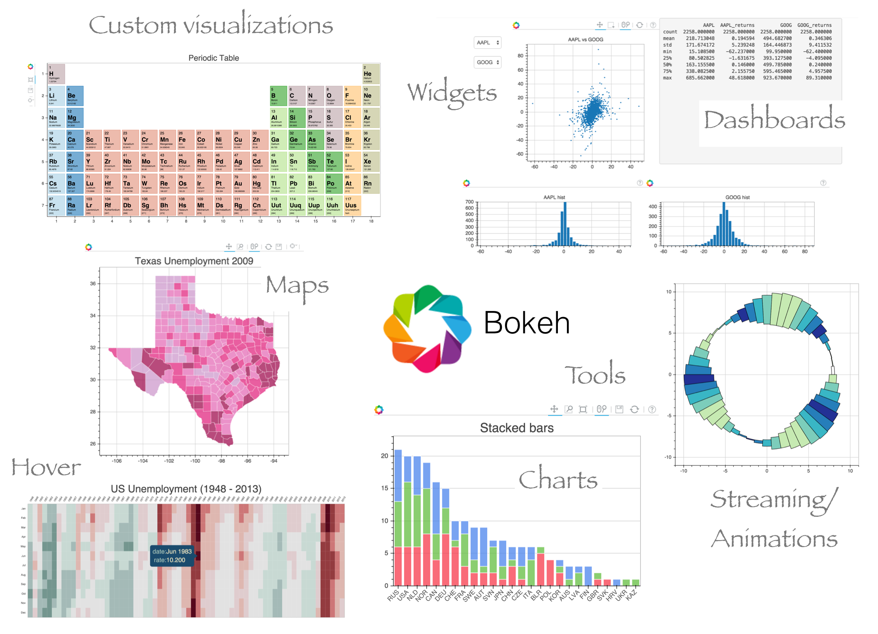
Existing Tools
Proprietary Software:
Open-Source Software:
Notes:
Image sources:
https://tableau.lcsexams.com/images/TableauLogo.jpg
https://www.edx.org/sites/default/files/course/image/promoted/analyzing_and_visualizing_data_with_excel_378x225.jpg
https://www.graphpad.com/www/graphpad/includes/themes/graphpad/images/mainpage-banner-graphpad-prism7.png
https://www.sas.com/en_us/_jcr_content/socialShareImage.img.png
http://pandas.pydata.org/_static/pandas_logo.png
https://camo.githubusercontent.com/b48021e8685bc09fb2ca887f341d8c7645e71ae1/687474703a2f2f696d616765732e706c6f742e6c792f6c6f676f2f706c6f746c796a732d6c6f676f4032782e706e67
https://upload.wikimedia.org/wikipedia/en/thumb/5/56/Matplotlib_logo.svg/1280px-Matplotlib_logo.svg.png
https://avatars1.githubusercontent.com/u/1562726?v=3&s=400
https://www.analyticsvidhya.com/wp-content/uploads/2016/10/shiny.png

Slide 4
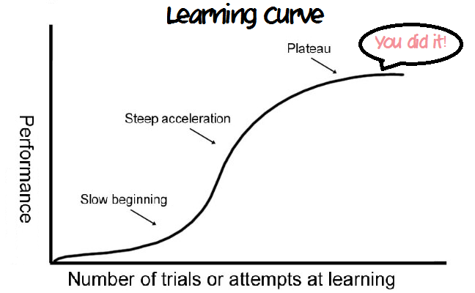
Motivation
Simplify the process of constructing interactive dashboards
Allow creation of simple as well as complex data visualizations
Distribute under open-source licensing agreements in an easy to access format
Complexity Image gere
Notes:
https://darnell82.files.wordpress.com/2014/08/at-no-cost-too-you-free-professional-headshots-from-dating-company-mesh.gif
https://mindprintlearning.com/blog/site/uploads/2016/04/LearningCurve2.png
http://i.huffpost.com/gen/2534202/images/o-COMPLEXITY-facebook.jpg

Slide 5
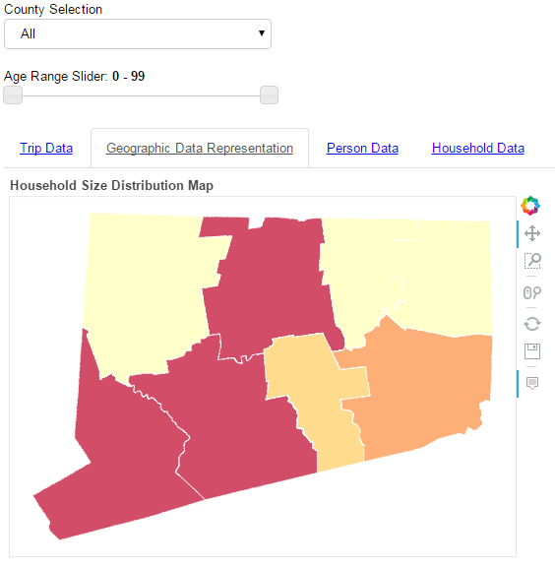
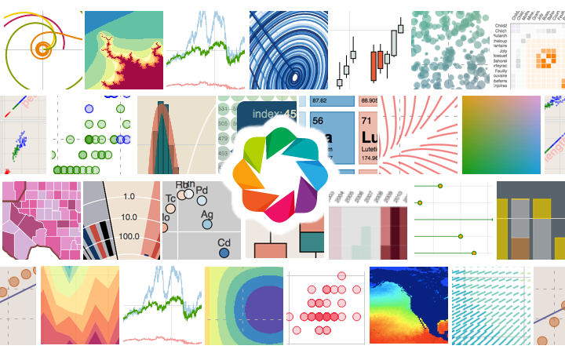
What is TRENDD Dashboard?
An Easy to use Open Source Python-based Dashboard Library
Notes:
http://pandas.pydata.org/_static/pandas_logo.png
http://chdoig.github.io/scipy2015-blaze-bokeh/images/bokeh.png
https://i.ytimg.com/vi/yroK0n-Z9Pk/maxresdefault.jpg

Slide 6
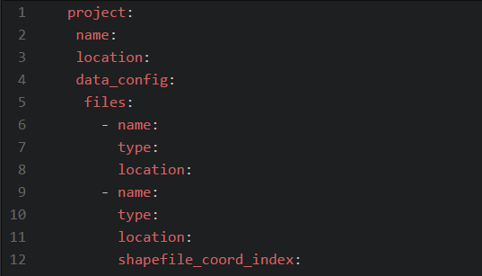
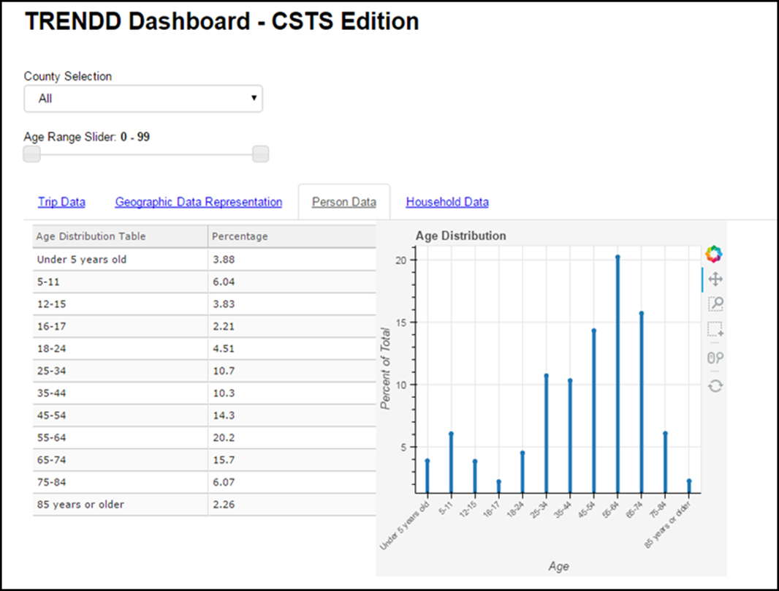
How Does it Work?
TRENDD
Code
Base
Data Files
YAML configuration file

Slide 7
Live Demo

Slide 8
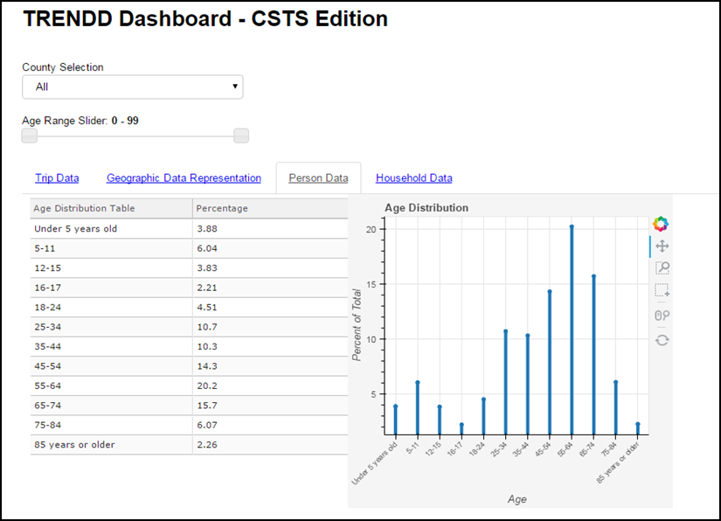
Dashboard Elements
Top-Level Filtration Widgets
Data Tabs
Interactive Visualizations

Slide 9
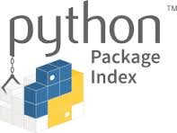
Accessing TRENDD
TRENDD will be published through the Python Package Index (pip)
Alternatively, the TRENDD code base can also be accessed through our GitHub repository: github.com/foss-transportationmodeling
Notes:
https://pypi.org/
https://assets-cdn.github.com/images/modules/open_graph/github-mark.png

Slide 10
Future Additions
Future Additions - TODO:
Publish TRENDD Dashboard
Incorporate additional selection widgets for data querying and filtration
Allow for multi-logic checks in data filtration
Expand allowable visualization types to include all available to Bokeh
Expand allowable data types to include all common formats
Incorporate webpage embedding
Expand layout configuration options
Finalize user documentation

Slide 11
Questions & Comments?
For Publication and Updates, see:
github.com/foss-transportationmodeling
Or contact me personally,
Raymond Gerte
raymond.gerte@uconn.edu

Slide 12
Image Acknowledgement
https://ffctn.com/en/index
http://infosthetics.com/archives/2010/11/what_is_data_visualization.html
https://tableau.lcsexams.com/images/TableauLogo.jpg
https://www.edx.org/sites/default/files/course/image/promoted/analyzing_and_visualizing_data_with_excel_378x225.jpg
https://www.graphpad.com/www/graphpad/includes/themes/graphpad/images/mainpage-banner-graphpad-prism7.png
https://www.sas.com/en_us/_jcr_content/socialShareImage.img.png
http://pandas.pydata.org/_static/pandas_logo.png
https://camo.githubusercontent.com/b48021e8685bc09fb2ca887f341d8c7645e71ae1/687474703a2f2f696d616765732e706c6f742e6c792f6c6f676f2f706c6f746c796a732d6c6f676f4032782e706e67
https://upload.wikimedia.org/wikipedia/en/thumb/5/56/Matplotlib_logo.svg/1280px-Matplotlib_logo.svg.png
https://avatars1.githubusercontent.com/u/1562726?v=3&s=400
https://www.analyticsvidhya.com/wp-content/uploads/2016/10/shiny.png
https://darnell82.files.wordpress.com/2014/08/at-no-cost-too-you-free-professional-headshots-from-dating-company-mesh.gif
https://mindprintlearning.com/blog/site/uploads/2016/04/LearningCurve2.png
http://i.huffpost.com/gen/2534202/images/o-COMPLEXITY-facebook.jpg
http://pandas.pydata.org/_static/pandas_logo.png
http://chdoig.github.io/scipy2015-blaze-bokeh/images/bokeh.png
https://i.ytimg.com/vi/yroK0n-Z9Pk/maxresdefault.jpg
https://pypi.org/
https://assets-cdn.github.com/images/modules/open_graph/github-mark.png

