Slide 1
Validating Trip Distribution using GPS Data
In Southeast Michigan
2017 Transportation Planning and Applications Conference
Sean McAtee
May 15, 2017

Slide 2
Presentation Overview
Zone to Zone Travel Time
Personal Vehicle Trip Patterns
Commercial Vehicle Trip Patterns

Slide 3
Travel Times (Personal Travel)

Slide 4
Validate Network "Skims"
Skims vs. StreetLight
Survey vs. StreetLight
Skims vs. Survey

Slide 5
Observed: StreetLight vs. Survey

Slide 6
Comparison: Skim vs. StreetLight

Slide 7
Comparison to Model
The model is running fast!
How does StreetLight reflect Terminal Time?
✓ Driving around looking for parking = Included
✗ Walking to/from the vehicle = Not Included
Speed and terminal times adjustments are necessary prior to trip distribution calibration
Bigger sample size helps with localized adjustments (e.g., county and area type)

Slide 8
Passenger Vehicles

Slide 9
Household Survey
Difference: StreetLight – [2015 HH Survey]
134% RMSE
 | Detroit | Wayne | Oakland | Macomb | Washtenaw | Monroe | St. Clair | Livingston | Total
Detroit | (521,918) | (34,080) | 71,759 | (25,454) | 3,034 | (77) | (555) | 379 | (506,912)
Wayne | (34,792) | (856,192) | 125,202 | 19,008 | 17,472 | (8,398) | 776 | (4,793) | (741,717)
Oakland | 79,092 | 124,302 | 2,140,679 | 56,052 | 21,684 | 2,277 | (833) | (7,660) | 2,415,593
Macomb | (32,297) | 20,462 | 59,127 | (808,758) | 2,609 | 626 | (22,159) | 8 | (780,382)
Washtenaw | 3,800 | 13,028 | 22,365 | 1,873 | 274,617 | (5,528) | 181 | (92) | 310,245
Monroe | (443) | (9,168) | 2,265 | 135 | (6,341) | (193,425) | 95 | 242 | (206,641)
St. Clair | (490) | 743 | 19 | (22,856) | 186 | (162) | (294,363) | (520) | (317,442)
Livingston | (113) | (8,178) | (3,606) | (1,069) | 132 | 217 | (527) | (159,602) | (172,746)
Total | (507,162) | (749,083) | 2,417,810 | (781,069) | 313,393 | (204,468) | (317,384) | (172,037) | 0
Survey filtered to include only auto driver trips

Slide 10
County Level % Difference
County | Trip Difference | VMT Difference
Detroit | -14% | -20%
Wayne | -21% | -14%
Oakland | 50% | 26%
Macomb | -31% | -15%
Washtenaw | 29% | 11%
Monroe | -58% | -32%
St. Clair | -68% | -57%
Livingston | -36% | 4%
Assign scaled & expanded StreetLight trip table
High Income County
High Income County

Slide 11
StreetLight vs Activity
Blue = StreetLight LOWER than Activity
Red = StreetLight HIGHER than Activity
Notes:
Activity Index: Population + Employment * [Sum(Pop) / Sum(Emp)]
StreetLight Index: Scaled so the regional total matches Activity Index

Slide 12
Median Income
Blue = LOWER relative income
Red = HIGHER relative income

Slide 13
% Differences by Income

Slide 14
Expansion Options
Origin-Destination Matrix Estimation
Adjust data using SEMCOG's assignment procedure and traffic counts
Requires disaggregation and re-aggregation of the StreetLight data
TAZ-Level IPF
Start with activity index
Adjust for income trip rate variation
Adjust for auto mode share

Slide 15
Commercial Vehicles

Slide 16
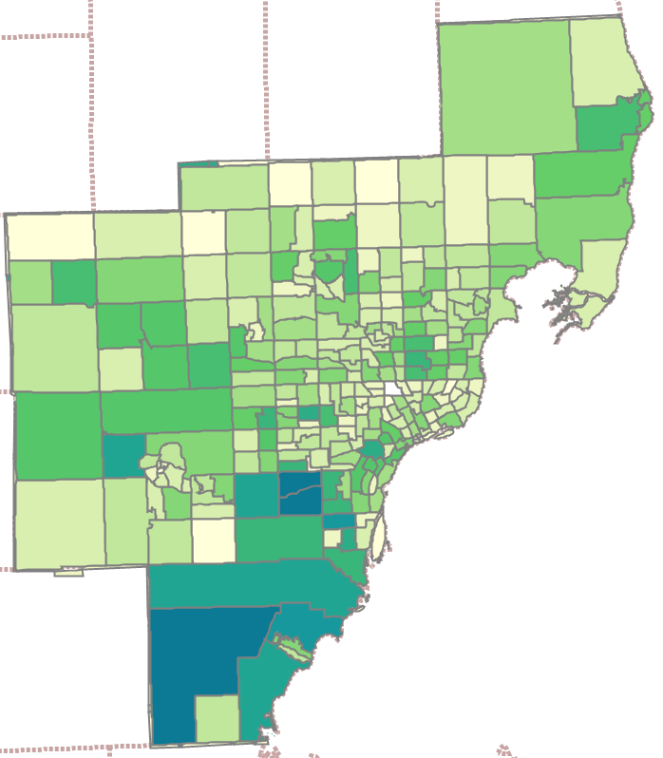
Truck Activity Heat Map
What? Not much here!

Slide 17
Truck Activity Heat Map

Slide 18
Monroe County

Slide 19
Monroe County
A
D
C
B

Slide 20
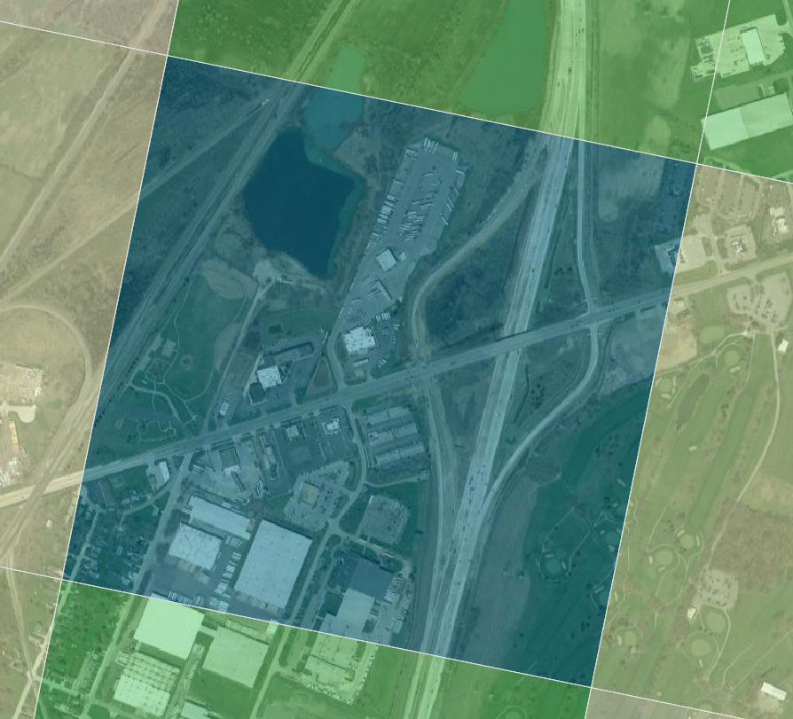
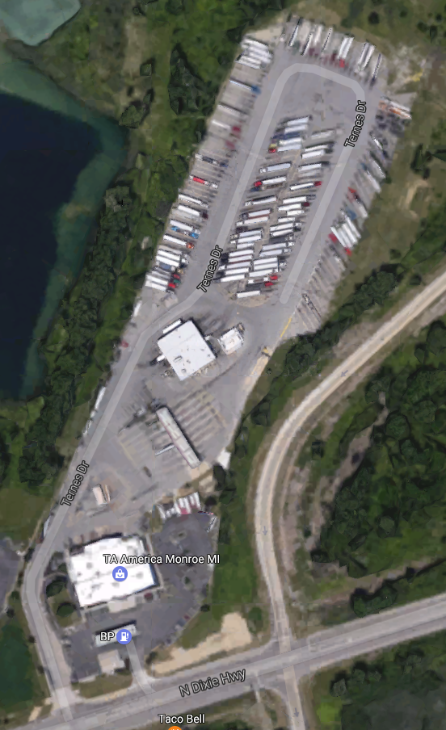
Monroe County - A
Large Truck Stop:
TL America

Slide 21
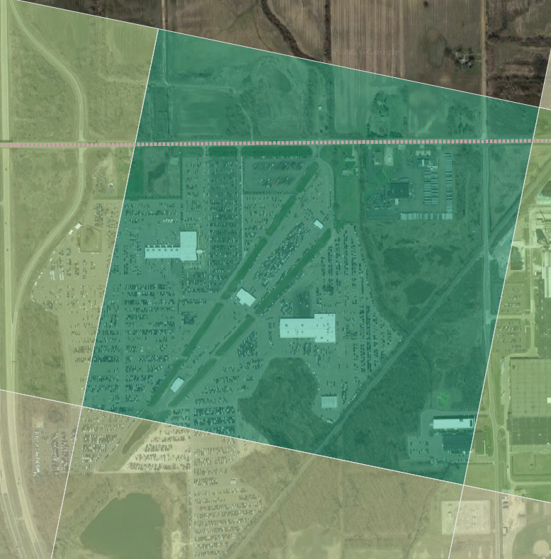
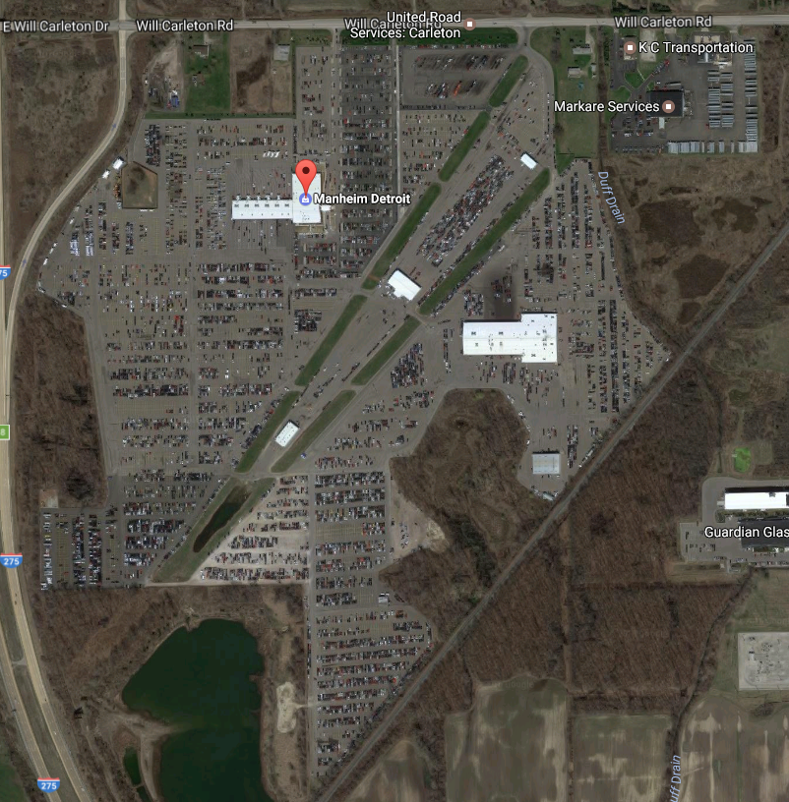
Monroe County - D
Large Auto Auction Site
Manheim Detroit

Slide 22
Monroe County
Cabella’s, Truck Stop
Large Warehouse
Recycler
Rest Area

Slide 23
Solution
Identify major convenience stops
Add small zones to data structure
Link trips through these small zones

Slide 24
Summary
We are working with a sample
Biases can still creep into the datasets
Travel time: seems reliable
Evaluate the data in a way that accounts for possible biases
Passenger vehicles: can be biased
It may be necessary to adjust for income or other demographics
Commercial vehicles: seems more robust
But it is important to understand the definition of a trip.

Slide 25
Collaborators
SEMCOG
Li-yang Feng
Jilan Chen
Cambridge Systematics
Maria Martchouk
Mathew Trostle
David Kurth
StreetLight
Laura Schewel
Neal Bowman

Slide 26
Questions?

