Slide 1
Airport and Ground Access Choice Modeling
Chrissy Bernardo, Surabhi Gupta, & Peter Vovsha
WSP

Slide 2
Airport and Ground Access Choice Modeling
Airports are large, important generators of regional trips
They also face many of their own important planning issues
Air passengers have very different behavior from other travelers
Questions:
What will the mode split of trips to my region’s airport look like in the future?
Can we divert more air passengers to smaller regional airports by improving ground access by highway? By transit?
How does changing the fare on transit service to the airport impact ridership? How does that impact transit conditions? Highway conditions?
What is the impact of adding transit service to an airport on highway conditions around the airport?

Slide 3
Airport Choice Modeling Levels
Model Type | Scope | High-Level | Mid-Level | Low-Level
Regional airport capacity and growth analysis | Multiple, competing regional airports | Regional air travel totals | Airport-by-airport passenger numbers | Airport by mode by market
Airport ground access planning and operations | Detailed ground access network for single airport | Airport passenger and employee totals | Terminal-by-terminal numbers by mode | Detailed segment (line/link) by market (including employees)

Slide 4
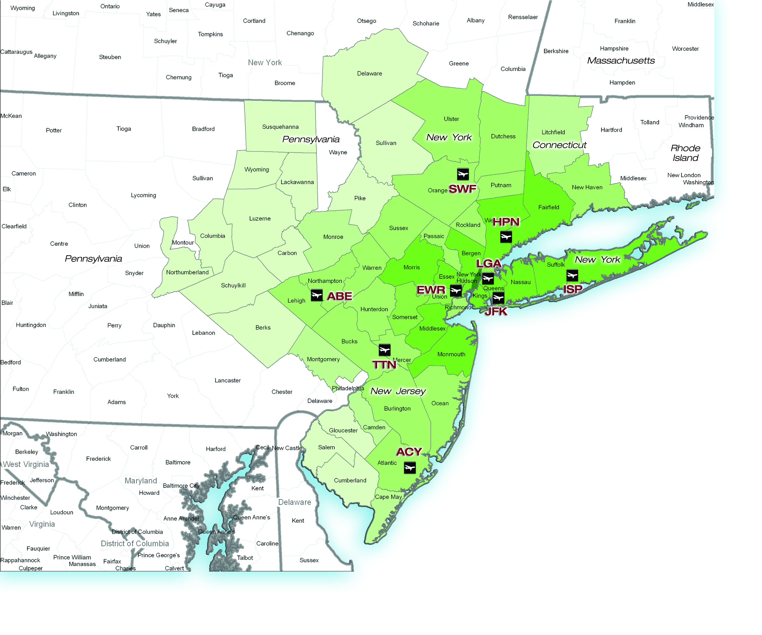
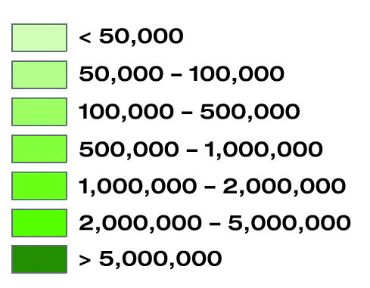
Regional Airport Modeling
Year 2005
Million Annual Passengers

Slide 5
Model Output – Regional Airports
Have rail directly to airport
Large Regional Airports

Slide 6
Airport / Mode Choice Driving Factors
Regional Growth
Magnitude and pattern of population and employment growth
Change in regional demographic characteristics (income)
Ground Access
Highway access – increased congestion, tolling, taxi / Uber fares?
Improved transit airport access
Existing or new service
Air Capacity and Air Service Changes
Airfares at specific airports, number of flights to destination city, etc.

Slide 7
Modeled Alternatives: Airport Ground Access
Mode
AirTrain w/ auto access
AirTrain w/ transit access
Long Term Parking + AirTrain
Rental car + AirTrain
Auto park/short term
Drop off/pick up
Auto park/off airport/shuttle
Commuter Rail + AirTrain
Subway A + AirTrain
Subway B + AirTrain
General transit
Local bus
Local bus + AirTrain
Airport Shuttle Bus
Other
Shared ride (Super Shuttle)
Taxi/limousine
Uber/Lyft/Gett
Auto

Slide 8
Model Output – Airport Ground Access
 |  |  |  |  |  | Trips on an Average Annual Day
 |  | Uses AirTrain? |  | Pays AirTrain Fare? Boolean |  | Market |  |  |  |  |  |  |  |  |  | Total
 |  |  |  |  |  | Employee |  |  |  | Air Passenger |  |  |  |  | Other
 |  |  |  |  |  |  |  |  |  | Resident |  | Visitor
Mode |  | Yes | No |  |  | Total Employees | Single | 10-ride | 30-day | Business | Non-Business | Business | Non-Business | Connecting Flight
1 | Drop-off |  | x |  |  | 0 | 0 | 0 | 0 | 2,270 | 11,922 | 1,691 | 12,432 | 0 | 853 | 29,167
2 | Auto Park - Short Term |  | x |  |  | 0 | 0 | 0 | 0 | 387 | 1,467 | 0 | 0 | 0 | 362 | 2,215
3 | Auto Park - Long Term / Airtrain | x |  |  |  | 0 | 0 | 0 | 0 | 820 | 5,325 | 0 | 0 | 0 | 126 | 6,271
4 | Auto Park - Off Airport/ Shuttle |  | x |  |  | 0 | 0 | 0 | 0 | 80 | 386 | 0 | 0 | 0 | 17 | 482
5 | Rental Car / Airtrain | x |  |  |  | 0 | 0 | 0 | 0 | 0 | 0 | 1,250 | 2,366 | 0 | 20 | 3,636
6 | Employee Drove Yourself |  | x |  |  | 9,810 | 1,691 | 1,804 | 6,315 | 0 | 0 | 0 | 0 | 0 | 0 | 9,810
7 | Employee Drove Yourself / Airtrain | x |  |  |  | 5,143 | 737 | 1,105 | 3,302 | 0 | 0 | 0 | 0 | 0 | 0 | 5,143
8 | Employee Shared Ride |  | x |  |  | 2,428 | 388 | 194 | 1,845 | 0 | 0 | 0 | 0 | 0 | 0 | 2,428
9 | LIRR / Airtrain | x |  | 1 |  | 647 | 64 | 97 | 487 | 479 | 1,216 | 298 | 1,471 | 0 | 100 | 4,211
10 | Subway - Howard Beach / Airtrain | x |  | 1 |  | 953 | 179 | 197 | 577 | 107 | 1,192 | 210 | 1,392 | 0 | 156 | 4,010
11 | Subway - Jamaica / Airtrain | x |  | 1 |  | 1,978 | 348 | 289 | 1,341 | 385 | 2,369 | 450 | 3,298 | 0 | 336 | 8,816
12 | Local bus |  | x |  |  | 10,665 | 1,506 | 1,945 | 7,214 | 7 | 21 | 12 | 40 | 0 | 0 | 10,745
13 | Local bus - Jamaica/ Airtrain | x |  | 1 |  | 1,939 | 306 | 301 | 1,332 | 13 | 64 | 0 | 132 | 0 | 15 | 2,162
14 | Local bus - Lefferts Blvd / Airtrain | x |  |  |  | 1,857 | 346 | 452 | 1,059 | 0 | 0 | 0 | 285 | 0 | 70 | 2,212
15 | Local bus - Howard Beach /Airtrain | x |  | 1 |  | 942 | 139 | 184 | 618 | 0 | 90 | 6 | 22 | 0 | 20 | 1,080
16 | NYC Airporter |  | x |  |  | 0 | 0 | 0 | 0 | 102 | 327 | 221 | 477 | 0 | 18 | 1,145
17 | Shared Ride/ Hotel Courtesy |  | x |  |  | 0 | 0 | 0 | 0 | 245 | 2,057 | 570 | 5,968 | 0 | 57 | 8,898
18 | Taxi/Limousine |  | x |  |  | 197 | 0 | 0 | 197 | 6,664 | 13,236 | 2,908 | 17,875 | 0 | 160 | 41,040
19 | Uber/Lyft |  | x |  |  | 79 | 39 | 0 | 39 | 2,869 | 5,075 | 2,406 | 6,934 | 0 | 239 | 17,602
20 | Airtrain | x |  |  |  | 3,710 | 467 | 564 | 2,680 | 22 | 622 | 8 | 595 | 10,583 | 483 | 16,022
 | Total Daily Trips |  |  |  |  | 40,346 | 6,210 | 7,132 | 27,005 | 14,448 | 45,369 | 10,031 | 53,287 | 10,583 | 3,031 | 177,095

Slide 9
Trips by Market

Slide 10
Access Mode by Market

Slide 11
Model Output – Airport Transit
JM
Rail and Subway Trips
y_{JF}
y_{FJ}
Subway & Local Bus Trips
Local Bus Trips
y Daily Riders
Connecting Passengers
z Daily Riders
z_{LH}
z_{FL}
T7
HB
LB
z_{HL}
z_{LF}
T5
x Daily Riders
FC
T8
Long Term & Employee Parking
z_{F1}
y_{F1}
Rental Car Trips
x₄₂
T4
z_{1F}
y_{1F}
x₂₄
T1
T2

Slide 12
Multi-Resolution Data
Aggregate
Regional
Airport
Total enplanements by airport / terminal, proportion of connecting passengers
Total employees
LOS by various modes to/from regional origins/destinations
Projected population, employment, and real income growth
Detailed LOS at/on airport
Projected terminal development plans
Survey of air passengers and/or employees

Slide 13
Construction of LOS for Entire Trip
Airport model
Gate at Term. 1
Regional model
Major Station
Term. 1
Light Rail
Term. 2
Main St.
Rail
Access point
Hotel

Slide 14
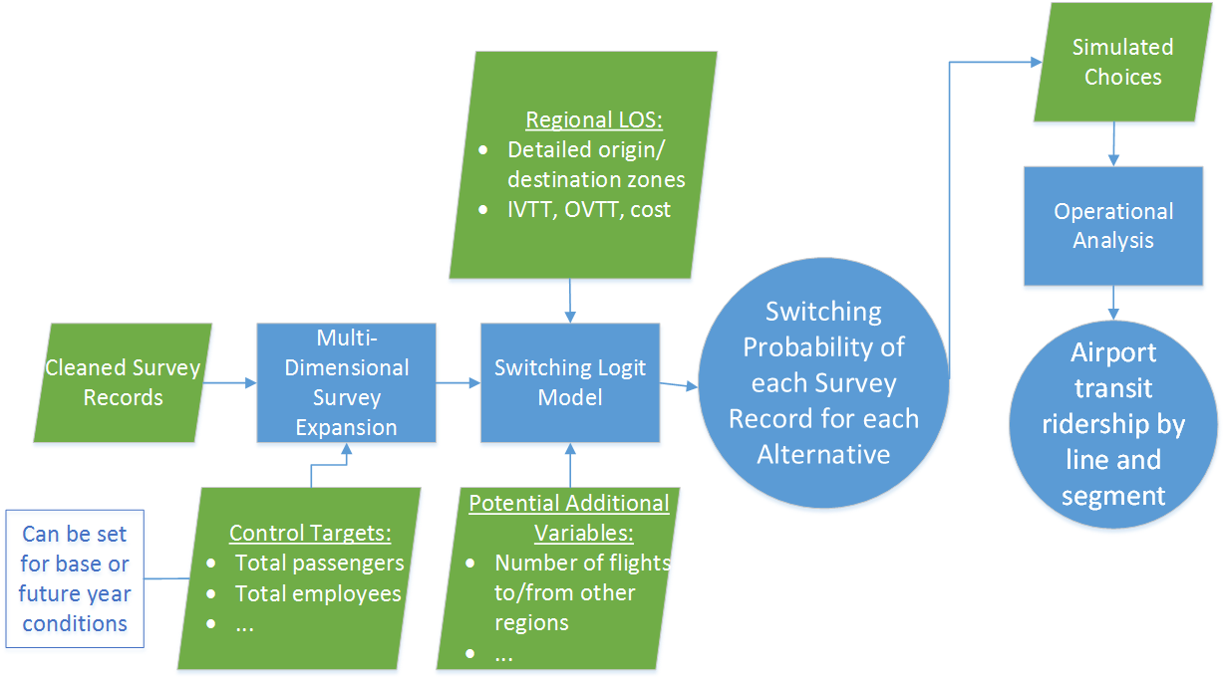
Multi-Resolution Airport Model
Notes:
Sample enumeration model
General model can potentially be expanded to ports for freight movements

Slide 15
Interesting Results
Air passengers have high VOT
$40/hr for non-business travelers
$60/hr for business travelers
Air Passengers highly value:
Reliability
Convenience (especially when traveling with bags)
Visitors (particularly international travelers):
Less familiar with local transit systems
Less inclined to drive (especially rental car)
Cost may be proportional to party size (transit), OR give an “economy of scale” with larger groups (long term parking, taxi/Uber)
Airport employees make up a substantial share of transit ridership to airports, but are much more price-sensitive

Slide 16
Contacts
Chrissy Bernardo
Senior Modeler
Systems Analysis Group
Chrissy.Bernardo@wsp.com
Peter Vovsha
Assistant Vice President
Systems Analysis Group
Peter.Vovsha@wsp.com

