Slide 1
Interagency Coordination in Long Range Transportation Planning
Alena R. Cook, PE
May 2017

Slide 2
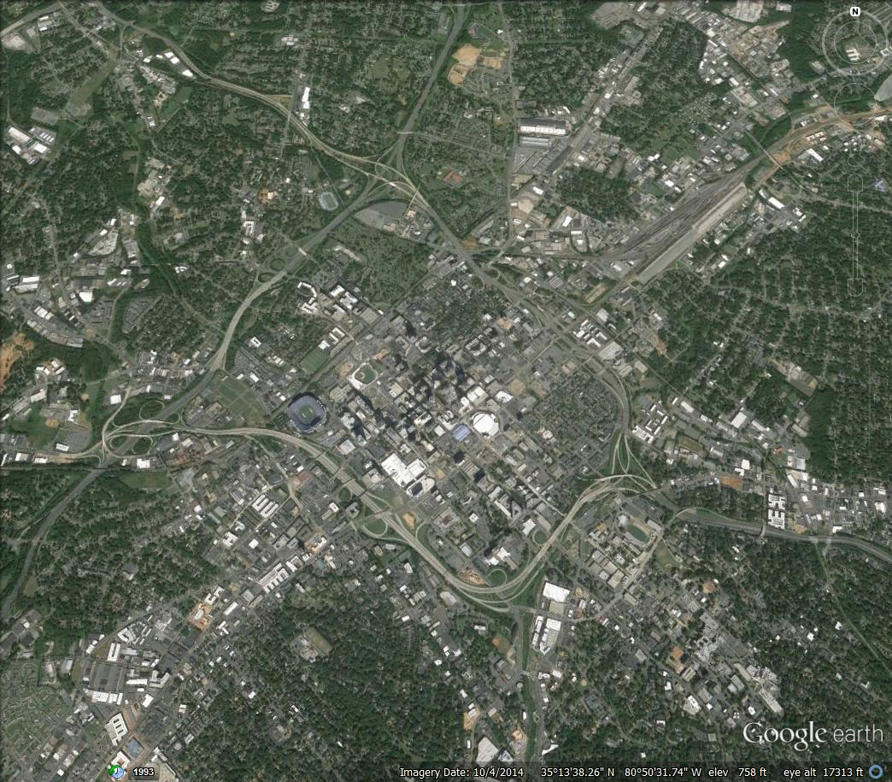
Purpose
Interagency Coordination In Long Range Transportation Planning
Describe best practices for data sharing and coordination between long range planners and other agencies during transportation plan development

Slide 3
Goals
Interagency Coordination In Long Range Transportation Planning
Improve quality of transportation planning decisions
Enhanced usefulness of transportation planning products
Potential benefits & efficiencies for all agencies from sharing data and coordination

Slide 4
Purpose
Interagency Coordination In Long Range Transportation Planning
What agencies do you think may want/ need to be engaged in long range transportation planning?

Slide 5
Agencies
Interagency Coordination In Long Range Transportation Planning
NC Dept. of Environmental Quality
Division of Water Resources
Division of Coastal Management
Division of Marine Fisheries
NC Dept. of Natural & Cultural Resources
State Archaeology Office
State Historic Preservation Office
NC Wildlife Resources Commission
US Army Corps of Engineers
US Fish and Wildlife Service
EPA
US Forest Service
National Park Service
NOAA- National Marine Fisheries
NC Dept. of Agriculture- NC Forest Service, Farmlands
NC DHHS
NC Dept. of Commerce
Tennessee Valley Authority

Slide 6
Process to Develop- part 1 NCDOT contracted with ITRE
Interagency Coordination In Long Range Transportation Planning
Identified agencies & representatives (contact list)
Gathered information by telephone interviews, etc.
Used Informational Webinar, Workshop, Meetings to determine data sharing and coordination

Slide 7
Process to Develop- part 2
Interagency Coordination In Long Range Transportation Planning
Drafted Interagency Coordination Protocol document & associated tools based on input received
Reviewed, Finalized Protocol recommendations
Share, Educate staff about best practices in Protocol

Slide 8
Key Elements
Interagency Coordination In Long Range Transportation Planning
Contacts for each agency, spreadsheet tool
At what points in the transportation planning process to coordinate
What types of information & data to share,
What questions to ask
Updates throughout the process
Seeking input, not agreement or approval

Slide 9
Transportation Planning Process
Interagency Coordination In Long Range Transportation Planning
I
III
IV
V
Develop Plan Vision
Conduct Needs Assessment
Analyze Alternatives & Scenarios
Develop Final Plan
Adopt Final Plan
II

Slide 10
Purpose
Interagency Coordination In Long Range Transportation Planning
When (at what point) in the process do you think it’s most critical for agencies to be engaged?

Slide 11
Protocol 1- Initiate Contact
Interagency Coordination In Long Range Transportation Planning
Send notification that planning process is being initiated
Share information about planning process
Develop email distribution list for regular updates
WHEN?
WHY?
Let agencies know study starting
Find correct contacts
Educate about process
I
Develop Plan Vision

Slide 12
Protocol 2- Coordinate on Data & Goals
Interagency Coordination In Long Range Transportation Planning
Planners share study information, Community Understanding Report, GIS data layers, etc.
Resource agencies share plans, data, and tools
Feedback on all data & Measures of Effectiveness
Develop Environmental Features Map
WHEN?
WHY?
Ensure have best/ complete data
Select appropriate MOEs & have right data to support
I
Develop Plan Vision

Slide 13
Protocol 3- Validate Priorities
Interagency Coordination In Long Range Transportation Planning
Planners share transportation deficiencies
Resource agencies share information on resources and may provide input on priorities
->Possible workshop in the study area
WHEN?
WHY?
Learn about resources/ deficiencies
Understand issues/ concerns
Identify priorities: areas to serve and areas to protect
Conduct Needs Assessment
II

Slide 14
Protocol 4- Coordinate on Project Proposals
Interagency Coordination In Long Range Transportation Planning
Planners: Problem Statements, Draft Alternatives, etc.
Resource agencies share information and give input
->Opportunity to attend 1 of 2 meetings
(one central, one in study area)
WHEN?
WHY?
Understand draft proposals and potential impacts
Get input on alternatives
Discuss possible options
III
Analyze Alternatives & Scenarios

Slide 15
Protocol 5- Review Draft Plan
Interagency Coordination In Long Range Transportation Planning
WHEN?
Planners distribute draft plan &
seek final comments
IV
Develop Final Plan
Protocol 6- Review Final Plan
WHEN?
Planners distribute final plan &
survey on the process
V
Adopt Final Plan
WHY?
Obtain final input & communicate how input was used
Get feedback for future improvements to the process

Slide 16
Purpose
Interagency Coordination In Long Range Transportation Planning
What hurdles or challenges do you experience (or would you anticipate) with agency engagement in planning?

Slide 17
Challenges Critical Success Factors
Interagency Coordination In Long Range Transportation Planning
Continuous changes to GIS data layers/ contacts Need maintenance/ update plan
Limited Time Engage in way desired & most efficient
Reluctance to Comment Emphasize seeking input, not agreement or approval
Sharing information with others Document well
Trust Establish good relationships

Slide 18
Acknowledgements
Interagency Coordination In Long Range Transportation Planning
Dan Thomas, PE- (retired) NCDOT Transportation
Planning Branch
Leigh Blackmon Lane- (formerly) ITRE- NCSU
llane@louisberger.com
Adrienne Heller- (formerly) ITRE- NCSU
aheller@louisberger.com
The many NCDOT, FHWA, MPO, RPO and other agency representatives that participated in this effort in various ways.

Slide 19
Interagency Coordination In Long Range Transportation Planning
Questions NCDOT- Transportation Planning Branch Alena R. Cook, PE 919-707-0910 arcook@ncdot.gov
https://connect.ncdot.gov/projects/planning/Pages/default.aspx
Click Integration Project, See ‘Interagency Coordination Protocol’

