Slide 1
Using a Statewide Model to Help Improve State Long-Range Plan Decision-Making: The Utah DOT Experience
Paul Hershkowitz, Wilbur Smith Associates
John Thomas, Utah DOT
Michael Fazio, City of South Salt Lake*
Jonathan Avner, Wilbur Smith Associates
David Hurst, Wilbur Smith Associates
*Formerly with Utah DOT

Slide 2
Purpose of Presentation
Describe the LRP process.
Overview of how the statewide model was applied in the development of the Utah DOT Long-Range Plan (LRP).

Slide 3
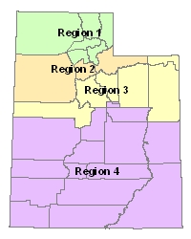
LRP Process
LRP team – UDOT, Bio-West, InterPlan, WSA
Foster better communication and understanding between the Regions and Planning
Regions were the key - Bottom up, not top down
Regions - project driven
Needs by region by phase (2010-2020, 2021-2030, 2031-2040, & unfunded)

Slide 4
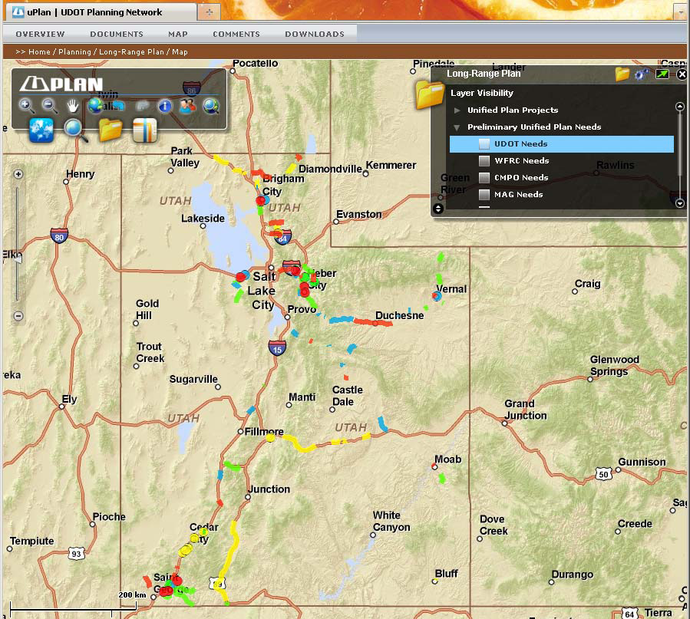
LRP Process (2)
Value-added: “this is what our analysis shows, what do you think?”
Needs to projects w/ region involvement
Fiscally constrained
Tiered by type of project
PI : Libraries, RPOs, MPOs, UDOT & uPLAN websites
Streamlined document

Slide 5
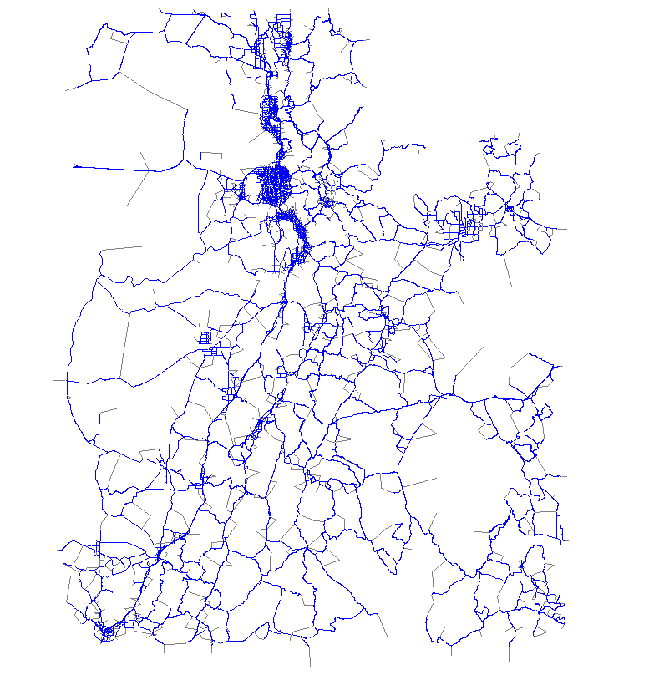
USTM LRP Application
Utah Statewide Travel Model (USTM) - developed (Phase I) and calibrated (Phase II) - 2007-2009
Currently daily vehicle and truck model – “match the maps”
Whole state, including MPOs – but focus is on rural and “emerging” areas. Supplements, doesn’t replace, MPO models
LRP was one of the apps for which USTM was built
Notes:
3228 internal zones and 27 external zones.

Slide 6
USTM LRP Application (2)
Regional briefing – LRP process and USTM
Deficiencies (capacity needs) by region
Improvements (projects) to resolve deficiencies
No-Build – 2008, 2020, 2030, 2040, unfunded “needs”
Baseline (w/ MPO projects) – 2008, 2020, 2030, 2040, unfunded “needs”

Slide 7
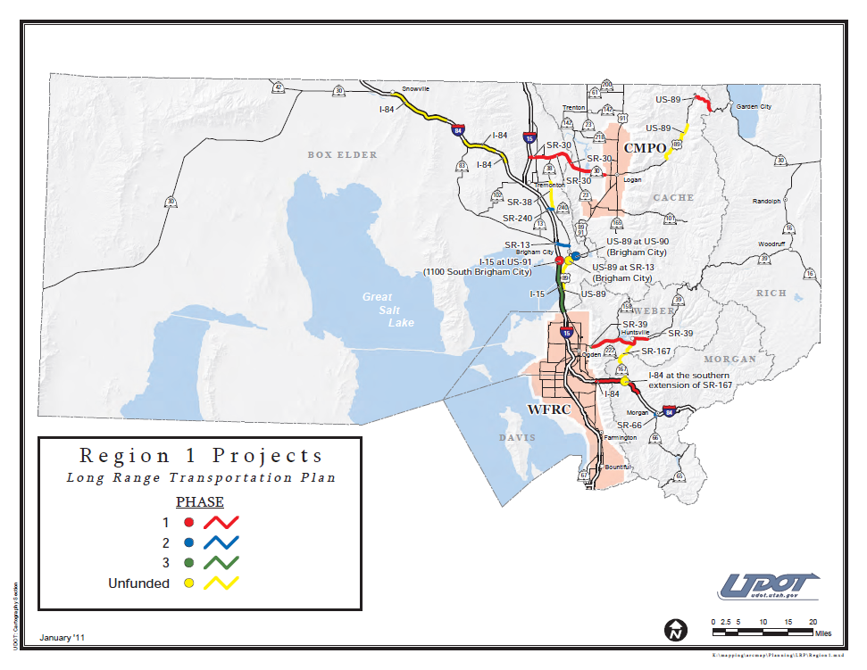
USTM LRP Application (3)
Regional review, then iterated model runs
Some projects moved to different phases or deleted (based on funding) after iterations
Model results input to project fact sheets

