Slide 1


Model Validation & Application for Significant Growth Areas in Florida
Presented by: Myung-Hak Sung
Thursday, May 12, 2011
TRB Planning Applications Conference

Slide 2
Population Projections by State
(In Thousands)
State | 2000 | 2030 | Percent Change
California | 33,872 | 46,445 | 37.1
Texas | 20,852 | 33,318 | 59.8
New York | 18,976 | 19,477 | 2.6
Florida | 15,982 | 28,686 | 79.5
Illinois | 12,419 | 13,433 | 8.2
Pennsylvania | 12,281 | 12,768 | 4.0
Ohio | 11,353 | 11,551 | 1.7
Michigan | 9,938 | 10,694 | 7.6
New Jersey | 8,414 | 9,802 | 16.5
Georgia | 8,186 | 12,018 | 46.8
United States | 281,422 | 363,584 | 29.2

Slide 3
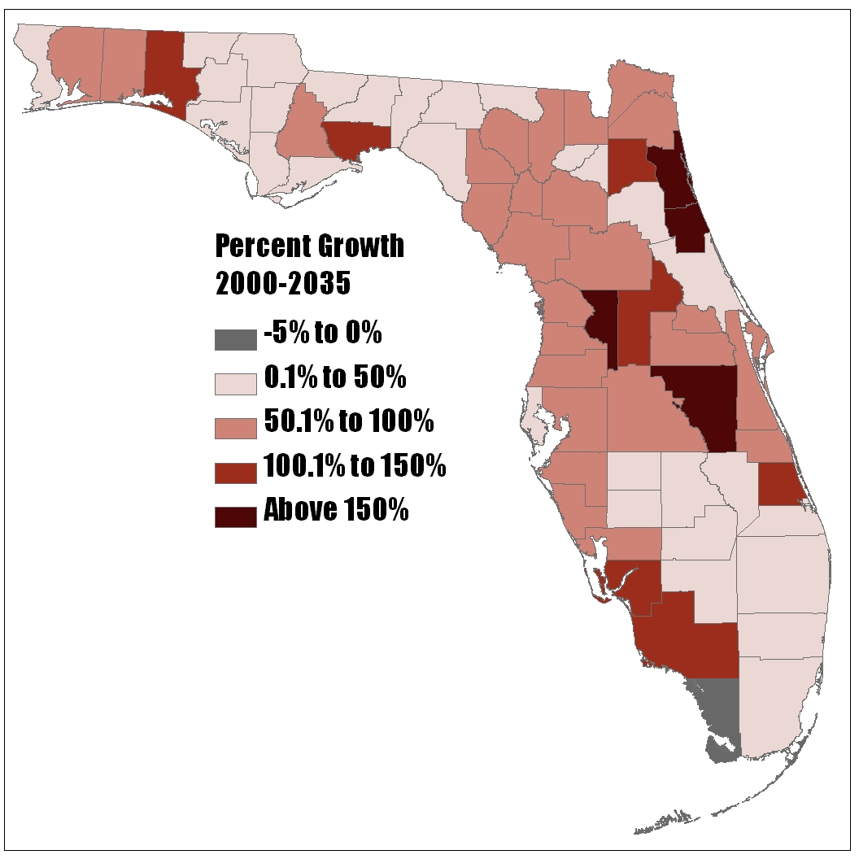
Florida Population Growth by County
Source: Bureau of Economic and Business Research

Slide 4
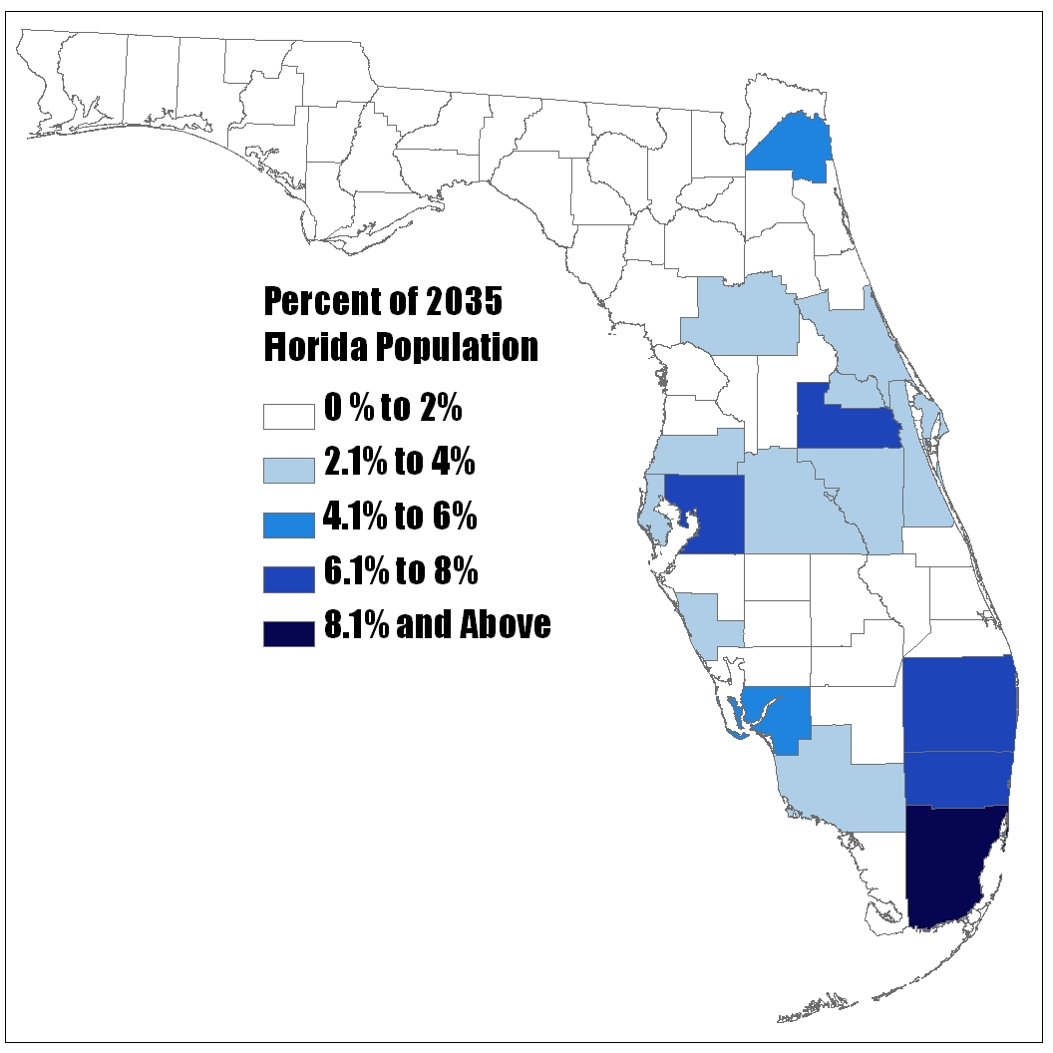
Percent of 2035 Florida Population by County
Source: Bureau of Economic and Business Research

Slide 5
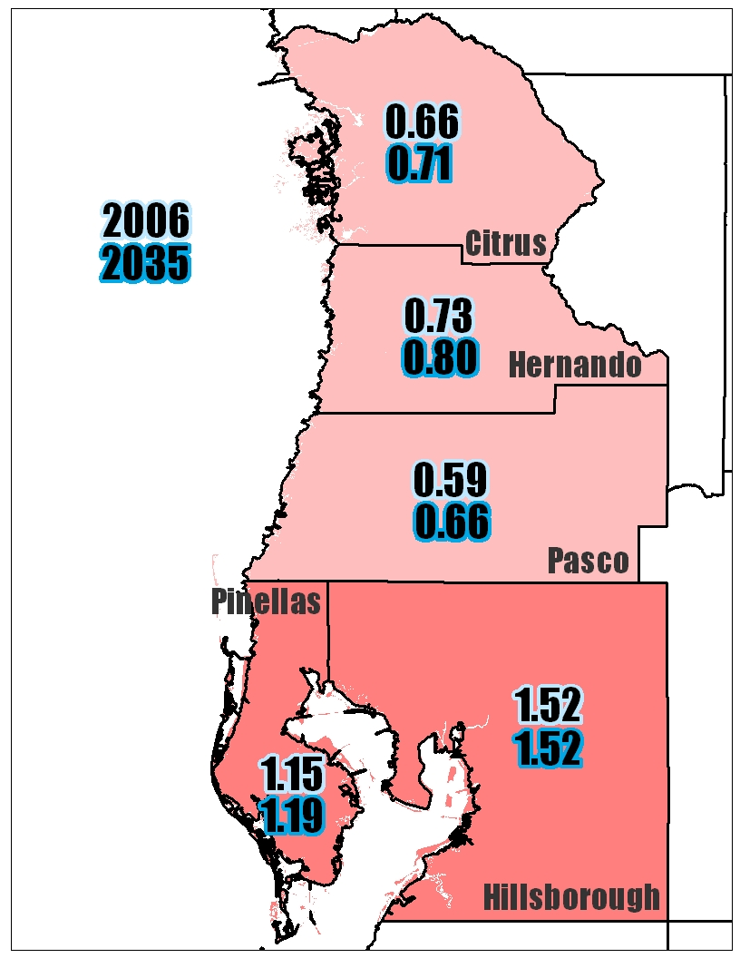
Tampa Bay Area Workers Per Household

Slide 6
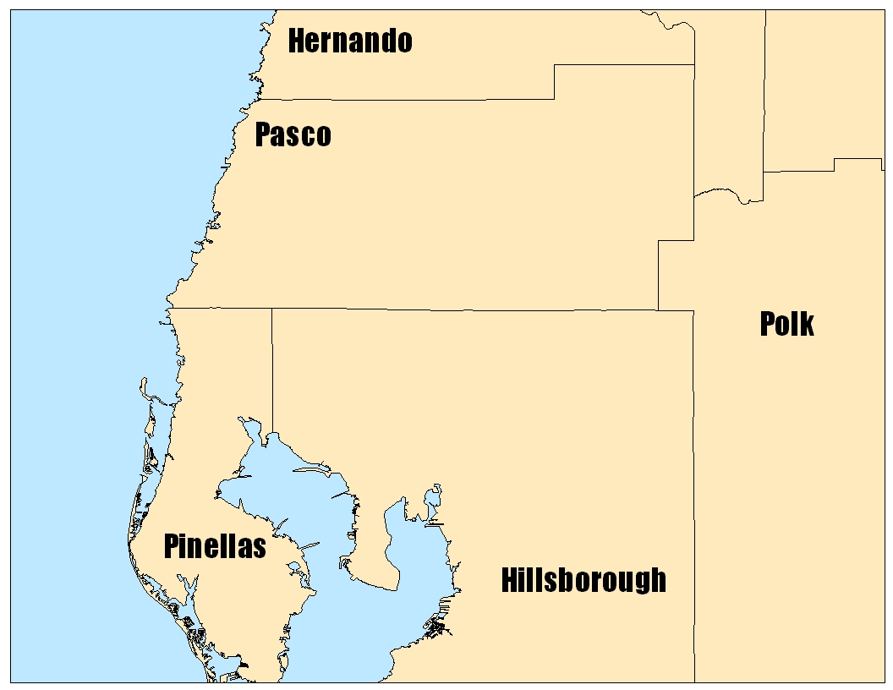
A Transit Corridor Study Area
Wesley Chapel
VA Hospital
USF
Downtown Tampa

Slide 7
Gravity Model
Friction Factor
Trip Probability
Trip Length

Slide 8
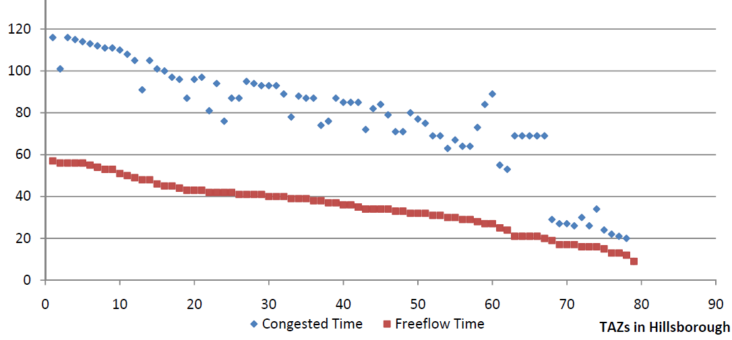
2035 Peak Period Travel Time
Wesley Chapel to Hillsborough
Time (Minutes)
Number of TAZs in Hillsborough
Congested Time Free Flow Time

Slide 9
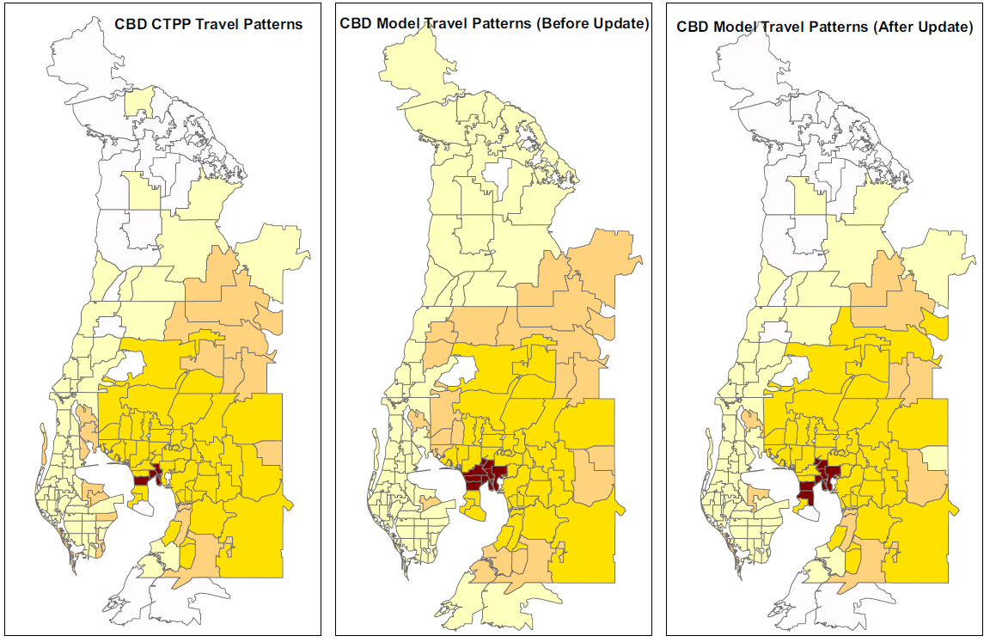
Orientation Ratio - Downtown
CTPP Data
Model (Original)
Model (Updated)

Slide 10
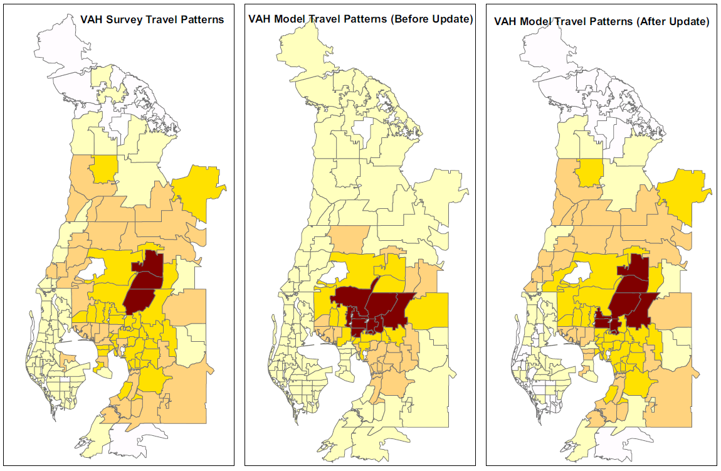
Orientation Ratio - VA Hospital
Survey Data
Model (Original)
Model (Updated)

Slide 11
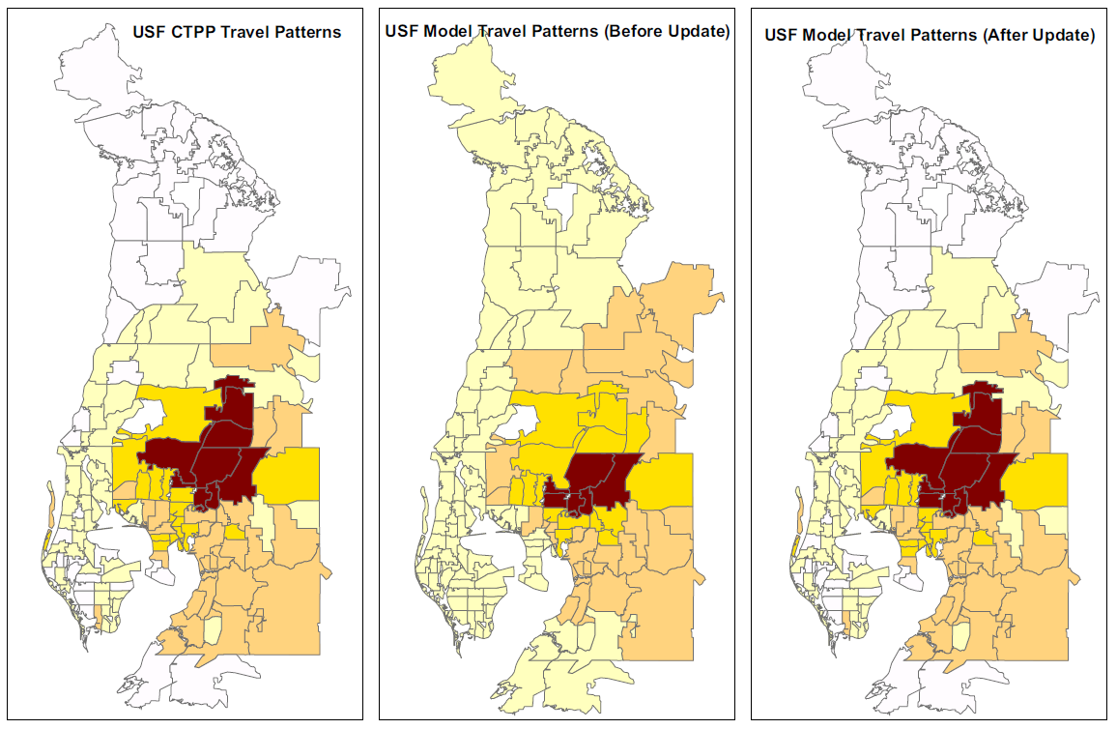
Orientation Ratio - University of S. Florida
CTPP Data
Model (Original)
Model (Updated)

Slide 12
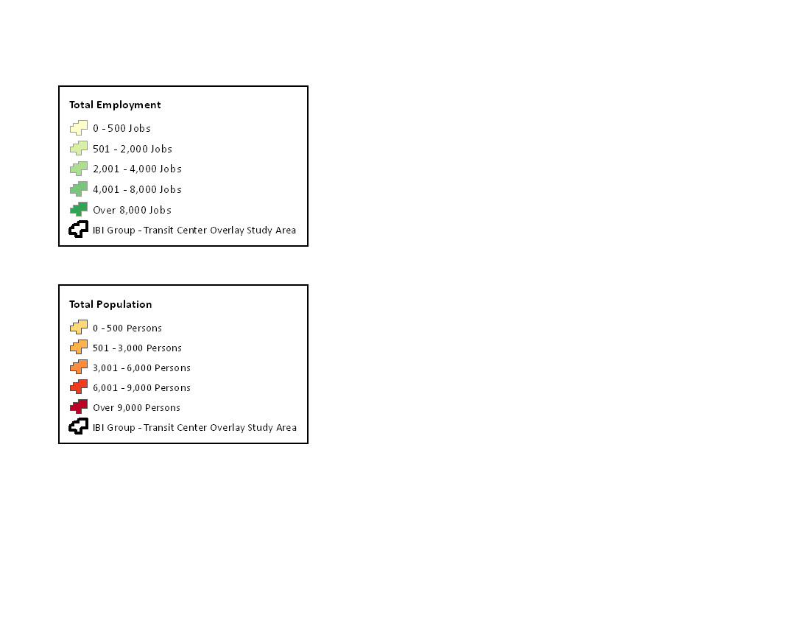
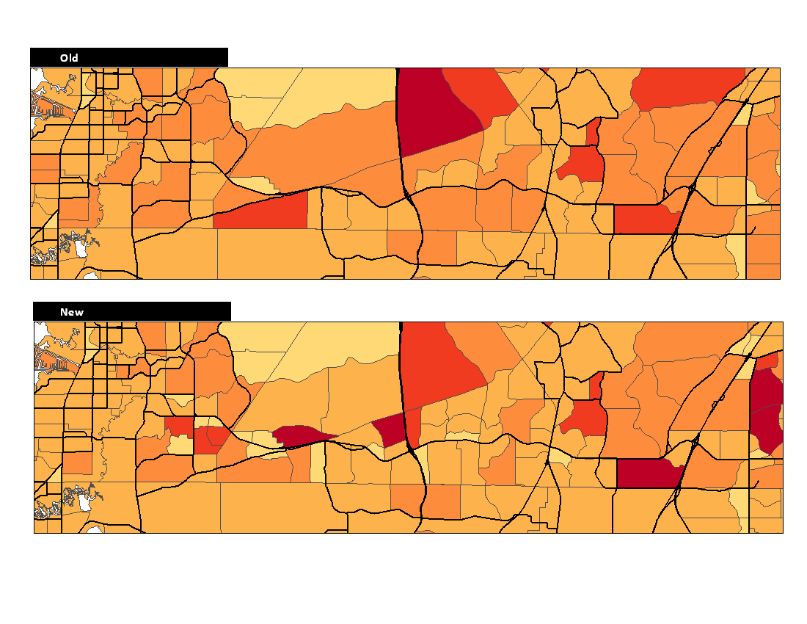
2035 Population Southern Pasco County
Original
0-500
501-3,000
3,001-6000
6,001-9,000
9,000+
Updated

Slide 13
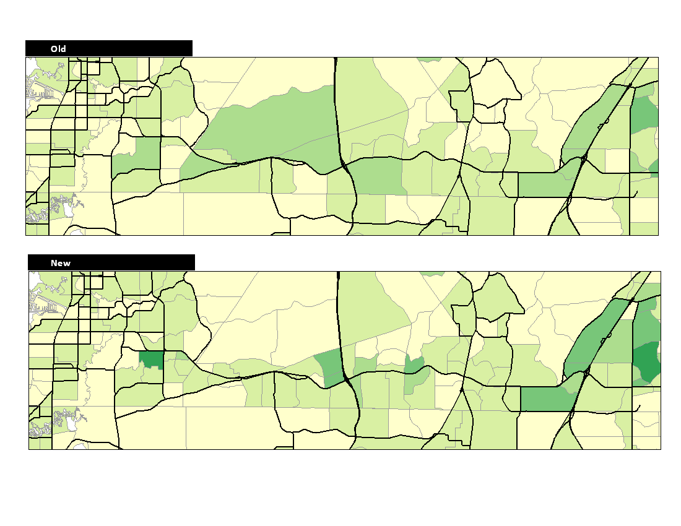
2035 Employment Southern Pasco County
Original
0-500
501-2,000
2,001-4,000
4,001-8,000
8,000+
Updated

Slide 14
2035 Daily Work Trips
Original
Updated
Wesley Chapel
Wesley Chapel
5,550
1,930
Downtown Tampa
Downtown Tampa

Slide 15

Questions….?
Good Luck Modeling!!!

