Slide 1
Planning and Policy Impacts of Alternative Public Transport Modelling
Jim Lam
Jian Zhang
Howard Slavin
Srini Sundaram
Andres Rabinowicz
Caliper Corporation
May 2011

Slide 2
Motivation
Achieve Reliable Transit Assignments
Behavioral Issues Path Choice
Modeling Issues
Notes:
Achieve results that reflect future patronage in response to changes and improvements / changes in fare policy
Access & transfer choices
Use of compound modes
Stability of choices
Taste variation including Value of Time
Realistic path-finding
Large number of similar alternatives
Severe capacity limitations
Complex transfer alternatives
Assignment parameters and calibration methods

Slide 3
Background Work in New York City
Method developed and used since 1989
Subjective Calibration
Computationally intensive (MSA)

Slide 4
Static Methods Still Relevant
Schedule based assignment not helpful for long range planning
Computational issues for large scale schedule based simulation
Static methods must be shown to be reliable and not distort future plans

Slide 5
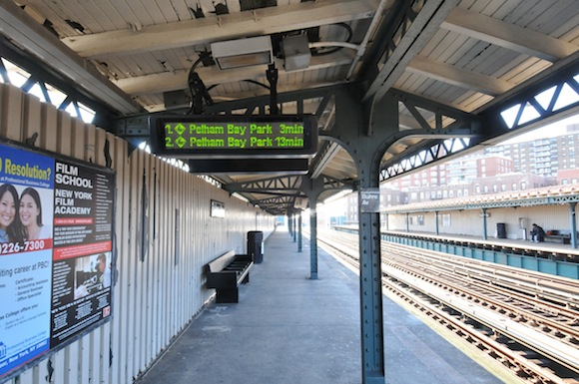
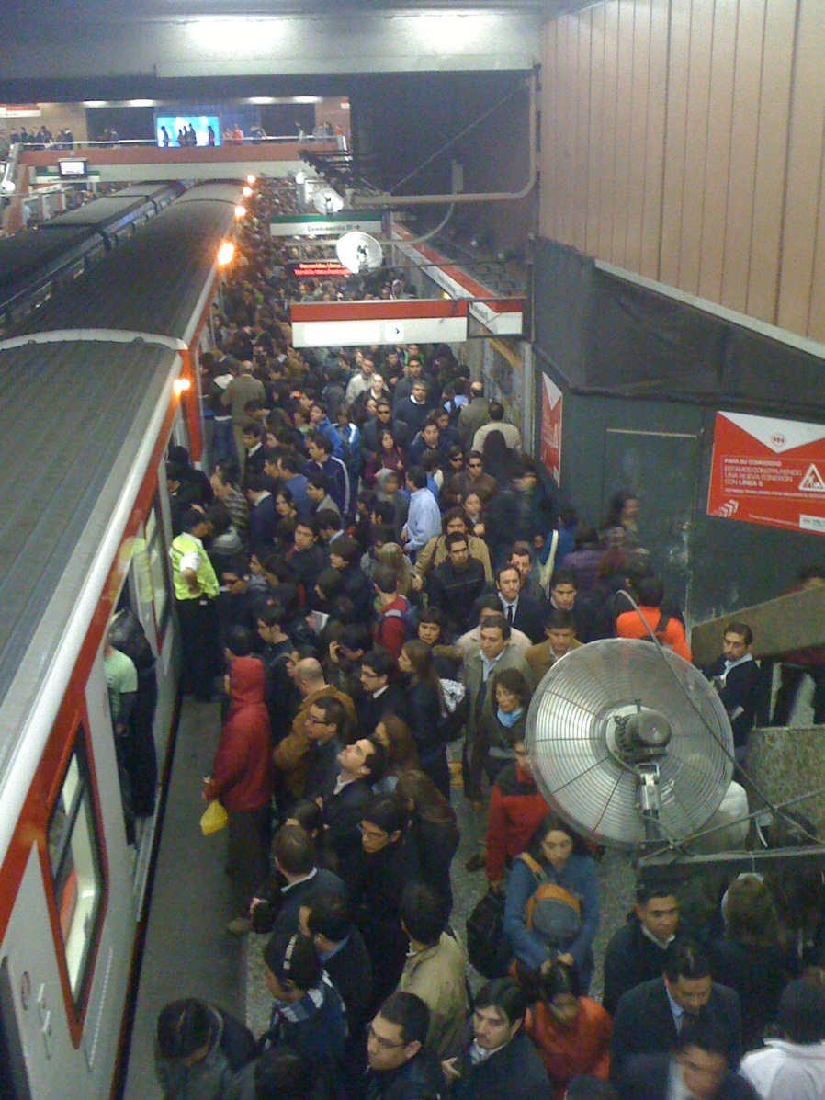
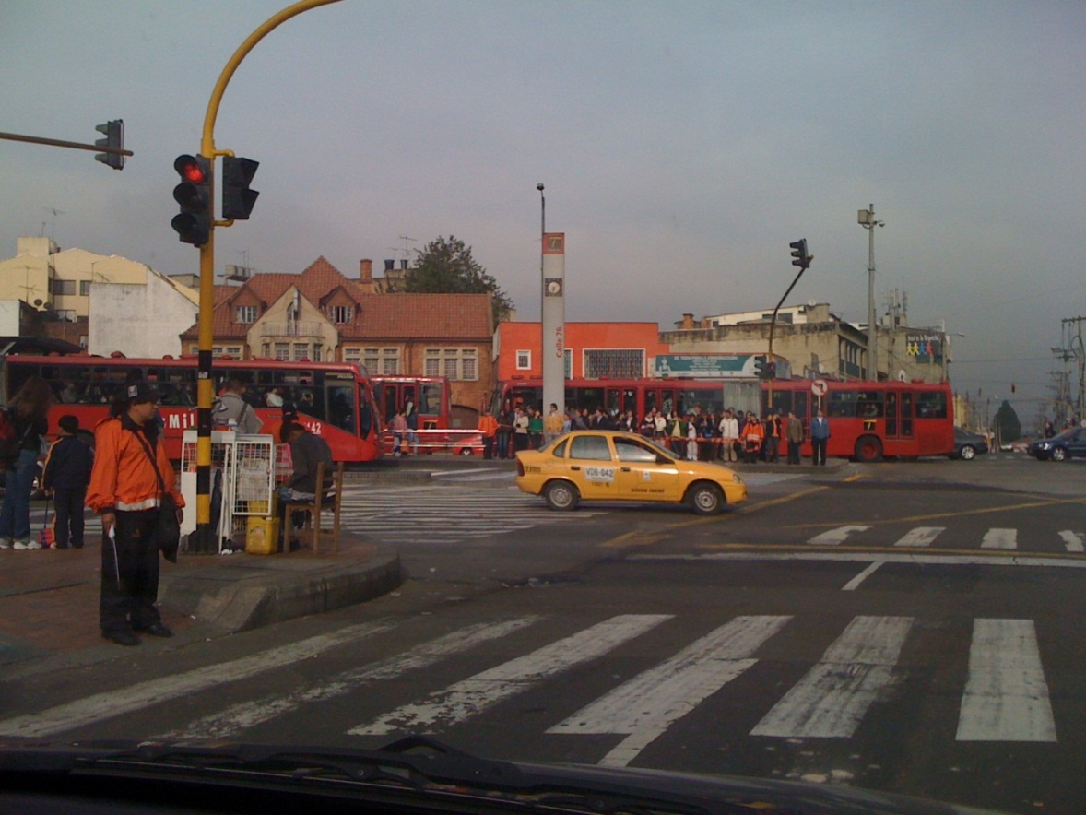
Congestion in Transit Systems

Slide 6
New NYMTC Model Updates
Model was very slow
Inadequate equilibration logic
Insufficient calibration, validation
Frequency based assignment favors frequent over fast services
New data sources available
Notes:
Frequency-based assignments favor slower, more frequent service over faster less frequent service. This can give misleading guidance to planners.
New data sources provided further fuel for making improvements

Slide 7
Using AFC Data to Improve Transit Assignments
Vastly more accurate O-D tables
Sub-modal and route boarding data for calibration and validation
Comparison of alternative methods

Slide 8
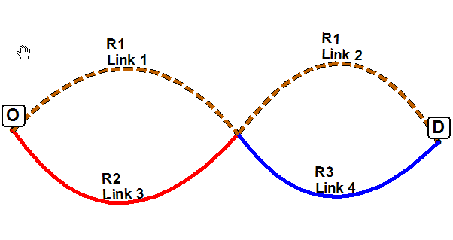
Illustrative Simple case (1 O-D pair)
3 transit lines, 1 tram (R1) & 2 buses (R2 & R3)
4 possible paths (R1, R2-R3, R2-R1 and R1-R3
200 trips from O to D

Slide 9
Case 1: Without Route Congestion Effects
Route | Freq | Fare | Cap
R1 | 20 | $3 | 120
R2 | 10 | $1 | 50
R3 | 10 | $1 | 50
Path | SP | Tranplan | Tpplus | OS | Pathfinder
R1 | 200 | 22 | - | 66 | 66
R2, R3 | - | 90 | 134 | 90 | 134
R2, R1 | - | 44 | - | 44 | -
R1, R3 | - | 44 | 66 | - | -
Notes:
1. Mention no free transfers 2. Mention that the pathfinder will give the same percentages as EMME2 if fares are excluded (or if all combinations have the same fares)

Slide 10
Pathfinder Improvements
Use criteria other than frequency to split flows among hyper-paths – Simple Logit
Sample Equation: -(0.1 * Transit Time + 0.3*Walk Time + 0.1*Walk Distance + 0.3*Wait Times + 0.1*#Boardings)
Path | Pathfinder | Pathfinder (with logit)
R1 | 66
R2, R3 | 134
R2, R1 | -
R1, R3 | -
Path | Pathfinder | Pathfinder (with logit)
R1 | 66 | 134
R2, R3 | 134 | 66
R2, R1 | - | -
R1, R3 | - | -
Notes:
A complete flip happens. Two buses is more onerous. The path size equation penalizes extra wait times and additional boardings.

Slide 11
Case 2: With Route Congestion Effects
Route | Freq | Fare | Cap
R1 | 20 | $3 | 120
R2 | 10 | $1 | 50
R3 | 10 | $1 | 50
Path | SUE | Pathfinder UE | Pathfinder UE with logit
R1 | 152 | 142 | 162
R2, R3 | 48 | 43 | 38
R2, R1 | - | 16 | -
R1, R3 | - | - | -
Notes:
1. Mention no free transfers 2. Mention that the pathfinder will give the same percentages as EMME2 if fares are excluded (or if all combinations have the same fares)

Slide 12
Transit Assignment Comparison
Transit OD Matrix – Best Estimate from BPM Model; 2.6 million Transit Trips, 4 hr AM period
Improved SUE and Enhanced Equilibrium Pathfinder Methods
Initial Calibration to match overall boardings by region and mode
Save Assignment Paths for selected OD pairs for each method
Compare with patterns illustrated by the Farecard AFC Data

Slide 13
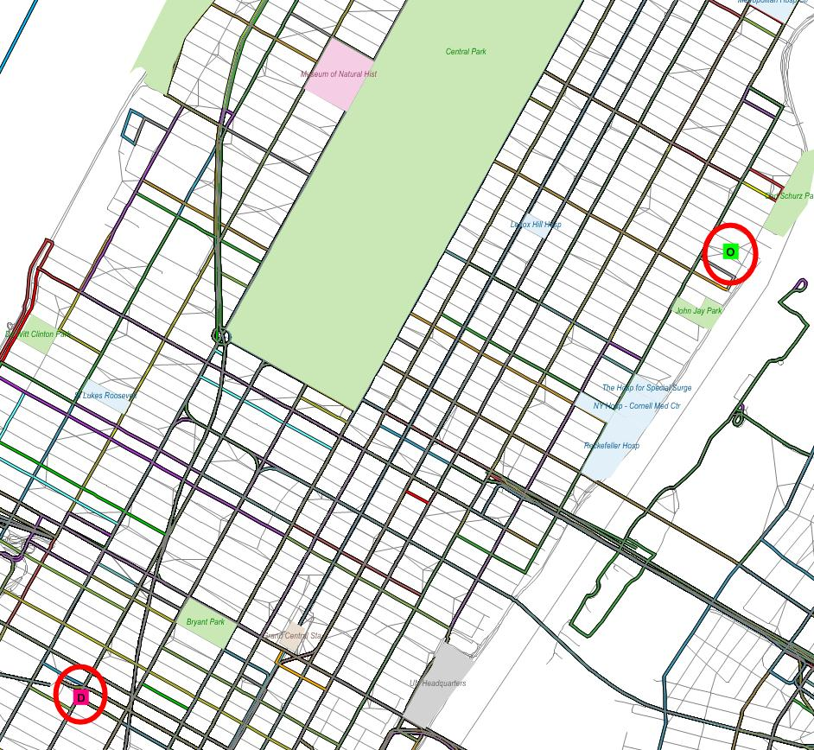
Sample OD Pair: Upper East Side to Midtown Manhattan
Feasible Route Alternatives
Walk and Subway NYC Bus and NYC Subway
Multiple NYC Buses

Slide 14
Sample OD Pair – Flow Patterns Comparisons
Low-Walk Weight (1.5 – 2.0)
Individual patterns are highly parameter specific
Overall match to boardings still reasonable in all scenarios
At very high walk weights (~3), UE PF uses multiple buses (not shown)
Pattern | AFC | SUE | Eq. PF
Bus-Subway | 85% | 52% | 20%
Only-Subway | 0% | 48% | 80%
Multiple Bus | 15%
High-Walk Weight (> 2)
Pattern | AFC | SUE | Eq. PF
Bus-Subway | 85% | 94% | 100%
Only-Subway | 0% | 6% | 0%
Multiple Bus | 15% | 0% | 0%

Slide 15
Conclusions
Capacity constraints are essential
Results highly dependent upon calibration parameters (especially at the route level)
Both SUE and PF-Equilibrium methods can be calibrated and be used for highly congested and large systems

