Slide 1
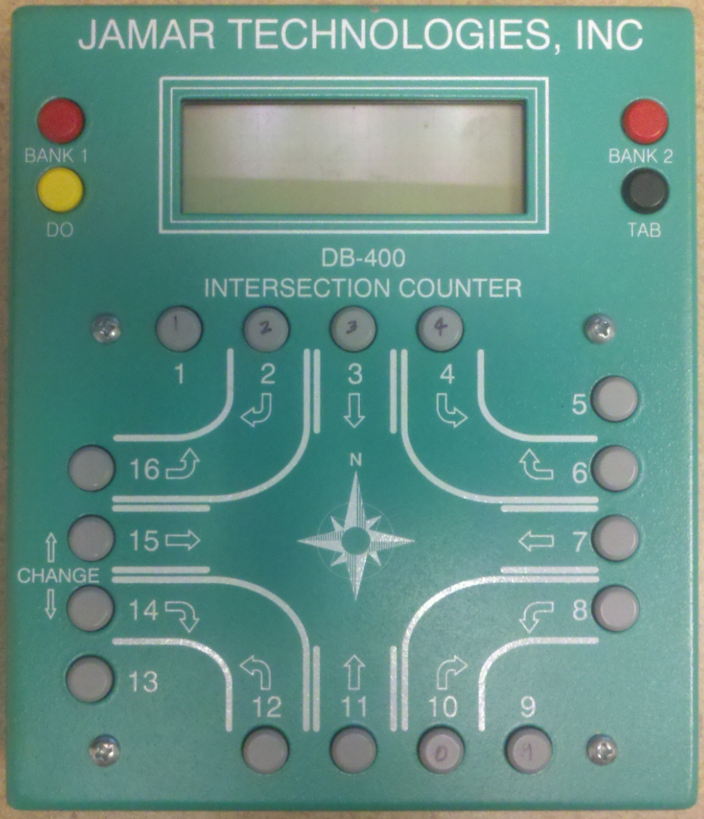
Repurposing Turning Movement Counters for
Park-N-Ride Counts
Andrew Rohne • TRB Applications Conference • May 12, 2011
Notes:
DRAFT – April 7, 2011

Slide 2
Motivation
Need PNR Counts
Have TMC boards collecting dust
The counter only knows to count
Can collect more detailed data
Notes:
We needed PNR counts for our transit on-board survey. I know that not everyone parking at the PNR lots actually use the bus, so counting cars was out. We have a few turning movement boards collecting dust in the office, and they only know how to count (they don’t know if a button is NBR turns or if it is people getting off a bus and getting picked up). We can also collect more detailed data, which will hopefully result in better weights for the survey.

Slide 3
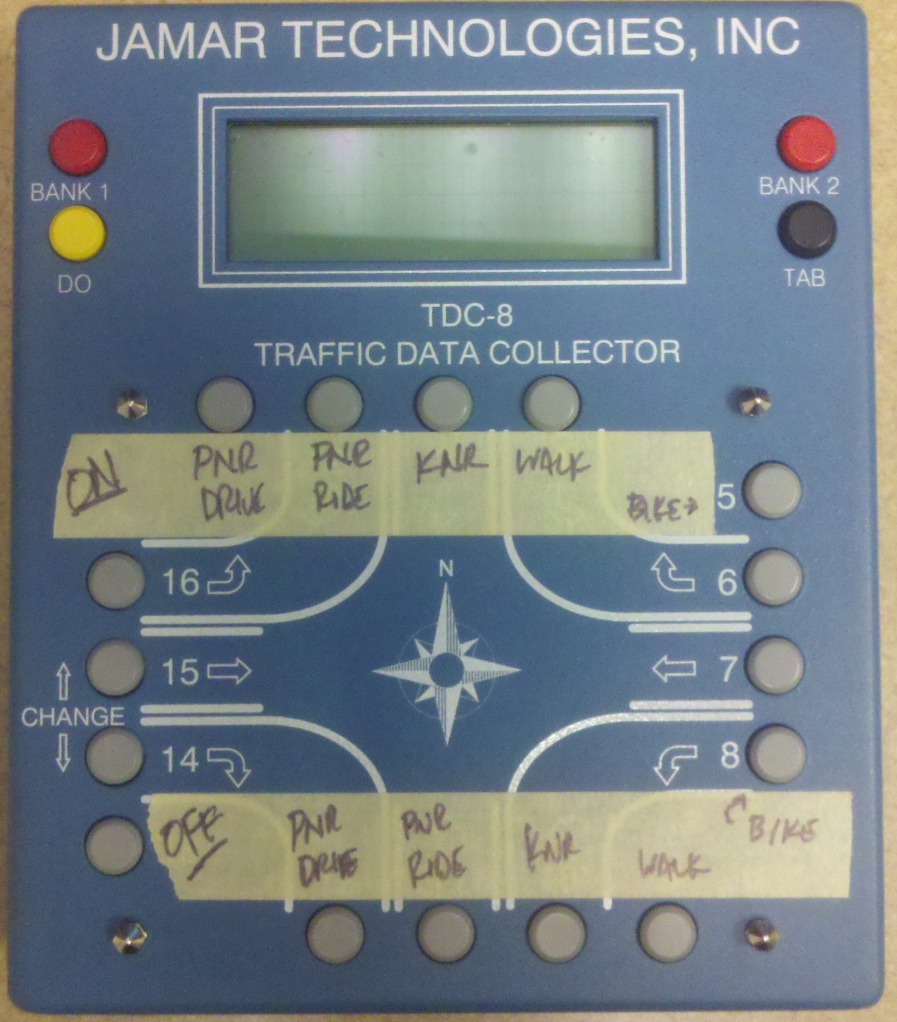
The Repurposed Board
2nd Route
3rd Route
Notes:
This is one of the boards ready for a PNR count. There are places for PNR Drive, PNR Ride (carpooling to PNR), KNR (pick-up/drop-off), Walk, and Bike. If a PNR location served two routes, we could split the routes using the bank buttons.

Slide 4
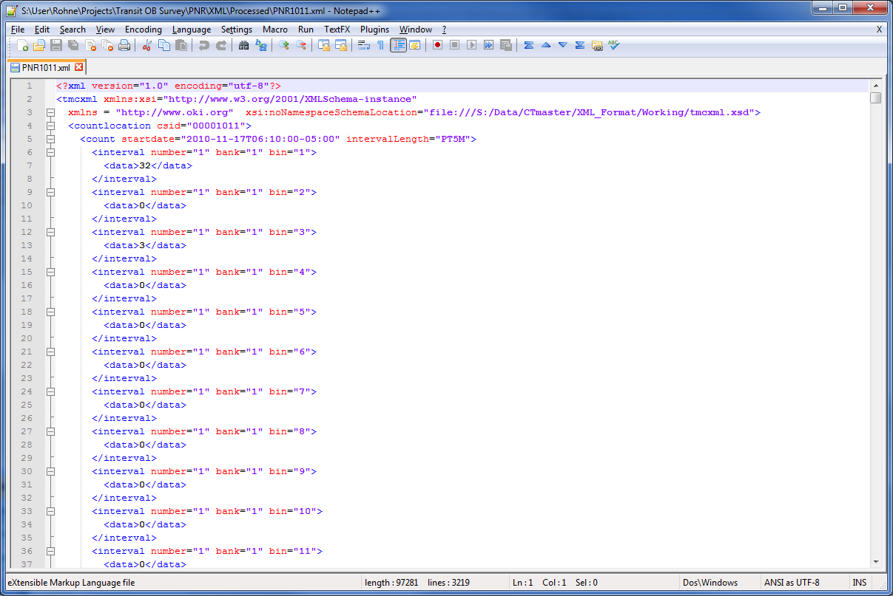
Processing
Notes:
We use our own custom software to download the traffic counter data and place it into an XML file. This is one of the XML files. We can read this file in Excel.

Slide 5
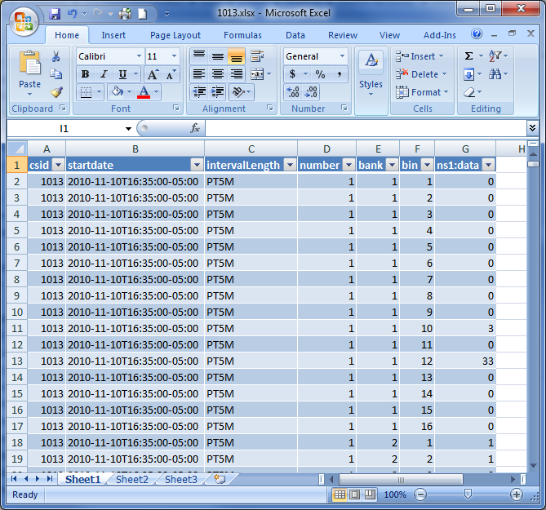
Processing – XML in Excel
Notes:
This is what the XML data looks like in Excel.

Slide 6
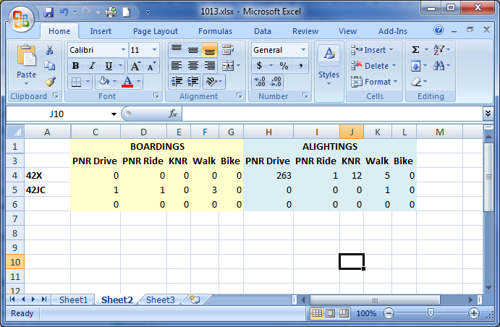
Output Table
Notes:
This is the data for one of the PNR locations, showing the high number of people getting off the bus and driving away or being picked up, and the few people getting on the bus. This was an afternoon count, so note few boardings and a lot of alightings.

Slide 7
Data
Notes:
This is data for locations that had an exclusive PNR lot. If you look at the red lines, those are the number of vehicles counted at the locations. There seems to be an issue counting the cars, as there are several cases where there are fewer cars than people that drove their vehicles there. Note the prevalence of KNR at the first PNR location, and the non-motorized users at PNR 1020.

Slide 8
Lessons Learned
Seems superior to counting cars
Counting during daylight is easier
Arrive to stops early
Organize counters
Don’t trust this to bus drivers
Notes:
I had a number of issues counting while it was dark (early morning, late night) – headlights from people dropping people off, difficulty seeing, etc. In our PNR locations, the first busses in the afternoon were normally the busiest, and the busses around 6:30 AM were normally the busiest. Knowing this, it was better to count in the afternoon.
Arriving to the stop early is critical, as OB Express busses will frequently get to the PNR early from downtown, and people will arrive to a PNR sometimes 20 minutes before the first bus in the AM.
We found that counting cars was an unnecessary hassle. Many PNR locations were being used by people parking to carpool, and many other times we couldn’t count the cars very well.
This was done as a volunteer effort, and I sent each one with a pad of paper that had the location, ID number (for the turning movement board), and my cell phone number in case there were problems. They could fall-back to the paper, take notes, etc. If we did want to count cars, there were blanks written on the paper to fill in (cars at the start and end of the count).
Finally, don’t trust this to bus drivers. Not only will they mess it up, but they need to be concerned with operating the bus and boarding/alighting operations (paying, etc.).

Slide 9
Questions?
Andrew Rohne
Transportation Modeling Manager
OKI Regional Council of Governments
arohne@oki.org • @okiandrew
513-621-6300

