Slide 1
An Automated Approach for Identifying Type of Non-signalized Intersection and Estimating Delays in Statewide Model Application
Yanping Zhang
Durham-Chapel Hill-Carrboro MPO
Laurence Brown, Roy Nunnally and Steve Smith
Indiana DOT
13th TRB National Transportation Planning Applications Conference

Slide 2
Background
Indiana Statewide Travel Demand Model (ISTDM)
2009 Upgrade – Version 5
Signal delay in ISTDM V4
Stop delay in ISTDM V5
3680 signalized intersection nodes
4768 centroid nodes
28347 other nodes

Slide 3
Intersection Delay Calculation Process
Inputting Signalized Intersection
Locating Stop-controlled Intersection
Calculating Link Priority
Determining Link Priority & Stop Type
Adding Progression Factors & Calculating Initial Delay
Calculating Initial Delay
Adjusting Link Speed and Calculating Capacity

Slide 4
Location and Type
  Stop-Controlled Intersection
  At least 3 links/legs that are
  not centroid connectors, and
  not freeway links
  Type of Stop-Controlled Intersection:
  All Way Stop-Controlled (AWSC)
  Two-Way Stop Controlled (TWSC)

Slide 5
Link Priority
Function Class Level | FHWA_FC 1 | FHWA_FC 2
1 | 1 | 11
2 | 2 | 12
3 | 6 | 14
4 | 7 | 16
5 | 8 | 17
6 | 9 | 19
999 | 0 | >19
For each stop-controlled intersection, determining its link (leg) priority.
Minimum function class value = High priority
2nd Minimum function value = Medium priority
Other = Low priority
Examples: {2, 2, 5, 6} = {High, High, Medium, Low}
{4, 5, 5, 6} = {High, Medium, Medium, Low}
{5, 5, 5, 6} = {High, High, High, Medium}

Slide 6
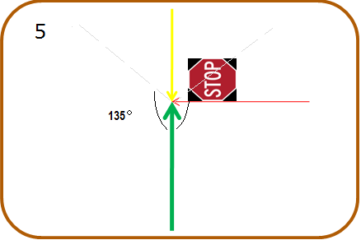

Stop Sign Location - 3 Link Intersection
4

Slide 7


Stop Sign Location - 4 Link Intersection
5
6

Slide 8
Stop Location & Type–Processing Steps
If more than 2 high priority links, AWSC intersection
If 2 high priority links, TWSC intersection and stop signs on other 2 links
If 1 high priority link, and
  If more than 2 medium priority links, AWSC intersection,
  Otherwise, select one medium priority link with larger angle to the high priority link, and
  2.1 If the angle between the selected link and the high priority link is less than 135⁰, AWSC intersection
  2.2 Otherwise, TWSC intersection and stop signs are on all other links except these two.

Slide 9
Delay Calculation
Highway Capacity Manual (Eqn 17-38 & 17-55)
Where t_{s} is service time
t_{flow} is the function of degree of saturation for AWSC, or of degree of utilization for TWSC.
Simplification
Using this initial delay to adjust the free-flow link travel time, and the final delay is calculated by link volume- delay function.

Slide 10
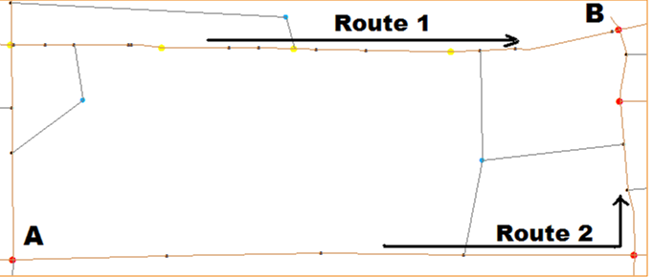
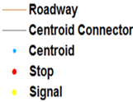
Result and Example
2006 Base Year Model - 2758 TWSC and 388 AWSC
A-B Time (Minutes) | Free-Flow Time (No INT Delay) | Free-Flow Time (w/ Signal Delay) | Free-Flow Time (w/ All INT Delay)
Route 1 | 3.826 | 4.275 | 4.275
Route 2 | 3.993 | 3.993 | 4.493

Slide 11
Conclusions
Automated approach to handle intersection delays easily
Build on the model with signalized delays
Coded in GISDK and implemented in TransCAD
Overwriting by manual input
Future development - Other type non-signalized delays, such as yield sign and roundabout

