Slide 1

Discrete Choice Models of the Preferences for Alternative Fuel Vehicles
Thomas Adler & Mark Fowler, Resource Systems Group, Inc.
Aniss Bahreinian, California Energy Commission
Stephane Hess, University of Leeds, United Kingdom
Laurie Wargelin, Abt SRBI, Inc

Slide 2
Objectives
Overall study objective: Update vehicle choice module of California’s transportation fuel use forecasting model.
  Incorporate new vehicle/powertrain alternatives
  Reflect changes in vehicle preferences
  Reflect changing fuel price perceptions

Slide 3
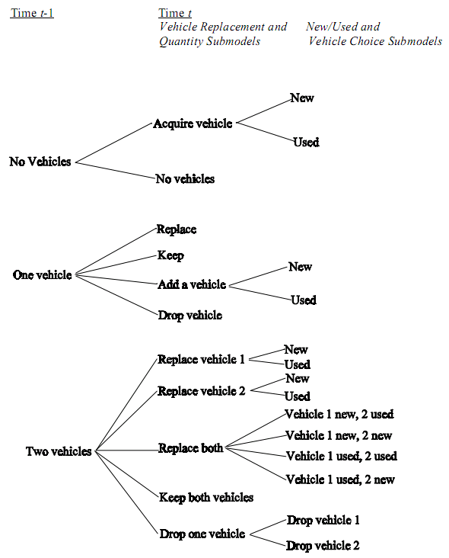
Background – CALCARS Model
California Light Duty Vehicle Conventional and Alternative Fuel Response Simulator (CALCARS)
  Developed to forecast vehicle purchase and use
  Micro-simulation model that tracks household vehicle holdings and use
  Operational since 1996 with periodic updates
Component Models
  Number of vehicles
  Vehicle replacement
  Vehicle type choice
  Vehicle use
Focus of this presentation
Source: CALCARS Documentation, 1996

Slide 4
Study Approach
Survey data used to estimate vehicle choice models
  Similar surveys completed several times over past 15 years
  Recent surveys conducted in 2004/2005 and 2007
  Current survey conducted November 2008 – January 2009 just after rapid increases in gasoline prices
Two-stage revealed and stated preference survey
  Stage 1: Revealed preference questions to identify current vehicle holdings and use
  Stage 2: Stated preference experiments customized based on vehicle holdings to determine vehicle choice behavior

Slide 5
Vehicle Choice SP Experiment Choice Alternatives
Total of105 possible vehicle types
Seven fuel types:
  Gasoline
  Diesel
  Hybrid-electric
  Plug-in hybrid
  CNG
  Flex-fuel
  Battery electric
15 body styles
  Subcompact car
  Compact car
  Mid-size car
  Large car
  Sport car
  Small cross-utility car
  Small cross-utility SUV
  Mid-size cross-utility SUV
  Compact SUV
  Mid-size SUV
  Large SUV
  Compact van
  Large van
  Compact pick-up truck
  Standard pick-up truck

Slide 6
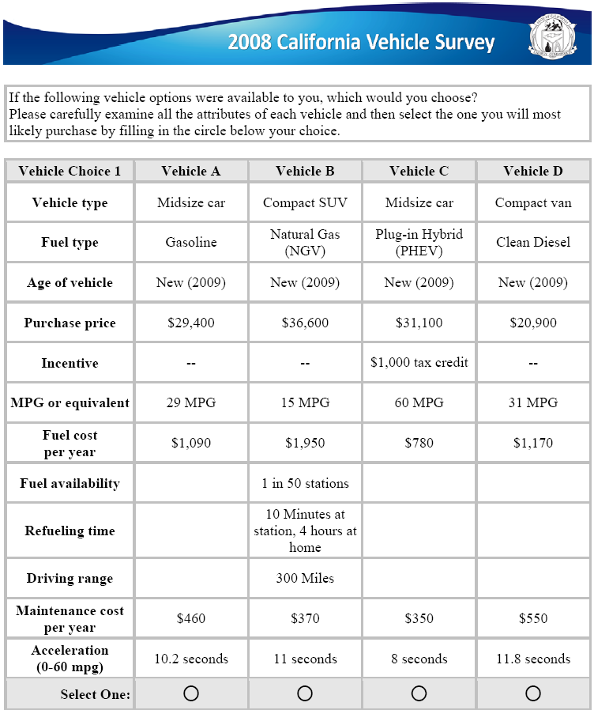
SP Survey Design
Eight primary purchase factors:
  Purchase price
  Annual fuel cost
  Annual maintenance cost
  Fuel efficiency
  Vehicle age
  Acceleration (0-60mph)
  Fueling
    Availability
    Fueling time
    Range
  Alternative fuel incentives
    Tax credit
    Rebate
    Eligible for high occupancy vehicle lanes
    Free public parking
(0-60 mph)

Slide 7
Selected Model Estimation Results
Compared to 2005 study:
  Lower value on vehicle acceleration
  Similar value for free parking incentive
  Higher value for HOV access incentive (ref: Kelly Blue value of $4,000 for Prius HOV sticker)
  Higher value on fuel efficiency
  Significant positive value for plug-in hybrid

Slide 8
Conclusions
Consumers’ vehicle preferences have changed over time and models should be updated periodically to reflect those changes
Vehicle choices can have significant effects on carbon footprint and air quality so:
  More comprehensive vehicle choice models should be incorporated in regional travel demand forecasting models

