Slide 1
Steve Farnsworth – Texas Transportation Institute
An Innovative Approach to Mapping Vehicle Classification Data
13 ^{th} TRB National Transportation Planning Applications Conference
Session 22 : Speed Data-ing
May 12, 2011

Slide 2
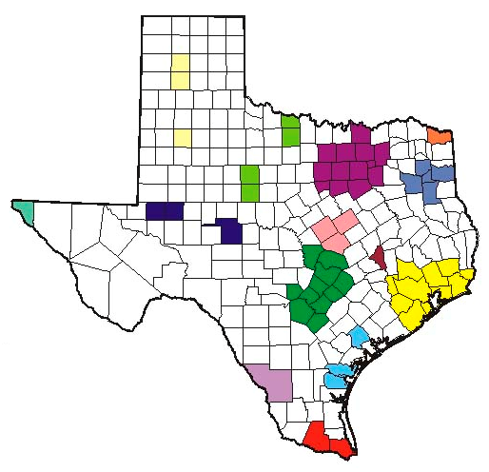
Background
Texas Department of Transportation (TxDOT) Travel Survey Program
Commercial Vehicle
Workplace
Household
External

Slide 3
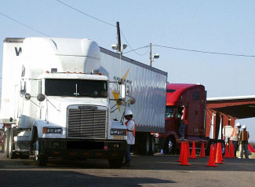
Data Collection
Classification count data is collected
For 24-hour period
In both directions
Grouped in 15-minute increments*
Number of locations varies by urban area size
Sites grouped by functional class
Sites randomly selected

Slide 4
Mapping Development
Needed method to convey results
Ease of use for various entities
Functionality
Adaptable

Slide 5
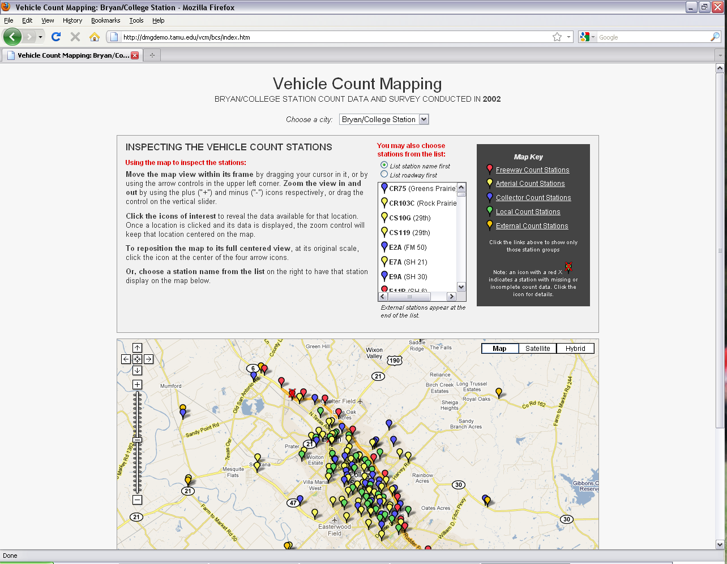
Mapping Application
Notes:
Map will be hyperlinked to internet site where map is hosted.
If no (or slow) internet, skip slide 6 and proceed with slide 7.

Slide 6
Questions?
Steve Farnsworth
Texas Transportation Institute
(979) 862-4927
s-farnsworth44@tamu.edu

Slide 7
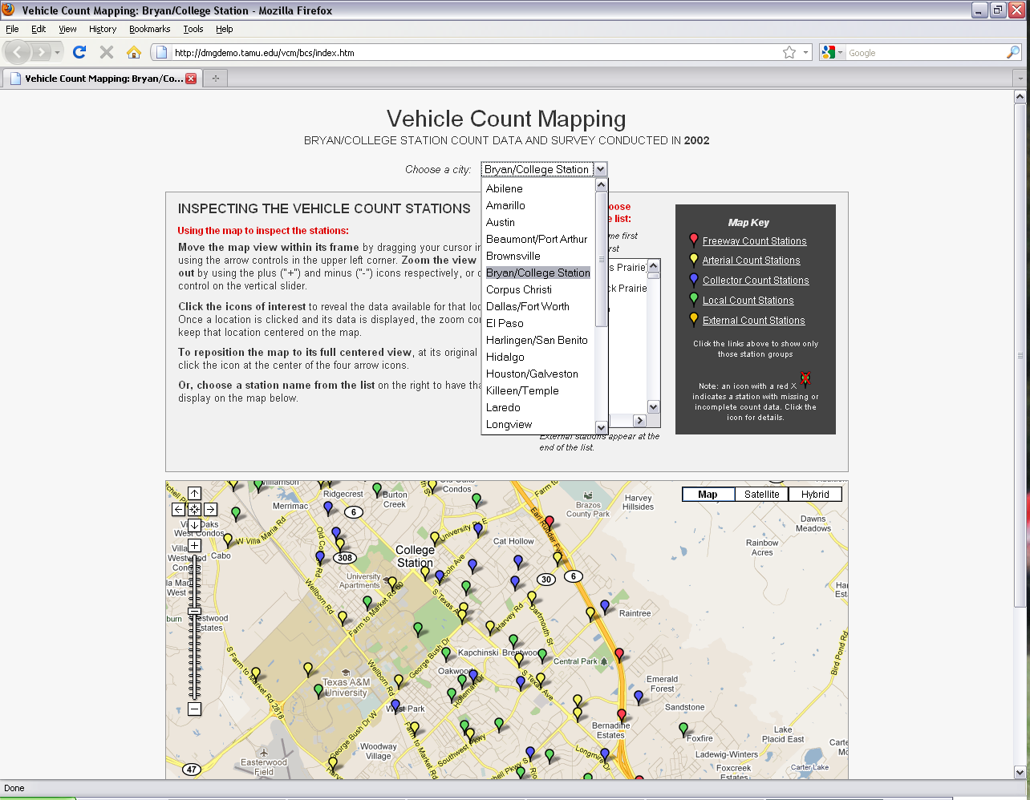
Mapping Overview

Slide 8
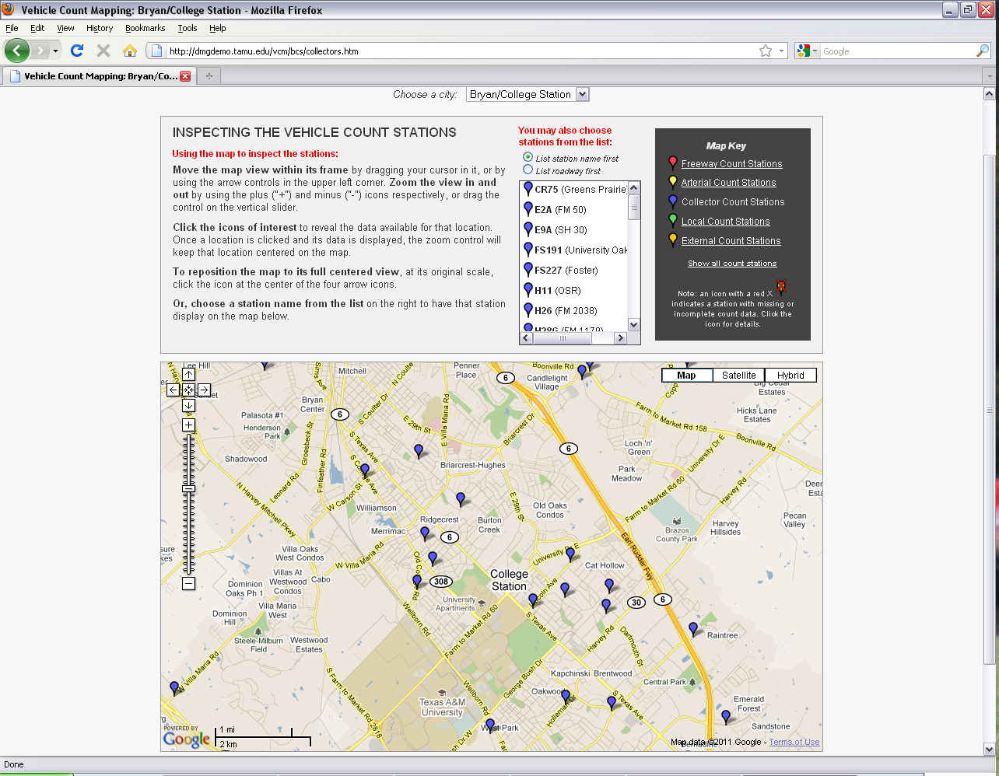
Mapping Overview

Slide 9
Mapping Overview

Slide 10
Mapping Overview

Slide 11
Mapping Overview

Slide 12
Mapping Overview

Slide 13
Mapping Overview

Slide 14
Mapping Overview

Slide 15
Questions?
Steve Farnsworth
Texas Transportation Institute
(979) 862-4927
s-farnsworth44@tamu.edu

