Slide 1
Development of a Regional Special Events Model and Forecasting Special Events
Light-Rail Ridership
13th TRB Transportation Planning Applications Conference
Lavanya Vallabhaneni, Maricopa Association of Governments
Rachel Copperman, Cambridge Systematics
Rachel Copperman, Arun Kuppam, Jason Lemp, Tom Rossi, Cambridge Systematics
Vladimir Livshits, Lavanya Vallabhaneni, Maricopa Association of Governments
May 9, 2011

Slide 2
Background – MAG Region
Maricopa Association of Governments (MAG) - designated MPO for transportation planning for the metropolitan Phoenix area
Currently there are more than 300 special events of significance in MAG that generate a total annual attendance of a few million people

Slide 3
Background – Light Rail Transit
New Light Rail Transit service opened in early 2009
  ridership numbers started to exceed regional forecasts along all LRT lines
LRT intercept survey indicated that a significant portion of riders were non-commute trips occurring during off-peak hours and weekends
  Possibly due to heavy utilization of LRT lines by special events patrons

Slide 5
Project Overview
Conduct survey of Special Event attendees at various locales
Produce an application-ready stand alone four-step trip based travel forecasting model
Emphasis on Transit Ridership
  Federal Transit Administration (FTA) is funding project

Slide 6
Surveyed Events
Arizona Fall Frenzy
Diamondbacks game
Arizona State Fair
AFL Rising Stars Game
ASU Football Game
KISS Concert
Cardinals Game
Mill Avenue Block Party
PF Changs Marathon
FBR - WM Golf Open
ASU Basketball Game
NBA Phoenix Suns Game
Spring Training Game
Wrestlemania
Pride Parade
Crossroads of the West Gunshow
Conan O’Brien Show
First Friday
Diamondbacks game
NBA Phoenix Suns Game

Slide 7
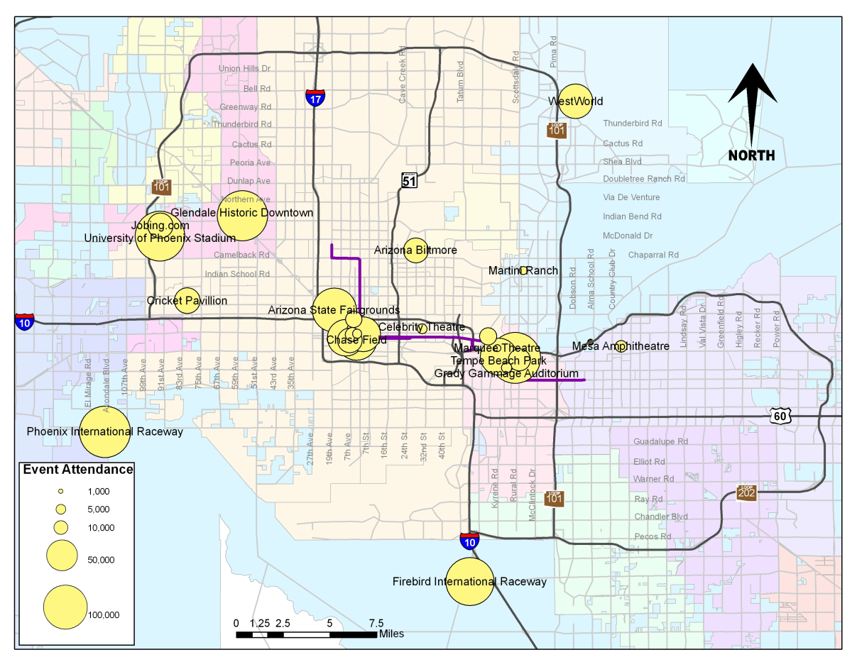

Slide 8
Survey Data Collection
Partnered with West Group Research who conducted the survey
Targeted 100-600 surveys per event for a total of 5,943 useable/completed surveys
Collected counts by Gate and Time Period for about half of events

Slide 9
Survey Questions
Location (Gate) and time of interview
Pre-event and post-event location
Departure time from origin location
Mode of Travel to/from event
Access mode to/from transit
Parking cost and location
Party Size to/from Event
Length of planned stay at event
Socioeconomic Characteristics

Slide 10
Post-Survey Tasks
Data entry and completeness checks – WGR and MAG
Geocoded Addresses – MAG
Compiled Event Information – CS and MAG
Survey Expansion and Weights – CS
  Weighted data by Gate, Time Period, and Party Size
  Expanded to total attendance at event

Slide 11
Special Event Model Overview
Stand-alone model and is designed similarly to a daily travel demand model
It can be applied separately to each type of special event and for each day of week (weekday, Saturday, or Sunday)
The SEM components parallel the basic components of the Four-Step model

Slide 12
SEM - Objectives
Predict for Each Event:
  Number of trips by location type (home-based, hotel-based, work/other-based)
  Trip Time-of-Day
  Origins (and destinations) of trips
  Mode choice of trips
  Vehicle miles traveled (VMT) and transit boardings generated as a result of special events

Slide 13
Model Inputs: Event-Level
Base Year Daily Attendance
Forecast Year Daily Attendance
Venue Capacity
Event TAZ(s) location
Day of Week of Event
Start and End Time of Event
Set vs. Continuous Start and End Time
Parking Cost
Event Market Area – Regional, Multi-Reg., National

Slide 14
Model Inputs: Forecast-Level
Forecast Year
Annual Population Growth Rate
Forecast Year Peak and Off-Peak Skims
Forecast Year Zonal Data
Forecast Year Hotel Employment
Auto Operating Cost

Slide 15
Trip Generation
Model Overview: Predicts the number of person trips traveling to and from special events
Base Year:
  Person trips = attendance at the event
Forecast year:
  Person trips = minimum { Base Year Attendance * Growth Rate, Venue Capacity }

Slide 16
Time-of-Day
Model Overview –Determines arrival and departure time distribution of person trip
Determined based on Arrival Time to Event and Planned Duration of Stay at Event from Survey
Set Start and End Time Events
  Arrival time distributed between 0-3 hours before event start time, and up to 0.5 hours after start time
  Departure time distributed between 0-1 hour before event end time, and up to 0.5 hours after end time

Slide 17
Time-of-Day (cont.)
Continuous Start and End Time Events
  Arrival time is distributed uniformly between the event start time and 3 hours before the event end time
  Departure time is determined based on arrival time and event duration with all event attendees leaving at or before the event end time
Time-of-Day is aggregated to four time periods (AM Peak, Mid-Day, PM Peak, Night) or half-hourly, depending on skim inputs

Slide 18
Trip Distribution
Model Overview
  Trips beginning and ending at a location external to the MAG region are identified and distributed to external stations
  Probability of trips beginning or ending at home, work, hotel or other location is determined.
    As part of this procedure, income and vehicle segmentation is applied to trips originating at home.
  Location TAZ of home, work, hotel, and other-based trips is assigned

Slide 19

Trip Distribution – External Trips
8.7% of attendees at each event are assumed to travel from outside of the MAG region (determined from Survey)
    8.1% of external trips to event are converted to hotel-based for trips from the event
External stations from which trips enter the region was determined using the survey data
  Total survey percentages are used for all events

Slide 20
Trip Distribution – Location Type
Percentage of each location type (home, work, hotel, and other) to each event is based on
  Event market area (national, multi-reg., regional),
  Event time of day and day of week combination (weekday evening, all-day, other)
Percentages derived from Survey data for event type combination

Slide 21
Trip Distribution – Location Type
Event Market Area | Day of Week – Time of Day | Home | Work | Hotel | Other
National | Weekday Evening | 61.3 | 4.8 | 28.8 | 5.1
National | All Day | 64.7 | 1.4 | 28.8 | 5.1
National | Other | 65.7 | 0.4 | 28.8 | 5.1
Multi-Regional | Weekday Evening | 81.8 | 6.3 | 9.1 | 2.8
Multi-Regional | All Day | 86.2 | 1.9 | 9.1 | 2.8
Multi-Regional | Other | 87.6 | 0.5 | 9.1 | 2.8
Regional | Weekday Evening | 89.0 | 6.9 | 3.1 | 1.0
Regional | All Day | 93.9 | 2.0 | 3.1 | 1.0
Regional | Other | 95.3 | 0.6 | 3.1 | 1.0

Slide 22
Trip Distribution – SE Segmentation
Home Location Type SE characteristics based on Event Market Area
  Multi-regional and national events attract higher income households with more vehicles
  Regional events draw attendees with lower household incomes and less vehicles
Segmentation:
  HH Income: low (less than $40,000); middle ($40,000 to $100,000); high (more than $100,000)
  Vehicle Availability: 0, 1, 2+ vehicles available in HH

Slide 23
Trip Distribution – Origin TAZ
Trip distribution model predicts the origin choice of trips to the event by location type
Three destination (or origin) choice models were estimated
  Home
  Hotel
  Work and Other

Slide 24
Trip Distribution – Origin TAZ
Specified in the multinomial logit form
Size measures:
  Home: number of HBNW trips produced in a zone (from regular travel model)
  Hotel: hotel employment
  Work and Other: HBW attractions (from regular travel model)
Utility Measures:
  Distance from TAZ to Event
  Land-Use at Origin
  Mode Choice logsum

Slide 25
Trip Distribution - Distance

Slide 26
Mode Choice
Model Overview – The mode choice model determines the probabilities of choosing different modes at the TAZ level.
  External Trips: Set mode choice percentages for all events – auto modes only
  Internal Trips: Determined by a nested multinomial logit model

Slide 27
Mode Choice – Nesting Structure
Root
Transit
Walk/
Bike
Shared Ride-3+
Shared Ride-2
Drive Alone
Drive Access
Light Rail
Walk Access
Bus
Light Rail
Bus
Auto

Slide 28
Mode Choice - Coefficients
Nesting Coefficients
  Constrained to 0.6 for the second-level nest and 0.24 for the third-level nest
Level-of-Service
  Constrained to VOT of $5 and OVTT = 2 x IVTT
    Cost: -0.018
    IVTT (min.): -0.015
    OVTT (min.): -0.03
  Non-motorized: Unconstrained distance coeff.
    Distance: -0.249

Slide 29
Mode Choice – Coefficients
Socio-Economic Variables: Income, Vehicle Availability for home location type
  Higher income and higher vehicle availability more likely to use auto or drive to LRT
Land-Use at Origin
  Origin is CBD, less likely to use auto or drive to LRT
Origin Location Type:
  Work trip – more likely to drive alone
  Hotel trip – less likely to drive to transit

Slide 30
Trip Assignment
Output from SEM will be person trip tables for each Mode and time-of-day
Converted to vehicle trips and added to Current Trip Assignment in Regular Model

Slide 31
Model Validation
Validation Data
  Special Events Survey data
  Transit Boarding counts
  Highway counts
Mostly focus on trip lengths and mode shares

Slide 32
Thank You.
Questions?

