Slide 1
Impact of Crowding on Rail Ridership: Sydney Metro Experience and Forecasting Approach
William Davidson, Peter Vovsha
(PB Americas)
Rory Garland, Mohammad Abedini
(PB Australia)
Acknowledgment: Michael Florian (INRO)

Slide 2
Proposed Sydney Metro Line

Slide 3
State of the Art & Practice
Most of applied models use simplified unconstrained transit assignment:
Ridership greater than capacity is allowed
Inconvenience and discomfort in crowded transit vehicles (standing) ignored
Basic theory is there:
Constraining total capacity by effective headways [Cepeda Cominetti & Florian, 2005] – convergent algorithm but solution may not be unique
Penalizing in-vehicle-time in crowding vehicles similar to VDF in highway assignment [Spiess, 1993] – unique solution
Attempts to estimate crowding functions in UK and elsewhere:
RP
SP

Slide 4
How Some Models Look Like

Slide 5
2 Effects Intertwined
Capacity constraint (demand exceeds total capacity)
Riders cannot board the vehicle and have to wait for the next one
Modeled as effective line-stop-specific headway greater than the actual one
Similar to shadow pricing in location choices or VDF when V/C>1
Crowding inconvenience and discomfort (demand exceeds seated capacity):
Some riders have to stand
Seating passengers experience inconvenience in finding a seat and getting off the vehicle
Modeled as perceived weight factor on segment IVT

Slide 6
Capacity Constrained at Boarding Nodes and Not by Segments
Total capacity = 3,000
1. Segment IVT weight
2. Effective headway
1,800
A
1,500
A
A
1,800
1,800
1,500
2,000
600
B
500
B
600
B
2,400
2,000
2,400
1,200
C
1,000
C
600
C
3,600
3,000
3,000

Slide 7
Effective Headway Calculation (Line & Stop Specific)
Board
Δ Capacity=
Total capacity-
Volume+Alight
Stop
Volume
Stop
Eff.Hdwy Factor
Alight
1
0
1
Board/ΔCap

Slide 8
Effective Headway Calculation (Technical Details)
Effective headway function is applied
on top of wait time function (not necessarily 0.5 headway!)
Before calculation of combined headways
Variety of functions proposed (no real estimation can be done):
Shadow pricing (optimization problem w/explicit constraints)
Penalty function

Slide 9
Suggested Effective Headway Function
Effective headway can grow up to 50% at each iteration
Imposes additional equilibrium conditions:
Effective headway equal to actual headway if segment is underutilized
Effective headway greater than or equal to actual headway if segment is fully utilized

Slide 10
Critical Points of Crowding Function

Slide 11
Crowding Functions for British Rail and London Underground

Slide 12
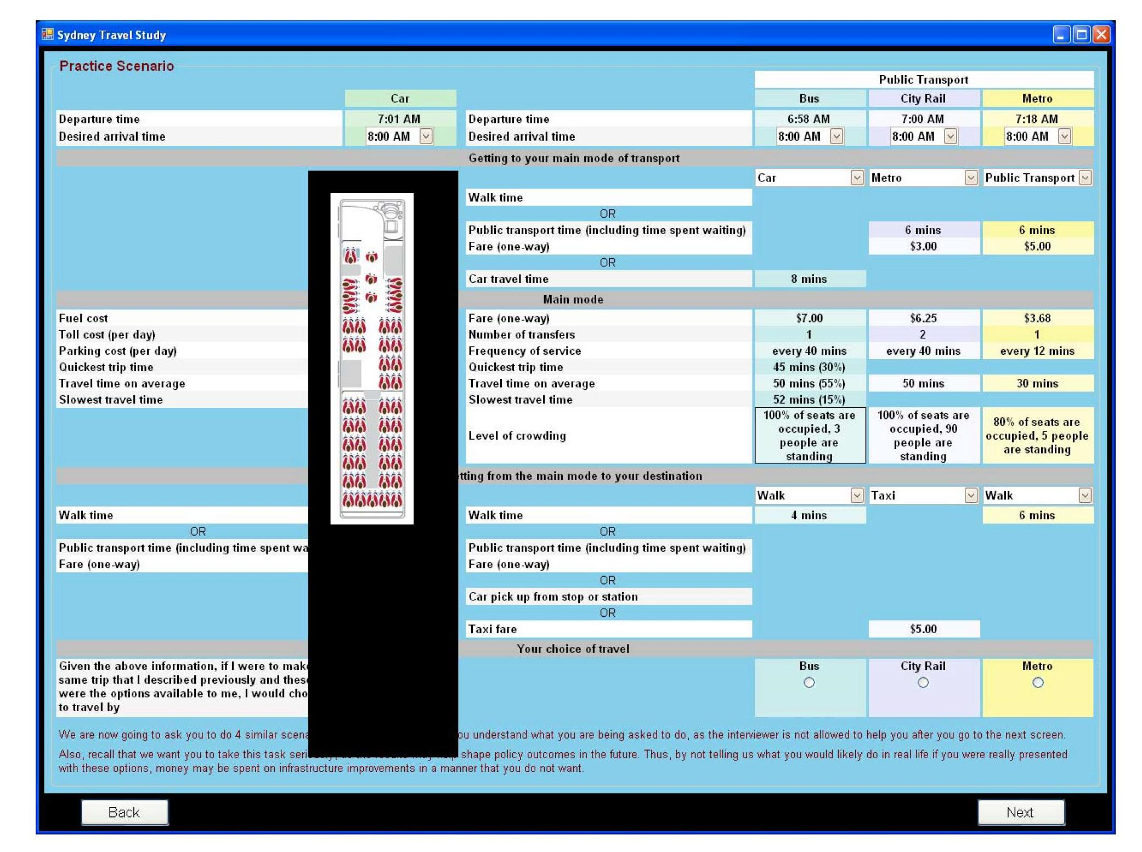
SP Survey (D. Hensher)

Slide 13
Crowding Function Applies Incremental Costs as Vehicles Fill Up

Slide 14
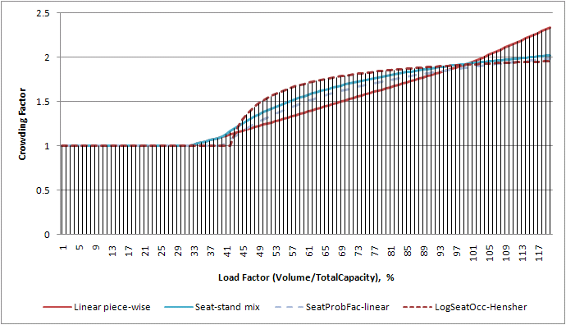
Adopted Crowding Function Seated Capacity = 40% of Total

Slide 15
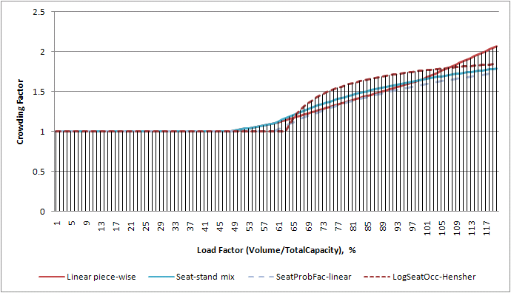
Adopted Crowding Function Seated Capacity = 60% of Total

Slide 16

Crowding Functions Summary
Significant variation from study to study but some consensus:
Perceived weight for standing 2.0-2.5 at least for trip lengths 30+ min (confirmed by Sydney SP)
Can be further segmented by person type, trip purpose, and trip lengths (may be impractical for model application)
Vehicle design & proportion between total and seated capacity affect crowding function:
Crowding function has to be adaptable to vehicle parameters
Blend seating and standing passengers properly:

Slide 17
Mode Choice
Notes:
A Nested Logit structure enables MNTM to capture all choices relevant to the allocation of demand between competing routes and modes.
Bill, you should probably talk about the origins of the model structure. My understanding is that this structure emerged through the estimation process in Chicago – I think you said that a number of different structures were tested and this one gave the best performance. There will be those in the audience that want to point out that this means that we have not tested this particular structure in Sydney – so what is the case, or evidence, for the reliability of this transfer? I’m not sure if there is an easy answer to this but we should try and prepare for it.
The metro egress may also come up. The rationale for this emerged from consideration of the key markets for Stage 2 (west) metro. We hypothesised that people would be faced with the choice of transferring from CityRail to Metro at various point along the western corridor (Parramatta, Strathfield or Central) and that it would be important to include this choice within the model.
This slide also provides an opportunity to discuss the limitations of the model structure:
the choices have been structure to best reflect the intended metro markets
some choices are not permissible eg Metro to CityRail interchange – although this could be included

Slide 18
Model System Overview

Slide 19
Capacity & Crowding Effects
Segment Volumes
and Characteristics
Effective Headways
Station to Station
Assignment & Average
Segment Crowding
Station to Station
Assignment & Average
Done

Slide 20
Equilibration Strategy
Global iteration (mode choice & assignments) | Averaging of trip tables and auto LOS before the next global iteration | Inner iteration of transit assignment | Averaging of transit segment volumes and boardings before the next inner iteration
0=Starting LOS and mode choice |  | 0.1=Effective headways equal to actual headways, crowding factors equal to 1.00 | Starting transit volumes
1 | 1.00 of iteration-1 plus 0.00 of iteration-0 | 1.0=Effective headways and crowding factors from iteration-0 | 1.00 of iteration-1.0 plus 0.00 of iteration-0
 |  | 1.1=effective headways updated | 0.90 of iteration-1.1 plus 0.10 of iteration-1.0 (av.)
 |  | 1.2=crowding factors recalculated | 0.80 of iteration-1.2 plus 0.20 of iteration-1.1 (av.)
2 | 0.75 of iteration-2 plus 0.25 of iteration-1 (av.) | 2.0=Effective headways and crowding factors from iteration-1 | 0.75 of iteration-2.0 plus 0.25 of iteration-1.2 (av.)
 |  | 2.1=effective headways updated | 0.65 of iteration-2.1 plus 0.35 of iteration-2.0 (av.)
 |  | 2.2=crowding factors recalculated | 0.55 of iteration-2.2 plus 0.45 of iteration-2.1 (av.)
3 | 0.50 of iteration-3 plus 0.50 of iteration-2 (av.) | 3.0=Effective headways and crowding factors from iteration 2 | 0.50 of iteration-3.0 plus 0.50 of iteration-2.2 (av.)
 |  | 3.1=effective headways updated | 0.40 of iteration-3.1 plus 0.60 of iteration-3.0 (av.)
 |  | 3.2=crowding factors recalculated | 0.30 of iteration-3.2 plus 0.70 of iteration-3.1 (av.)
4 | 0.25 of iteration-4 plus 0.75 of iteration-3 (av.) | 4.0=Effective headways and crowding factors from iteration 3 | 0.25 of iteration-4.0 plus 0.75 of iteration-3.2 (av.)
 |  | 4.1=effective headways updated | 0.15 of iteration-4.1 plus 0.85 of iteration-4.0 (av.)
 |  | 4.2=crowding factors recalculated | 0.05 of iteration-4.2 plus 0.95 of iteration-4.1 (av.)

Slide 21
Mode Choice Framework
More flexibility compared to transit assignment since non-additive-by-link function can be applied:
Distance effect:
Short trips – tolerance to crowding
Long trips – probability of having a seat essential
Example of OD function to be explored:

Slide 22
Conclusions
(Project forecasts cannot yet be released at this stage)
Capacity constraints and crowding can be effectively incorporated in travel model:
Transit assignment
Model choice
Essential for evaluation of transit projects:
Capacity relief
Real attractiveness for the user
Explanation of weird observed choices (driving backward to catch a seat)

Slide 23
Next Steps
The method is currently being incorporated in the LACMTA travel model:
Westside transit corridor extension study
New SP planned as an extension of OB survey
Incorporated in transit assignment & skimming, mode choice, and UB evaluation
Direction for further improvement:
Distance effects on crowding
Integration of crowding functions in mode choice
Explicit modeling of standing and seating passengers
Crowding at transit stations / P&R lots
Incorporation of service reliability effects

Slide 24
Thanks for Your Attention!
Q?

