Slide 1
Analysis of a Multimodal Light Rail Corridor using an Activity-Based Microsimulation Framework
S. Ellie Volosin & Ram M. Pendyala, Arizona State University, Tempe, AZ
Brian Grady & Bhargava Sana, Resource Systems Group, Inc.
Brian Gardner, Federal Highway Administration, Washington DC
May 8 – 12, 2011; Reno, Nevada
13th TRB National Transportation Planning Applications Conference

Slide 2
Outline
Background
Project overview and objectives
Geographical area and regional network
Preparing the network
Trip-based demand
Execution of TRANSIMS
Trip-based results
Light rail line extensions
Synthetic activity file generation
Activity-based analysis - preliminary results
Ongoing work and Conclusions

Slide 3
Background
Need for planning tools that offer greater level of detail
Disaggregate models better able to replicate human behavior more closely
  Microsimulation models track each traveler individually
Limited work on microsimulation of transit modes

Slide 4
Project Overview
TRANSIMS deployment case study in Greater Phoenix Metropolitan Region
Funded by Federal Highway Administration
Emphasis on two developments
  Microsimulation of transit modes
  Activity demand generation module
Application to a mixed mode corridor including auto, bus, and rail modes

Slide 5
Project Objectives
Implement, calibrate, and validate TRANSIMS model
Evaluate performance of mixed mode network
  Intersection delay
  Rail crossings
  Transit transfers and boardings
Use calibrated model to predict conditions with future light rail extensions

Slide 6
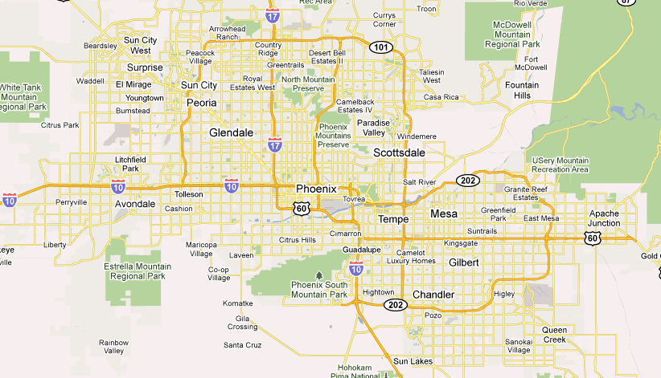
Phoenix Metropolitan Area

Slide 7
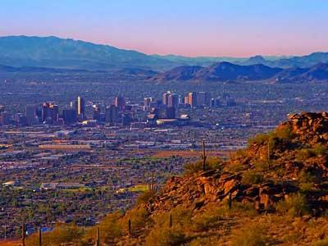
About the Greater Phoenix Region
4.28 million people in the metropolitan area
City of Phoenix is the 5th largest in the U.S.
Eight separate cities in the region with more than 100,000 people each

Slide 8
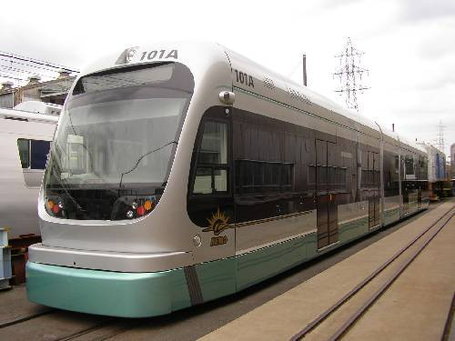
Light Rail System
Light Rail Transit (LRT) line began service in Dec, 2008
Starter line ~ 20 miles long
Serves West Mesa, North Tempe, and Central Phoenix
Important service stops
  Arizona State University
  Mill Avenue Shopping District
  Professional Sports Facilities
  Phoenix Sky Harbor Airport
  Phoenix Central Business District

Slide 9
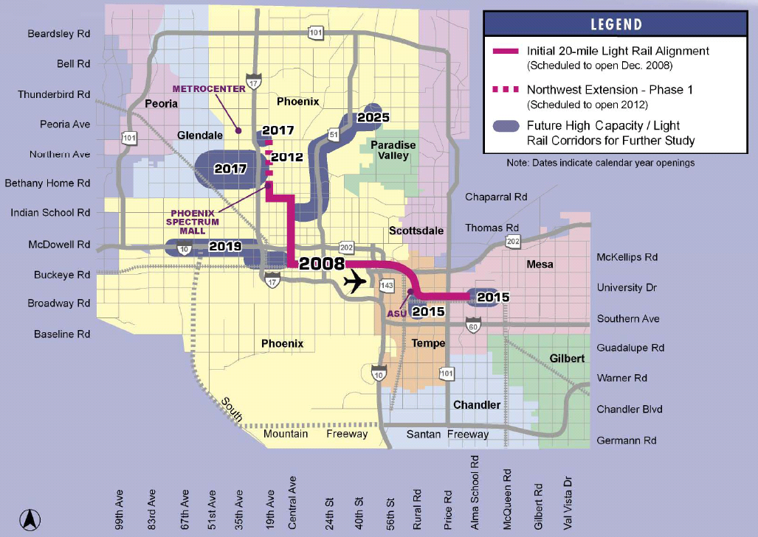
Future Light Rail Expansion

Slide 10
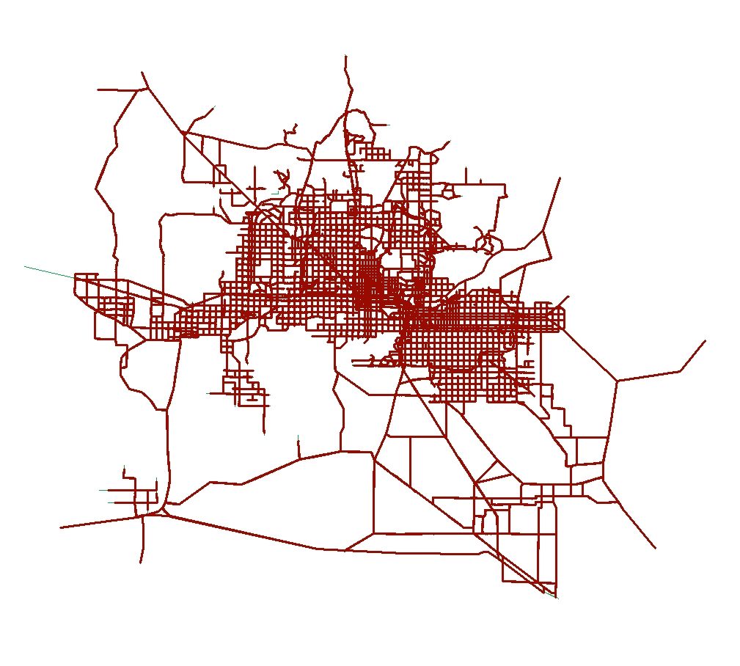
Network Development
Network adapted from 4-step model network
  Centroid connectors deleted
  All speeds and capacities set to physical values
  External connectors retained
TRANSIMS built-in network conversion tool

Slide 11
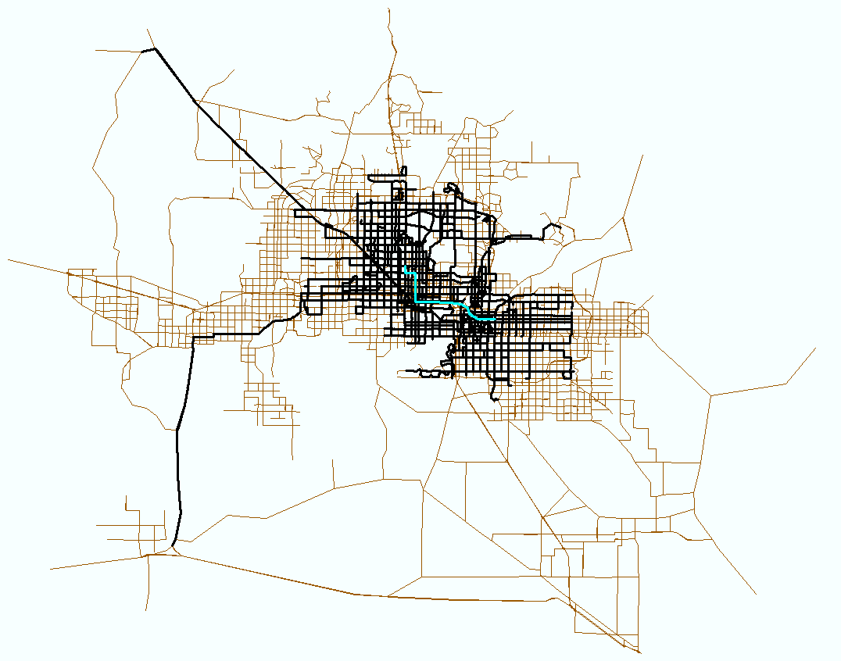
Network Development
Transit network created from route stops and route characteristics
  Route headways vary by service times
  Routes coded with stops and “pass-by” points
Manual adjustments made to lane connectivity

Slide 12
Definition of Activity Locations
Activity locations (ALs) constitute the start and end point of every trip
  Alternative to the zone centroid in the 4-step model
All activity locations are assigned a corresponding zone
Each zone must have at least 1 AL assigned to it
Developed a program to
  Identify zones with no ALs
  Locate the closest AL to that zone centroid
  Reassign the AL found to the zone in question

Slide 13
O-D Trip Tables
Initial implementation was O-D trip table-based
  Obtained from the 4-step model
  Trip tables by mode: SOV, HOV, bus, express bus, light rail
  Trips by purpose (6 purposes)
Time of day applied through diurnal distributions
  Calculated from NHTS 2009 data
  Distributions by mode and purpose
TRANSIMS trip conversion tool
~15 million trips in Greater Phoenix Metro Area

Slide 14
Rail Bias
Found light rail boardings below observed ridership numbers
Two possible transit options in TRANSIMS
  “transit” or “transit with rail bias”
Found that coding all transit trips as “transit with rail bias” improved boarding counts
Rail bias is set higher than 1
  Prompts transit riders to prefer rail over bus

Slide 15
Execution of TRANSIMS
TRANSIMS Studio: GUI built to aid in TRANSIMS model building
TransVIS: visualization tool built for TRANSIMS
Currently running TRANSIMS Studio
  64 bit Windows machine
  6 processors = 6 traveler partitions
1 full microsimulation takes about 2 days
  Adding more processors could reduce run times

Slide 16
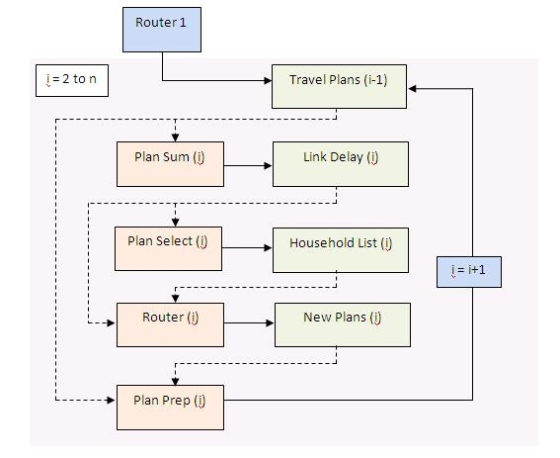
Router Stabilization
Iterative method
In each iteration, re-route only select travelers
Plan Sum finds travel times based on free-flow speed

Slide 17
Microsimulator
Process similar to that of Router stabilization
  Microsimulator is used rather than Plan Sum
  Microsimulator considers congestion along continuous time axis
Cellular automata model
  Every travel lane is a series of cells
  Only one vehicle can exist in a cell at a time
Microsimulator includes parameters for following distance, reaction time, look-ahead distance, etc.

Slide 18
Results based on O-D Tables
Facility Type | Number of Observations | Observed Vehicle Counts | TRANSIMS Volume | % Difference
Collector | 228 | 769139 | 902272 | 17.31%
Expressway | 69 | 598068 | 926566 | 54.93%
Freeway | 49 | 3451424 | 4804426 | 39.20%
Major | 3571 | 34868806 | 40892809 | 17.28%
Total | 3917 | 39687437 | 47526073 | 19.75%
Mode Type | Observed Boardings | Transims Model Boardings | % Difference
Local Bus Total | 197566 | 194496 | -1.55%
Express/Rapid Bus Total | 6826 | 21012 | 207.82%
Light Rail Total | 40772 | 37605 | -7.77%
Total | 245164 | 253113 | 3.24%

Slide 19
Results based on O-D Tables
Total travel time for all trips = 5824751 hours
Average travel time = 30.08 minutes
Maximum vehicles on the network = 652159 at 3:49:51 pm
Time schedule problems still experienced
  Departure time
  Arrival time
  Wait time

Slide 20
Light Rail Specific Results
Stop Location | EB Boardings | WB Boardings
West End of Line | 1982 | 0
Business District | 1266 | 419
Business District | 1693 | 322
State Government Buildings | 1517 | 772
Professional Sports Facilities | 398 | 695
Sky Harbor Airport | 1432 | 582
Mill Avenue Shopping District | 407 | 404
Tempe Transit Center | 288 | 697
Arizona State Main Campus | 609 | 991
Loop 101 Park n Ride | 75 | 1334
East End of Line | 0 | 2660

Slide 21
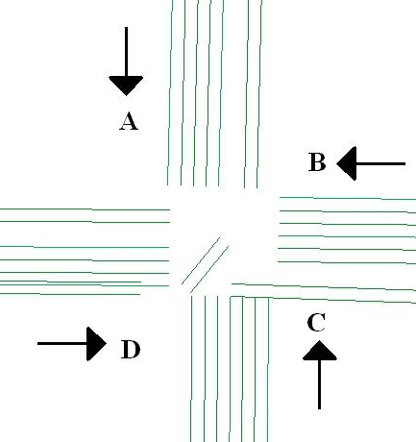
Delays at Mixed-Use Intersections
Intersection 1: Downtown Phoenix
Direction | Avg. 15-Min Volume | Avg. Delay | Max. Queue
A | 225.33 | 1.66 | 0
B | 122.92 | 0 | 2
C | 160.08 | 0 | 0
D | 120.83 | 0 | 0
Intersection 2: Suburban Tempe
Direction | Avg. 15-Min Volume | Avg. Delay | Max. Queue
A | 139.42 | 1.74 | 3
B | 107.75 | 1.48 | 3
C | 105.17 | 0.46 | 2
D | 179.75 | 3.59 | 8

Slide 22
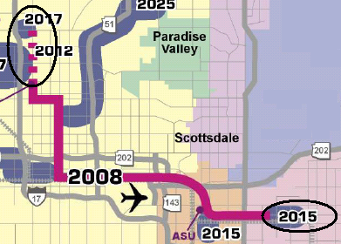
Light Rail Scenario
Selected two planned extensions
  Northern extension
  Mesa extension
All transit trips in the O-D tables still coded as “transit with rail bias”
Even with fixed demand, transit riders have a choice

Slide 23
Light Rail Scenario Results
Mode Type | Base Network Results | LRT extension results | % Difference
Local Bus | 197142 | 209381 | 6.2%
Express Bus | 21745 | 27652 | 27.2%
Light Rail | 44475 | 52878 | 18.9%
Grand Total | 263362 | 289911 | 10.1%
Found expected increase in rail boardings
Also found increase in bus boardings
  Could be due to a greater number of travelers taking advantage of transfer opportunities

Slide 24
Generating Synthetic Population
PopGen software used
  Developed at ASU
  Chosen for its flexibility
  No learning curve for ASU researchers
Synthesis performed to generate 2009 population
Synthetic Population Summary
  Number of Household File Records = 1521189
  Average Persons per Household = 2.76
  Average Workers per Household = 1.32
  Average Vehicles per Household = 1.81

Slide 25
Synthetic Activity Generation
Used TRANSIMS built-in activity generator: ActGen
Inputs:
  Synthetic population with household descriptions
  Survey file with activities pursued by persons in varying household types
Output:
  File containing daily activity schedules for every person in the population
Used synthetic population from PopGen
Input survey file created from NHTS 2009

Slide 26
Preparation of Input Survey Data
Trials made with different survey samples
  Only Arizona survey records
    4511 survey records
    2.99 activities per person generated
    8.37 activities per household generated
  All U.S. survey records
    136136 survey records
    4.52 activities per person generated
    12.83 activities per household generated
Used entire US survey records for richer sample from which to draw activity records

Slide 27
Preliminary Activity Generation Model
Activity-based travel simulation in the early stages at this time
All activities simulated for morning peak period
  6:00 to 9:00 AM
Model not yet validated

Slide 28
Ongoing Work
Initial results from activity generation simulation show an under-estimation of trips and transit boardings
Exploring possible ways to enhance replication of base year traffic volumes and boardings
  Focus on ActGen module
Will apply the activity-based model to analyze two proposed light rail extensions

Slide 29
Questions
http://simtravel.wikispaces.asu.edu

Slide 30
Results based Activity Files
Total travel time for all trips = 406944 hours
Average travel time = 50.53 minutes
Maximum vehicles on the network = 55774 at 8:45:31 am
Most common problems
  Departure time
  Transit Capacity

Slide 31
Light Rail Specific Results
Stop Location | EB Boardings | WB Boardings
West End of Line | 38 | 0
Business District | 6 | 4
Business District | 5 | 0
State Government Buildings | 0 | 27
Professional Sports Facilities | 0 | 10
Sky Harbor Airport | 0 | 1
Mill Avenue Shopping District | 1 | 0
Tempe Transit Center | 0 | 0
Arizona State Main Campus | 0 | 1
Loop 101 Park n Ride | 0 | 0
East End of Line | 0 | 2

Slide 32
Delays at Mixed-Use Intersections
Intersection 1: Downtown Phoenix
Direction | Avg. 15-Min Volume | Avg. Delay | Max. Queue
A | 23.33 | 0 | 0
B | 3.83 | 0 | 0
C | 17.67 | 0 | 0
D | 7 | 0 | 0
Intersection 2: Suburban Tempe
Direction | Avg. 15-Min Volume | Avg. Delay | Max. Queue
A | 1.83 | 0 | 1
B | 1 | 0 | 1
C | 1 | 0 | 1
D | 1.86 | 0 | 0

