Slide 1
Freight Data and Decision Makers: How they were Introduced in Utah
David Hurst, John Stevens, & Paul Herskowitz – Wilbur Smith Associates
Walt Steinvorth – Utah DOT

Slide 2
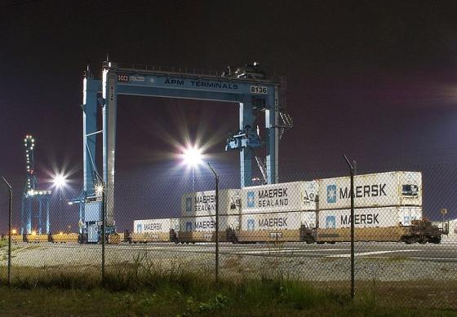
Overview
Type of Data
Analyze
Display
Decision Makers
Do’s and Don'ts

Slide 3
Data
Transearch
  Very comprehensive
  Often used in unison with STB Waybill
  Aggregated into multiple geographies from vendor
FAF
  Complete with foreign movements
  Identifies movements by mode
  Base geography is State/MSA combination
    Can be disaggregated to county level or lower with use of other data sets such as the Commodity Flow Survey
Notes:
Both datasets are national/global
Transearch geography based on need (county, TAZ, etc) all mode types
FAF 114 domestic regions, including 64 metro areas all mode types 44 commodity types Free
Others are either not as complete or local (which is not as valuable to statewide purpose)
Issues = data not compatible across sources or years. This was an issue as UDOT attempted to use the Transearch data (2007) in another study in 2010.
Timeliness when addressing economic changes = release of both datasets delayed while accounting for recession

Slide 4
Analyze
Model Comparisons
  Compared Freight Data to Travel Demand Model
Summarize Data
  Tabulation and general summary based on origin/destination
Notes:
Truck flows estimated from existing counts
Adjusted for future year assumptions (like forecasts of employment by industry)
The truck trip table is a matrix representation of truck movements for use in the model assignment
Allows better understand the interaction of freight and passenger travel on state’s transportation network
Examples:
VA Statewide
Utah Statewide
Various MPO Models

Slide 5
Display
Maps
Reports
  State
  MPO
Notes:
Interactive is the ability to have data layered and then choose to look at certain mode or certain commodity or specific county (think action script)

Slide 6
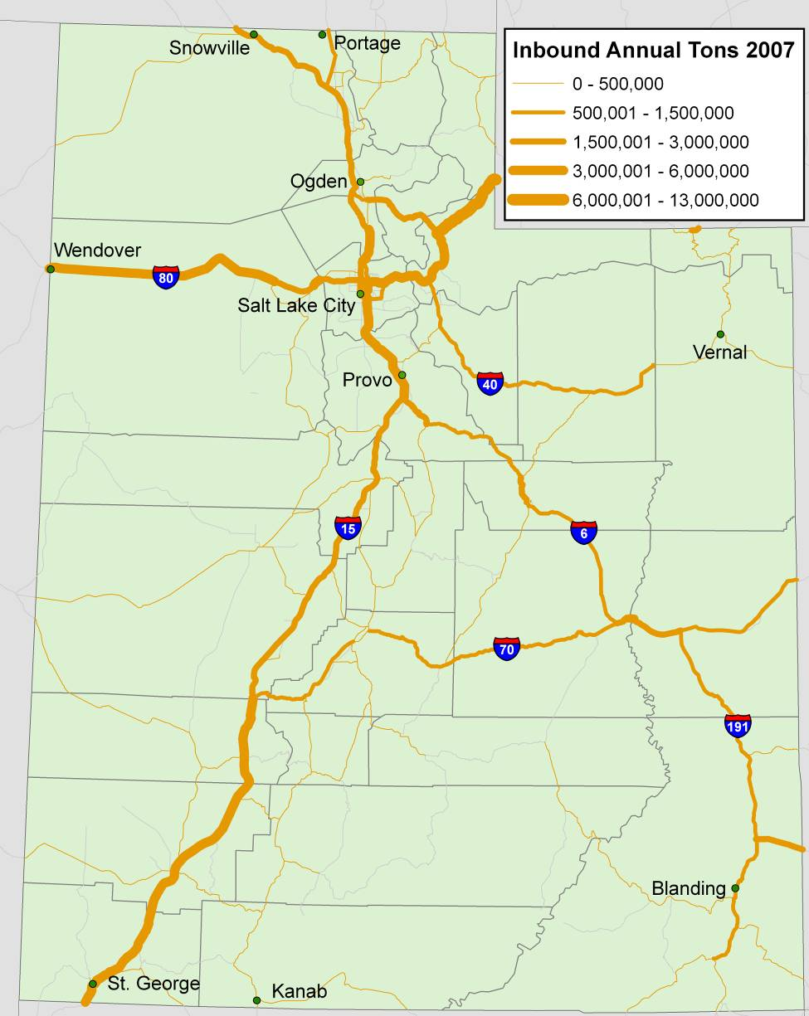
Examples
Description | Truck (in millions) | Rail (in millions) | Air (in millions) | Other (in millions) | Total Tons (in millions) | % of Total
Nonmetallic Minerals | 96.6 | 1.3 | 0.002 | 0.01 | 97.9 | 14%
Secondary Traffic | 79.9 | 0 | 0 | 0 | 79.9 | 11%
Food or Kindred Products | 45.9 | 15.3 | 0.003 | 0.005 | 61.1 | 9%
Chemicals or Allied Products | 40.4 | 17.3 | 0.05 | 0.004 | 577 | 8%
Electrical Equipment | 49.8 | 3.4 | 0.05 | 0.1 | 53.4 | 7%
Farm Products | 29.4 | 18.4 | 0.01 | 0.005 | 47.8 | 7%
Machinery | 30.7 | 0.3 | 0.08 | 0.01 | 31 | 4%
Misc Mixed Shipments | 0 | 29.7 | 0.08 | 0 | 29.8 | 4%
Misc Manufacturing Products | 29.1 | 0.3 | 0.01 | 0.05 | 29.4 | 4%
Primary Metal Products | 24.0 | 3.9 | 0.001 | 0.009 | 27.9 | 4%
All Other | 136 | 60.3 | 0.2 | 1.6 | 198 | 28%
Grand Total | 561.6 | 150 | 0.4 | 1.8 | 713.9 | 100%

Slide 7
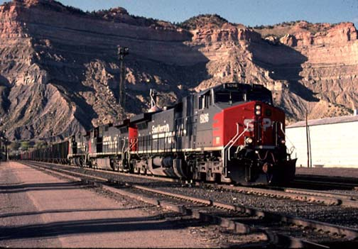
Presentation to Decision Makers
Statewide Freight Report
  Distributed to all stakeholders
MPO Reports
  A localized version of state report
  4 MPO’s in state

Slide 8
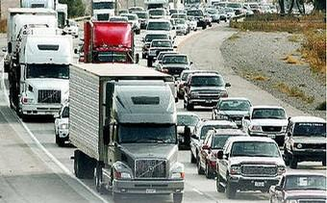
Lessons
Interaction/distributions with MPO
  Benefit to them, would not normally have
  Check data on local level
Freight Report
  Education of terms
  Importance of certain routes to state economy
Freight Committee
  Excellent QA/QC of data
  Beneficial during routing process to validate

Slide 9
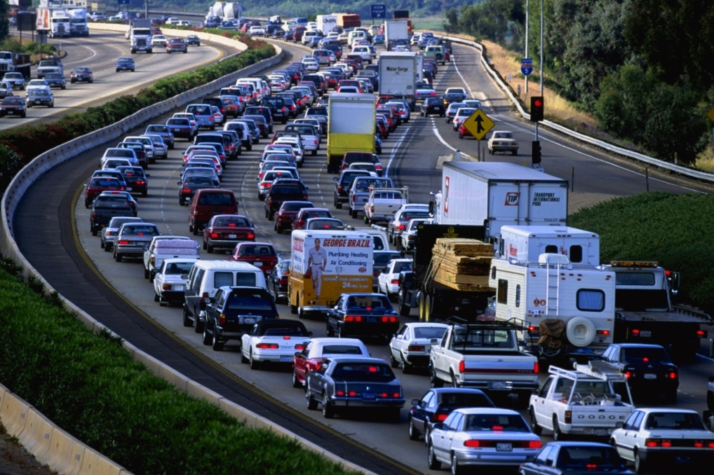
Lessons
Opened lines of communication
  Brought Freight to the forefront
  Allowed MPO’s and State to understand:
    goods movements
    How related internally
    Interaction with regional neighbors

Slide 10
Future Work
Future
  3D Display and Animation
  Interactive choice display
  Micro simulation

Slide 11
Conclusion
Do
  Involve multiple stakeholders
  Identify local experts/users for guidance
  Devote time for checking data
  Question movements
Don’t
  Attempt to compare datasets (source or year)

