Slide 1
A Genetic Algorithm for
Truck Model Parameters from
Local Truck Count Data
Vince Bernardin, Jr, PhD & Lee Klieman, PE, PTOE
Bernardin, Lochmueller & Associates, Inc.
Seyed Shokouhzadeh & Vishu Lingala
Evansville Metropolitan Planning Organization

Slide 2

Problem
A Common Problem
  Need to account for trucks
  No/old truck survey data for the region
  Only truck data available:
  classification counts

Slide 3

NEW Solution?
A Possible Solution
  Genetic algorithm to find truck model parameters based on best fit to truck count data

Slide 4
Matrix Estimation?
Different from OD Matrix Estimation
  Although both rely on counts
  No seed trip table
  Provides an actual model for forecasting
  Mathematically: Solution space is much smaller – not underdetermined like ODME

Slide 5
Previous Work
Parameter Estimation from Counts
  About a dozen papers
  No truck model applications
  No genetic algorithms – mostly simpler model specifications with analytic gradients

Slide 6
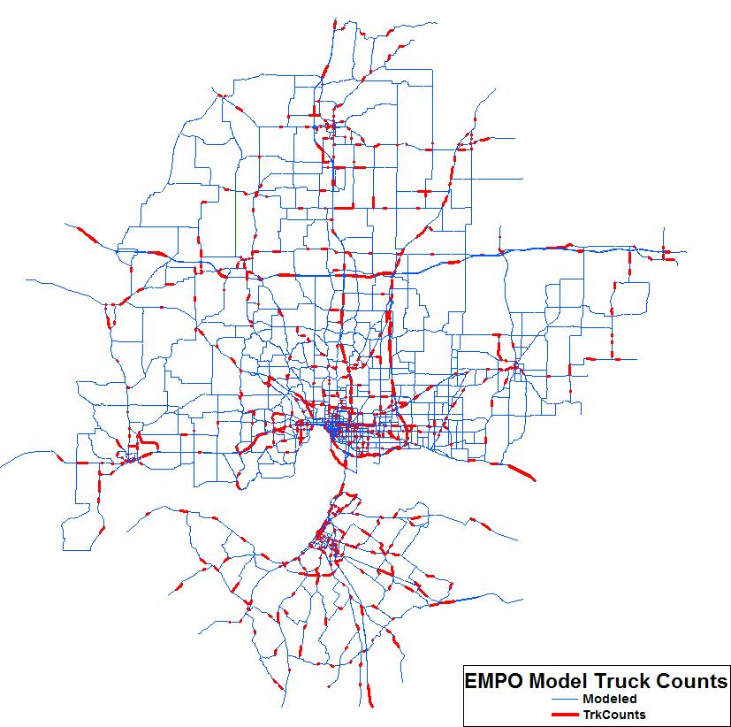
Evansville
The Evansville MPO test case
  Small/mid-sized
    350,000 pop.
    200,000 emp.
    2,000 sq. mi.
  5,000 road miles
  974 truck counts

Slide 7
Truck Model
Simple Three-Step Model Structure
  Four classes
    Internal/External
    Single/Multi-Unit
  Total of 40 estimable
  parameters
  Initially, no special generators, k-factors
Truck Trip Generation
Truck Trip Distribution
Truck Trip Assignment

Slide 8
generation
Truck Trip Generation
  Regression models initially based on 5 employment categories & households
  No info on square footage, but may test estimate of developed acreage by industry

Slide 9
Destination choice
Truck Destination Choice
  In addition to travel time & attractions currently testing two additional variables
  Spatial autocorrelation (competing destinations) accessibility variable
  Ohio River crossing additional impedance
  Ability to test more variables

Slide 10
Assignment
Multi-Class Generalized Cost Assignment
  Travel time
  Length
  Right and left turn penalties
  Lower functional class penalty
    Proxy for clearance, turn radii, lane width, etc.
  Non-truck route penalty

Slide 11
calibration
Iterative Bi-Level Program
Genetic Algorithm
Evolve parameters to minimize squared errors versus counts
Truck Model
Apply the base model given a set of parameter as inputs

Slide 12
Genetic algorithm
Overview
  Initial “population” of solutions
  Evaluate “fitness” of each solution
  Kill least fit solutions
  Create new generation of solutions by
    Randomly mutating fit solutions
    Combining fit solutions

Slide 13
Initial Solution
Best Guess
  Borrowed parameters from
    Old survey
    Old model
    QRFM
    Other models

Slide 14
Fitness
Least Squared Errors (LSE)
  Evaluate fitness by applying
  the truck model and calculating RMSE
  LSE method enjoys certain advantages, more frequently convex, but could also try minimizing MAPE
  Diversity not currently considered

Slide 15

Mutation
Mutation
  Draw new parameter randomly from normal distribution around previous solution parameter
  Currently only mutating best solution
  A couple of ‘hyper-mutants’ (mutate all parameters) each generation

Slide 16

Combination
Re-combination
  ‘Mate’ two attractive solutions
  ‘Child’ solution has a 50%
  chance of getting each parameter from either parent solution

Slide 17
Challenges
Issues & Challenges to Date
  Poor initial solutions
  Questionable count data
  Computational intensity
    Long running time (weeks)
    Memory management (crashes)

Slide 18
Initial PROGRESS
Improved solution (RMSE)
                All SU MU
  Best initial solution: 179% 215% 178%
  Best evolved solution: 155% 182% 168%
  Initial improvement: 24% 33% 10%
Results slowly but steadily improving – methodology working & may produce a good solution – given a few more weeks computing time

Slide 19
On-going WORK
Hopes for further improvement
  Cleaned, updated count data
  Alternative truck model specifications
    Generate trips from developed area by industry?
    Test special generators and/or k-factors
  Better speed from faster computers
  Better speed by adjusting
    Population size
    Mutation rate
    Kill rate

Slide 20
Conclusion
Findings
  Basic methodology working
    Even for complex model specification
  Identified challenges of genetic programing as an alternative model calibration technique
    Computational intensity
    Count data quality

Slide 21
Thank You!
  Vince Bernardin, Jr., Ph.D.
  VBernardin2@BLAinc.com
  812.479.6200

