Slide 1
An AQ Assessment Tool for Local Land Use Decisions
13th TRB
Transportation Planning Applications Conference
May 9, 2011
Reno, Nevada
Mark Filipi, AICP PTP

Slide 2
Metropolitan Council Background
  Established in 1967 to coordinate
  planning and development in the
  region.
Responsibilities include:
  Operate region’s largest bus system,
  Collect and treat wastewater, and
  Plan for future growth.
2009 legislative mandate to prepare
Land Use and Planning Resources
Report .

Slide 3
Land Use and Planning Resources Report
Identify and assess land use &
transportation strategies for 3 goals:
    Reduce air pollution,
    Mitigate congestion, and
    Reduce costs for operation, maintenance or improvement of infrastructure.
Develop voluntary land use air quality
assessment tool for local decision-makers.

Slide 4
Air Quality Assessment Tool
Assess green house gases (along with
other criteria pollutants).
Based on local data to maximum
extent possible.

Slide 5
Travel Model Data Requirements
Data needed to develop assessment tool:
  Vehicle-miles-traveled data (VMT) – by trip purpose and community.
  VMT elasticity relationships to adjust “Base Case” VMT to “Alternative Land Use/Design Scenario” VMT based on difference between development scenarios.

Slide 6
AQ Emission Rate Data Requirements
Data needed to develop assessment tool:
  Air pollutant emission rate data generated with MOVES2010 using local input data from various available existing sources.

Slide 7
“Base Case” Land Use VMT Data
Regional travel demand model used to estimate and tabulate baseline “Base Case” VMT.
VMT aggregated for:
  Home-Based,
  Non-Home Based, and
  Through trips

Slide 8
Method for Estimating and Aggregating Community Oriented VMT
Distance along shortest time path skimmed for all TAZ pairs (5 time periods – averaged travel time).
Number of vehicle trips (home-based and non-home based) between all TAZ pairs output from model.

Slide 9
Method for Estimating and Aggregating Community Oriented VMT
Vehicle trips multiplied by distance between pairs to estimate VMT for all TAZ pairs.
VMT summed by TAZ by:
  Community of residence for home-based trips (production end)
  Community as origin and/or destination for non-home based trips.

Slide 10
Community Aggregation
TAZ based VMT aggregated to communities based on:
  Existing list of community TAZs, and
  TAZs with only a portion in a community – GIS used to calculate area in community and homogenous distribution of land uses assumed to exist, so TAZ total VMT multiplied by calculated percent in community.

Slide 11
Truck Trips
Concern for impacts of commercial traffic prompted tabulation of VMT by truck traffic.
Truck trip model used to estimate number of truck trips between each TAZ pair for same time periods as auto traffic.
Skimmed distance multiplied by trips to estimate truck VMT.

Slide 12
Through Trip VMT
Concerns for under-estimating through trip impacts on some communities was raised.
Through trip VMT tabulated for SOV, HOV and truck trips.

Slide 13
Methodology for Estimating Through Trip VMT
Technique implemented individually for each community.
Trips beginning or ending in TAZs of each
community were zeroed out.
If a TAZ was in more than one community, the trips were reduced proportionally.

Slide 14
Methodology for Estimating Through Trip VMT
Community specific trip tables were than
assigned using All-or-Nothing assignment using congested travel times in the five time periods as the impedance.
Loaded networks combined to a daily loaded network and converted to a GIS shapefile.

Slide 15
Methodology for Estimating Through Trip VMT
GIS program used to clip out the road network of each community and tabulate.
Speadsheet program used to tabulate the VMT.

Slide 16
Methodology for Estimating Through Trip VMT

Slide 17
Methodology for Estimating Through Trip VMT

Slide 18
Calculation of VMT rates for HB and NHB Trips
Population, household and employment data taken from Council website to ensure consistency with publicly available data.
VMT for Home-Based trips divided by # of households in community.
VMT for Non-Home Based trips divided by # of employees.

Slide 19
Range of Resulting VMT Rates
SubArea | HB VMT per HH | NHB VMT per Employee
Central City | 32 | 19
Suburb | 55 | 27
Free Standing Growth Center | 42 | 22
Rural Community | 93 | 65
Township | 115 | 84
Definitions:
Free Standing Growth Center – typically old farm community with job opportunities commensurate with residential intensity
Rural Community – Typically a few households clustered around a crossroads with a few businesses thrown in

Slide 20
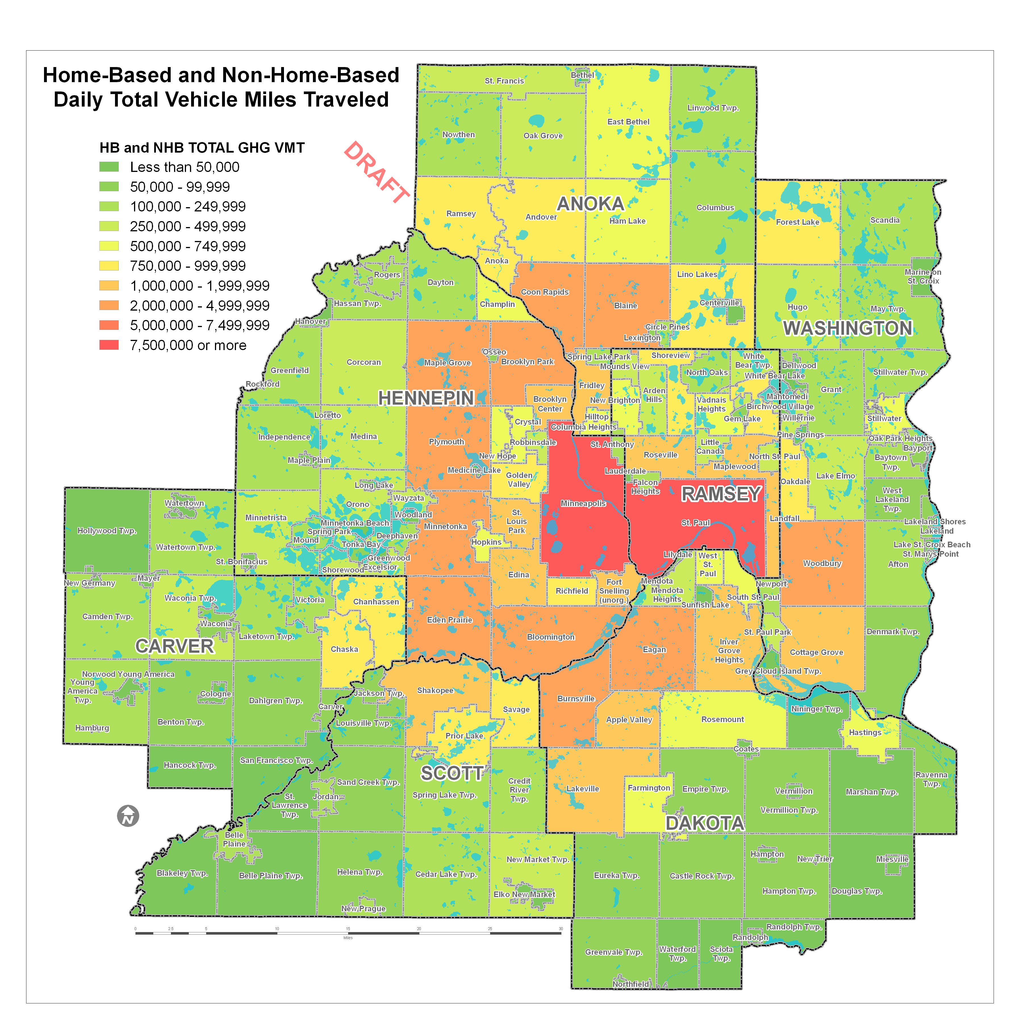
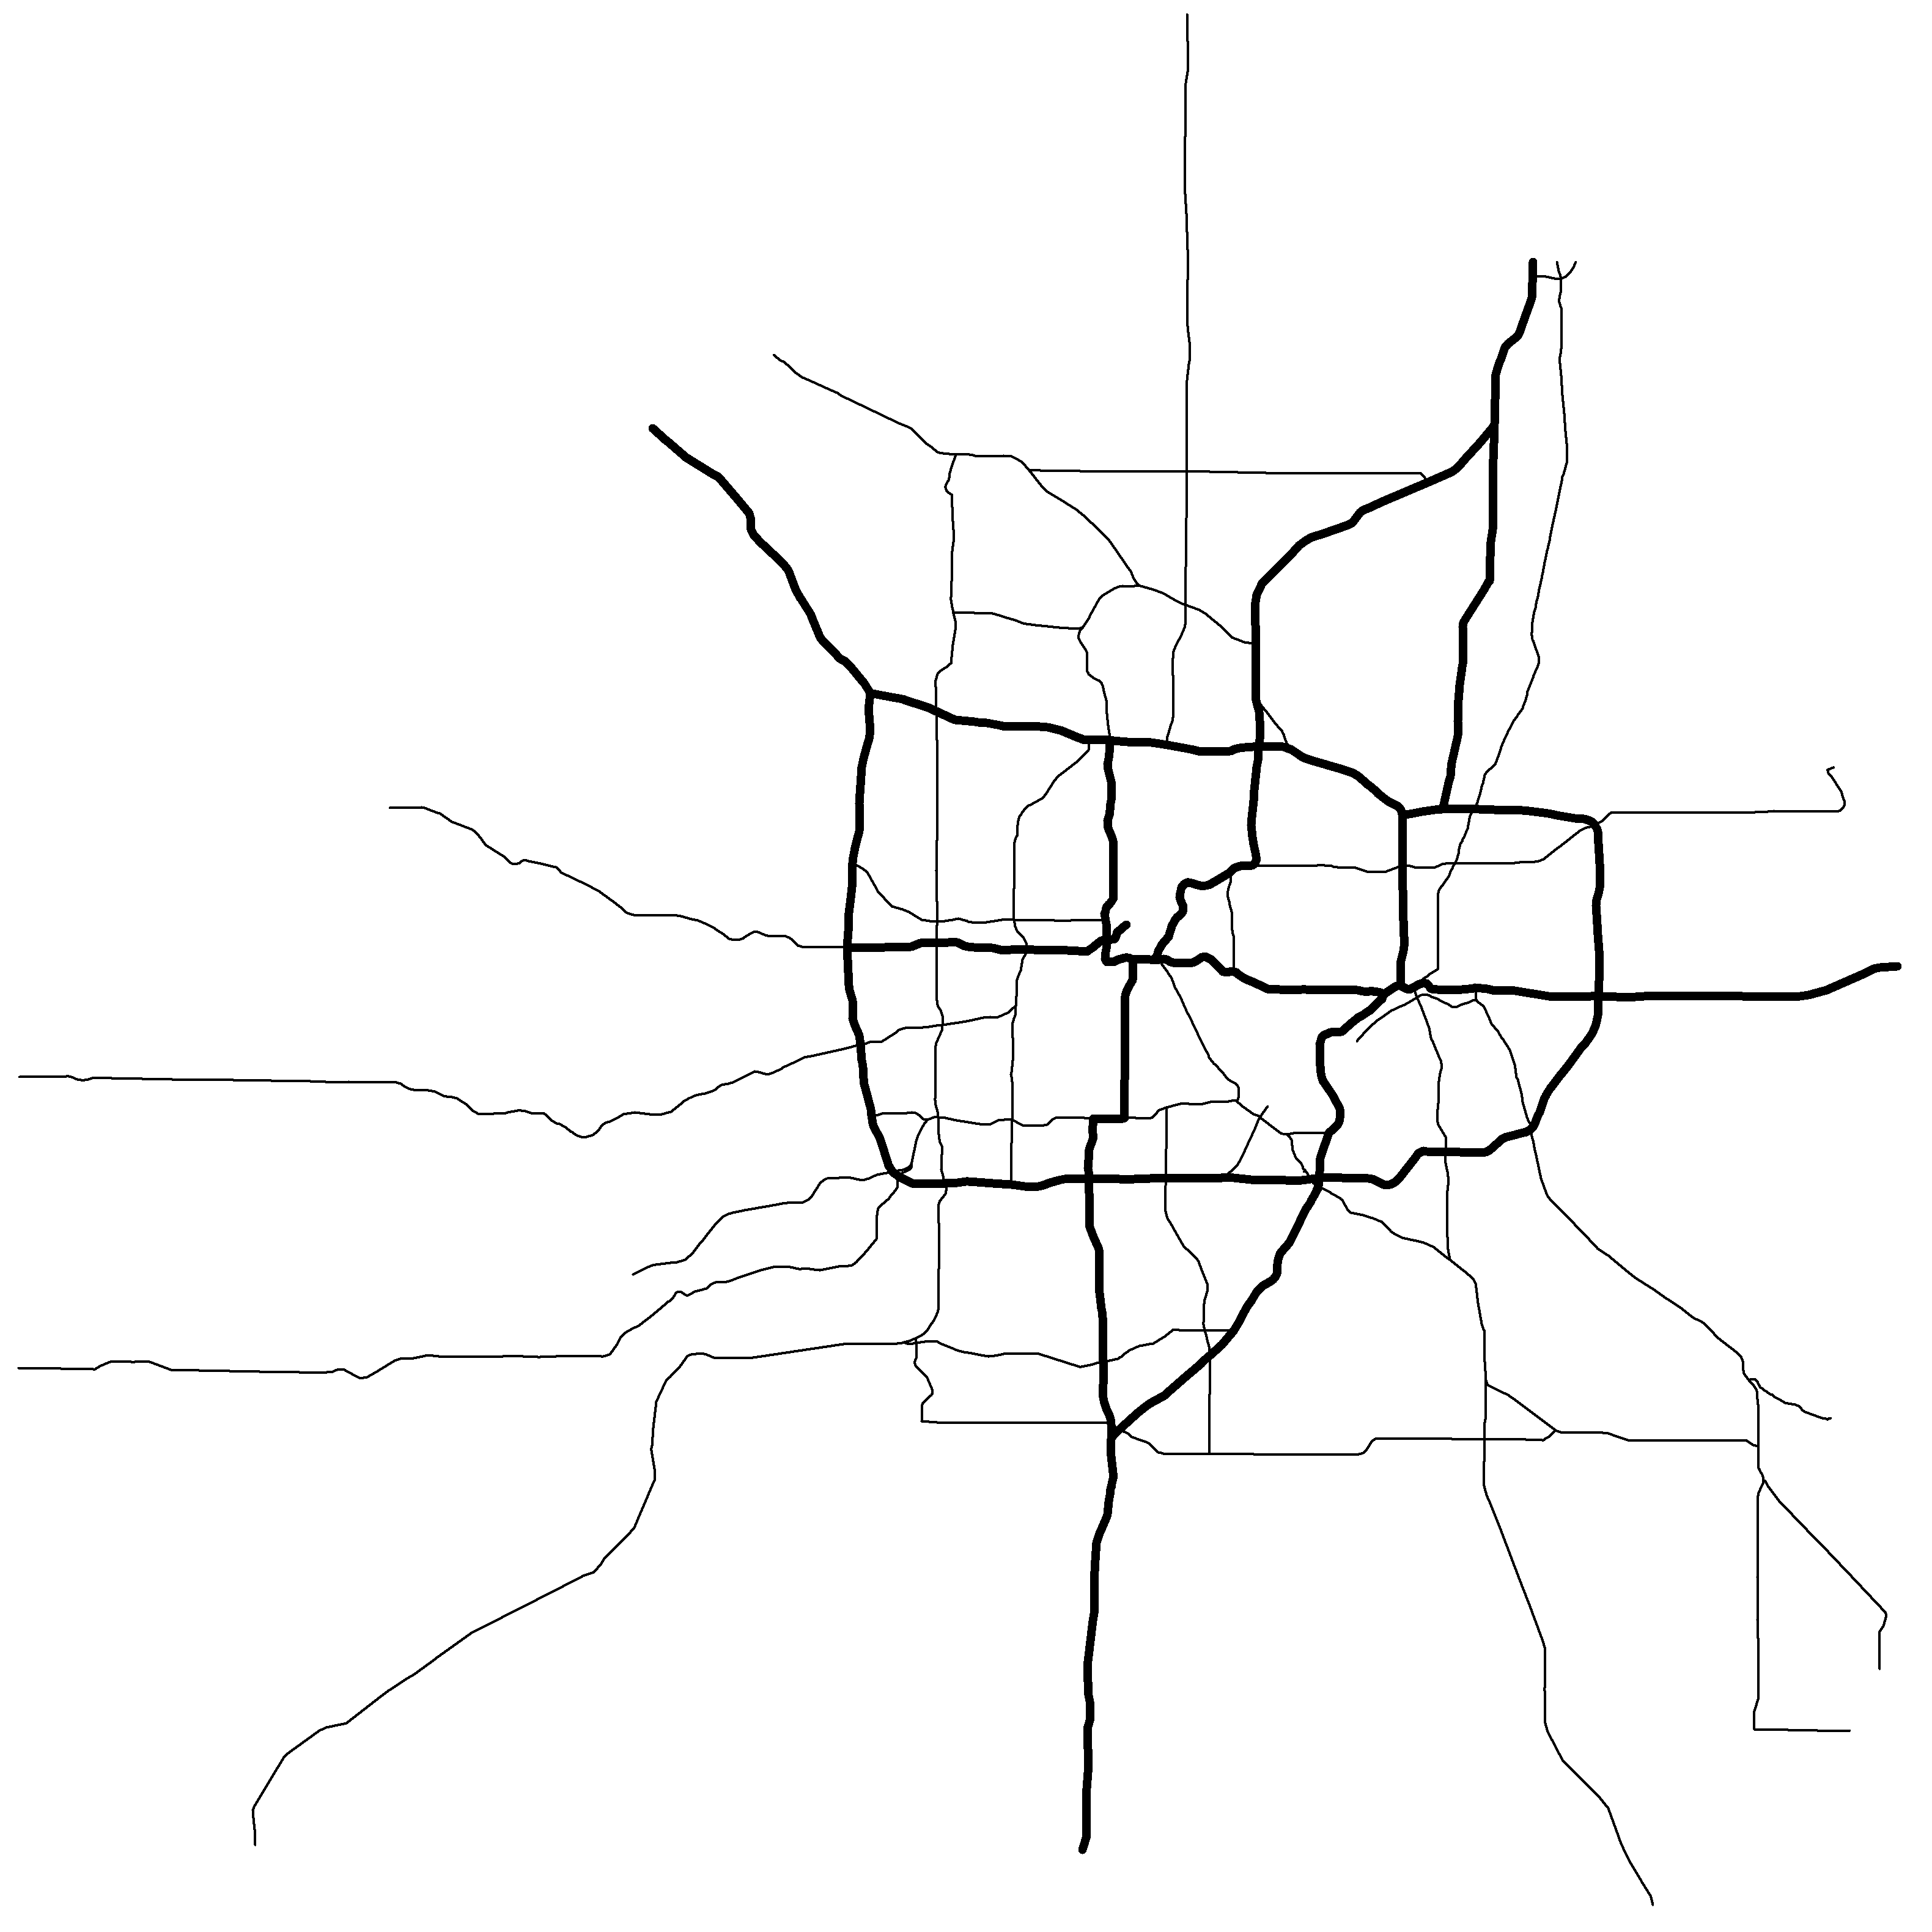

Slide 21
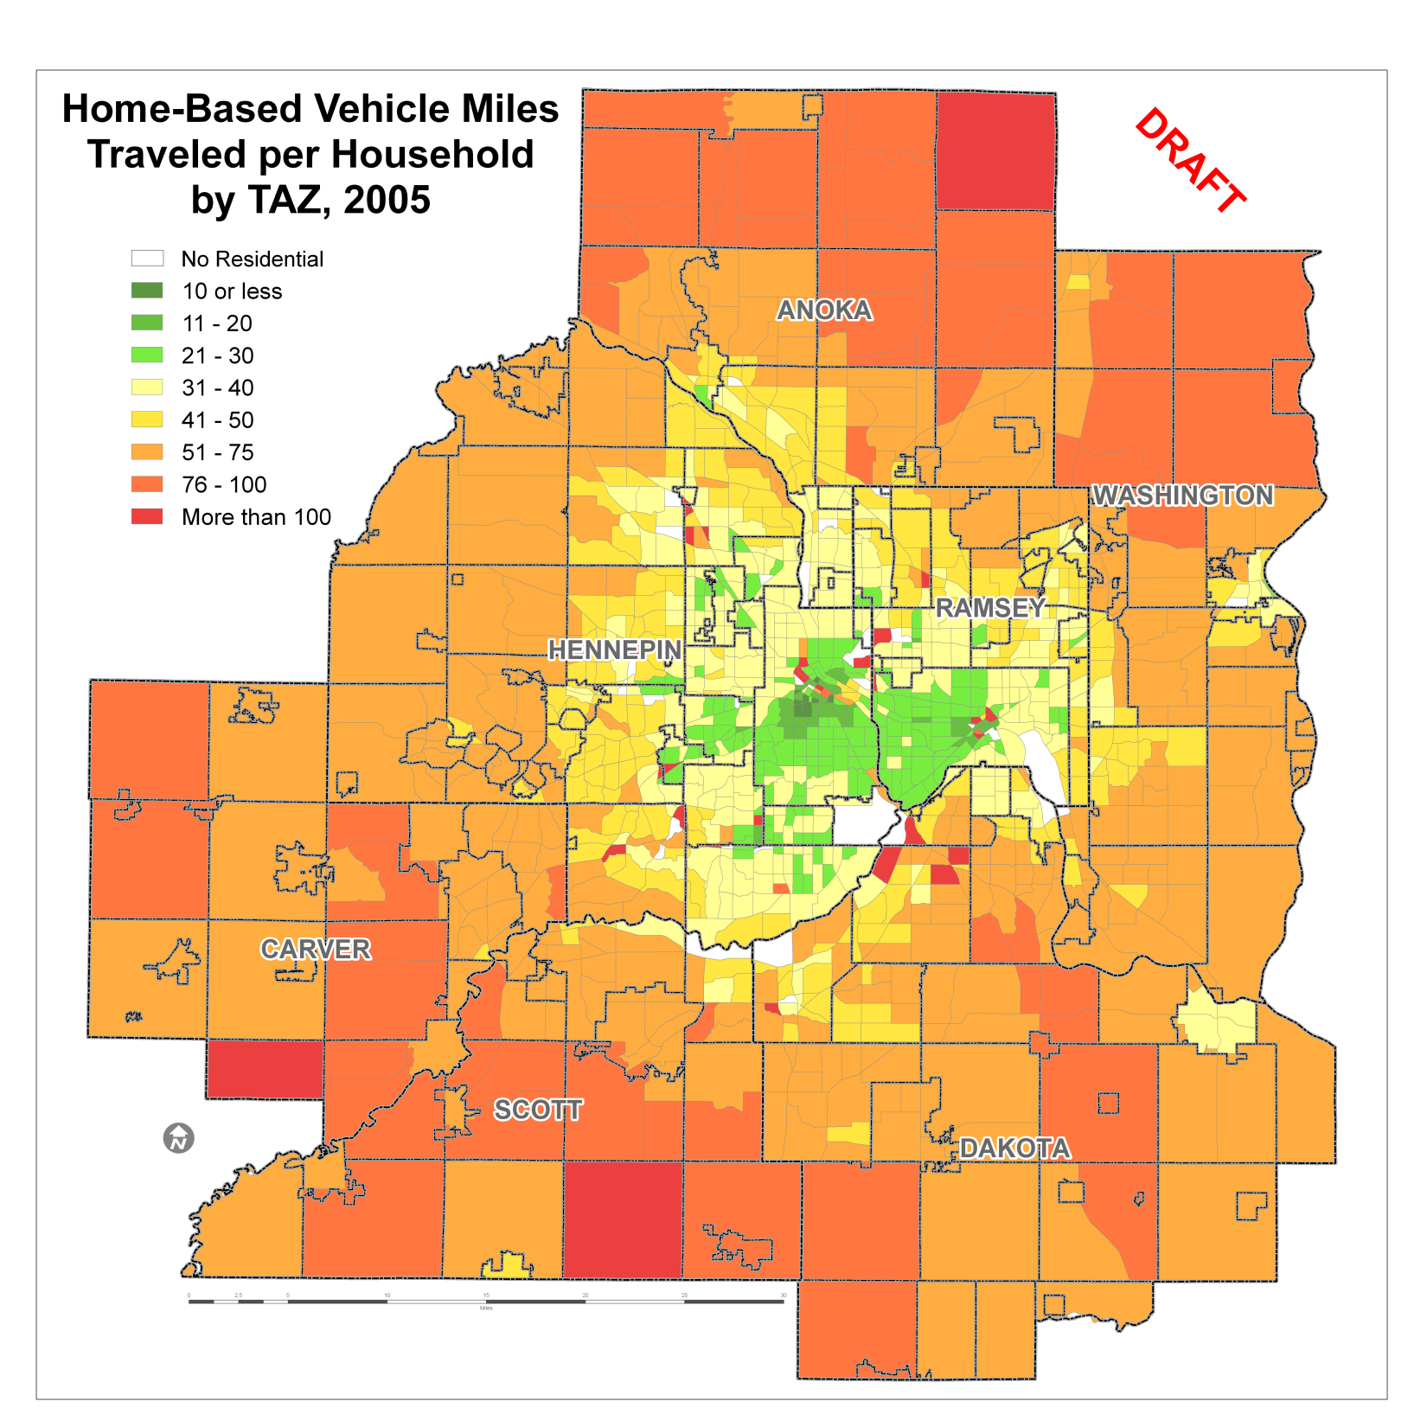

Slide 22
Land Use Strategies and Elasticities
Travel and the Built Environment: A Meta-Analysis; Ewing and Cervero; JAPA; Summer 2010
TCRP Report 95: Traveler Response to Transportation System Changes:
  Ch. 13: Parking Pricing and Fees
  Ch. 15: Land Use and Site Design
  Ch. 17: Transit Oriented Design

Slide 23
Land Use Strategies and Elasticities
Strategy | Built Environment Variable | Elasticity
Concentration of Population and Households | Population and/or Household Density | -0.04
Diversity of Land Uses | Land Use Mix Jobs/Housing Balance | -0.09 -0.02
Design | Intersection/Street Density Percent 4-way Intersection | -0.12 -0.12
Accessibility | Job Accessibility by Automobile Job Accessibility by Transit | -0.20 -0.05
Transit | Distance to Nearest Transit Stop | -0.05

Slide 24
Assessment Tool Implementation
Initially implemented as a spreadsheet based platform – some elements password protected
Long term implementation as application on Council website – facilitate maintenance of data from:
  Updates of travel forecast model
  Updates of air pollutant emission rates

Slide 25
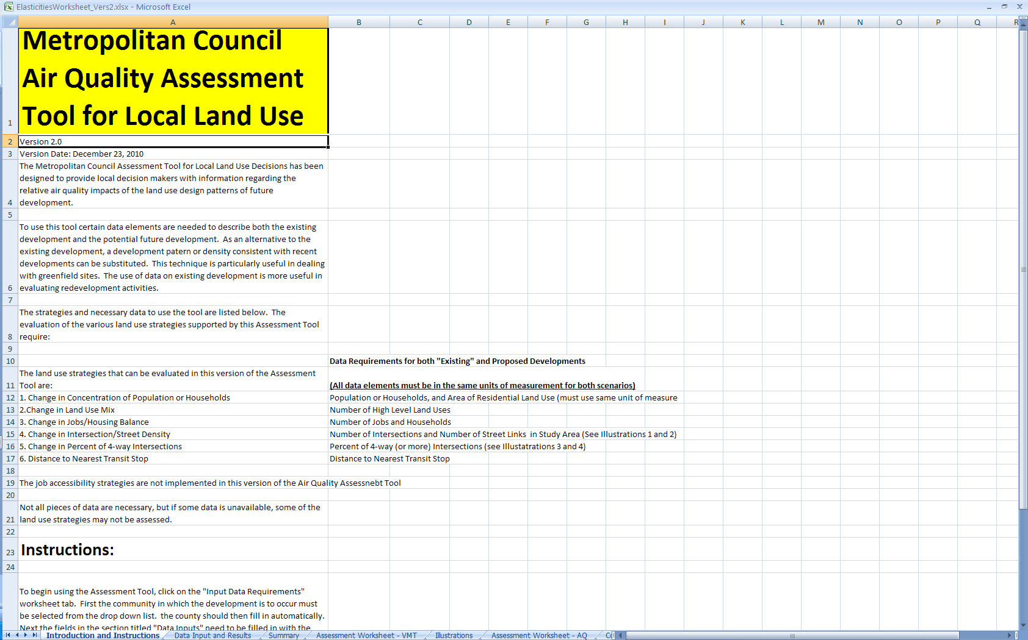
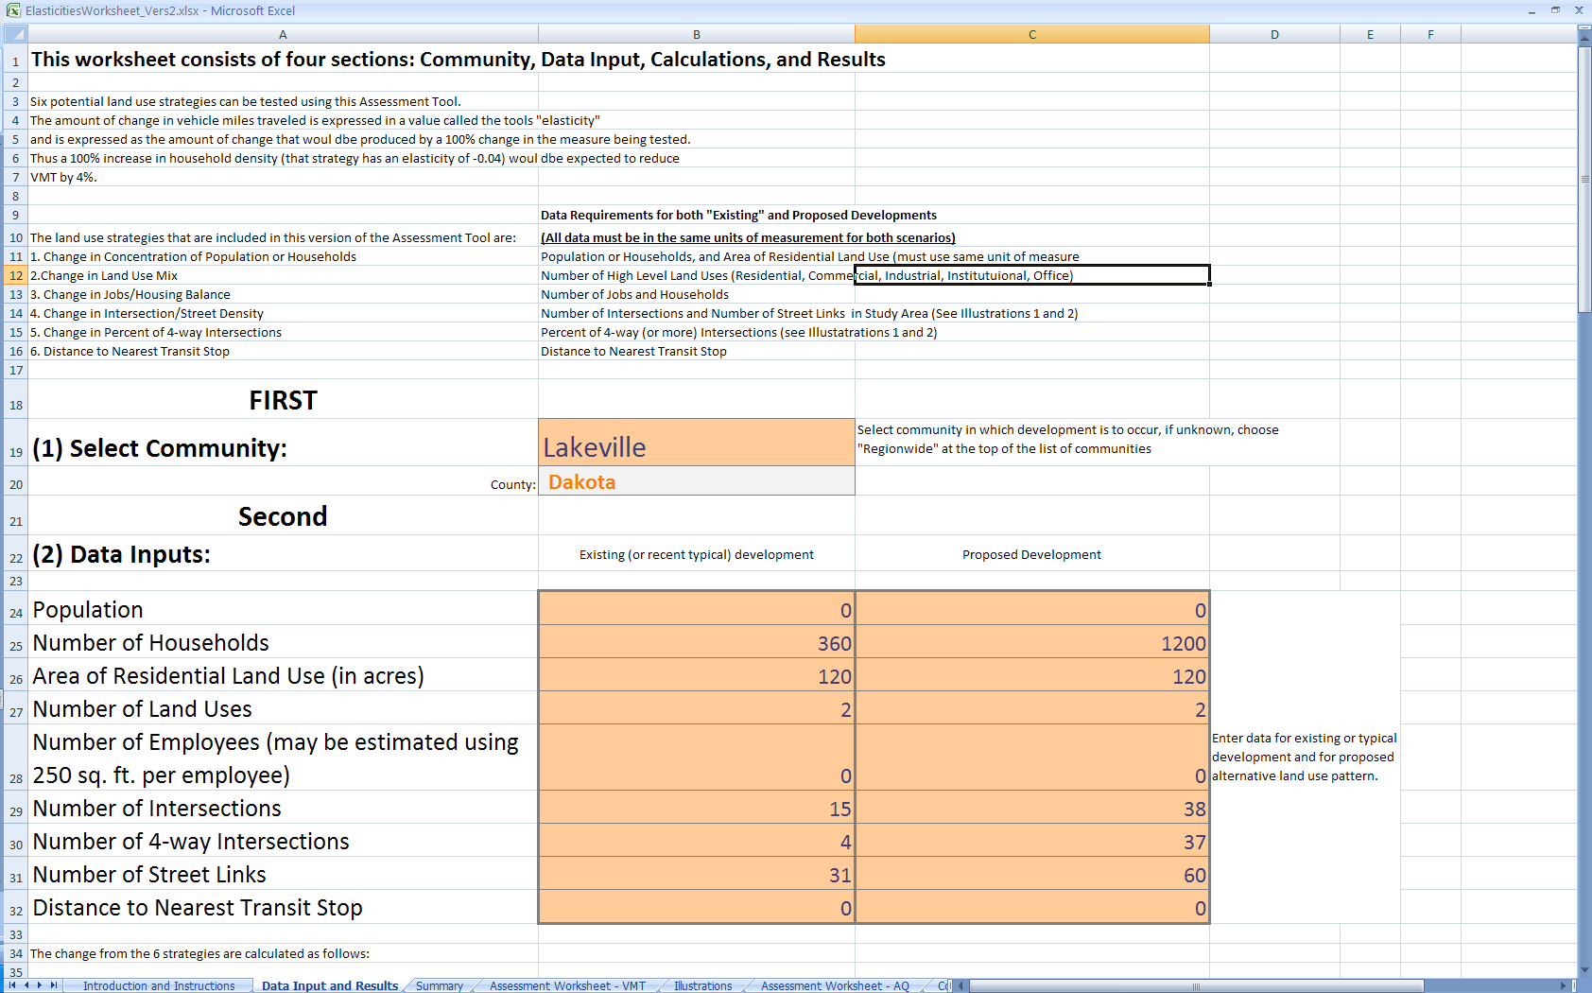
Assessment Tool Implementation

Slide 26
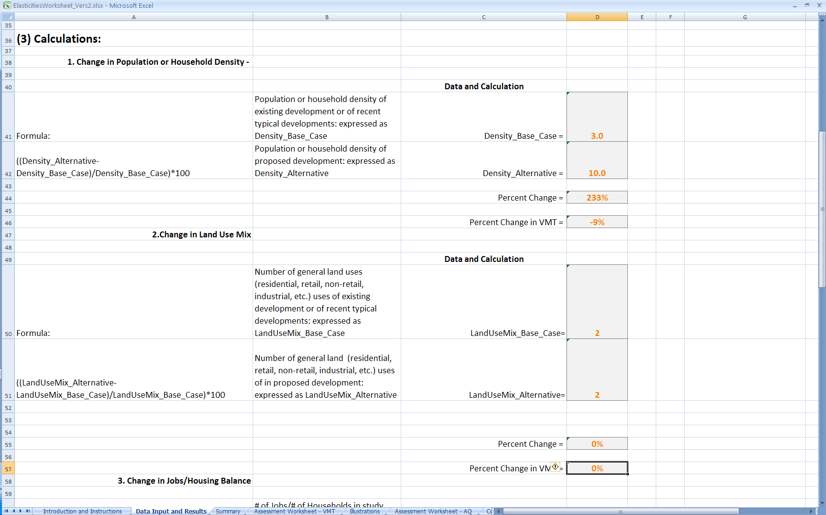
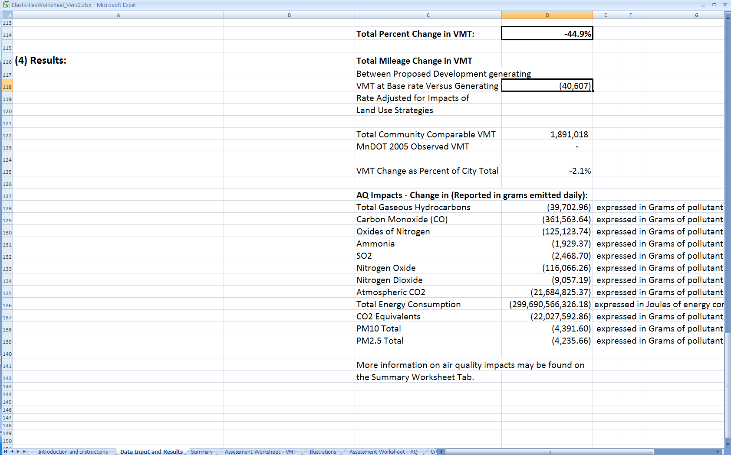
Assessment Tool Implementation

Slide 27
Assessment Tool Implementation
Conclusions:
  This is not a tool to estimate actual total emissions, just potential reductions between alternative land use scenarios.
  Requires “Base Case” and “Alternative Land Use/Design” scenarios to calculate change in independent variable.
  Can assist local decision makers in considering air quality impacts of land use decisions.

Slide 28
An AQ Assessment Tool for Local Land Use Decisions
13th TRB
Transportation Planning Applications Conference
May 9, 2011
Reno, Nevada
Mark Filipi, AICP PTP
mark.filipi@metc.state.mn.us
651-602-1725

