Slide 1
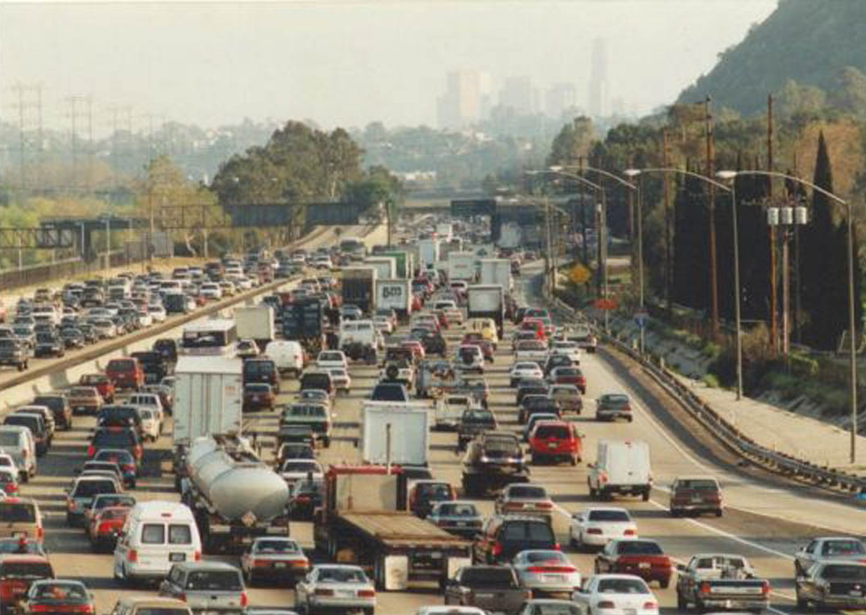
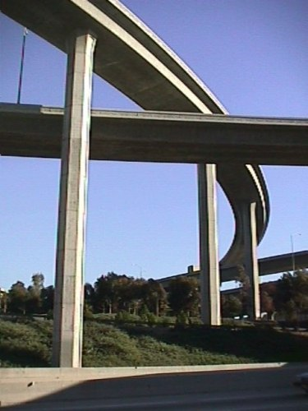
Estimating Mobile Source GHG In Los Angeles County:
A Web-based Tool for Calculating the Greenhouse Gas Benefits of Transportation Improvement Projects
Presented by:
David Jackson & Michael Snavely, Cambridge Systematics, Inc.
Robert Calix, Los Angeles County Metropolitan Transportation Authority
May 9, 2011

Slide 2
LA Metro GHG Impact Toolset Agenda
Background/Context
Technical Approach
Web-Based Analysis
Applying Tools in the Gateway Cities COG
Results

Slide 3
1. Background SB 375 Mobile-Source GHG Reduction Legislation
Sets GHG reduction targets for MPOs
Targets for 2020 and 2035 vs. 2005
Metric : lbs CO₂e per capita
MPOs must develop “Sustainable Communities Strategy” (SCS) that:
Lays out regional strategy for meeting targets
Is integrated w/long range planning process
Has “reasonably expected” funding
Notes:
SCS:
- note that bill language and ARB direction is largely land use focused. Integration with housing needs assessment requirements

Slide 4
1. Background SCAG Region SB 375 GHG Reduction Targets
Lbs carbon/capita
Per weekday
8%
13%

Slide 5
1. Background
Los Angeles County: Strained Infrastructure
Los Angeles
County
Notes:
Fee

Slide 6
1. Background Los Angeles County: Strained Infrastructure
Estimated Growth 2005 - 2035

Slide 7
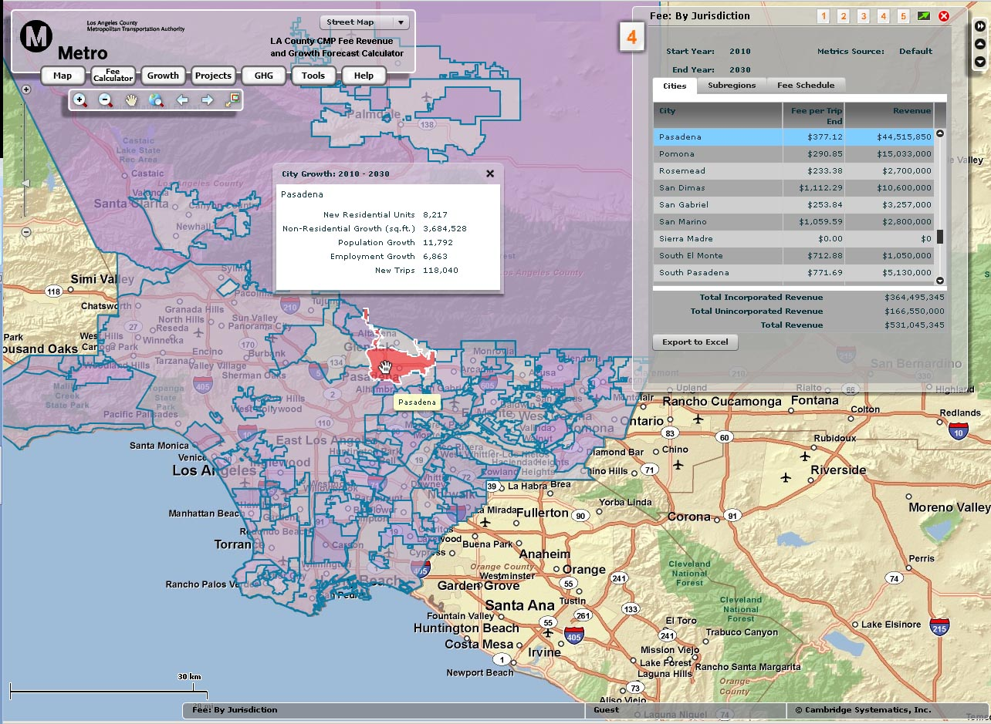
1. Background Opportunity to Measure (and fund) GHG Reduction…
CS Moving Cooler sketch-planning methodologies
Adapt to reflect specific nature of travel within LA County.
Metro’s Existing Congestion Mitigation Fee program site
Project & growth database accessible to all cities
Fee on new development to fund improvements to network
If projects coincide, fee solves unfunded mandate problem

Slide 8
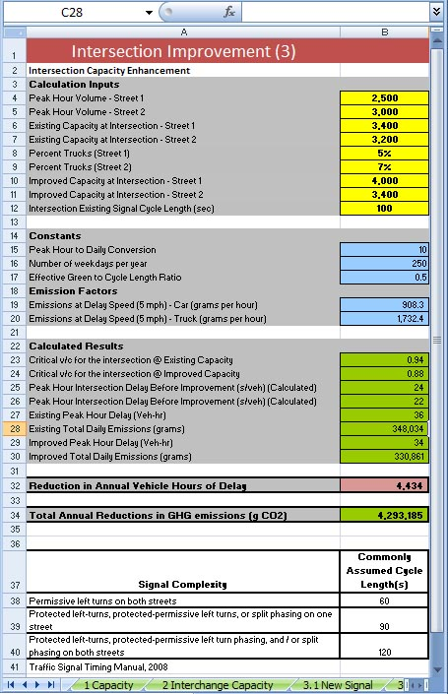
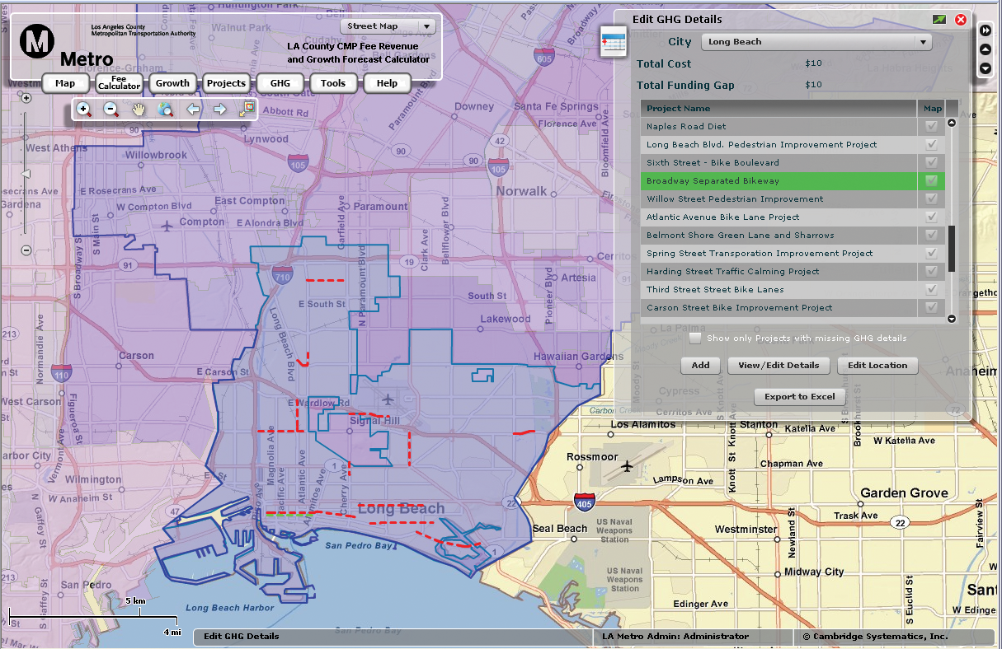
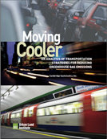
2. Technical Approach Process Overview
Adapt “best practices” project methodologies to region
Local research for elasticities, speed-flow curves, etc. to accurately portray traveler response in LA County
Project-specific inputs that city staff can fill-in
Develop and test a draft analytical spreadsheet tool
Develop and test tool in a web-based environment.

Slide 9
2. Technical Approach Applicable Projects w/ GHG Reduction Potential
Intersection Improvements
Corridor System Operations Improvements
Roadway Capacity Improvements
On/Off-Ramp Capacity
RR Grade Separations
Transit Enhancements
Park-and-Ride Lots
Bike/Pedestrian Projects
Transit/Managed Lanes (HOT, Shared Busway)
Limited to improvements eligible for fee program
Either Reduce VMT – or – Reduce Delay

Slide 10
2. Technical Approach Process Overview
VMT Reduction Projects (bike/ped, transit, park/ride)
Project-Specific Details
(extent, frequency)
Corridor-Specific Details
(ADT, Ridership)
Average Trip Lengths
Apply Local Elasticity
Project Effectiveness
Change in Travel Time or Cost
Vehicle Trip Reduction
VMT Reduction
Area-Specific Details
(Density, Activity Centers)
Other
Local Factors
(e.g, lot usage %)
LDV CO₂e Emission Factors
CO₂e Reduction

Slide 11
2. Technical Approach Process Overview
Delay Reduction Projects – Corridor (Signal Sync, etc.)
LDV CO₂e Emission Factor by Speed
“No Project” Inputs
Corridor Details
e.g. ADT + operations
Corridor No-Project
Peak VHT & Congested Speed
No-Project
CO₂e Emissions
Apply
Appropriate Speed/Flow Curve
CO₂e Reduction
“Project” Inputs
Corridor Details
+
Project-Specific
(e.g. extent,
# intersections)
Corridor Project Peak VHT & Congested Speed
Project CO₂e Emissions
LDV CO₂e Emission Factor by Speed

Slide 12
2. Technical Approach Process Overview
Delay Reduction Projects – Intersection Projects
Existing Condition
LDV CO₂e Emission Factors
Intersection Peak Period Approach
Volumes
Intersection Existing Delay Calculations
Change in Total Peak Delay
CO₂e Reduction
Project-Specific Details
Post -Improvement Delay Calculation

Slide 13
2. Technical Approach Summary of Outputs – GHG Emission Calculations
Project Type | Project Performance Outputs | CO₂ Emissions Calculation
Bike/‌pedestrian Transit Park-and-ride Managed lanes | Reduction in VMT Improvement in transit speeds | Total reduction in VMT is multiplied by average VMT weighted speed light-duty vehicle emissions factor Additional transit revenue miles are multiplied by urban bus VMT weighted speed emission factor Emission factors (g/mi) for pre- and post-improvement urban bus speeds are multiplied by total transit miles
Road capacity On/Off-Ramp capacity Intersection improvement System ops. Grade separation | Change in peak speeds Change in intersection daily hours of delay Change in corridor average speed resulting from signal timing Total reduction in delay for at-grade rail crossings | Emission factors (g/mi) for pre- and post-improvement speeds multiplied by total VMT Idle emission factor is multiplied by pre- and post-improvement intersection hours of delay.

Slide 14
3. Web-Based Analysis LA Metro CMF Webtool
Socioeconomic
Forecast Data
Project Database
Fee Calculator
GHG Analysis

Slide 15
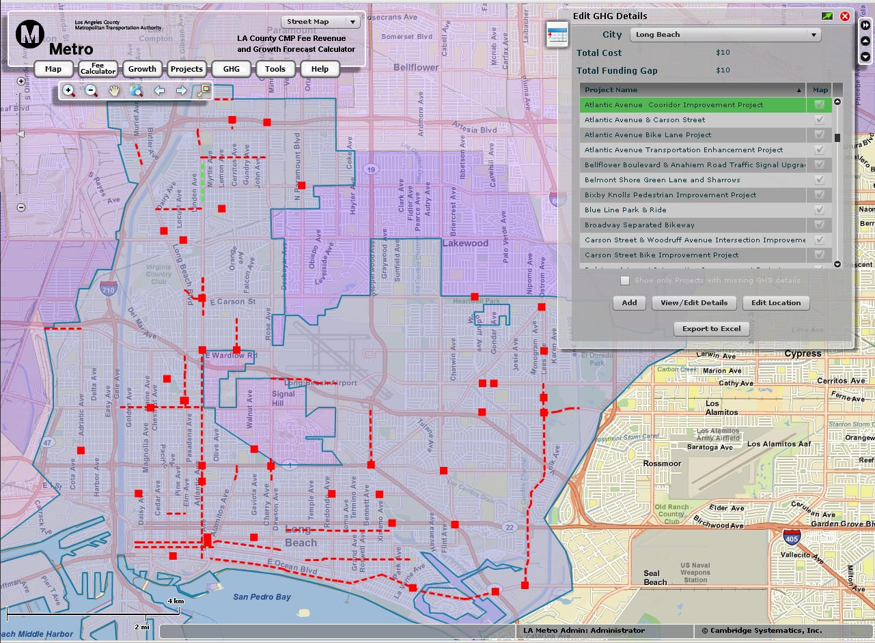
3. Web-Based Analysis LA Metro Project-Level GHG Sketch-Planning Tool

Slide 16
3. Web-Based Analysis LA Metro Project-Level GHG Sketch-Planning Tool

Slide 17
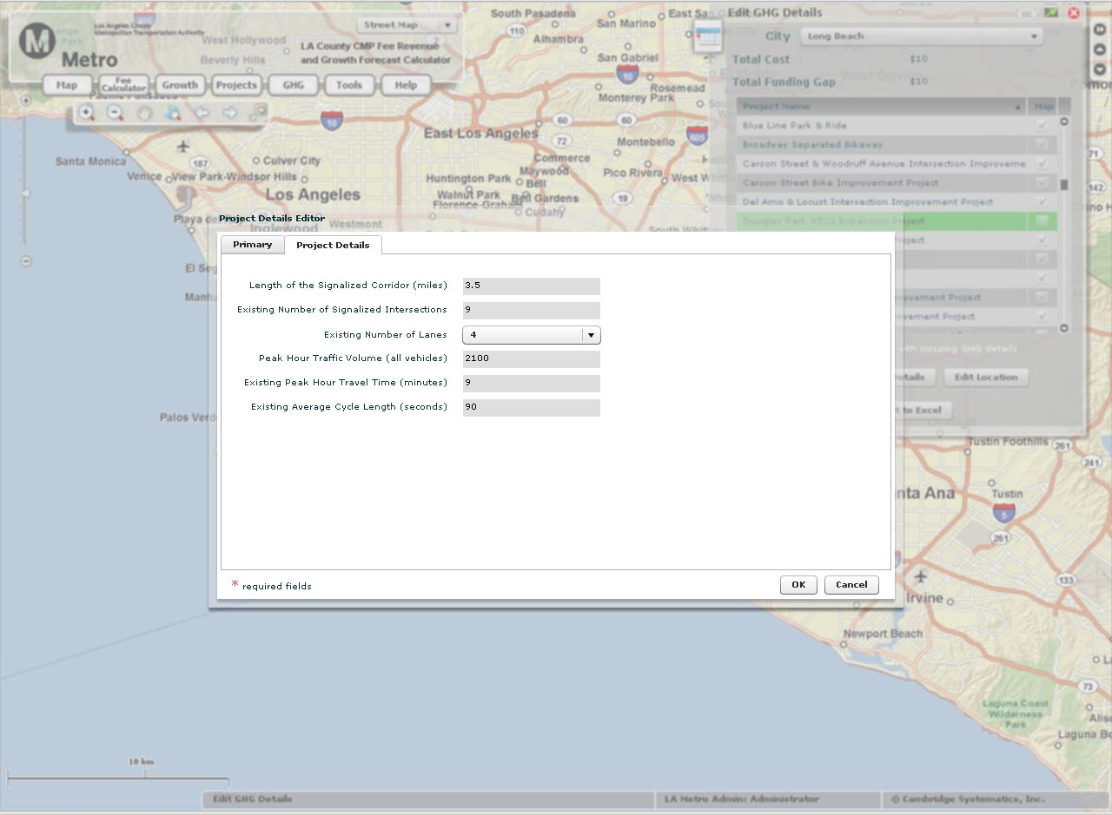
3. Web-Based Analysis LA Metro Project-Level GHG Sketch-Planning Tool
User-specified
Derived on
back-end

Slide 18
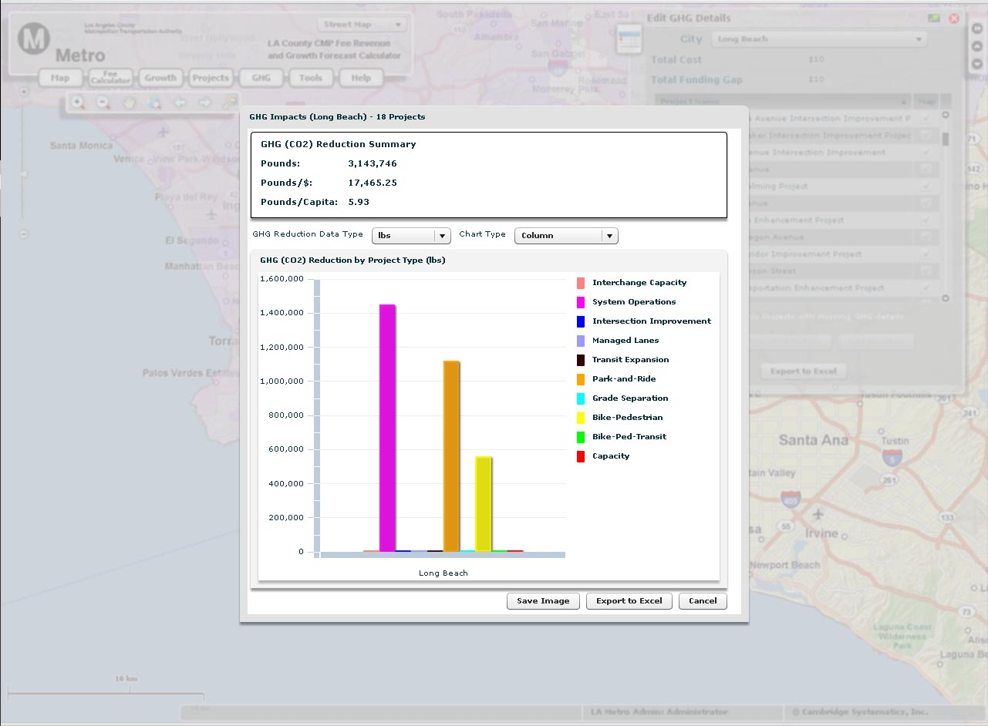
3. Web-Based Analysis LA Metro Project-Level GHG Sketch-Planning Tool

Slide 19
4. Applying Tools in the Gateway Cities COG
Gateway Cities COG
Notes:
Fee

Slide 20
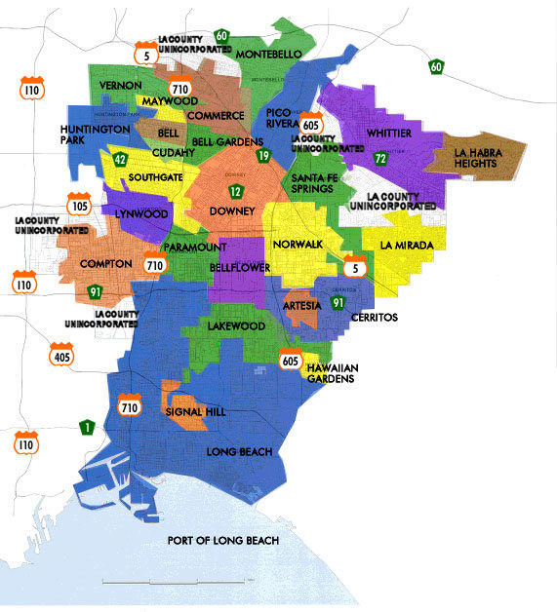
4. Applying Tools in the Gateway Cities COG Background
27 Cities + Port of Long Beach
Already dense & built out
Low-income
Very congested roadway network
Transportation GHG reduction benefits
Initial SCS Analysis using Metro toolset shows considerable
per capita reduction from Transportation projects

Slide 21
6. Results
Project-level sketch planning tools serve policy need
Web-based interface allows easy data entry for all users
Transportation projects show potential for significant GHG reduction in communities at/near capacity
Integration with congestion mitigation fee offers SCS funding solution
Opportunities exist to improve and expand functionality

Slide 22
CONTACT
David Jackson
Cambridge Systematics, Inc.
Bethesda, MD
301-347-0100
Michael Snavely
Cambridge Systematics, Inc.
Oakland, CA
510-873-8700
Robert Calix
LA County Metropolitan Transportation Authority
Los Angeles, CA
213-922-5644

