Slide 1

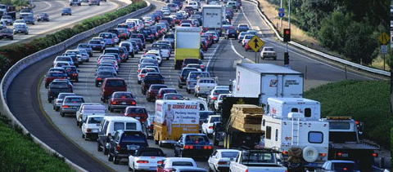
Transportation Energy and Emissions
Policy Analysis Tool with Applications
TRB Planning
Applications Conference
May 8 - 12, 2011
Reno, NV
Jeremy Raw
FHWA
Stephen Lawe
Resource Systems Group
Colin Smith
Resource Systems Group

Slide 2
Presentation Overview
STEEP-AT:
Strategic Transportation Energy and Emissions Policy analysis tool
Overview of STEEP-AT (Jeremy)
STEEP-AT application to Florida (Stephen)

Slide 3
FHWA Interest in Greenhouse Gas Planning
Guidelines and Procedures
Analysis Tools and Methods
Support for Policy Analysis
  Mitigation Strategies
  Policy Evaluation

Slide 4

Genesis of STEEP-AT
  Based on the GreenSTEP model
    GREENhouse gas Statewide Transportation Emissions Planning Model
  Originally developed by the Oregon Department of Transportation (ODOT) Transportation Planning Analysis Unit (TPAU)
  A modeling tool to assess the effects of policies and other factors on transportation sector GHG emissions
  Built in the R statistical computing language
  FHWA funded project to make available to other states
www.r-project.org

Slide 5
FHWA Plans for STEEP-AT
  Preliminary tool release is imminent (Summer 2011)
    Free Software
    Documentation
    Case Studies (Oregon and Florida)
  Testing with additional states
  Project will be supported and potentially extended to other areas

Slide 6
Caveats for STEEP-AT
  Not a “One Stop” Solution
    Only Strategic Policy Analysis
    Not for detailed emissions analysis (use MOVES)
    Not for project level evaluation (use travel model + MOVES)
  STEEP-AT operates on a county level and has been used for statewide policy testing

Slide 7
Model Sensitivities
Land use and demographics
Transportation supply
    Population demographics (age structure)
    Personal income
    Relative amounts of development occurring in metropolitan, urban and rural areas
    Metropolitan, other urban, and rural area densities
    Urban form in metropolitan areas (proportion of population living in mixed use areas)
    Amounts of metropolitan area transit service
    Metropolitan freeway and arterial supplies
Policies
    Pricing: fuel, vehicle miles traveled (VMT), parking
    Demand management – employer-based and individual marketing
    Car-sharing
    Effects of congestion on fuel economy
    Effects of incident management on fuel economy
    Vehicle operation and maintenance – eco-driving, low rolling resistance tires, speed limits
    Carbon intensity of fuels, including the well to wheels emissions , and production of power to run electric vehicles.
Vehicle fleet characteristics
    Auto and light truck proportions by year
    Average vehicle fuel economy by vehicle type and year
    Vehicle age distribution by vehicle type
    Electric vehicles (EVs), plug-in hybrid electric vehicles (PHEVs)
    Light-weight vehicles such as bicycles, electric bicycles, electric scooters, etc.

Slide 8
STEEP-AT: Model Structure
Generate synthetic households
Recalculate household vehicle travel and adjust allocation to vehicles
Apply urban area land use and transportation system characteristics
Aggregate characteristics by county, income group and development type
Model vehicle ownership types and ages
Model heavy vehicle VMT
Model initial estimates of household vehicle travel
Adjust MPG due to congestion
Model household vehicle types and allocate VMT to vehicles
Calculate fuel consumption by type
Calculate household cost per vehicle mile
Calculate lifecycle CO₂e emissions by fuel type

Slide 9
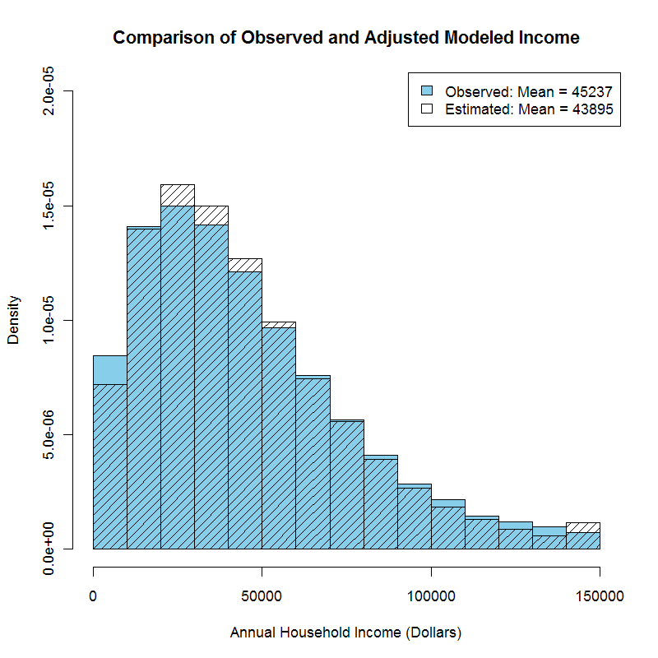
Data Inputs and Outputs
Generate synthetic households
Inputs:
Population forecasts by county, age to 2040
PUMS data
Household income forecasts
Outputs:
Synthetic population for the state
Household attributes include size, age of household members, and household income

Slide 10
Data Inputs and Outputs
Generate synthetic households
Apply urban area land use and transportation system characteristics
Model vehicle ownership types and ages
Inputs:
NHTS data on vehicle ownership by household type
Outputs:
Vehicle ownership by household
Can be aggregated by household attributes, e.g. county, age, area type such as rural or metropolitan

Slide 11
Data Inputs and Outputs
Generate synthetic households
Apply urban area land use and transportation system characteristics
Model vehicle ownership types and ages
Model initial estimates of household vehicle travel
Inputs:
NHTS data on daily travel
Model sensitive to transportation supply data, land use (residential density), household attributes
Outputs:
Daily VMT by household

Slide 12
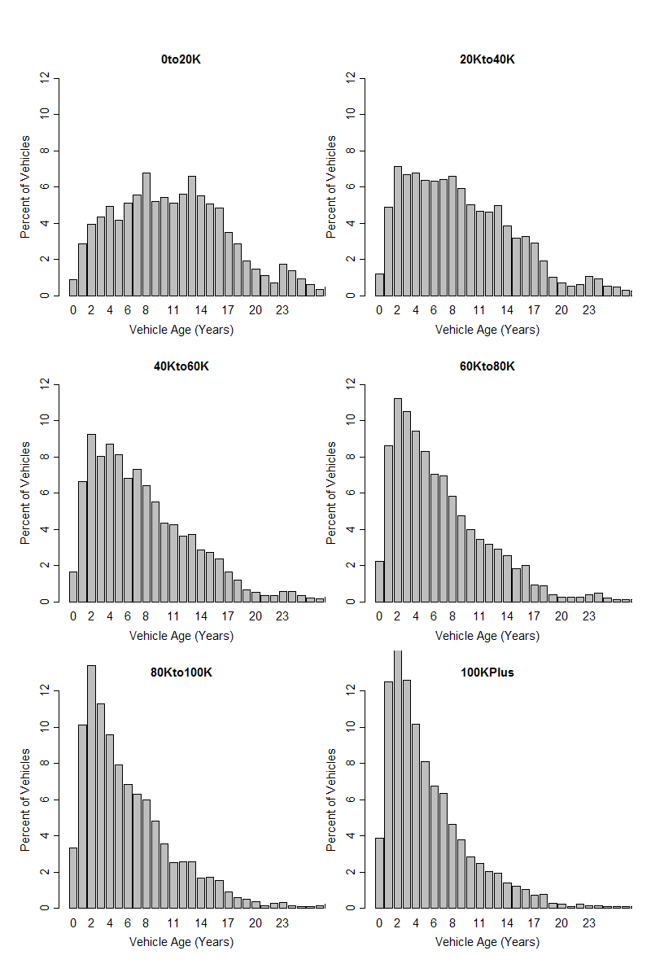
Data Inputs and Outputs
Generate synthetic households
Apply urban area land use and transportation system characteristics
Model vehicle ownership types and ages
Model initial estimates of household vehicle travel
Model household vehicle types and allocate VMT to vehicles
Inputs:
NHTS data on vehicle ages
Outputs:
Vehicle age and VMT allocated to all vehicles

Slide 13
Data Inputs and Outputs
Generate synthetic households
Recalculate household vehicle travel and adjust allocation to vehicles
Apply urban area land use and transportation system characteristics
Aggregate characteristics by county, income group and development type
Model vehicle ownership types and ages
Model heavy vehicle VMT
Model initial estimates of household vehicle travel
Adjust MPG due to congestion
Model household vehicle types and allocate VMT to vehicles
Calculate household cost per vehicle mile

Slide 14
Data Inputs and Outputs
Recalculate household vehicle travel and adjust allocation to vehicles
Aggregate characteristics by county, income group and development type
Model heavy vehicle VMT
Adjust MPG due to congestion
Inputs:
Urban mobility report: speed vs ADT per lane
MOVES relationships between speed and fuel economy
Outputs:
Fuel used per day

Slide 15
Data Inputs and Outputs
Recalculate household vehicle travel and adjust allocation to vehicles
Aggregate characteristics by county, income group and development type
Model heavy vehicle VMT
Adjust MPG due to congestion
Calculate fuel consumption by type
Inputs:
Fuel type proportions by year
Carbon intensity by fuel type
Outputs:
Emissions by fuel type and by vehicle type, by county
Calculate lifecycle CO₂e emissions by fuel type

Slide 16
STEEP-AT: Model Structure
Generate synthetic households
Recalculate household vehicle travel and adjust allocation to vehicles
Apply urban area land use and transportation system characteristics
Aggregate characteristics by county, income group and development type
Model vehicle ownership types and ages
Model heavy vehicle VMT
Model initial estimates of household vehicle travel
Adjust MPG due to congestion
Model household vehicle types and allocate VMT to vehicles
Calculate fuel consumption by type
Calculate household cost per vehicle mile
Calculate lifecycle CO₂e emissions by fuel type

Slide 17
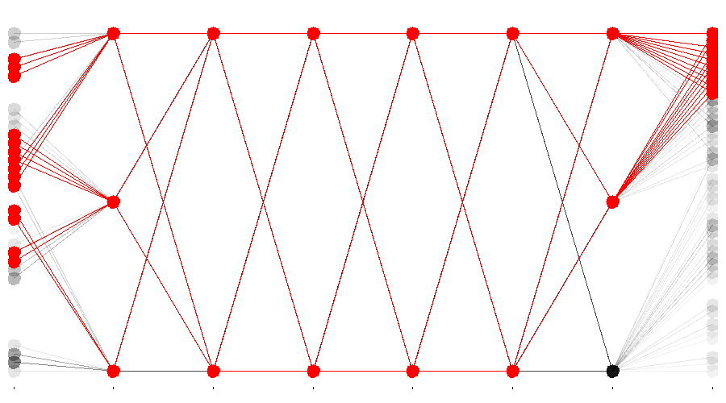
Policy testing in Oregon
Several rounds of scenario development and modeling
Round 1: Broadly explore the territory to understand the possibilities, implications for meeting 2050 target.
Round 2: Narrow down potential scenarios, make adjustments, examine trajectories for GHG reduction: look at 2020 and 2035 as well as 2050.
Round 3: Further narrow/adjust scenarios. Evaluate and recommend leading candidate(s).
Objectives of Round 1 (completed)
Understand:
Magnitude of possible GHG emissions reductions
Change needed to reduce GHG emissions by 75%
Identify
Pathways to get Oregon to the reduction goal
Key factors/interactions for reducing GHG emissions
Scenarios to carry to next round of modeling
Round 2 is now underway
Modeled 144 combinations of levels of six policy groups: Urban Characteristics, Pricing, Marketing, Roads, Fleet Characteristics, Technology
Combination of highest levels reduces GHG by just over 70%
Technology (e.g. vehicle efficiency improvements) has the largest effect, then urban characteristics and pricing
>60%
VMT
Reduction
GHG
Reduction
Urban
Pricing
Marketing
Roads
Fleet
Tech
Notes:
Process divided into three rounds, each increasing detail on fewer and fewer policies.
First round complete: exploration of the policy space, understand how the policies work and interact and what general level of change is needed to reduce GHGs by 75%
First round included testing 144 combinations of policies.
Six groups of policies:
Urban characteristics: e.g. promoting high density mixed use land use development, no sprawl/low density growth, transit investments
Pricing: e.g. Fuel tax, carbon tax, VMT tax
Marketing: e.g. travel demand management policies such as Individualized Marketing Programs
Roads: Capacity, incident management
Fleet: Vehicle age, vehicle type, car-sharing
Technology: vehicle MPG, PHEVs, EVs, fuel type, power source
Two or three levels of each policy developed, base (e.g. as projected without specific policy interventions) and then one or two levels with policies implemented to reduce GHG. E.g Technology high level has a combination of increased MPG for gasoline cars, increased uptake of PHEVs and EVs, additional renewables used to generate electricity.
Chart shows plot of results for all policy combinations with medium and high technology levels with >60% GHG reductions. On left is VMT reduction – not all these policies have significant VMT reductions, often technology improvements have little VMT reduction benefits or even increase it as cost of driving reduces.
On right is GHG reduction: here there a large set of policy combinations where GHG reduction >60%. Suggests vehicle technology and also electricity generation policies will be very important for meeting GHG reduction goals.

Slide 18
Application of STEEP-at
in Florida

Slide 19
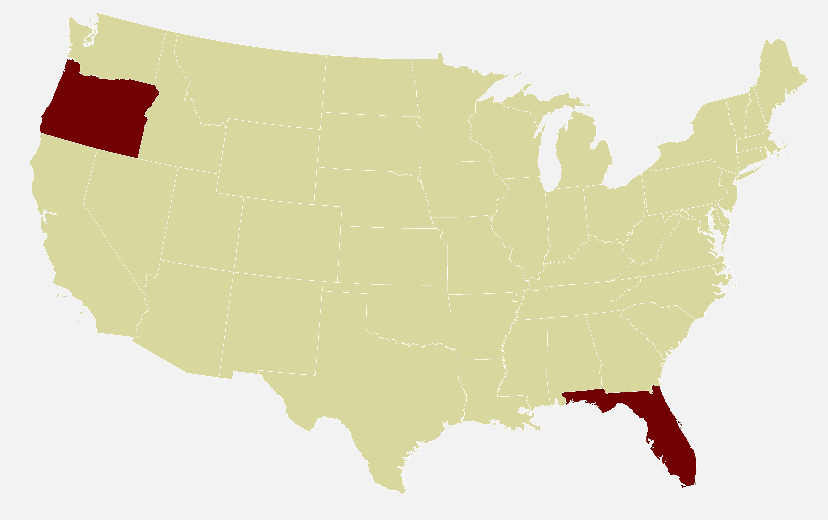
Data Inputs and Outputs
1.
Model Transferability to Florida
    Calculation based components, e.g. population synthesizer: updated input data (PUMS data)
    Components estimated with national data, e.g. daily VMT model based on NHTS data, are transferable
    Components based on state/regional data not transferable, re-estimated with local data, e.g. vehicle choice models
2.
Computational Issues in FL vs. OR
2005* | Oregon | Florida
Population | 3.6 million | 17.5 million
Density | 37/sq mi | 322 /sq mi
VMT | 3.528e10 | 1.724e11
    R is an open source statistical analysis environment
    Many calculations at household level: run times 2 hours per year per scenario vs. 40 minutes
    Memory use: up to 6GB vs. <2GB, requires 64 bit OS to run on Windows
*2005 is the model base year

Slide 20
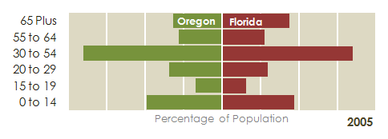
Age Profiles in Oregon and Florida
    In 2005 Oregon population was a little younger than Florida’s
    65 Plus group is 14% of population in Oregon, 18% in Florida
    The gap is forecast to widen between now and 2040

Slide 21
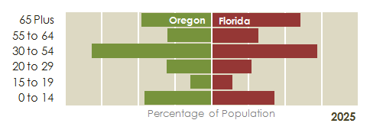
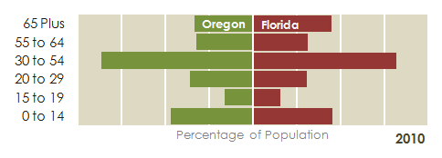
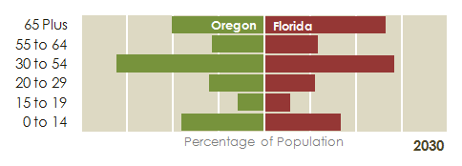
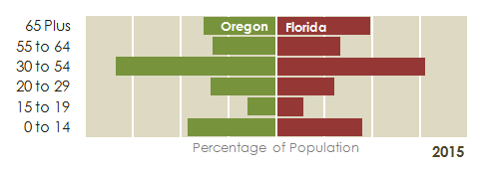
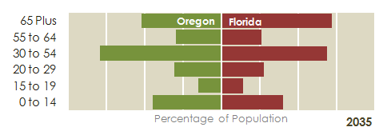

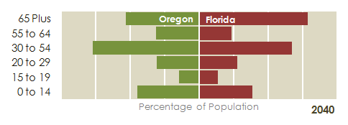
Age Profiles in Oregon and Florida
In 2040, the 65 Plus segment of the population is forecast to be 21% in Oregon, and 32% in Florida

Slide 22
Age in STEEP-AT
Generate synthetic households
Model initial estimates of
household vehicle travel
    Population synthesizer creates a population that has the correct age profile
    Household income model assigns incomes based on age profile in the household
Recalculate household vehicle travel and adjust allocation to vehicles
    Models predict lower VMT for lower incomes and lower vehicle ownership
    Plus 65 households more likely to have zero VMT, lower average VMT
    Budget constraint models the effects of travel costs: lower income households affected more by price increases, e.g. higher gas prices
Model vehicle ownership
types and ages
    Models include income variables (which are dependent on age)
    Households with only plus 65s more likely to be zero vehicle or low vehicle ownership households
Other policy responses
    Workplace TDM: have to be in workforce
    EV, PHEV: depends on daily VMT, plus 65s more likely to stay within charge range

Slide 23
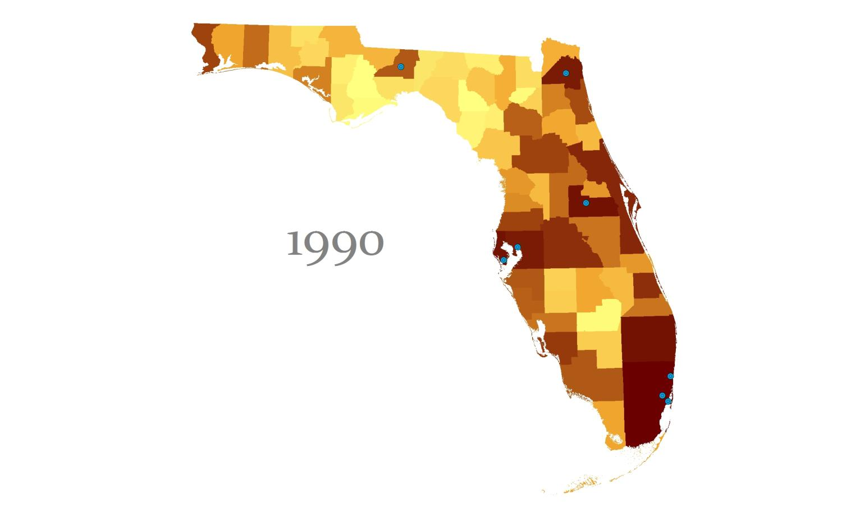

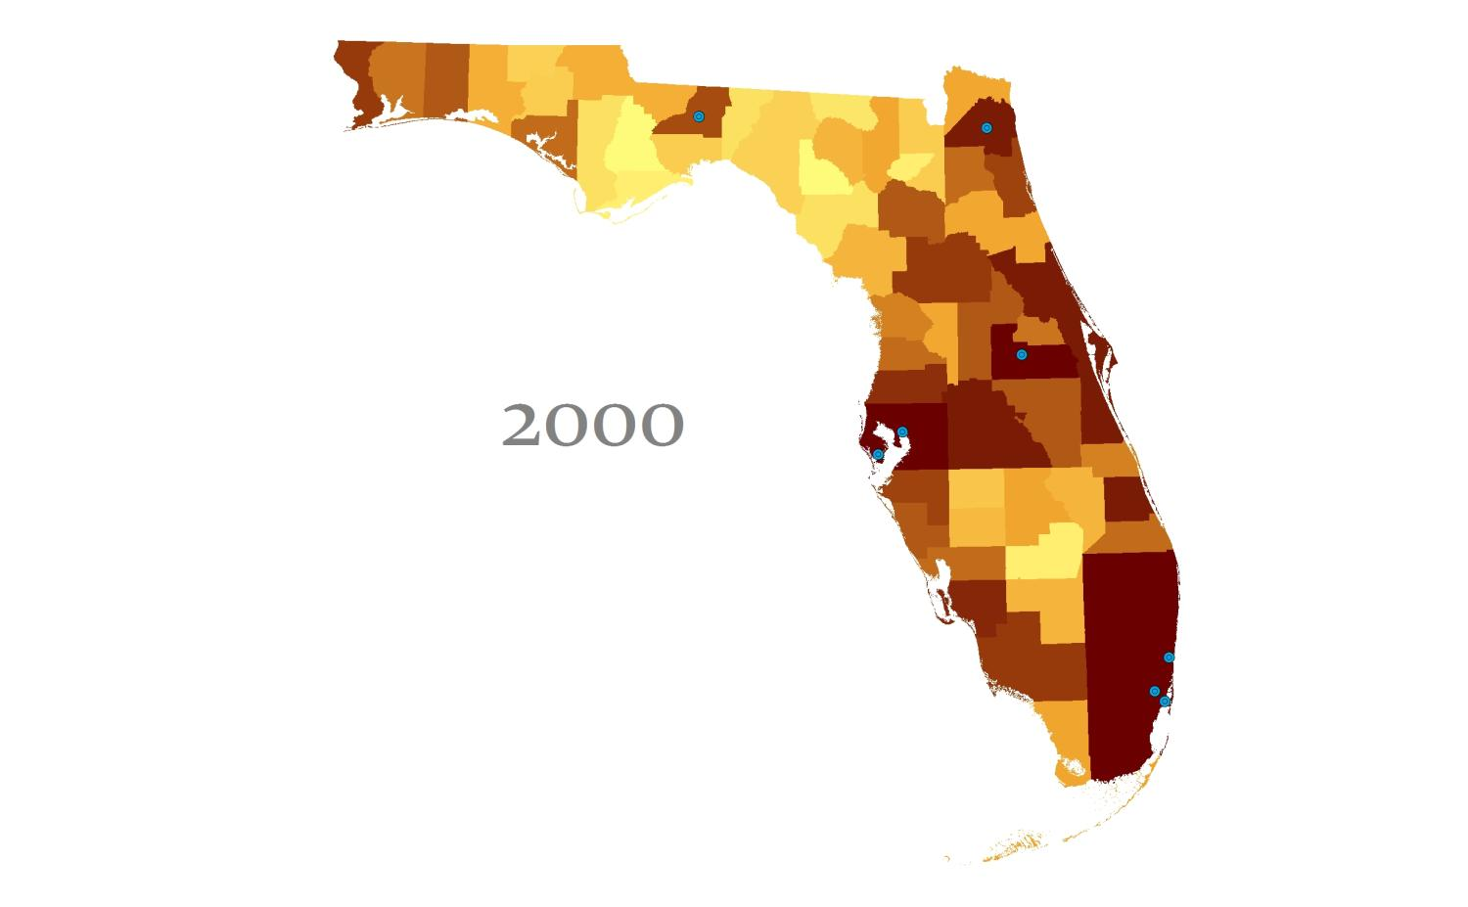
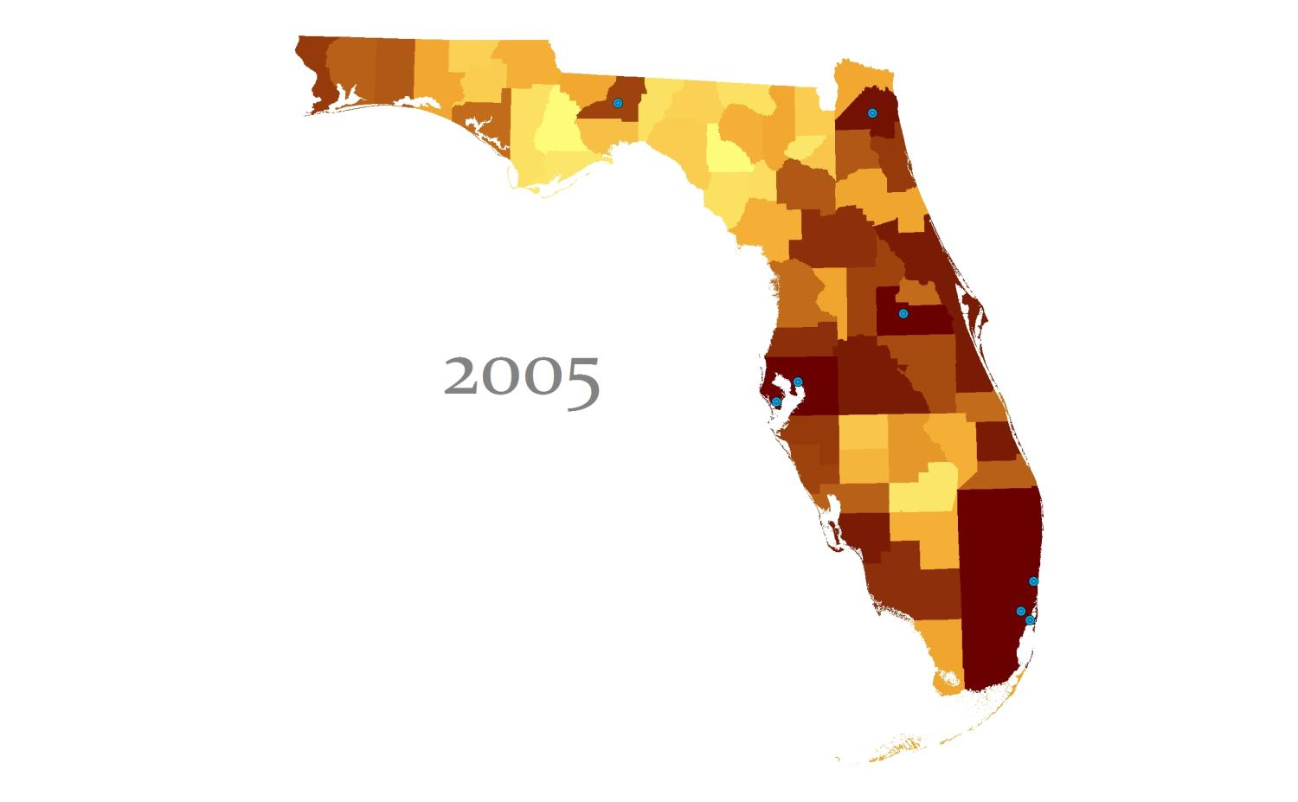






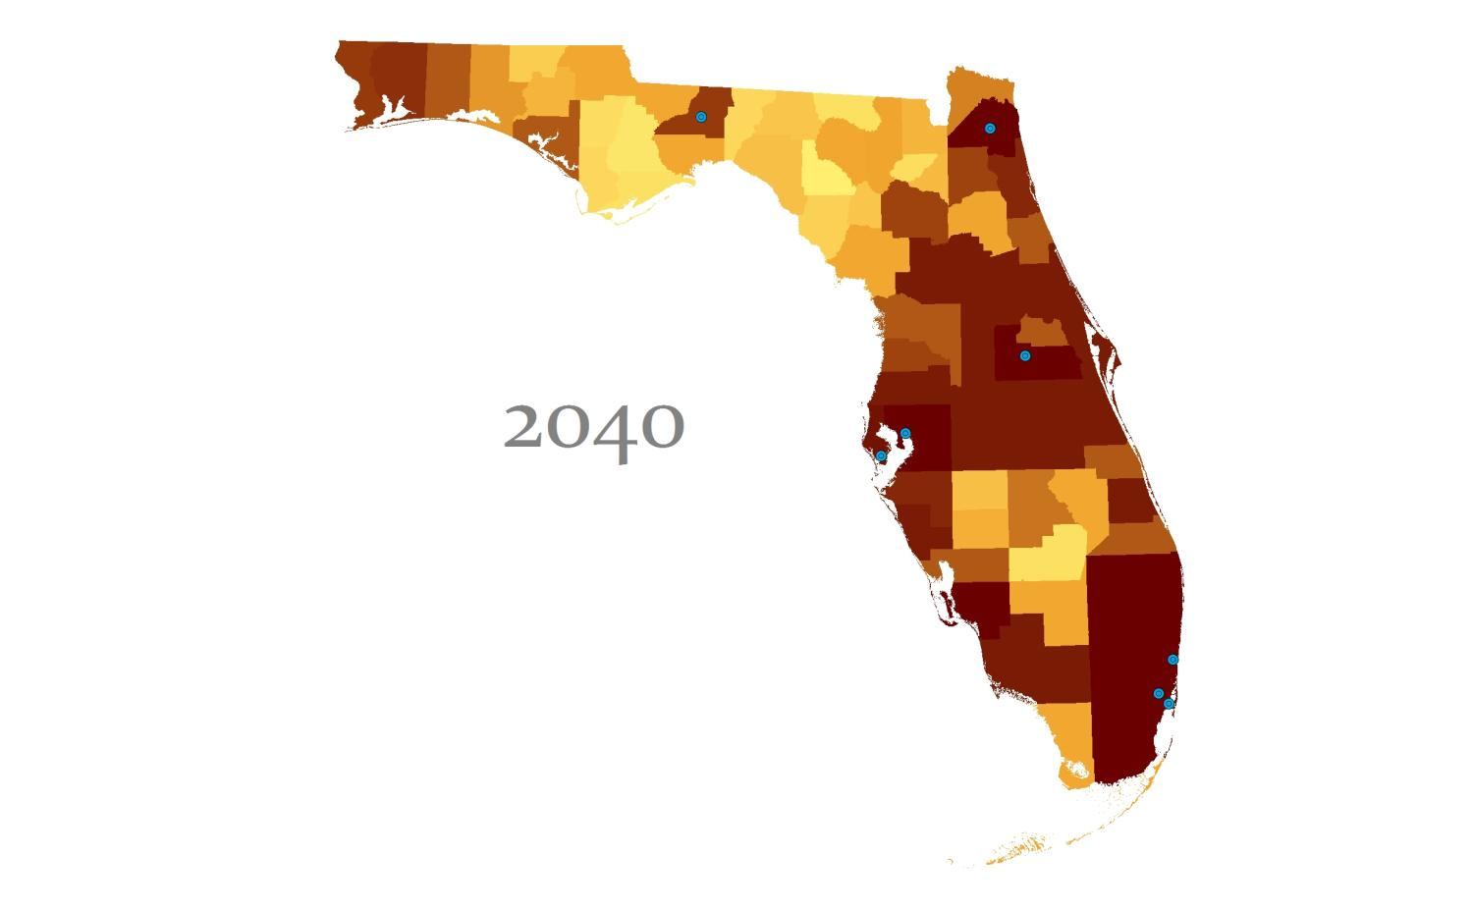

More People = More Emissions
0
7,500
CO₂ eq Emissions in Tons / Day
Cities > 100,000 people in 1990

Slide 24
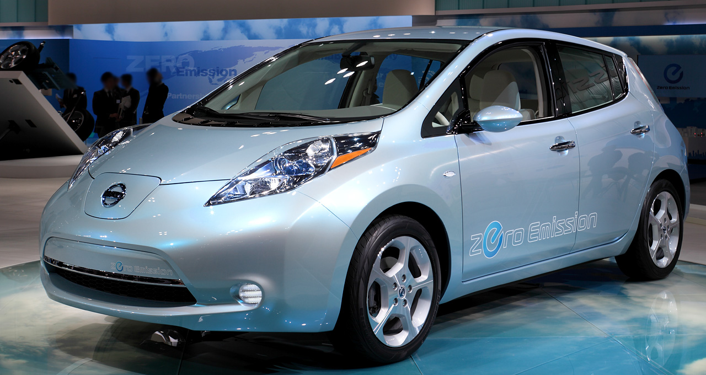
Case Study: increased Electric Vehicle use
Electric plug in vehicles are now being introduced, with Federal, State and local incentives for consumers.
How much will CO₂ be reduced if these vehicles gain market share?
Scenario:
  2040
  Typical electric autos range = 100 miles
  Typical electric light trucks range = 200 miles
  40% of all autos and light trucks that drive up to average electric range are electric vehicles
GreenSTEP approach:
  Electric vehicle power consumption converted into CO₂ equivalents
  Emissions rate per kWh power consumed reflect the overall average for all power consumed in Oregon, 1.114 pounds/kWh
  It does not distinguish differences between power providers, but it is an end-user rate (includes power transmission loss effects)
Nissan Leaf
First US deliveries due in December 2010
Battery powered electric car
Range 100 miles in city driving
Lithium ion battery pack, 24kWh capacity
Recharge time from empty:
120V/15amp household outlet = 20 hours
240V/30amp home charging dock = 8 hours
500V commercial charging station = 30 min

Slide 25
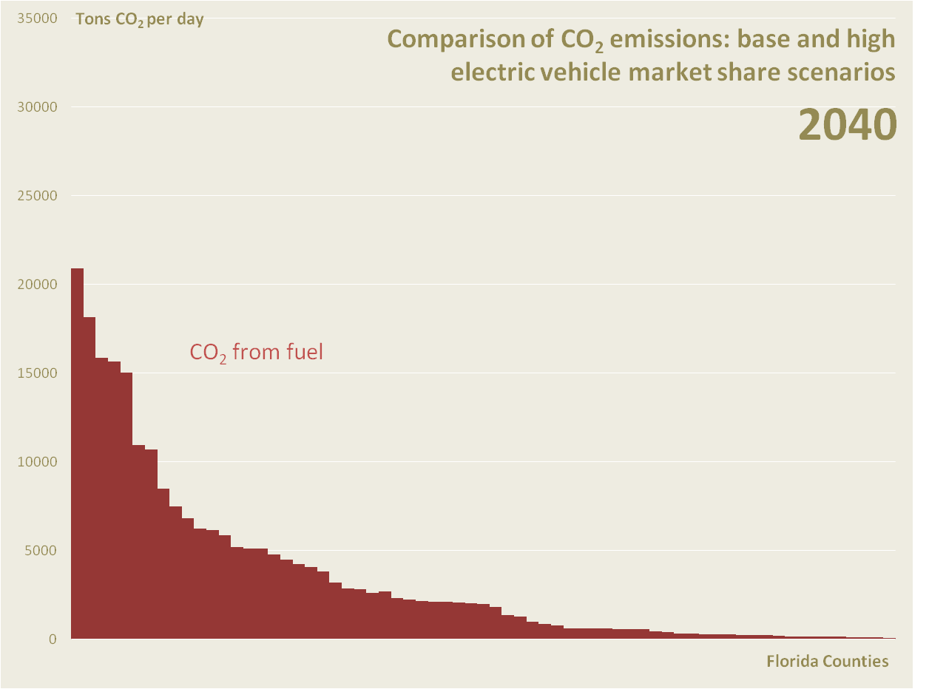
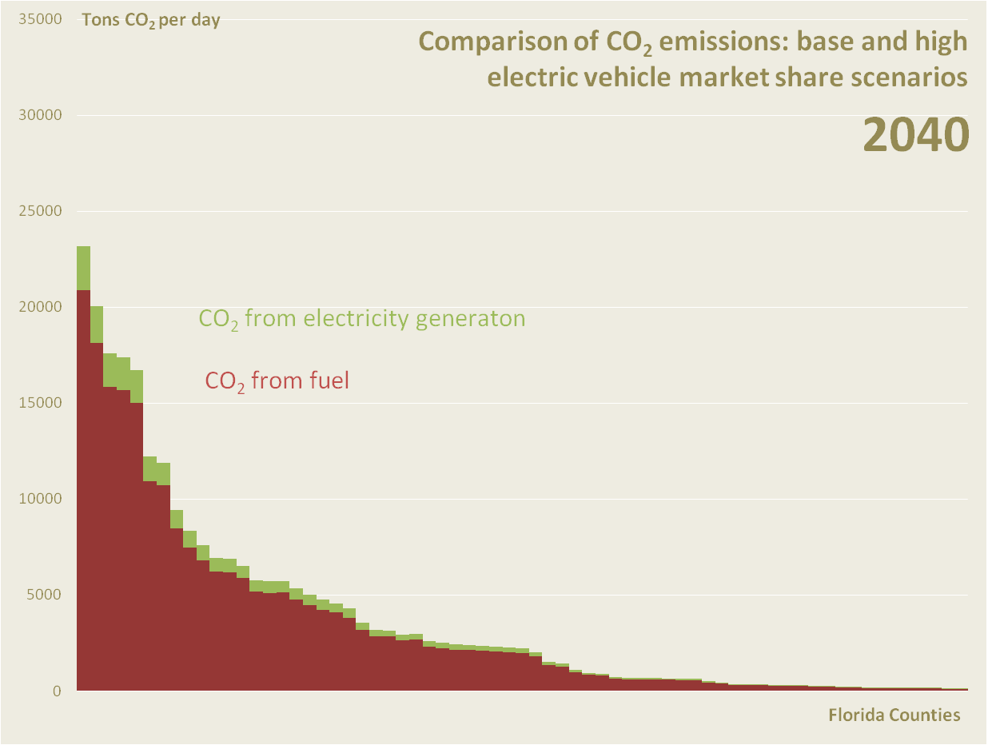
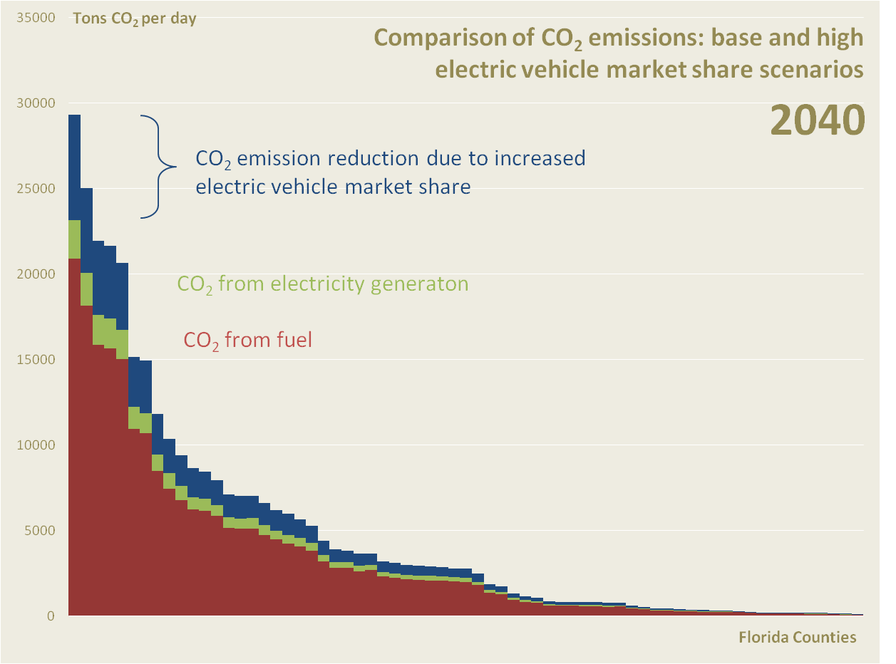
~20% Reduction

Slide 26
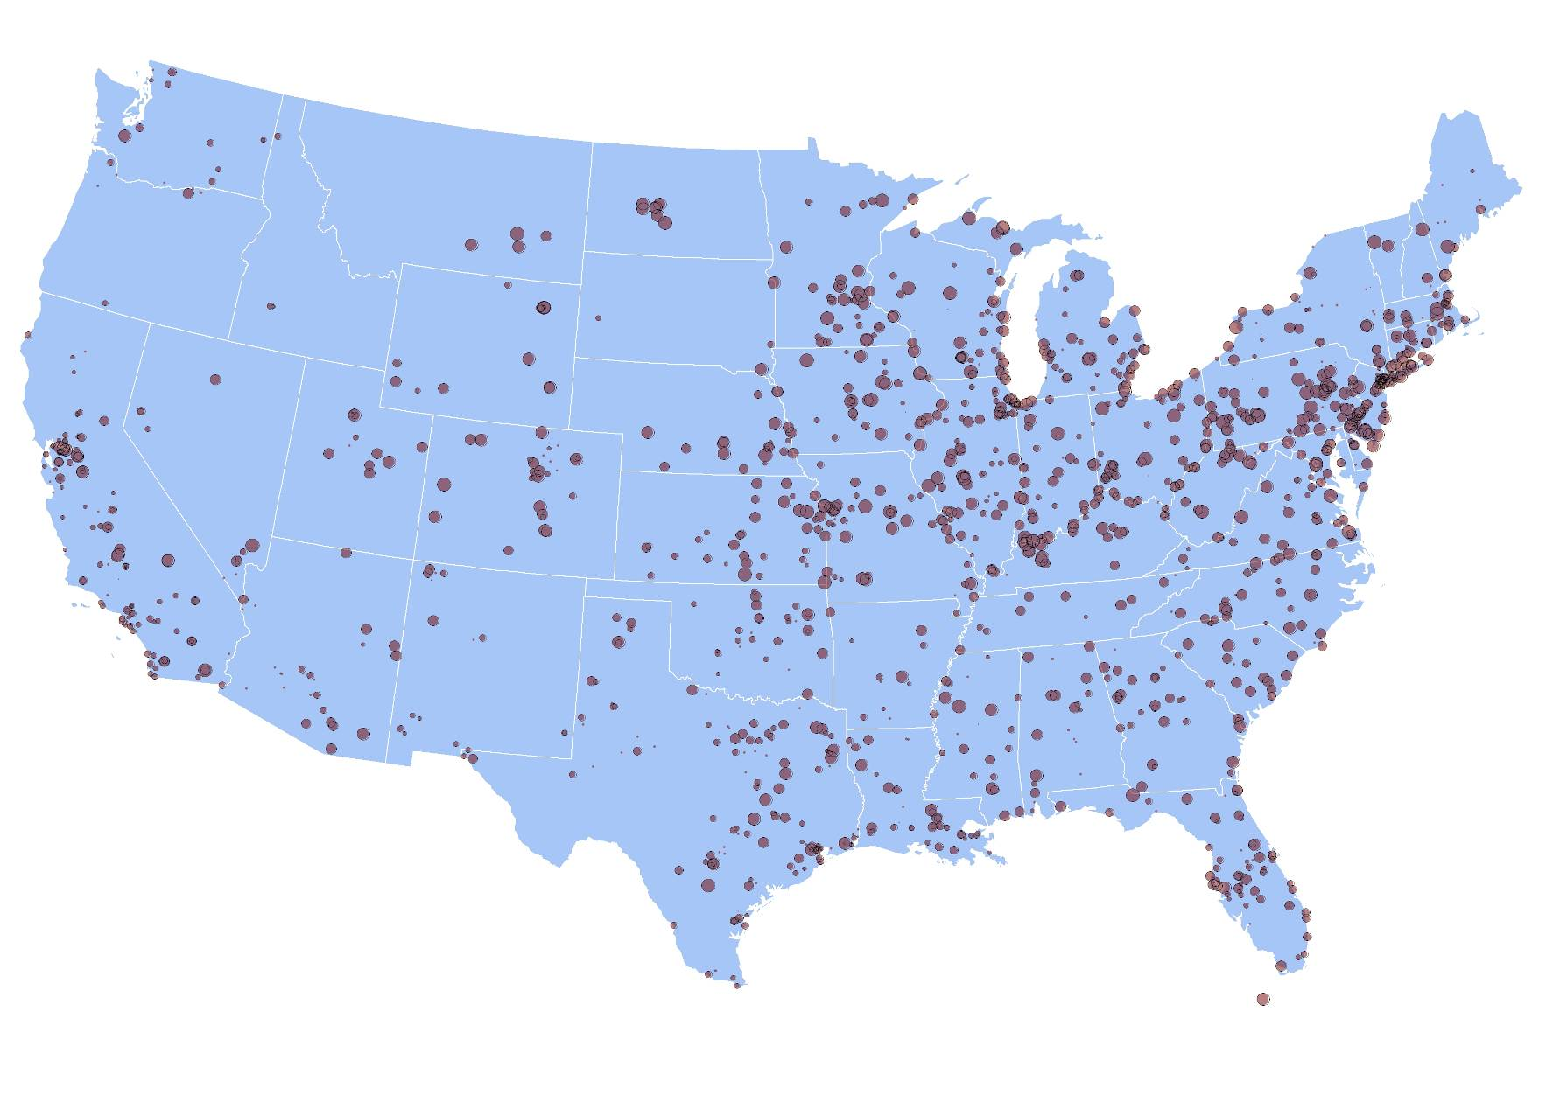
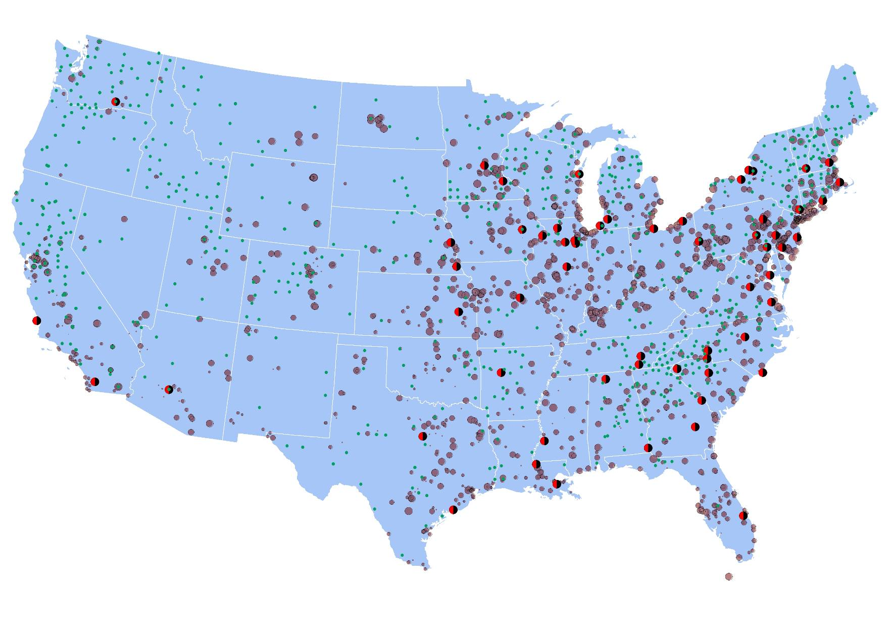
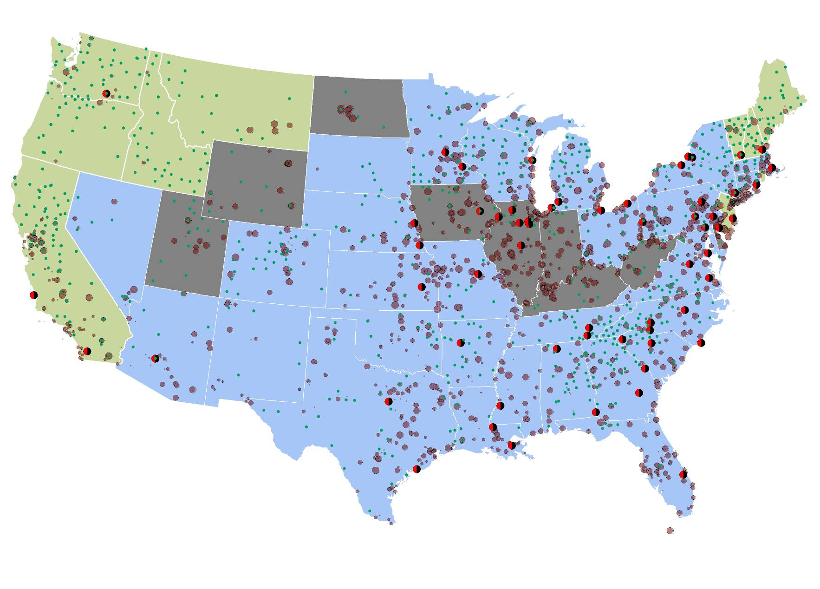
Plug In Autos - Where Matters
Cleanest States
Dirtiest States
CO₂ lbs/MWh
scaled
3300
200
Nuclear Power Plants
Renewable Power Plants
26

Slide 27
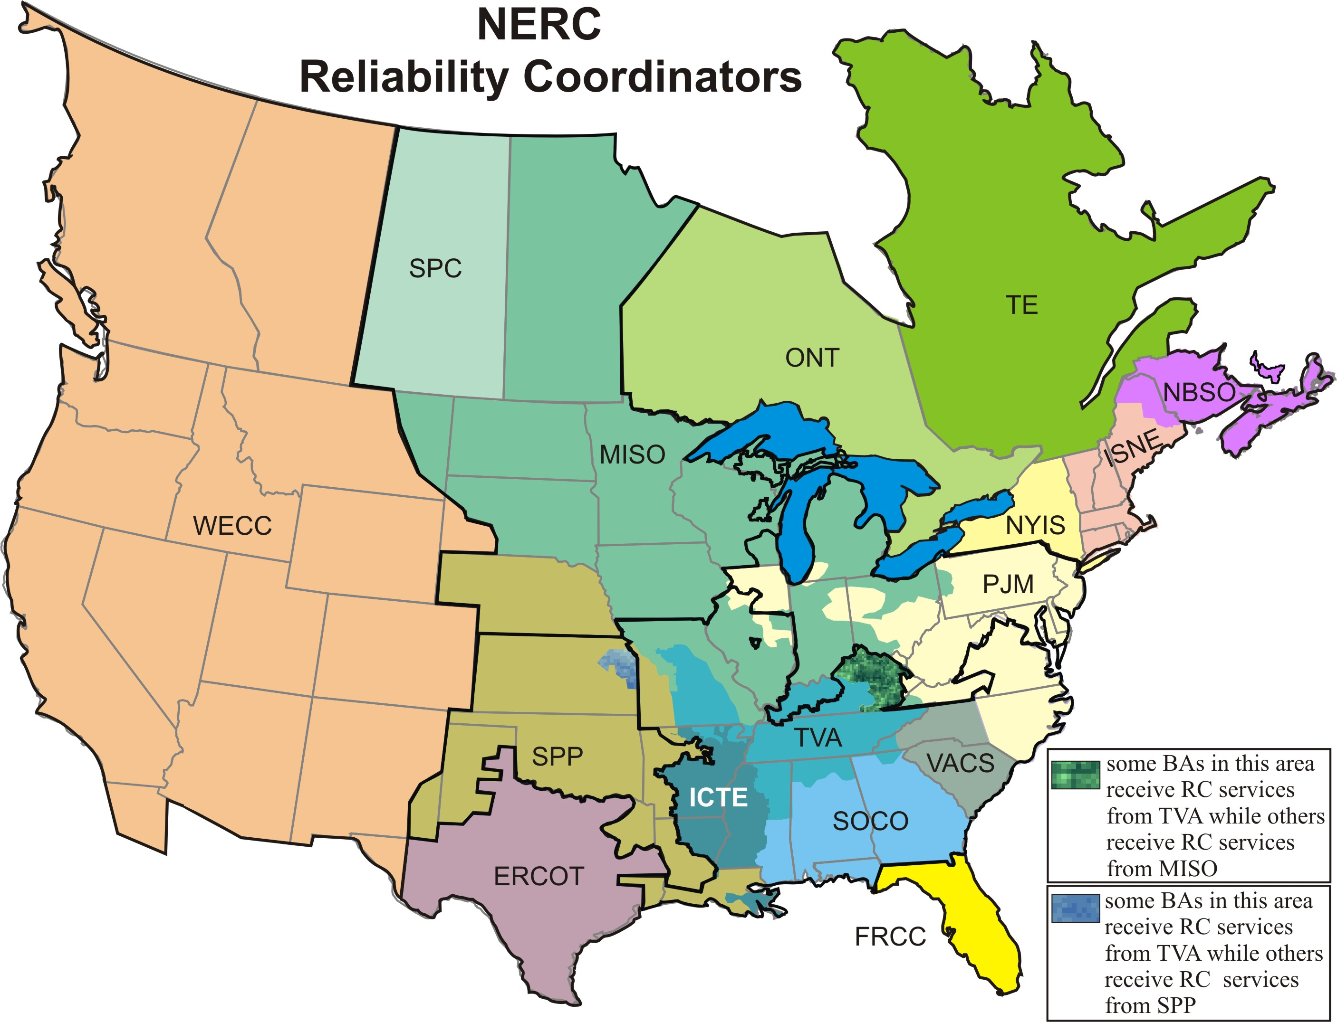
Knowledge of the Electric Grid
Analysis uses the Florida Reliability Coordinating Council’s region

Slide 28
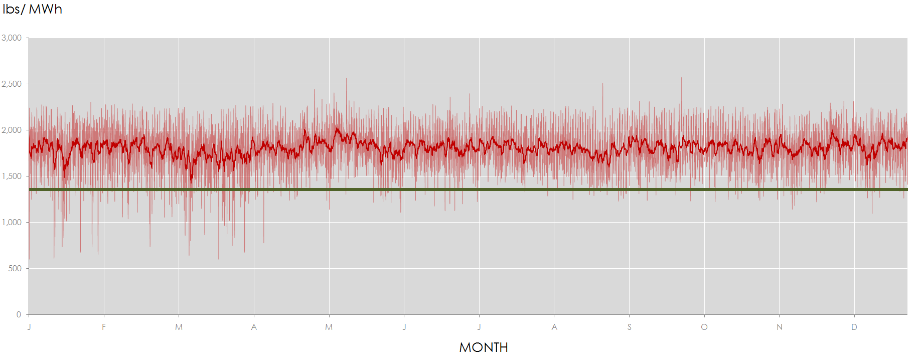
Impact of Accounting for Marginal Facilities
Ignoring electric sector misses ~ 4.7 billion pounds of GHG emissions in 2040 alone.
This is equivalent to not counting 400,000 gas-fired cars in the Florida fleet.
Analysis uses the Florida Reliability Coordinating Council’s region
RSG uses the hour by hour plug-in demand matched against the region’s fluctuating marginal power plant mix.
Oregon GreenSTEP assumes a system average for all hours of the year.

Slide 29
Thank You

