Slide 1

Integrated Model of the Urban Continuum:
Design, Development and
Prototype Implementation
SimTRAVEL: Simulator of Transport, Routes, Activities, Vehicles, Emissions, and Land
Ram M. Pendyala, Arizona State University, Tempe, AZ
Yi-Chang Chiu & Mark Hickman, University of Arizona, Tucson, AZ
Paul Waddell, University of California, Berkeley, CA
Brian Gardner, Federal Highway Administration, Washington DC
&
The Many Students and Post-Doctoral Researchers
Who Make It All Happen
May 8 – 12, 2011; Reno, Nevada
13th TRB National Transportation Planning Applications Conference

Slide 2
Background
Three major streams of research
  Land use modeling
  Activity-travel behavior modeling
  Dynamic traffic assignment and simulation
Common thread across innovations in model systems
  Microsimulation approaches involving disaggregate representation of behavioral units, time, and space
Modeling urban systems calls for integration of these three streams of research
Progress in integrated modeling slow and devoid of sound behavioral basis (Timmermans, 2003)
  Ad-hoc statistical coupling and data stitching of disparate model systems

Slide 3
Project Description
Project objective
  Develop a set of methods, computational procedures, data models and structures, and tools for the integration of land use, activity-travel behavior, and dynamic traffic assignment model systems in a microsimulation environment.
    Universally applicable framework, methods, tools, and data structures
    Open-source enterprise
Among first set of projects funded by the FHWA Exploratory Advanced Research Program (EARP)

Slide 4
Design Considerations
Behavioral
  Consistency in behavioral representation, and temporal and spatial fidelity
  Explicit recognition of inter-relationships across choice processes
  Example: Response to increase in congestion from home to work
    Short term - Alter route and/or departure time
    Medium term - Adjust work schedule/arrangements
    Long term - Change home and/or work locations
Computational
  Separate model systems can take several hours to run a single simulation
  Run times for integrated model systems could be prohibitive
  Advances in computational power and parallel processing offer hope

Slide 5
Design Considerations
Data
  Land use data available at the parcel level
  Employment and residential data available at the unit-level (e.g., individual employer)
  Higher-resolution network data with detailed attributes and vehicle classification counts by time-of-day
  Detailed activity-travel data including in-home activity information
Policy
  HOV/HOT lanes, congestion pricing, parking pricing, fuel price shifts
  Alternative work arrangements (flex-hours, telecommuting)
Beyond Interface
  Make connections across choice processes within a unified entity (as opposed to loose coupling)

Slide 6
Integrated Model System: Linkages
Land Use
Location choices → Activity-travel patterns
Network conditions → Location choices
Network conditions →
Activity-travel patterns
Travel Demand
Traffic Assignment
Activity-travel patterns → Network conditions

Slide 7
Integrated Model System: Overview
Peak/Off-peak Travel Times
Base Year Bootstrapping
Population Synthesis Land Use Model
Activity Travel Simulation
Dynamic Traffic Assignment and Simulation
Updated Travel Times
Convergence?
N
Y
TOD OD Trip Times
Base Year Simulation
Future Year n
Future Year n + 1
Population Synthesis Land Use Model
Population Synthesis
Land Use Model
Population Synthesis
Land Use Model
Activity Travel Simulation
Activity Travel Simulation
Activity Travel Simulation
Dynamic Traffic Assignment and Simulation
Dynamic Traffic Assignment and Simulation
Dynamic Traffic Assignment and Simulation
N
N
N
Demand and Supply Convergence?
Y
Demand and Supply Convergence?
Y
Demand and Supply Convergence?
TOD OD Trip Times
TOD OD Trip Times
Y
TOD OD Trip Times

Slide 8
Integrated Model Design
Base Year Simulation: Bootstrapping
  To obtain time-varying travel skims
  Start with peak/off-peak skims from 4-step model
  Apply model systems sequentially
  Iteratively run until demand and supply models converge
Model Year Simulation: Integrated Model
  Location choices are simulated once for a model year
  Activity-travel patterns are generated and vehicles are routed until both demand and supply side convergence is achieved
  The converged time-of-day skims feed into the model simulation for subsequent year
  This process is repeated on an annual time step

Slide 9
Integrated Model: Supply and Demand
Activity-Travel Model
t = 0 min
t = 1
t = 2
t = 9
Trip and Vehicle Information
Person pursuing activity at destination
Trip and Vehicle Information
Update O-D Travel Times
DTA Model
New Link Travel Times
Path is identified and
trip is simulated
Update Time-Dependent Shortest Path
6 second interval
1440 minutes

Slide 10
Supply and Demand Model Integration
In each minute, demand model provides a list of vehicle trip records to dynamic traffic assignment model
Dynamic traffic assignment model routes and simulates the trips along time-dependent shortest path to destinations
DTA model communicates back arrival times of vehicles that have reached their destinations
Schedules are adjusted and subsequent activity-travel engagement decisions are made based on actual arrival time
The above steps are repeated to generate activity engagement patterns for all individuals for an entire day

Slide 11
Iterative Process: Feedback Loops
Feedback origin-destination travel times after each iteration
Mimics learning process of individual from one day to the next
Each iteration represents an adaptation of activity-travel schedule based on past experience
Process is continued until “convergence” is achieved both on the demand and supply side
Convergence offers consistency between
  Input travel times used for travel choices in demand model
  Output travel times from network assignment and microsimulation model
How does one define “convergence” in the integrated modeling context?

Slide 12
Iterative Process: Convergence
Supply Side Convergence
  Well-established and incorporated into modeling paradigms
  Compare origin-destination travel times from one iteration to the next
  Use of relative gap function
Demand Side Convergence
  No well-established criterion for convergence; simulation results are accepted as stochastic realizations of underlying process
  Compare daily trip tables at the end of each iteration and compare between iterations to monitor convergence
  Use successive averaging schemes as appropriate to bring process to stop

Slide 13
Time-Space Prism Constraints
In-home Activity
A prism configured based on the fastest travel mode in the choice set
Time
Prism vertices generated by stochastic frontier models
PM Work Activity
Travel mode availability by time of day and mode continuity checked within and across prisms
AM Work Activity
1
In-home Activity
v
Home
Work
Urban Space

Slide 14
Demand Side Convergence: TSP Constraints
At more disaggregate level, examine time-space prism vertices for each individual in synthetic population
  Time-space prisms are based on origin-destination travel times (travel speeds) and therefore well connected to the supply side
  If time-space prisms show “stability” from one iteration to the next, process may be approaching convergence
  Need to define notion of “stability” in a time-space prism context → Work in progress

Slide 15
Integrated Model Prototype
SimTRAVEL: Simulator of Transport, Routes, Activities, Vehicles, Emissions, and Land
Model Systems
  PopGen: Synthetic population generation model
  UrbanSim/OPUS: Land use microsimulation model system
  OpenAMOS: Activity-based travel microsimulation model system
  MALTA: Simulation-based dynamic traffic assignment model
  FAST-TrIPs: Flexible Assignment and Simulation Tool System for Transit and Intermodal Passengers

Slide 16
SimTRAVEL Design

Slide 17
SimTRAVEL Design: Longer Term Choices

Slide 18
SimTRAVEL Design: Medium Term Choices

Slide 19
SimTRAVEL Design: Short Term Choices

Slide 20
SimTRAVEL Design: Convergence
No

Slide 21
SimTRAVEL Software
Completely open-source and freely available to community
Programming Languages
  Python used for UrbanSim and OpenAMOS
  C/C++ used for MALTA/FAST-TrIPs
Database Management
  PostgreSQL is commonly supported across all model systems
  Other database protocols are also supported by individual model systems, including, SQLITE, MySQL, text, HDF5 binary format
Graphic User Interfaces
  Individual Model Systems - PyQt4 used for GUI’s in PopGen, OpenAMOS and UrbanSim; Java for MALTA
  Integrated Model – OPUS serves as Master Controller to launch various model systems

Slide 22
SimTRAVEL: Data Flows
Land Use:
UrbanSim
Travel Demand:
OpenAMOS
Traffic Assignment:
MALTA
FAST-TrIPs

Slide 23
Interface: UrbanSim and MALTA
Data flow between the model systems
  One way: UrbanSim ← MALTA
Data exchanges
  Travel times and travel costs (←)
Implementation
  MALTA/FAST-TrIPs writes out time-varying O-D skims to text files

Slide 24
Interface: UrbanSim and OpenAMOS
Data flow between the model systems
  One way: UrbanSim → OpenAMOS
Data exchanges
  Household location choices (→)
  Fixed activity location choices (→)
  Land use information (→)
    Activity opportunities available at each unit
Implementation
  Shared databases
  OPUS – the software infrastructure used by UrbanSim writes out PostGreSQL database tables at the end of simulation run
    Household and person tables with locations appended and a land use table

Slide 25
Interface: OpenAMOS and MALTA
Data flow between the model systems
  Two way: OpenAMOS ↔ MALTA/FAST-TrIPs
Data exchanges
  Minute-by-minute: Information about trips to be loaded (→) and information about trips that have arrived at destination (←)
  End of iteration: Travel times and costs (←)
Implementation
  Python embedding (call Python code from C/C++ code)
    MALTA makes requests for trips at the start of every interval
    OpenAMOS generates activity-travel patterns after processing the person arrival information for the interval
  MALTA/FAST-TrIPs writes out time-varying O-D skims to text files

Slide 26
Software Environments
Single workstation environment (implemented)
  The three model systems run on a single workstation
    Enables faster and smoother integration
  Allows application to small/medium metropolitan regions
Distributed computing environment (ongoing work)
  Various solutions are being explored
    Running the model systems in a cluster computing environment using MPI/OpenMP protocols
  Allow application to large/mega metropolitan regions

Slide 27
Test Application: Study Area
Maricopa County, AZ
  A subarea comprising of City of Chandler, Town of Gilbert and Town of Queen Creek
  Spatial resolution of analysis is Traffic Analysis Zone (TAZ)
  The subarea covers a small area
    505,350 persons residing in 167,738 households
    159 Traffic Analysis Zones
  Test application includes…
    Background traffic from O-D trip tables + activity-travel demand for synthesized households/persons of three-city region
    Non-mandatory activity destinations located throughout Greater Phoenix Metropolitan Region

Slide 28
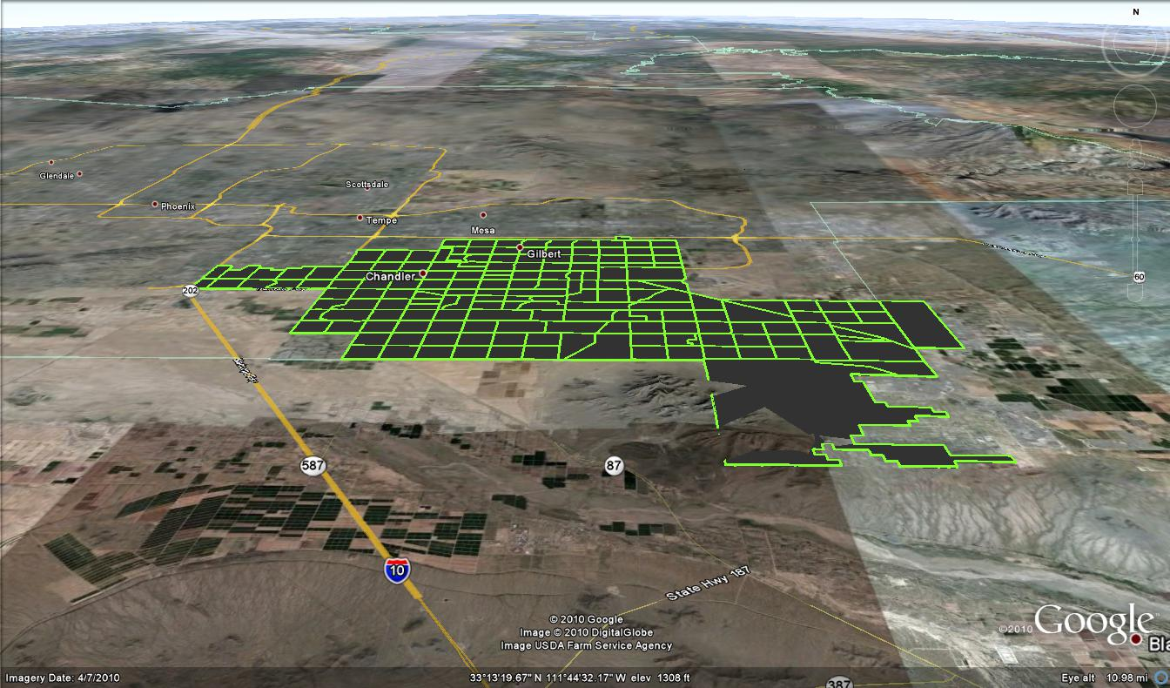
Study Area

Slide 29
Test Application
To provide efficiency in model testing
  Runs conducted on five percent population sample
  Limited to auto mode only
  Hourly O-D skims are used
Simulation Runs
  Sequential Application (Bootstrapping procedure)
  Dynamic Application
  The software system is flexible and can accommodate both applications

Slide 30
Sequential Application
This implements the bootstrapping procedure
UrbanSim, OpenAMOS, and MALTA are run sequentially and data is passed across models
  Arrival information is returned but there is no schedule adjustment done in response to the arrival information
  Shorter-term activity-travel engagement decisions are not simulated “dynamically”

Slide 31
Dynamic Application
This implements the proposed integrated model design
UrbanSim is run to generate the location choices
OpenAMOS is run to make longer- and medium-term activity-travel engagement decisions, including child dependencies
OpenAMOS-MALTA is run with minute-by-minute handshaking
  MALTA returns information about all trips that arrived at destination
  OpenAMOS processes arrival time to adjust schedules and also to simulate subsequent activity-travel engagement decisions “dynamically”
  OpenAMOS passes trips that need to be loaded to MALTA
  At the end of the iteration, hourly O-D skims are fed back to OpenAMOS for subsequent iteration

Slide 32
Preliminary Results
For both sequential and dynamic runs, convergence was achieved after only a few iterations
  Sequential application: 2 Iterations
  Dynamic application: 3 Iterations
  Consistent with the low level of demand associated with 5 percent sample and free flow conditions prevail on the network (background traffic not loaded for this experiment)

Slide 33
Preliminary Results
Convergence Progress: Total Trips Generated

Slide 34
Preliminary Results
Trip Start Time Distribution

Slide 35
Preliminary Results
Out-of-home Activity Type Comparison

Slide 36
Computational Performance
Test runs conducted on a Dell Precision T5400, quad core machine with Intel Xeon Processors and 32 GB RAM
Processing time for 5 percent sample of three-city region with no background traffic (dynamic model)
  UrbanSim: Few minutes
  OpenAMOS: 2 hours
  MALTA: 2 hours
Model systems scale well and full population runs with background traffic are underway

Slide 37
OpenAMOS: Schedule Generation
A household was randomly chosen to show the formation of schedules in OpenAMOS
Characteristics
  4 person household
  Persons 1 and 4 are adult workers
  Persons 2 and 3 are non-adult students
  Persons 3 is the only dependent child

Slide 38
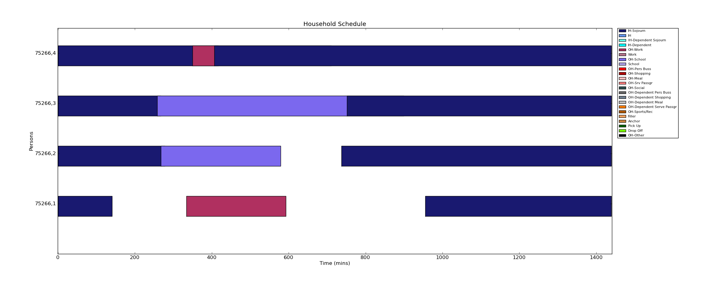
OpenAMOS: Schedule Generation
Step 1: Fixed Activity Schedule

Slide 39
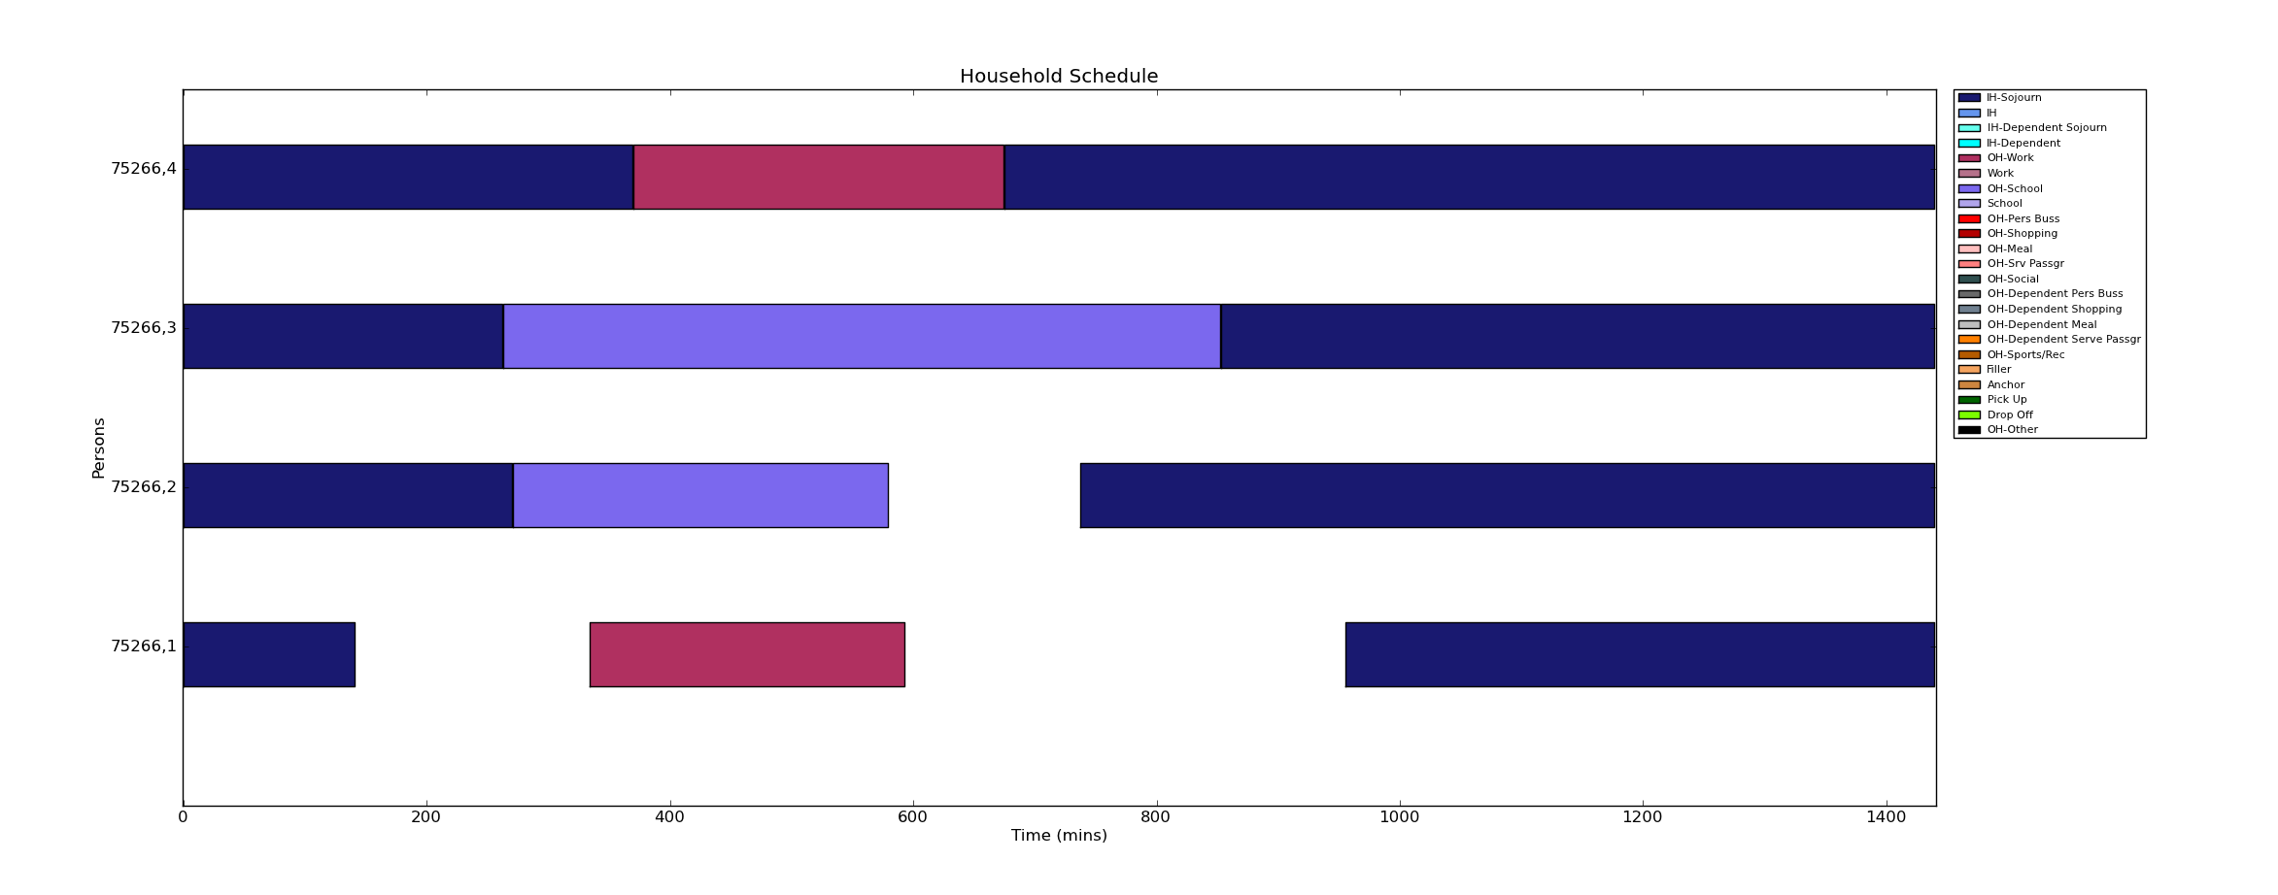
OpenAMOS: Schedule Generation
Step 2: Reconcile Fixed Activity Schedule

Slide 40
OpenAMOS: Schedule Generation
Step 3: Schedule Adjustment to Reflect Daily Status and Dependent Child Activities

Slide 41
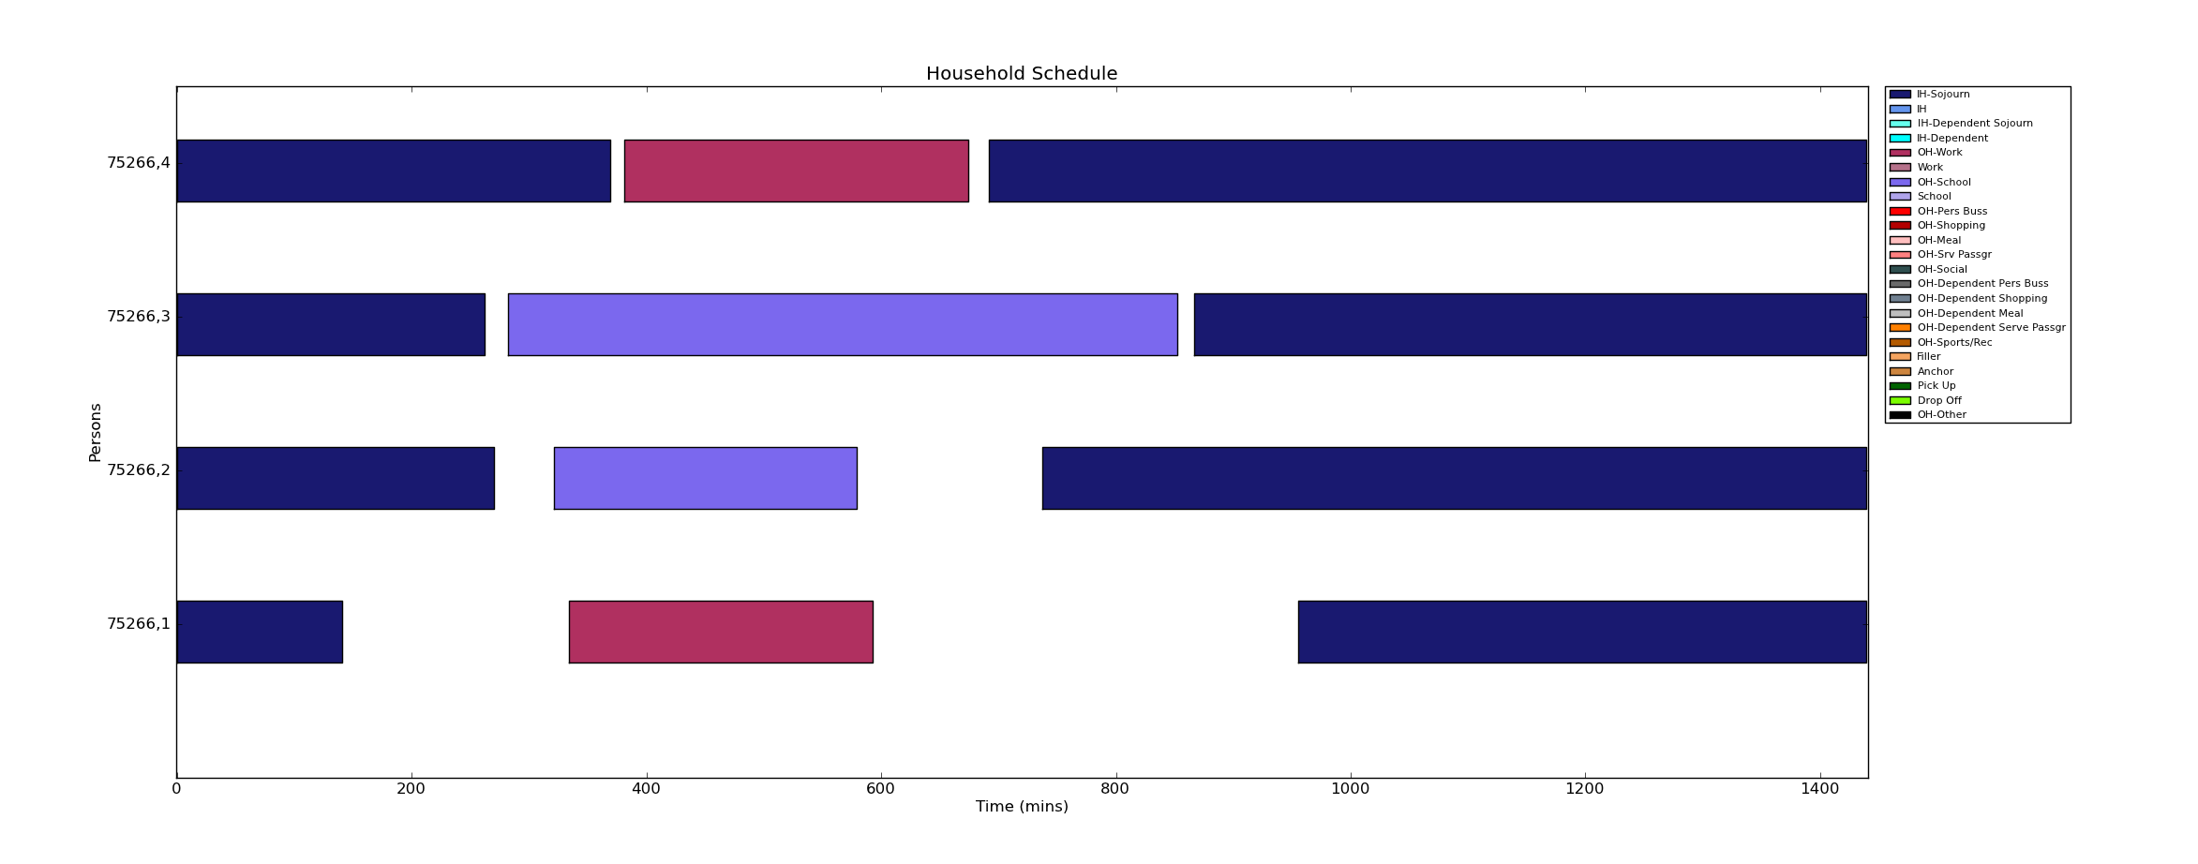
OpenAMOS: Schedule Generation
Step 4: Adjust Schedules to Introduce Appropriate Travel Episodes

Slide 42
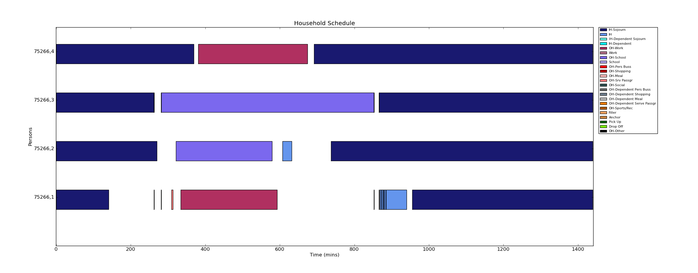
OpenAMOS: Schedule Generation
Step 5: Generate Flexible Activities and Allocate Dependent Child Activities to Adults

Slide 43
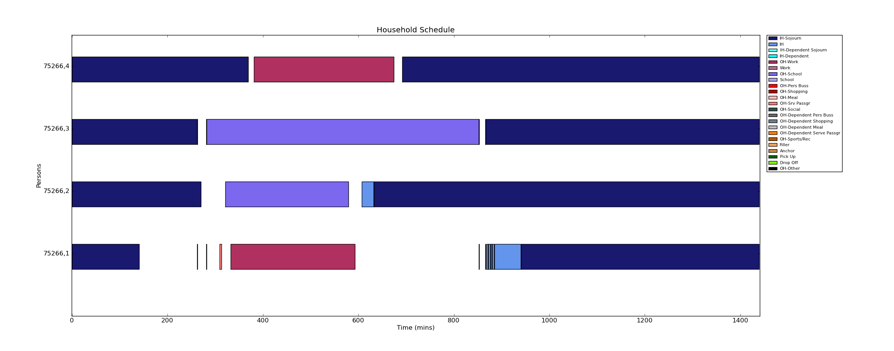
OpenAMOS: Schedule Generation
Step 6: Adjust Schedules to Fill the Entire Day

Slide 44
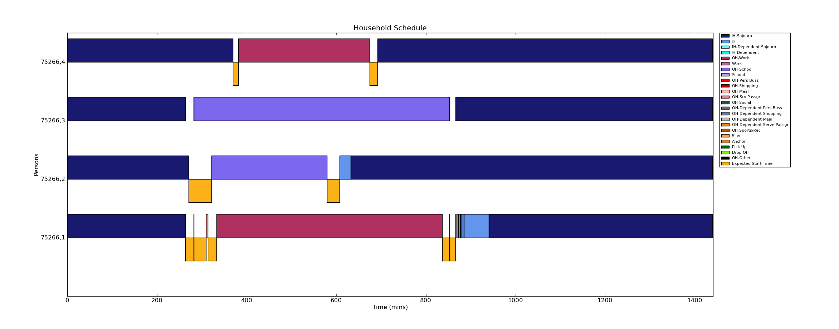
OpenAMOS: Schedule Generation
Step 7: Final Activity and Trip Schedule

Slide 45
Scenario Analysis
Model testing involves evaluation of of policies for the full population
Scenario type | Conditions
Socio-economic scenarios | Change in population across the region
 | Change in population in some parts of the region
 | Change in employment density
Highway scenarios | Change in fuel price or value pricing scheme
 | Change in link capacity (Example: link removal)
Transit scenarios | Change in transit fares
 | Change in transit service frequency
Travel demand management scenarios | Alternative work schedules
 | Telecommuting
 | Introducing HOV lanes
 | Introducing HOT lanes

Slide 46

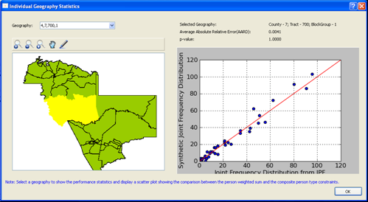
PopGen Software

Slide 47
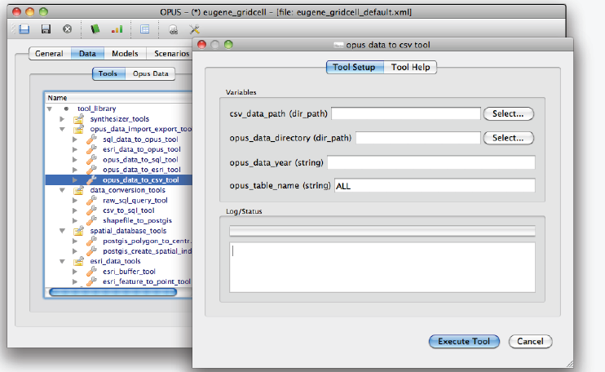
UrbanSim Software

Slide 48
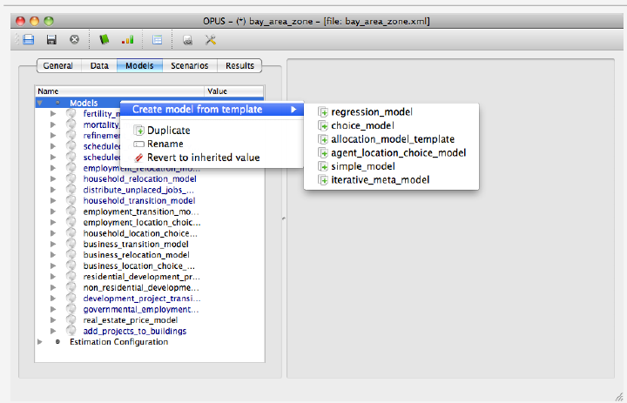
UrbanSim Software

Slide 49
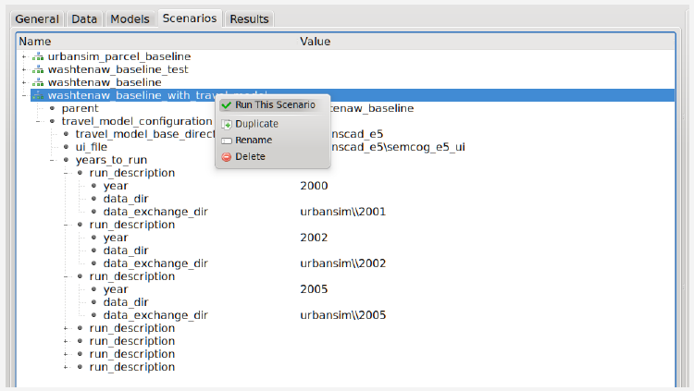
UrbanSim Software

Slide 50
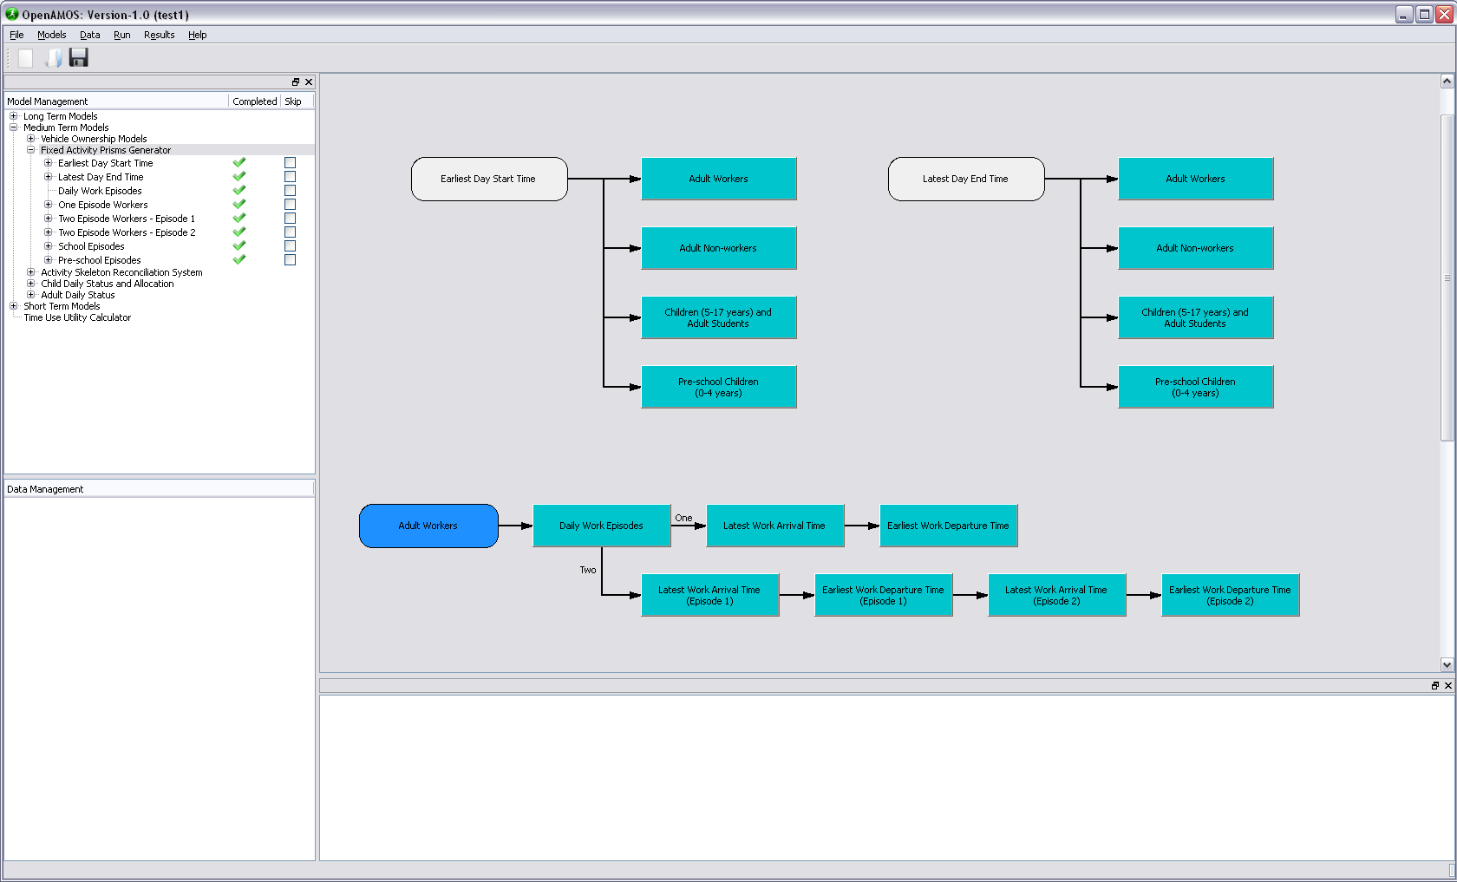
OpenAMOS Software

Slide 51
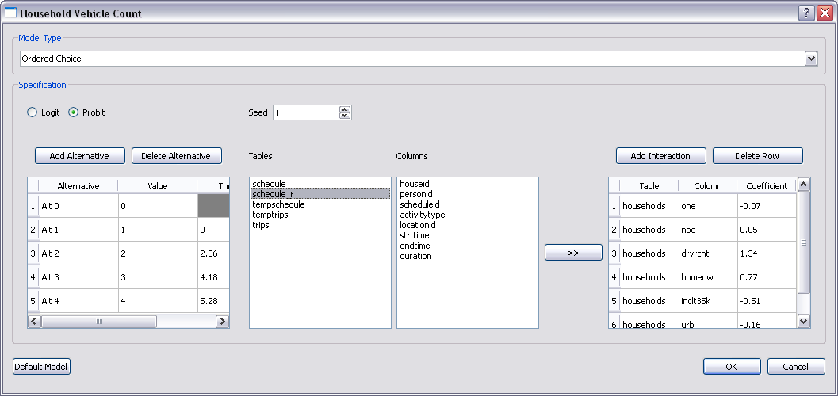
OpenAMOS Software

Slide 52
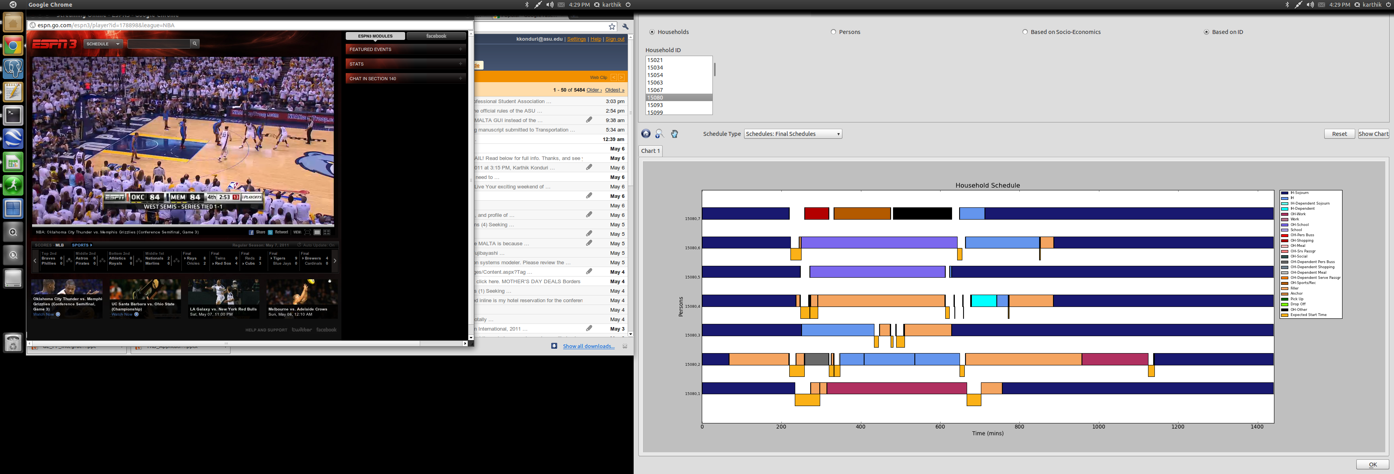
OpenAMOS Software

Slide 53
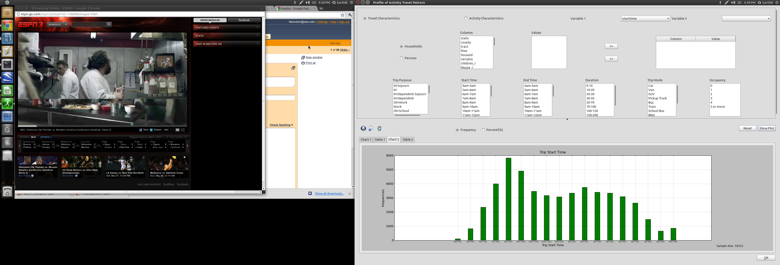
OpenAMOS Software

Slide 54
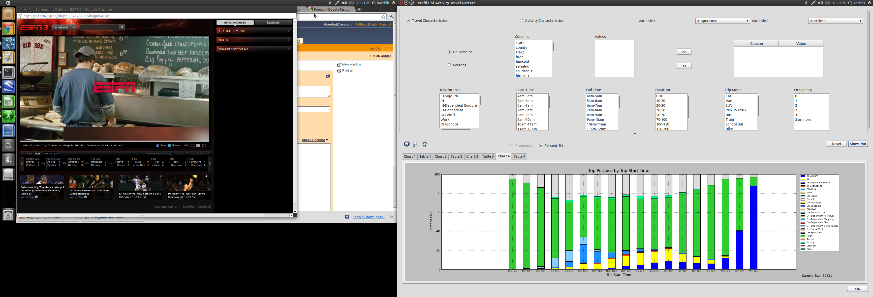
OpenAMOS Software

Slide 55
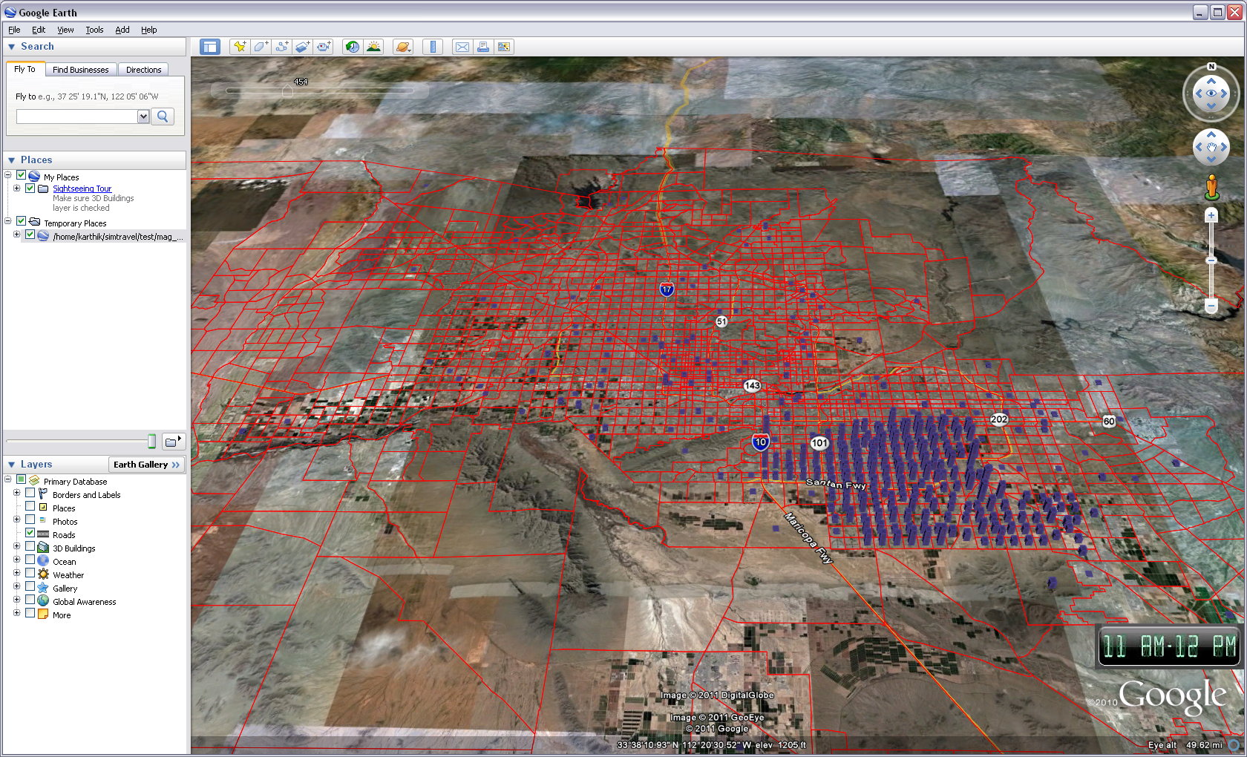
Google Earth Visualization

Slide 56
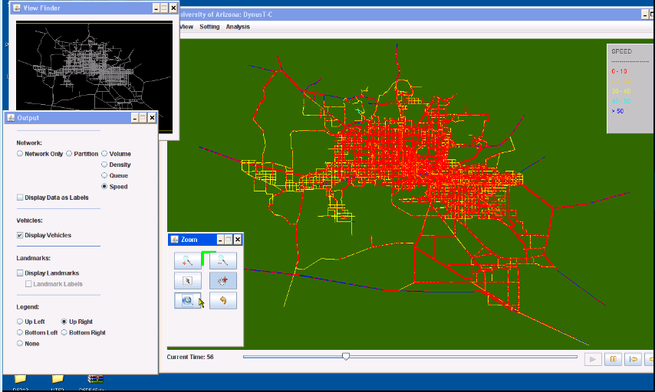
MALTA Software

Slide 57
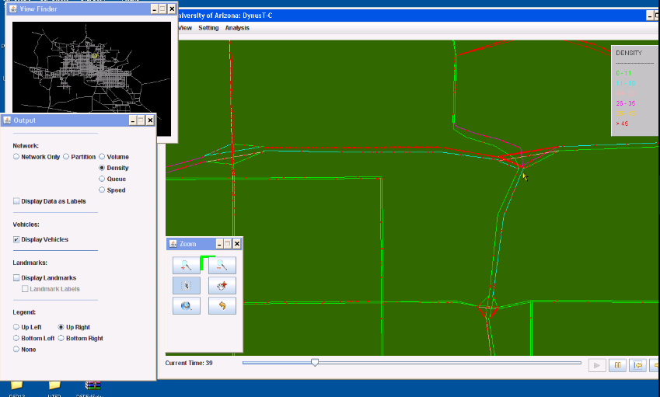
MALTA Software

Slide 58
Resources
Wiki: simtravel.wikispaces.asu.edu
Code Repositories
  PopGen: http://code.google.com/p/populationsynthesis/
  OpenAMOS: http://code.google.com/p/simtravel/
  UrbanSim: https://svn.urbansim.org/
  MALTA: https://dev.urbansim.org/malta

Slide 59
Ongoing Work
Calibration and validation of individual model systems as well as integrated system
Run the integrated model for the full population including background traffic
Address computational issues
  Explore distributed environments
Scenario analysis

Slide 60
Acknowledgements
Project sponsor
  Federal Highway Administration, Exploratory Advanced Research Program
  Project Manager: Brian Gardner
Peer Review Panel
  Konstadinos Goulias, David Boyce, Maren Outwater, John Gliebe, Vladimir Livshits, Keith Killough, Aichong Sun

Slide 61
Questions?

