Slide 1

Integration of Dynamic Traffic Assignment in a Four-Step Model Framework –
A Deployment Case Study in PSRC Model
13TH TRB National Transportation Planning Applications Conference
By:
Robert Tung, PhD
With:
Yi-Chang Chiu, PhD (U of Arizona)
Sarah Sun (FHWA)
WSDOT
PSRC

Slide 2
Motives
Static trip based macro model is limited in solving modern transportation issues.
Activity Based Model (ABM) is promising by may be costly to implement.
DTA tools are increasingly sophisticate and efficient in handling large multimodal network.
Combination of 4-Step model and DTA is potentially a Low-Hanging Fruit & cost-effective approach to add temporal dynamics to static trip based models.

Slide 3
Objectives
Implement a full DTA feedback mechanism in a static 4-step trip based model framework (PSRC)
Document the findings and issues learned from the process.
Focus on network development, calibration and validation, scenario analysis, and computing resources.
Deriving insights from comparing the proposed DTA-embedded approach with the existing method.
Understand the cost and benefit of integrating DTA in the 4-step process.
Tung & Chiu : Integration of DTA in a 4-Step Model Framework

Slide 4
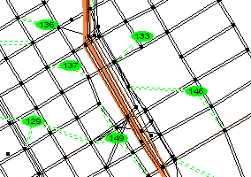
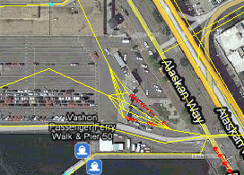
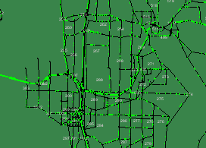
Multi-Resolution Modeling (MRM)
MACRO
MICRO
O/D
DTA
Static/Instantaneous Paths
Region Wide
Zonal Trips
Analytical Equilibrium
Demand Driven
Planning/Forecasting
MESO
Static Paths
Corridor/Intersection
Individual Vehicles
Simulation One-Shot
Supply Driven
Operational
Dynamic/Time Varying Paths
Subarea / Corridor
Vehicle Platoons
Simulation Equilibrium
Supply Driven
Planning/Operational

Slide 5
MRM Issues
Macro-Micro Approach:
Pros:
        Widely used in practice. Many tools are available.
Cons:
        Macro demand are not consistent with micro network.
        No temporal dynamics on demand slices.
        No feedback.
Macro-Meso-Micro Approach:
Pros:
        Meso demand are more consistent with micro network.
        Demand reflect temporal dynamics.
Cons:
        Learning curve for planners.
        Require more computing resource.
        Mostly auto only.
        No feedback.

Slide 6
DTA Primer
 | STA | DTA | MICRO
Loading | Analytical | Meso Sim | Micro Sim
Shortest Path | Instantaneous | Time Dependent | Instantaneous
Route Choice | FW/OBA/TAPAS | GFV | Logit/MSA
Connectivity | Link | Link/Lane | Lane/Turn
Resolution | Hour | Minute | Second
Solution | UE | DUE | Non-UE
Convergence | Unique | Non-Unique | Non-Unique
Speed | Static Average | Time Varying | Time Varying
Flow Model | VDF | Speed-Density | Car Following
Arrival Time Profile | No | Yes | Yes

Slide 7
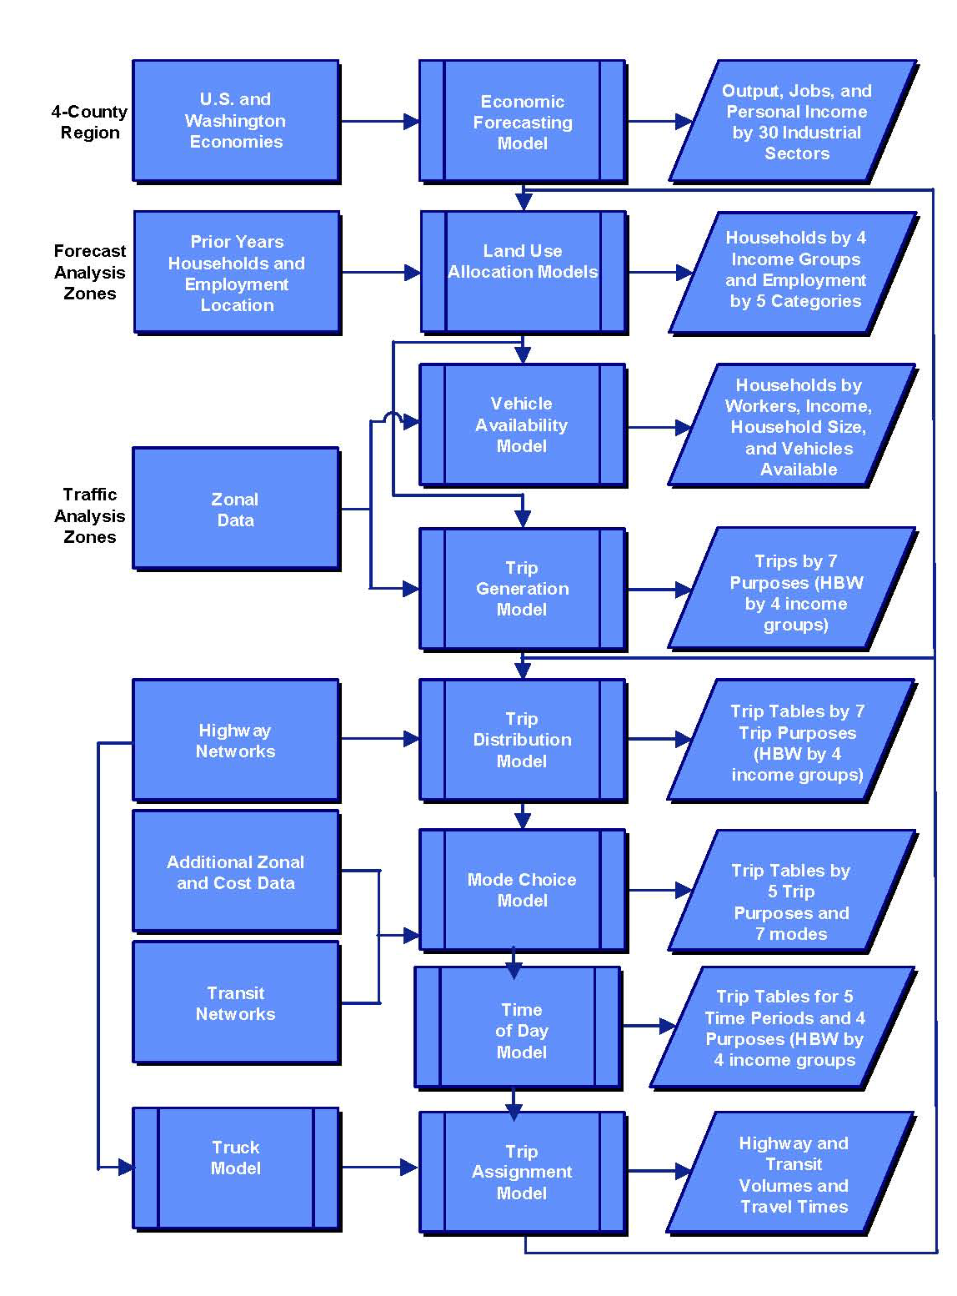
DTA Integration in PSRC
Land Use
Trip Generation
Trip Distribution
Modal Choice
Time of Day
Trip Assignment
DTA Auto Skims

Slide 8
DTA Integration Concept
Generation
Distribution
Modal Choice
Assignment
Land Use
Generation
Distribution
Modal Choice
DTA
Land Use

Slide 9
Task Outline
Network Conversion & Enhancement
Intersection Controls
Time-of-Day Model and 24-Hour Demand
Interface between DTA and TDM
24-Hour Continuous DTA Simulation & Assignment
Calibration and Validation
Scenario Analysis (HOT, Tolling, Work Zone)

Slide 10
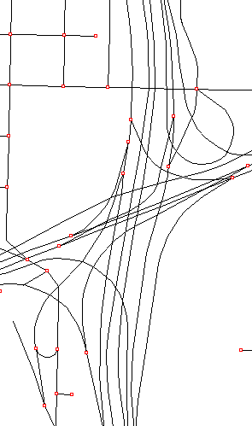
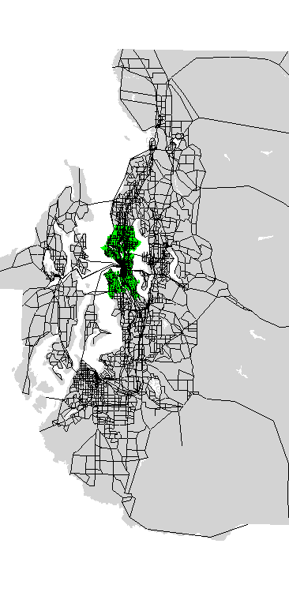
Network Conversion
Centroids:
  From single point to multi-point loading
  Use arterial links as trip generation and apply loading weights
  Use standard nodes as trip destination
Links/Nodes:
  Maintain realistic connectivity and GIS shape
  Nodal orientation is important
Controls:
  Use actuated signals as default if real data are not available
  Use reasonable max and min green times

Slide 11
Demand Conversion
Use temporal (departure) profile derived from survey or TDM with directionality and peaking characteristics retained
Assemble 24-hour demand from time varying period O-D tables
Use smaller time interval as possible (15-minute)
Separate demand by mode and purpose
PSRC 2006 Diurnal Profile
PSRC 2006 Auto Demand by Period
Period | SOV | HOV | Truck | Total
AM | 983,292 | 176,292 | 104,580 | 1,264,164
Mid-day | 1,721,472 | 536,416 | 201,042 | 2,458,930
PM | 1,124,537 | 382,502 | 116,784 | 1,623,823
Evening | 888,251 | 410,576 | 57,164 | 1,355,991
Night | 490,499 | 105,715 | 44,203 | 640,417
Daily | 5,208,051 | 1,611,501 | 523,773 | 7,343,325

Slide 12

DynusT
Simple , lean and easy to integrate with macro and micro models
Developed since 2002, tested (in test) for 20 regions since 2005
  Used in several national projects
Memory efficient
  Capable of large-Scale multimodal 24-hr simulation assignment
Fast simulation/computation
  Multi-threaded
Realistic microlike mesoscopic traffic simulation
  Anisotropic Mesoscopic Simulation (AMS)
Managed Open Source in 2010/2011

Slide 13
DynusT Algorithmic Structure
TD O-D
TD Network
AMS Simulation
TD SP
Assignment
Convergence

Slide 14
Anisotropic Mesoscopic Simulation (AMS)
Stimulus-response model
Net influence for speed adjustment primarily comes from traffic in the front (SIR)
Can define different “average traffic conditions” to model uninterrupted and interrupted flow conditions
Uninterrupted Flow
Interrupted Flow

Slide 15
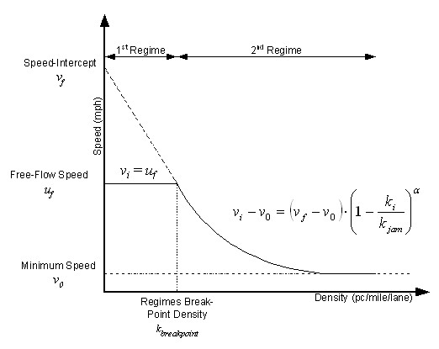
AMS q-k-v Curves
Modified Greenshield’s model:

Slide 16
AMS Examples
α=3.35 Jam Density = 200 Density Breakpoint = 25
Free Flow Speed = 60 Minimum Speed = 6 Speed Intercept=92

Slide 17
AMS Examples continued…
Jam Density = 200 Density Breakpoint = 25
Free Flow Speed = 60 Minimum Speed = 6

Slide 18
Compare BPR to AMS

Slide 19
BPR Examples

Slide 20
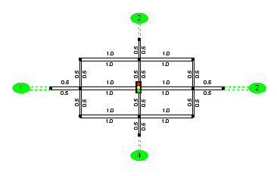
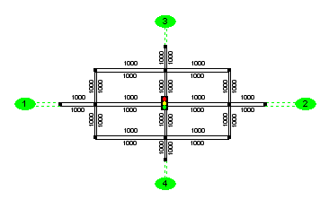
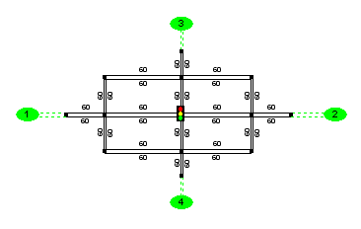
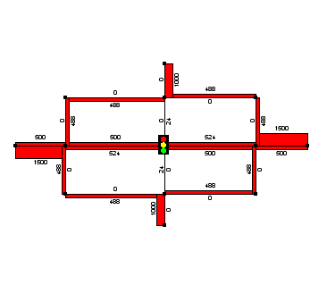
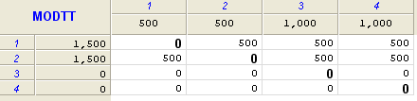
STA vs. DTA Comparison
Simple Network Example
BPR: α=0.6 β=5.8 AMS: α=3.35

Slide 21
STA vs. DTA Comparison
Simple Network Example
Average Trip Time by Demand Level
Demand | STA | DTA
250x3 | 2.8 | 2.2
350x3 | 3.1 | 2.4
450x3 | 4.6 | 6.6
550x3 | 8.7 | 14.0
650x3 | 18.5 | 21.7
750x3 | 38.9 | 29.1
1,000x3 | 194.7 | 47.8
1,500x3 | 2,017.7 | 85.0

Slide 22
Time Dependent Shortest Path
The key feature in DTA
Able to produce Experienced travel time and route that is far more realistic than Instantaneous travel time and route produced in STA.
Experienced travel time is affected by vehicles departing earlier and later
Experienced travel time can only be realized after the trip is completed (Arrival Time Profile)

Slide 23
PSRC Time of Day Model
Discrete Logit Choice Model by 30-Minute Interval
Aggregated to five periods: AM, MD, PM, EV & NI
U_{ijkpm} = a_{k} + c1_{k}D_{ijk} + c2_{k}D_{ijk}SE + c3_{k}D_{ijk}SE² + c4_{k}D_{ijk}SL + c5_{k}D_{ijk}SL² + v + d
Where: i = Production zone j = Attraction zone
    k = Time interval p = Purpose (HBW, HBO, HBShop)
    m= Mode (SOV, HOV) D = Delays
    SE = Shift early factor SL = Shift late factor
    V = Socio-demographic variables
    d = Dummy variables

Slide 24
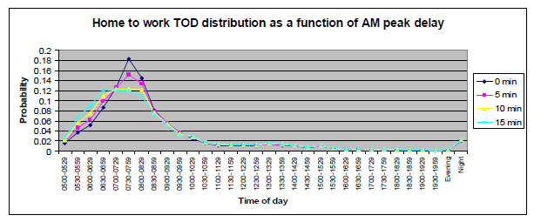
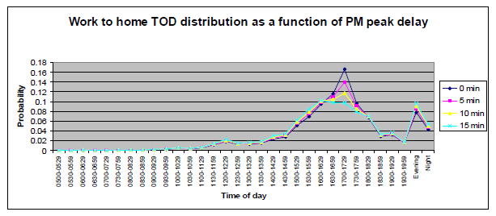
PSRC Time of Day Model

Slide 25
Time of Day Choice Model
Pros & Cons
Comparing to static TOD model, choice model adds temporal dynamics that enables peak spreading
The Shift variables can reasonably spread peak trips over shoulder periods
The model is sensitive to changes in delays or generalized costs that is crucial for congestion relief studies
Because TOD was calibrated based on base year HH survey and skims data, the model coefficients become questionable for future years of much higher demand and congestion, and resulting TOD profiles are often unrealistic.
Variations of TOD Profiles by Period
AM MD PM EV NI

Slide 26
DTA Based TOD Model
Baseline Year Model Development:
  Start from initial departure time profile
  Delay calculated by DynusT can be fed back by 30 min increment to the TOD model
  TOD model will adjust the departure time profile
  Iterative process until convergence
  Consistency between TOD and DTA is established
Time of Day Model
24-Hour Temporal
24-Hour DTA
Time Varying Skims
Future Year Development Considerations:
  Departure or arrival time profiles based on trip purposes
  Minimizing total schedule delay + travel time based on trip purposes
  Decisions applied to future years

Slide 27
DTA Based TOD Model

Slide 28
Next…
On-going research project funded by FHWA to investigate the costs and benefits of integrating DTA in a 4-step framework. Results are pending in 2012.
Findings of this project will be shared with modeling community.
Contact Robert Tung rst@rstintl.net for more information.
Thank you !

