Slide 1


Early Report on the Central Phoenix Inner Loop Traffic Operations Model
Phase I
Daniel Morgan, Caliper Corporation
Micah Henry, Maricopa Association of Governments

Slide 2
Objective
Add simulation modeling based on modern traffic modeling software and methods to Maricopa Association of Government’s (MAG) suite of analysis tools
Develop a traffic operations model that will support the Central Phoenix Transportation Framework Study (CPHX)
Train staff to use the model
Notes:
A tool with which to prioritize capacity, operational, and safety improvements

Slide 3
Scope
Focus on the Central Phoenix portion of the MAG region (i.e., that area covered by the CPHX)
Study area bounded by Loop 101 on the north, east, and west, and the Gila River Indian Community/Loop 202 on the south
Inclusion of all vehicular modes (Auto, Truck, Bus, Rail)

Slide 4
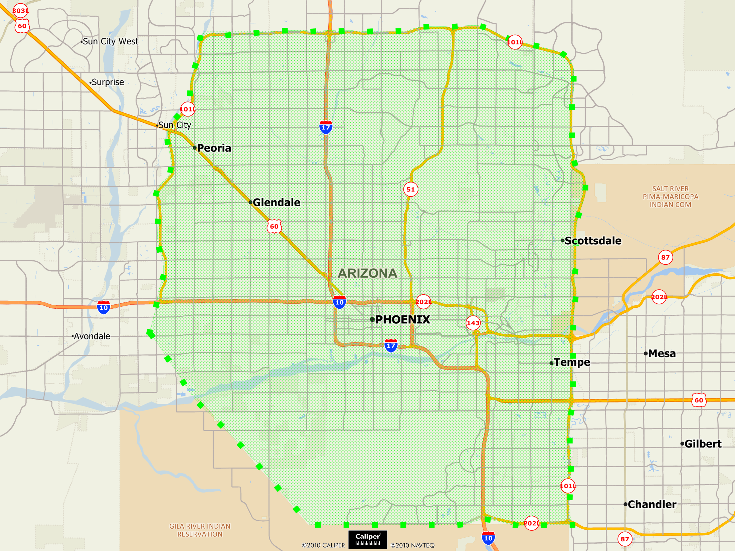
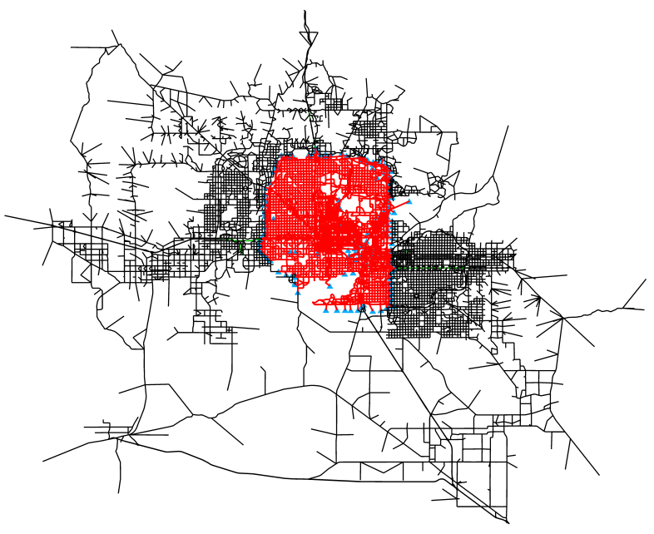
Study Area

Slide 5
Geography
530 square miles of Central Phoenix and parts of Glendale, Peoria, Scottsdale, Tempe, Chandler
Including freeway facilities under the purview of the Arizona Department of Transportation (AZDOT)
Including public transportation services provided by Valley Metro members:
  City of Phoenix
  Regional Public Transportation Authority (RPTA)
  METRO (Light Rail)

Slide 6
Scale
2,470 Miles (320 Freeway/2,150 Surface)
  Approx. 5,690 in the planning network
  Plus 20 miles of light rail
23,400 Links/17,250 Nodes
  884 Origins and Destinations
  794 TAZ Centroids/90 boundary nodes
7,800 Lane-miles (1,300 Freeway/6,500 Surface)
1,700 Signalized Intersections

Slide 7
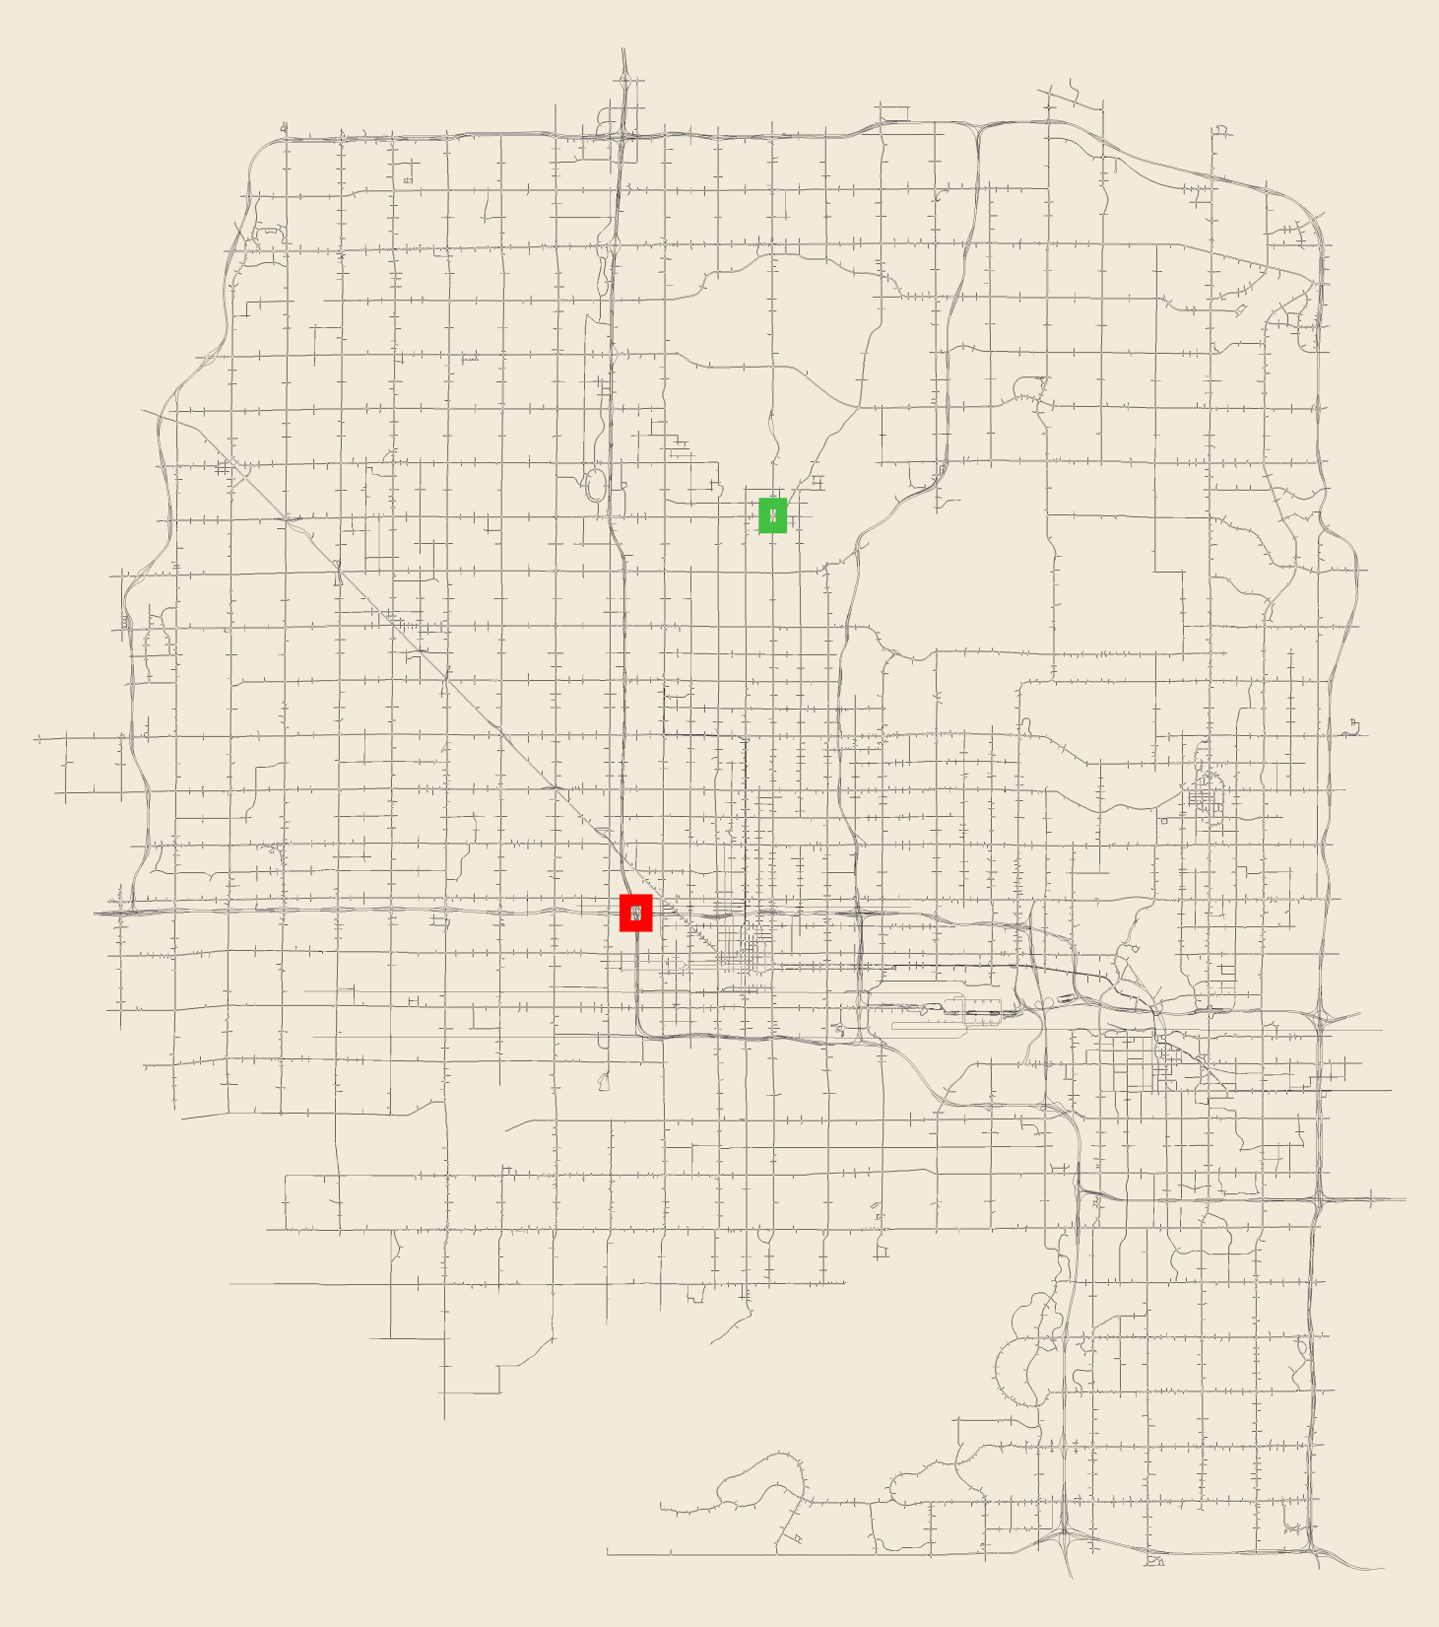
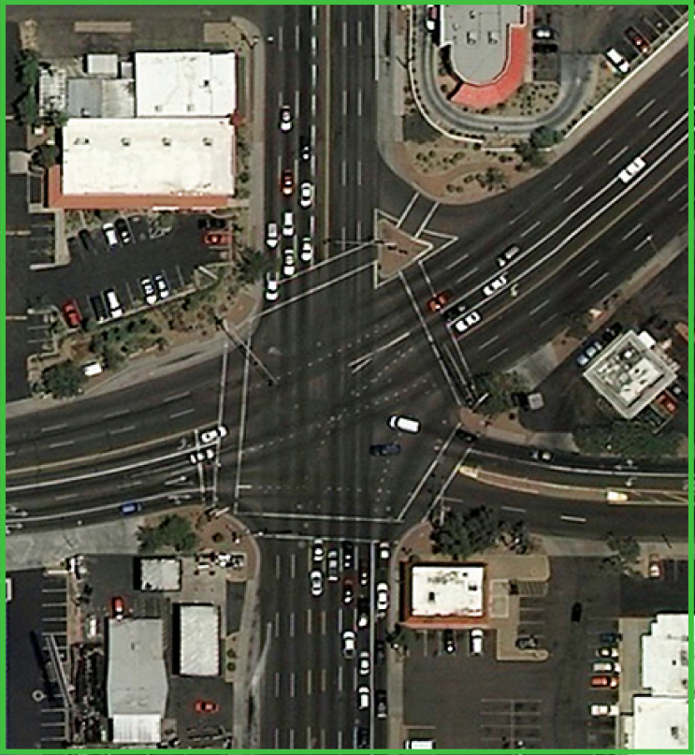
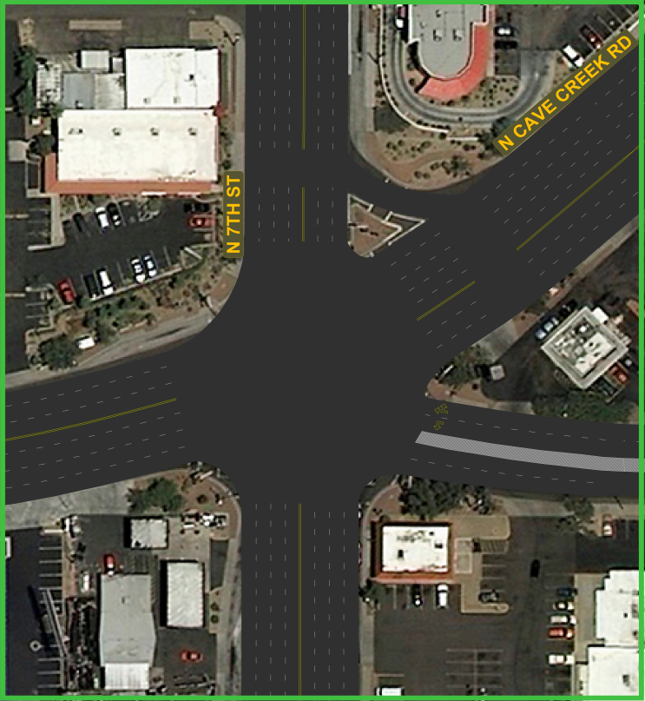
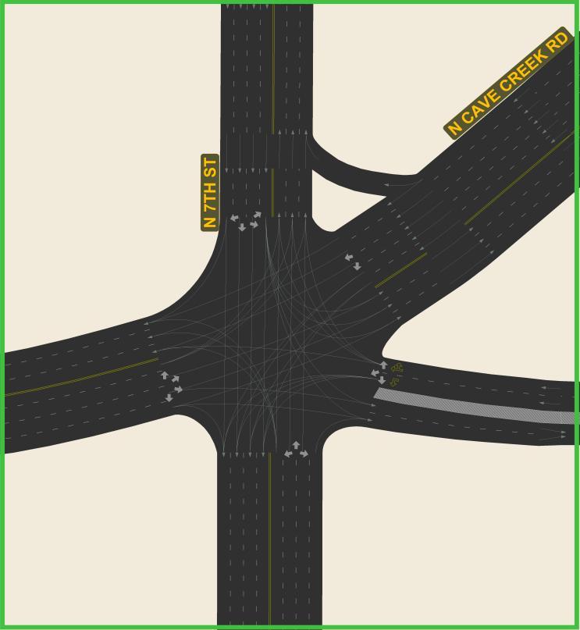
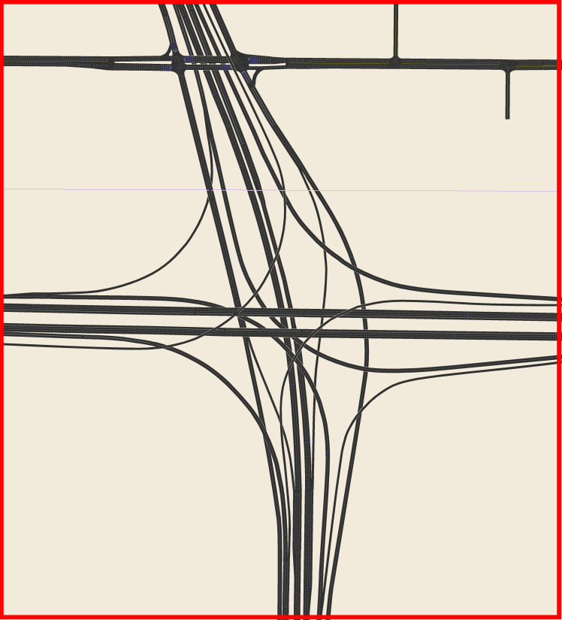
Level of Detail

Slide 8
Status
Study Design (92%)
  Draft a Study Design Document
Simulation Model Data Preparation (90%)
  Prepare Simulation Model Inputs
Model Framework Development & Testing (15%)
  Produce a Validated Simulation Model
Staff Training (1%)
  Output: Project Manual, Training Classes
Schedule
  Model to be completed by the end of 2011

Slide 9
Study Design
A microscopic multimodal traffic simulation model in TransModeler
An integrated TransModeler-TransCAD modeling framework
A dynamic approach to traffic demand estimation
A simulation-based dynamic traffic assignment approach to modeling route choice
A 2D and 3D GIS model for project evaluation and visualization

Slide 10
Model Data Preparation
Road Network
  Geography, lane-level geometry, centroids, centroid connectors
Traffic Demand Data
  Freeway continuous count detectors, arterial midblock counts, arterial turning movement counts
Traffic Control Data
  Signal timing plans, time-of-day, actuated detector locations
Public Transportation
  Routes, stops, schedules

Slide 11
Model Framework
Dynamic O-D estimation
Simulation-based DTA
  TransModeler microsimulation-based DTA
  Hybrid (or multi-resolution) simulation-based DTA
  Companion DTA TransDNA that runs on the MAG planning network

Slide 12
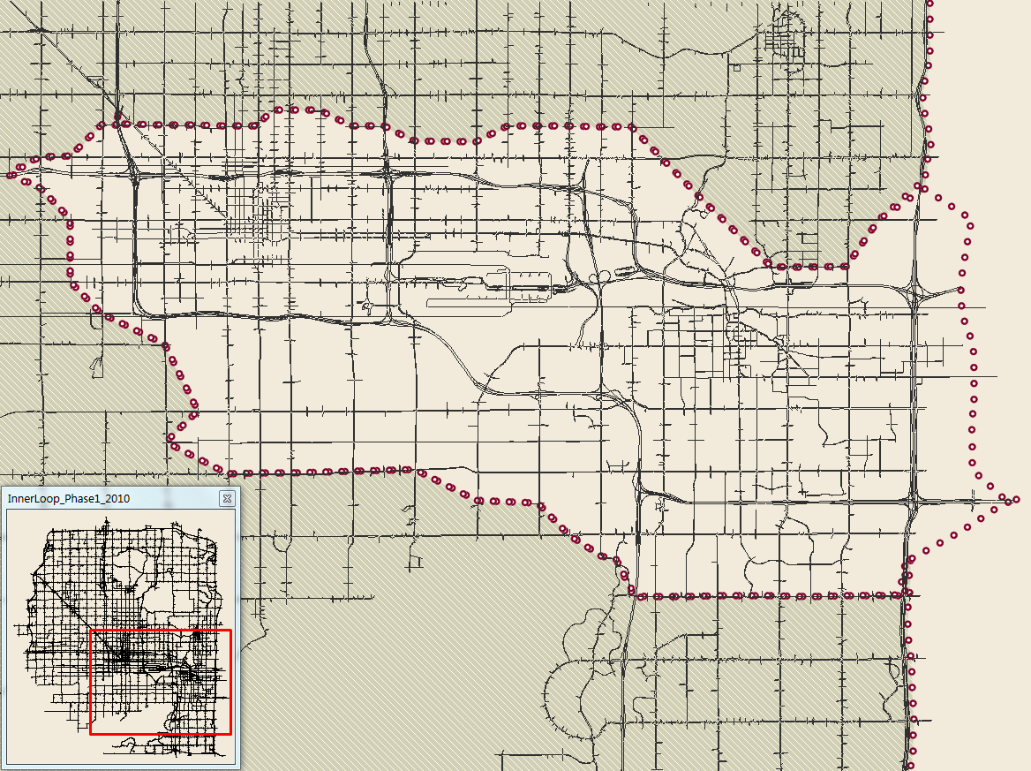
Study Design Test of Concept
80 square miles (15%)
634 miles (27%)
447 signalized intersections (26%)

Slide 13
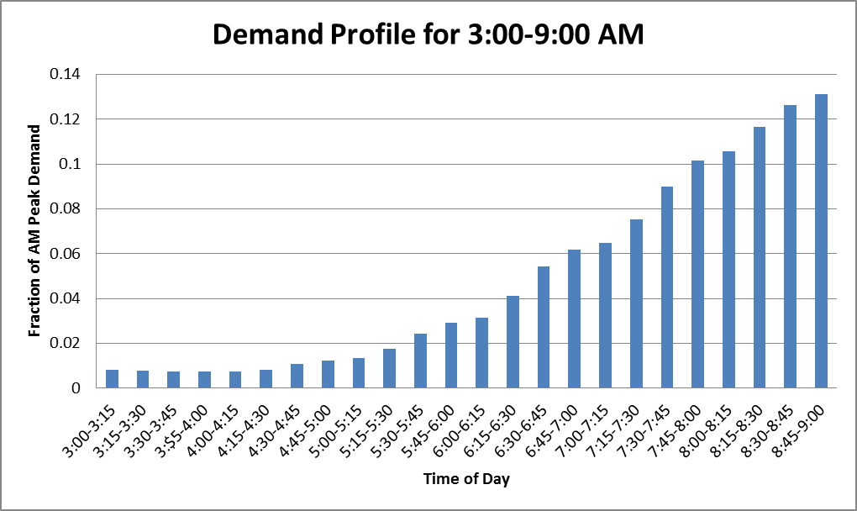
Performance
Target Peak Periods
  AM: 6:00 – 9:00 AM, Approx. 1.4 million trips
  PM: 3:00 – 6:00 PM, Approx. 2 million trips
AM Model Run Times for Study Design Test*
  3:00 – 9:00 AM, 545,900 trips
  56.5 minutes per simulation
  13.6 minutes to re-compute route choices
  All told, 50 iterations completed in 72 hours
* Based on an Intel Core i7 processor with 6 cores hyper- threaded (12 virtual cores) and 24 GB RAM

Slide 14
Results

Slide 15
Next Steps
Complete model data preparation
  Develop bus routes and stops
  Complete review and refinement of signal timings outside the study design area
Calibration and Validation
  Extend the O-D estimation and DTA to the entire study area
Performance Enhancements
  Evaluate and catalog the properties of micro and meso simulation methods
  Explore distributed computing, other speed-ups

Slide 16
Future
Deliver model
Train MAG staff to use the model
Phase II
  Gather new data
  Refine calibration/validation
  Project demonstration/application

Slide 17
Single Point Urban Interchange

