Slide 1
Travel Demand Modeling Tools to Support Smart Growth and Climate Change Policies
13th TRB National Planning Applications Conference
May 8-12, 2011. Reno, Nevada
Tara Weidner, Rosella Picado and Erin Wardell
Parsons Brinckerhoff

Slide 2
Proposed GHG reduction strategies
Road pricing
Compact land use and smart growth
Non-motorized transportation
Public transportation improvement
Ride-sharing, car-sharing and alternative commute / work schedules
Regulatory
Operational and intelligent transportation systems
Bottleneck relief and capacity expansion
Multi-modal freight strategies
Cambridge Systematics, Inc. (2009). Moving Cooler.
Notes:
The renewed focus that climate change has placed on compact smart growth, travel demand management, vehicle technology, and road pricing strategies places new and increased demands on the complexity of travel demand models.

Slide 3
Desired policy levers
TAZ– level land use characteristics
Parcel – level land use density and development mix
Pedestrian environment characteristics
Road capacity and HOV lane expansion
Traffic operations improvements
New or improved transit service
Improved transit accessibility
Transit fare policies
Road pricing (tolls, congestion, VMT)
Parking pricing and management
Transportation demand management
Port and airport ground access policies
Goods movement strategies
California MPO Self-Assessment of Modeling Capability
Notes:
As part of devising strategies for mitigating climate change, MPOs and other planning agencies are being asked to ensure that their models are sensitive to a wide range of policy levers, ranging from micro-level location of various types of housing and employment types, to regional goods movement and congestion pricing schemes.

Slide 4
Desired exogenous factors
Population attributes: income, age, employment status, household size, type of housing unit, presence of children
Population rate of growth
Regional employment mix and distribution
Gasoline prices
Vehicle fleet fuel efficiency
Person mobility attributes
Notes:
At the same time, models need to know about background factors that affect forecasts, and therefore policy outcomes, and given the uncertainty in how any of these outcomes may eventually be realized, various levels of risk analysis may even be called for.

Slide 5
Travel demand models are being asked to inform:
Alternatives analyses
Project evaluation
Environmental justice
Revenue generation
Risk and uncertainty analyses
Long term housing and commercial needs
Public involvement workshops
Regional consensus building
Notes:
Travel demand models are being stretched in multiple, conflicting directions: from serving as tools that can be applied effectively in public workshops, to answering questions related to long term impacts of transportation policies on a state’s industries, to showing how such policies impact localized, minority populations. No single tool can serve all purposes.

Slide 6
Travel demand modeling tool options
Sketch planning and visioning tools
More advanced, integrated and comprehensive models are:
costly to develop,
require highly skilled staff to develop and use,
take longer to run,
generate vast amounts of data
When is this investment worth the effort?
3-step models + post-processors
Advanced trip-based models
Activity-based models
Integrated land use & transport models
Notes:
The landscape of travel demand modeling tools that may be applied to support climate change policies is vast, ranging from sketch planning tools to comprehensive integrated land use and transport models.
Better versions of a simple model are often times better than a not-so-great more comprehensive model. So while there are overlapping capabilities, there are also clear instances of concrete benefits obtained by moving to a more complex model.

Slide 7
One answer: California RTP modeling guidance
 | Region Characteristics
Modeling Tool | Air quality attainment | Population Size and Growth | Congestion | Capacity Projects
No network model | yes | slow growth | none | limited
3-step model + post-processor | yes | slow -moderate | little | limited
4-step model + post-processor | no | moderate – rapid | some | large transit projects
Enhanced 4-step model; may use post-processor | no | rapid, population 200,000 + | severe | n/a
Advanced 4-step model | no | 4 largest MPOs | severe | n/a
Notes:
California RTP modeling guidelines – model complexity a function of region size, rate of growth, and air quality compliance.
Modeling requirements evolving over time – in 4 years’ time fast growth and non-attainment regions are expected to use micro-simulation land use and transport models
But …
the larger regions are also using simpler, fast tools to assist in the development of sustainable community strategies,
While going beyond the guidance to develop complex land use models to examine long term impacts of alternative development scenarios

Slide 8
Modeling tool selection criteria
Type of answer sought by stakeholders
Strategies and policy levers
Performance measures, equity impacts
Strengths and weaknesses of various modeling approaches
Resources available to develop and apply the model --staff, data, schedule, funding
Notes:
[slide that lists modeling tool selection criteria].
The selection or development of an appropriate tool needs to consider (a) the type of answer sought by stakeholders, (b) the resources available to develop and apply the model, including agency staff knowledge and availability, schedule, and budget, and (c) the data available to develop and validate models. Understanding the strengths and weaknesses of these modeling approaches and how well they capture the impact of GHG emission-reduction strategies is a critical step in selecting appropriate modeling tools to support the various stages of the transportation planning process.

Slide 9
Modeling Tools – Strengths and Weaknesses

Slide 10
Sketch planning & visualization tools
Land use planning / consensus building
VMT and emissions based on average input trip lengths and elasticities
Sketch-level alternative evaluation
density
simple j-h balance
vehicle emissions
building emissions
Notes:
Sketch planning / visualization tools – CarbonFIT
GreenStep – different type of sketch planning tool?

Slide 11
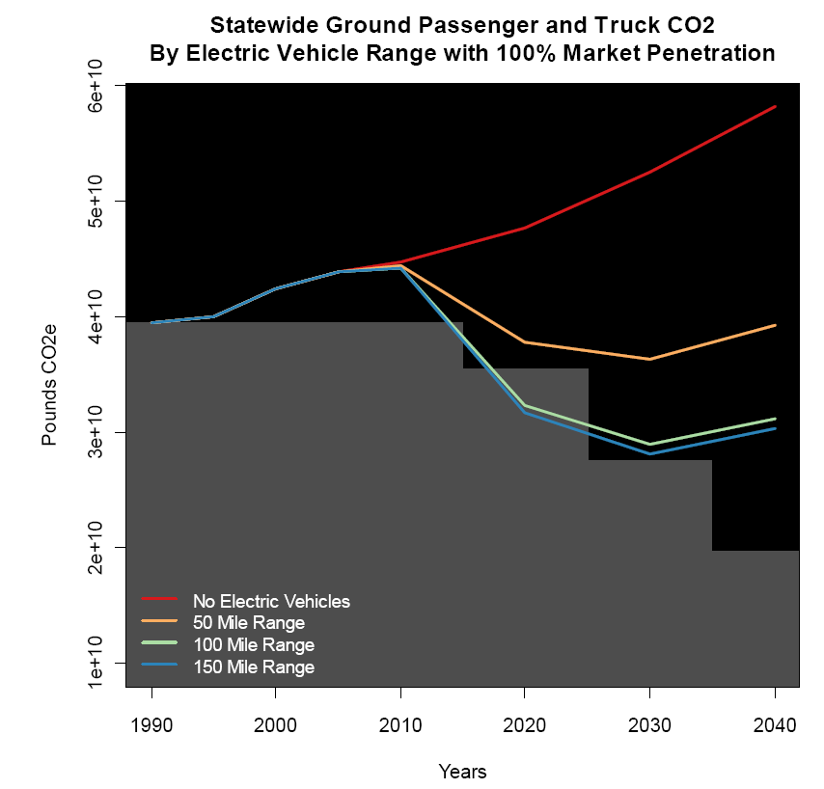
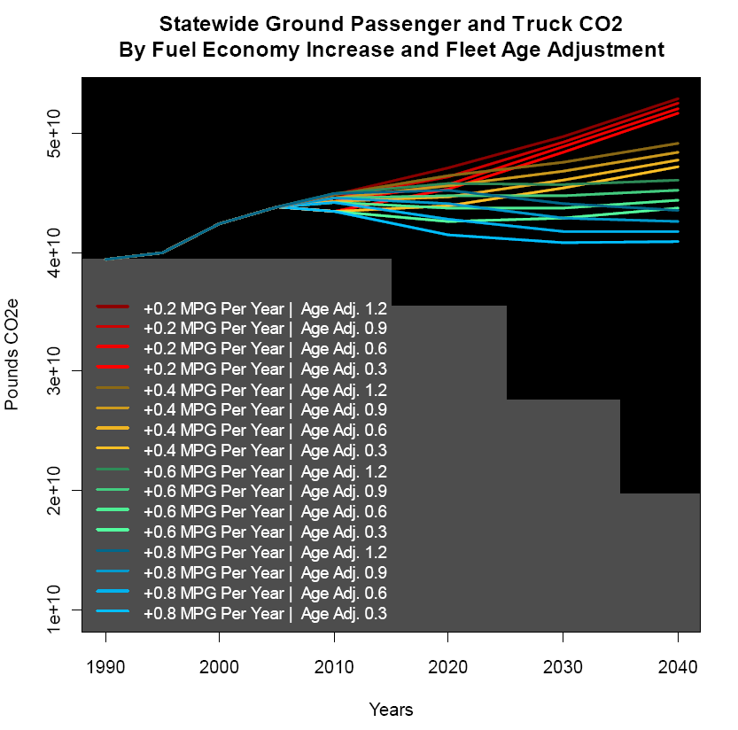
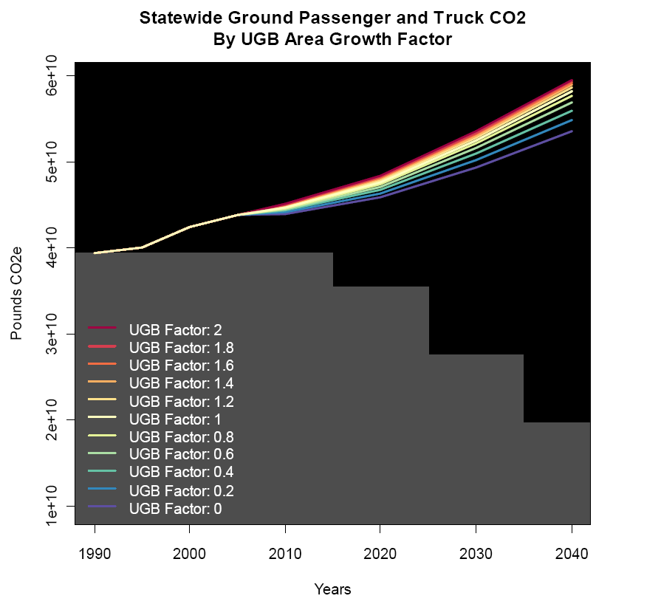
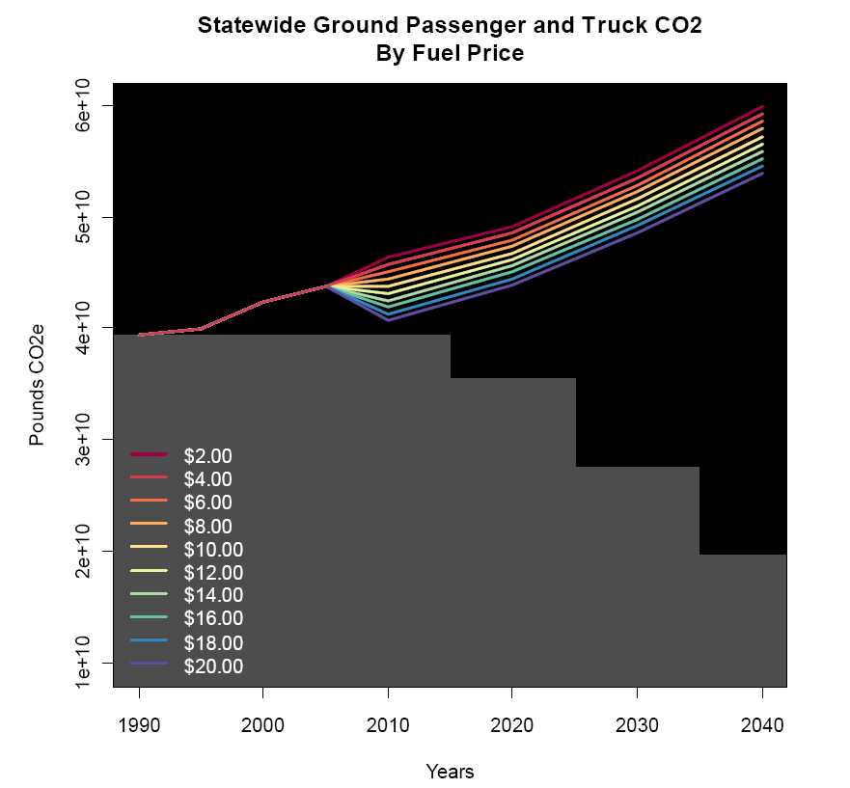
Sketch planning and visualization tools: GreenSTEP
Disaggregate representation of households and their demand for vehicles, travel, and fuel consumption
Simplified representation of transport system
Notes:
GreenSTEP is written in R, an open source statistical modeling application. It links a series of submodels (linear regression or logit choice models) that forecast outputs such as vehicle ownership and household daily vehicle miles traveled. The demand side of the model is disaggregate; it includes a synthetic population generator and an auto ownership model. The supply side is handled in a more aggregate way. GreenSTEP addresses an entire state on a county basis to be responsive to regional differences. The model distinguishes between households living in metropolitan, other urban, and rural areas to reflect the different characteristics of those areas in terms of density, urban form, transportation system characteristics, and demand management programs. The model runs in five year increments from 1990 to 2040. The outputs of the model include fuel consumption by fuel type, electric power consumption by electric vehicles, and carbon dioxide equivalents for fuel and electric power consumed

Slide 12
Trip-based model + post-processor
Gain over simpler method:
Local vehicle trips forecasted by 3 or 4-step model
Both trip ends are known
VT and VMT elasticities are often from local household survey
Limitations:
Assumption of constant elasticities valid only over limited range
Unable to assess vacant to non-vacant impacts
Silent on whether the trip reductions are true reductions or mode shifts
None to very limited applicability to transit and pricing strategies
Notes:
Post-processor tools – A Blueprint for the Sacramento Region
Hugely successful process for building consensus among multiple stakeholders for a land use and transportation vision for the region. The Sacramento Blueprint project is the basis for the California 2009 Sustainable Communities Strategy and Climate Protection Act (SB375).

Slide 13
Advanced trip-based models
Retain the advantages of a multi-modal trip-based model:
Adequate trip market stratification
Comprehensive mode choice model
Adequate representation of transit accessibility and competing levels of service
Auto ownership and destination choice models informed by multi-modal accessibility variables
While accounting for the effect of land use form, transit and pricing explicitly in the model specification
Notes:
Advanced trip-based models
Include SCAG mix density variable plot
Include SANDAG transit accessibility graphic

Slide 14
Activity-based models
Gains over trip-based models:
Model entire tours consistently
Use accessibilities relevant to the traveler, instead of zonal aggregates
Rich set of person and household attributes able to inform travel decisions
Explicitly account for constraints derived from household member interactions
Able to identify the true price paid by different users for parking and transit, and other mobility attributes
Mathematical consistency across all travel decisions results in improved, more realistic responses to policy
Notes:
Modeling entire tours consistently, for example mode for intermediate trips is consistent with the mode used for the entire tour.
Activity-Based Models – SANDAG or generic? Describe capabilities more than a model?
Parking lot choice (to evaluate the effect of parking policies on emissions caused by long term mode choice, parking search circulation)
Transit accessibility
Carpooling – explicit modeling of intra-household interactions and constraints
Mobility attributes – NY congestion pricing, understanding the impact of license plate rationing; availability of free/discounted parking or transit passes.
Long term choices – place of work

Slide 15
Integrated land use / transport models
Dynamically account for the effect of transport level of service on land use, and vice-versa
Allow examining and comparing the long term effects of climate change transport policies
Explicit assumptions on land development potential (zoning, density, mixed use)
Inter-industry relationships influence on location decisions, more realistic land use mix
Market signals and access (generalized cost) influence land use changes (vacant land, redevelopment, densification) and demand for transportation
Notes:
Integrated land use / activity based models – Oregon Statewide model
Long term changes in residential and commercial development

Slide 16
Matching the Tool to the Policy

Slide 17
Compact/Smart development
Quickly winnow down multiple scenarios
Comprehensive along land use types and household types
Order of magnitude
Complementary effects of compact development, transit and pricing on transport network at facility level
Market-drive densities
Explicit land use policy levers
Sketch planning tool
Post-processor
Advanced 4-step model
Integrated LU/T model
GHG emission reductions due to anticipated changes in density, land use mix
Notes:
Comparison of strengths and weaknesses for modeling compact development

Slide 18
Transit service
GHG reductions from user subsidies,
mobility attributes
GHG reductions across subpopulations
Rich distributional impacts
None to limited
existing service
Single-purpose market
GHG reduction potential
Alternatives analysis and project design
GHG reductions by population segment
Direct demand
model
Advanced 4-step model
Activity-based model
Notes:
Matching the tool to different types of transit projects and expected impact analysis

Slide 19
Conclusions
No single modeling tool can address the multiple and varying needs of the planning process, or is universally better
The tradeoffs between simplicity and behavioral realism is more than a tradeoff between fast and simple vs. long and complex models
The selection of an appropriate tool depends on
Strategies and policies
Detail of the answer sought (VMT?, equity?)
Stage of the planning process

