Slide 1
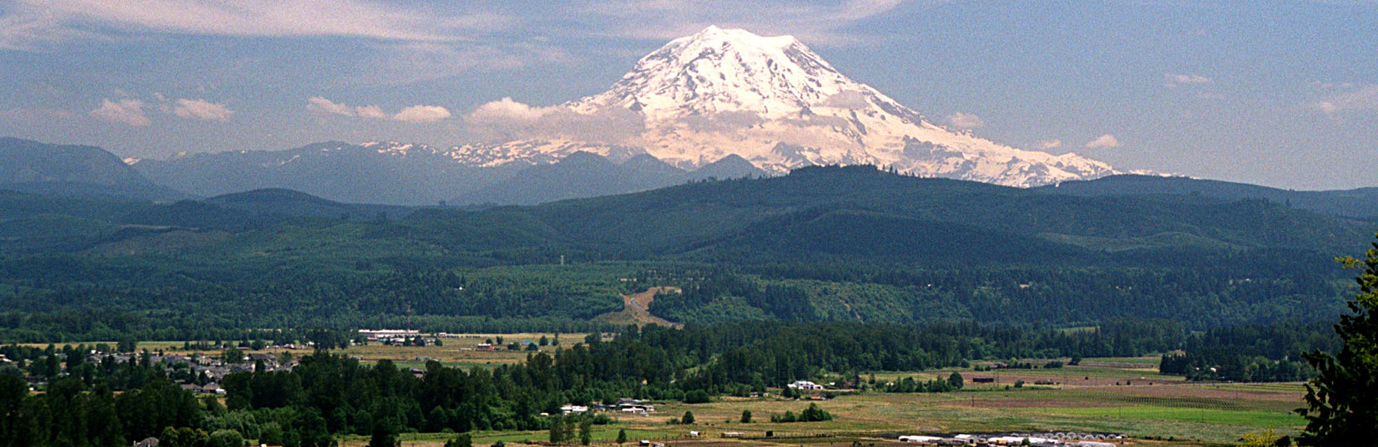

Land Use and Travel Model Integration
Linking Land Use and Transportation Models:
Transportation User Benefits and Site Values
13th TRB National Planning Applications Conference
May 8-12, 2011
Notes:
today’s keywords user benefits and site values – commit those to memory in case I meander a bit and get off-message

Slide 2


2
Presentation Overview
Background
Model Integration/Application
Analysis/Results
Conclusions/Future Directions
Notes:
here’s a quick overview of today’s presentation – first i’ll provide some context for modeling at PSRC, then i’ll talk about our integrated model framework, then i’ll cover our recent analysis efforts, and i’ll end with some conclusions and thoughts about where we think we’re headed

Slide 3
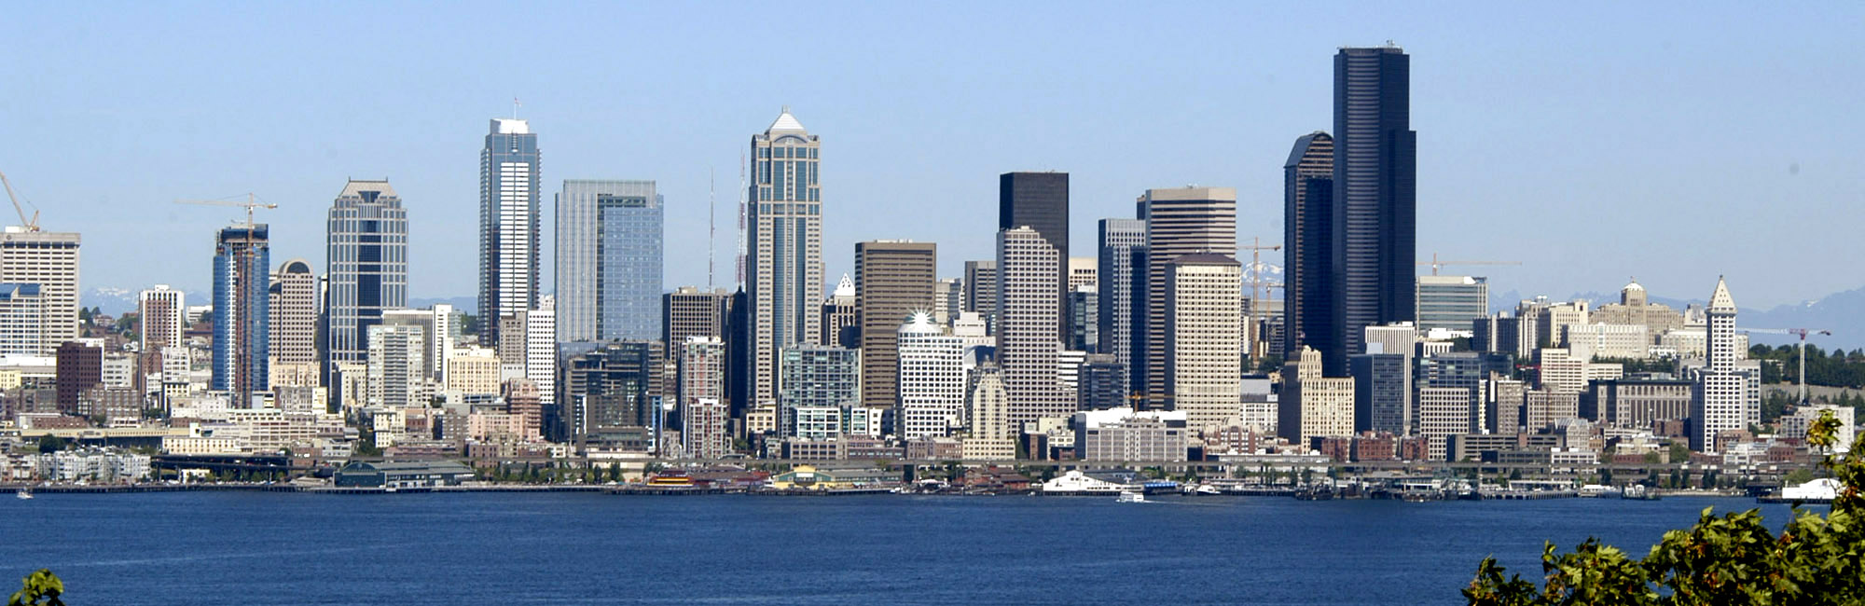
Background

Slide 4
4
4
PSRC Model/Analytical Tool Framework
Regional Economic Forecasts
Transport System
URBANSIM
Land Use Forecasts
Travel Forecasts
Air Quality Analysis
Benefit-Cost Analysis
Notes:
basic flow chart of current PSRC modeling framework – land use and travel models are the centerpiece, 2-way communication, bca tool feeds off travel model

Slide 5
5
5
UrbanSim Characteristics
Micro-simulation of actions of actors on parcels and buildings:
Households and Workers
Jobs
Developers / Landowners
Primary Inputs:
Allowable development (comp plans)
Transportation system
Major planned developments (pipeline developments)
Regional economic forecasts
Many operating assumptions:
Relocation rates
SQFT needed per job by sector
Construction costs
Vacancy rates
Simulates each year from 2001-2040
Notes:
main takeways – disaggregate, microsimulation, 40-years of simulating, 20-40 minutes run time per year

Slide 6
6
UrbanSim Set of Models
Land Development Models
Process Pipeline Events
Real Estate Price Model
Expected Sale Price Model
Household Location Models
Development Proposal Choice Model
Employment Location Models
Building Construction Model
Household Transition Model
Employment Transition Model
Household Relocation Model
Employment Relocation Model
Household Location Choice Model
Employment Location Choice Model
Economic Transition Model
Workplace Location Models
Home-based Job Choice Model
Workplace Location Choice Model
6
Notes:
2 basic groups of models – location choice and land development, real estate price model and the site values it produces will be a focus of today’s presentation

Slide 7
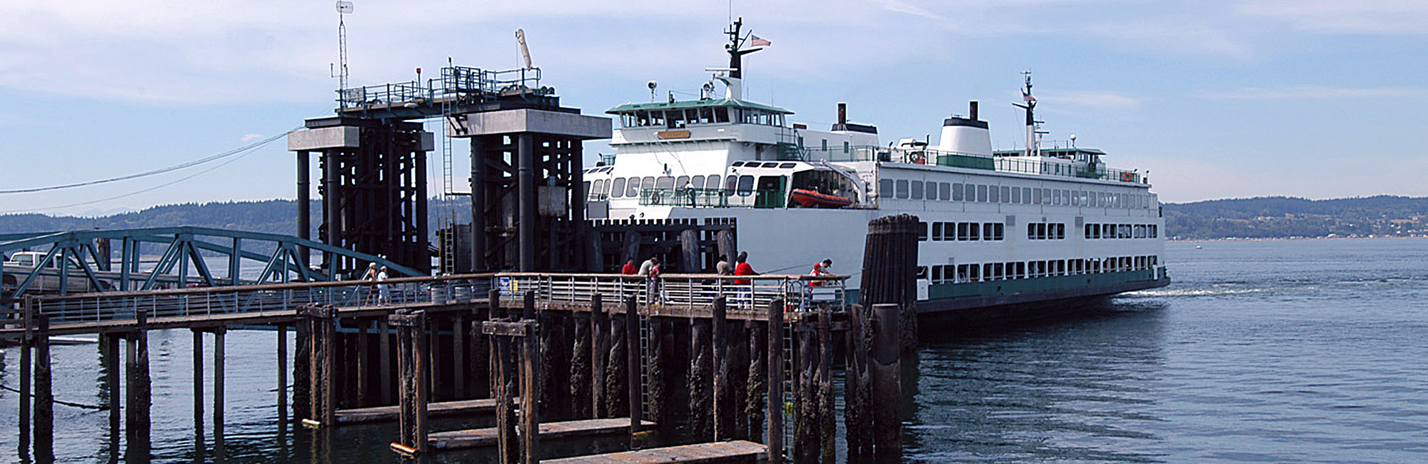
Model Integration/Application

Slide 8
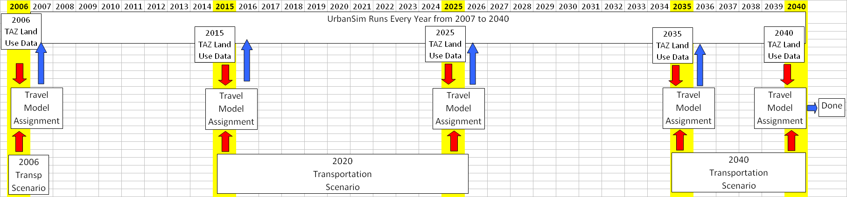
8
8
Model Handshake – Current Setup
Model Inputs and Integration | Analysis Year
 | 2006 (base) | 2015 | 2025 | 2035 | 2040
Land Use Model Runs, using accessibilities from: | a previous travel model run for land use model run 2006 | 2006 travel model for land use model runs 2007 through 2015 | 2015 travel model for land use model runs 2016 through 2025 | 2025 travel model for land use model runs 2026 through 2035 | 2035 for land use model runs 2036 through 2040
Travel Model Runs, using population and employment from: | 2006 land use model run | 2015 land use model run | 2025 land use model run | 2035 land use model run | 2040 land use model run
Notes:
here’s our automated, integrated set-up, used during our recent long range plan update – 40 urbansim runs, 5 “hybrid” travel model runs, 2 transportation scenarios (2020/2040), 6 days run time

Slide 9
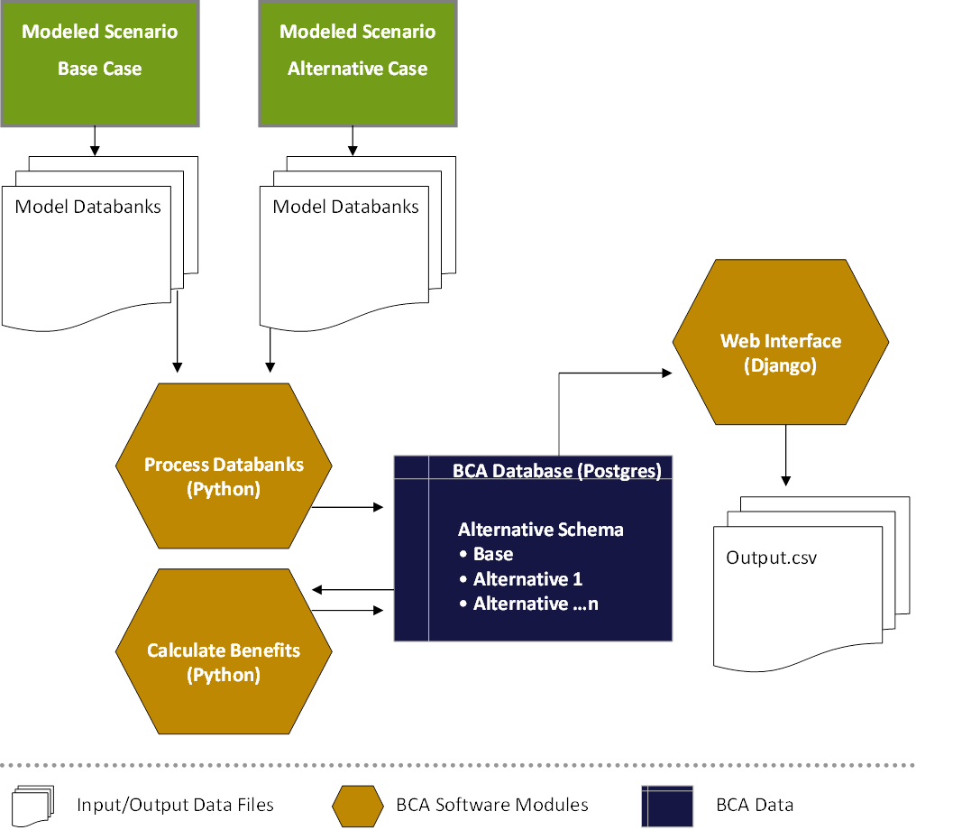
9
9
Benefit-Cost Analysis Tool
Post Travel Demand Model
Process
Compare with Base Case
Calculation/Accounting of
Consumer Surplus
Regional/Sub-Region
Geographies
Consumer Surplus Categories:
Travel Time Savings
Improved Reliability
Vehicle Operating Cost Savings
Toll/Fare Cost Savings
Accident Cost Savings
11 User Classes
5 Time Periods
275 Million Calculations
Notes:
here are the basics on our bca tool, this is where we get our user benefit data – travel time savings, diagram on right show basic flow between travel model and bca database.

Slide 10
10
Real Estate Price Model Details
Process Pipeline Events
ID | Land Use Type
2 | Civic and Quasi-Public
3 | Commercial
7 | Government
9 | Hospital, Convalescent Center
10 | Industrial
13 | Mobile Home
14 | Multi-Family Residential
15 | Condo Residential
18 | Office
19 | Park and Open Space
20 | Parking
24 | Single Family Residential
25 | Transportation, Communication, Utilities
26 | Vacant Developable
28 | Warehousing
30 | Mixed Use
Real Estate Price Model
Expected Sale Price Model
Development Proposal Choice Model
Building Construction Model
14 of 30 Land Use Types have price prediction sub-models. Non-modeled categories include water bodies, military bases, schools, existing ROW, and other undevelopable types or categories not associated with traditional market pricing / development dynamics
10
Notes:
repm is actually a set of regression equations for several different land use types, current analytical focus is on total site value without differentiating by type

Slide 11
11
11
Real Estate Price Model Details
 |  |  | T-statistics
 | Name | Description | SF | MF | Condo | Mobile Home |  | Mixed | Comm | Ind | Office | WareH | Util | Parking | Vac Dev
 | constant | Base unit price per land use type | 146.8 | 43.5 | 17.9 | 18.2 |  | 25.5 | 57.7 | 18.3 | 27.1 | 26.7 | 18.9 | 11.7 | 22.0
Location of Parcel
 | inugb | Parcel within urban growth boundary | 21.7 | - | 2.9 | 19.5 |  | 5.4 | 12.6 | 3.8 | 3.2 | 1.2 | 5.0 | 6.4 | 5.1
 | art600 | Arterial within 600 ft | 46.3 | - | - | - |  | - | - | - | - | - | - |  | -
 | hwy2000 | Highway within 2000 feet | 29.5 | - | - | - |  | - | - | - | - | - | - |  | 6.0
Accessibility / Travel Model Output
 | hbwavgtmda | Average drive time from home to work | 84.1 | 21.7 | 1.4 | 1.9 |  | 6.7 | 15.3 | 7.8 | 4.8 | 12.1 |  |  | 2.1
 | lngcdacbd | Generalized cost of travel to Seattle CBD (logarithm) | 387.6 | 67.1 | 15.4 | 17.7 |  | 16.2 | 40.3 | 10.5 | 15.9 | 13.1 |  | 4.3 | 14.6
Characteristics of Buildings & Land
 | is_pre_1940 | Built prior to 1940 (Proxy historic character) | 0.7 | - | - | - |  | - | 0.7 | - | 1.5 | 0.6 | - |  | 65.6
 | ln_bldgage | Age of building (logarithm) | 26.4 | 5.3 | 7.4 | 9.1 |  | 11.6 | 28.1 | 8.8 | 8.1 | 11.6 | - |  | -
 | lnlotsqft | Size of building lot (logarithm) | - | - | - | - |  | - | - | - | - | 31.0 | - | 2.2 | 38.4
 | lnsqft | Size of building (logarithm) | 341.2 | 57.5 | 12.2 | 37.2 |  | 9.3 | 27.4 | 6.6 | 5.3 | 41.0 | 7.8 |  | -
 | ln_invfar | Inverse of floor area ratio (logarithm) – | 189.0 | 58.5 | 4.9 | - |  | 16.7 | 72.3 | 32.8 | 44.9 | - | 18.8 | 18.8 | -
Neighborhood / Proximity to Land Uses
 | lnemp30da | Employment within 30 min drive (logarithm) | 99.4 | 21.7 | 2.3 | 7.4 |  | 6.7 | 9.7 | 1.4 | 1.5 | 2.6 | 6.0 |  | 1.9
 | lnempden | TAZ employment density (logarithm) | 59.0 | 7.1 | 4.3 | 15.7 |  | 0.9 | 10.6 | 4.0 | 17.1 | 4.1 | 5.4 | 9.0 | 7.0
 | lnretempwa | Retail and food service employment in zone (logarithm) | 40.7 | 8.4 | 0.5 | 4.8 |  | 0.9 | 12.9 | - | - | - | - |  | -
 | lnpopden | Zonal population density (logarithm) | 6.7 | - | - | 3.7 |  | 2.5 | - | 0.2 | - | - | - |  | 9.5
 | lnavginc | Average zonal household income (logarithm) | 394.4 | 43.0 | 13.1 | 12.9 |  | 0.9 | - | - | 8.5 | - | - |  | 8.1
Notes:
some detail on the variables in the repm regression models, uses zonal accessibilities: am sov travel time, generalized cost to Seattle CBD, total employment within 30-minute drive

Slide 12
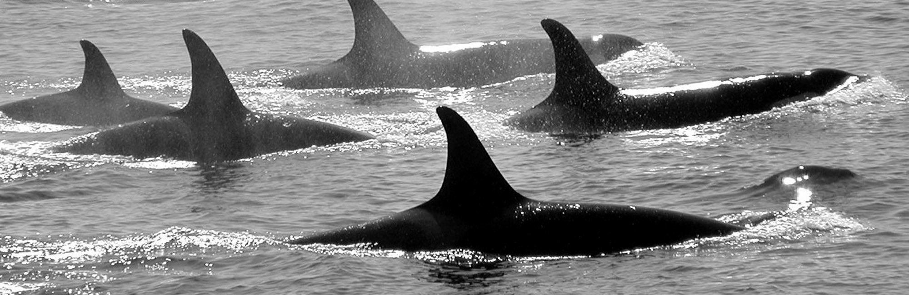
Analysis and Results

Slide 13
13
13
First Round Analysis Recap
Goal:
Explore correlation of changes in location choices of households and jobs to changes in accessibility across different transportation system alternatives
Literature Review:
Expectation of modest changes to land uses in response to incremental changes in transportation systems
Findings:
Consistent with expectations, but difficult to interpret land use response
Presented at 2010 TRB Innovations in Travel Modeling
Published in Transportation Letters: The International Journal of Transportation Research: Testing the Puget Sound’s land use model response to transportation strategies
Notes:
before I get into discussing the analysis in today’s presentation, I want step back and provide some context about we’re looking at these relationships…

Slide 14
14
14
First Round Sensitivity Tests
Base Case Scenario
Transportation Networks (2020, 2040)
Modest investments in roads and road-based transit
Near-term voter-approved rail transit extensions
Very limited tolling (two bridge crossings)
No real growth in vehicle operating costs
Modest real growth in parking costs
Alternative Scenarios
Lower parking costs in selected neighborhoods (zones)
Higher vehicle operating costs forecast
Major extensions of rail transit
Major investments in highway capacity

Slide 15
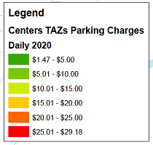
15
15
Alternatives
Light Rail
Commuter Rail

Slide 16
16
16
Second Round Analysis
Goal:
Explore correlation between transportation system user benefits (travel time savings) and real estate prices
Expectations:
Travel time savings benefits will be capitalized in land values over the long run
Lower transportation costs should result in higher site values, and vice versa
Analysis:
Keep Operating Cost and LRT Scenarios
Use Broader Sub-Region Geographies
Additional Scenarios Analyzed:
Major Freeway Capacity Halved
Major Freeway Capacity Doubled
Major Freeways = I-5, I-405, I-90, SR520

Slide 17
17
17
Second Round Analysis Results
Change in Total Site Values and Travel Time Savings by Alternative (2040)

Slide 18
18
18
Second Round Analysis Results
Changes in Total Site Values by Alternative by Sub-Region (2040)

Slide 19
19
19
Second Round Analysis Results
Percent Changes in Total Site Values by Alternative by Sub-Region (2040)

Slide 20
20
20
Second Round Analysis Results
Travel Time Savings by Alternative by Sub-Region (2040)

Slide 21
21
21
Second Round Analysis Results
Correlation of Travel Time Savings and Site Values (All Scenarios)

Slide 22
22
22
Second Round Analysis Results
Correlation of Travel Time Savings and Site Values (No LRT Scenario)

Slide 23
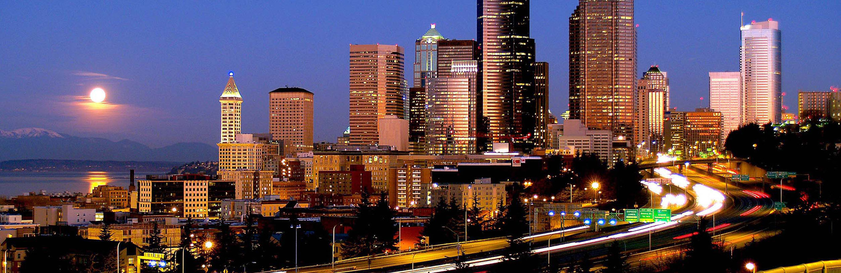
Conclusions/Future Directions

Slide 24
24
24
Conclusions/Future Directions
Basic Conclusion
Stronger correlation between site values and user benefits than between choice model results and zonal accessibilities
Follow-Up Analyses
Narrower geographies
User Classes
User benefit categories
Land uses categories/types
Choice models vs. user benefits
More sensitivity tests?
BCA Tool Questions
User benefits shared equally at origins and destinations
Investigate impact of different assumptions for discount rates and terms for present value calculations

Slide 25
25
25
Future Directions
Accessibility Variables
Continue to test zonal composite variables used in the real estate price and employment location choice models
Test simplified accessibilities for household and workplace location choice models
Expansion of zone structure (from 938 to over 3,500) should help alleviate aggregation problems
Activity-based travel model development will open up additional opportunities for disaggregate access measures
Revisit Integration Structure
Frequency of travel model runs for feedback (more or less frequent)
Activity-based model development will probably require a different approach to integration

Slide 26
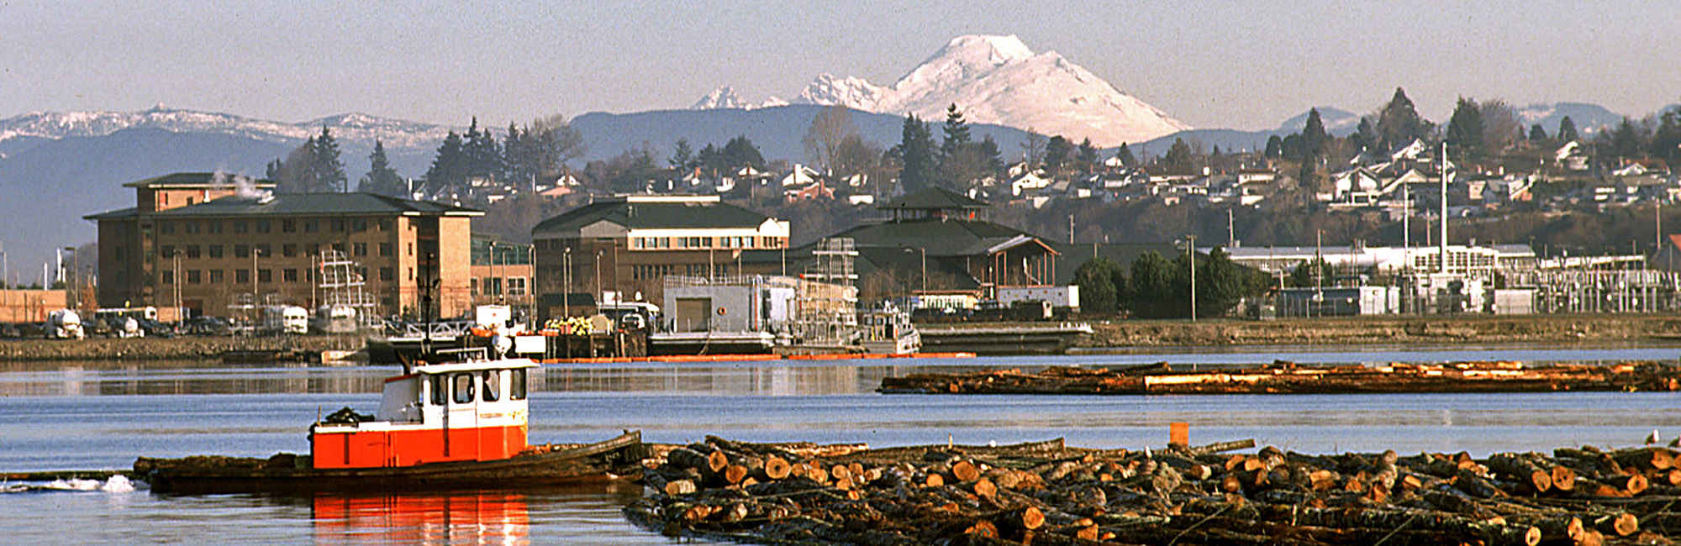
Puget Sound Regional Council:
Matthew Kitchen, Chris Johnson,
Peter Caballero, Mark Simonson,
and Stefan Coe
Maren L. Outwater, Resource Systems Group Inc

