Slide 1
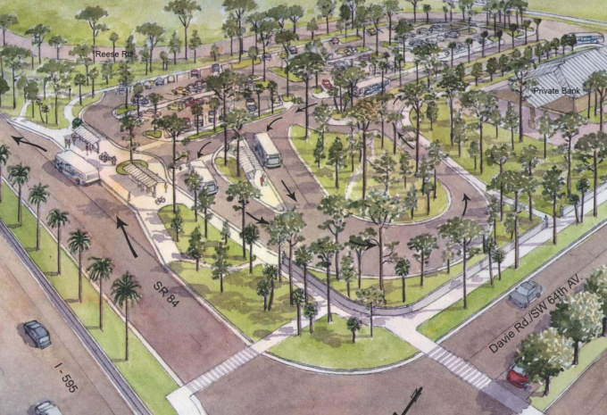
Davie Road/S.R. 84 Transit Facility Demand Estimation
Presented by
Jeff Weidner & Jeremy Mullings
Florida Department of Transportation
Yongqiang Wu & Kasey Cursey
Gannett Fleming, Inc.
Presented to
13th TRB National Transportation Planning Applications Conference
Reno, Nevada
May 9, 2011

Slide 2
Overview
Project Background
Transit Activity Estimation
Parking Demand Estimation
Summary
2

Slide 3
Participating Agencies
Florida Department of Transportation (FDOT), District 4, Office of Modal Development – LEAD
FDOT District IV, Systems Planning Office
Broward County Transit (BCT)
Town of Davie
South Florida Commuter Services
South Florida Education Center (SFEC) Transportation Facilities
Cruisin’ Community Transit Connection (CCTC)

Slide 4
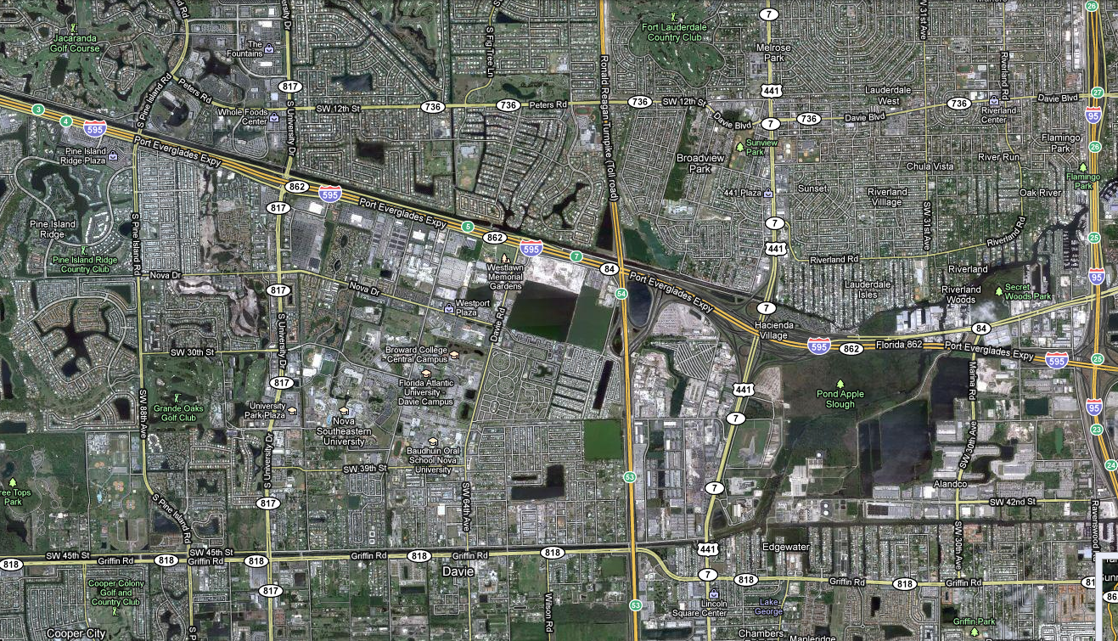




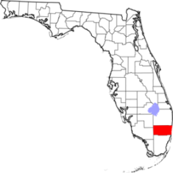
Project Location – Town of Davie, Broward, FL
Davie PnR
South Florida Education Center (SFEC)

Slide 5
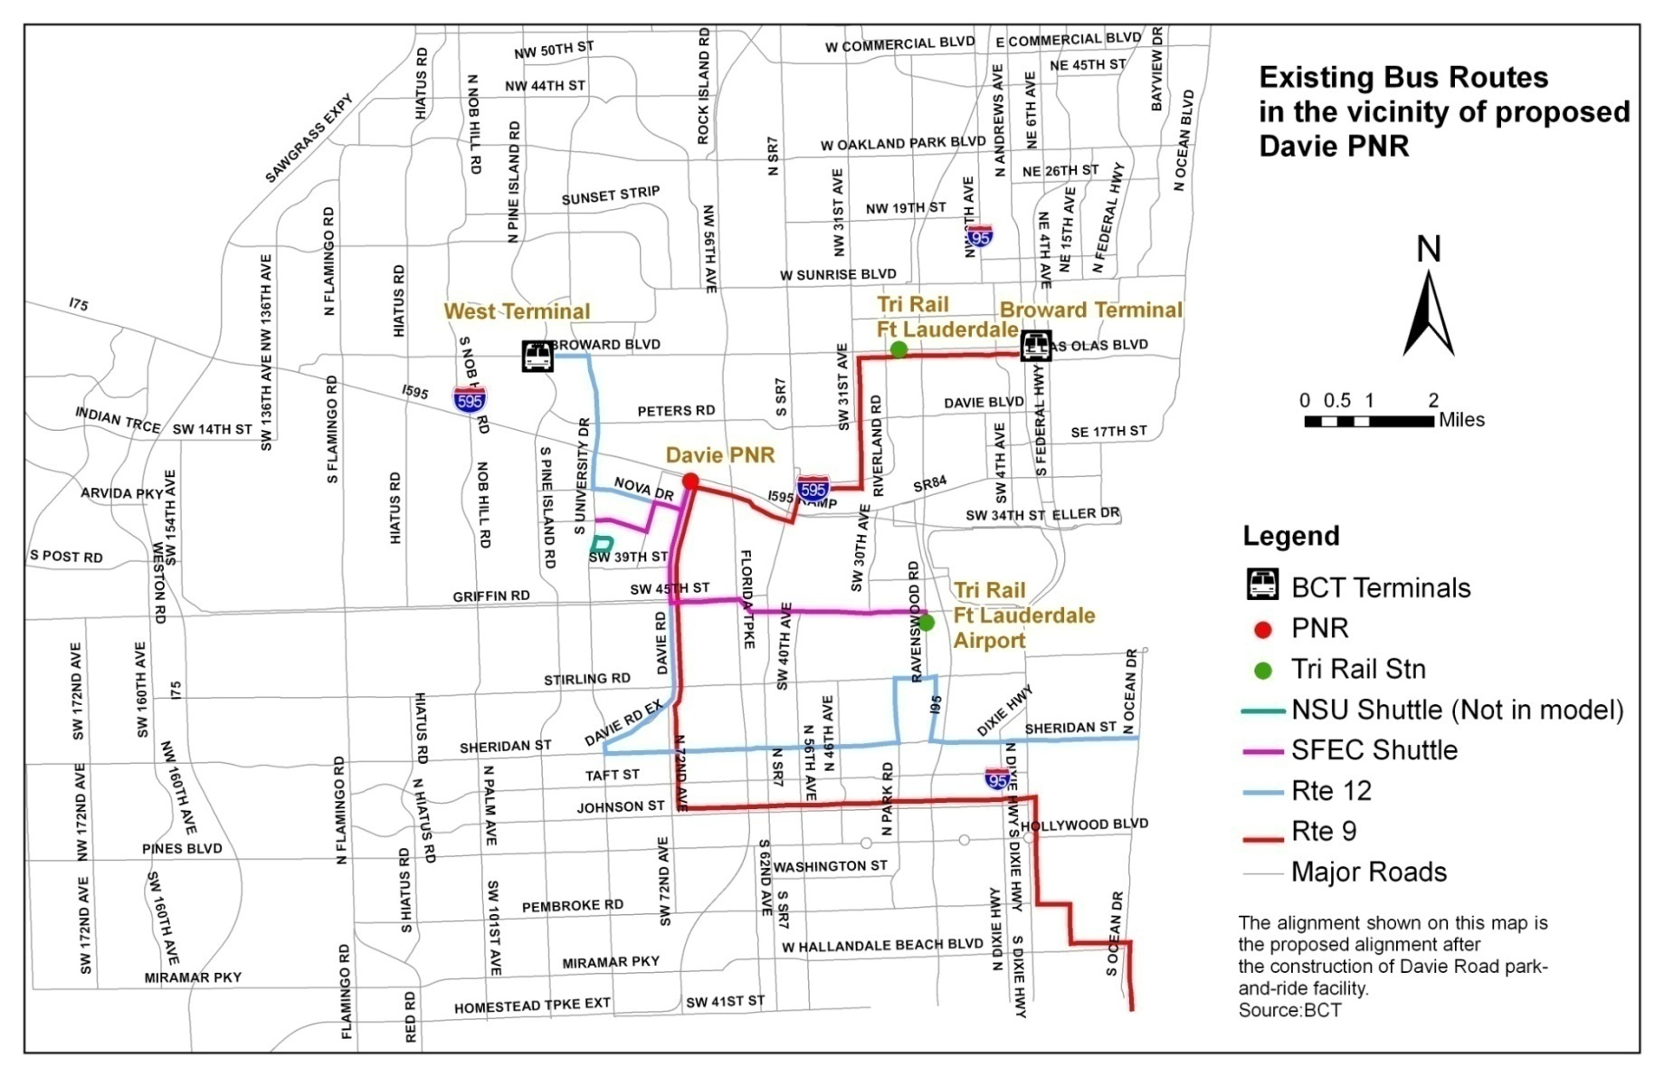
Existing Bus Services
Notes:
Route 12 operates between West Regional Terminal and North Beach Park running along major thoroughfares such as Sheridan St, Davie Rd, and University Dr.

Slide 6
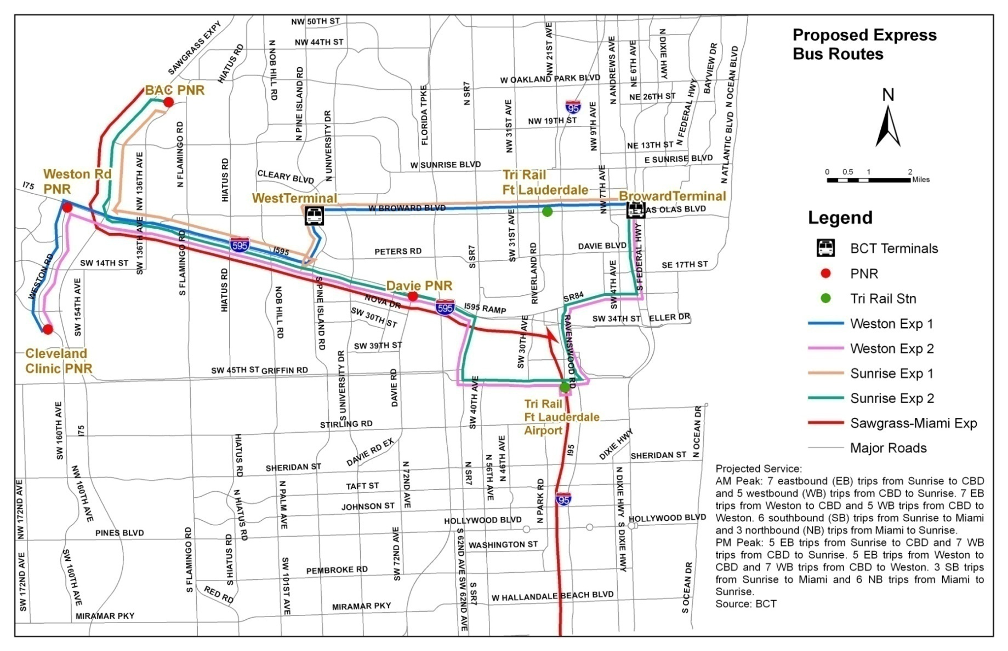
Proposed Express Services

Slide 7
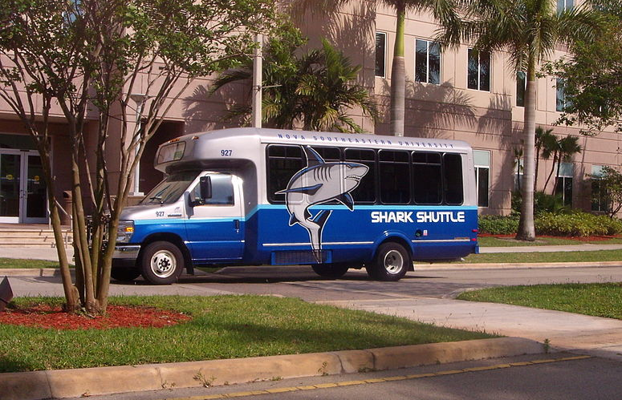
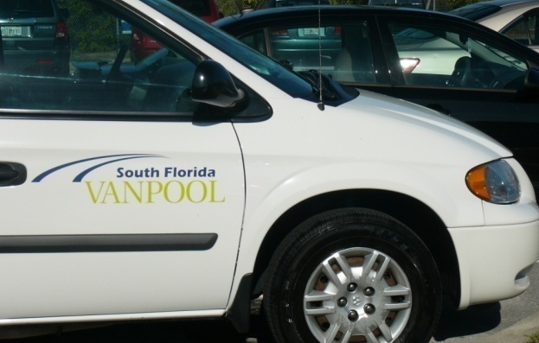
Project Needs
Develop a Park-and-Ride Transit Facility to Support Regional Connectivity and Multimodal Options in Broward County
Provide Access to Local and Express Bus Services
Provide Connections between Bus Service and the SFEC Campus Shuttle Services
Provide a Location for Commuters Using Van-pool and Carpool Options

Slide 8
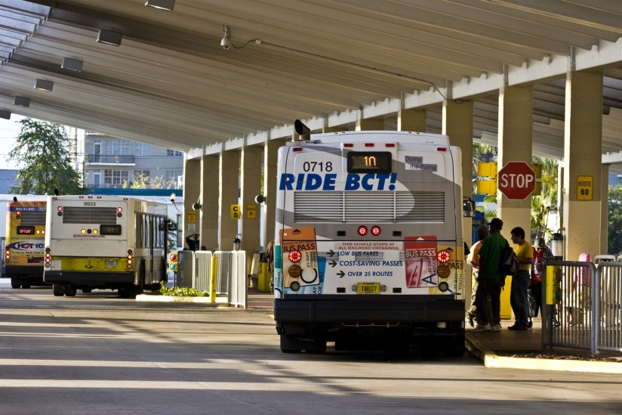
Study Objectives
Develop a General Order-of-Magnitude for Transit Activity at the Proposed Davie Facility
Determine the Number of Parking Spaces Required to Meet the Demand

Slide 9
Transit Activity Estimation
General Methodology
Use model (SERPM) to estimate future ridership
Use historical ridership for post-model adjustment when appropriate
Coordinate with local agencies
Use professional judgment

Slide 10
Southeast Florida Regional Planning Model
Covers Three Counties (Palm Beach, Broward, and Miami-Dade) in South Florida
Multimodal
Automobile
Trucks
Bus (regular, express, limited stop)
Rail (light, heavy, commuter)
Time-of-Day (AM, OP, PM)
Validated to 2005 Conditions
Includes 2030 Adopted LRTP Model

Slide 11
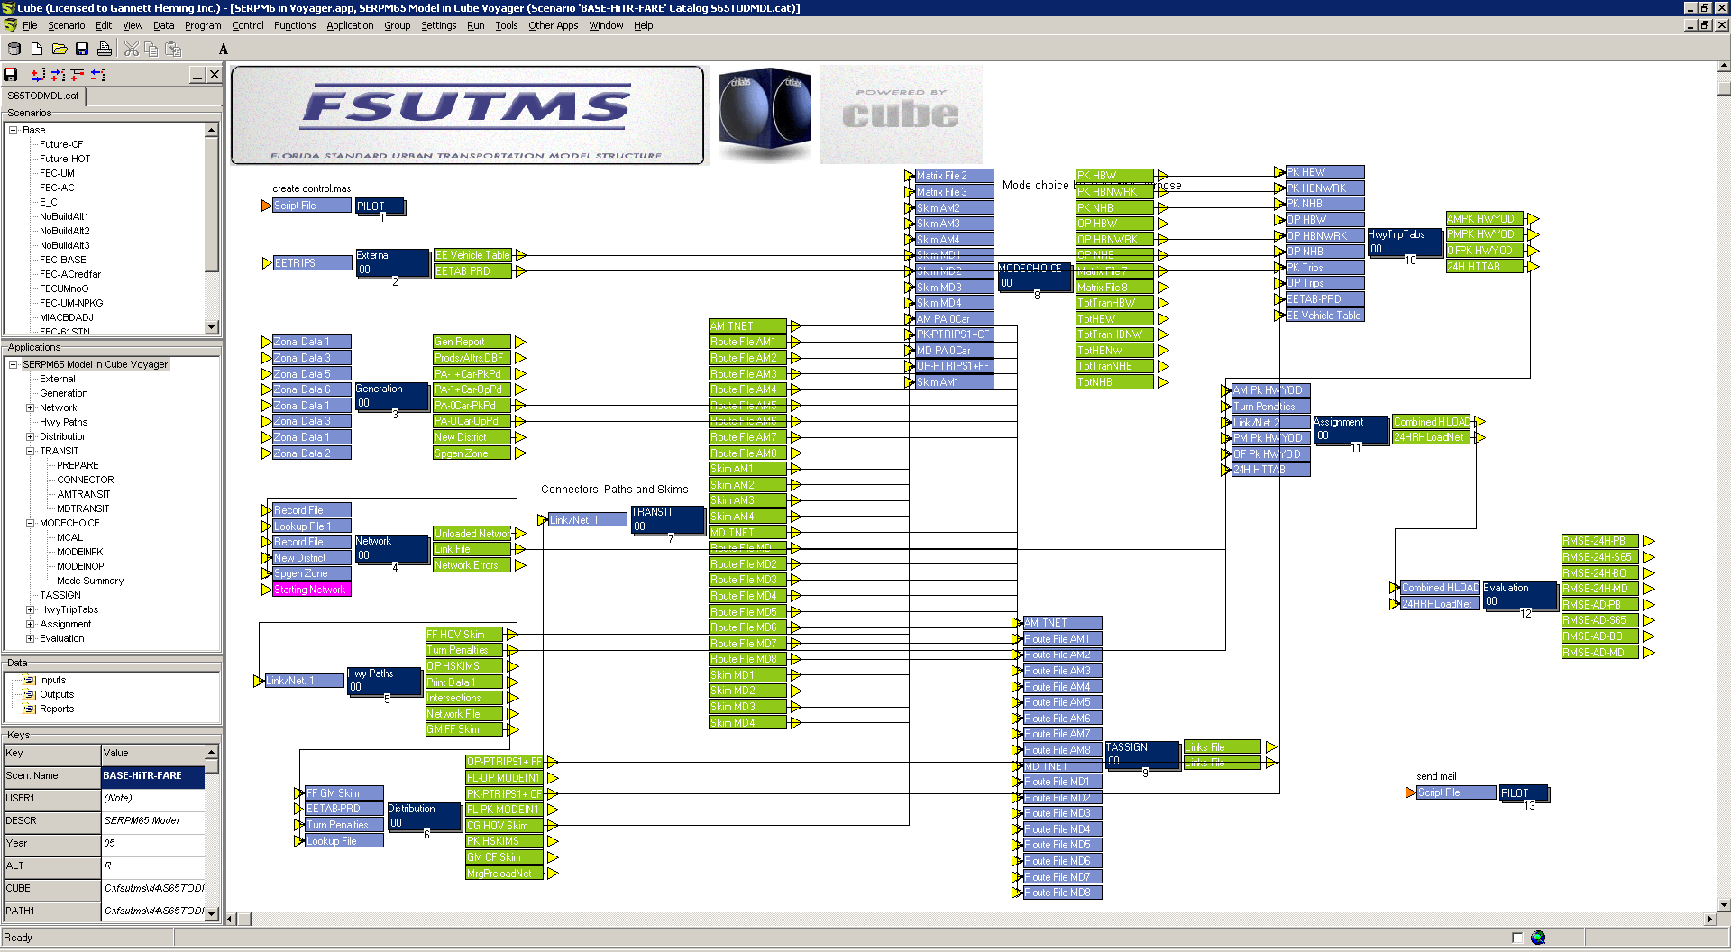
SERPM Flow Chart

Slide 12
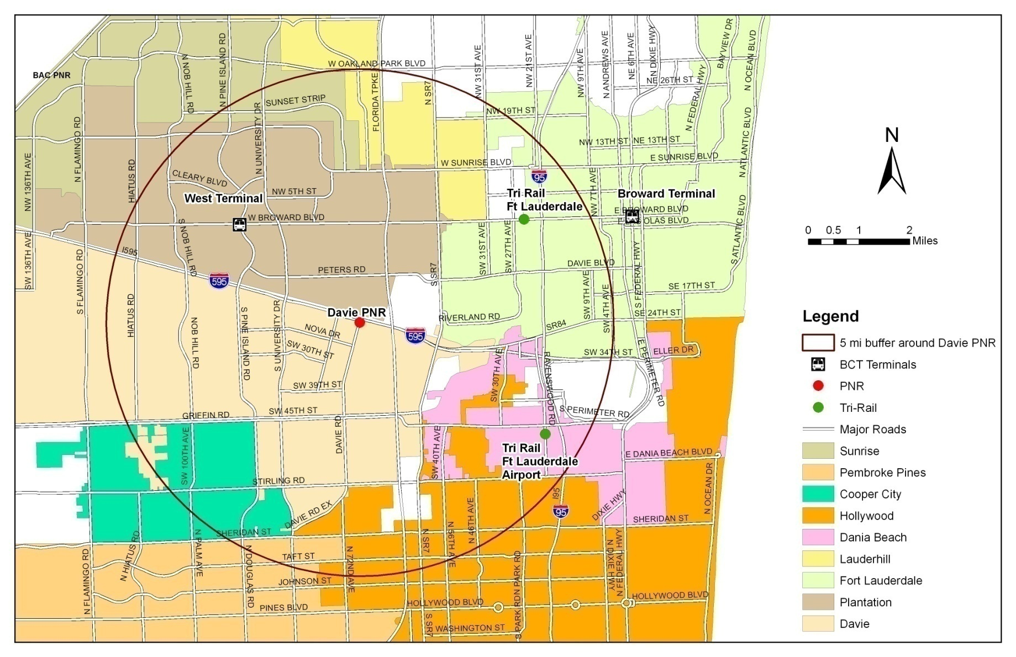
Future Population & Employment Growth
33%
12

Slide 13
Estimated Transit Activity
Route | 2030 Daily Boardings at Davie PnR | Sources
Route 9 | 148 | Model/BCT Local Data
Route 12 | 125 | Model/BCT Local Data
Sunrise Express 2 | 85 | Model
Weston Express 2 | 85 | Model
Sawgrass – Miami Express | 57 | Model
Total Transit Activity | 500

Slide 14
Parking Demand Estimation
Park-and-Ride Demand
Based on projected transit activity
Vanpool and Carpool Demand
Based on FDOT Guidelines and Coordination with FDOT’s South Florida Commuter Services

Slide 15
Total Parking Demand for Local Buses
Route | Adjusted Peak Period Boarding | PnR Share | Space Needed
Route 9 | 65 | 4% | 3
Route 12 | 99 | 4% | 4
Total Spaces |  |  | 7

Slide 16
Total Parking Demand for Express Buses
Route | Projected Peak Period Boarding | PnR Share | Space Needed
Sunrise Express | 85 | 25% | 21
Weston Express | 85 | 25% | 21
Sawgrass-Miami Express | 57 | 25% | 14
Total Spaces |  |  | 56

Slide 17
SFEC Campus Shuttle
Will Provide a Connection to Davie Park-and-Ride Lot During Peak Periods
Coordinated with Director of Facilities
Students and faculty may use shuttle at Davie to avoid parking on Campus
Built a 1,000-Space Garage in 2008
No near-term needs
Needs 12 in the Future
Current ridership 250/day
Apply 5% factor

Slide 18
Carpool and Vanpool Parking Demand
Based the State Park-and-Ride Lot Program Planning Manual by FDOT, April 2001
Formula (Adaption of the ITE Model)
Demand = a*Vp + b *Vs
Where
Vp = Total design period traffic on primary facilities
Vs = Total design period trafic on secondary facilities
a, b = Diversion Factors on the primary/secondary facilities
Design Period Traffic from the Model
a = 0.03, b=0.01(Manual Recommended)

Slide 19
Total Parking Demand
Route | Space Needed
Local Bus (minimal for 2010) | 7
Express Bus | 56
SFEC Campus Shuttle | 12
Carpool/Vanpool | 65
Total Estimated Demand for Parking | 140

Slide 20
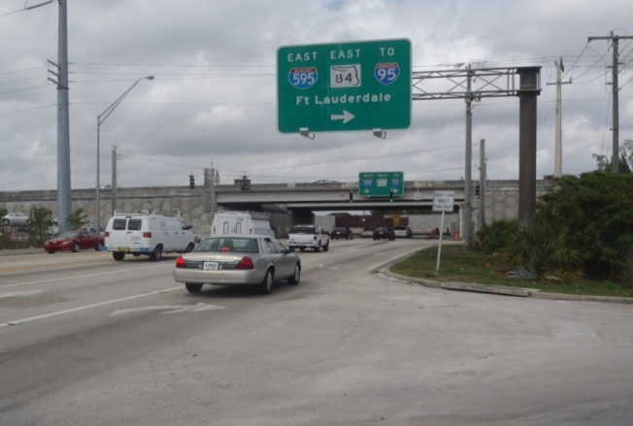
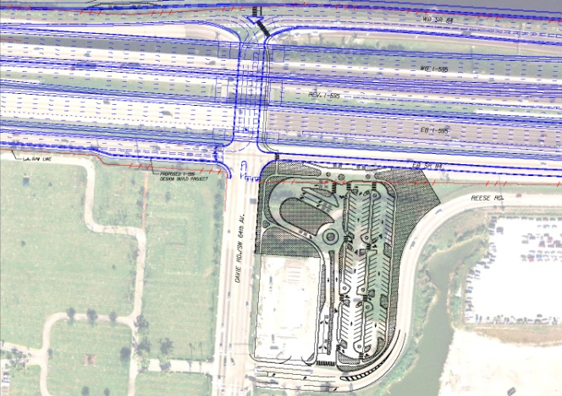
Summary
Involved Using SERPM Model, Post Model Adjustment Procedures, FDOT Guidelines, and Professional Judgment
Total Transit Activity at Davie Projected to be 500 Daily Boardings
Will need 140 Parking Spaces
Final Design Scheduled for July 1, 2011.

Slide 21

Questions?

