Slide 1
Validating an Interregional Travel Model:
A Case Study in California
Nicholas J. Linesch
Giovanni Circella
Urban Land Use and Transportation Center
Institute of Transportation Studies
University of California, Davis
TRB Planning Applications – 2011.05.08
Notes:
Some variety in fonts is pleasing to the eye. Some off-white color (gold) may also look good.

Slide 2
Modeling

Slide 3
Inputs
Models
Outputs
Zone System
Short Distance Personal Travel Model
(SDPTM)
Trip Lists
Road Network
Trip Tables
Transit Network
Loaded Network
Long Distance Personal Travel Model
(LDPTM)
Population
Travel Times and Costs
Employment
Other Zonal Properties
Short Distance Commercial Vehicle Model
(SDCVM)
Summary Travel Statistics
Maps
Long Dist. Commercial Vehicle Model
(LDCVM)
Graphs
External Travel Model
(ETM)

Slide 4
Data Flows
Data collection
Data processing
Data management
Data distribution
Feedback and assessment
Data
Information
Knowledge
*Idea from Russell Ackoff

Slide 7
Long Distance
MPO Interregional
Definition: A long distance trip in the CSTDM is one that is greater than 100 miles
*>50 miles for commercial vehicles
Definition: An MPO interregional trip is any trip that crosses an MPO boundary
16.2%
16.6%
Notes:
A couple of things are affected here:
1)Distance between stations
Error increases with # of exits on the freeway
On the highway, vehicles have to keep going
It is hard to assess how much these account for
It would be interesting to study if the error in this approximation and if it is bigger or smaller than the error percent we have in the sampling procedure
Similar to when we were evaluating the randomness In the model.
Can not assess small changes if it is within the randomness margin of error.

Slide 8
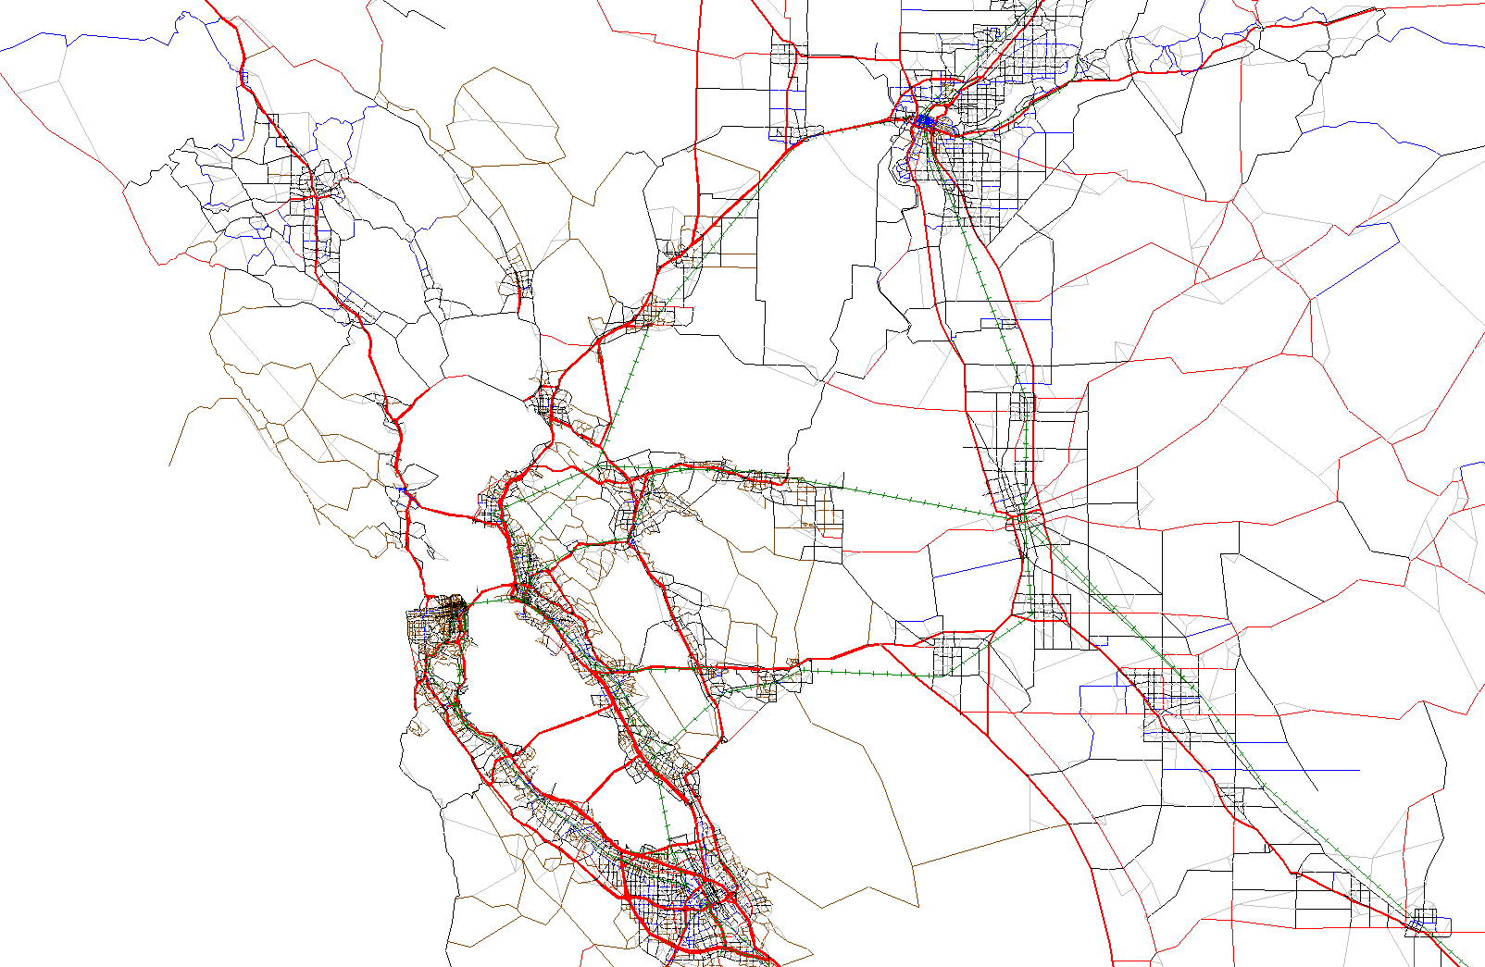
Notes:
----- Meeting Notes (5/6/11 09:02) -----
The gold screenline crosses through the city directly.

Slide 9
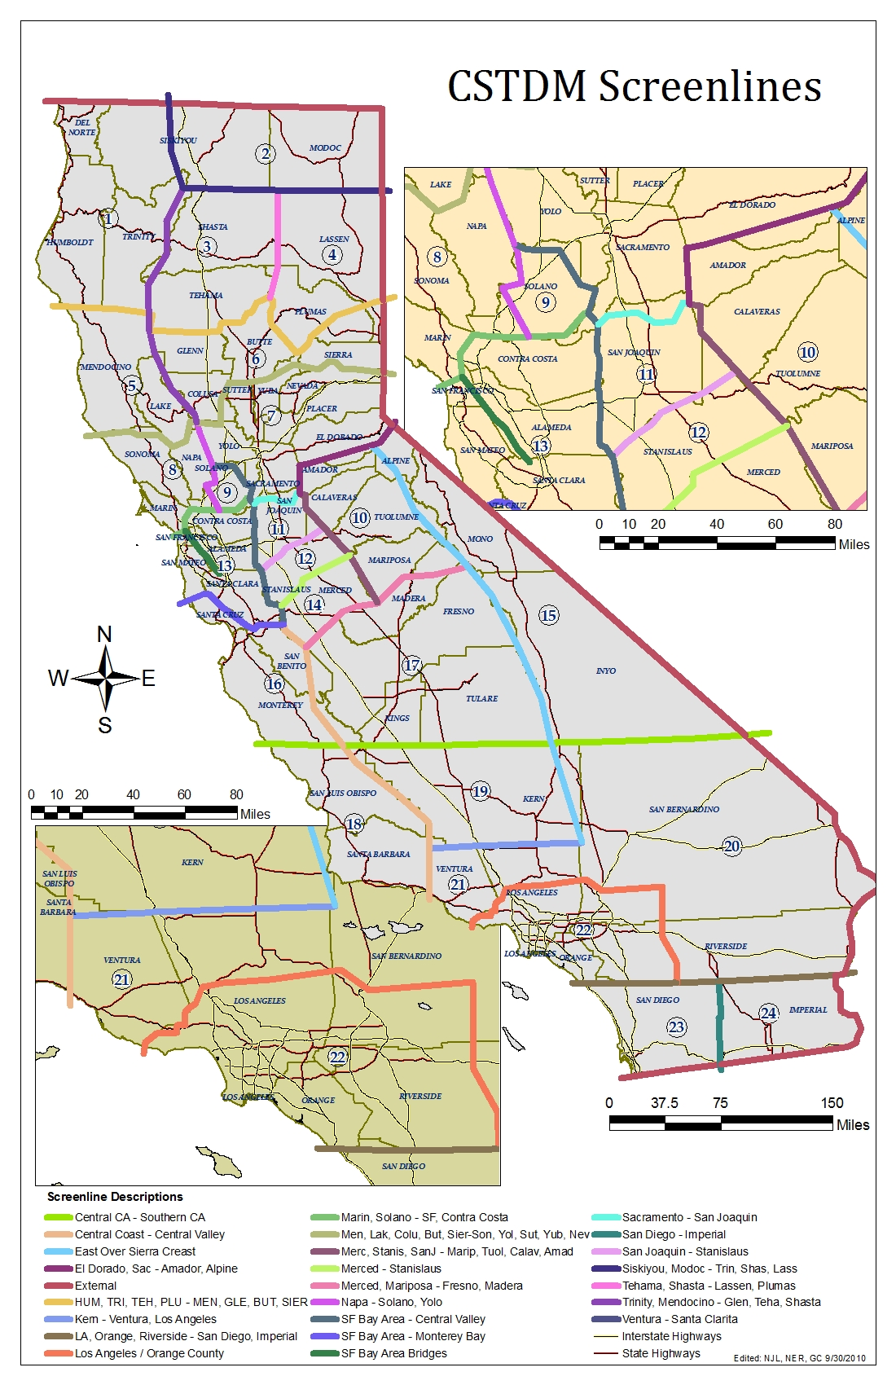
Notes:
----- Meeting Notes (5/6/11 09:02) -----
How is the database built? Getting the TSN data and Raw data from Caltrans. Processing is using access & R to make the statistics.

Slide 10
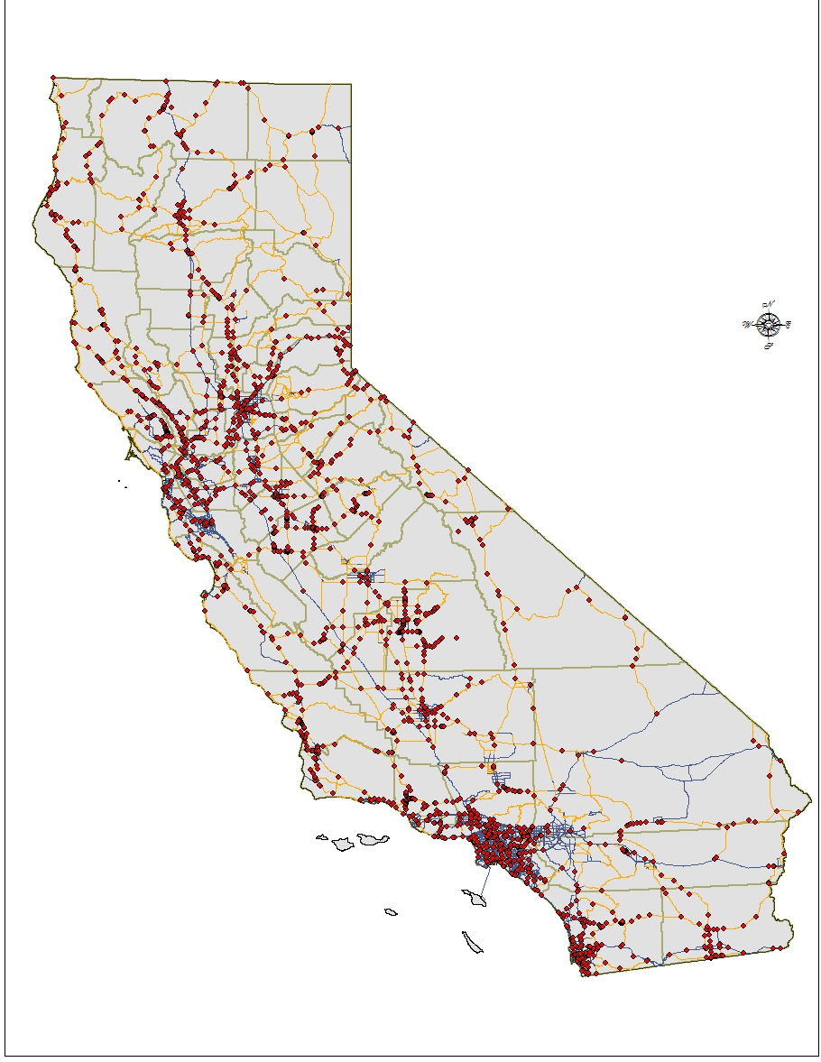
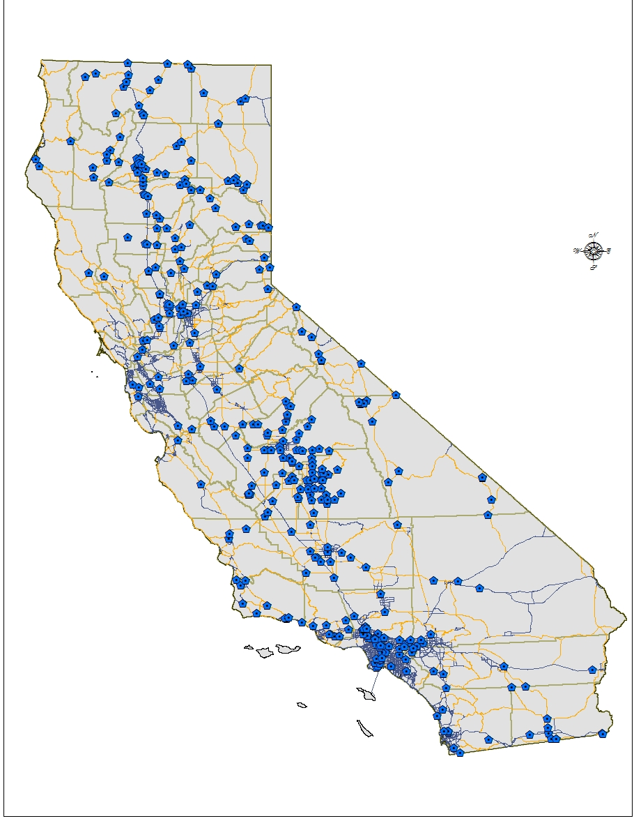
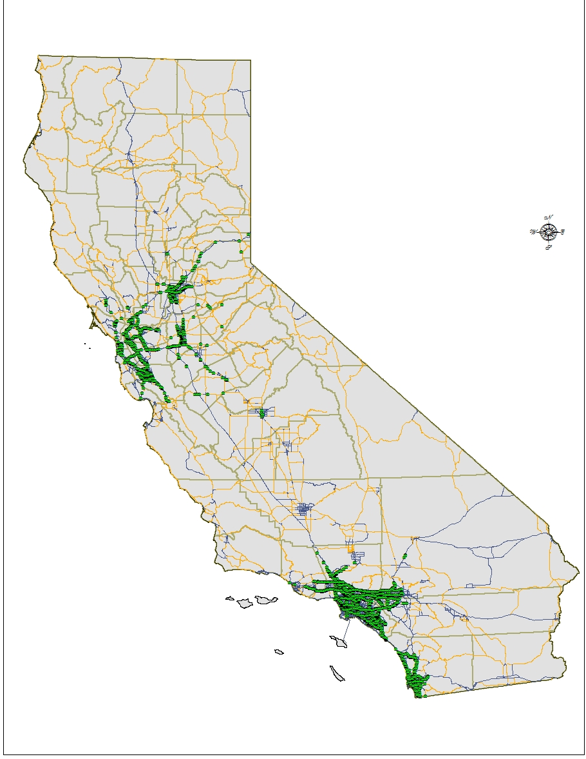
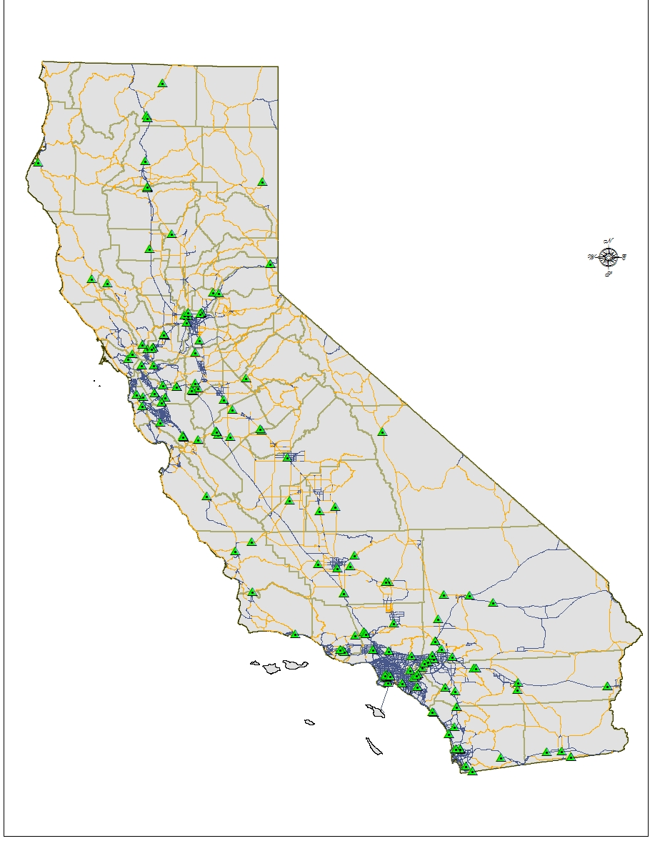
Statewide Count Database 2008
WIM Stations
Truck Stations
TSN Stations
PeMS Detectors

Slide 11
Theory

Slide 12
Theory

Slide 13
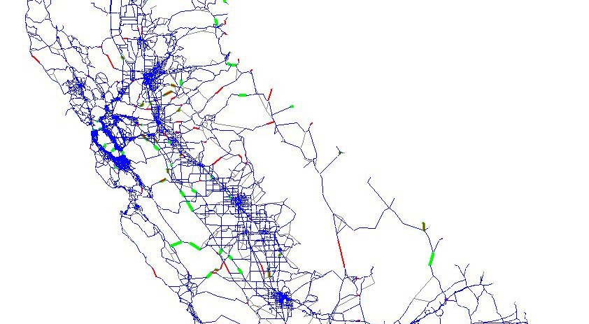
Model Validation: Counts vs. VMT?
Notes:
VMT is a computed measure which will introduce some error. Put some information about our software approach and integration between the programs and striving for automatic system.
----- Meeting Notes (5/7/11 16:52) -----
Why did the circled elements
End with: What are the

Slide 14
Discussion
Can VMT be used for further model validation?
Is this strategy of VMT estimation helpful for policy involving GHG reduction strategies?
Notes:
Why?
There is an interest in VMT WRT GHG emissions
Where do previous VMT estimates come from?
Now we can build the specific VMT estimate with specific estimate assumptions
We can make a comparison to the modeled volumes for policy analysis. Does the policy really reudce VMT.

Slide 15
Thank you
Nicholas J. Linesch
njlinesch@ucdavis.edu
Modeler, Graduate Student
Urban Land Use and Transportation Center
University of California, Davis

