Slide 1



Integrated Dynamic Traffic and Transit
Assignment Considering Traffic Congestion and a Schedule-Based Transit Network
May 8, 2011 (2:45PM~4:30PM)
13th TRB National Transportation Planning Applications Conference
Hyunsoo Noh, Alireza Khani, Mark Hickman,
and Yi-Chang Chiu
The University of Arizona
Notes:
Pretty high-level conceptual integration among auto, transit vehicles and passengers including integration between ABM and DTA.

Slide 2
Contents
  Background and Motivation
  Dynamic Traffic Assignment Models
  Transit Assignment Model
  Integration Models
  Application (Rancho Cordova, CA)
  Result
  Conclusion

Slide 3
Background and Motivation
  Activity-based model
    Tour-based model
    Sequential activity choice model
  Necessity of time-dependent traveler model
  Necessity of intermodal architecture
Background DTA Model FAST-TrIPs Integration Model Application Result Conclusion
Notes:
Activity-based model (ABM)
Tour-based or sequential activity choice model
Tour-based model
Tours are generated and specified to multiple trips (e.g., DaySim)
Sequential activity choice model
Centered on anchor activities, every trip is generated at current place and time according to time-space prism (TSP) (e.g., OpenAMOS)
Travel behavior is more dependent on a specified current situation
Necessity of time-dependent traveler model
The next activity is affected by the time arrival at a specific activity.
Activity Cancel, Rescheduling, and so on.
For the reason, it requires an integration between activity and DTA model
Necessity of intermodal architecture
Activity modes are specified to auto-transit, walk (or bike)-transit

Slide 4
Dynamic Traffic Assignment Model
  DynusT and MALTA*
* MALTA: Multi-resolution Assignment and Loading of Transportation Activities
Background DTA Model FAST-TrIPs Integration Model Application Result Conclusion
Notes:
DynusT
Simulation-based assignment model
Anisotropic mesoscopic simulation (AMS)
Speed-Influencing Region(SIR) is interpreted for each vehicle
MALTA
Faster simulation tool using parallel processing environment
AMS
Any assignment model can be mounted on MALTA (C++)

Slide 5
Flexible Assignment and Simulation Tool for Transit and
Intermodal Passengers (FAST-TrIPs)
FAST-TrIPs
  Frequency-based model
  Schedule-based model
Frequency-based Assignment
  “Strategies” assignment approach
  Headways for 10 minutes or less, or without the schedule
Schedule-based Assignment
  Route (specifically run) for transit schedule
  Preferred arrival time (PAT)
  Logit-based SUE model
Background DTA Model FAST-TrIPs Integration Model Application Result Conclusion
Notes:
Frequency-based assignment model using Spiess and Florian methodology.
Schedule-based assignment model

Slide 6
Schedule-based Assignment Model
Link-Based Time-Expanded (LBTE) Schedule Network
e₁
[25, 7]
[cost, departure time]
e₅
e₆
[6, 19]
[6, 8]
e₁₀
[4, 15]
e₂
[7, 1]
e₇
e_{s}
[6, 28]
e_{t}
A
B
C
e₁₁
[4, 21]
D
e₃
[8, 5]
e₈
[4, 11]
e₁₂
[10, 13]
e₉
e₁₃
e₄
[7, 10]
[5, 16]
[10, 23]
e₁₄
[10, 43]
Route 1
Route 3
Route 2
Route 4
Background DTA Model FAST-TrIPs Integration Model Application Result Conclusion
Notes:
Each link represents each run of a route, by the schedule of each route
Each link has attributes such as cost and departure time
Contribution: reduce the network size as eliminating more transfer nodes

Slide 7
Transit Network
  Link-based schedule network
  Google's General Transit Feed Specification (GTFS)
Transportation Network
  Access link
GTFS Stop Time
Trip ID
Arrival Time
Departure Time
Stop ID
Stop Sequence
Trip Headsign
…
Transportation Node
Link-based Schedule
Node ID
Node Latitude
Node Longitude
Node Type
…
Link ID
Node I
Node J
Link Type*
Link Mode
Dep/Arr Time
…
GTFS Stop
Stop Latitude
Stop Longitude
Stop Code
Stop ID
…
* OD, Access, and
Transit links
Background DTA Model FAST-TrIPs Integration Model Application Result Conclusion
Notes:
GTFS Stop Time and Stop information will be used for generating each schedule link.
Transportation Node (zone or parcel centroid or node) and GTFS stops are used for generating access links.

Slide 8
Hyperpath
  Different strategies at each stop by each traveler.
  A logit type hyperpath using log-sum .
e₁
[25, 7]
[cost, departure time]
e₅
e₆
[6, 19]
[6, 8]
e₁₀
[4, 15]
e₂
[7, 1]
e₇
e_{s}
[6, 28]
e_{t}
A
B
C
e₁₁
[4, 21]
D
e₃
[8, 5]
e₈
[4, 11]
e₁₂
[10, 13]
e₉
e₁₃
e₄
[7, 10]
[5, 16]
[10, 23]
e₁₄
[10, 43]
Route 1
Route 3
Route 2
Route 4
Background DTA Model FAST-TrIPs Integration Model Application Result Conclusion
Notes:
Each passengers strategy will be applied on the schedule network at each stop.
As connecting this strategy from origin to destination, a hyperpath is searched.

Slide 9
Assignment Model
  MSA using Hyperpath with Logit model
  Gradient projection
Assignment Procedure
O-D,PAT, Mode
Hyperpath Search
Demand
(by O-D, PAT, Mode)
Demand
Loading Demand on
Hyperpath
Capacity Penalty Update
Converge?
No
Yes
Stop
Background DTA Model FAST-TrIPs Integration Model Application Result Conclusion
Notes:
- Analytic model.
- Assuming demand for O-D, PAT and specific mode (including intermodal),
- a hyperpath will be searched and
- the passenger demand will loaded on the path considering capacity of each transit vehicle.
- As going through the convergence step, we will decide if we need more iteration.

Slide 10
Integration Model 1
Tour-Based Integration
Tour-Based Model
(Data: Trip, Tour)
traveler.dat
(Auto, Transit,
and Auto-Transit)
Intermodal Path
Auto
Assignment
Auto –
Transit
Simulation
Passenger
Simulation
Transit
(Intermodal)
Assignment
DynusT
FAST-TrIPs
Auto, Transit Skim
Background DTA Model FAST-TrIPs Integration Model Application Result Conclusion
Notes:
Integration model 1: integration between tour-based activity model and DTA (specifically) DynusT model.
integration between vehicle DTA model and passenger DTA model using transit vehicles or intermodal modes
- Above all, assume that tours (trips) are given to DTA model and
Take a data conversion process. “traveler.dat” which is input file for DynusT and FAST-TrIPs
After going through each DTA assignment model, activate vehicle – passenger simulation
Intermodal paths are given from transit (intermodal) assignment for creating the next iteration traveler.dat
Final auto and transit skim will be forwarded to tour-based activity model.

Slide 11
Integration Model 2 (session 6)
Activity Choice Model
Activity-Based Model
(O/D, Mode at Time Intv.)
Convergence
(Transit Assignment)
FAST-TrIPs
Auto Assignment
FAST-TrIPs
MALTA
Auto Path
(Intermodal)
Transit (or Intermodal)
Assignment
Re-Assignment
for Missing
MALTA
Auto + Transit Vehicle
Simulation
FAST-TrIPs
MALTA
Arrival
(Auto,
Passenger)
Passenger Simulation
Convergence
(Auto Assignment)
Day-to-Day
Auto Skim
Transit
(or Intermodal)
Skim
Day-to-Day
Background DTA Model FAST-TrIPs Integration Model Application Result Conclusion
Notes:
Integration model 2: Integration between sequential activity choice model and DTA (MALTA) model
Adding vehicle-passenger DTA model
Starting from o-d demand at each time interval which are given from the sequential activity choice model,
The data will be given to MALTA and FAST-TrIPs and for intermodal case, FAST-TrIPs will give the auto path part to MALTA.
And then vehicle-passenger simulation is made. If any arrival, it will be forwarded to activity model for the next discretionary trip.
Auto and Transit (passenger) skim will be generated and after going through the convergence check, finalize a day trip.

Slide 12

Simulation Structure
Activities and travel requests
e,g,, OpenAMOS, DaySim
Google GTFS and/or transit line information
Auto trips
Transit and intermodal trips
Routes, stops, schedules
Auto Skims
Transit Passenger Assignment
Simulation of Vehicle Movements
(Auto, Transit)
Auto part of Intermodal
Passenger arrival from auto
Passenger arrival time, stop, boarding behavior
Missing-
a-bus
New Path
Transit vehicle
approach
Passenger Simulation
Need to stop
STOP
STOP
Bus # 2321
Pass. # 12
Pass. # 25
Pass. # 47
Bus # 2322
Pass. # 87
Pass. # 19
…
Stop # S21
Pass. # 24
Pass. # 99
…
Stop # S33
Pass. # 76
Pass. # 59
Pass. # 41
Transit vehicle
arrival
Dwell time, Hold
Passenger experience
Vehicle Skims
Transit Passenger Skims and Statistics
DynusT | MALTA
FAST-TrIPs
Background DTA Model FAST-TrIPs Integration Model Application Result Conclusion
Notes:
- More in detail about vehicle and passenger simulation models
Given demand by activity models and transit network using GTFS,
Auto and transit or intermodal passenger trips from are separated in vehicle and transit passenger assignment and simulation model
GTFS info. is also separated to vehicle and transit passenger model to run transit vehicles and passengers
Initially auto skims are given to transit passenger assignment side to create intermodal path and auto part of it will be returned to vehicle movement model.
After transit assignment, passenger arrivals are simulated in passenger simulation.
On the other hand, if bus is approaching a stop, it will check out if there are any passengers waiting for the bus and the simulation side let the transit vehicle know if the bus need to stop.
And then transit vehicle will stop a the stop and updating dwell time and holding time by some holding policy and moving on along the route.
at last passenger experience will be recored to generate skims and statistics.

Slide 13
Vehicle Simulation
yes
Dwell=on or
Hold=on?
no
Transit Movement
(Mixed w/ Traffic)
Hold = off
Dwell = off
t= t+dt
no
Approaching
to a stop?
yes
Pass.
at Stop &
Transit Veh
FAST-TrIPs
no
Boarding or
Alighting?
yes
if (Dwell=off)
Dwell Time =f( # of pass.);
End=t+Dwell Time;
If (t < End) Dwell=on, else Dwell =off
If (t < Dep) Hold = on, else Hold =off
Update Dwell Time
And Holding Status
(on, off)
Background DTA Model FAST-TrIPs Integration Model Application Result Conclusion
Notes:
This diagram shows more specifical dwell time and holding policy.
Initially hold and dwell are off and then through two steps update dwell time and holding status by the # of passengers and schedule time.

Slide 14
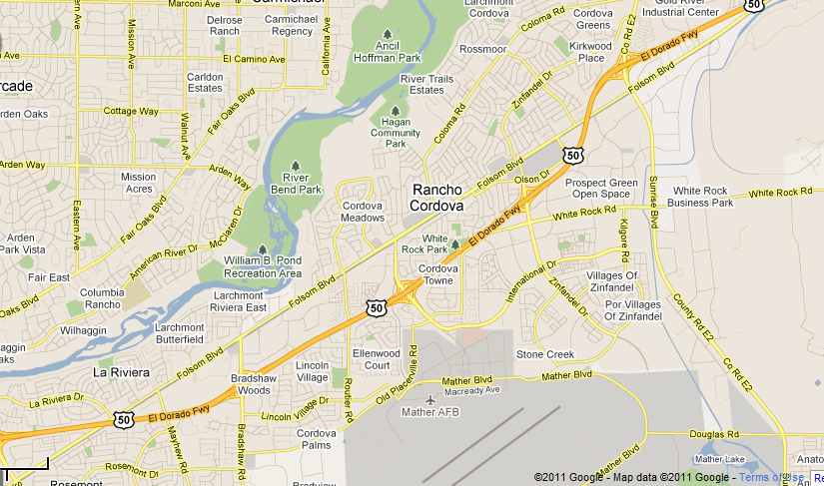
Application
Auto Network (Rancho Cordova, CA)
Trade Center Dr &
Sunrise Blvd LRT
(cap.: 487)
Folsom Blvd &
Mather Field Rd
(cap.: 235)
Road Network
Butterfield Way &
Folsom Blvd
(cap.: 406)
Number of Nodes
Number of Links
Number of Zones
Number of Parcels
Number of Park-&-Ride
448
850
121
20,486
3 (LRT)
http://www.sacregion511.org/rideshare/parkandride/
Background DTA Model FAST-TrIPs Integration Model Application Result Conclusion
Notes:
For application we uses Rancho Cordova is prepared.
- Road network is, as you can see it is relatively small, but number of parcels are large enough.
We have 3 p-&-r facilities which has its own capacity of the facility.

Slide 15
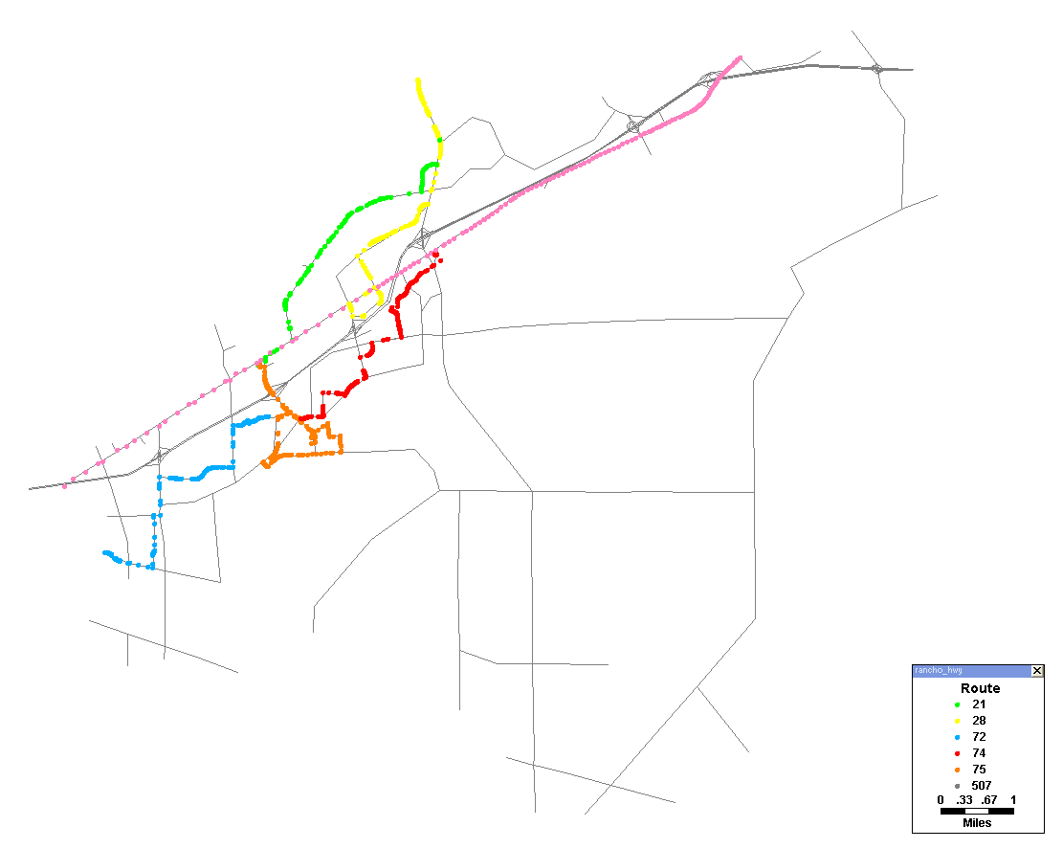
Transit Network (Rancho Cordova, CA)
Park-&-Ride Facility
28
28
21 72 74 75 507
21
(LRT Gold line)
21
507
Folsom Blvd &
Mather Field Rd
74 507
Trade Center Dr &
Sunrise Blvd LRT
74
Butterfield Way &
Folsom Blvd
74
Transit Network
Number of Stops
Number of Trips
Number of Stop Times
Number of Routes
163
1,206
16,117
5 Bus + 1 LRT
75
75
72
72
Background DTA Model FAST-TrIPs Integration Model Application Result Conclusion
Notes:
Transit network as you can see,
163 stops, 1,206 trips, 16,117 schedules, and 5 bus routes and 1 LRT
Three park and ride facility are available bus routes.
transferability is pretty high on Folsom Blvd & Matherfield Rd

Slide 16
Result
Scheduled Hyperpath
Mode: Walk-Transit-Walk
Access time : 2.92 Mins.
On: 335305,7:40:00,370
Off: 335305,7:48:00,9923/5290
On: 344131,7:44:00,370
Off: 344131,7:52:00,5290/9923
Transfer time : 0.85 Mins.
Parcel # 562770
Folsom Blvd & Sunrise Blvd
507
On: 336347,7:28:00,7066
Off: 336347,7:34:00,7069
Folsom Blvd & Mather Field Rd
75
9923 | FEMOYER ST & SCHIRRA AVE
MATHER BLVD & BLECKLEY ST | 5290
Parcel # 499638
PAT: 7:45 ~ 8:00
Background DTA Model FAST-TrIPs Integration Model Application Result f Conclusion

Slide 17
Scheduled Intermodal Hyperpath
Mode: Auto-Transit-Walk
On: 335305,7:40:00,370
Off: 335305,7:48:00,5290/9923
On: 344131,7:44:00,370
Off: 344131,7:52:00,5290/9923
Parcel # 562770
Access time : 4.86 Minutes.
Folsom Blvd & Mather Field Rd
75
9923 | FEMOYER ST & SCHIRRA AVE
MATHER BLVD & BLECKLEY ST | 5290
Parcel # 499638
PAT: 7:45 ~ 8:00
Background DTA Model FAST-TrIPs Integration Model Application Result Conclusion
Notes:
Assumptions: park-and-ride facilities are given and should be used for making Auto-transit-walk mode

Slide 18
Simulated Passenger Paths
Mode: Walk-Transit-Walk
Planned path for PassID 102 :
444 (7:24AM) - walk - LRT Gold – Transfer at stop 7069 to Bus Route 75 - Alight at 5290
Background traffic: 72,501 Vehicles
Time: 6~10AM
At time 447 (7:27AM)
PassID 102 transferred to 7066
and got on 345158
Parcel # 562770
At time 453 (7:33AM)
vehID 345158 arrived at 7069
passID 102 got off 345158
At time 454 (7:34AM)
PassID 102 transferred to 370
At time 459 (7:39 AM)
PassID 102 got on 335305
At time 467 (7:47 AM)
vehID 335305 arrived at 5290
PassID 102 got off
Arrived at destination
75
Parcel # 499638
PAT: 7:45 ~ 8:00
MATHER BLVD & BLECKLEY ST | 5290
Background DTA Model FAST-TrIPs Integration Model Application Result Conclusion

Slide 19
Simulated Intermodal Hyperpath
Mode: Auto-Transit-Walk
Planned path for PassID 102 :
454 (7:34AM) - Auto – Transfer at stop 7069 to Bus Route 75 - Alight at 5290
Background traffic: 72,501 Vehicles
Time: 6~10AM
Parcel # 562770
At time 458 (7:38AM)
PassID 102 transferred to 370
At time 459 (7:39 AM)
PassID 102 got on 335305
At time 467 (7:47 AM)
vehID 335305 arrived at 5290
PassID 102 got off
Arrived at destination
75
MATHER BLVD & BLECKLEY ST | 5290
Parcel # 499638
PAT: 7:45 ~ 8:00
Background DTA Model FAST-TrIPs Integration Model Application Result Conclusion

Slide 20
Conclusion
More realized and integrated intermodal transportation among auto, transit vehicles and passengers
Integration between activity model and DTA model
On-going Works
  “Missing-a-bus”
  Convergence between different models
  Full integration of transit, auto, and passenger assignment with activity models
Background DTA Model FAST-TrIPs Integration Model Application Result Conclusion
Notes:
Discretionary trip of the sequential activity choice model may affect to the UE of DTA model.
Auto assignment may play a role of exogenous variable of the schedule-based assignment model.
Convergence Issues
Discretionary activity choice trip on the UE of DTA model
Exogenous auto assignment for the schedule-based assignment model

Slide 21

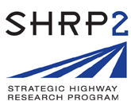

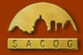


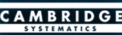


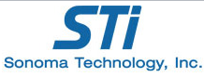
Acknowledgement
These projects are funded by
FHWA Exploratory Advanced Research (EAR) Program
SHRP2 C-10B
Our collaborators are
FHWA EAR Program
SHRP2 C-10B

Slide 22
Thank you !

