Slide 1
Parsimony in Advanced Transportation Forecasting
We are to admit no more causes than such as are both true and sufficient to explain their appearances
TRB Planning
Applications Conference
May 8 - 12, 2011
Reno, NV
Stephen Lawe
Resource Systems Group
Maren Outwater
Resource Systems Group
Joe Castiglione
Resource Systems Group
Notes:
1

Slide 2
Rational for Advanced Models
The policy questions facing the industry have changed:
Traffic shifts by time-of-day
  Peak spreading, peak shifting
Tolling and Pricing Impacts
  Tolling, congestion pricing
Travel time reliability effects
  Behavioral response to reliability
Operations impacts
  Signals and coordination & ITS
Travel Demand Management
  Flexible work schedules, Work / shop at home

Slide 3
Definition: Advanced Models
For the purpose of this presentation “Advanced Travel Modeling” will be defined as:
Spatially and temporally disaggregate model systems that represent behaviorally realistic individual or agent-based decision making

Slide 4
Definition: Parsimony
Parsimony:
Unusual or excessive frugality; extreme economy or stinginess
Economy in the use of means to an end

Slide 5
Parsimony in Scientific Thinking
Aristotle: Lex Parsimoniae – used in Posterior Analytics as an Ontological Principle
“We are to admit no more causes of natural things than such as are both true and sufficient to explain their appearances.”
Isaac Newton
“That is done in vain by many means which may equal well be done with fewer”
        Nash (not from A Beautiful Mind)

Slide 6
Principle of Parsimony - Lex Parsimoniae
A methodological principle dictating a bias towards simplicity in theory construction, where the parameters of simplicity vary from kinds of entity to the number of presupposed axioms to characteristics of curves drawn between data points.
William Ockham
(Ockam’s Razor)

Slide 7
Principle of Parsimony applied to Travel Modeling
This does not mean:
  the simplest explanation is most likely the correct one
  Instead it means:
    We should tend towards simpler theories until we can trade some simplicity for increased explanatory power
  Application to Transportation Modeling
    Model structural detail should be consistent with our understanding of behavior
    “Simpler Theories” are often those which are behaviorally descriptive and explainable
      - Conventional models (eg. 4-step) do not necessarily represent “Simpler Theories”

Slide 8
Linked Model System
Develop a linked model in Jacksonville, FL and Burlington, VT
  DaySim: Provides detailed estimates of travel demand
  TRANSIMS: Provides detailed estimates of network performance
  MOVES: Provides detailed estimates of air quality
LOS Skims
DaySim
Exogenous Trips
TRANSIMS STUDIO
Demand File
Iteration/Convergence
File Manager
TRANSIMS
MOVES
MOEs / Indicators

Slide 9
Spatial & Temporal Resolution
Multiple spatial and temporal resolutions used in the model system
SPATIAL RESOLUTION | Fine | Intermediate | Coarse
Basic spatial unit | Parcels | Activity locations | Zones
Model systems | DaySim | TRANSIMS | DaySim & TRANSIMS
Number in Jacksonville | 620,000 | 30,000-220,000 | 1,300
TEMPORAL RESOLUTION | Fine | Intermediate | Coarse
Basic temporal unit | Seconds | Minutes | Hours
Model systems | TRANSIMS Microsimulator | DaySim <-> TRANSIMS | DaySim & TRANSIMS
Interval in Jacksonville | 1 second | 1-15 minutes | 1-24 hours

Slide 10
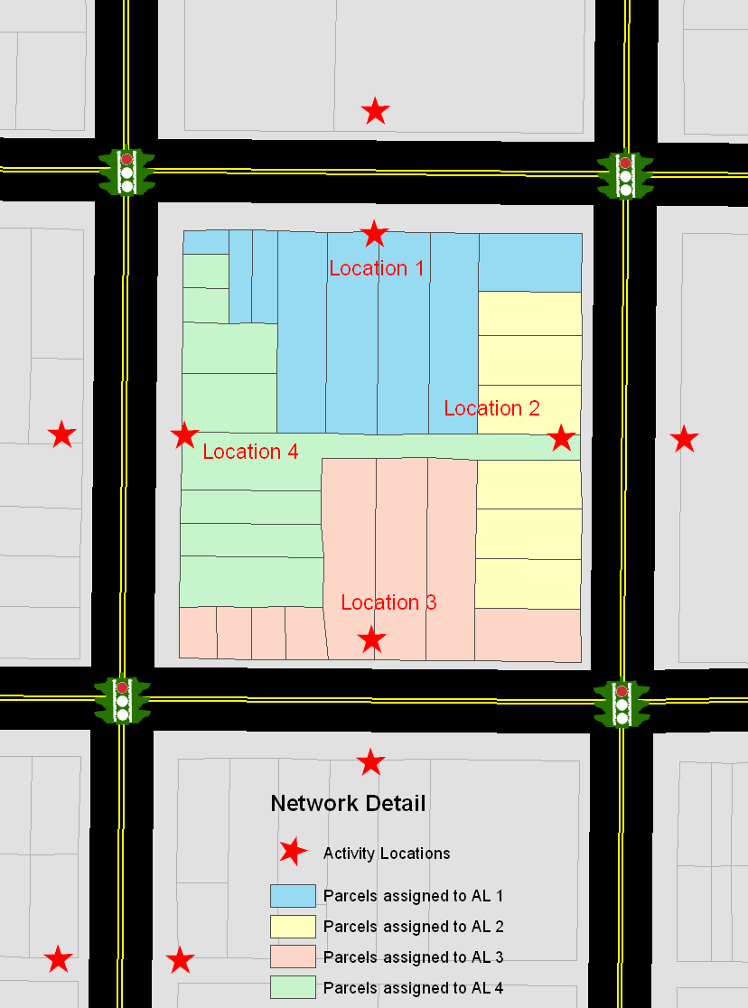
Spatial Resolution
Parcels are core spatial choice unit in DaySim
Activity locations are basic spatial unit in network assignment
Parcel level land use and socioeconomic data requires significant data review and cleaning
Traffic controls and other spatially detailed roadway network configurations require review and adjustment

Slide 11
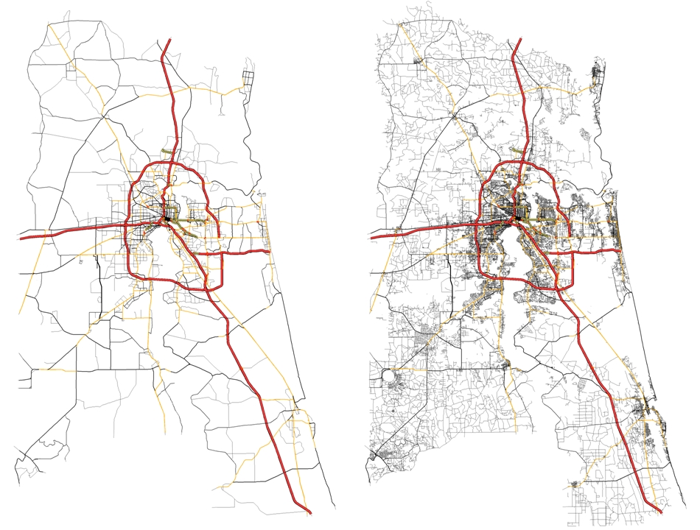
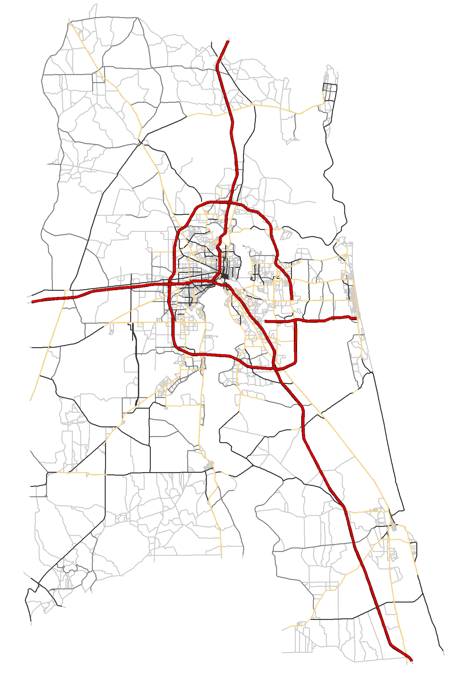
Network Resolution
Networks in Jacksonville at 3 different spatial resolutions
Planning network
Finegrained network
All streets network
9,865 links
29,284 activity locations
15,933 links
51,292 activity locations
96,362 links
216,350 activity locations

Slide 12
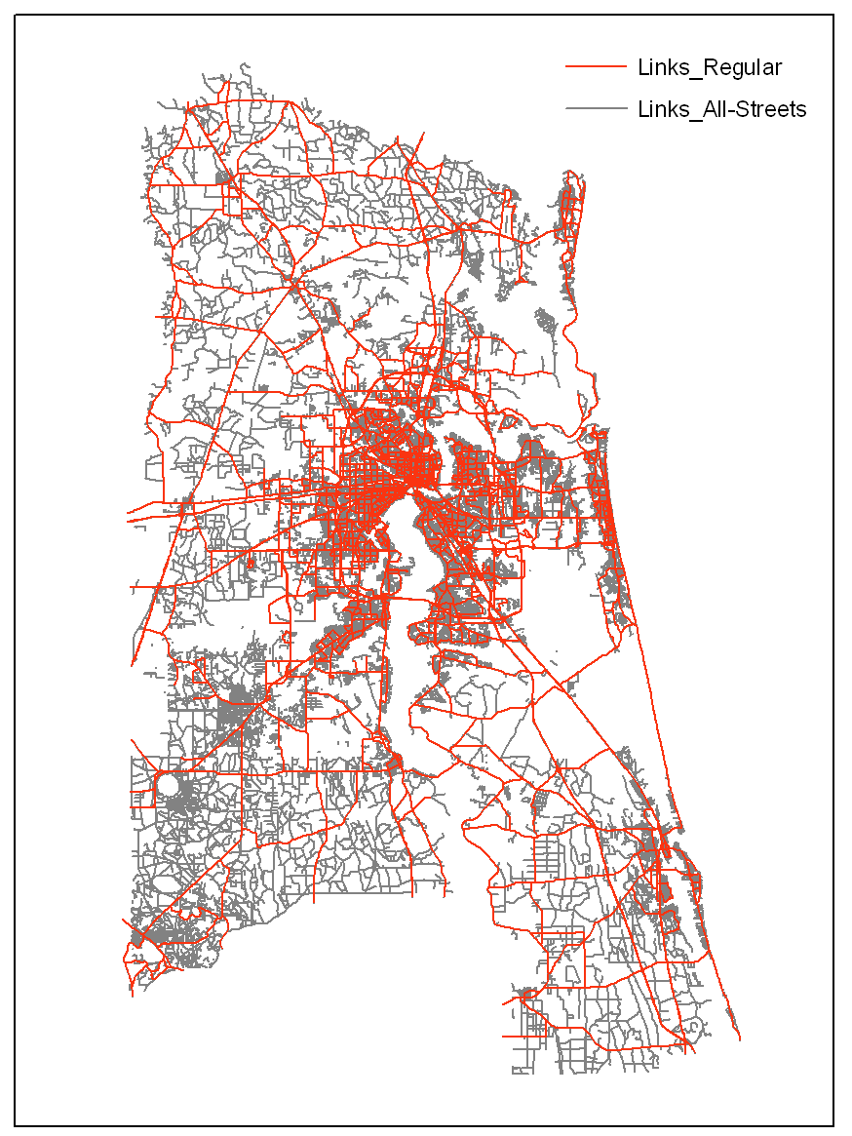
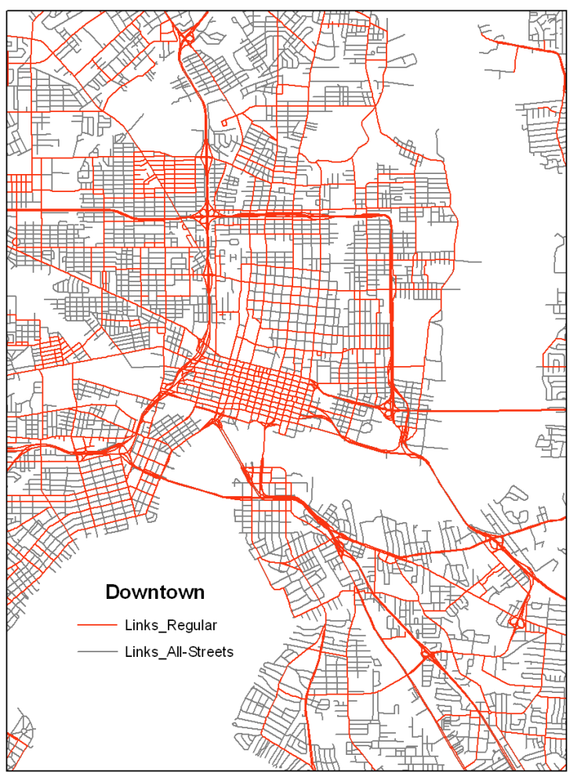
All Streets Jacksonville Network Resolutions

Slide 13
Temporal Resolution
Current skim resolution: 22 time periods, TAZ-level
Future skim resolution: 48 time periods, “activity-level” resolution

Slide 14
Local vs. Regional: Tour & Trip Time-of-Day
Local Test Regional Test
Trip Tour

Slide 15
Convergence
Condition where experienced impedances and costs produced by the model are approximately equal to expected impedances and costs input to the model and overall demand flows are stable
Necessary for model system integrity and policy sensitivity
Applies to both network assignment convergence and overall model system convergence

Slide 16
Low vs. High Iteration: Tour & Trip Time-of-Day
Low Iteration (3x25) High Iteration (6x40)
Trip Tour

Slide 17
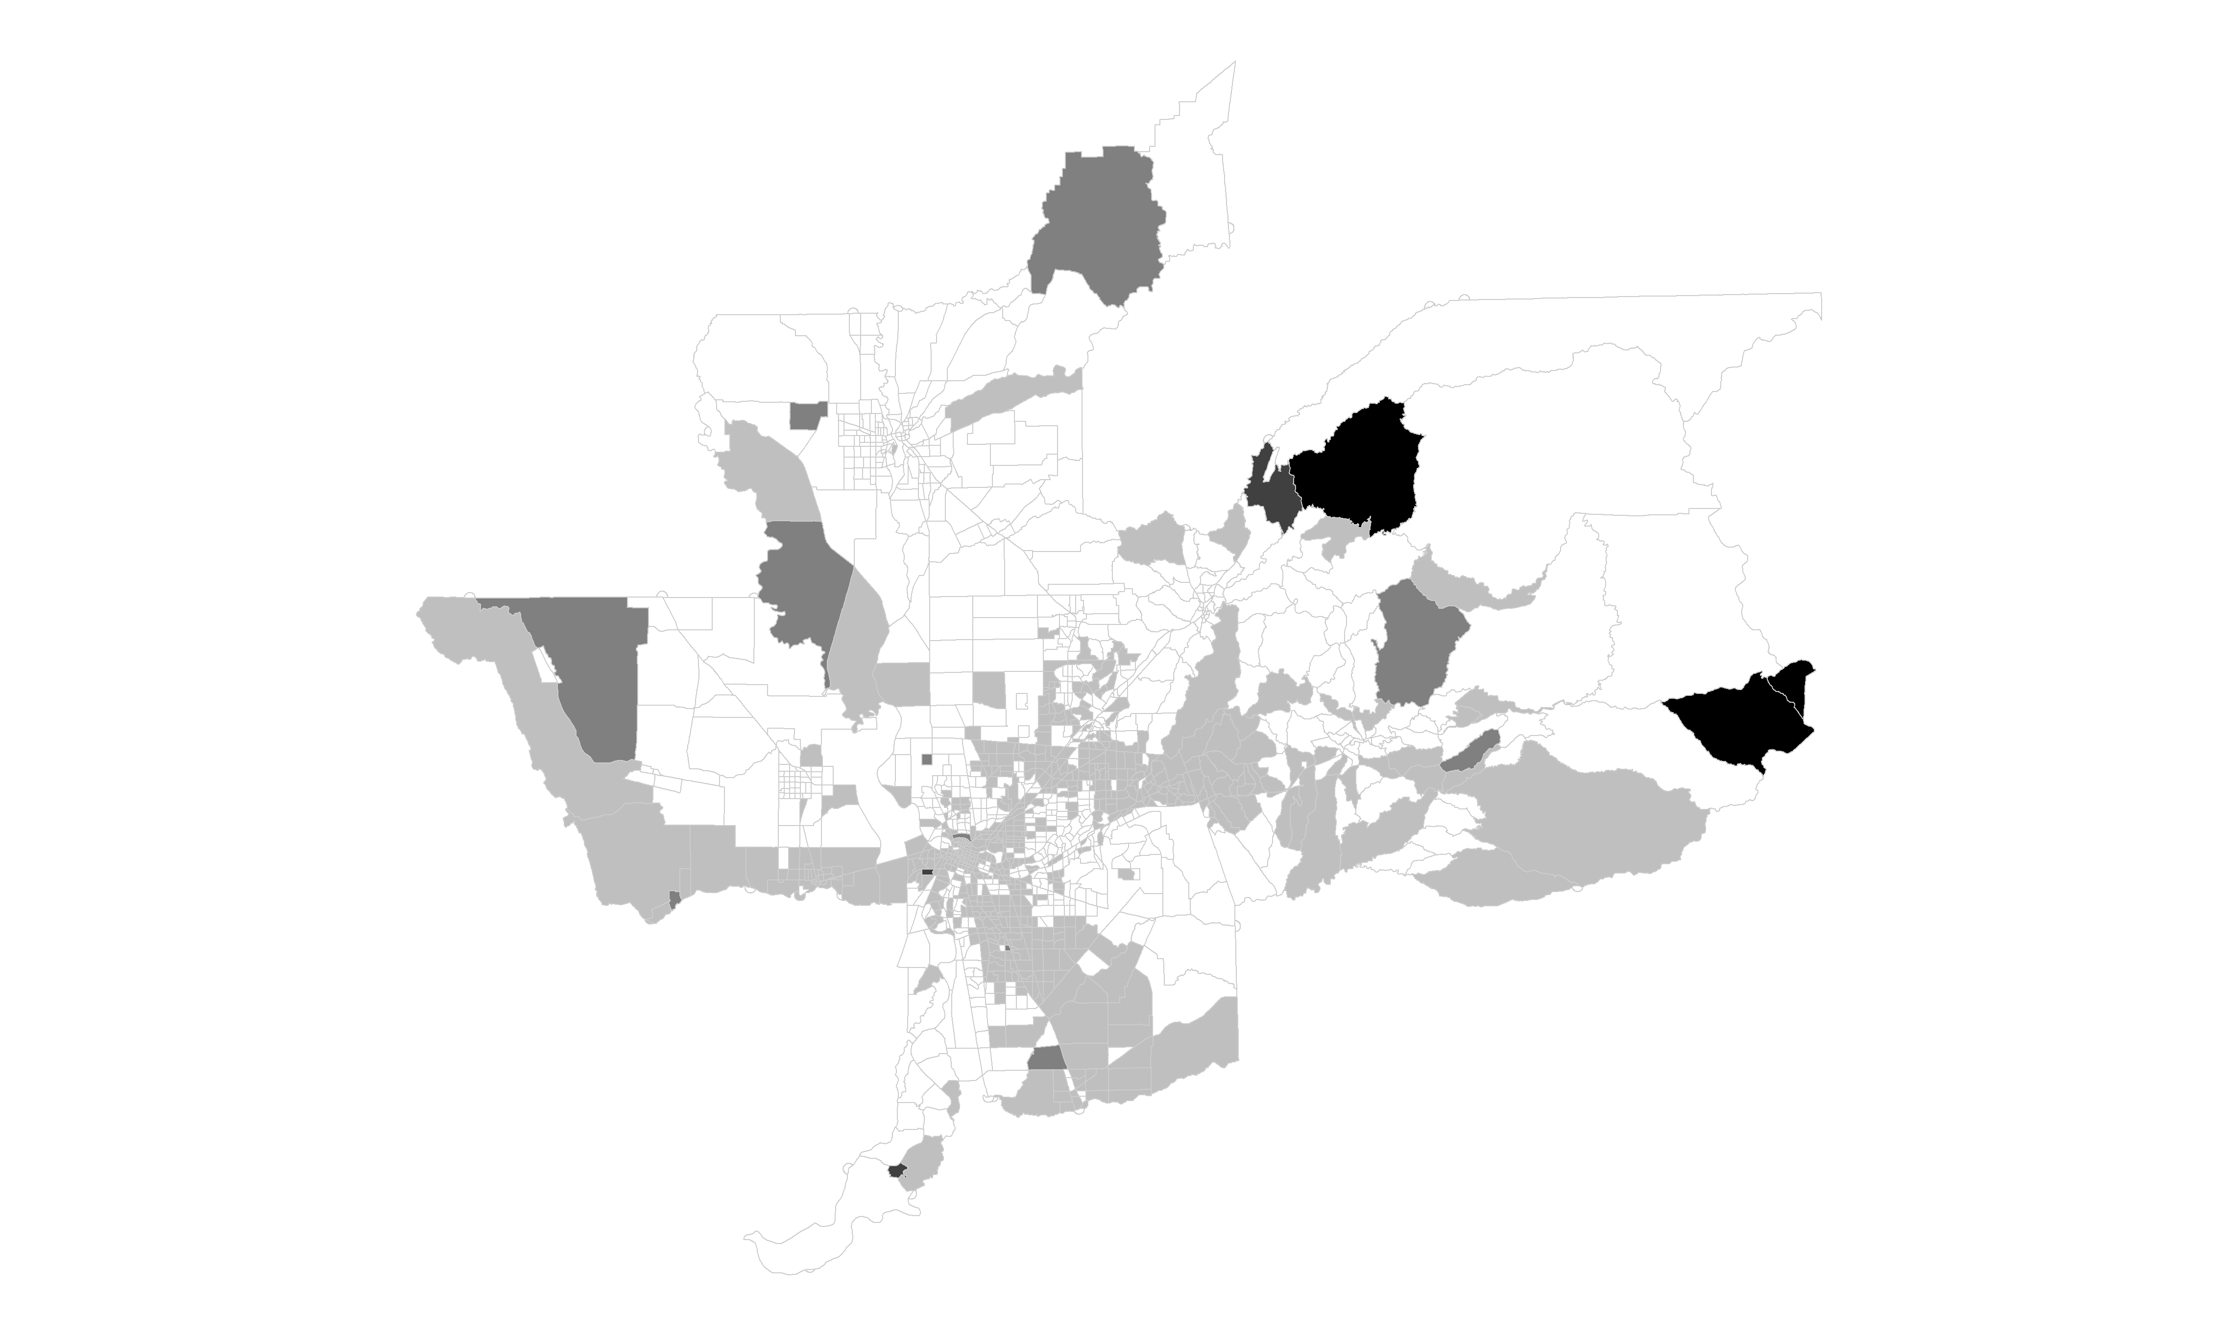
Spatial TripGap Measure (TAZ-level)
V4 DaySim
3 system iterations
25 assignment iterations

Slide 18
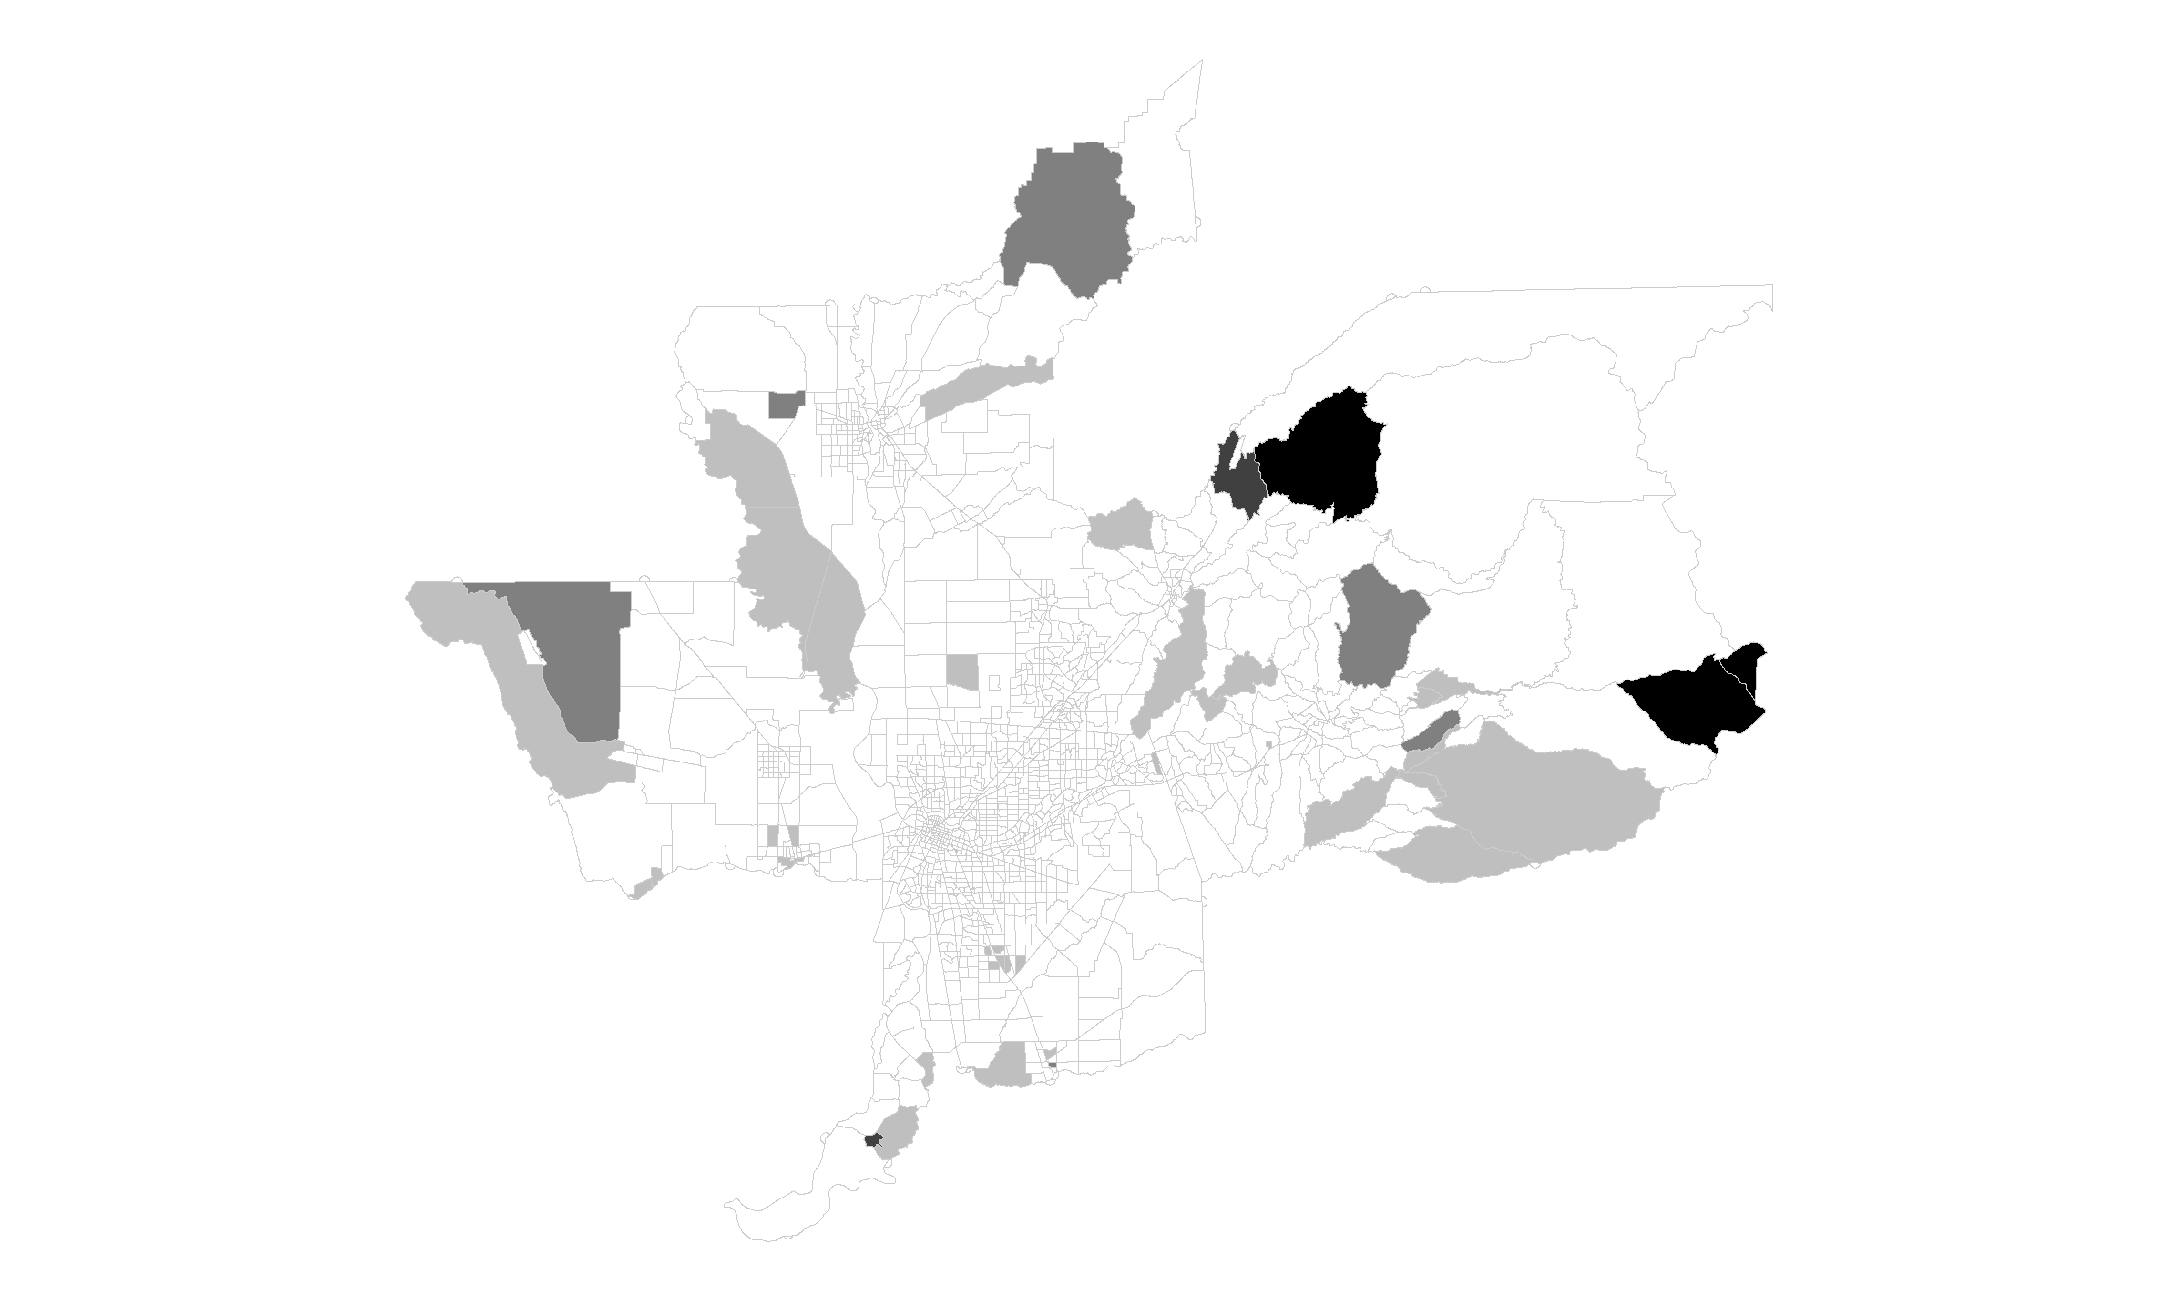
Spatial TripGap Measure (TAZ-level)
V22 DaySim
6 system iterations
40 assignment iterations

Slide 19
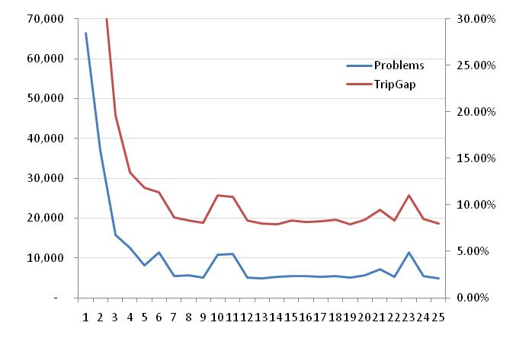
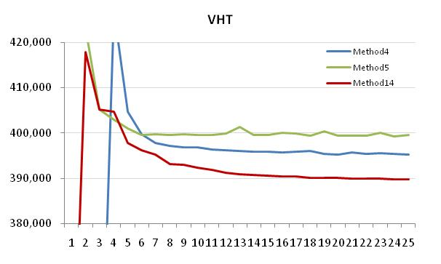
Network Convergence Lessons Learned
“problem” trips undermine the purpose and integrity of the model and convergence metrics
Different methods will converge to different total system costs

Slide 20
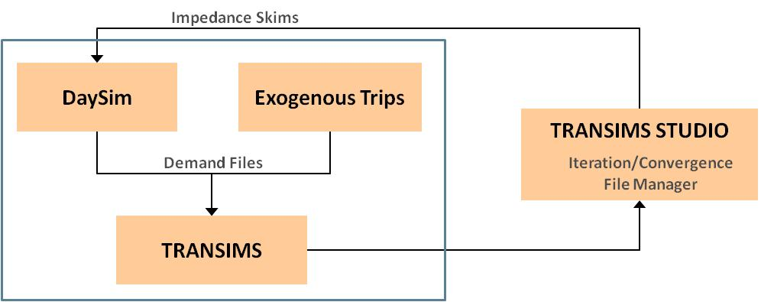
Integrated Model System
Integrated Activity Based model with Microsimulator

Slide 21
System Convergence
System convergence definition and measures for advanced integrated models not well established
  Demand convergence: changes across system iterations should be minimized
  Impedance convergence: inputs should be approximately equal to outputs
  Link flow/cost convergence

Slide 22
Basic Observations of Stability
In the model system we are testing we have observed a general region-wide stability with:
  40 microsimulator iterations (internal iterations)
  6 system iterations (system iterations)
It is not clear, however, whether this is sufficient for localized project-level stability.
Furthermore, as increased detail is added, further iterations are warranted.
Finally, it may well be the case that some level of detail such as operations level network detail may never converge in a microsimulator context

Slide 23
Considerations of Parsimony
Policy motivation for increased detail
Model stability & forecasting confidence
Consideration of Parsimony
Data support and behavioral defensibility
Understandability and use in policy context

Slide 24

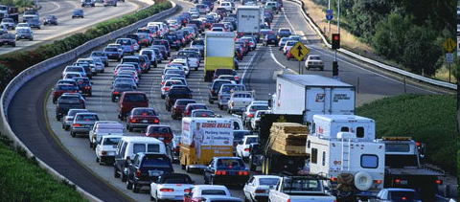
Thank You and Happy Mothers Day
Stephen Lawe
Managing Director
Resource Systems Group
slawe@rsginc.com
May 8, 2011

