Slide 1
Computational Challenges and Advances in Transportation Computing
Andres Rabinowicz
Howard Slavin
Jonathan Brandon
Srini Sundaram
Caliper Corporation
May 2011

Slide 2
Current Computational Burdens are High and are Getting Higher
Many more zones for conventional models with 5,000-12,000 and up being used.
Dynamic Traffic Assignments can multiply the computing time needed for static assignments by more than an order of magnitude
Numerous complex choice model evaluations
Agent-based models with millions of agents are at the core of activity models and traffic microsimulation

Slide 3
Computing Demands Keep Increasing
Feedback Loops
Calibration Runs
Large numbers of scenarios
Equilibrium Convergence Issues
More complex and interdependent choices in disaggregate models of all types
But run times need to be acceptable or compromises are made…

Slide 4
Progression of Intel Architecture
Processor | Year | GFLOP | MHZ
8080 | 1974 |  | 2
8086 | 1978 |  | 5
8088 | 1979 |  | 5
80286 | 1982 |  | 6
80386 | 1985 |  | 16
80486 | 1989 |  | 25
Pentium | 1993 |  | 66
Pentium Pro | 1995 |  | 200
Pentium II | 1997 |  | 300
Pentium III | 1999 |  | 500
Pentium 4/Xeon | 2001 | 7 | 1500
Pentium M | 2002 | 2 | 1700
Core Duo | 2006 | 23 | 2930
QuadCore | 2007 | 42 | 2660
I5 650 | 2010 | 26 | 3200
I7 965 | 2011 | 52 | 3333
Source: http://www.intel.com/support/processors/sb/cs-023143.htm
Notes:
Fewer frequency increases
MIPS: Million instructions per second
Source: http://www.intel.com/support/processors/sb/cs-023143.htm
http://www.intel.com/support/processors/sb/CS-028241.htm#3

Slide 5
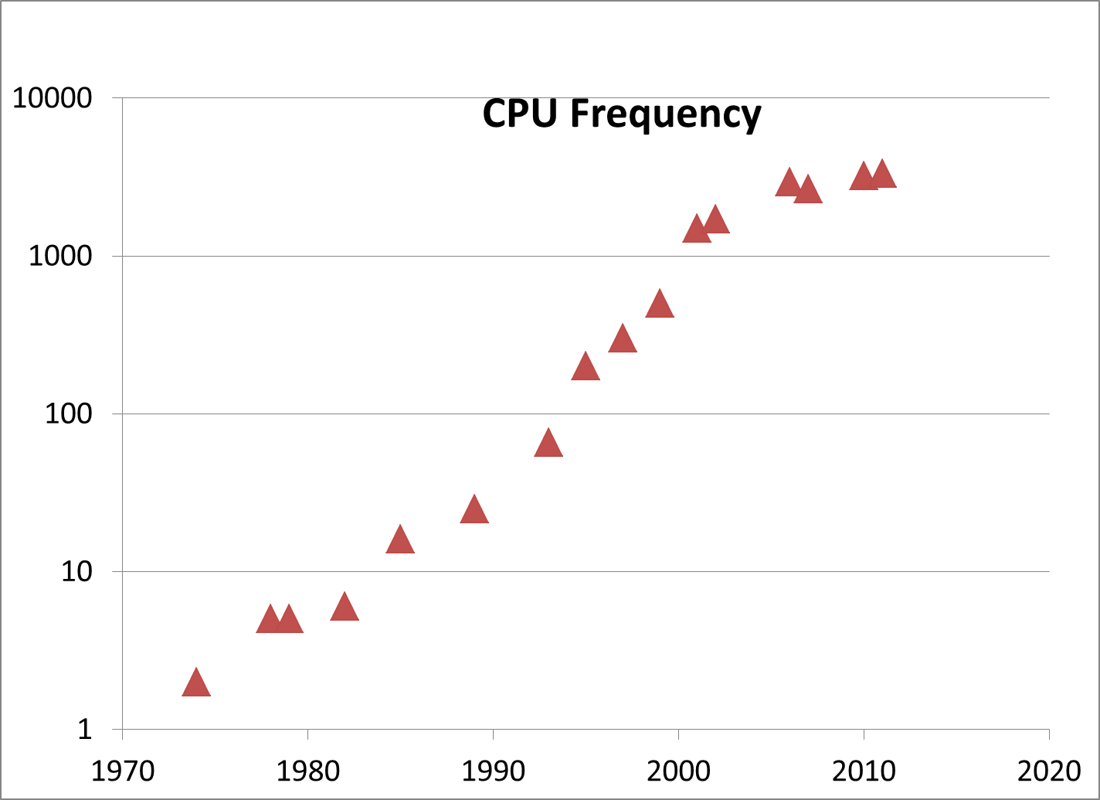
Notes:
Between 93 and 2000 the average speed clock increased tenfold, then it stopped.
Moore’s Law
In 1965, Intel co-founder Gordon Moore predicted that the number of transistors on a chip would double about every two years. Since then, Moore’s Law has fueled a technology revolution as Intel has exponentially increased the number of transistors integrated into it processors for greater performance and energy efficiency.

Slide 6
History of the Multi-Core Processor
Dual core chips introduced in 2005
Cores are like multiple CPU with some shared components
Currently chips with 6-10 physical cores are available
PCs can have multiple chips with multiple cores
Expectations are that the number of cores per chip will keep growing
Speculation is that by 2017, computers will have 100s of cores

Slide 7
Multi-core Desktop Computer
Notes:
Forecast of the percentage of PC shipping with two or more processor cores. In 2006 only 35% of the computers sold had more than 1 core … nowadays 100% of new computers are multicore computers

Slide 8
Hardware Improvements Keep Coming
Multi-core chips now in low-end machines
Hyper-threading—2 threads per physical core is standard
Turbo-boost increases the clock speed when some cores are unused
64-bit hardware commonplace
Memory constraints of less importance
There are more cores per chip each year, but multiple cores are not used unless the software is designed to use them.
Notes:
32 bit has limit of 2GB memory access. In 64 bit the mem is unlimited. This has a big impact since more can be kept in fast memory rather than being read/written to disks.

Slide 9
Effect of CPU Cores on Traffic Assignment
Notes:
PGCounty convergence by number of cores on 8 core (OCHO.caliper.com)

Slide 10

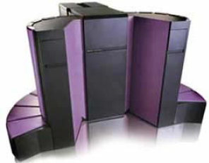
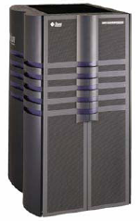
The 10 GFlop Personal Computer 10⁴ more power for the money vs 1991
2005
4xShuttle
$4,000
1991
Cray Y-MP C916 $40,000,000
1998
Sun HPC10000 $1,000,000
Notes:
In the past, high-performance computing was mainly available to government agencies and big research labs; these were groups that had the means to purchase supercomputers. A Cray supercomputer available 15 years ago cost about $40 million and provided a performance of about 10 gigaflops. In 1998, a comparable performance from a Sun HPC server cost about $1 million. Today, a four-processor Dell configuration can provide the same level of performance for only $4,000. As a result of the price drop and cluster availability, most supercomputers have been now replaced by commercial-off-the-shelf (COTS) computer clusters that provide affordable high-performance distributed environments.

Slide 11
GFLOPS
Manufacturer | Processor | Model | Model Number | GFLOPs FP64 | GFLOPs FP32
AMD | GPGPU | FireStream | 9270 | 240 | 1200
AMD | GPU | Radeon HD | 5870 | 544 | 2720
Fujitsu | CPU | SPARC64 | VII | 128 | -
IBM | CPU | POWER7 | - | 264.96 | -
Intel | CPU | Core 2 Duo | E8600 | 26.64 | -
Intel | CPU | Core 2 Extreme | QX9775 | 51.2 | -
Intel | CPU | Core 2 Quad | Q9650 | 48 | -
Intel | CPU | Core i3 | 540 | 24.48 | -
Intel | CPU | Core i5 | 670 | 27.68 | -
Intel | CPU | Core i7 | 965 | 51.2 | -
Intel | CPU | Core i7 | 980 XE | 107.6 | -
Intel | CPU | Itanium | 9350 | 29.76 | -
Intel | CPU | Xeon | W5590 | 53.28 | -
Intel | CPU | Xeon | X7460 | 63.84 | -
nVidia | GPGPU | Tesla | C1060 | 77.76 | 933.12
nVidia | GPGPU | Tesla | C2050 | 515.2 | 1288
nVidia | GPU | GeForce | 480 | 168 | 1350
Notes:
http://jonon.gs/blog/computers/gflop-comparison-table-of-cpus-and-gpus/
http://www.intel.com/support/processors/sb/cs-023143.htm
http://en.wikipedia.org/wiki/Comparison_of_Nvidia_graphics_processing_units#Tesla

Slide 12
Processing Time For NYMTC Model Run
STEP | BPM PROCEDURE | 1996 BASE | 2002 BASE | 2005 BASE (64 bit)
1 | CREATE NEW SCENARIO | 10 min. | 10 min. | 1 min.
2 | RUN HIGHWAY NETWORK BUILDER | 15 min. | 5 min. | 2 min.
3 | NETPREP | 20 min. | 15 min. | 11 min.
4 | HIGHWAY PRESKIMS | 12 hrs. | 4 hrs 52 min. | 1 hr 16 min.
5 | TRANSIT NETWORK DATABASE & SKIMS | 48 hrs. | 18 hrs 35 min. | 2 hrs 5 min.
6 | ACCESSIBILITY INDICIES | 2 hrs. | 20 min. | 15 min.
7 | HOUSEHOLD AUTO JOURNEY (HAJ) | 1 hrs. | 15 min. | 7 min.
8 | MODE DESTINATION STOPS CHOICE (MDSC) | 18 hrs. | 5 hrs 20 min. | 2 hrs 33 min
9 | TRUCKS/COMMERCIAL VEHICLES MODEL | 2 hrs. | 2 hrs. | 24 min.
10 | EXTERNAL MODEL | 5 min. | 5 min. | 1 min.
11 | PRE-ASSIGNMENT PROCESSING/TIME OF DAY (PAP) | 1 hrs. | 1 hrs. | 13 min.
12 | HIGHWAY ASSIGNMENT | 16 hrs. | 16 hrs. | 56 min.
13 | TRANSIT ASSIGNMENT | 72 hrs. | 52 hrs 55 min. | 3 hrs 30 min.
TOTAL |  | 173 hrs. | 87 hrs. | 11 hrs 30 min.

Slide 13
Cloud Computing
Good for parallel applications and distributed processing
Low cost and peak capacity if needed for short periods of time
Limited advantages for very large models with heavy data transfer requirements
Somewhat slower than optimized hardware environments
Potentially more expensive for heavy, continuous computing loads
Private clouds can be optimized for demand models

Slide 14
Cloud Cost vs. Desktop Cost
Notes:
1.16/Hr for a High CPU Instance … $2.48 for a high memory instance.
$1500 for a Dell Workstation
Additional cost for data transfer and storage as well as software leasing not accounted

Slide 15
Cloud Computing (Software as a Service – SaaS)
Advantages | Disadvantages
Save Hardware Cost | Requires Stable Internet Connection
Easier Maintenance | Data Center crashes … all virtual machines will be affected
Easy to Deploy | Data Security
Save Energy | Cost of Data Transfer and Storage
Space | Cost of instances
Backup | No control over hardware

Slide 16


Cloud Computing: Data Transfer @ 1.5 Mbps
Model | Input GB | Output GB
PG County | 1.2 (1:42) | 8.6 (13:17)
SANDAG | 5.5 (7:50) | 18 (1 day 3:49)
NYMTC | 11 (16:59) | 34 (2 day 4:32)
Rolling Stones Get Off Of My Cloud Lyrics
(m. jagger/k. richards) I live in an apartment on the ninety-ninth floor of my block And I sit at home looking out the window Imagining the world has stopped Then in flies a guy who's all dressed up like a union jack And says, Iive won five pounds if I have his kind of detergent pack I said, hey! you! get off of my cloud Hey! you! get off of my cloud Hey! you! get off of my cloud Don't hang around cause twos a crowd On my cloud, baby The telephone is ringing I say, hi, it's me. who is it there on the line? A voice says, hi, hello, how are you Well, I guess Im doin fine He says, it's three a.m., there's too much noise Don't you people ever wanna go to bed? Just cause you feel so good, do you have To drive me out of my head? I said, hey! you! get off of my cloud Hey! you! get off of my cloud Hey! you! get off of my cloud Don't hang around cause twos a crowd On my cloud baby I was sick and tired, fed up with this And decided to take a drive downtown It was so very quiet and peaceful There was nobody, not a soul around I laid myself out, I was so tired and I started to dream In the morning the parking tickets were just like A flag stuck on my window screen I said, hey! you! get off of my cloud Hey! you! get off of my cloud Hey! you! get off of my cloud Don't hang around cause twos a crowd On my cloud Hey! you! get off of my cloud Hey! you! get off of my cloud Hey! you! get off of my cloud Don't hang around, baby, twos a crowd
Notes:
Time in hrs @ speed of 1.5 Mbps.
NYMTC Reported these speeds May/2011: Corporate desktop – Download 0.29 MBPS Upload 0.48 MBPS ; sharing Internet via DSL in the BPM Lab – Download 4.83 MBPS Upload 0.73 MBPS

Slide 17
Software Strategies for Improved Performance
Distributed Processing-locally or in the cloud
Multi-threaded shared-memory model computing
GPU/APU assisted general computing
All of the above in combination
Of course, better algorithms and better implementation are always good.

Slide 18
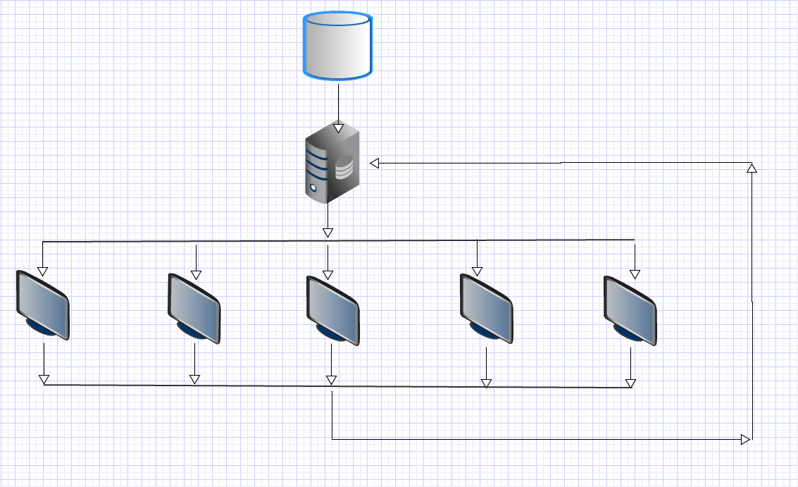
Distributed Processing on Multiple Computers
Very simple to implement for independent processes such as different time periods
Heavy overhead from data transfers
Load balancing essential for good performance
Requires user management

Slide 19
Multi-threading
Benefits from shared memory
Enables fine-grain parallelism unavailable from distributed processing
Requires significant re-engineering of software components
Yields enormous upside in performance
Has a dark side if not done properly

Slide 20


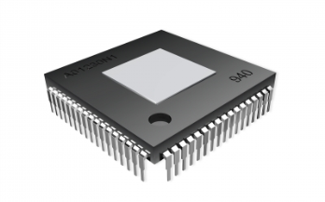
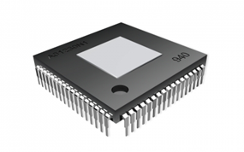
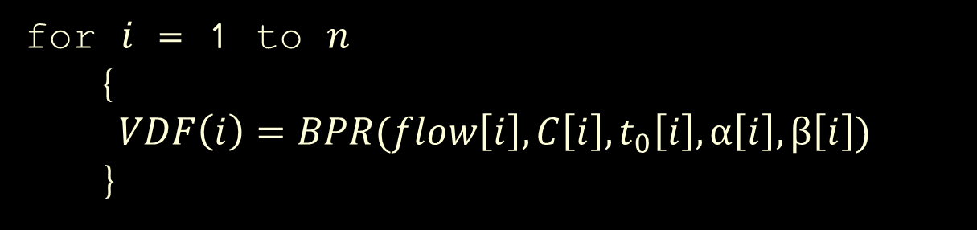
Non-Threaded Program
F(x_1)
…
F(x_n)
…
F(x_2)
F(x_3)
F(x_4)
F(x_5)
F(x_6)
F(x_7)
F(x_8)
…
for $i$ = 1 to $n$
{
$$VDF\left(i\right)=BPR(flow\left[i\right], {C\left[i\right],t}_{0}\left[i\right], α\left[i\right],β\left[i\right])$$
}
Notes:
Use a single processor, behavior is deterministic

Slide 21
Threaded Program
F(x_1)
…
F(x_n)
…
F(x_2)
F(x_3)
F(x_4)
F(x_5)
F(x_6)
F(x_7)
F(x_8)
…
for $i$ = 1 to $n$
{
$$VDF\left(i\right)=BPR(flow\left[i\right], {C\left[i\right],t}_{0}\left[i\right], α\left[i\right],β\left[i\right])$$
}

Slide 22
Software Issues in Multi-threading
Correctness of computations
Consistency of floating point calculations
Consistency of results irrespective of the hardware used and the number of cores
Data Races
Memory Requirements

Slide 23

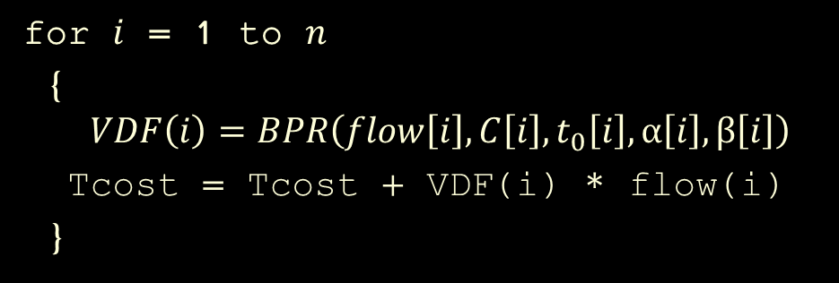
Multithreading Principal Challenges
Data racing
Deadlocks
Starvation
Livelock
Order Dependency
Computational Overhead
Memory Overhead
for $i$ = 1 to $n$
{
$$VDF\left(i\right)=BPR\left(flow\left[i\right], {C\left[i\right],t}_{0}\left[i\right], α\left[i\right],β\left[i\right]\right)$$
Tcost = Tcost + VDF(i) * flow(i)
}
Notes:
At its heart, multithreaded programming seems simple enough. Instead of having just one processing unit doing work sequentially, you have two or more executing simultaneously. Because the processors might be real hardware or might be implemented by time-multiplexing a single processor, the term "thread" is used instead of processor. The tricky part of multithreaded programming is how threads communicate with one another.
A race occurs when two or more threads in a mutithreaded program try to access the same shared data and at least one of the accesses is a write operation. Races are hard to identify. The consequences will be visible at a much later time or even in totally different part of the program itself.
A deadlock occurs when two or more threads wait on each other, forming a cycle and preventing all of them from making any forward progress. Deadlocks are usually introduced by developers trying to solve the race conditions.
Computational Overhead – Loss of Optimization
Two threads lod Tzcost at the same time and add befire the other is done giving the wrong total system cost

Slide 24
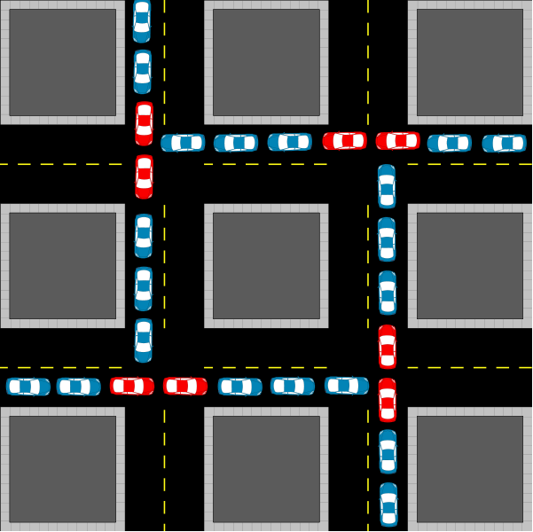

Multithreading Principal Challenges
Data racing
Deadlocks
Starvation
Livelock
Order Dependency
Computational Overhead
Memory Overhead
for $i$ = 1 to $n$
{
$$VDF\left(i\right)=BPR\left(flow\left[i\right], {C\left[i\right],t}_{0}\left[i\right], α\left[i\right],β\left[i\right]\right)$$
Tcost = Tcost + VDF(i) * flow(i)
if Tcost > K then break
}
Notes:
One thread runs and locks and breaks is greater than K, meanwhile other threads are waiting for the lock to be released
Alphonse and Gaston are friends, and great believers in courtesy. A strict rule of courtesy is that when you bow to a friend, you must remain bowed until your friend has a chance to return the bow. Unfortunately, this rule does not account for the possibility that two friends might bow to each other at the same time. This example application, Deadlock, models this possibility

Slide 25
Multithreading Principal Challenges
Data racing
Deadlocks
Starvation
Livelock
Order Dependency
Computational Overhead
Memory Overhead
Notes:
Starvation
Starvation describes a situation where a thread is unable to gain regular access to shared resources and is unable to make progress. This happens when shared resources are made unavailable for long periods by "greedy" threads. For example, suppose an object provides a synchronized method that often takes a long time to return. If one thread invokes this method frequently, other threads that also need frequent synchronized access to the same object will often be blocked.

Slide 26
Multithreading Principal Challenges
Data racing
Deadlocks
Starvation
Livelock
Order Dependency
Computational Overhead
Memory Overhead
Notes:
Livelock Livelocks occur when threads are scheduled but are not making forward progress because they are continuously reacting to each other's state changes. High CPU utilization with no sign of real work being done is a classic warning sign of a livelock. Livelocks are incredibly difficult to detect and diagnose.
A thread often acts in response to the action of another thread. If the other thread's action is also a response to the action of another thread, then livelock may result. As with deadlock, livelocked threads are unable to make further progress. However, the threads are not blocked — they are simply too busy responding to each other to resume work. This is comparable to two people attempting to pass each other in a corridor: Alphonse moves to his left to let Gaston pass, while Gaston moves to his right to let Alphonse pass. Seeing that they are still blocking each other, Alphone moves to his right, while Gaston moves to his left. They're still blocking each other, so

Slide 27

Multithreading Principal Challenges
Data racing
Deadlocks
Starvation
Livelock
Order Dependency
Computational Overhead
Memory Overhead
A + B + C + D $≈\text{D}\text{ + }\text{C}\text{ + }\text{B}\text{ + }\text{A}$

Slide 28
Multithreading Principal Challenges
Data racing
Deadlocks
Starvation
Livelock
Order Dependency
Computational Overhead
Memory Overhead
Notes:
Computational Overhead – Loss of Optimization
Thread management – work load – each thread should get enough work

Slide 29
Multithreading Principal Challenges
Data racing
Deadlocks
Starvation
Livelock
Order Dependency
Computational Overhead
Memory Overhead

Slide 30
Favorable Candidates for Multi-Threading
Network Skims
Traffic Assignments
Matrix computations
Nested Logit and more complex models
Certain other activity model components
Traffic micro-simulation

Slide 31
Running times for selected procedures over time

Slide 32
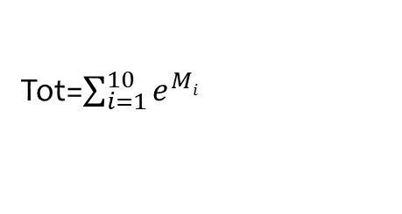
Multithreading: Matrix Operations
Tot=$\sum_{i=1}^{10}{e^{Mi}}$
Notes:
Adding 10 - 10K matrix exponentiation

Slide 33
Multithreading: Transit Skims
Seattle Model: 1091 TAZ; 45000 links; 6000 nodes; 850 Routes; 28000 Stops
Notes:
Seattle Model: 1091 TAZ; 45000 links; 6000 nodes; 28000 Stops
Run on JZ deskto

Slide 34
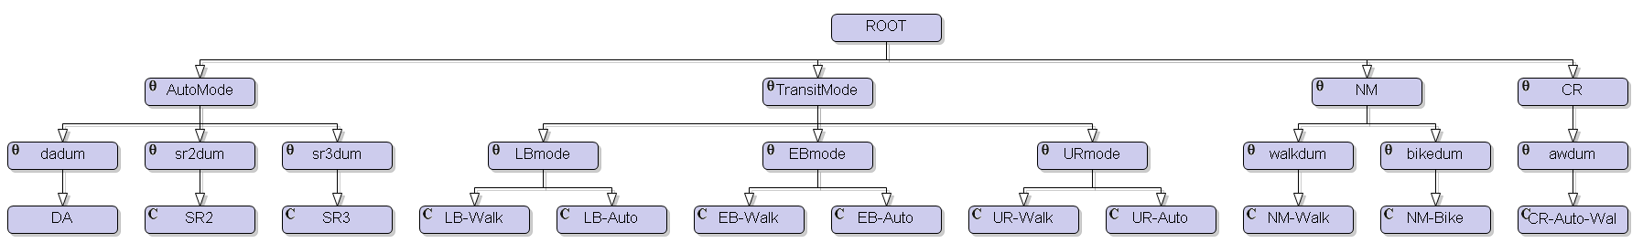
Multithreading: Nested Logit
SCAG Nested logit choice model (HBW)
4109 Zones
12 Modes

Slide 35
Multithreading: Nested Logit Model

Slide 36
Multithreading: Traffic Assignment
Notes:
PGCounty convergence by number of cores on 8 core (OCHO.caliper.com)

Slide 37
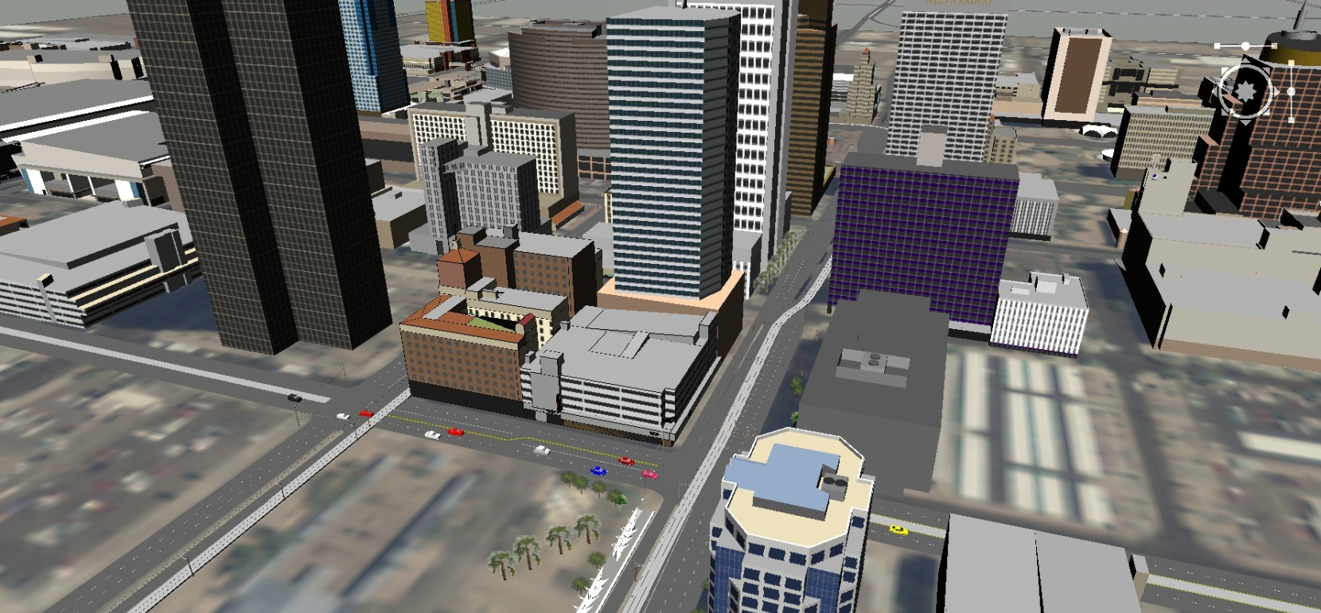
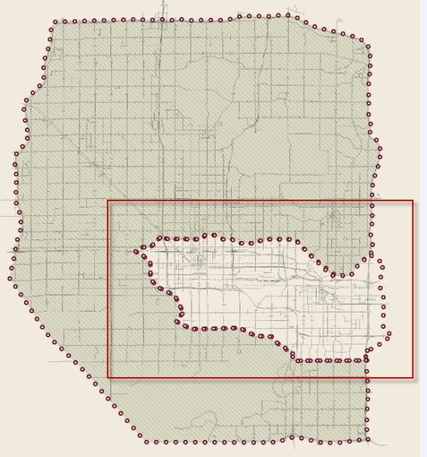
Multithreading: Large Scale Simulation
15 min period; 25,000 Trips; 80 square miles (downtown Phoenix and parts of Tempe; 634 miles of Freeway and Arterial links; 447 Signalized Intersections

Slide 38
Multithreading: Large Scale Simulation

Slide 39
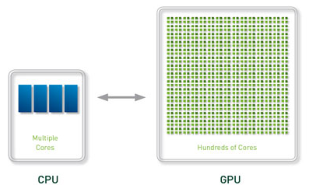
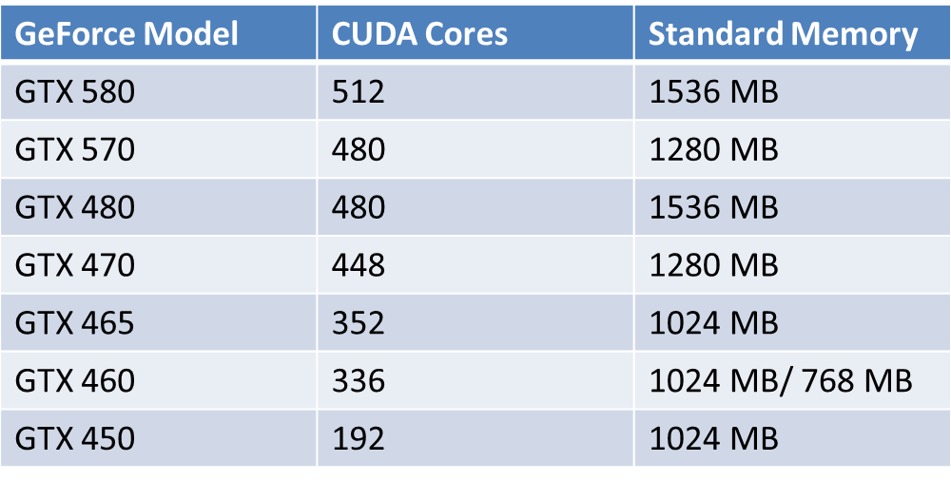
Threading with CUDA
Advanced GPU architectures provide hundreds of light weight threads
Notes:
The model for GPU computing is to use a CPU and GPU together in a heterogeneous co-processing computing model. The sequential part of the application runs on the CPU and the computationally-intensive part is accelerated by the GPU. From the user’s perspective, the application just runs faster because it is using the high-performance of the GPU to boost performance.
The GPU has evolved over the years to have teraflops of floating point performance. NVIDIA revolutionized the GPGPU and accelerated computing world in 2006-2007 by introducing its new massively parallel architecture called “CUDA”. The CUDA architecture consists of 100s of processor cores that operate together to crunch through the data set in the application.
The Tesla 20-series GPU is based on the “Fermi” architecture, which is the latest CUDA architecture. Fermi is optimized for scientific applications with key features such as 500+ gigaflops of IEEE standard double precision floating point hardware support, L1 and L2 caches, ECC memory error protection, local user-managed data caches in the form of shared memory dispersed throughout the GPU, coalesced memory accesses and so on.
"GPUs have evolved to the point where many real-world applications are easily implemented on them and run significantly faster than on multi-core systems. Future computing architectures will be hybrid systems with parallel-core GPUs working in tandem with multi-core CPUs." Prof. Jack Dongarra Director of the Innovative Computing Laboratory The University of Tennessee
Distance matrix between a set of 11K points ->

Slide 40
Multithreading with CUDA
Pros
Cons
More cores than on CPU
Designed for Math
Includes a Linear Algebra library
All data has to be copied
Memory is limited
All code resides on device

Slide 41
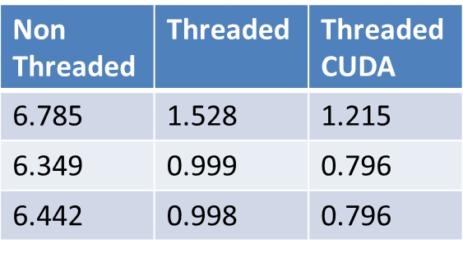
CUDA: Spherical Euclidian Distance
Matrix Size: 6585 x 6585 on a 6 Core Computer

Slide 42
New Frontier Transportation Modeling Problems will absorb any new computing power that we are given
Regional High Fidelity Microsimulation faster than real-time for prediction
Dynamic O-D Estimation from counts
Activity and Tour Re-optimization
Full equilibration of activity models
Network Traffic Signal Optimization(needed for forecasting the future with traffic simulation)

Slide 43
Conclusions
Improvement to run times cannot exclusively rely on hardware
Software needs to adapt to multi-core chips
Multithreading algorithms is more complex and prone to problems than single-threaded ones
Cloud computing is not Utopia
New GPU computing can further improve run times

