Slide 1
Recent Practices in Modeling Non-Motorized Travel
presented to
Transportation Planning Application Conference
presented by
Feng Liu, John (Jay) Evans, Tom Rossi
Cambridge Systematics, Inc.
May 8, 2011

Slide 2
Presentation Outline
Background
Review of Recent Modeling Practice
Modeling Approaches
Lessons Learned
End Notes

Slide 3
Background
Modeling Non-Motorized Travel (pre-2000)
  LUTRAQ 1991-1997
  Non-Motorized Travel Modeling (Rossi 2000)
  Guidebook on Methods to Estimate Non-Motorized Travel (FHWA 1999; by Cambridge Systematics)
  Notable practices
    Metro, Portland
    DVRPC, Philadelphia
    Montgomery County, Maryland
    MTC, San Francisco
    CATS, Chicago
    Edmonton, Canada

Slide 4
Recent Practices
Modeling Non-Motorized Travel (post-2000)
  Identified as one of eight deficiencies and one of advanced practices in TRB Special Report 288 “Metropolitan Travel Forecasting” (TRB 2007)
  16% of all responses (n=207) modeled non-motorized trips: 54% large MPOs (n=35)
  16% medium MPOs (n=69)
  3% small MPOs (n=103)
  38% of 34 large MPOs treated walk as a mode and 26% for bike in mode choice (VHB 2007)

Slide 5
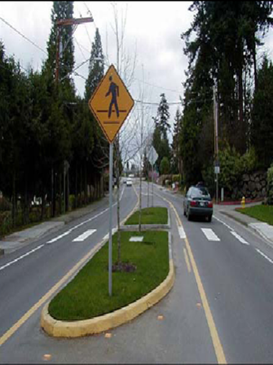
Recent Practices
Modeling Non-Motorized Travel (post-2000)
  NCHRP 8-61 review of 22 large MPOs and 7 medium MPOs (2008-2010)
    45% treated walk as a mode for HBW, 41% HBO and NHB
  CS’ review of recent practices in 28 large MPOs (2010-2011)
    68% incorporated non-motorized travel
    53% treated non-motorized travel as part of a mode choice model

Slide 6
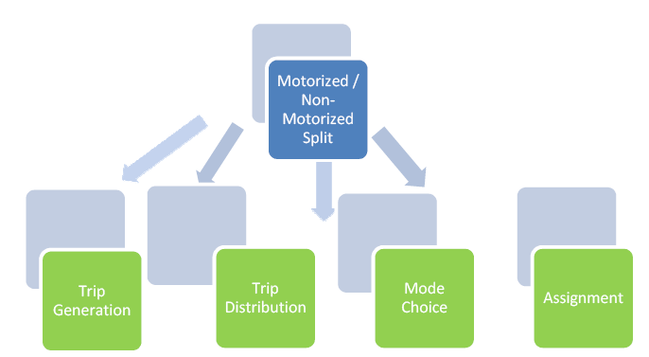
Modeling Approaches
Modeling Structure
  A: As part of trip generation
  B: Between trip generation and distribution
  C: Between trip distribution and mode choice
  D: As part of mode choice

Slide 7
Modeling Approaches
Pros and Cons
 | Pre-Trip Distribution | Pre-Mode Choice | Mode Choice
Data requirements | Lower (stratification need) | Medium | Higher (richer stratification needed)
Model estimation | More functional forms available | Likely logit structure | Likely nested logit structure
Calibration and validation | Trip ends only | Trip ends and patterns | Modal split and patterns
Policy sensitivity | Variables for trip ends but not for trip patterns and very limited trade-off among modes | Variables for trip ends and patterns and some trade-off among modes | Higher potential for evaluating trade-off among modes but actual variables used are limited

Slide 8
Modeling Approaches
Variables
Variable Type | Descriptions
Urban design | Density, land use mix/diversity, design (street density, connectivity, continuity)
Non-motorized facilities | Sidewalks, bike lanes/paths
Composite measures | Pedestrian and bicycle environment factors, walkability index/indicator
Traveler characteristics | Household income, vehicle availability, student status
Accessibility | Proximity to activities
Impedance | Time or distance from origin to destination

Slide 9
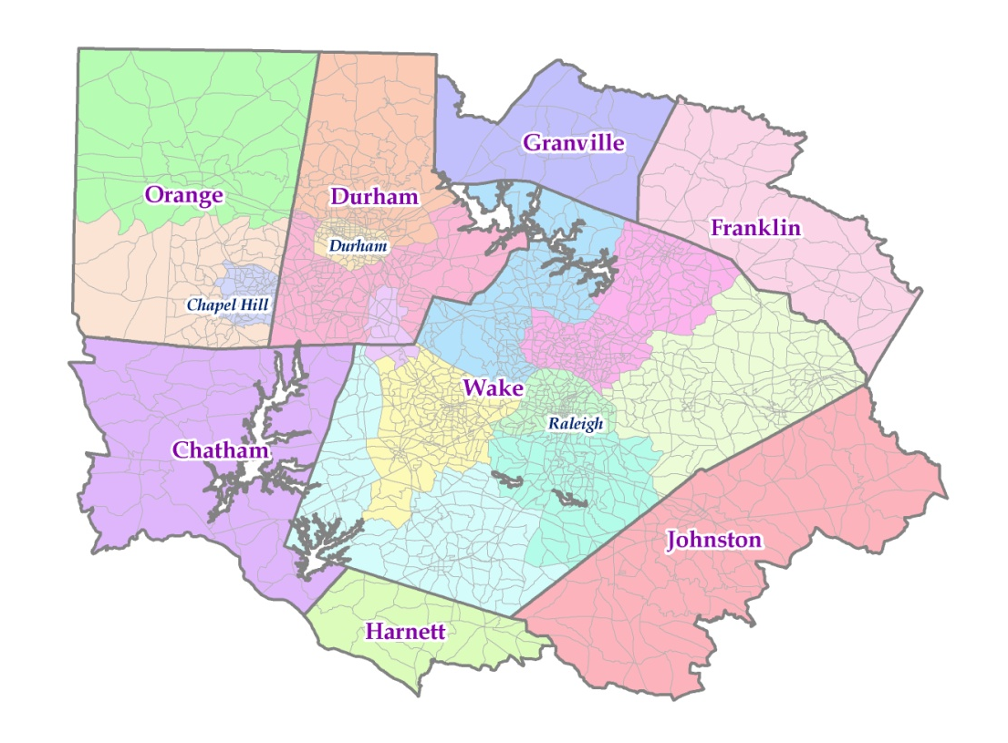
Triangle Region Non-Motorized Model Development Project
Project Stakeholders
  Durham-Chapel Hill-Carrboro Metropolitan Planning Organization
  Triangle Regional Model Service Bureau
Triangle Region

Slide 10
Objectives
Develop and implement enhancements to
Triangle Regional Model (TRM) to
  Better capture travel demand impacts of non-motorized travel (walking and bicycling) due to land use and facility/infrastructure changes
  Plan for adequate non-motorized facilities/infrastructure
  Gauge the effects of non-motorized trip-making on other travel modes

Slide 11
Modeling Approach:
Potential Variable Categories
Three potential areas were identified for new variables to be incorporated into the model:
  Land use mix and density
  Zonal network characteristics
  Person and household characteristics

Slide 12
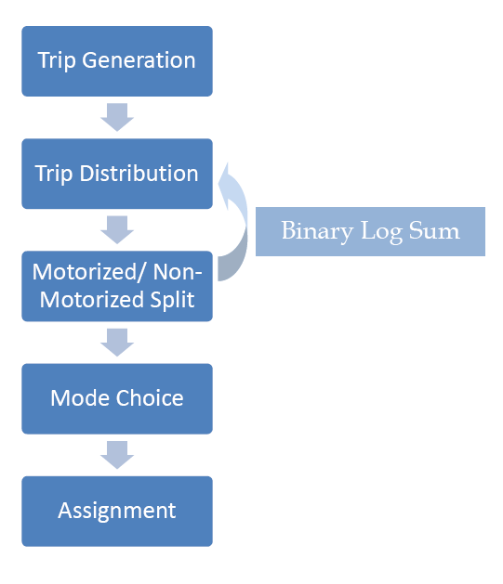
Enhanced Model Components
Revised Trip Generation
  New Survey Data
    2006 household travel survey
    2006 transit on-board survey
  New Variables
    Land use mix measure
    Average block perimeter
  Output
    Total person trips
    For both ends of trips

Slide 13
Enhanced Model Components
Revised Trip Distribution
  Existing model used composite motorized travel time
  Revised model includes revised impedance variables to account for non-motorized travel

Slide 14
Enhanced Model Components
Motorized/Non-Motorized Split
  Explored incorporating non-motorized choice into mode choice model
  Data limitation

Slide 15
Enhanced Model Components
Motorized/Non-Motorized Split
  Inputs
    Socioeconomic indicators
    Density indicators
    Composite motorized time
    Non-motorized distance
  Outputs
    Non-motorized trip tables
    Provides feedback to
    trip distribution

Slide 16
Lessons Learned
Data and Modeling Challenges
  Travel survey (stratification by geography, socioeconomic strata, and mode choice)
  Non-motorized infrastructure database
  Mode choice model estimation
  Validation data for non-motorized travel
Model Sensitivity
  Responses to urban design changes
  Representation of non-motorized travel markets
  Evaluation of specific non-motorized facility investments

Slide 17
Non-Motorized Travel Modeling
Improvement Options
Modeling Approach
  Sensitivity to potential policy and planning evaluations
Refined Geography
  Non-motorized transportation analysis zones (TAZs)
  Parcel-based geography
  Examples

Slide 18
Non-Motorized Travel Modeling
Improvement Options
Refined Measurements
  GIS database of non-motorized infrastructure
  GPS-based household surveys with targeted non-motorized travelers
  Selection of variables to minimize correlations
  Measuring variables accurately in a refined geography
  Quantifying and forecasting variables in an objective way

Slide 19
End Notes
Contact Information
  Feng Liu, Ph.D.
  Senior Associate/Project Manager
  Cambridge Systematics, Inc.
  4800 Hampden Lane Ste 800
  Bethesda, MD 20814
  (301) 347-0100
  fliu@camsys.com
  www.camsys.com

