Slide 1
Incorporation of Pricing in the
Time-of-Day Model
For
“Express Travel Choices Study” for the
Southern California Association of Governments (SCAG)
Presentation For
13th TRB National Transportation Planning Application Conference
Reno, Nevada
May 8-12, 2011
Kazem Oryani, WSA
Cissy Kulakowski, WSA
Liren Zhou, WSA
Lihe Wang, WSA
Tom Adler, RSG
Mark Fowler, RSG
SOUTHERN CALIFORNIA
ASSOCIATION of GOVERNMENTS

Slide 2
Outline of Presentation
Objective
Model Steps
Data Analysis
  Year 2001 Household Survey
  Year 2003 SCAG Model
  Year 2010 Stated Preference Survey
Time-of-Day Model
Model Replication
Scenario Analysis
Prototype Test Results
Future Steps

Slide 3
Objective:
To update and enhance the existing trip-based SCAG regional travel demand model to allow it to be used for the analysis of different pricing alternatives.

Slide 4
Model Steps:
Enhancements by WSA
Enhancements by PB

Slide 5
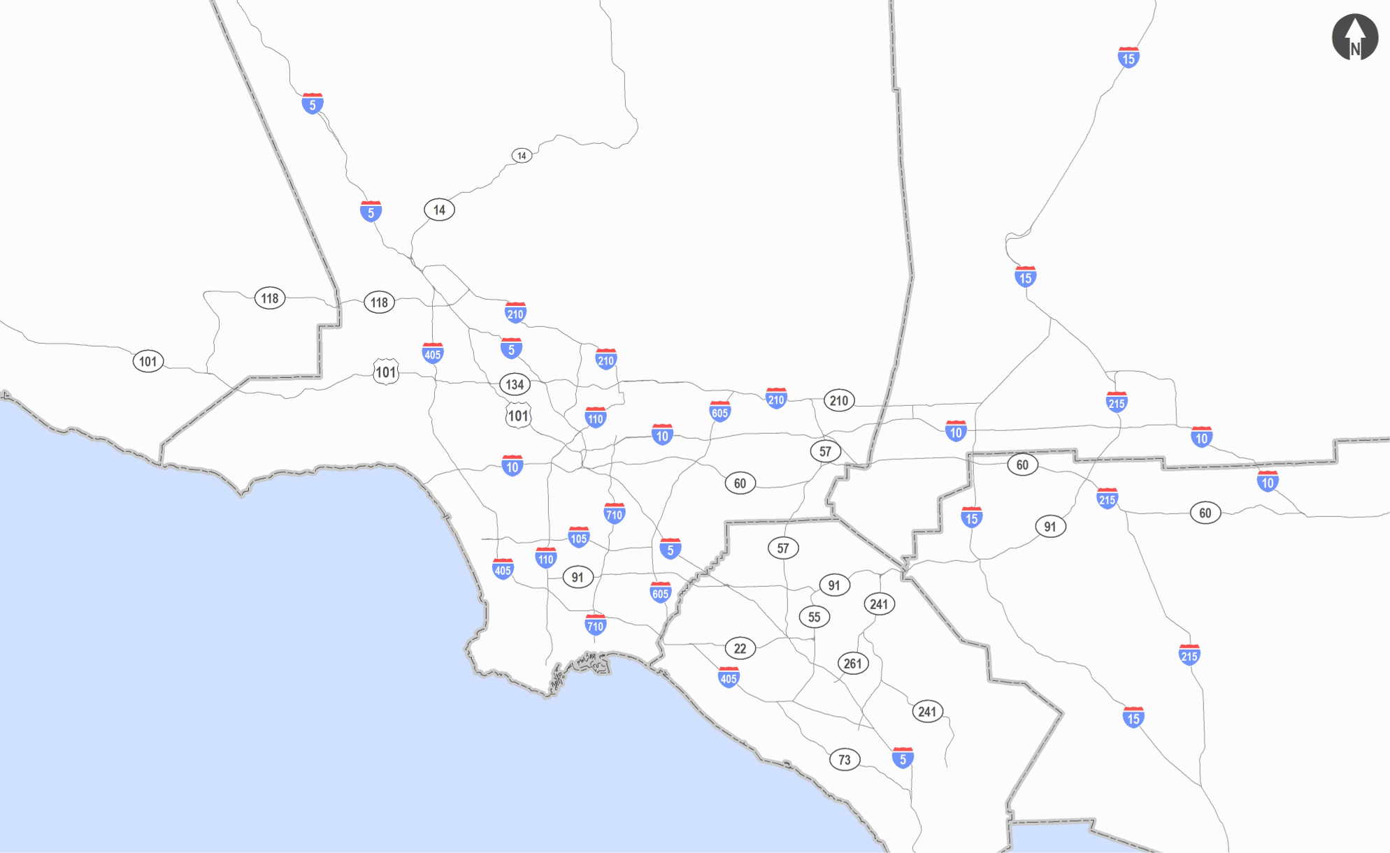
Year 2003 Home-based County to County Work Trip Flows
416
Los Angeles Co.
673
Ventura Co.
5,772
San Bernardino Co.
80
202
104
140
143
383
130
694
Pacific Ocean
75
LEGEND
80
Riverside Co.
437
Intracounty Travel
92
Riverside Co.
Intercounty Travel
Orange Co.
1,700
84
Note: All trips shown in thousands
Imperial Co.
Source: SCAG 2003 Model Validation and Summary, January, 2008.

Slide 6
Year 2020 Home-based County to County Work Trip Flows
515
Los Angeles Co.
1,063
Ventura Co.
6,345
Los Angeles Co.
San Bernardino Co.
91
175
153
135
181
357
205
74
Pacific Ocean
58
Riverside Co.
1,236
LEGEND
512
Intracounty Travel
92
Riverside Co.
Intercounty Travel
Orange Co.
2,094
150
Note: All trips shown in thousands
Imperial Co.
Source: SCAG 2003 Model Validation and Summary, January, 2008.

Slide 7
Data Analysis:
Year 2001 SCAG Household Travel Survey
  Person trip: 84,000
  Activity episodes: 190,000
  Distribution of survey trips by trip purpose
  Home-based trips
    - Direct work trips: 15 percent
    - “Other” home-based trips: 12 percent
Work-based Other Trips: 10 percent
Non-Home-based Trips: 30 percent

Slide 8
Data Analysis:
Distribution of Survey Trips by Trip Purpose

Slide 9
Data Analysis:
Departure Time Distribution by Purpose
Home-based Auto From-Home Trips
Home-based other (Sample: 4,980)
Home-based school (Sample: 1,465)
Home-based shopping (Sample: 2,868)
Home-based serve passenger (Sample: 3,483)
Home-based social/recreational (Sample: 2,668)
Home-based university (Sample: 443)
Home-based work (direct) Sample: 7,368)
Home-based work ( strategic (includes a stop)) (Sample: 1,679)
Home-based
school
Home-based
work (strategic)
Percentage of Daily Trips
Home-based
work (direct)
Time of Day

Slide 10
Data Analysis:
Departure Time Distribution by Purpose
Home-based Auto To-Home Trips
Home-based other (Sample: 4,312)
Home-based school (Sample: 1,084)
Home-based shopping (Sample: 3,555)
Home-based serve passenger (Sample: 2,973)
Home-based social/recreational (Sample: 3,043)
Home-based university (Sample: 387)
Home-based work (direct) Sample: 6,437)
Home-based work (strategic (includes a stop))
(Sample: 2,546)
Home-based
work (strategic)
Percentage of Daily Trips
Home-based
school
Home-based
work (direct)
Time of Day

Slide 11
Data Analysis:
Travel Time (minute) Distribution by Purpose
Home-based Auto From-Home Trips
Home-based
school
Home-based other
Home-based school
Home-based shopping
Home-based serve passenger
Home-based social/recreational
Home-based university
Home-based work (direct)
Home-based work ( strategic (includes a stop))
Percentage of Daily Trips
Home-based
work (strategic)
Home-based
work (direct)
Time of Day

Slide 12
Data Analysis:
Year 2003 SCAG Model:
  Congested and free-flow travel times
  Distance
  Zonal population density
  Zonal employment density

Slide 13
Year 2010 Stated Preference Survey:
Stated Preference Survey to Support Model Changes
  3,600 survey record for all six SCAG counties
  Discrete choice model by trip purpose: work,
  business trips, non-work
  Time-of-day: peak, off-peak
$2.00
$3.00
$4.00
$3.00
$2.00

Slide 14
Year 2010 Stated Preference Survey:
Hypothetical Reaction to Pricing For Range of Fees

Slide 15
Year 2010 Stated Preference Survey:
Change in Tripmaking (Trip Suppression / Inducement)
Peak Non-work Trip
(Negative = Suppression, Positive = Inducement)

Slide 16
Year 2010 Stated Preference Survey:
Ability to Shift Time of Travel - Current Peak Period Travelers

Slide 17
Year 2010 Stated Preference Survey:
Travel Time Shift Model - Work Commute Trips

Slide 18
Time-of-Day Model:
Time-of-Day Model Variables
Each time-of-day choice model includes a combination of the following variables:
Origin zone characteristics (such as CBD, density, other)
Destination zone characteristics (such as CBD, density, other)
Trip purpose
Mode
Traveler’s household size
Traveler’s household income
Number of household workers
Number of household vehicles
Traveler’s age
Traveler’s employment industry type

Slide 19
Time-of-Day Model:
Model Estimated
1. Home-based work direct trips (HBWD) from home
2. Home-based work direct trips (HBWD) to home
3. Home-based work strategic trips (HBWS) from home
4. Home-based work strategic trips (HBWS) to home
5. Home-based shopping trips (HBSH) from home
6. Home-based shopping trips (HBSH) to home
7. Home-based other (including social and recreational) trips (HBSR) from home
8. Home-based other (including social and recreational) trips (HBSR) to home
9. Other-based other (OBO) trips

Slide 20
Time-of-Day Model:
HBWD From-Home Trip Time-of-Day Choice Model Summary

Slide 21
Model Replication: Time-of-Day by 31 Time Slices
Home-based Work Direct Trips (HBWD) From Home

Slide 22
Model Replication: Time-of-Day
Home-based Work Direct Trips (HBWD) From Home

Slide 23
Model Replication: Time-of-Day by 31 Time Slices
Home-based Work Direct Trips (HBWD) To Home

Slide 24
Model Replication: Time-of-Day
Home-based Work Direct Trips (HBWD) To Home

Slide 25
Model Replication: Time-of-Day
Scenario Analysis Flow Chart
D/MC: Destination/Mode Choice
TOD MNL: Multi-Nominal Logit Time-of-Day Model Base Run with No Pricing
Price/User Fee MNL: Multi-Nominal Logit Time Shift Model including Pricing
Priced TOD: Time-of-Day Matrices With Pricing Impacts
Base TOD: Base Time-of-Day Matrices Without Pricing Impacts
Shift Shifted Trips Due to Pricing
Shift Adj.: Adjusted Amount of Shifted Trips
Adj. Price TOD: Adjusted Time-of-Day Matrices Before Trip Suppression
Positive Adj. Shift: Shifted Trips not Subjected to Trip Suppression
TS (0.1): Trip Suppression (Factor to be determined for each Origin-Destination Pair based on Trip Suppression Model)

Slide 26
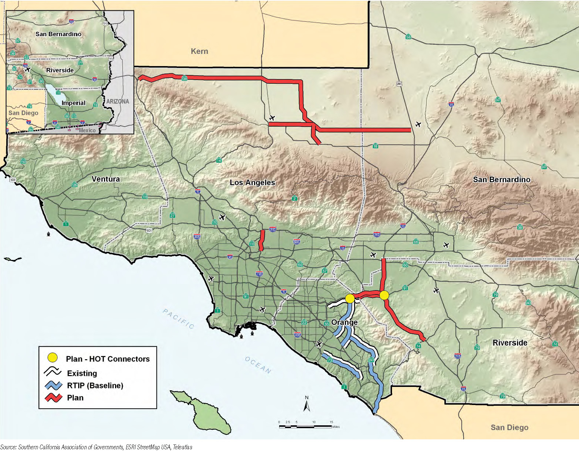
HOT Lane Projects

Slide 27
Prototype Test Results - Comparison of Diurnal and TOD Method
Improvement of Volume / Count Match
(RMSE Statistics)
  AM Peak - 2.2%
  Midday - Similar
  PM Peak - 4.3%
  Night - 4.8%

Slide 28
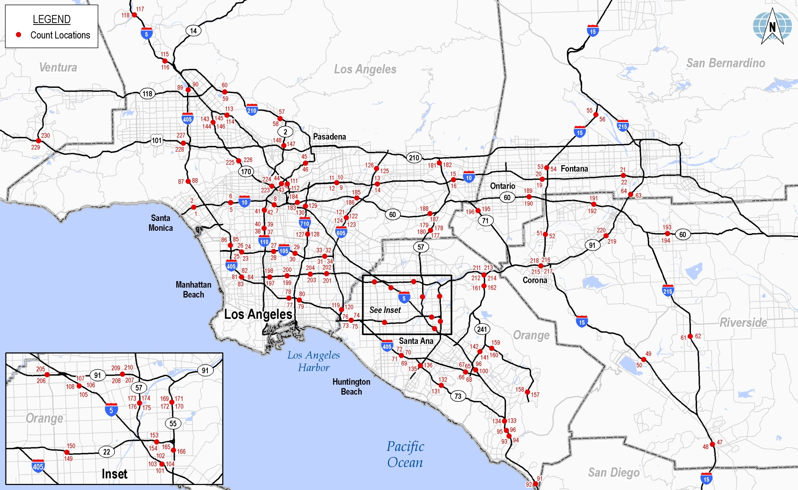
Count Locations

Slide 29
Comparison of Diurnal and TOD Method
Assignment Summary Statistics Using Diurnal Method
Assignment Summary Statistics Using Time-of-Day Method

Slide 30
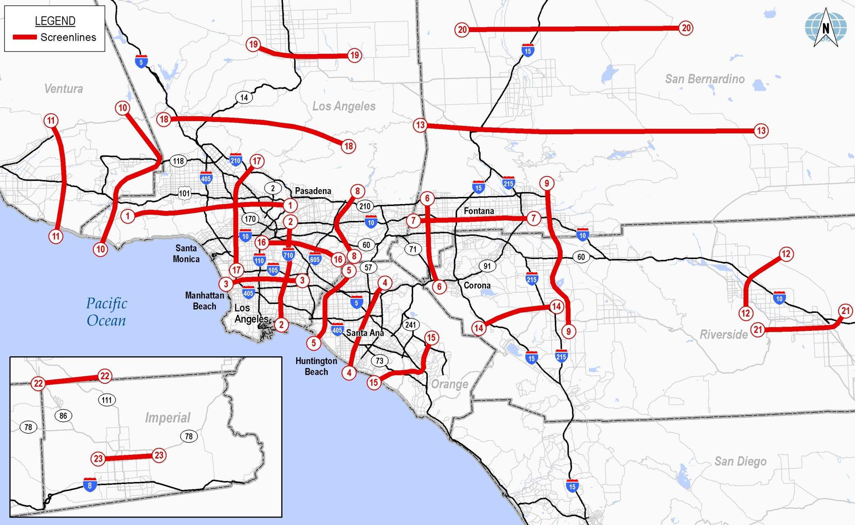
Regional Screenline Locations

Slide 31
Prototype Tests Priced Cases
VMT Charge $0.05 Per Mile, 3 Hour AM, 4 Hour PM Peak Periods
Trip Table Effects
  Reduction of 6.0 Percent in AM Peak Trip
  Reduction of 5.8 Percent in PM Peak Trip
  Increase of 5.0 Percent in Midday Trips
  Increase of 7.3 Percent in Night Trips
VMT Charges vs. No Toll
Pricing Assumptions - $0.05 Per Mile for AM and PM Peak Periods
(Trip Table)

Slide 32
Prototype Tests Priced Cases (cont’d)
VMT Charge $0.05 Per Mile, 3 Hour AM, 4 Hour PM Peak Periods
Screenline Effects
  Reduction of 6.2 Percent in AM Peak Trip
  Reduction of 8.0 Percent in PM Peak Trip
  Increase of 8.2 Percent in Midday Trips
  Increase of 6.8 Percent in Night Trips
VMT Charges vs. No Toll
Pricing Assumptions - $0.05 Per Mile for AM and PM Peak Periods
(Screenline Comparison)

Slide 33
Prototype Tests Priced Cases (cont’d)
Regional Freeway Pricing
Cordon Pricing
Parking Pricing

Slide 34
Summary of Prototype Tests
Use of TOD Improves Model Calibration / Validation Status
The Higher / Vaster Application of Pricing, the Higher Impacts
in AM and PM Peak Trip Reduction
Targeted Cordon and Parking Pricing in Hypothetical
Downtown LA Pricing:
  Affected Trips About 2.0 Percent
  Trip Reduction for AM and PM Peak From -1.0 to -0.3 Percent
Future Steps: Tests and Scenario Analysis With Integrated Model

Slide 35
Acknowledgement:
Contributions of Annie Nam, Guoxiong Huang, Wesley Hong and Warren Whiteaker of Southern California Association of Governments, Linda Bohlinger of HNTB Corporation, Edward Regan of Wilbur Smith Associates, Thomas Adler, Mark Fowler of RSG are greatly appreciated.
SOUTHERN CALIFORNIA
ASSOCIATION of GOVERNMENTS
Contact: Kazem Oryani
Email: koryani@wilbursmith.com
Phone: 203-865-2191

