Slide 1

13th TRB Transportation Planning Applications Conference
May 11, 2011
Risk Assessment & Sensitivity Analysis of Traffic and Revenue Projections for Toll Facilities
Phani Jammalamadaka
Yagnesh Jarmarwala
Worapong Hirunyanitiwattana, PE
Naveen Mokkapati, PE

Slide 2

Outline
Background
Traffic/Transactions and Revenue (T&R) process
Sensitivity analysis
Risk analysis
Discussion on uncertainty in T&R
Case study
Summary/next steps
2

Slide 3
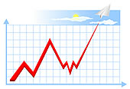
Background
Traffic and revenue (T&R) forecasts - typically point estimates
Bond investors, rating agencies, etc. prefer rigorous sensitivity/risk assessments in toll road T&R forecasts
Risk analysis helps to
  Quantify uncertainties in inputs
  Determine impacts of inputs on output
  Analyze output sensitivities
  Quantify uncertainties of the output
Multi-agency toll project financing negotiations
Evolving risk analysis processes in T&R estimation
3

Slide 4
Typical T&R Process
Existing
Forecasted
Existing
Planned
(MTP, CIP, etc.)
Demand
Supply
Regional TDM
Toll Diversion
Model
Toll Traffic/Transactions
Transponder Shares, Revenue Recovery, Truck Shares, Revenue Days, Toll Rates
Sensitivity Analysis
Toll Revenue
4

Slide 5
Sensitivity Analysis
Demonstrate impacts of changes to inputs
Determine most and least influential inputs
Test impacts of extreme events
Estimate reasonable high and low
Typically not a time-intensive process
A relatively common and reasonably effective method for accommodating risk in demand and revenue
forecasts is the use of sensitivity analyses or “stress tests” (Kriger et al., 2006)
5

Slide 6
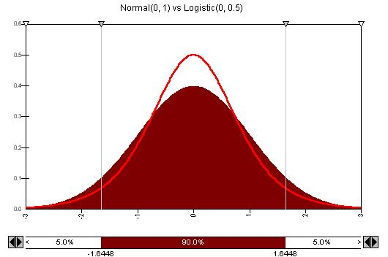
Risk Analysis
Typical Process
  Determine uncertainty distributions of inputs
  Model relationship between inputs and outputs
  Estimate output ranges/probabilities using multiple simulations (Monte Carlo)
Sensitivities/elasticities are a by-product of risk analysis
Challenges (in T&R risk analysis)
  Variables to include in risk analysis and correlations
  Quantification of uncertainty of inputs not easy
  Could lead to misleading conclusions
    Variables used for risk analysis
    Extreme events
6

Slide 7

Select Uncertainty Factors
Demographics (Population, Employment) | Weather
Value of time (Income) | Accidents
Vehicle operating cost (Gas prices) | Construction activity
Toll rates | Feeder/Competing routes
Trip generation rates | Congestion management policies
Revenue days (Weekend/Weekday traffic) | Travel Demand Modeling Factors
Toll revenue recovery
Truck traffic shares
Toll transponder usage
7

Slide 8
Uncertainty Propagation Through TDM
According to Zhao and Kockelman (2002)
Uncertainty grows through trip generation, trip distribution
and mode choice models
Uncertainty drops at the traffic assignment model
  Final flow uncertainties higher than levels of input uncertainties
More difficult to anticipate flows on uncongested networks
8

Slide 9
Case Study Model
Sub Area Network
Urban area highway model
AM, PM and OP time periods
741 Zones (including 116 External Zones)
4667 Roadway Links
3106 Nodes
816 Zone Connectors
Assumptions
Validated travel demand model
Commuter corridor
High toll transponder participation
Market share based toll diversion algorithm
No congestion pricing
Mostly developed corridor (Brownfield corridor)
Growth in trips to 2030 (1.6% annual growth)
No transportation improvements through 2030
Toll Road
Freeways
Arterials
9

Slide 10
T&R Risk Analysis Process
Develop Sub area Model
Trip Generation
Trip Distribution
Transaction Probability Analysis
Regression model to forecast daily traffic/transactions
Revenue Probability Analysis
Develop distributions for input variables (Revenue days, Truck shares, Transponder shares, Toll rates)
Monte Carlo simulation (1000 runs) to obtain revenue distribution
Toll Assignment
Develop input distributions (Population, Employment, Value of time, Toll rates, Vehicle operating costs)
Monte Carlo simulation (1000 runs) to obtain traffic/transaction distribution
Regression model to forecast revenue
Modal Split
10

Slide 11
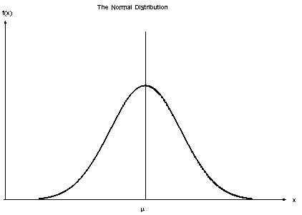
Uncertainties in Input Variables
Transaction Variables
Population (Census vs. Forecast)
Employment (Census vs. Forecast)
VOT (SP Survey, CPI)
Toll Rates, Vehicle Operating Costs (AAA, CPI)
General Uncertainty/Safety Factor
Revenue Variables
Truck Shares (based on observed trends on similar toll facilities)
Revenue Days (based on observed trends on similar toll facilities)
Transponder Shares (based on observed trends on similar toll facilities)
11

Slide 12
Impacts of Population on Toll Traffic
12

Slide 13
Impacts of Employment on Toll Traffic
13

Slide 14
Impacts of Value of Time on Toll Traffic
14

Slide 15
Impacts of Vehicle Operating Cost on Toll Traffic
15

Slide 16
Traffic Sensitivity Analysis Summary
16

Slide 17
Revenue Sensitivity Analysis Summary
17

Slide 18
T&R Uncertainties
Year | Traffic Distributions
 | Lower Bound (P5) | Mean | Upper Bound (P95)
2011 | 96 | 100 | 104
2030 | 80 | 100 | 122
Year | Revenue Distributions
 | Lower Bound (P5) | Mean | Upper Bound (P95)
2011 | 83 | 100 | 111
2030 | 69 | 100 | 141
18

Slide 19
Sensitivity & Traffic/Transaction Probabilities
10 year Demographic Lag
P5 of Population
Toll Rates inflation of 5% per year
P95 of Population
Probability
Probability ~ 23%
P5 of VOC
P95 of VOC
19

Slide 20
Sensitivity & Revenue Probabilities
100% increase in Truck Shares
10% increase in Revenue days
P5 for Toll Rates
P95 for Toll Rates
50% decrease in Revenue Recovery
Probability
Probability ~ 44%
P95 for Revenue days
P5 for Revenue days
20

Slide 21
Revenue Forecast Stream
21

Slide 22
Revenue Forecast Stream
22

Slide 23
Summary
Quantification of T&R uncertainties very important given the inherent uncertainties/imperfections in inputs and models
Possible ways to quantify T&R uncertainties
  Discrete sensitivity analysis
  Risk analysis to create probability ranges for the outputs
  Combined sensitivity analysis, risk analysis and extreme event impacts (recommended)
Case study
  Subarea model to enable multiple Monte Carlo simulations
  Estimation of input variable uncertainties
  Estimation of T&R uncertainties using Monte Carlo simulations
  Sensitivity analyses, including extreme event impacts
23

Slide 24

Next Steps
Quantification of T&R risks associated with
  Trip rates
  Modal splits
  Trip distribution parameters
  Volume delay functions
  Revenue recovery rates
  Toll facility “ramp-up” factors
  Toll diversion algorithm impacts
  Extent of sub-area model
  Managed lane facilities
  Greenfield facilities
Correlation impacts of input variables
24

Slide 25

Questions?
Phani Jammalamadaka
pjammalamadaka@wilbursmith.com
Yagnesh Jarmarwala
yjarmarwala@wilbursmith.com
Worapong Hirunyanitiwattana, PE
whirunyan@wilbursmith.com
Naveen Mokkapati, PE
nmokkapati@wilbursmith.com
25

