Slide 1

Comparisons of Synthetic Populations Generated From Census 2000 and American Community Survey (ACS) Public Use Microdata Sample (PUMS)
13th TRB Application Conference, Reno, NV
May 11th, 2011
Wu Sun
Clint Daniels
& Ziying Ouyang, SANDAG
Peter Vovsha
& Joel Freedman, PB Americas
Notes:
Authors include team members from SANDAG and PB.

Slide 2
Presentation Outline
Project Background
SANDAG PopSyn
Feature
Scenarios
Methodology
Geographies
Key steps
Control variables
Data Sources
Validations
Results Analysis
Conclusions
Notes:
My presentation will focus on the data source, validations and result analysis after briefly going over project background and general topics of popsyn.

Slide 3
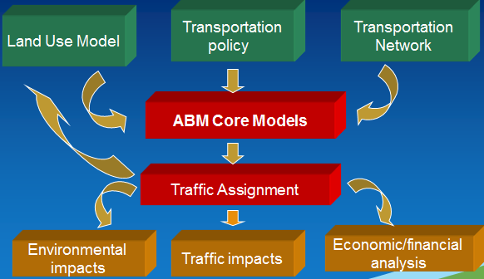


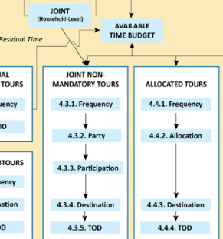
Project Background
SANDAG & SANDAG Travel Models
SANDAG PopSyn & ABM
What is a PopSyn?
What role does a PopSyn play in an ABM?
Notes:
SANDAG is a regional metropolitan planning org (MPO), one of the 4 large MPOs in California
Like many MPOs, sandag uses a 4-step transportation model to conduct RTP, RTIP…
In 2009, SANDAG started to develop activity-based model. An ABM relies on micro-data to represent individual activities and decisions at the household and person level.
Popsyn creates a synthetic population to predict individual and household travel activities. PopSyn is the first model component in the ABM modeling chain

Slide 4
SANDAG PopSyn Development
PopSyn I
PopSyn I
Based on Atlanta PopSyn
Updated controls and programming
No person level controls
PopSyn II
PopSyn II
Notes:
Development includes two stages.
PopSyn I is based on Atlanta PopSyn, with more household control categories , and only balance at household level.
In PopSyn II we add many more new features.

Slide 5
PopSyn II Features
Formulated as an entropy-maximization problem
Balance person and household controls simultaneously
Applicable to both Census 2000 and ACS data
Updated household weight discretizing step
Added household allocation from TAZ to small geography
Database-driven and OOD
Notes:
PopSyn II is formulated as an entropy-maximization problem
In PopSyn II,
All input and out are in SQL database

Slide 6
PopSyn Scenarios
Year 2000 PopSyn
Year 2008 PopSyn
Future year PopSyn(s)
2000 Census Base Year
2010
2008 ACS
Base Year
2050
Future Years
Notes:
Two base year popsyn scenarios depending on the data source and the forecast series.
Many future year popsyns based on the planning study needs

Slide 7
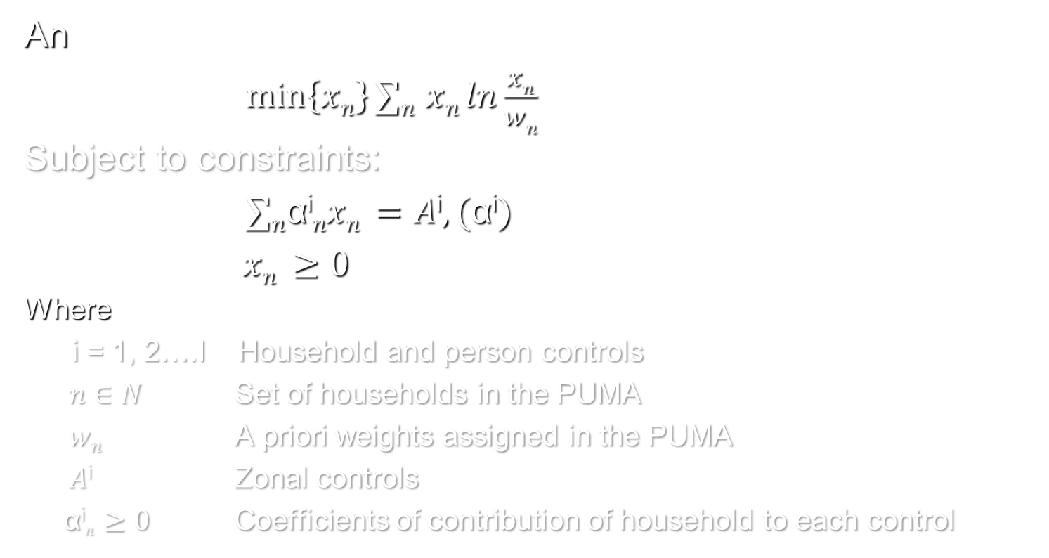
Methodology
An entropy-maximization problem by Peter Vovsha
$\min\left\{xn\right\}∑n$ $xn ln\frac{xn}{wn}$
Subject to constraints:
$∑n$α^{i}$nxn =A\text{i},(\text{α}\text{i})$
$xn ≥0$
Where
i = 1, 2….I Household and person controls
$n∈N$ Set of households in the PUMA
$wn$ A priori weights assigned in the PUMA
$A\text{i}$ Zonal controls
α^{i}$n ≥0$ Coefficients of contribution of household to each control
Notes:
Ask peter if you have any questions.

Slide 8
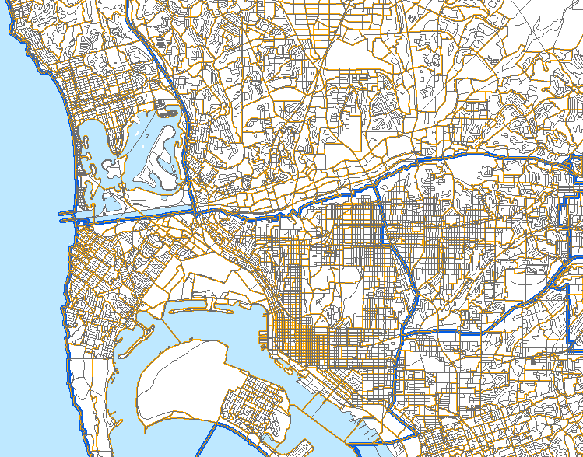
PopSyn Geographies
MGRA (33,000)
TAZ (4,605)
PUMA (16)
Notes:
PopSyn uses various geographies
At small geography level, 33k MGRA. is census block like geography shown in grey color line.
The next level up is TAZ in tan color, and 16 PUMA in blue

Slide 9
SANDAG PopSyn Key Steps
Create control targets
Balance HH Weights
Create Sample HHs
Discretize HH Weights
Allocate HHs
Create validation
measures
Validate PopSyn
Notes:
created targets by hh and pop control categories at TAZ level, and validation measures at PUMA level as input data to popsyn
Key steps
Create a sample of households in each TAZ from the correspondent PUMA
Balance sample household weights to ensure the controlled totals across all person and household dimensions at TAZ level
Discretized the balanced household weights by a Monte Carlo-based algorithm that uses the distribution of fractional values of the household balanced weights, and eliminated the bias toward large fractional values (although they still have better chances to be selected).
Allocate households from TAZ to MGRA
Since the ABM is operated at MGRA level, Households/group quarters in a TAZ are randomly allocated to MGRAs contained in the TAZ by distributions of numbers of households /group quarters in each MGRA.

Slide 10

Control Variables
Household level controls
Household size (1,2,3,4+)
Household income (5 categories)
Number of workers per household (0, 1, 2, 3+)
Number of children in household (0, 1+)
Dwelling unit type (3 categories)
Group quarter status (4 categories)
Person level controls
Age (7 categories)
Gender (2 categories)
Race (8 categories)
Notes:
Total of 39 controls, 22 household, 17 person
Income: <$30k, $30to60k, $60kto100k, $100to150k, and >=$150k
Single family, multi Family and mobile home
gqInst, gqCollege, gqMilitary, gqNonInstOther
AGE0TO17, AGE18TO24, AGE25TO34,AGE35TO49, AGE50TO64,AGE65TO79, AGE80PLUS
HISPANIC, WHITE, BLACK, NINDIAN, ASIAN, ISLANDER, RACEOTHER, MIXED

Slide 11
Data Sources
Census and ACS PUMS
Household and person level microdata
Census and ACS summary data
Source for base year control targets
Source for base year validation data
SANDAG estimates and forecasts
Source for future year control targets
Notes:
Talk a little about Census PUMS, SF1, SF3
Focus on ACS PUMS, and summary tables
ACS summary are estimates of household and pop
Everyone probably is very familiar with Census decennial data. So I will mainly focus on ACS.

Slide 12
ACS Vs. Census
 | ACS | Census
Frequency | Every year | Every 10 years
Data Collected | Both SF1 and SF3 data | SF1: number of people, age, race, gender, etc. SF3: income, education, disability status, etc.
Estimates | Period estimates | "Point-in-time" estimates
Sample Size | 1 in 40 households | Short form SF1: 100% count Long form SF3: 1 in 6 households
 | 1-year PUMS: 1% 3-year PUMS: 3% 5-year PUMS: 5% | PUMS: 5% sample
Notes:
The short form collects basic demographic information only. The long form collects basic demographic information plus more detailed housing and socioeconomic information.
Long form from Census 2010 no longer available, instead it is replaced by ACS. ACS data are not the same as Census 2000 long form data. While some ACS items are comparable to those from the Census 2000 long form, many are not.
What is ACS?
Ongoing survey that provides data every year
Collect demographic, socioeconomic and housing characteristics
Estimates with margin of error (MOE)
Releases: 1-, 3-, and 5-year estimates
ACS PUMS
Microdata
1%, 3%, and 5% samples

Slide 13
Why ACS?
Advantages
Timeliness: a new set of data every year for areas that are large enough (population > 65,000).
Disadvantages
Based on a smaller sample associated with increased error compared with decennial Census.
‘Period estimates’ vs. ‘Point in time’. Which year does the ACS PUMS data represent?
Notes:
No need to rely on 10 year old data.
Present a challenge

Slide 14
Validations
Objectives
Compare PopSyn against Census or ACS
Number of validation measures
Year 2000: 96
Year 2008: 86
Variables used as universes
Number of households
Number of persons
Controlled variables
Non-Controlled variables
Notes:
All controlled variables included in validation measures
Many non-controlled variables are included in the validation measures such as family & marital status, School enrollment, Employment status
Expect better performance for controlled variables

Slide 15
Validation Statistics
Mean percentage difference
Standard Deviations
Absolute values vs. percentage values
Geography: PUMA
Notes:
Universe validation uses absolute values
Non-universe validation uses percentage values

Slide 16
Results
Allocated Household Table
HHID | HH Serial # | GeoType | GeoZone | Version | SourceID
 | …
HH Serial # | PUMA | Attributes
PUMS Household Table
PerID | HH Serial # | Attributes
PUMS Person Table
Notes:
Final results are a list of allocated households that can be linked back to PUMS household and person tables
All tables in SQL Server dB
Linked together through HH serial number
Year 2008, 1.07 mil households, 3 mil persons

Slide 17
Results-Validation Excerpt
Label | Description | PopSyn | Census | Mean Diff. | Standard Dev.
1 | number of HHs | 985938 | 992681 | -0.6% | 0.9%
6 | size 1 | 24.2% | 24.2% | -0.4% | 1.5%
7 | size 2 | 32.3% | 32.0% | 0.8% | 1.0%
8 | size 3 | 15.9% | 16.1% | -1.8% | 2.0%
9 | size 4 | 27.7% | 27.7% | -0.7% | 3.3%

Slide 18
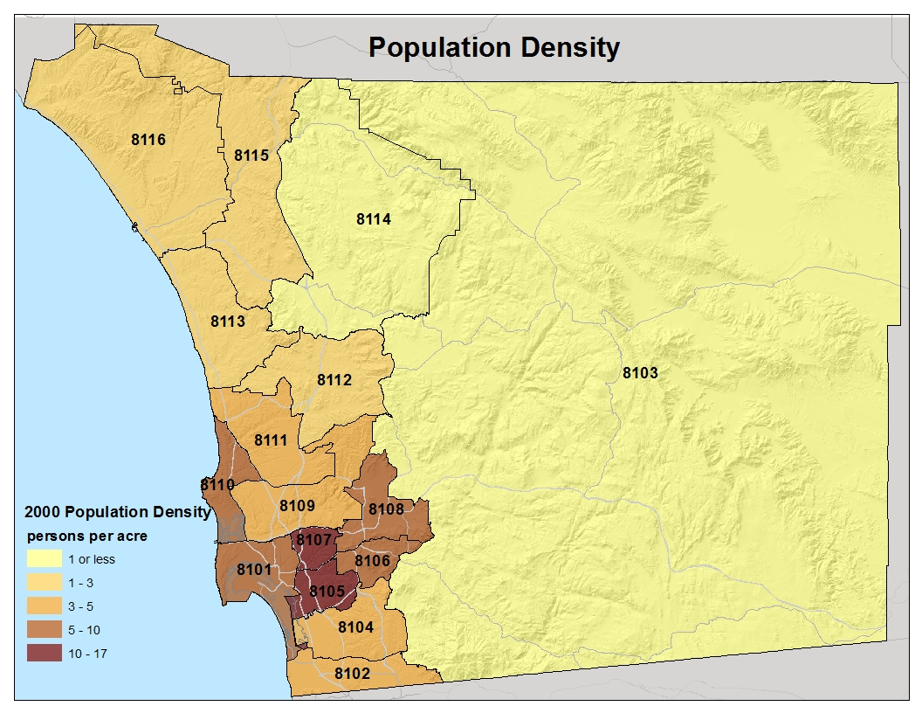
Census 2000 Population Density

Slide 19
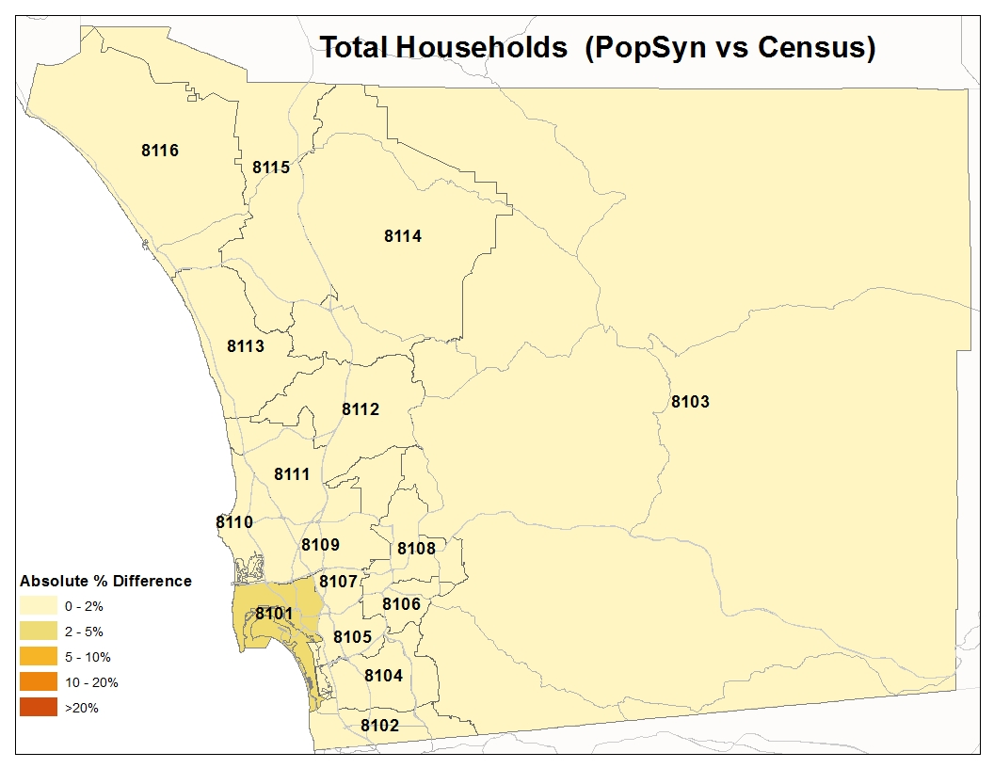
Results-Examples(I)

Slide 20
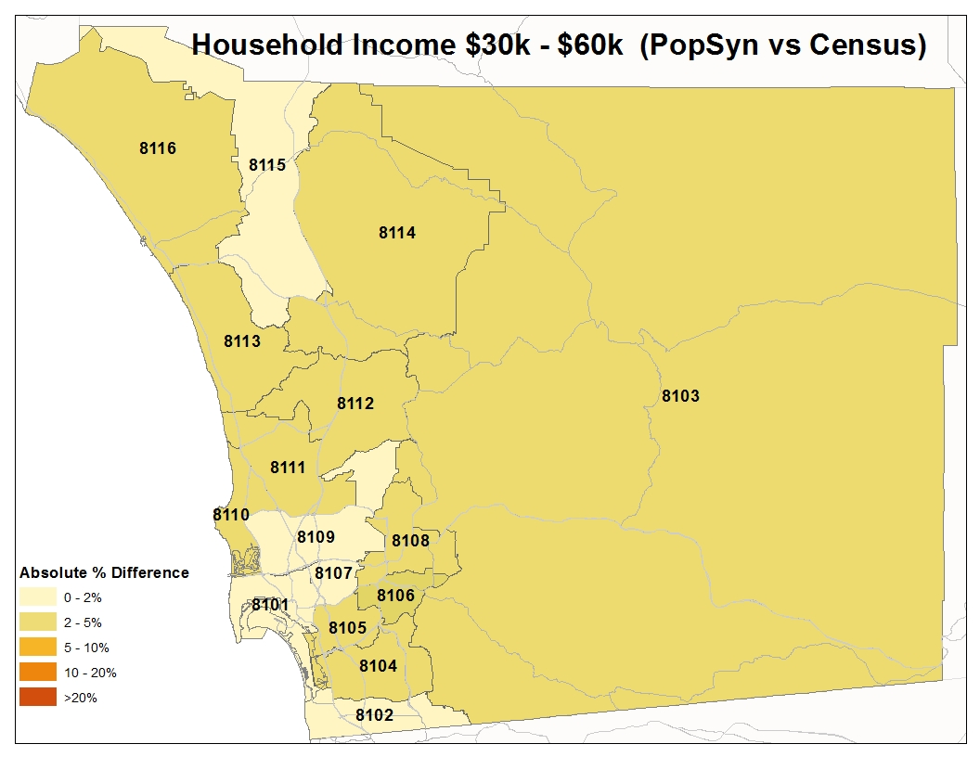
Results-Examples(II)

Slide 21
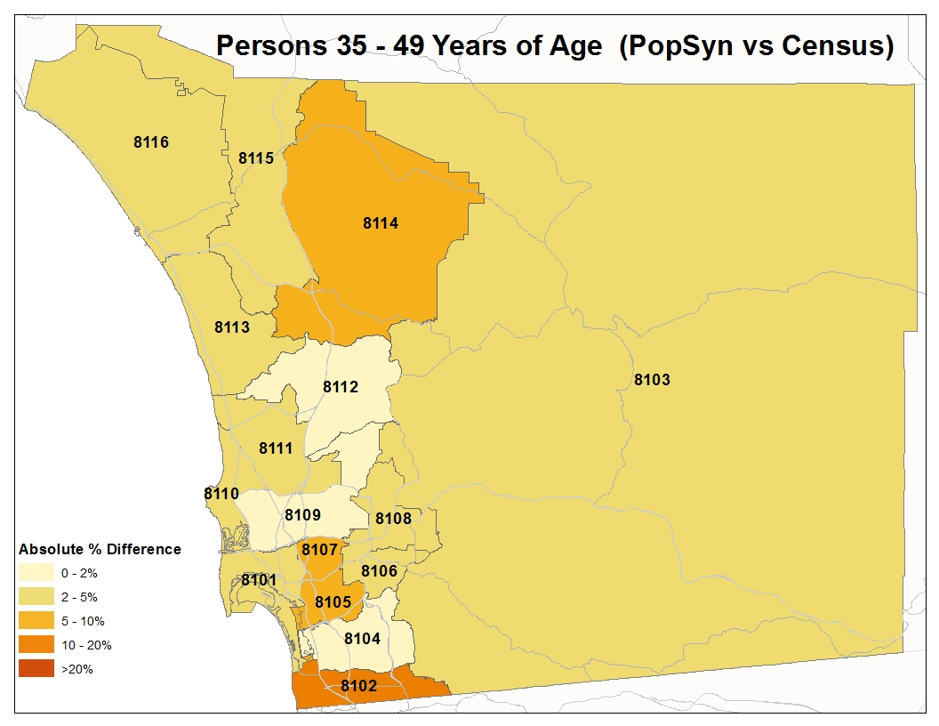
Results-Examples(III)
Notes:
Only 4% of age 35~49 pop in puma 8102.

Slide 22
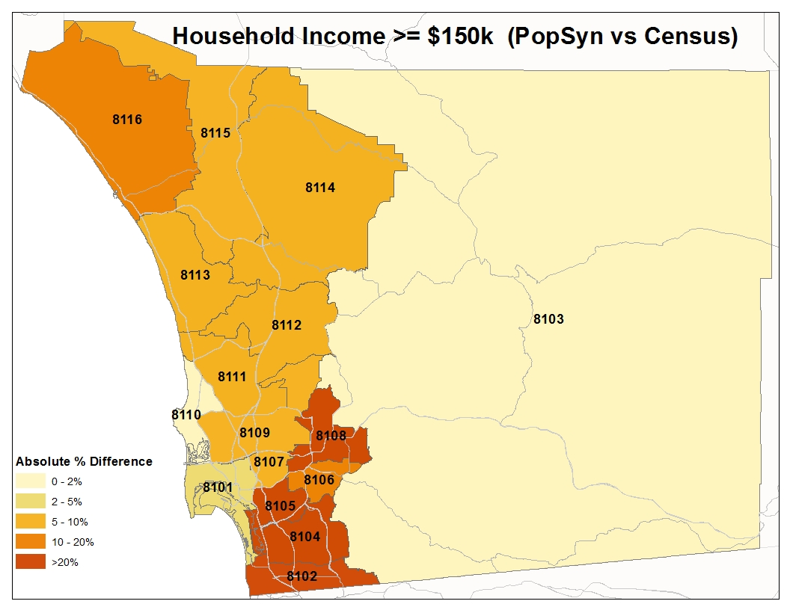
Results-Examples(IV)
Notes:
Explain why perform not that well. Reasons:
South bay not high income area, total of 11% in the 4 puma, range from only 0.9% at puma 8102 to 4.5% in puma 8108
Oceanside not high income area only 3% high income from census
Puma 8110, to 8113 is where La Jolla and Ranch Santa Fe are located, 50% high income are located in the area. Program performs well in these areas.

Slide 23
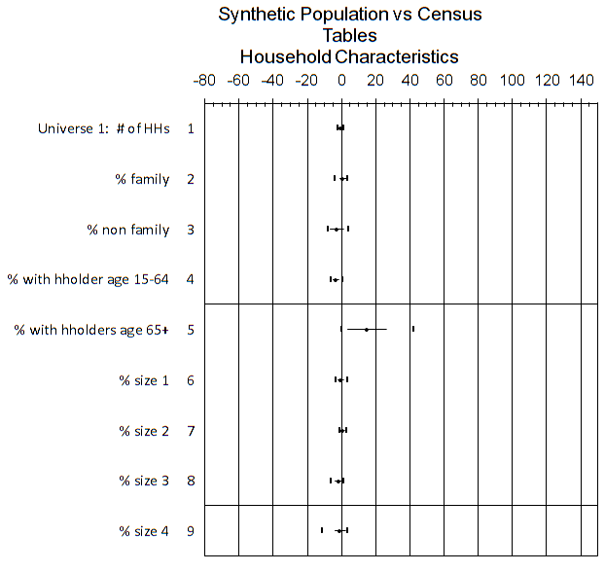
Results-Household Characteristics
Notes:
To things to look at on this chart:
0 line and the range.
If all validation measures fall exactly on 0 line, and there is no range, the it is perfect (an impossible)
If validation measures are closer to 0 line, and range is narrow then they are good results.

Slide 24
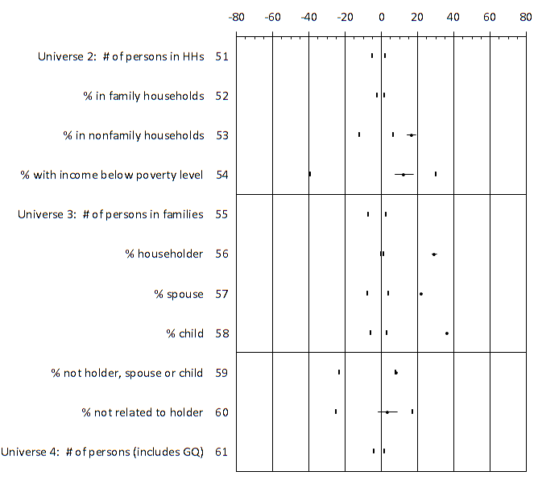
Results-Person Characteristics

Slide 25
Results-Summary(I)
Mean Diff. Range by PUMA | Census 2000 | ACS 2005-2009
>-2% & <2% | 40/96 | 28/86
>-5% & <5% | 59/96 | 50/86
>-10% & <10% | 78/96 | 67/86
>-20% & < 20% | 87/96 | 84/86

Slide 26
Results-Summary(II)
ACS-Based vs. Census-Based PopSyn(s)
Both produced acceptable results
Census PopSyn performed better than ACS PopSyn in validation measures
Consistency between targets and validation data
Census PopSyn: both from Census summary
ACS PopSyn: targets from estimates, validation data from ACS summary
Target accuracy at small geography is the key
Notes:
A) Both are acceptable.
B) Census better in terms of validation measures
Reasons: 1) In-consistency between target and validation data source; 2) With the improvement of targets (if estimated from ACS summary data), then we expect the performance should be better.

Slide 27
Results-Software Performance
Test environment
Dell Intel Xeon PC with dual 2.69 GHz processors and 3.5 GB of RAM
Performance
 | Year 2000 | Year 2008
Runtime | 11.8 min | 14.1 min
SynPop Pop | 2.77mil | 2.95mil
SynPop HHs | 0.99mil | 1.05mil
Notes:
Performed well. Run time is within 10 to 15 minutes.
Total HHs and Population affects run time.
Total number of TAZs also affects run time.

Slide 28
Issues and Future Work
Issues
Consistency of various geographies
Census/ACS geography
Transportation modeling geography
Land use modeling geography
Accuracy of land use estimates and forecasts at small geographies
Future Work
Add worker occupations as controls
Improve control target accuracy
Automate control target generations

Slide 29
Conclusions
Closed form formulation provides a sound theoretical basis
Balance household and person controls simultaneously
Applicable to both ACS and Census data
An early application using 2009 ACS 5-year data
Database-driven and OOD makes software easy to maintain, expand, and transfer

Slide 30
Acknowledgements
The authors thank SANDAG staff:
Daniel Flyte,
Ed Schafer,
Eddie Janowicz,
For their help in this project, especially in providing control target data.

Slide 31
Questions & Contacts
Questions?
Contacts
Wu Sun: wsu@sandag.org
Ziying Ouyang: zou@sandag.org
Clint Daniels: cdan@sandag.org

Slide 32
ACS 1-, 3-, and 5- Year Estimates
Data collected between... | Data pooled to produce | Data published for areas with
Jan. 1, 2009 and Dec. 31, 2009 | 2009 ACS 1-year estimates | populations of 65,000+
Jan. 1, 2007 and Dec. 31, 2009 | 2007-2009 ACS 3-year estimates | populations of 20,000+
Jan. 1, 2005 and Dec. 31, 2009 | 2005-2009 ACS 5-year estimates | populations of almost any size
Notes:
American Community Survey 1-, 3-, and 5-year estimates are period estimates, which means they represent the characteristics of the population and housing over a specific data collection period. Data are combined to produce 12 months, 36 months or 60 months of data. These are called 1-year, 3-year and 5-year data.

Slide 33
ACS PUMS 2009 5-Year Estimates for San Diego County
ACS Year | Households | Persons
2005 | 11,107 | 27,811 (No GQ)
2006 | 12,302 | 29,129
2007 | 12,058 | 28,286
2008 | 12,230 | 28,599
2009 | 12,180 | 28,497
Total | 59,877 | 114,511
Census Year | Households | Persons
2000 | 52,774 | 134,866
Notes:
Roughly 5% sample

