Slide 1

NCHRP 8-61 Travel Demand Forecasting: Parameters and Techniques
presented to
13th Transportation Planning Applications Conference
prepared and presented by
David Kurth and Thomas Rossi
Cambridge Systematics, Inc.
May 8, 2011
Transportation leadership you can trust.

Slide 2
Presentation Outline
Project Overview
Analysis of NHTS Data
Data from existing MPO models
What’s in the guidebook?
Next Steps

Slide 3
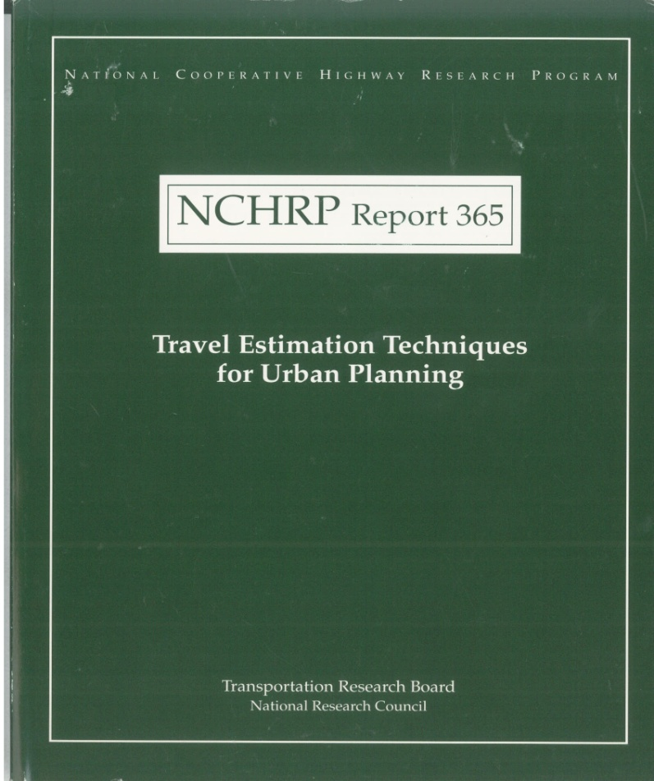
Project Overview
Background
1978 –NCHRP Report 187
  Quick Response Urban Travel Estimation Techniques and Transferable Parameters
1998 – NCHRP Report 365
  Travel Estimation Techniques
  for Urban Planning
2011 – Project 8-61
  Travel Demand Forecasting: Parameters and Techniques
Notes:
In 1978, TRB published NCHRP Report 187: Quick-Response Urban Travel Estimation Techniques and Transferable Parameters. This report described default parameters, factors, and manual techniques for doing simple planning analysis. The report and its default data were used widely by the transportation planning profession for almost 20 years. In 1998, drawing on several newer data sources including the 1990 Census and National Personal Household Travel Survey, an update to NCHRP Report 187 was published in the form of NCHRP Report 365: Travel Estimation Techniques for Urban Planning.
Since NCHRP Report 365 was published, significant changes have occurred affecting the complexity, scope, and context of transportation planning. Planning concerns have grown beyond "urban" to include rural, statewide, and special-use lands. Transportation planning tools have evolved and proliferated, enabling improved and more flexible analyses to support decisions. The demands on transportation planning have expanded into special populations (e.g., tribal, immigrant, old, and young) and broader issues (e.g., safety, congestion, pricing, air quality, environment, and freight). In addition, the default data and parameters in NCHRP Report 365 need to be updated to reflect the planning requirements of today and the next 10 years.

Slide 4
Project Overview
Project Panel, Staff, and Research Agency Team
NCHRP Staff for Project 8-61
Nanda Srinivasan, Sr. Pgm. Officer
Lori Sundstrom, Sr. Pgm. Officer
Project 8-61 Panel
Thomas Kane (Chair)
Michael Bruff
Ed Christopher
Nathan Erlbaum
Jerry Everett
Bruce Griesenbeck
Herbert Levinson
Richard Pratt
Bijan Sartipi
Shuming Yan
Dick Pratt
Kim Fisher (TRB Liaison)
Ken Cervenka (DOT Liaison)
Research Agency Team
Cambridge Systematics, Inc.
In Association With
Vanasse Hangen Brustlin, Inc.
Martin/Alexiou/Bryson, PLLC
Gallop Corporation
Dr. Chandra R. Bhat
Shapiro Transportation Consulting, LLC
Principal Investigator
Thomas Rossi
Notes:
As with all NCHRP projects, a project panel is overseeing the work. The research agency team includes Cambridge Systematics, VHB, MAB, Gallop, Dr. Bhat, and Phil Shapiro. The Research Agency Team is led by Tom Rossi.

Slide 5
Project Overview
Objectives
Revise and Update NCHRP Report 365
  Current travel characteristics
  Guidance on forecasting
    Procedures
    Applications
Develop User-Friendly Guidebook
  Range of approaches
    Application of straightforward techniques
    Optional use of default (transferable) parameters
  References to more sophisticated techniques
  Broad range of transportation planning issues
Notes:
The objective of this research is to revise and update NCHRP Report 365 to reflect current travel characteristics and to provide guidance on travel demand forecasting procedures and their application for solving common transportation problems. The update will present, in a user-friendly guidebook format, a range of credible approaches to allow different users to determine the level of detail and sophistication in selecting modeling and analysis techniques most appropriate to their situations. The updated guidebook will address the application of simple, straight-forward techniques, optional use of default parameters, and appropriate references to other more sophisticated techniques. The guidebook will be sufficiently broad, yet detailed enough, to allow practitioners to use travel demand forecasting methods to address the full range of transportation planning issues (e.g., environmental, air quality, freight, multimodal, and other critical concerns).

Slide 6
Project Overview
Status to Date
Analysis of 2001 NHTS data
  2009 NHTS analysis underway
Analysis of MPO model documentation
First draft of guidebook
Case studies underway

Slide 7
Analysis of NHTS Data
Process
Information developed for four variables of interest
  Person trip production rates
    Per household by trip purpose
  Reported average trip durations
    By mode and trip purpose
  Time of day of travel distributions
    By trip purpose
  Vehicle occupancy
    By trip purpose
Variables selected based on potential for transferability

Slide 8
Analysis of NHTS Data
Classifications
Trip purposes used for data summaries
  Home based work
  Home based school
  Home based other
  Non-home based
Urban area population classifications
Home based non-work
Notes:
Some variables do not vary significantly by urban area size or do not show reasonable trends

Slide 9
Analysis of NHTS Data
Sample Tabulations
Sample trip production tabulation (2001)
Home based work - MSA population less than 250,000
 | Workers
Autos | 0 | 1 | 2 | 3+ | Avg
0 | 0.0 | 1.2 | 2.3 | 1.6 | 0.6
1 | 0.0 | 1.0 | 1.7 | 4.7 | 0.7
2 | 0.0 | 1.3 | 2.5 | 2.8 | 1.7
3+ | 0.0 | 1.2 | 2.5 | 3.7 | 2.3
Avg | 0.0 | 1.1 | 2.4 | 3.6 | 1.5
SAMPLE

Slide 10
Analysis of NHTS Data
Sample Tabulations
Sample trip length tabulation (2001)
Home based work – Average travel time in minutes
MSA Population18 | Auto | Transit | Non-Motorized | All Modes
Greater than 3 million | 29 | 56 | 18 | 31
Between 1 and 3 million | 24 | 48 | 19 | 25
Between 500,000 and 1 million | 24 | 53 | 14 | 24
Between 250,000 and 500,000 | 21 | 30 | 11 | 21
Less than 250,000 | 20 | 59 | 11 | 20
Not in MSA | 21 | 57 | 8 | 21
All trips | 25 | 55 | 15 | 26
SAMPLE

Slide 11
Data from Existing MPO Models
Process
Information from over 70 MPOs
  Small, medium, large
  Direct contact or publicly available reports
  Information collected
    Model parameters
      Trip attraction rates
      Friction factor parameters
      Mode choice parameters
      Volume-delay function parameters
      …
    Model methods used
Notes:
This exercise was, of course, fraught with difficulty since there is no standard model in use throughout the nation. While we did focus on trip-based travel models to simplify our efforts, some of the issues that must be considered include:
Different base years for model estimation / calibration
Different explanatory variables (e.g. income group or auto ownership for trip generation)
Lack of detail regarding the source of the model parameters
The MPO data were used “strategically” to supplement model information that could not reasonably be developed from the NHTS data such as trip attraction models, trip distribution model parameters, or mode choice model parameters.

Slide 12
Data from Existing MPO Models
Sample Tabulation
Sample gamma function gravity model parameters
(home based work)
 | “b” | “c”
Large MPO 1 | 0.503 | -0.078
Large MPO 2 | -1.650 | -0.040
Large MPO 3 | -0.156 | -0.045
Medium MPO 1 | -0.812 | -0.037
Medium MPO 2 | -0.388 | -0.117
Medium MPO 3 | -0.020 | -0.123
Small MPO 1 | -0.265 | -0.040
Small MPO 2 | 0.850 | -0.200
SAMPLE
Notes:
As you can see, in some cases there was substantial variation in model parameters from the MPO models and it did not make sense to combine or average the data. However, in this case, we also tried to provide some additional information by plotting the data as shown on the next slide…

Slide 13
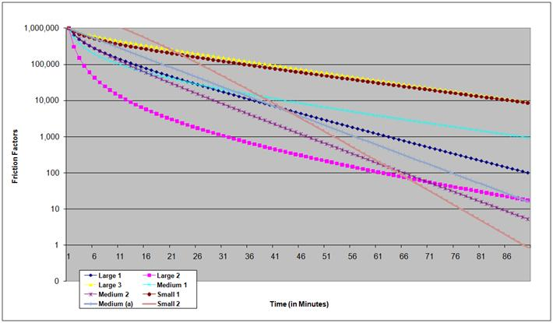
Data from Existing MPO Models
Sample Gamma Function Comparison (Home Based Work)
“Small 1”
SAMPLE
“Small 2”

Slide 14
What’s in the Guidebook?
Chapter 1. Introduction
  Purpose, objectives, and roadmap
  Summary of modeling process
  How parameters used
Chapter 2. Planning Applications Context
  Planning context affect on model
  Examples from urban areas
Notes:
Chapter 1. Introduction
This section will describe the purpose for the guidebook, its objectives, and how it is organized. It will provide a brief summary of the modeling process and how parameters fit into it.
Chapter 2. Planning Applications Context
The purpose of developing travel forecasting models is to provide information that can be used to make transportation planning decisions. These decisions may require different kinds of information from the model, depending on the context. The planning context, therefore, should be used to determine the model structure, parameters, and complexity. This, in turn, will ensure that the travel forecasting model is appropriate for each planning context. It is useful to develop a travel forecasting model that meets most (if not all) of an agency’s current and future planning needs. This section will discuss how the planning context affects the model’s capabilities and provide examples of different contexts found in U.S. urban areas.

Slide 15
What’s in the Guidebook? (continued)
Chapter 3. Development of Data
  Purposes
    Model development
    Model validation
    Model application
  Considerations
    Limitations of typical data
    Primary and secondary data sources
    Conversion of data from secondary sources
    Network coding procedures
Notes:
Chapter 3. Development of Data for Model Development and Validation
There are a variety of data types required for model development, validation, and application. This section will describe the types of data used for each of these functions. Model development data primarily include transportation networks and socioeconomic data. The chapter will describe primary and secondary data sources, limitations of typical data, conversion of data from other sources for use in modeling, and network coding procedures.

Slide 16
What’s in the Guidebook? (continued)
Chapter 4. Model Components
  Discusses each model component
  Each subsection presents:
    A brief description of best practice(s)
    Basis for development of the parameters
    Parameters classified by urban area category
    Explanations of use in model
      Estimation
      Validation
    Parameter transfer
Notes:
Chapter 4. Model Components
In each subsection of Chapter 4, we will present:
A brief description of the typical method(s) representing best practice. This may include alternative methods that may be appropriate in different contexts. For example, trip generation might include methods to estimate total person trips, total motorized person trips, or total vehicle trips. At this time we are not planning to provide a complete discussion of the theory behind the methods and the model estimation procedures; rather, we would provide references to the already extensive existing literature documenting these items.
The basis for the development of the data presented in the subsection.
Model parameters classified by urban area category, with explanations of how they can be used in model estimation, validation, and parameter transfer.
A chapter summary.

Slide 17
What’s in the Guidebook? (continued)
Chapter 4 subsections
Vehicle Availability
Trip Generation
Trip Distribution
External Travel
Mode Choice
Automobile Occupancy
Time-of-Day Characteristics
Truck/Freight Modeling
Highway Assignment
Transit Assignment
Notes:
The following are subsections of Chapter 4:
Vehicle Availability
Trip Generation
Trip Distribution
External Travel
Mode Choice
Automobile Occupancy
Time-of-Day Characteristics
Truck/Freight Modeling
Highway Assignment
Transit Assignment

Slide 18
What’s in the Guidebook? (continued)
Chapter 5. Model Validation Process
  Validation overview
    Consistent with other sources
    Appropriate out-references
    Not duplication of existing references
  Basic guidance
    Focus on information in the guidebook
Notes:
Chapter 5. Model Validation Process
Since one of the uses of the information in the guidebook will be for model validation, this section will provide basic guidance on validation with a specific focus on how to use the information in the guidebook in the validation process. This is not intended to duplicate other reference material on validation such as the update to the FHWA Model Validation Manual currently under development. The material presented in this chapter will provide an overview on validation consistent with the other sources with appropriate references to those sources.

Slide 19
What’s in the Guidebook? (continued)
Chapter 6. Advanced Modeling Practices
  Overview
  Tour and activity based approaches
  Traffic microsimulation
Chapter 7. Case Study Application(s)
  Two studies
    Smaller urban area with little transit
    Larger area with transit
  Illustrate use of the information from Chapters 4 and 5
  Draw on concepts presented guidebook
    Similar to approach in NCHRP Report 365
Notes:
Chapter 6. Advanced Modeling Practices
This chapter will provide an overview of advanced modeling practices including tour and activity based approaches and traffic microsimulation. While these may not be relevant for some guidebook users, such advanced practices will become more prevalent during the “lifetime” of the guidebook, and information from the guidebook will prove useful to many users of these models.
Chapter 7. Case Study Application(s)
A set of case studies will be developed to illustrate the use of the information presented in Chapters 5 and 6, drawing on the concepts presented in the entire guidebook. Two case studies will be presented, representing different types of planning applications contexts as described in Section 2. They include:
Smaller urban area with little transit
Larger area with transit
The case studies will walk through the process of developing and using model parameters for the specific context, similar to the process used in NCHRP Report 365. It is possible that the smaller case study will not include the entire modeling process.

Slide 20
Next Steps
Complete analysis of 2009 NHTS (Version 2)
Complete case studies
Peer review
Final report expected by the end of 2011

Slide 21

Contact Information
Nanda Srinivasan
Senior Program Officer
National Cooperative Highway Research Program
Transportation Research Board of the National Academies
500 Fifth Street, NW
Washington, DC 20001
202-334-1896
nsrinivasan@nas.edu
Thomas Rossi
Principal
Cambridge Systematics, Inc.
100 CambridgePark Drive, Suite 400
Cambridge, MA 02140
617-354-0167
trossi@camsys.com

