Slide 1


Census Transportation Planning Products Program Penelope Weinberger CTPP Program Manager - AASHTO
13th Annual TRB Planning Applications Conference, Reno, NV
(May 8, 2011)

Slide 2
Today’s presentation
CTPP Program
History
Content
CTPP Data Tabulations Based on 3-year 2006 – 2008 ACS
Design
Details
Uses
Data Access Software
Resources and Contacts

Slide 3
What is the CTPP Program?
The CTPP is an umbrella program of data products, custom tabulations, training, technical assistance, and research for the transportation community.
CTPP uses American Community Survey (ACS) data from U.S. Census Bureau.
WARNING!
Decennial Census has no Long Form –
There is No JTW data in Decennial Census!

Slide 4

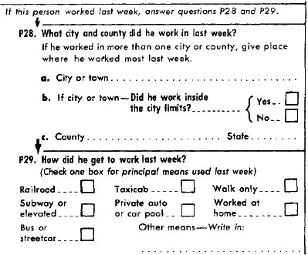
Historic Background
1960 Census “long form”
– journey to work question added
OMB required-Metro Areas
Coded to City or County
No Special Tabulations
Notes:
In 1960, the Office of Management and the Budget (OMB) first sponsored the tabulation and packaging of Census Journeyto-Work data at CB defined geographies. The transportation community quickly adopted ownership of the journey to work
questions and agreed to pay for a set of special tabulations at geographies conducive to transportation planning needs.
For the 1970 Census, 112 separate buyers, mostly MPOs, contracted directly with the CB for the data and prepared the
specifications for the data tabulations. By 1980, there were 152 purchasers. An ad-hoc committee of transportation planners
under the auspices of the Transportation Research Board developed the specifications. Users paid their share of the package
and a special grant from DOT of $260K paid CB staff to write the computer programs.
In 1990 and 2000, a national “pooled-fund” process was initiated by the states to cooperatively plan and purchase special
census data tabulations from the CB for transportation planning. The availability of the data for 1990 was further enhanced by
a special grant from the Bureau of Transportation Statistics (BTS) to distribute the data. Over 55,000 CDs were produced and
distributed.
The development of the 2000 data package was coordinated by the multi-organizational Census Transportation Planning
Package (CTPP) Working Group, and again, the states and MPOs paid the CB for the tabulations using AASHTO as a coordinator
of the process. Each state was assessed costs based on their total population. U.S. DOT agencies provided additional funding for
technical support, coordination, and software used by the MPOs to define their Traffic Analysis Zones (TAZs).

Slide 5
Historic background
 | Buyers/Users | Direct Cost | Tables
1960 | OMB | ??? | ???
1970 | Individual contracts (112) | $0.6 M | 43
1980 | Individual contracts (152) | $2.0 M | 82
1990 | Nationwide covering all States and MPOs | $2.5 M | 120
2000 |  | $3.0 M | 203
“2010” |  | $5.8 M | 200*

Slide 6
CTPP Program Activities and Costs
Develop specialized data products | 63%
Conduct research, training and outreach | 21%
Manage the program | 3%
Unallocated balance | 12%
Total Program Costs | $5,844,332
5-Year Program: 2008 ~ 2012

Slide 7
Research
NCHRP 8-79
Producing Transportation Data Products from the American Community Survey That Comply with Disclosure Rules
Using Census Data for Transportation Applications Conference
Commuting in America
NCHRP 8-36
Enhancing the American Community Survey Data as a source for Home-to-Work Flows: ACS LEHD Comparisons”–
Improving Home-to-Work and Employment Data for Transportation Planning

Slide 8
Training and Outreach
Seven Webinars
E-Learning
Site Visits
Conferences, Workshops
Technical Assistance
Software help
CTPP Status Report

Slide 9
Data Products
Archival Data
Profiles
3 year tabulations
5 year tabulations
Census transportation Analysis Zones and Districts (TAZ/TAD)
Workplace Allocation

Slide 10

The 3-year Product Design
2000 Geography
Product Structure
3-Parts
Part 1- Place of Residence
Part 2- Place of Work
Part 3- Flows between
Home and Work
with On-Line
Extraction Software
Nation (US Total)
State
State-County
State-County-MCD
State-Place
State-PUMA
State-POW PUMA
Metropolitan Statistical Area
MSA – EACH Principal City

Slide 11
3-year CTPP Product Summary
Highlights | Low Lights
Based on CTPP2000 Tables Many NEW Univariate Tables More Age Tables Streamlined Race Tables More HH and HH Lifecycle Tables More English Proficiency Tables Way more Flows Tables MOEs | Incomplete Coverage Rounded Reduced Number of Crosstabs with Mode -- Travel time -- Household income -- Vehicle availability -- Age -- Time leaving home Tables will have Suppression -- Means based on 3 values -- 3 records in Flow MOEs

Slide 12
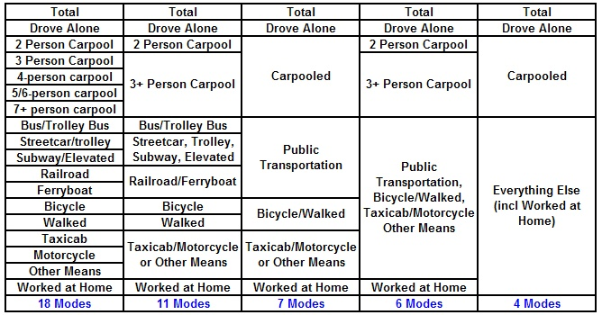
CTPP products collapsing schema

Slide 13
CTPP Basics
Planning Support for over 20 federal planning requirements
Data for supporting a wide variety of transportation planning tasks
Policy studies
Travel demand modeling
Congestion management
Emergency preparedness
Corridor and project studies
Transit new start and service planning
Environmental justice studies
Air quality conformity
Environmental justice reviews
Trends analyses

Slide 14
AKA
How many people live here and work there?
What’s the average commute time to my city?
How many or what percentage of workers use transit in my MSA?
What is the approximate income of workers commuting from the suburbs to the city?
What industries are located in my city?
What proportion of transit users are automobile owners?
What percentage of work trips are made in carpools?
What proportion of people telecommute?

Slide 15
Accessing the 3-year data
Available on the web
Free to use, but you do need to register
Online help and tutorials
http://ctpp.transportation.org/Pages/3yrdas.aspx

Slide 16
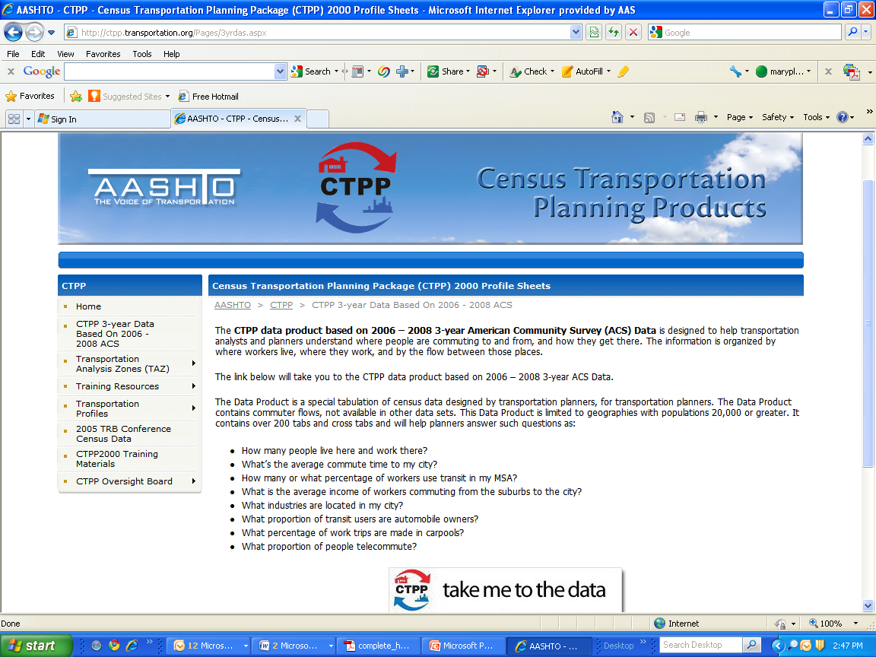

Slide 17
Accessing the 3-year data
Create sessions, which are groups of tables with a common geography selection
Select geography using a map and/or drill down through the geographic hierarchy
Search for tables by dimension name or any relevant word
Either within one of the parts or across all parts
Download your (or any) state

Slide 18
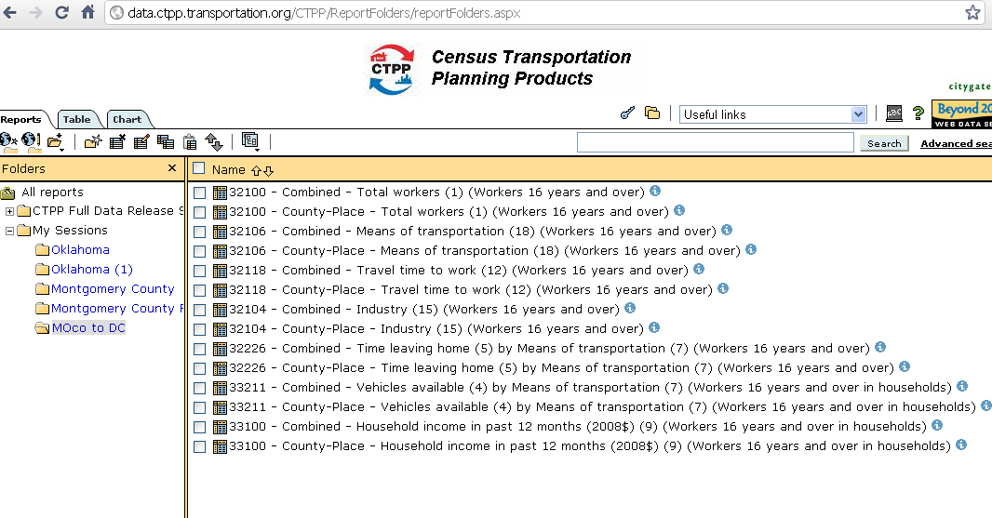

Slide 19
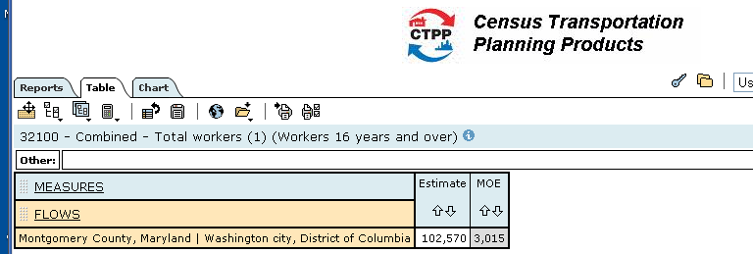
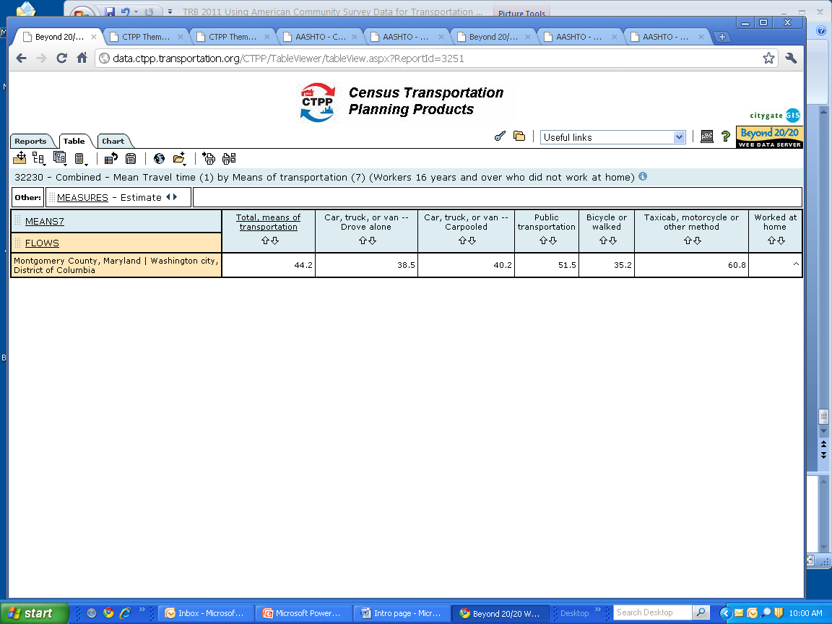

Slide 20
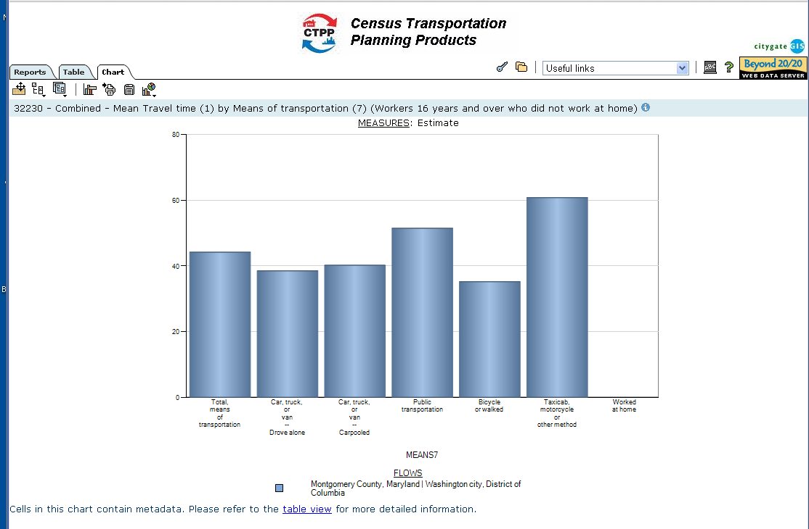

Slide 21
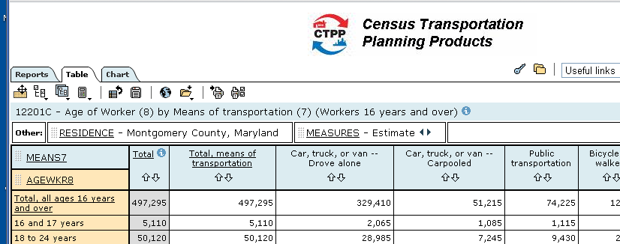
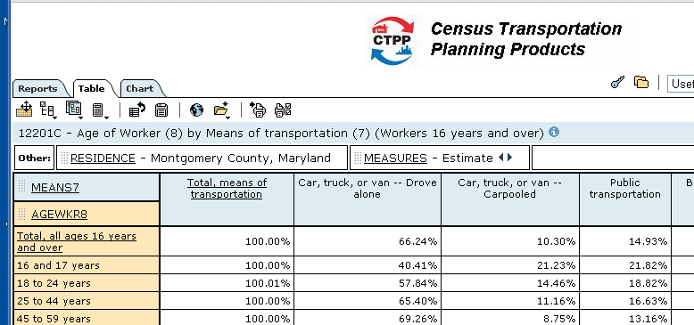

Slide 22
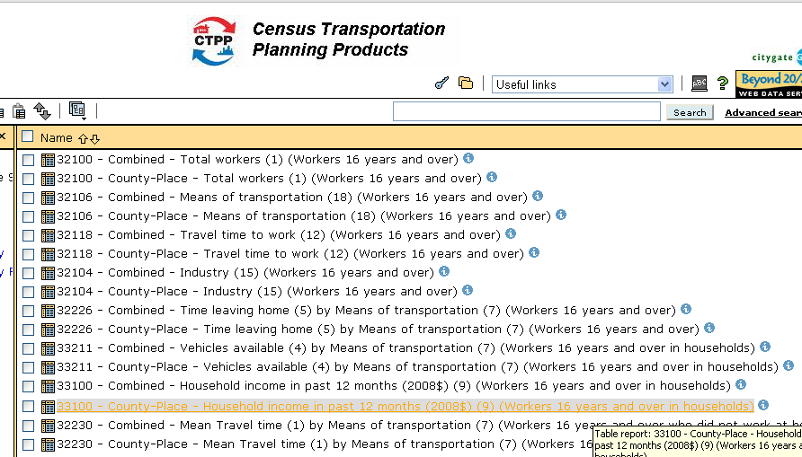
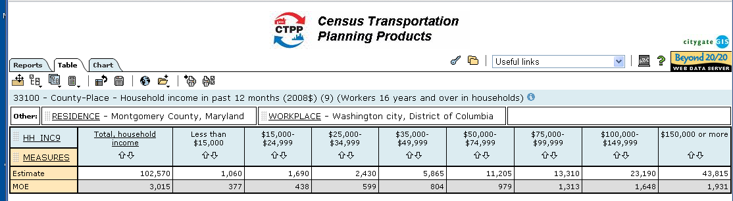

Slide 23
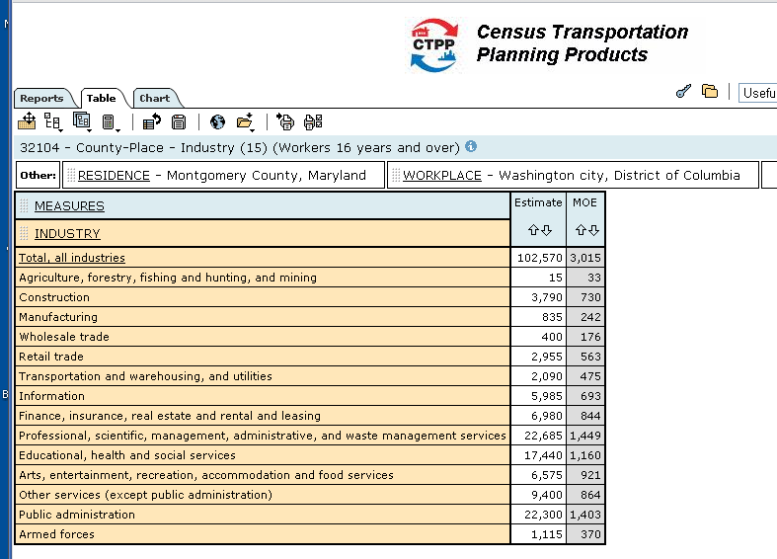

Slide 24
Viewing the data
Open any table, either in your “session” or from the public view.
From there, you can customize your view of the data:
Rearrange dimensions
Make selections on any dimension
View charts
Aggregate items using standard functions or provide a formula (margin of error will be recalculated for you for simpler formulas)
Save your report for future use
Save your selections and aggregations for use in other tables

Slide 25
Exporting the Data
Once you have set up the table you want to see, you can export it:
Export the data in CSV, XLS or Beyond 20/20 (IVT) format for use in your own analysis tools
Export SHP files for viewing maps in your own GIS engine
Entire sessions can be exported in a single operation.

Slide 26
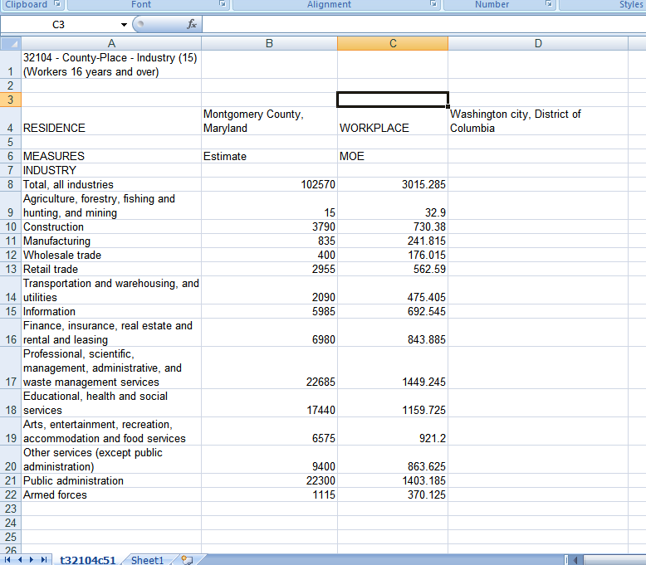

Slide 27
Resources
CTPP at AASHTO:
http://ctpp.transportation.org/Pages/default.aspx
CTPP at FHWA:
http://www.fhwa.dot.gov/ctpp/
Ed the Fed
http://www.edthefed.com/
TRB Census Data Subcommittee
http://www.trbcensus.com/

Slide 28
Contact Me
Penelope Weinberger AASHTO CTPP Program Manager 202-624-3556 pweinberger@aashto.org

