Slide 1
Visioning for a Future without Borders
Sondra Rosenberg, PTP – NDOT Project Manager
Dan Andersen – CH2M HILL Sr. Planner
13th TRB National Transportation Planning Applications Conference
May 11, 2011

Slide 2
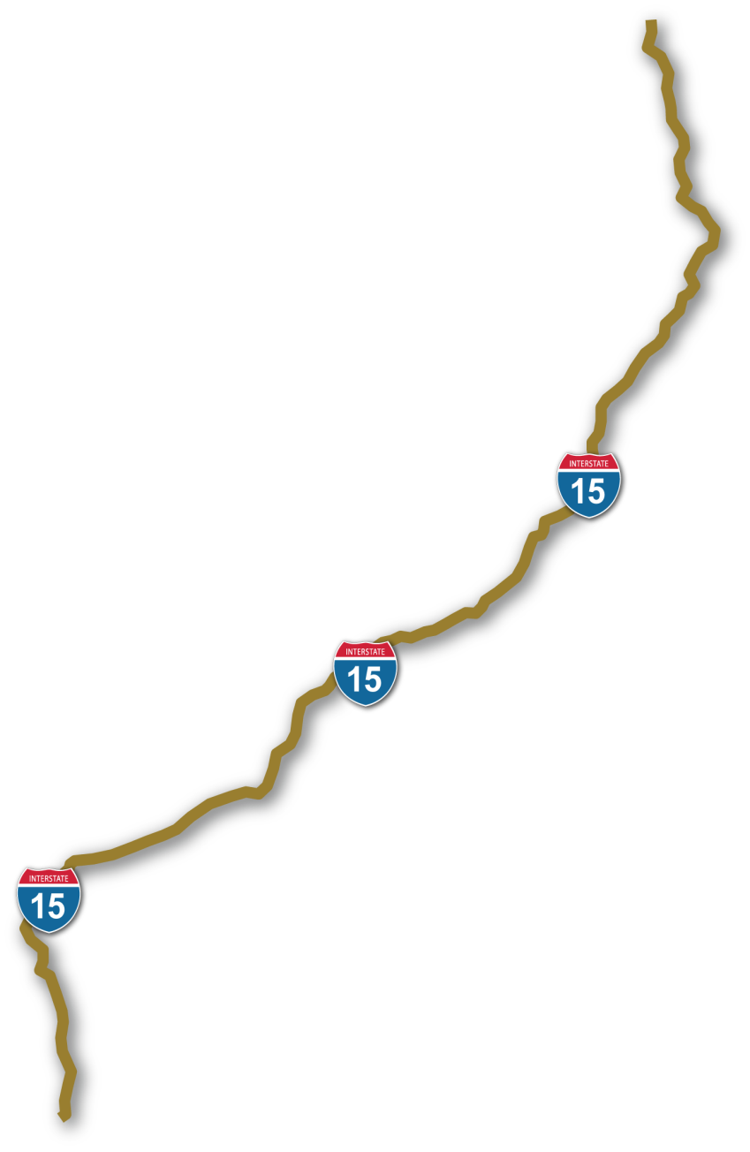
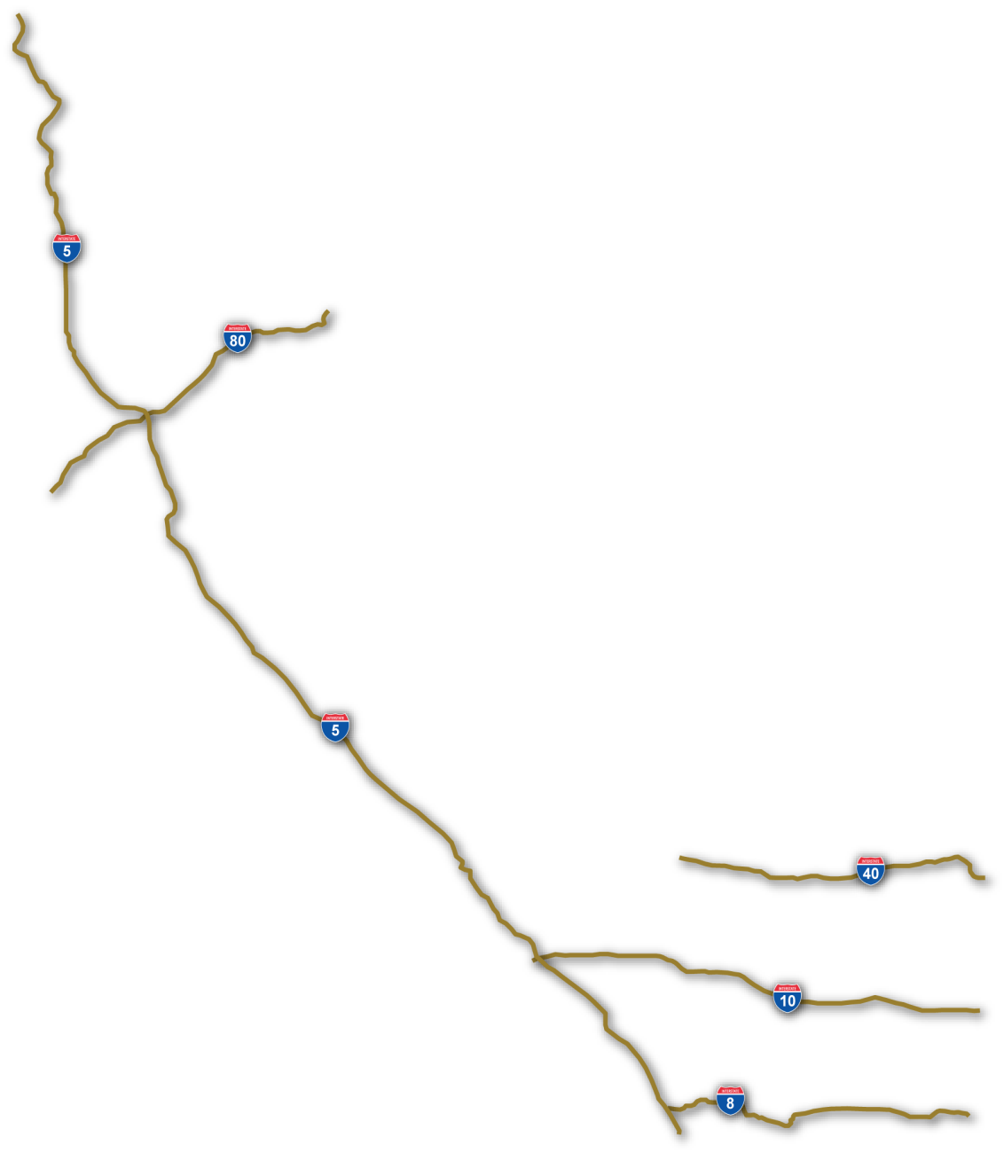
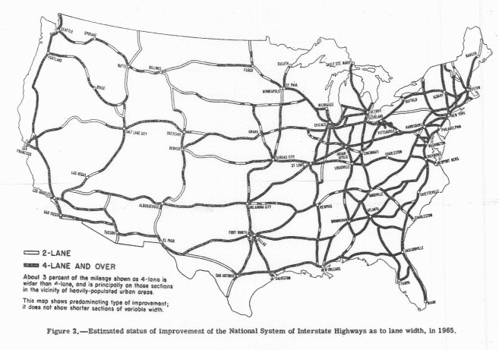
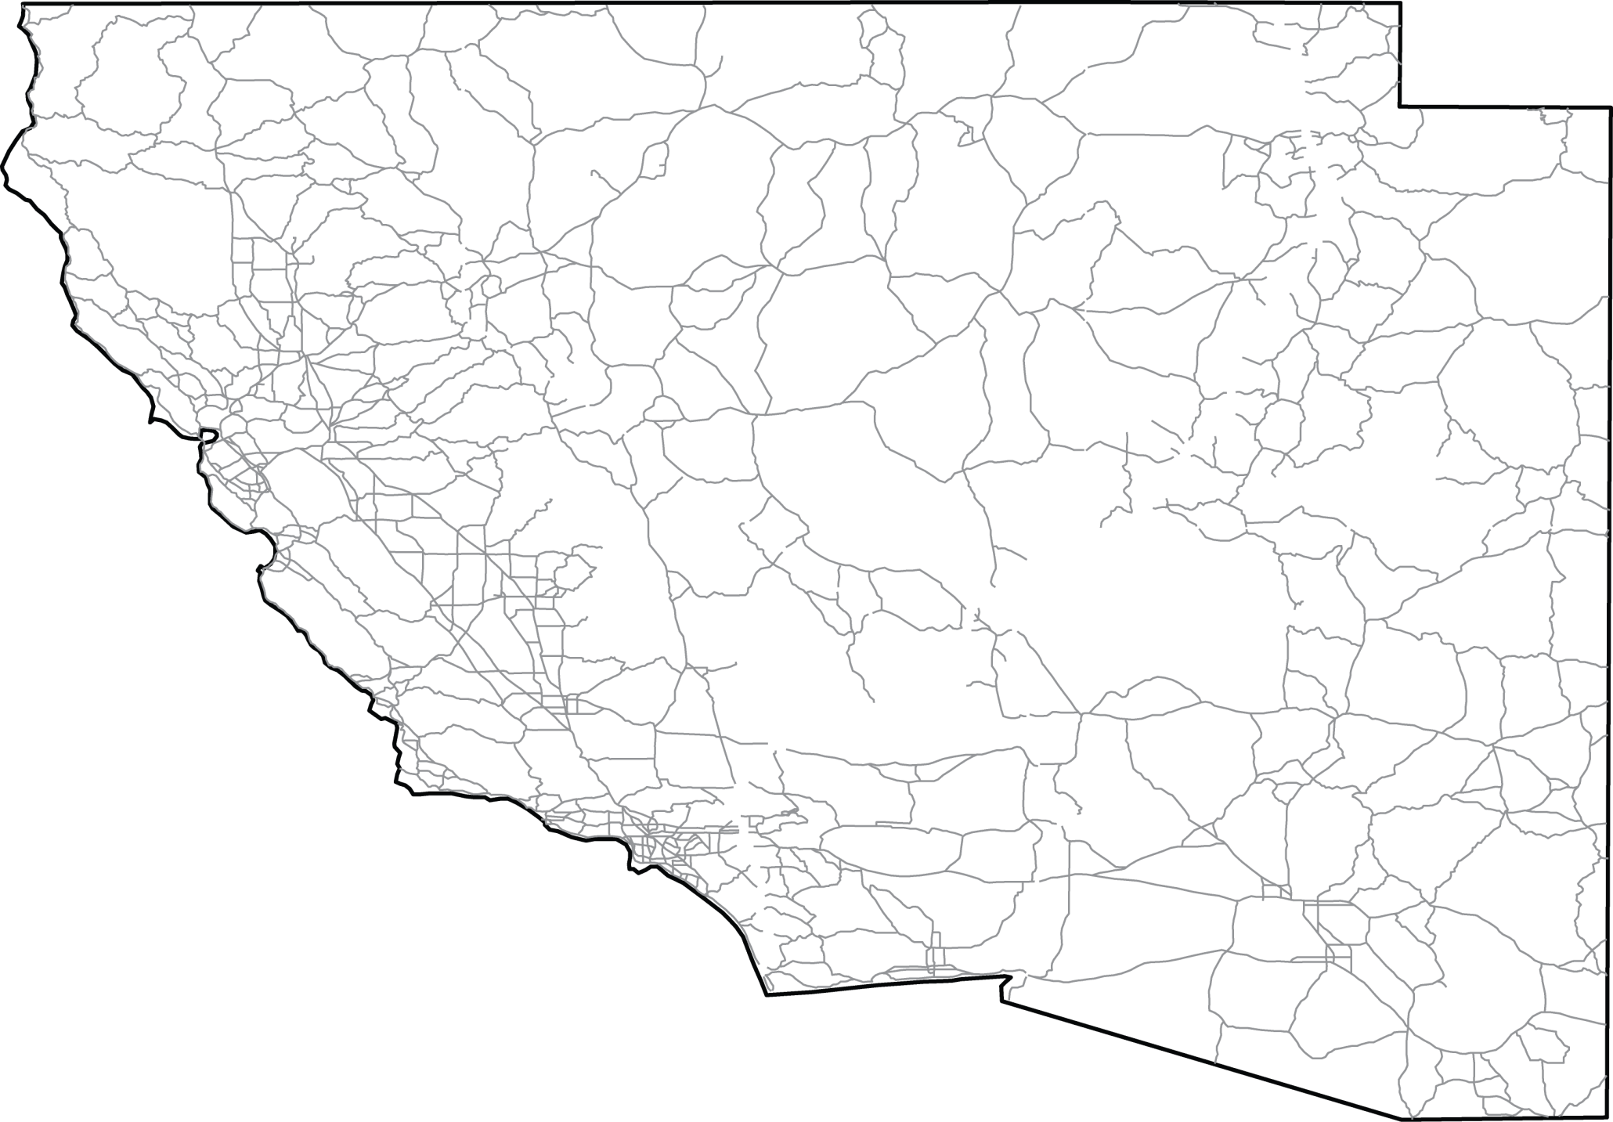

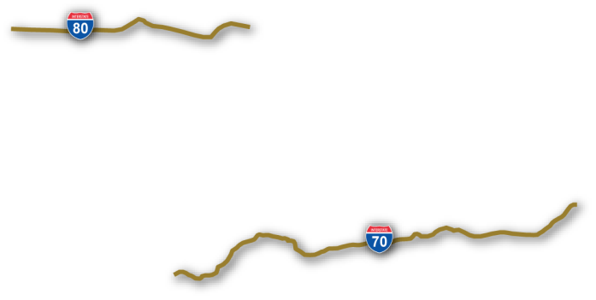
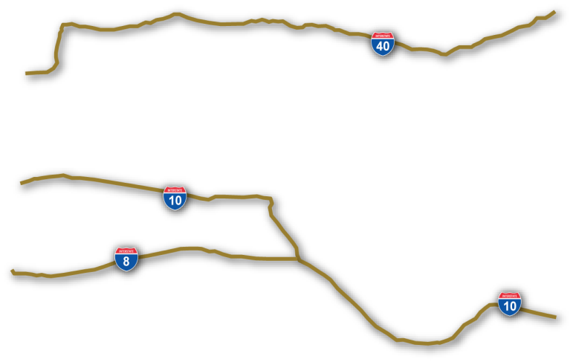
Future Without Boarders
Salt Lake City
Reno
To Denver
Sacramento
San
Francisco
Las Vegas
Los Angeles
Phoenix
San
Diego
Mexico
  Our Forefather’s Vision
  Our Alliance’s Vision
A Future without Borders

Slide 3
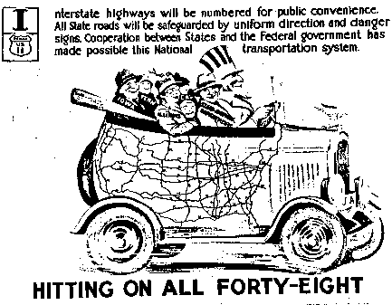
Made possible by “cooperation between States and the Federal Government”

Slide 4
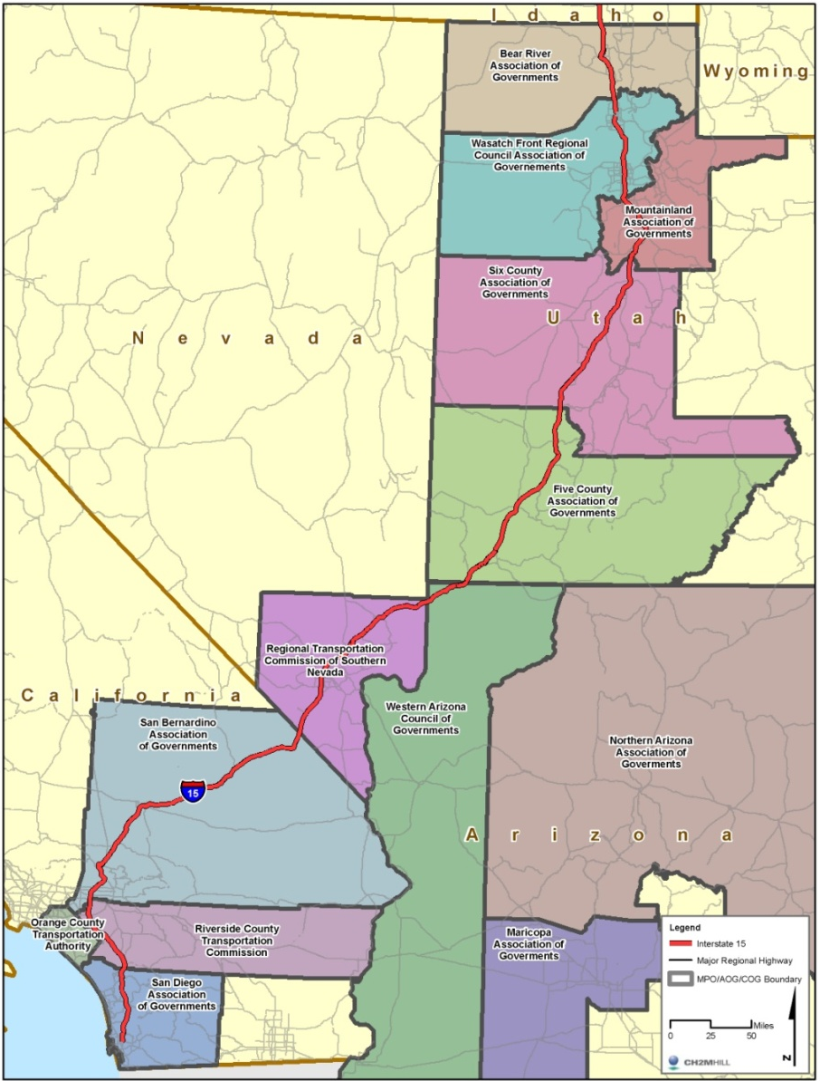
About the Corridor
840 miles
Traverses extreme dense urban and barren rural environments
Crosses many boundaries….
 | Cities | Counties | MPOs
California | 18 | 3 | 2
Nevada | 4 | 1 | 1
Arizona | 1 | 1 | 1
Utah | 46 | 9 | 4
Totals | 69 | 14 | 8

Slide 5
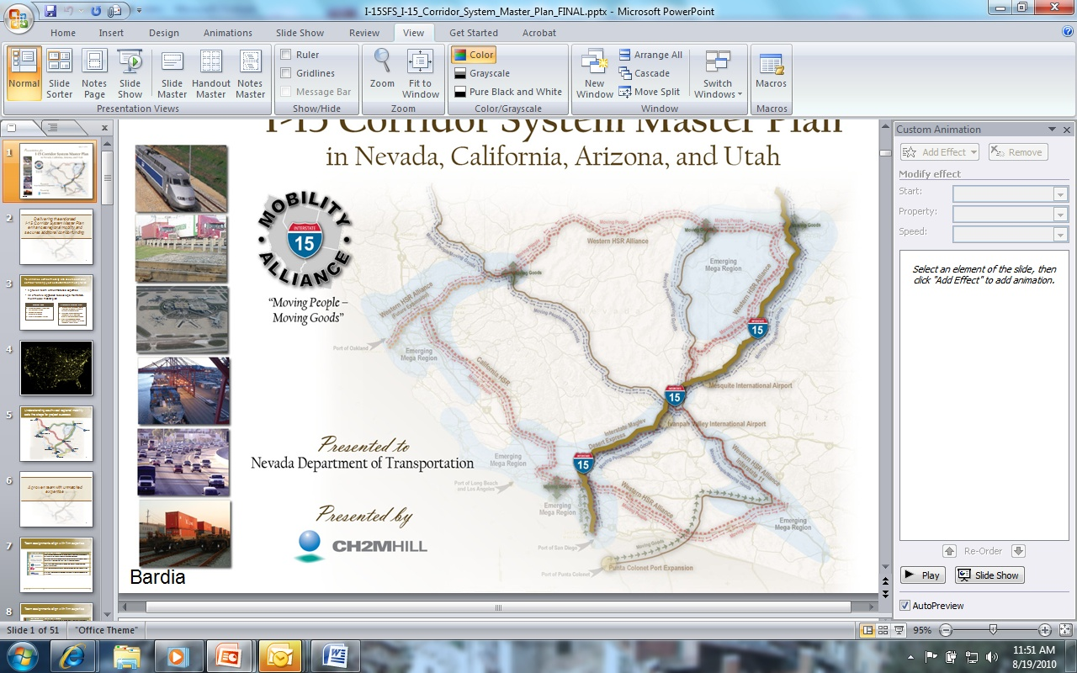
What do we hope to accomplish?
Mobility
  Multimodal corridor that significantly increases mobility of people and goods through highways, freight rail, transit and high-speed passenger rail
Sustainability
  Accommodate potential future shifts in, and sustainability of, travel patterns, mode choice, population, and technology
Adaptability
  Incorporate advanced technologies for the transport of energy, data and communications

Slide 6
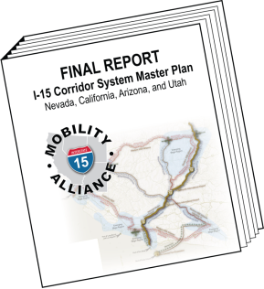
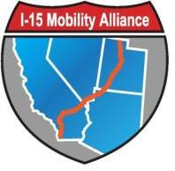
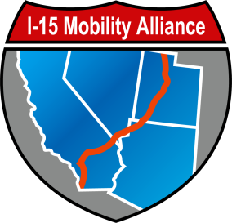
What does the Master Plan include?
Corridor vision and mission
Roles and responsibilities Alliance partners
Corridor policies and procedures
Public information and education
program
Searchable GIS database - UPlan
Early action projects
Unconstrained list of mobility enhancements
Prioritized list of multimodal projects
Targeted list of funding strategies

Slide 7
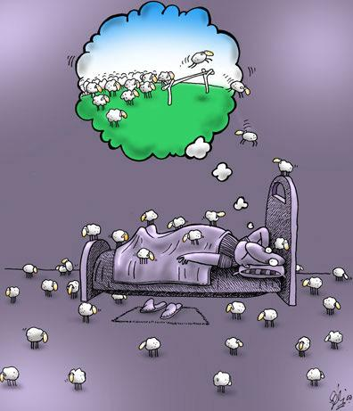
What Kept Us Up at Night…
Public and stakeholders do not engage or lose interest
Program lacks endorsement
Public and stakeholders not informed or unaware of the program
Public and stakeholders comments are localized in nature
Program is not sustained
…and a few more!

Slide 8


I-15 Mobility Alliance
Federal Highway Administration
State Departments of Transportation
  Arizona Department of Transportation
  California Department of Transportation
  Nevada Department of Transportation
  Utah Department of Transportation
Transportation/Transit Authorities
  Bear River Association of Governments
  Five County Association of Governments
  Mountainland Association of Governments
  Northern Arizona Council of Governments
  Orange County Transportation Authority
  Riverside County Transportation Commission
  RTC of Southern Nevada
  Freeway and Arterial System of Transportation
  San Bernardino Association of Governments
  San Diego Association of Governments
  Southern California Association of Governments
  Wasatch Front Regional Council
  LA County Metropolitan Transportation Authority
  Utah Transit Authority
Resource Agencies
  Arizona Game and Fish Department
  Bureau of Land Management
  National Park Service
  Nevada Division of State Parks
  Nevada State Office of Energy
  US Army Corps of Engineers
  Cities & Counties
  City of Fontana
  City of Henderson
  City of Las Vegas
  City of Layton
  City of North Las Vegas
  City of Ontario
  City of Orem
  City of South Salt Lake
  Clark County Department of Aviation
  Clark County Public Works
  County of San Bernardino
Notes:
In order to gain broad-base support for developing, implementing, and funding improvements, we needed a broad base of involvement—so we formed an alliance of public and private interests in the corridor. To date, we have over 50 agencies and organizations participating, which we hope to grow to several hundred in the coming years.

Slide 9







I-15 Mobility Alliance
  California High Speed Rail Authority
  BNSF Railway
  California Trucking Association
  Economic Development Corporation of Utah
  Envision Utah
  Las Vegas Convention and Visitors Authority
  NV Energy
  Port of Long Beach
  Salt Lake City Chamber of Commerce
  Southwest Airlines
  The Toll Roads
  Union Pacific Railroad
  Utah Trucking Association
Notes:
In order to gain broad-base support for developing, implementing, and funding improvements, we needed a broad base of involvement—so we formed an alliance of public and private interests in the corridor. To date, we have over 50 agencies and organizations participating, which we hope to grow to several hundred in the coming years.

Slide 10
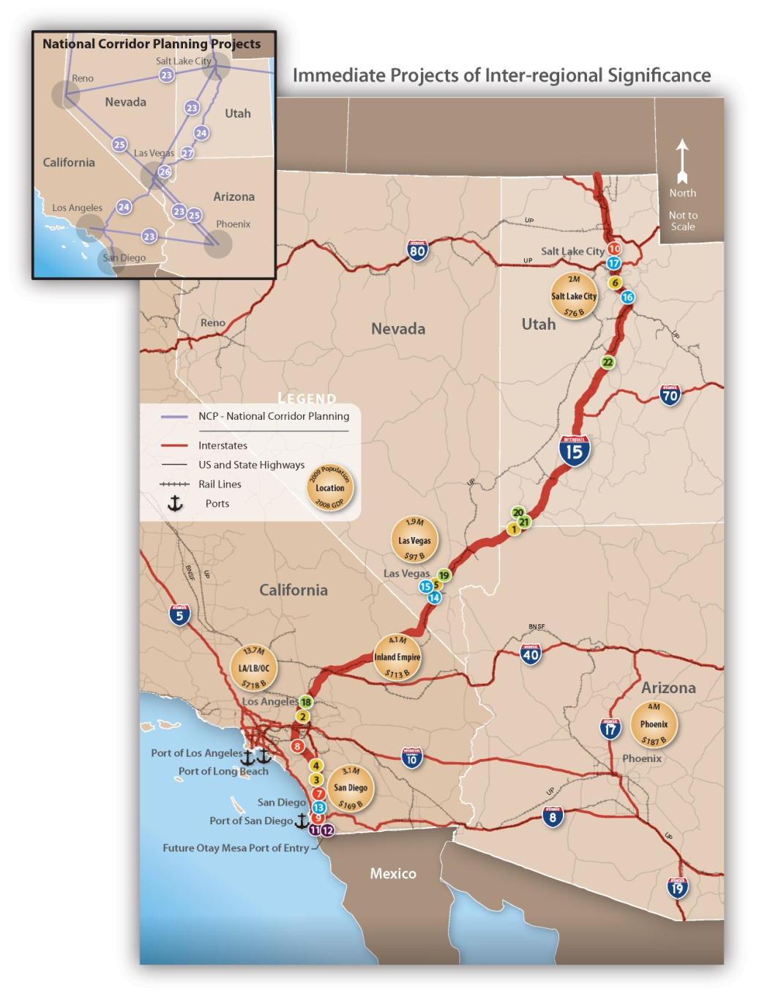
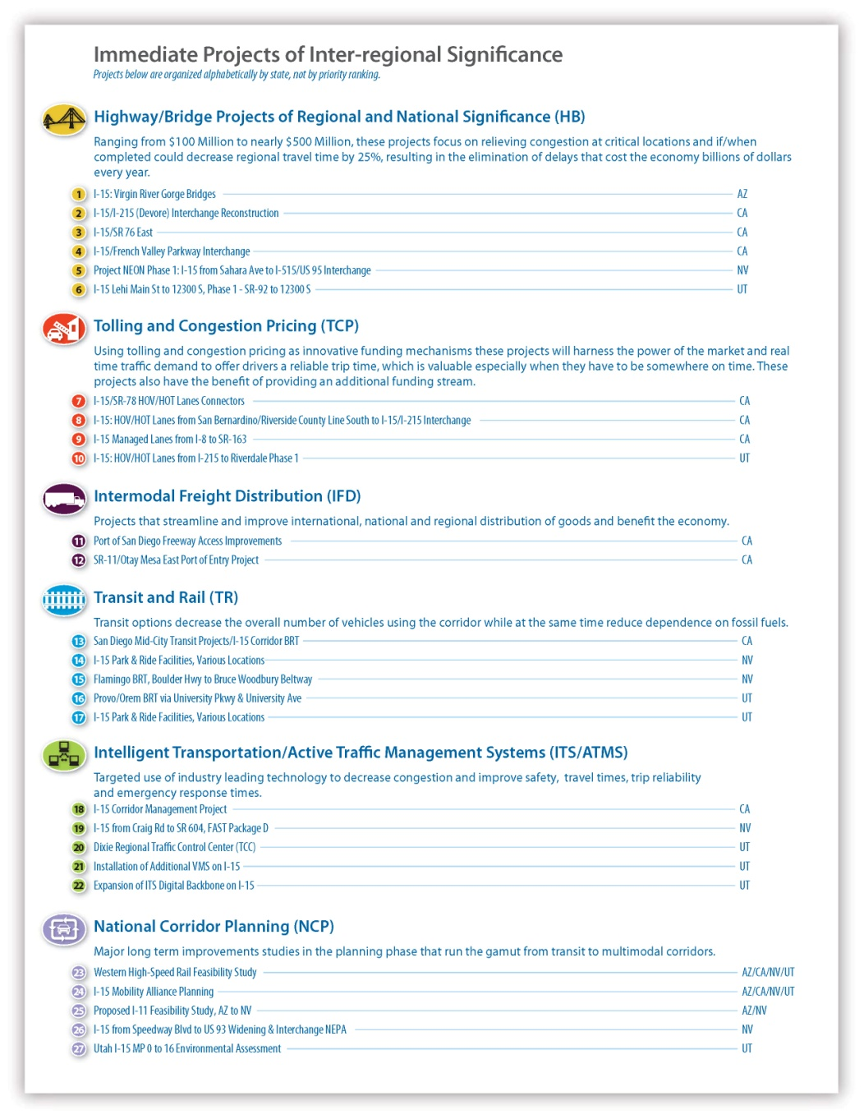
Celebrate Success of Early Action Projects
Notes:
The Alliance partners put aside their own turfs and agreed to 27 Immediate Projects of Inter-regional Significance that transcend local and state boundaries. Susan Martinovich, NDOT Director and AASHTO President, was able to carry this list with her to Washington DC for congressional briefings. We hope to increase the odds of receiving Federal funding for these projects by demonstrating broad and interstate support for each.

Slide 11
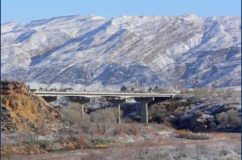
Spirit of Cooperation
Over 100 EAP projects submitted
Screened down to 23 following adopted process
Presented to Committee
Additions were accepted without controversy!!!!
Virgin River Gorge Bridges
Notes:
Tell story of Virgin River Gorge Bridge project: I-15 only crosses a small corner of Arizona, so they didn’t have any projects to submit. 2 days before the meeting it came to their attention that the bridges needed replacing. A failure in the Gorge could create a detour of 100 miles. The other partners overwhelmingly supported the addition of this project.

Slide 12
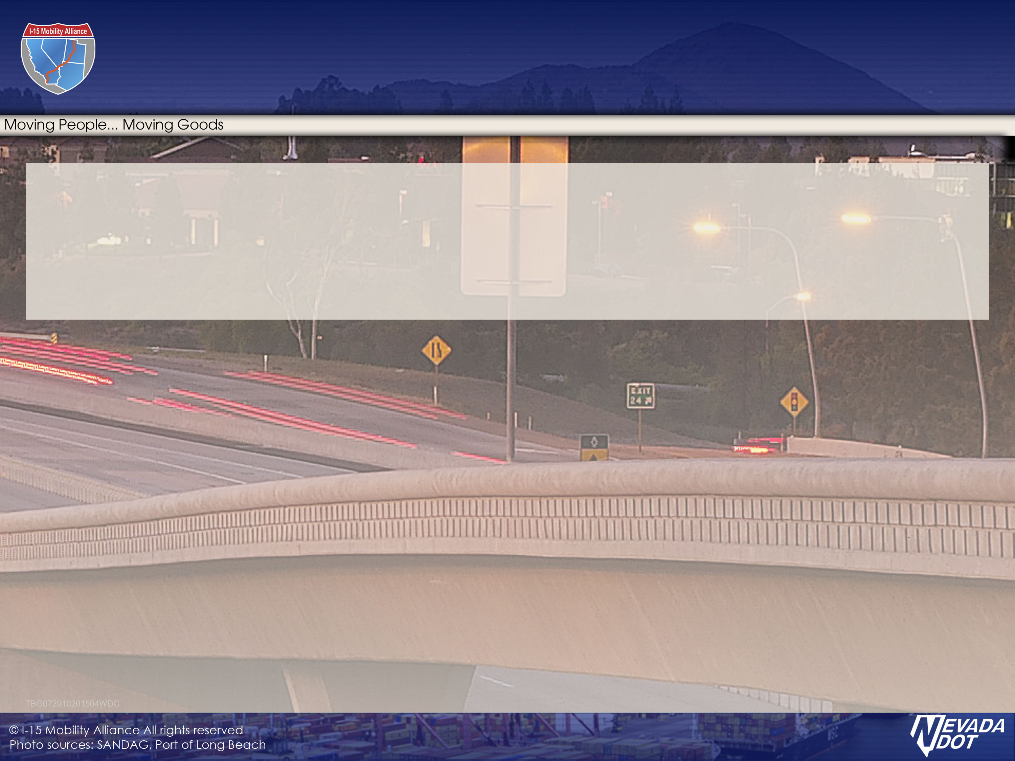
Factors Influencing Cooperation

Slide 13
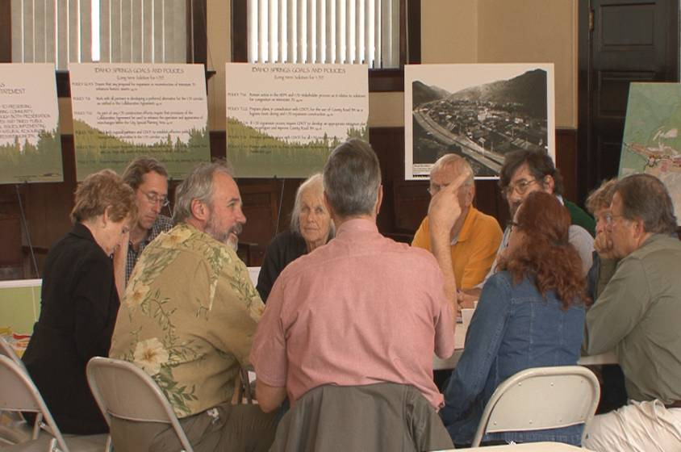
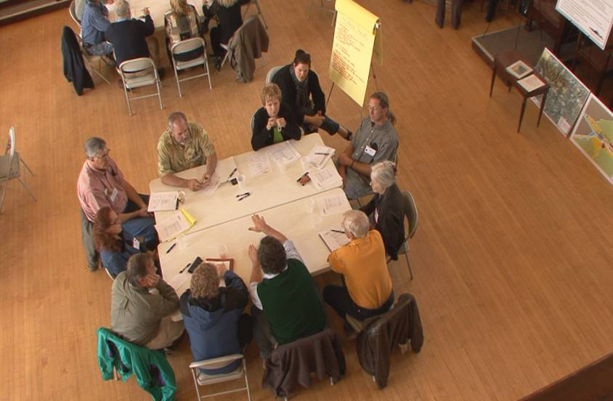
Factors Influencing Cooperation
Ownership in the process and solutions
Flexible structure that respects limited resources
Common interests

Slide 14
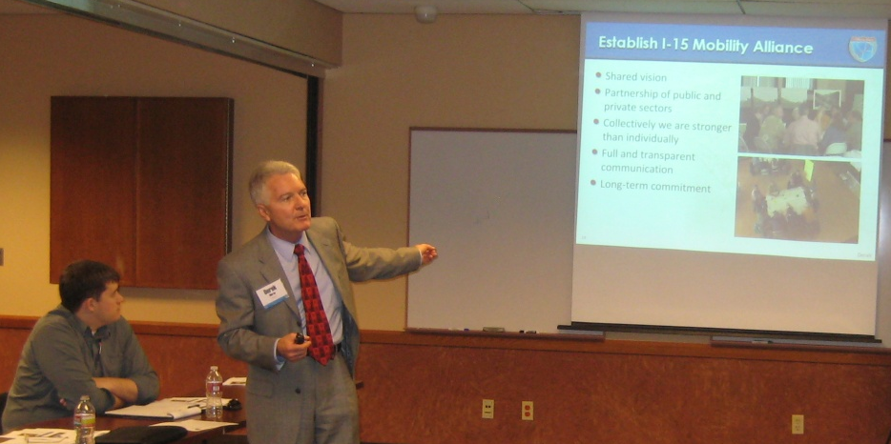
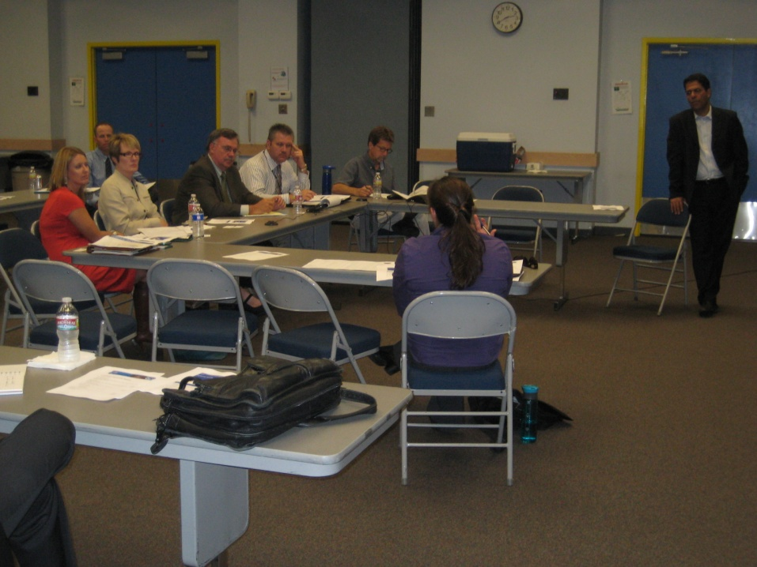
Ownership in the process and solutions
I-15 Mobility Alliance Partners (NOT Stakeholders)
Initial round of partnership meetings
  Recruit the support of transportation leaders
  Serve as focus group for Alliance structure, vision, and plan
Plenty of excitement
Some reservations:
  Too many demands on time
  Limited resources
  Lack of relevance

Slide 15
Flexible I-15 Mobility Alliance
Structure
USDOT
(FHWA, FTA, FRA, FAA)
Executive Board (ADOT, Caltrans,
NDOT, UDOT)
Guidance and approval of all matters
Sign MOUs and agreements
Endorse Master Plan and regional projects
Recommend all matters to Executive Board
Provide clarification and amplification on
Executive Board guidance to other
committees
Review and approve federal funding requests
Executive Operations Committee
Steering Committee
Develop and recommend vision and
strategies for Master Plan
Prioritize regional projects
Review technical reports and analyses
Review and incorporate public input
Consultant Team
Technical &
Planning Committees
Public
Technical consultant
Facilitation
Document preparation
Provide technical data,
assessments, and evaluations
Identify issues of importance
Initial review of work products
Identify issues of concern
Provide input on Master
Plan elements
Decision Maker
Recommender
Contributor
Notes:
The Executive Board, comprised of State DOT directors, will adjudicate any conflicts and has final approval of the Corridor System Master Plan, nevertheless, the Steering Committee is the heart of the Alliance, comprised of director level staff of partner organizations
To respond to time/resource constraints we broke the Tech/Planning Committee into multiple sub-committees, each only meeting once or twice during this initial phase, and comprised of subject matter experts.

Slide 16
Flexible I-15 Mobility Alliance Structure
Steering Committee
Composition
  Senior leaders from partner groups
Develop and recommend to Executive Board:
  Vision documents
  Alliance goals and objectives
  Policies and procedures
  Lists of prioritized projects
  Additional partners to be engaged
  Actions and activities on critical program elements
  Updates to the Master Plan
Executive Board (ADOT, Caltrans,
NDOT, UDOT)
USDOT
(FHWA, FTA, FRA, FAA)
Executive Operations Committee
Steering Committee
Consultant Team
Technical &
Planning Committees
Public
Notes:
Derek

Slide 17
Flexible I-15 Mobility Alliance Structure
Technical & Planning Committees
Composition
  Technical staff from partner groups
Sub-committees
  Programming
  Data
  Freight
  Operations
  Multimodal
  Sustainability
  Policy
  Outreach
Executive Board (ADOT, Caltrans,
NDOT, UDOT)
USDOT
(FHWA, FTA, FRA, FAA)
Executive Operations Committee
Steering Committee
Consultant Team
Technical &
Planning Committees
Public
Notes:
We broke the Technical and Planning Committee into multiple sub-committees to reduce the time commitment required of the technical staff, and to tap into subject matter experts within each partner organization.

Slide 18
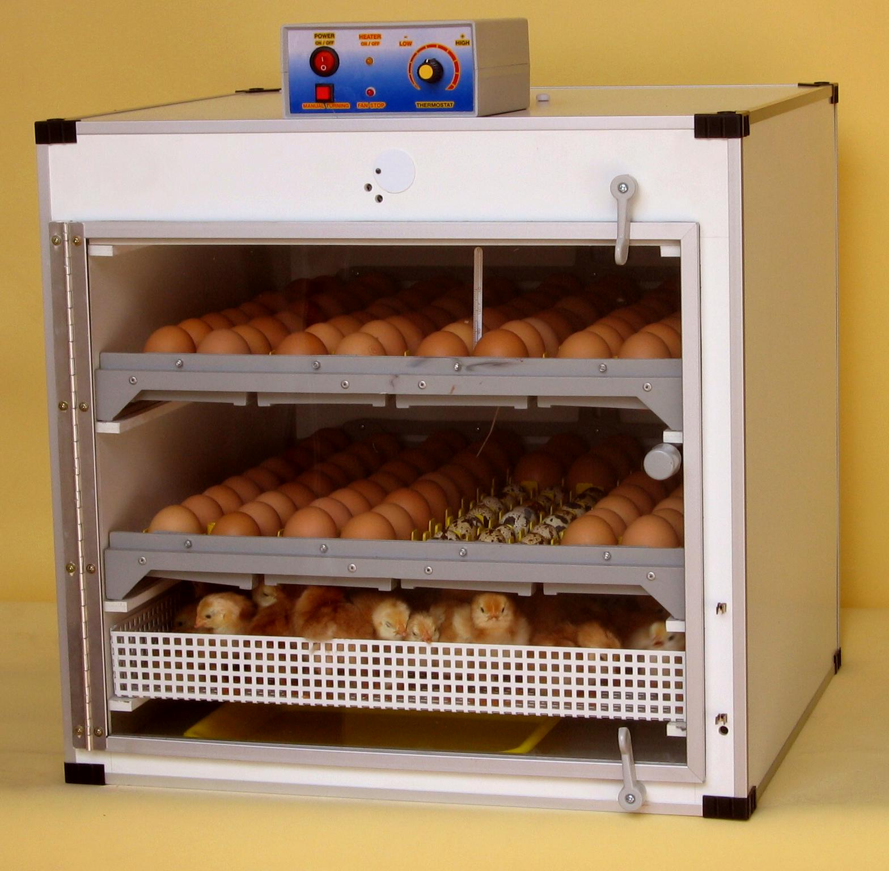
Flexible I-15 Mobility Alliance Structure
Executive Committees
USDOT
(FHWA, FTA, FRA, FAA)
Executive Board (ADOT, Caltrans,
NDOT, UDOT)
Executive Operations Committee
Steering Committee
Consultant Team
Technical &
Planning Committees
Public
Notes:
At present the Alliance is led by the DOTs, but our intent is to eventually turn control over to an elected and rotating leadership from within Alliance partners.

Slide 19

Focus on Common Interests
“Nothing unites like a common enemy”
  Lack of funding to address needed improvements
And common interests…
  Operations & ITS
  Sustainability
  Freight & goods movement
  Regional Data Management
Notes:
Typically, unless there is some controversy, no one shows up to the party…. We thought that might be the case, but sort of lucked out…. A side benefit of creating multiple Technical and Planning subcommittees is that we have provided experts in various fields and from 4 states an opportunity to share ideas and interests. The ITS geeks have a chance to talk with other ITS geeks without interference from the environmentalists or rail guys, and visa versa. Then periodically we bring them all together at the Steering Committee level.

Slide 20
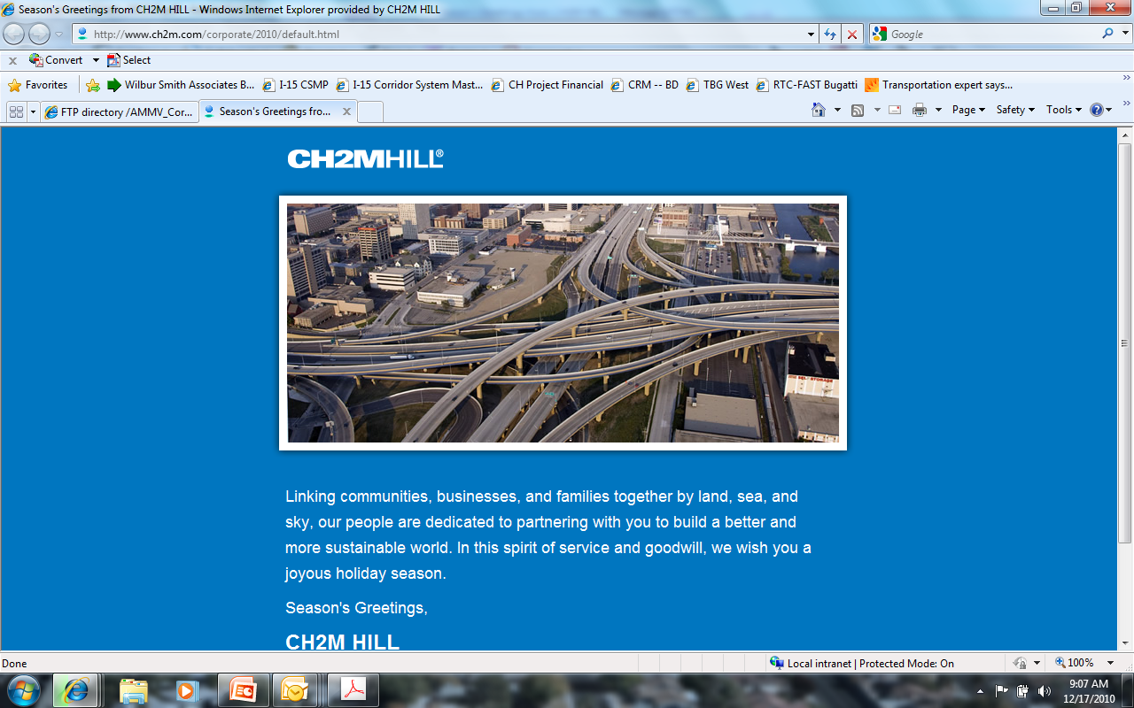
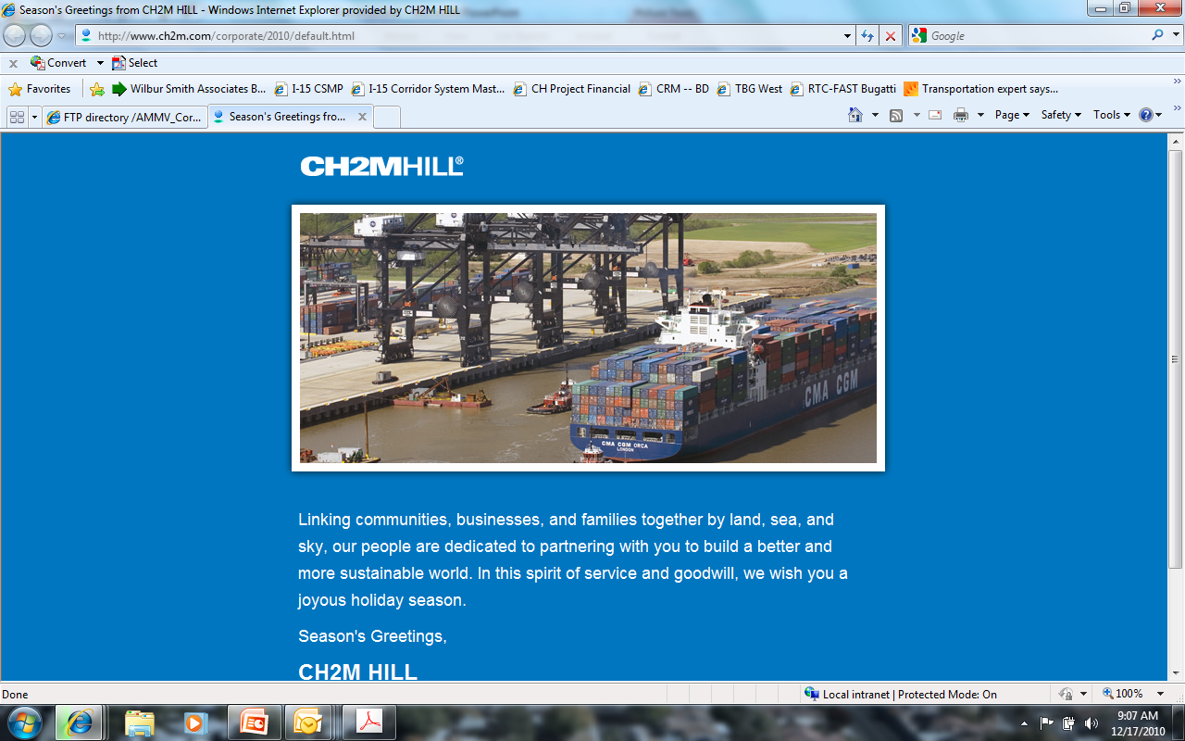
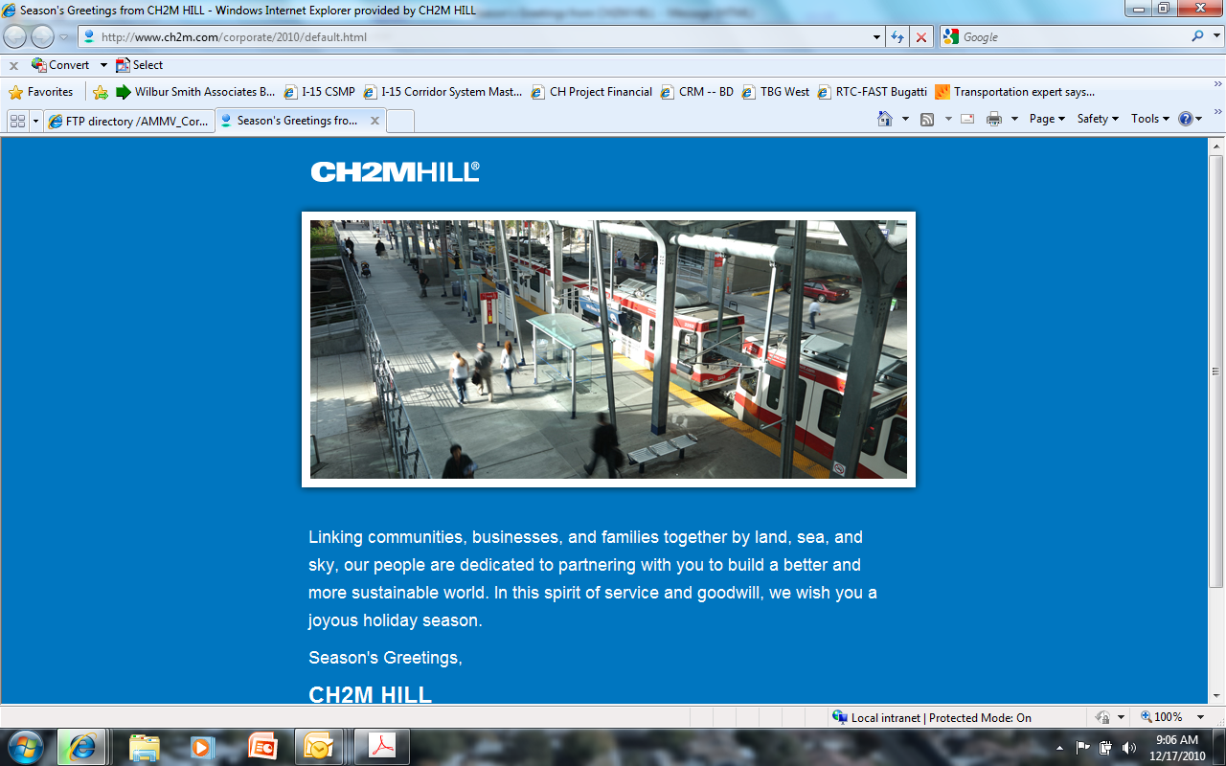
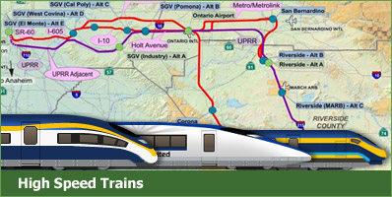
Focus on Common Interests:
Shared Mission Statement and Simple Tagline
Tagline
  Moving People – Moving Goods
Mission Statement
  I-15 Mobility Alliance is a strategic partnership that brings together government, business and community stakeholders in a shared vision to plan, develop, finance, construct and manage a safer, more efficient and reliable multimodal transportation corridor.
Notes:
Simple tag lines – lots of complexity

Slide 21
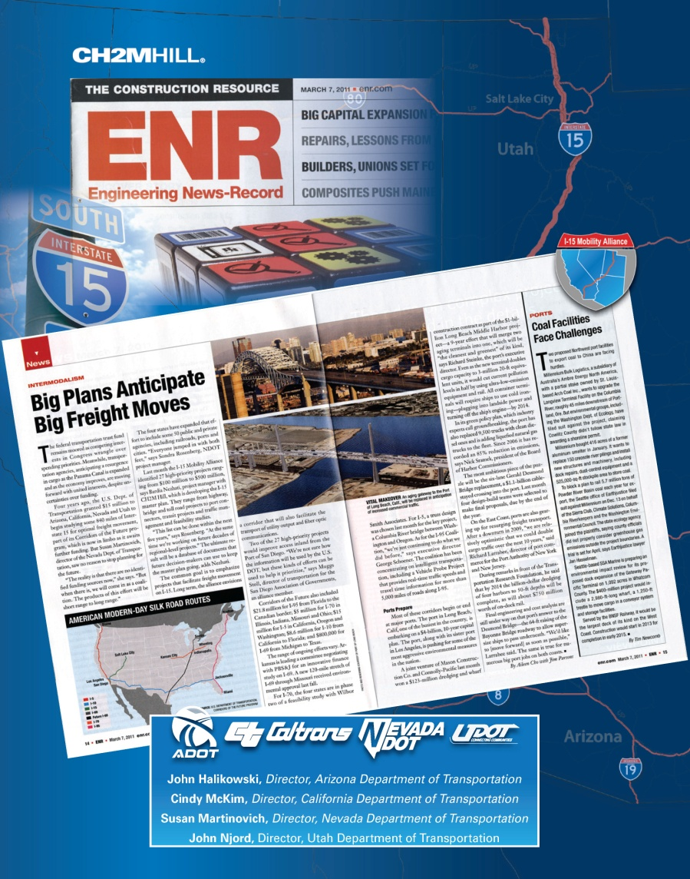
Building Momentum through
Sustaining the Alliance
Have a Champion
Rotate Leadership
Cultivate the “Sense of Excitement”
Broadcast accomplishments (e.g. ENR article, Immediate Projects of Inter-regional Significance…)
Grow Alliance Partnerships (from 51 to ???)

Slide 22
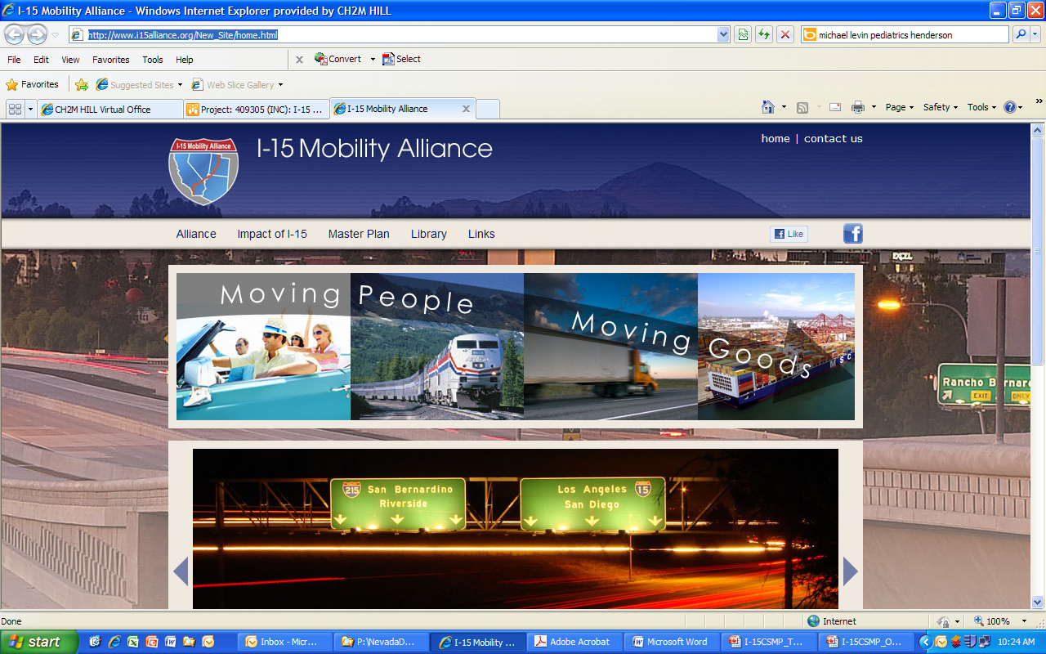
Building Momentum through Outreach
Public Website: i15alliance.org

Slide 23
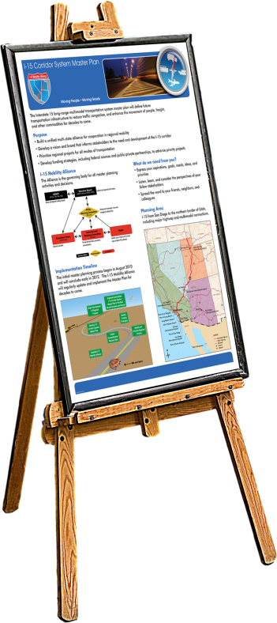
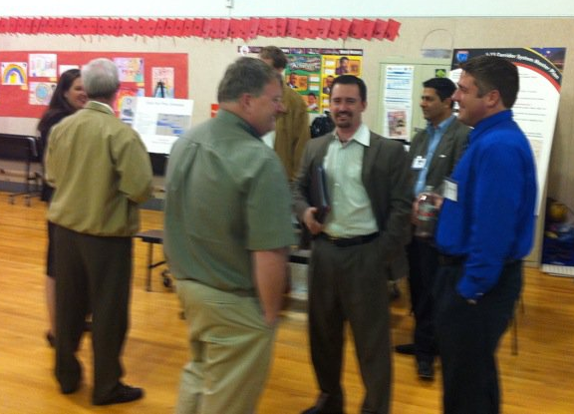
Building Momentum through Outreach:
“Piggy-back” Public Meetings
Participate in public meetings related to I-15 in all Alliance states
Display and handouts
NO PRESENTATION – be there to answer questions about the I-15 CSMP
Notes:
Piggy-back = demo of partnering

Slide 24
Where We’ve Been - Where We’re Going
Drafts DONE
Underway
Done!!

Slide 25
Lessons Learned
Complication: Public and stakeholders do not engage or lose interest
Resolution:
  Public, Private, Stakeholders, etc. = projects PARTNERS!
  Credible and transparent decision making process
  Respond, respond, respond….

Slide 26
Lessons Learned
Complication: Project partners not informed or unaware of the program
Resolution:
  Significant outreach and visioning via Partnership Meetings
  Understand goals of project partners
  Deploy several outreach techniques: project website, social media, public meetings

Slide 27
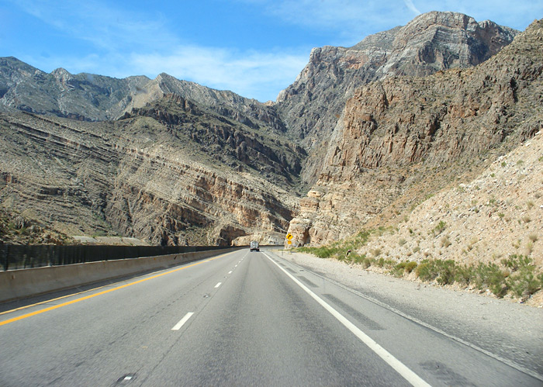


Lessons Learned
Complication: Partners comments are localized in nature
Resolution:
  Align regional and local vision, goals, and objectives
  Emphasize local benefits of regional improvements
Virgin River Gorge Bridges

Slide 28
Lessons Learned
Complication: Program lacks partner’s endorsement
Resolution:
  Ownership in the process and solutions
  Flexible structure that respects limited resources
  Common interests
Moving People – Moving Goods!

Slide 29
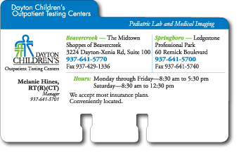

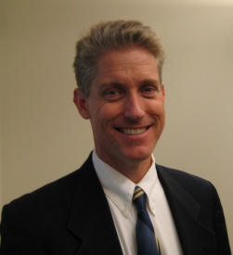
Questions?
Project Website: http://www.i15alliance.org
Sondra Rosenberg, PTP
NDOT Project Manager
Dan Andersen
CH2M HILL Sr. Planner
Sondra Rosenberg, PTP
NDOT Project Manager
Office: (775) 888-7241
Email: SRosenberg@dot.state.nv.us
Dan Andersen
CH2M HILL Sr. Planner
Office: (702) 953-1246
Email: Dan.Andersen@ch2m.com

Slide 30
Thank you

