Slide 1

Non-Traditional Public Engagement: E-Surveys and Virtual Public Meetings at the
NEW YORK STATE DEPARTMENT OF TRANSPORTATION
Joel Kleinberg
May 11, 2011 1:30-5:00 PM
Transportation Research Board
13th National Transportation Planning Applications Conference
NYS DOT
Region 10, Long Island

Slide 2
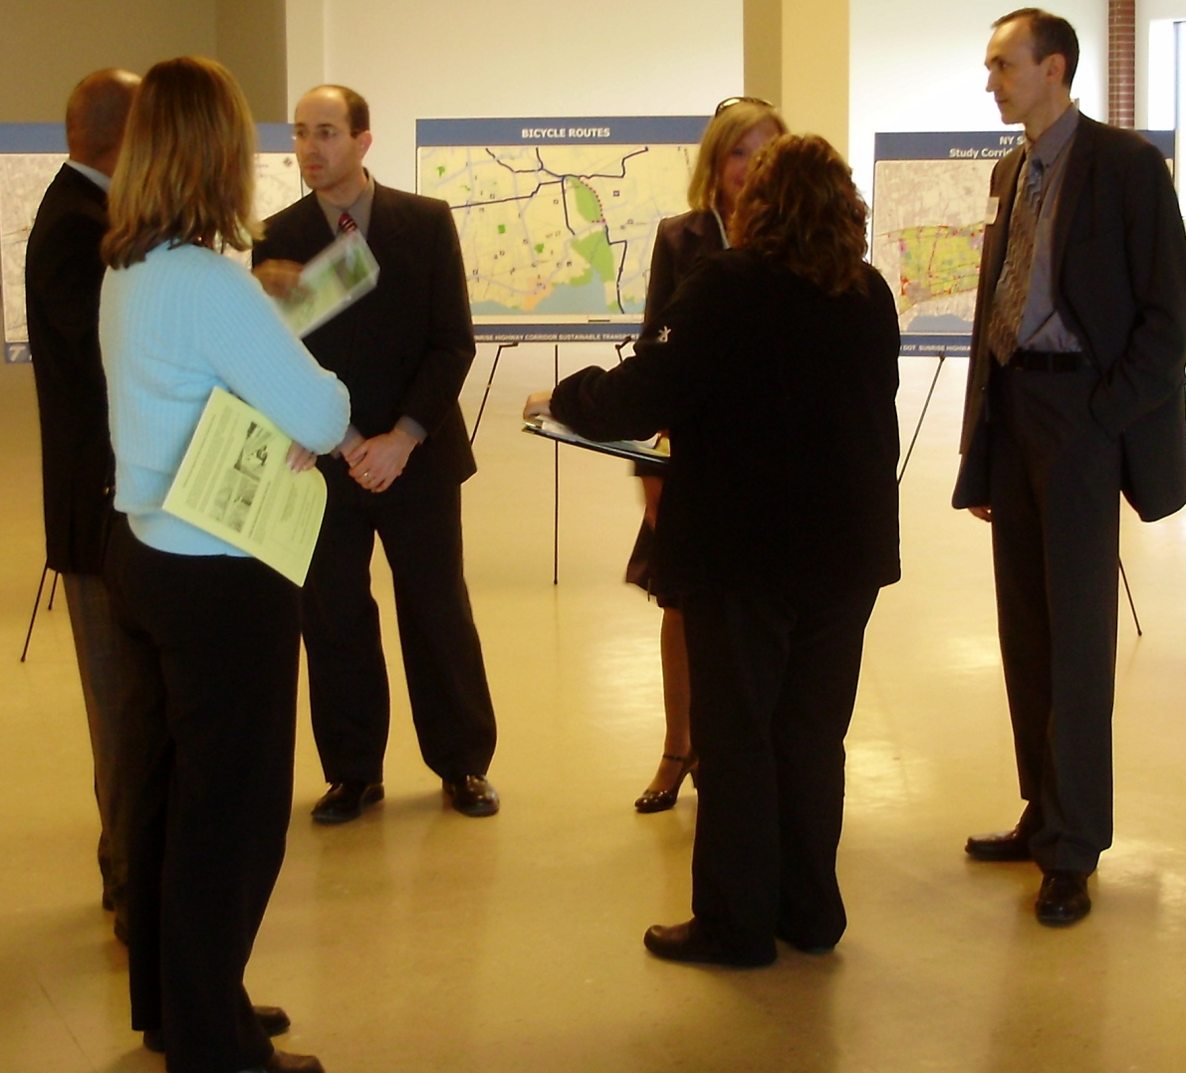
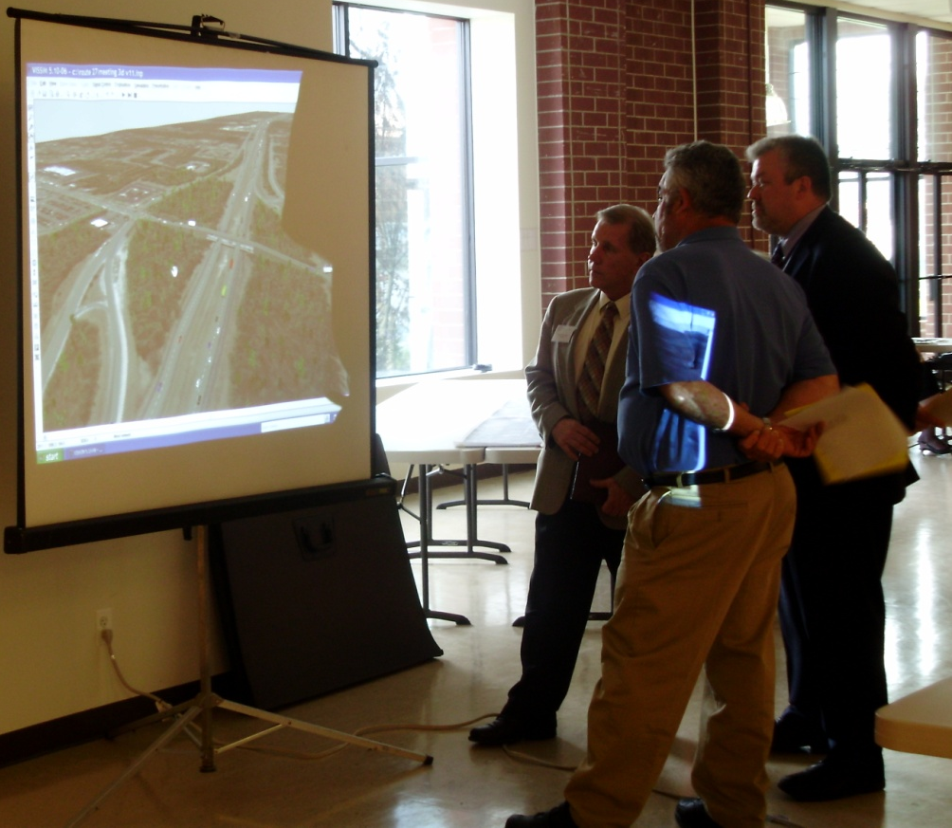
TRADITIONAL PUBLIC MEETINGS
Formats:
  Presentation to public
  Public hearing
  Design charrette

Slide 3
TRADITIONAL PUBLIC MEETINGS
Have you run or participated in meetings
as part of an agency public engagement/involvement process?

Slide 4
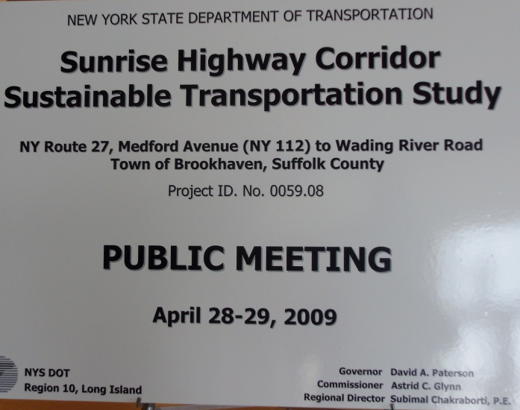
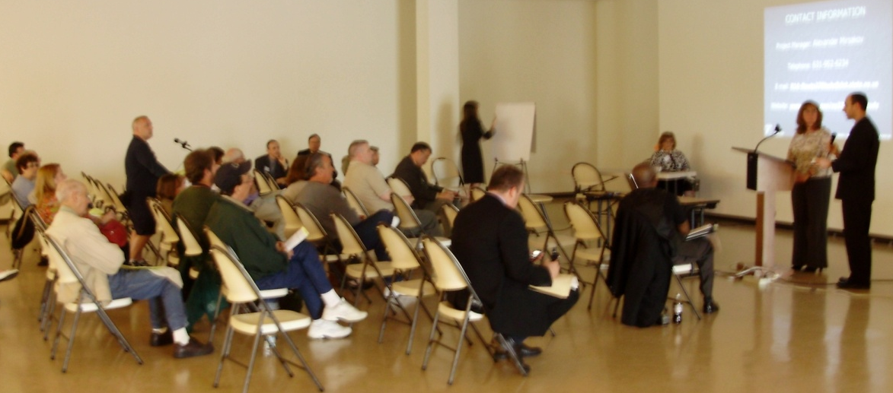
TRADITIONAL PUBLIC MEETINGS
The Benefits
  High comfort level, experience
  NEPA and SEQRA accepted
  Interactive nature

Slide 5
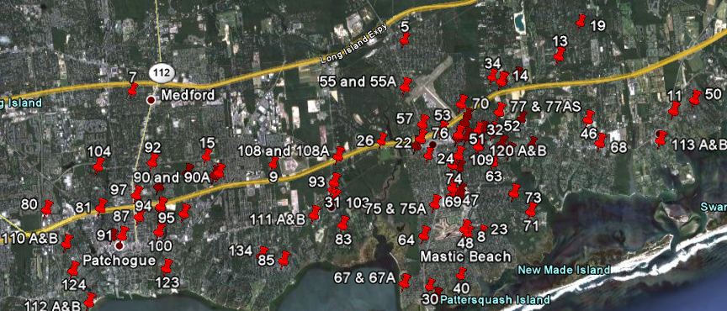
TRADITIONAL PUBLIC MEETINGS
The Drawbacks
  High cost
  “Grandstanding”
  Limits to involvement

Slide 6
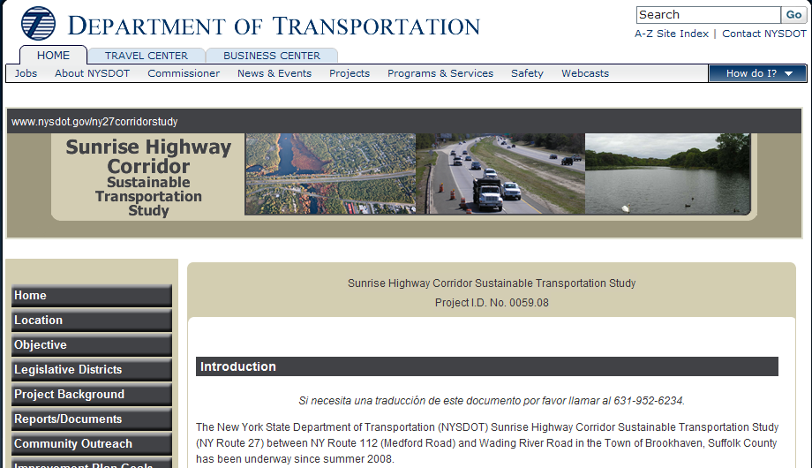
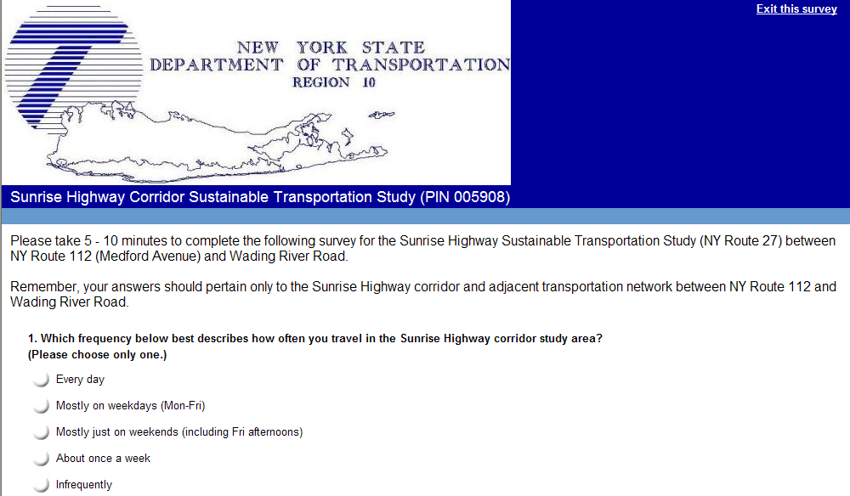
THE ELECTRONIC SURVEY
The Drawbacks
  Less comfort in agency, consultant and public
  Information one sided
  Bias: “vote early, vote often”
    (mitigation does exist, but not exact science)

Slide 7
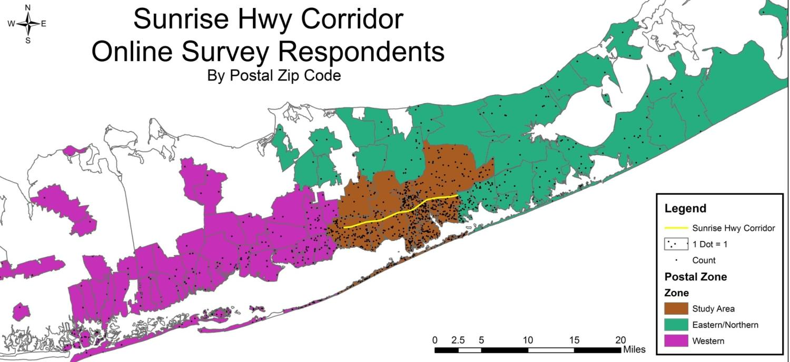
ELECTRONIC SURVEY
The Results
  1,250 completed surveys
  More representative of users
    Geography
    Age
    Gender

Slide 8
ELECTRONIC SURVEY
The Benefits
  Extremely low cost to produce and analyze
  Highly convenient for participants
      Time of day
      Geography
      Ability to travel
      Time to complete (skip logic)
  Title VI compliant
      LEP (easily translated)
      Visually deficient (fonts, colors)
      Paper and phone available for those without internet access

Slide 9
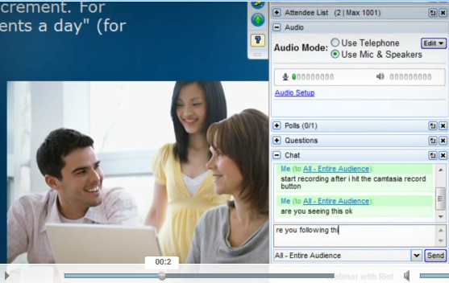



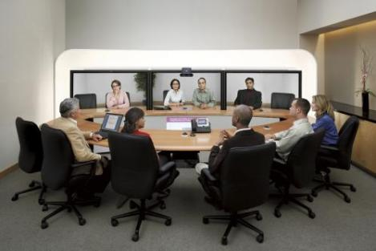
NET AND VIRTUAL PUBLIC MEETINGS
Examples:
Webinar
Social Media
Teleconference
Internet Voice Call
Video Conference

Slide 10
NET AND VIRTUAL PUBLIC MEETINGS
The Drawbacks
  Low comfort in agency, consultant and public
  Respondent anonymity results in need for continuous monitoring, etc.
  Less convenient (not time-flexible)
  Fundamental agency blocks
    IT blocks most applications from staff use
    Technology not in place, budget concern

Slide 11
INTERACTIVE ONLINE SURVEY
The Hybrid Approach
  Approach similar to online survey (inexpensive and convenient) but…INTERACTIVE
  Use of hotlinks
    Provide respondents with information
    Similar to public meeting (some will read, some will not)
    Informed decision-making

Slide 12
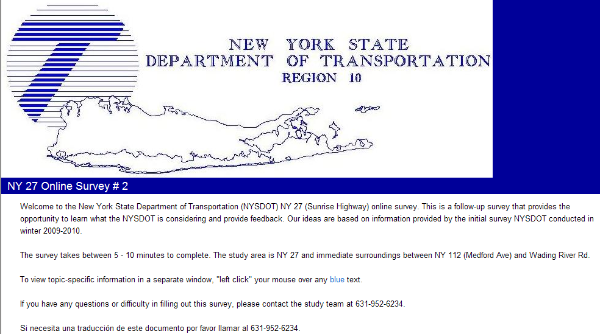
INTERACTIVE ONLINE SURVEY

Slide 13
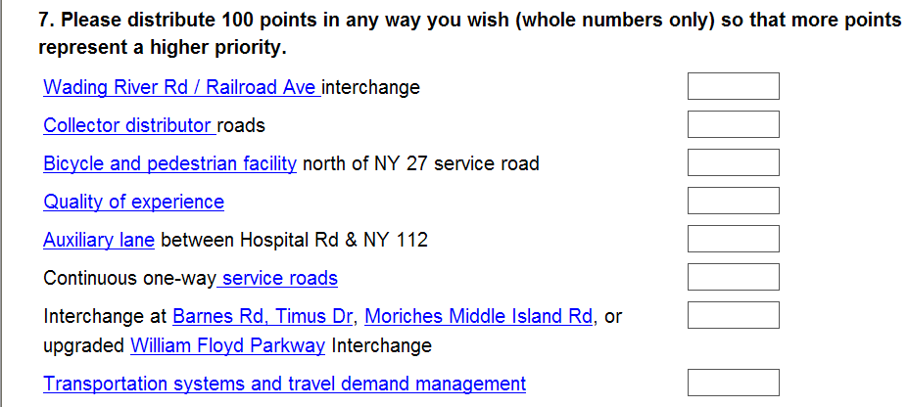
INTERACTIVE ONLINE SURVEY

Slide 14
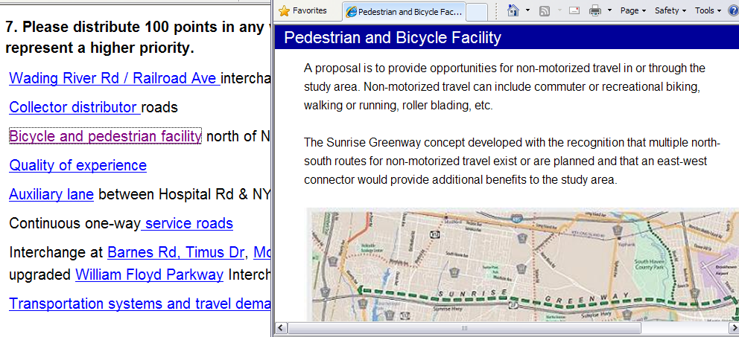
INTERACTIVE ONLINE SURVEY

Slide 15
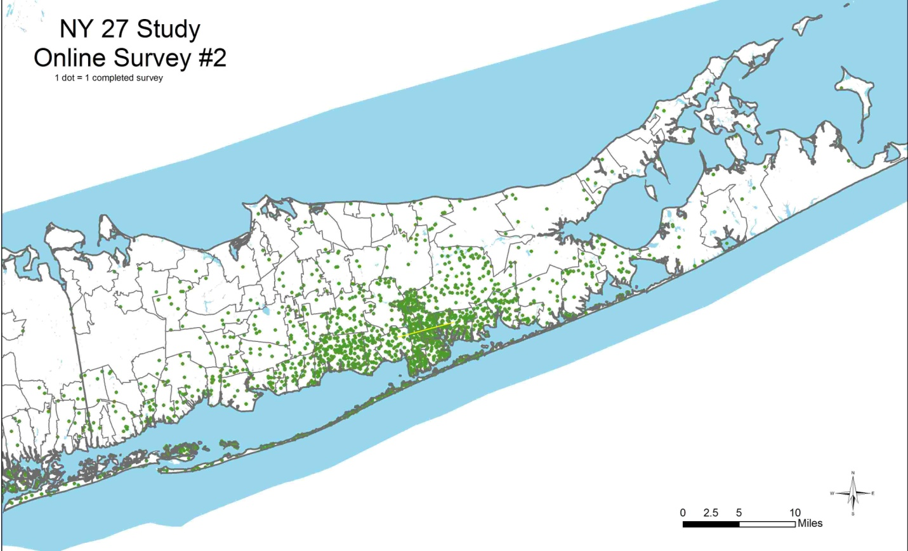
INTERACTIVE ONLINE SURVEY
The Results
  1,674 completed surveys
  Near-even distribution between study area residents, non-residents
  80 participants under 25 years, 100 over 65 years
*Participants from 122 Zip Codes, Several Not Shown
**Study Corridor Shown in Yellow

Slide 16
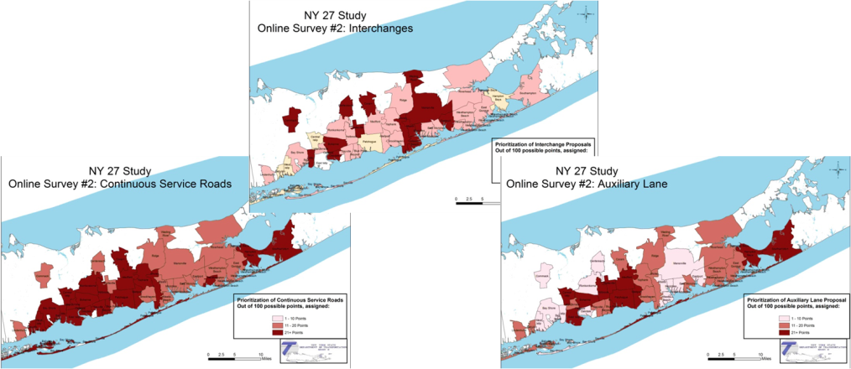
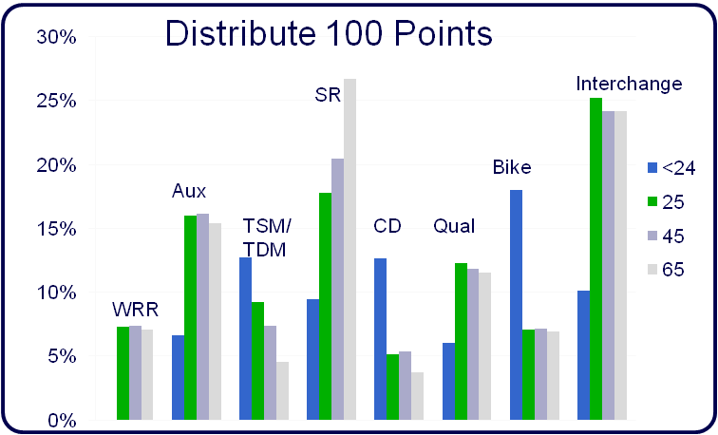
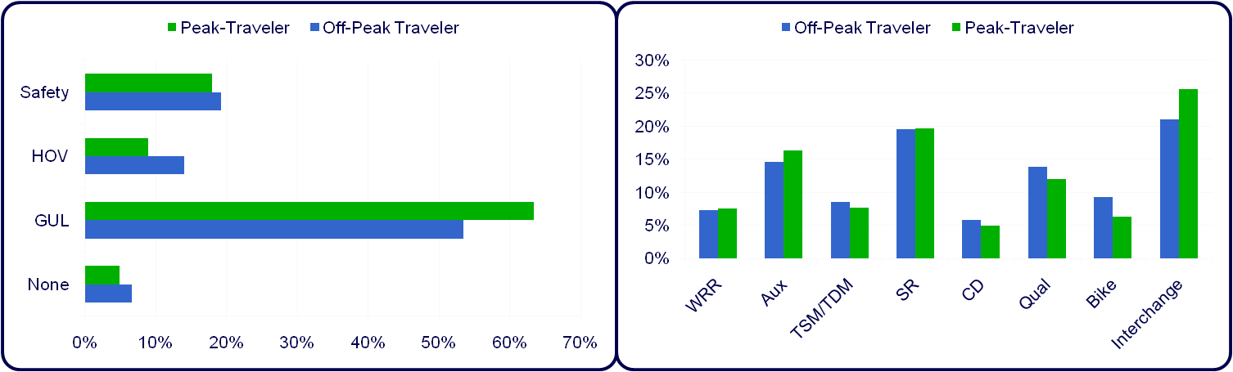
INTERACTIVE ONLINE SURVEY
Quantifiable: Influences on Respondent Preference
  Geographic
  Age
  Time/Purpose of Travel

Slide 17
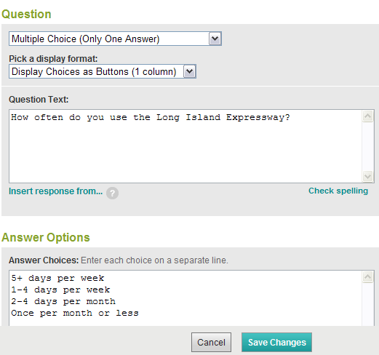
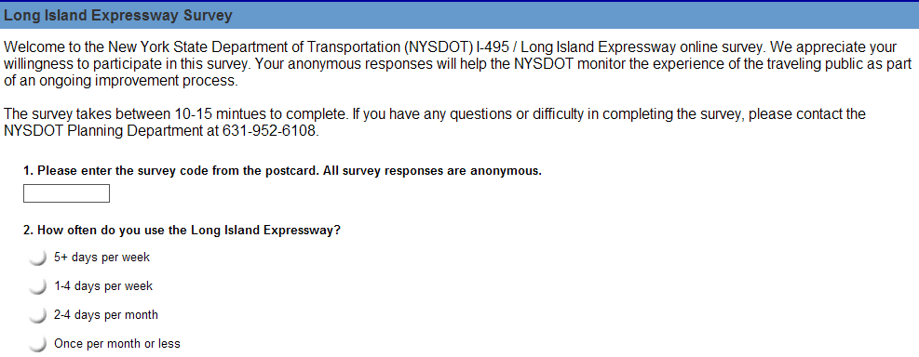
SURVEY CREATION

Slide 18
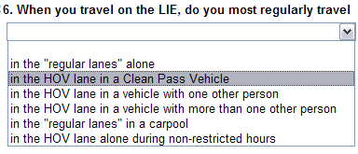
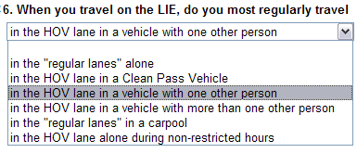
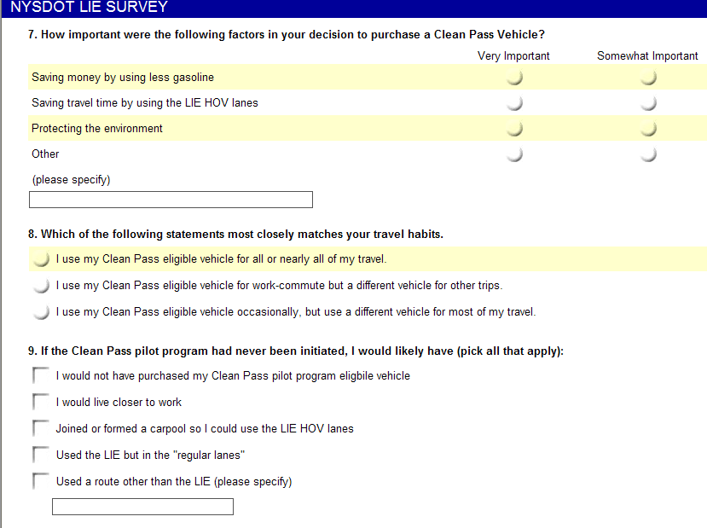
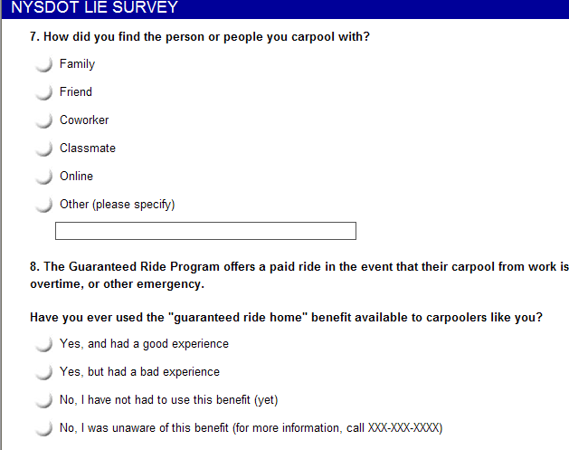
SKIP LOGIC

Slide 19
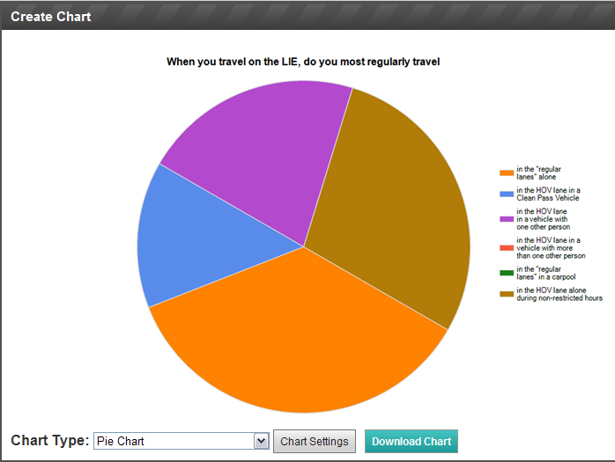
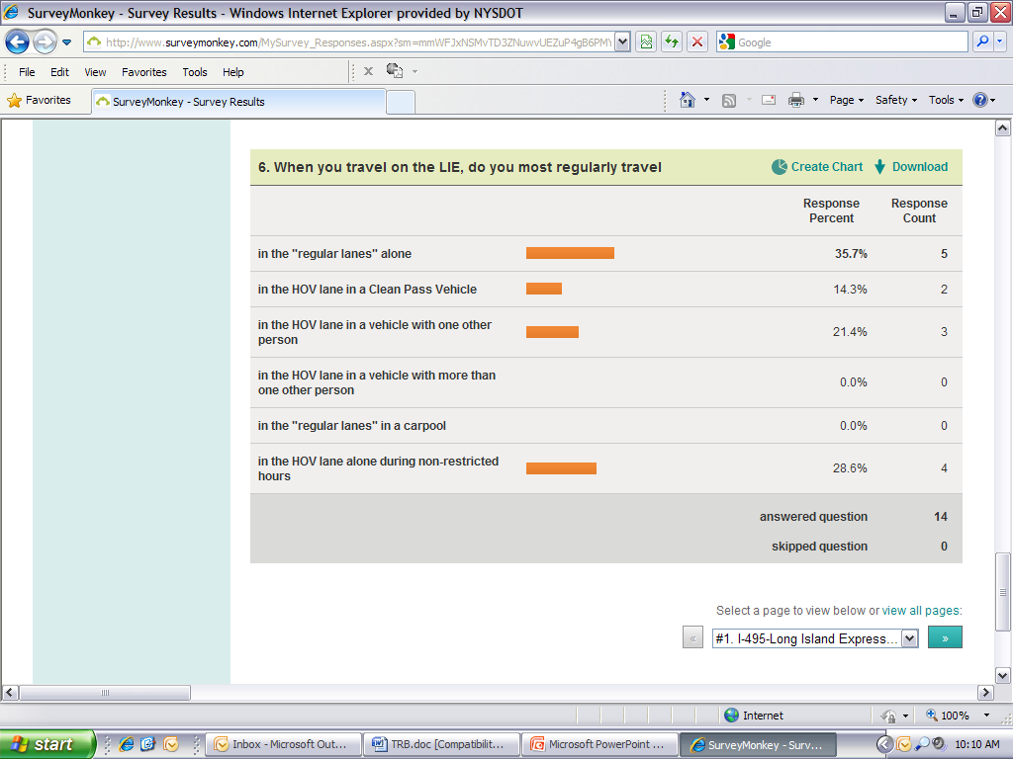
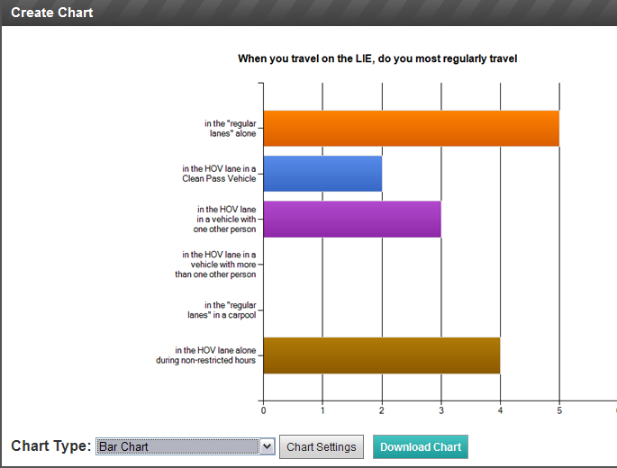
DATA ENTRY: DONE

Slide 20
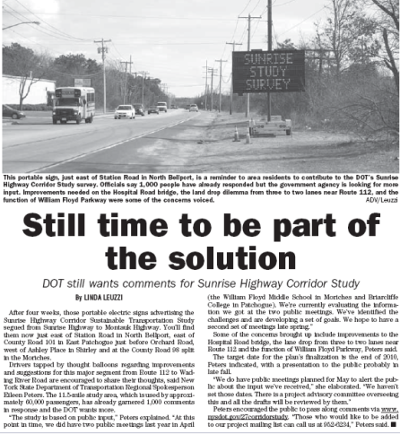
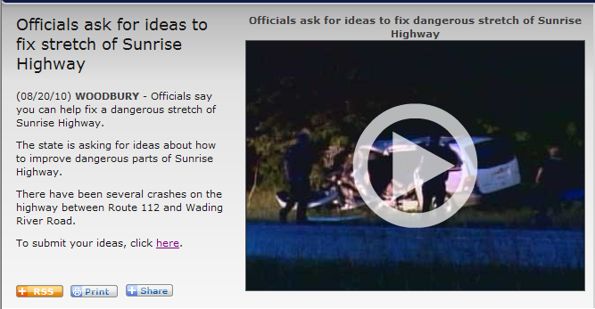
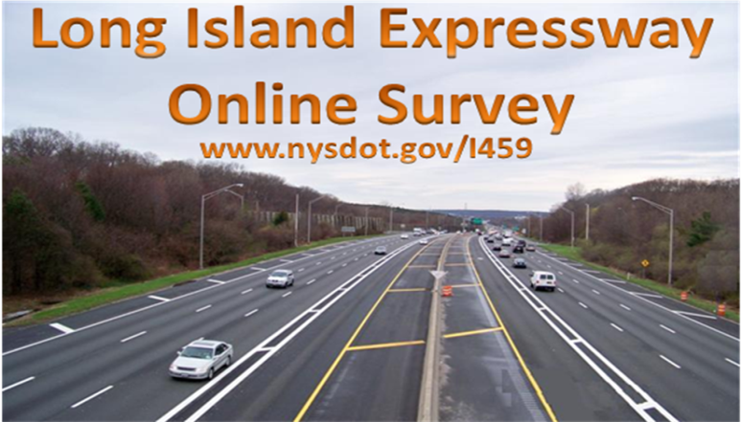
HIGH TECH SURVEY …
LOW TECH ADVERTISING
Post-card
E-mail
Fliers
Free media:
  TV: News 12 (Local TV News Station)
  Radio: Hostess Described Her Participation Survey #1
  Print: Long Island Advance (Local Media Outlet) 1 page story, Survey #1
Word of mouth, paper in hand

Slide 21
PUBLIC INVOLVEMENT
Cost/Benefit:
  Public Meeting: ~$67/ attendee
  First Online Survey: ~$4/respondent
  Second Interactive Survey: ~$1.67/respondent

Slide 22
PUBLIC INVOLVEMENT
Lessons Learned:
  Many options, each with plusses and minuses
  Must have a clear idea of your needs
  Convenience for public is key for participation
  Data usability is key for staff
  Cost effective is key to agencies
  Innovative vs. traditional methods

Slide 23
CONTACT INFO
JOEL KLEINBERG
New York State DOT, Long Island Region
250 Veterans Memorial Highway, Room 4A-4
Hauppauge, NY 11788
Jkleinberg@dot.state.ny.us
631-952-6108
23

