Slide 1
A Simple Framework to Access Potential Impact of Regional Toll System on Environmental Justice Population
Chi Ping Lam, Houston-Galveston Area Council
Chris Van Slyke, Houston-Galveston Area Council
Heng Wang, Houston-Galveston Area Council

Slide 2
Acknowledgment
Specials thanks to Texas Transportation Institute for their technical supports and advices
Dr. Jim Benson
Andy Mullen

Slide 3
Outline
Brief Introduction of Environmental Justice
Background of this study
Methodology

Slide 4
What is Environmental Justice?
The 1964 Title VI Civil Rights Acts assures that “no person in the United States shall, on the ground of race, color, or national region, be excluded from participation in, be denied the benefits or, or be subjected to discrimination under any program or activity receiving Federal financial assistance.”
In the 90’s the low-income populations were added to the environmental justice population with racial minority groups.

Slide 5
Bottom Line of EJ for us
Make sure that the long range transportation plan and transportation improvement program does no cause dis-benefit to minority and low-income population

Slide 6
Background: Expanding Toll
Government funding is not enough to fund all the demands of new roads
Toll road becomes more common as another funding mechanism to construct new road facility
There are many new toll roads in the year 2035 Regional Transportation Plan

Slide 7
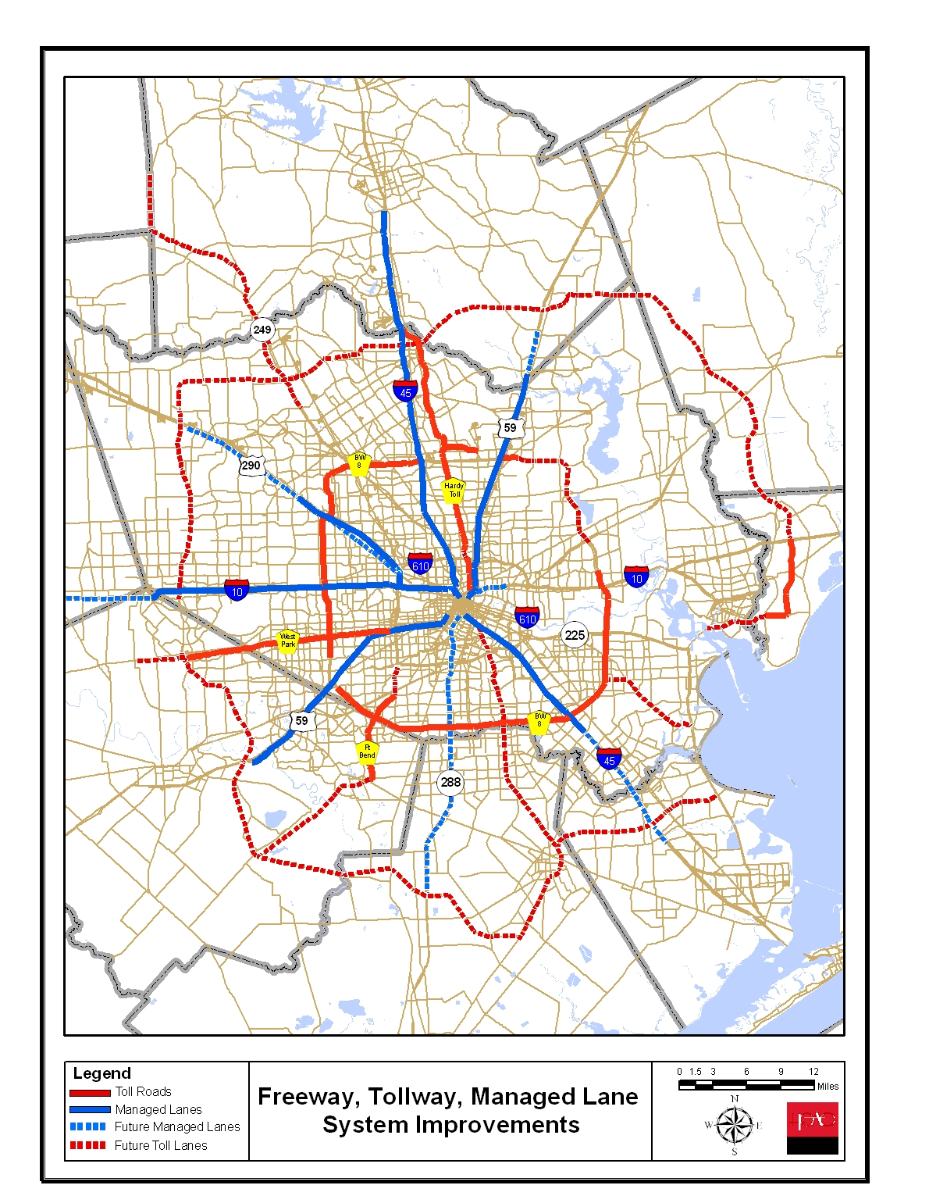
 | 2009 Network | 2035 RTP
Freeway | 3,669 | 4,339
Toll Roads | 658 | 2,049
HOT Lanes | 289 | 853
Arterial | 19,955 | 25,614
Total Lane Miles | 24,571 | 32,855
*The plan is likely to be scaled back in RTP update due to diminished funding

Slide 8
Two Questions Adked
H-GAC is asked to evaluate whether the purposed new toll system could negatively affect EJ population
Later, H-GAC is asked to assess the impact of proposed toll increase on existing toll facilities, on EJ and non-EJ population.

Slide 9
Current Analytical Capability
Still using traditional 4-step model
The resolution of the analysis will be based on traffic analysis zone, not individual household
The forecast will be in terms of trips and time
The methodology developed for this study should be applicable in future studies

Slide 10
First Question
Evaluate whether the purposed new toll ways could negatively and discriminatively affect the Title Vi (minority and low-income) population

Slide 11
Dis-benefit
We use “dis-benefit” to describe the negative and discriminatively impact
Considering both the our planning interest and analytical capability, we define dis-benefit as reduced accessibility of travelers coming from Title VI zones due to the proposed toll way system.
The accessibility is measured by travel time

Slide 12
Issues
Some travelers do not use toll roads because tollways do not offer a faster route for them
Do toll system affects them?
Given the same travel time saving by tolls, low-income travelers are less likely to use toll roads due to less financial power
If people takes slower, non-toll only route, will they loss accessibility due to new toll roads?
Are there significant difference impact on EJ and non-EJ population?

Slide 13
Procedures
Identify Title VI traffic analysis zone
Use gravity model to get travel tables
Run assignment to forecast travel time in two scenarios
All exist + commit network (Build)
E+C without the proposed toll way (No-build)
If the proposed toll way system cause dis-benefit to Title VI population, trips from Title VI TAZ should have longer travel time in the “with” scenario

Slide 14
Identify Title VI TAZ
Traffic analysis zones with 51% or more population are minority or low-income in 2000 census
1383 out of 2954 TAZ are identified
1.63 million people living in these zones. These are 31.3% of entire population in the MPO region of 5.21 million
Notes:
This is census 2000 numbers.

Slide 15
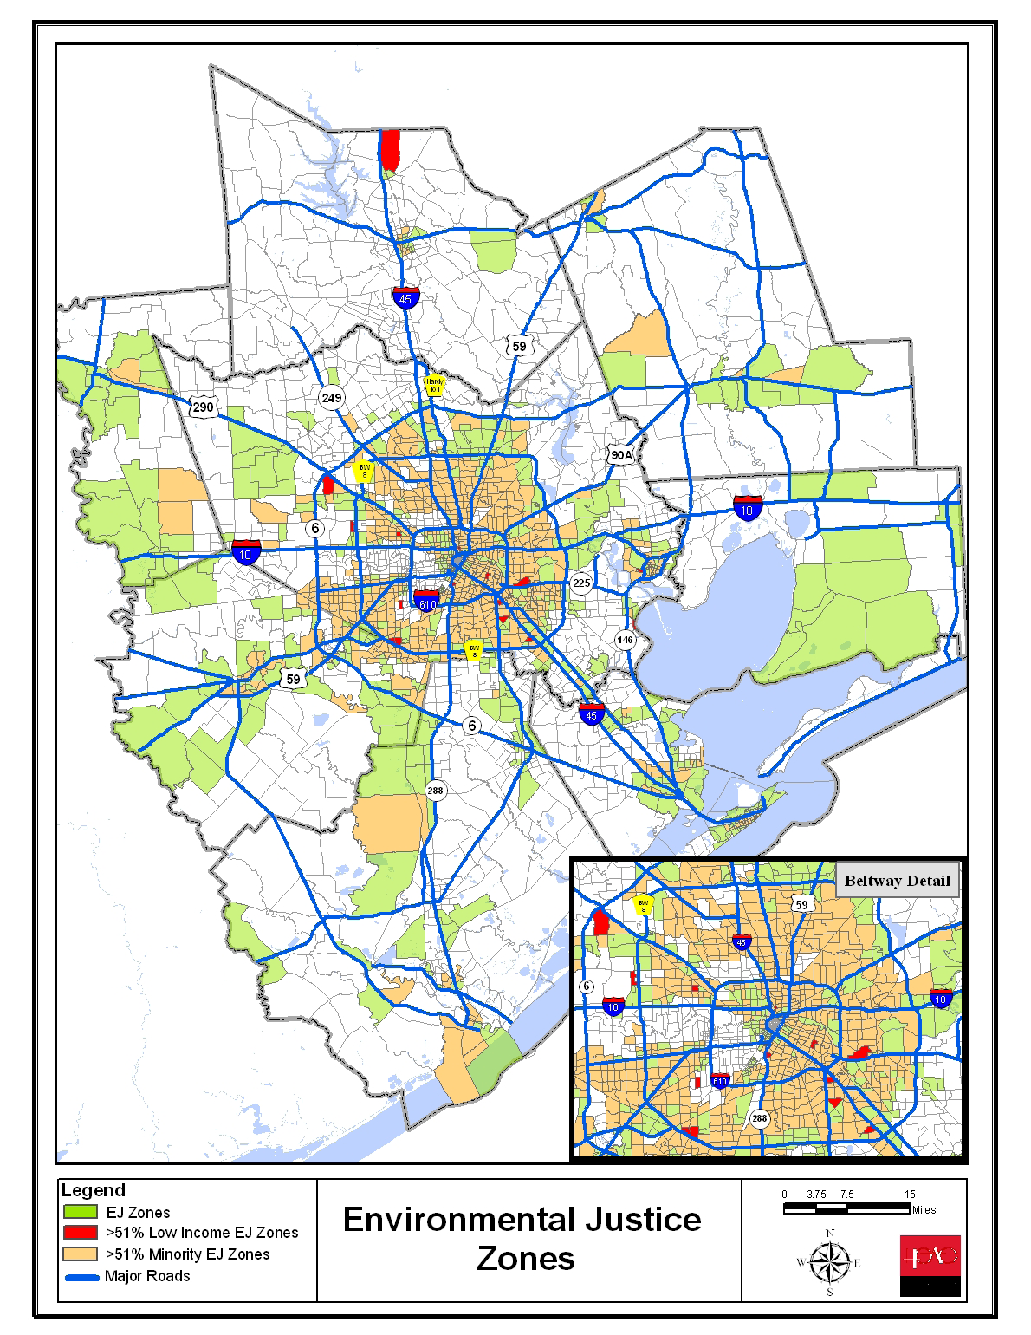

Slide 16
Two Scenarios
The scenario year is 2035
Build Scenario: complete E+C Network
No-Build Scenario: the E+C Network without any proposed toll lanes and HOT lanes
We are interested to know whether travel time is faster or slower between Build and no-Build Scenarios

Slide 17
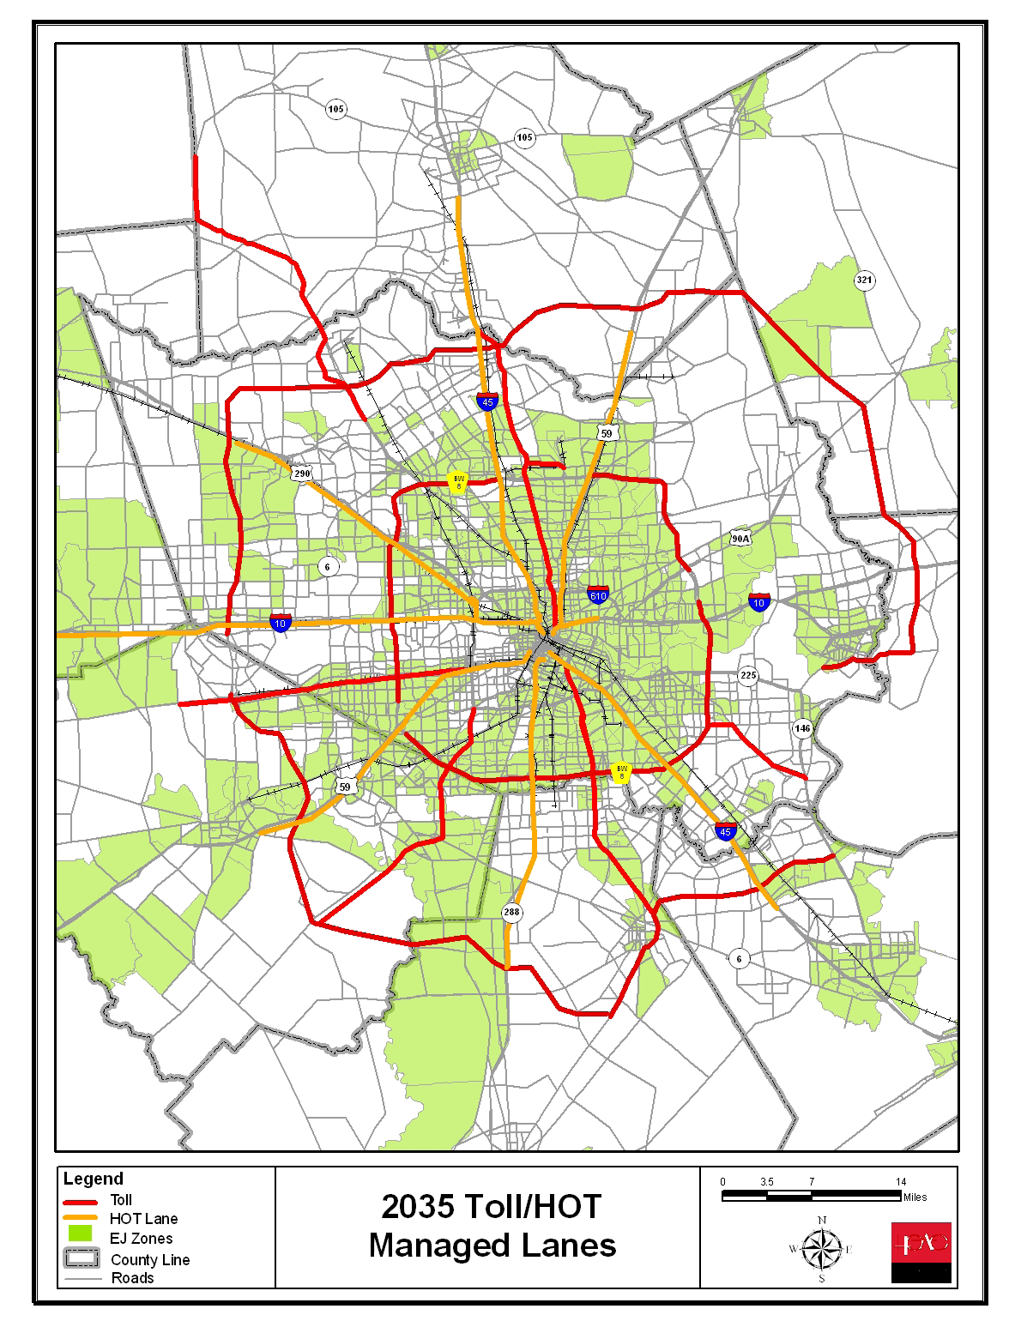
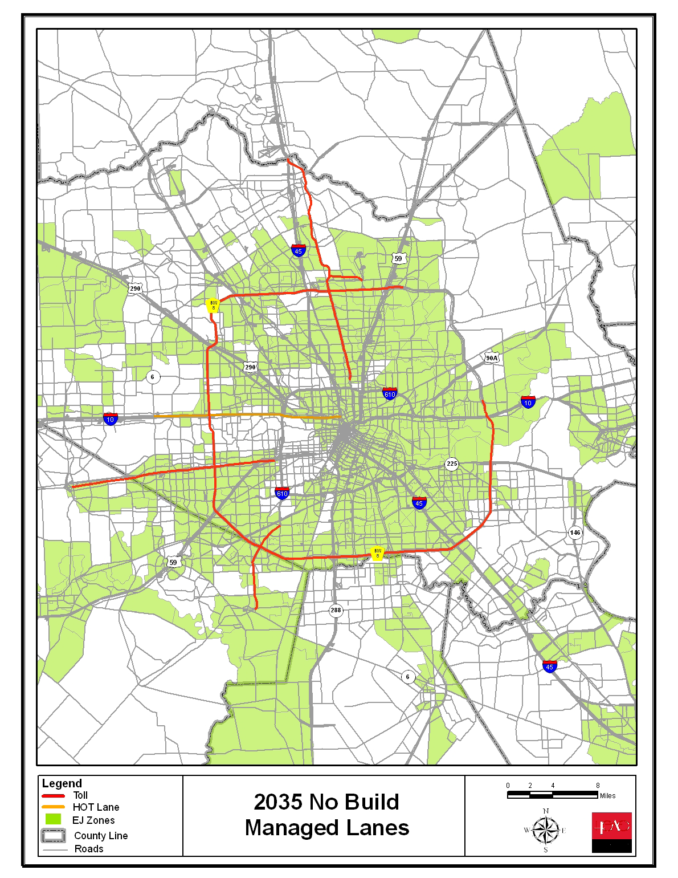
*The system is scaled back in RTP update due to diminished budget

Slide 18
Identify CANDIDATE Trips
Perform assignment to get travel time on:
Using both future toll/HOT and other links
Using on non future toll/HOT links only
For a trip, if its travel time on both future toll and other links is faster than travel time on non-future toll links only, it is considered as a toll CANDIDATE trip because it could save time using new toll links
Otherwise, it is a NON-CANDIDATE trip because there is no time saving to motivate it to use future toll links

Slide 19
More about Candidate Trips
A Candidate trip may use toll/HOT to save travel time, but it could also choose to use free path only to save toll cost.
The mode choice model also allows Non-Candidate trip to use existing toll
Therefore, for a single trip, the travel times of both free-path only and toll-path available must be calculated

Slide 20
4 Segments of Trips
Every trips belong to either one of the four segments of trips, according to their production zones and possible time saving by using tolls
Production Zones | Trips Save time using Toll | Trips cannot save time using toll
Title VI (EJ) Zones | Candidate Trips produced from EJ Zones | Non-Candidate Trips produced from EJ Zones
Non-Title VI (Non-EJ) Zones | Candidate Trips produced from Non-EJ Zones | Non-Candidate Trips produced from Non-EJ Zones
Notes:
Trips produced by Title VI zones that are classified as Candidate trips
The remaining trips produced by Title VI Zones that are classified as Non-Candidate trips
Trips produced by non-Title VI zones that are classified as “Candidate trips”
Trips

Slide 21
Dimension Summary
Therefore, 4 dimensions – 16 combinations
Build vs No-Build Scenarios
Free vs Toll path
EJ vs Non-EJ production zones
Candidate or Non-Candidate trips of saving time through the proposed new toll system
The analysis calculating the average travel time of each combination, and then compare the results

Slide 22
HBW Person Trips Average Travel Time
Production Zones | Candidate? | Number of trips | Build Network |  | No-Build Network
 |  |  | Toll Path Allowed | Free Path only | Toll Path Allowed | Free Path only
EJ Zones | Yes | 1,174,445 | 38.59 | 42.87 | 43.36 | 45.19
 | No | 1,487,852 | 20.81 | 20.89 | 21.66 | 21.76
Non-EJ Zones | Yes | 1,590,356 | 50.76 | 56.61 | 59.51 | 61.56
 | No | 1,627,399 | 23.40 | 23.46 | 24.61 | 24.70
Notes:
Candidate trips have longer average travel time than non-candidate trips. Expected as toll trips are generally longer.
Free-path only trips have longer travel time. It is also expected because people use toll to save time.
We are interested to see Build vs No-build

Slide 23
Build vs No-Build (HBW) Average Travel Time
Production Zones | Candidate? | Number of Trips | Difference in ATL for Toll Path Options (No-Build ATL – Build ATL) | Difference in ATL for Free Path Options (No-Build ATL – Build ATL)
EJ Zones | Yes | 1,174,445 | 4.77 | 2.32
 | No | 1,487,852 | 0.85 | 0.87
Non-EJ Zones | Yes | 1,590,356 | 8.75 | 5.05
 | No | 1,627,399 | 1.21 | 1.24

Slide 24
Key Analysis (1)
The build scenarios reduces the ATL for toll path options for both Title VI and non-Title VI zones. People can reduce travel time through the proposed toll system

Slide 25
Key Analysis (2)
The candidate trips from Non-Title VI zones enjoy more ATL saving than the candidate trips from Title VI Zones. At the same time, the ATL from Non-Title VI zones are longer. This is because
Title-VI Zones are generally more centrally located, their trips are shorter
Most title-VI zones are not located as close to the purposed new toll facilities as the non-title VI zones

Slide 26
Key Analysis (3)
Even for trips using free path only, the ATL are shorter in the Build scenarios. The purposed toll system takes away vehicles from free links, and hence improve average travel time for the entire network.
From EJ perspectives, this mean that non-toll users, particularly low-income travelers, could enjoy some benefits (travel time savings) due to the presence of the purposed new toll system

Slide 27
Conclusion of the Analysis
The ATL of the build scenarios are reduced for both toll path and free options, and from Title VI zones and Non-Title VI zones.
Title VI population will enjoy travel time saving due to the proposed toll system, no matter they decide to use it or not
The analyses did not find any significant and/or disproportionate negative impacts on title VI population, which satisfy the environmental justice law.

Slide 28
Question 2
In September 2009, Harris County officials voted to increase the EZ-tag toll rate from $1.25 to $1.30
H-GAC is asked to conduct an analysis of the impact on environmental justice (EJ) population

Slide 29
The methodology for question 1 is more about change in travel times for tolled path versus free paths
Therefore toll rates are not explicit variables used for methodology in question 1
The mode choice model is applied to answer the impact of toll rate increase, in terms of toll trips

Slide 30
Calculate effective toll rate increase
15% of toll users do not use EZ tag
The proposed toll increase is on EZ tag only
The effective system-wide toll rate increase must consider EZ tag and non-EZ tags users
The effective toll rate increase =
=(% tag users) * (% increase for tag users)
=(0.85) * ($0.05/$1.25) = 3.4%

Slide 31
Trips Change Due to EZ Tag increase
Applying 3.4% increase of toll to Year 2035 Build scenario
Production Zones | HBW Toll Trips Change | HBNW Toll Trips Change
EJ Zones | -1.6% | -0.5%
Non-EJ Zones | -1.9% | -0.8%

Slide 32
Quick Analysis (1)
High toll fares, less toll trips.
The sensitivity is less than 1, a somewhat inelastic.
HBNW has less sensitivity than HBW
Relatively few HBNW toll trips
There are strong reasons for them to use toll and hence less cost-sensitive.

Slide 33
Quick Analysis (2)
EJ zones responds with slightly less toll trip decrease percent-wise
Counter-intuitive as first sight
Geographical distribution maybe reason
EJ zones closer to existing toll roads and have shorter average trip length
So toll roads save more travel time in percentage
Perhaps disaggregate model may provide more insight

Slide 34
Summary
First Question: Will proposed toll system dis-benefit to environmental justice population for long term future?
Short answer to first question: The propose toll system improve mobility for entire transportation system, so EJ population, using toll roads or not, can travel faster on less-congested roads.

Slide 35
Summary (2)
Second Question: How upcoming toll increase impact EJ population and non-EJ population?
The 3.4% toll increase reduce around 1.6% and 1.9% HBW toll trips on EJ and non-EJ zones. The impact are not very large and not very different between EJ and non-EJ zones.

Slide 36
Any Question?

Slide 37
Thank you!

