Slide 1
East End Connector
Environmental Justice and Public Involvement
13th National Transportation Planning Applications Conference
Radha Krishna Swayampakala, PE, PTOE, GISP

Slide 2
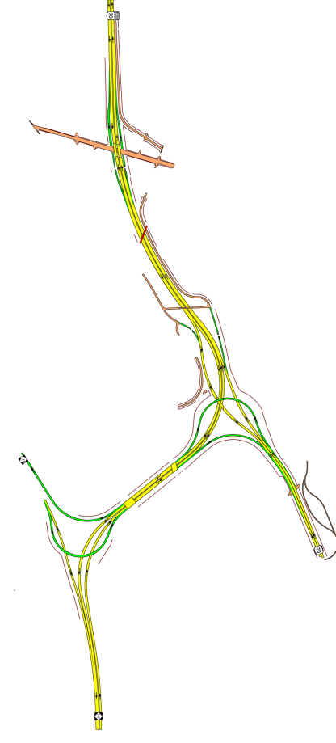
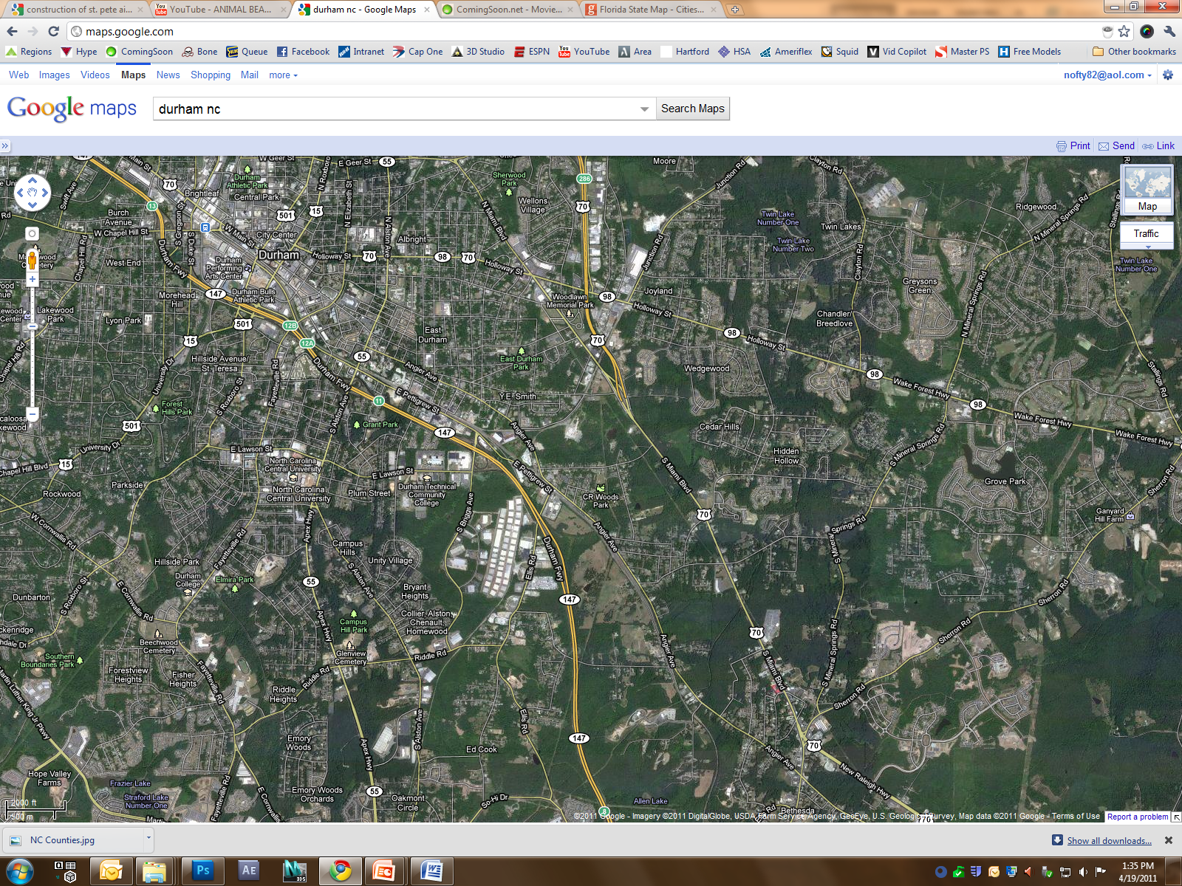
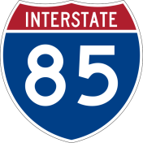
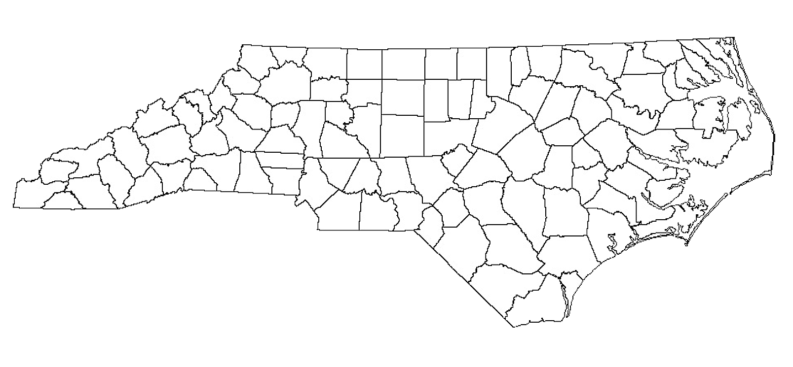
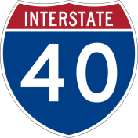
Project Location
_{Downtown}
Durham
N
N
Durham County
_{Durham}
Freeway
_{US}
₇₀
_{Research}
Triangle
_{Park}

Slide 3
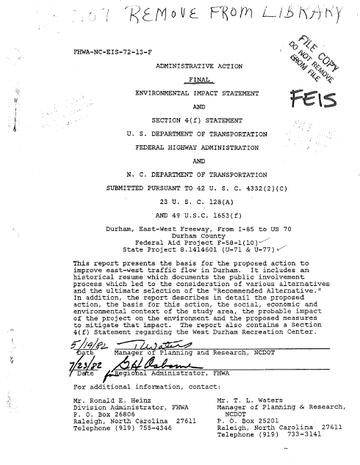
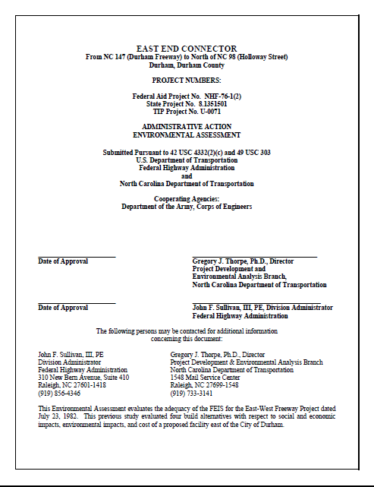
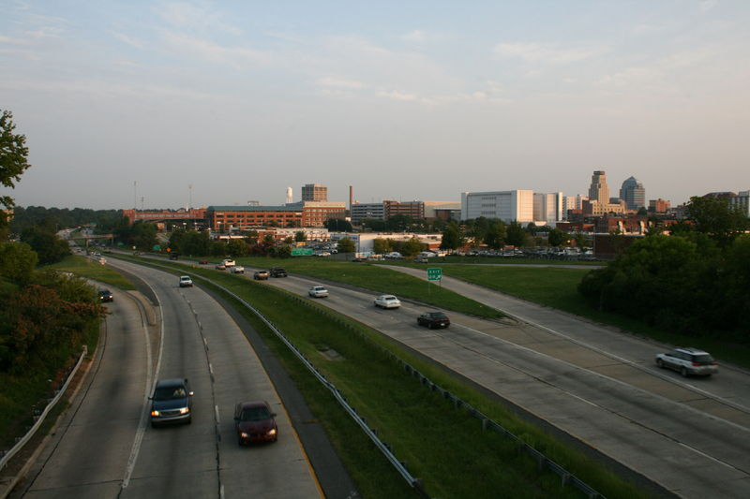
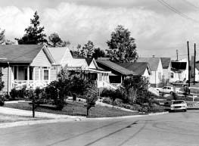
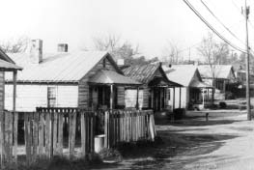
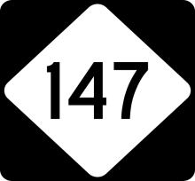
History
Introduced in the City of Durham Thoroughfare Plan
Initiate EIS Process As Per the New NEPA Act
FEIS and ROD Completed
East-West Expressway Construction Complete
NCDOT re-initiated the planning process
EA – Dec’09
Anticipated FONSI Completion - 2011
1959
1970s
1982
1992
2005
2011
Source: Transportation & Environmental Justice Case Studies
Published by FHWA, December 2000

Slide 4
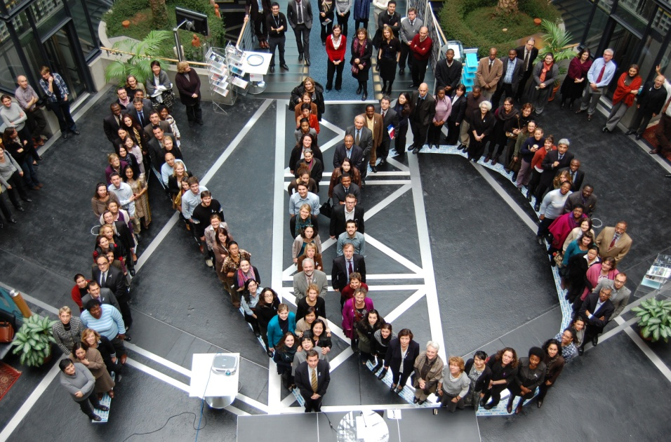
Challenges
Concern about the human/physical environmental impacts
Disagreement on the Project’s Purpose and Need
Uncertainty on benefits to local community
Distrust on various governmental agencies including DOT
Notes:
4

Slide 5
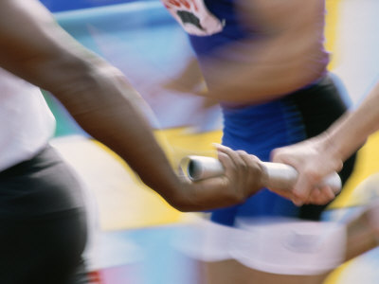
Goals
Provide a transparent, and active process
Involve as many of the area citizens, neighborhood associations, business owners, and agencies, as possible
Initiate the process as early as possible
Share information as soon as it is available
Notes:
5

Slide 6
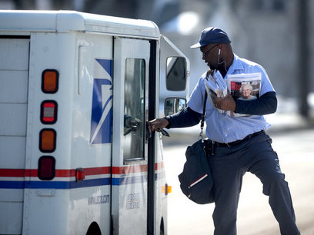
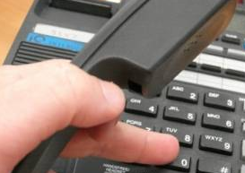
Actions
Frequent Newsletters and Website Updates
Project Toll-Free Hot Line and Email Address
Notes:
6

Slide 7
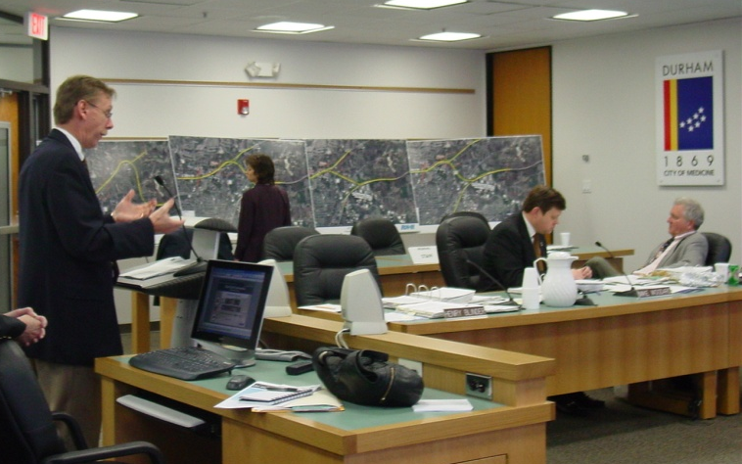
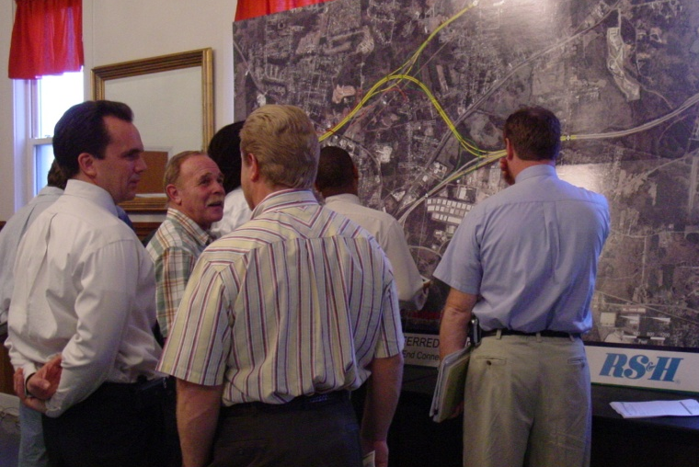
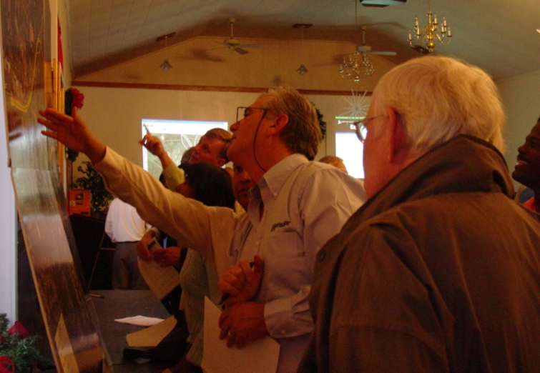
Actions
Series of Six Public Meetings
Eight Neighborhood Meetings
Eight Elected Officials Meetings
Sept, 2006
Jan, 2007
Dec, 2007
March, 2010
April, 2010
Sept, 2010
Notes:
7

Slide 8
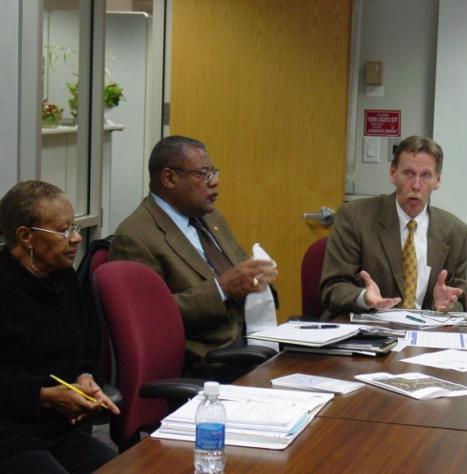
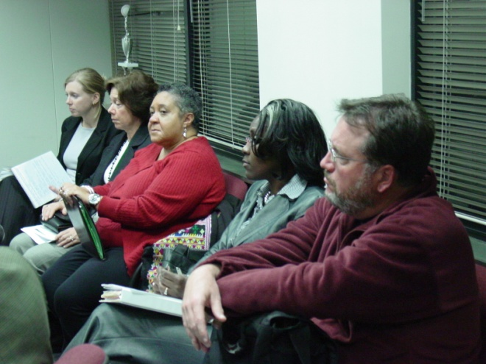
Actions
Ad Hoc Committee
Formed at the request of City of Durham Council
Includes ten local residents
Met 12 Times
Discussed various issues:
Human Impacts
Economic Development
Air Quality and Noise Impacts
Traffic Analysis
Visual Impacts

Slide 9
New Ideas / Issues
Explain the Project Impacts More Clearly
Provide Additional Improvements along Holloway St
Evaluate Rowena Avenue Sunshade Impacts
Improved Access at Carr Road Interchange
Additional Signage for Local Businesses along EEC
Notes:
9

Slide 10
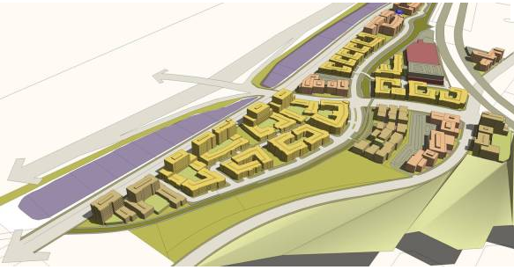
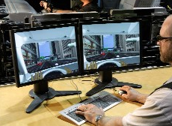
Project Impacts
Innovative Public Involvement Tools
3D Animation
3D Virtual Model
Artistic Renderings
Interactive Flash Animation
Notes:
10

Slide 11
3D Animation

Slide 12
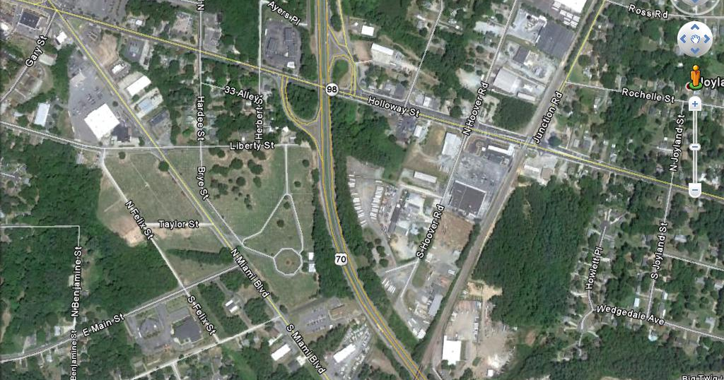
Improvements along Holloway St

Slide 13
Improvements along Holloway St

Slide 14
Improvements along Holloway St

Slide 15
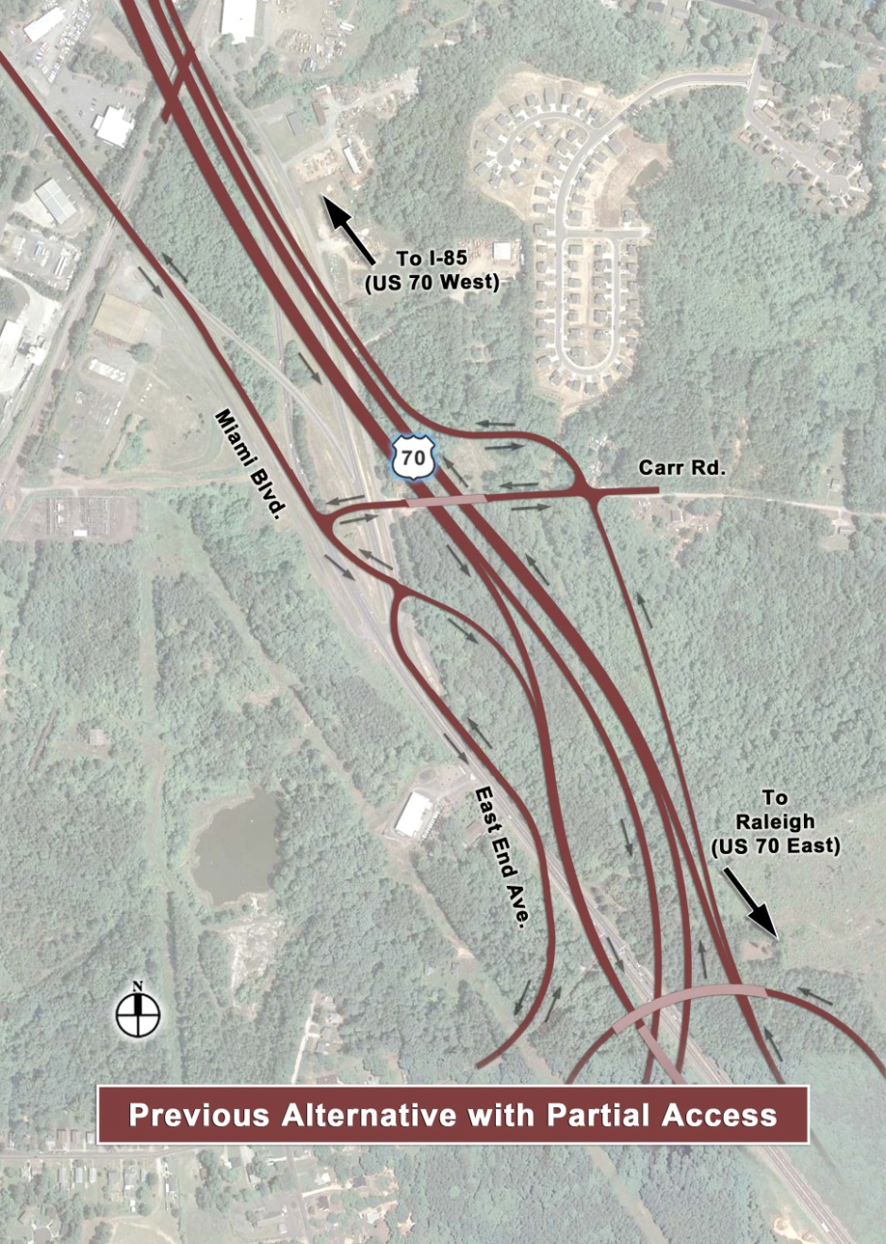
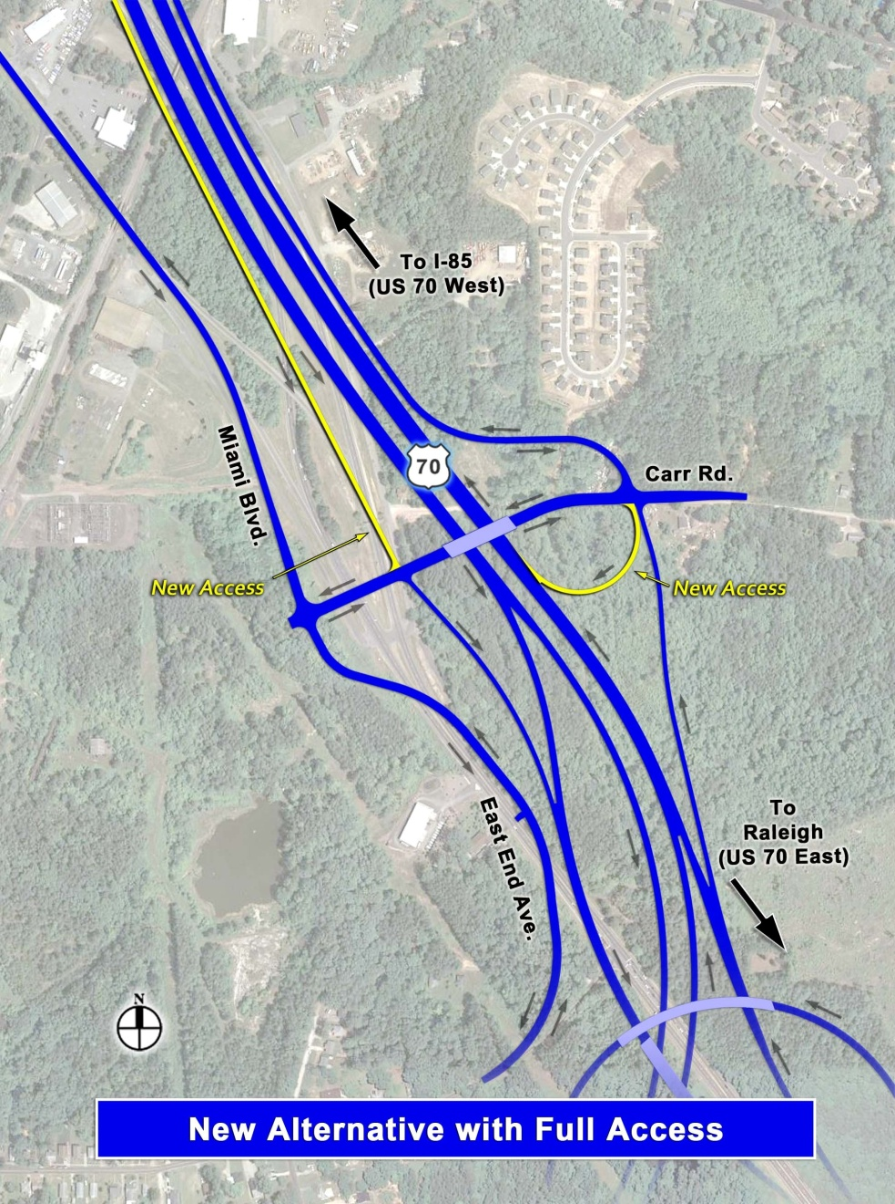
Carr Road Interchange
Notes:
15

Slide 16
Interactive Flash Animation
Interactive Flash Animation

Slide 17
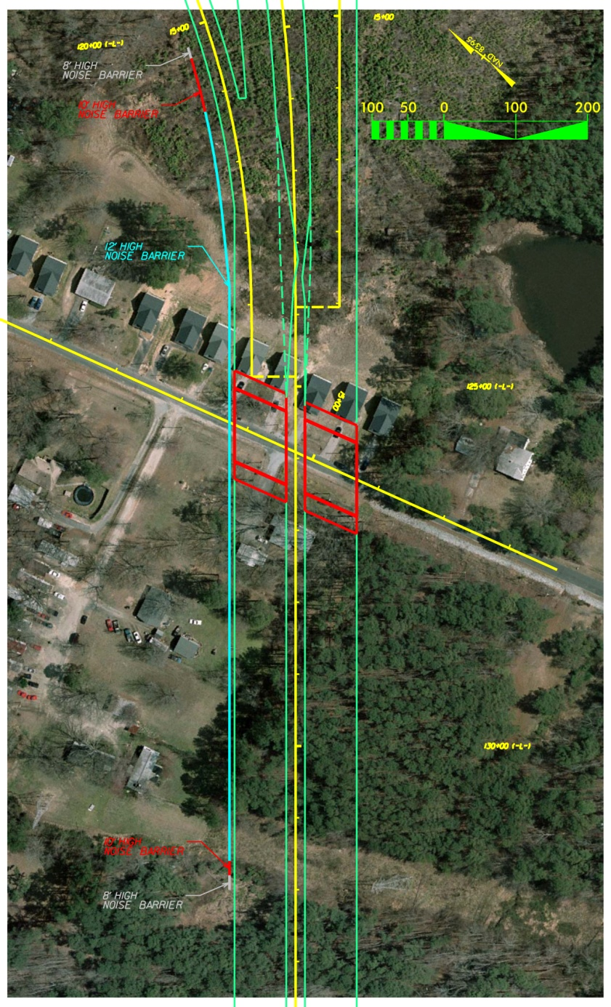
Sunshade Impacts

Slide 18
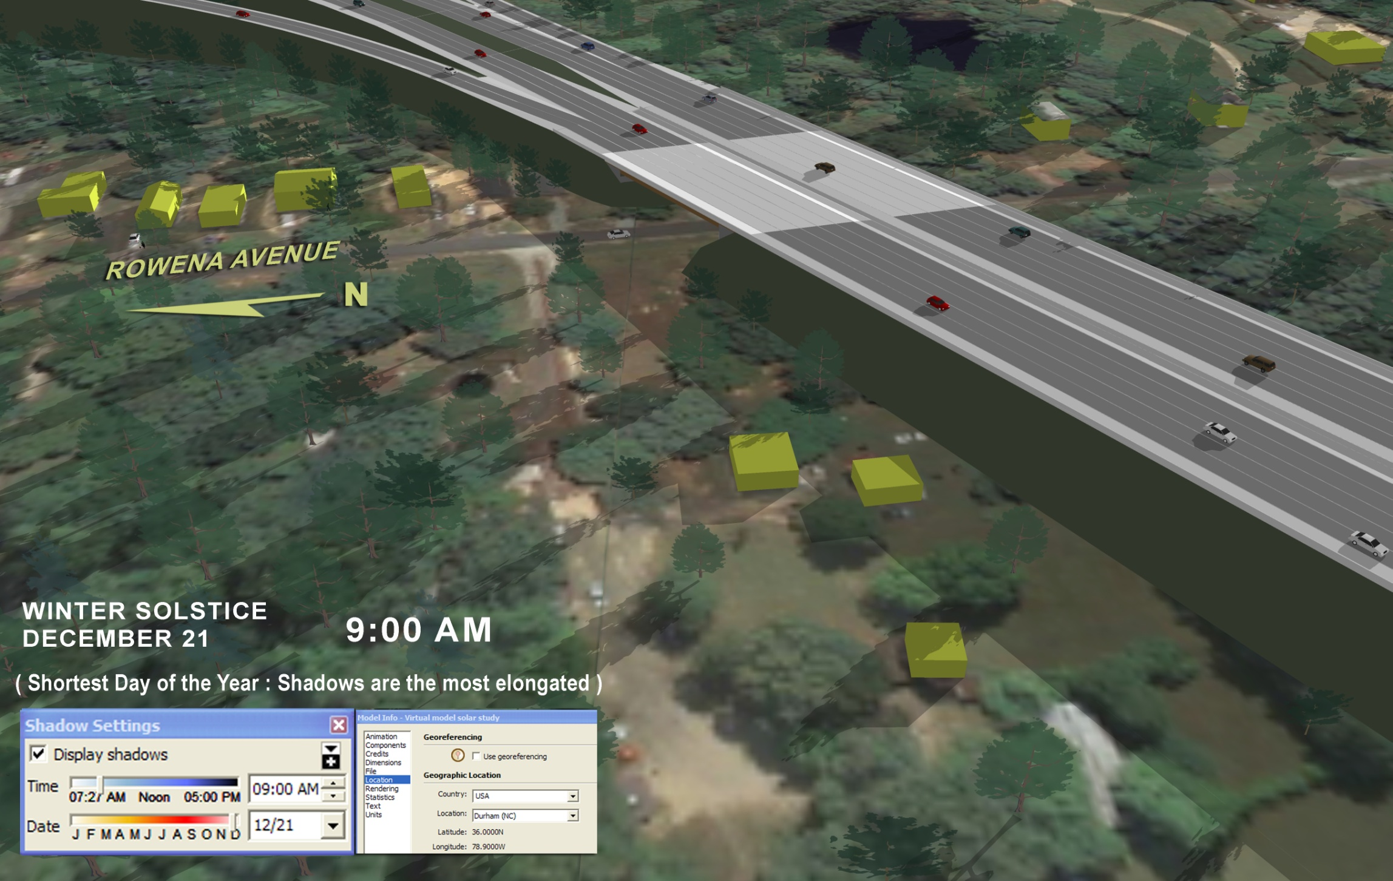
Sunshade Impacts

Slide 19
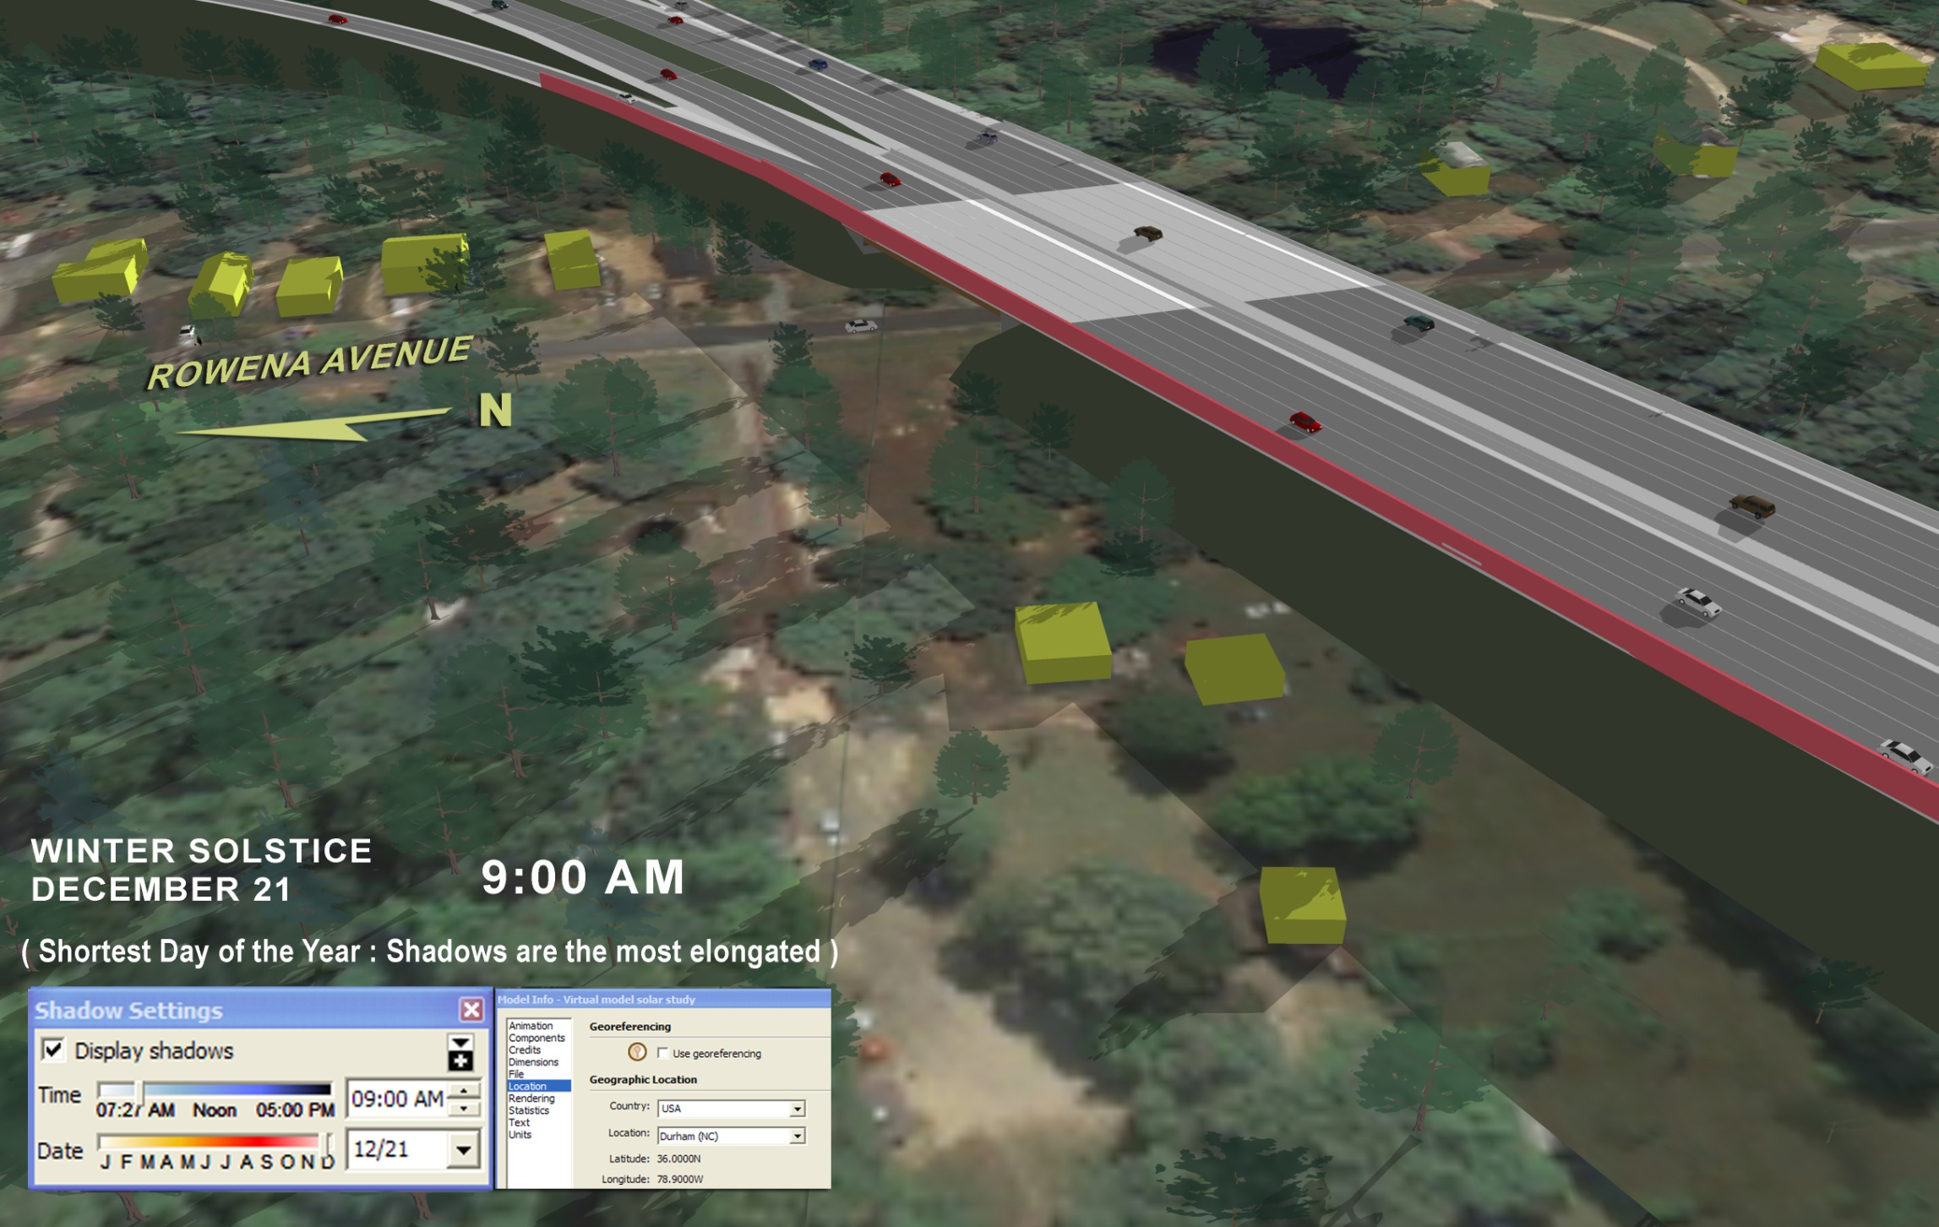
Sunshade Impacts

Slide 20
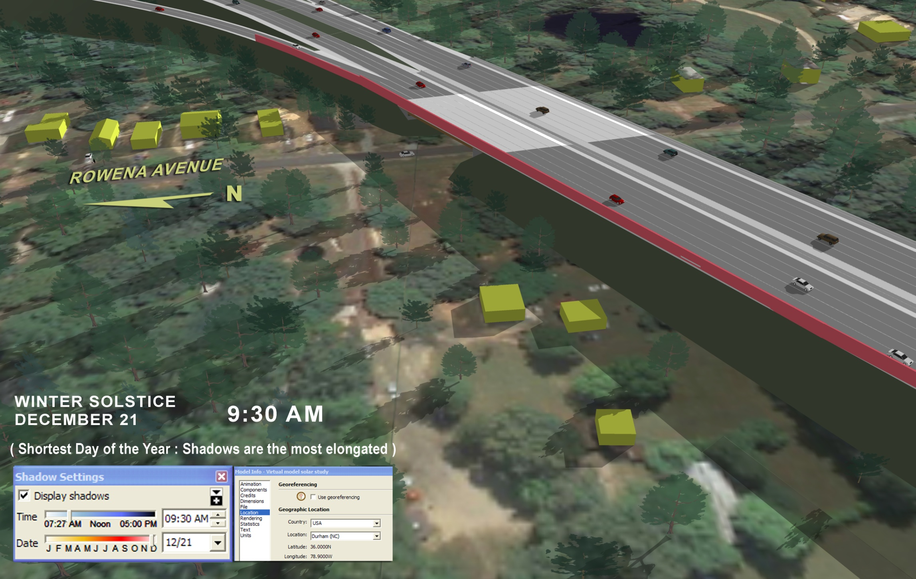
Sunshade Impacts

Slide 21
Lessons Learned
Be Proactive
Have More than One Approach
Keep it Simple and Transparent
Meet as Often as Requested
Be Responsive
Document Everything
Notes:
21

Slide 22
East End Connector
Thank You
Radha Krishna Swayampakala, PE, PTOE, GISP
(704)940-3688
Radha.swayampakala@rsandh.com

